Slide 1
Lucene
Scott Faria

Slide 2
Overview
What is it?
Why?
The Basics
Live Demo

Slide 3
What is it?
A full-text search library for Java
Allows for creation, storage and retrieval of documents
Documents are added to an index, which is a set of data structures that allow for efficient search
Search for documents using either a very powerful DSL or programmatically.
Supports string matching well beyond the capabilities of simple regex matching
Many plugins are available to do advanced search or text analysis
Notes:
Builds an inverted index that allows for efficient word -> position location in a body of text

Slide 4
Why?
Efficient search
Lucene is fast
Lucene is open-ended
Can do more than just match strings
Notes:
- In terms of both runtime and storage
String matching the traditional way is slow
- Can index plain text at around 150 GB/hour on modern, commodity PC hardware
- Searches of large data corpuses happen in milliseconds
Very low memory requirements
- Very small and modular (compared to other similar projects)
- Only use what you need
Very extensible
- Fuzzy search
- Multiple-language support
- Wildcard matching
- Text highlighting
- To name a few

Slide 5
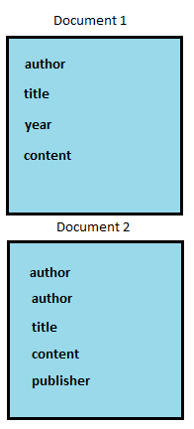
Document
The basic unit of storage in Lucene
Each document has a set of fields
This very flexible and source-agnostic model allows for the storage of many types of data
Notes:
- Very similar to NoSQL document store
- Fields are bound to Java implementations that allow for very advanced behavior
- Relational database
- PDF/Word/Text
- Pretty much anything, really

Slide 6
Indexing
Adding a document to the index is done via an instance of IndexWriter
The user constructs the document and then submits and commits it to the index for search.
Document fields can also be modified as they are added to the index
Notes:
- Document boosting
- Field boosting

Slide 7
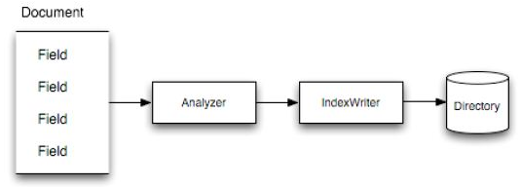
Indexing
Documents are analyzed by Lucene as they are written to disk
Analysis is configurable via an instance of Analyzer
Analyzers:
Perform stemming, i.e. “book” and “books” both become “book”
Stop word removal
Natural language-specific operations
Fields that have things that should be matched but not retrieved can be analyzed but not “stored”

Slide 8
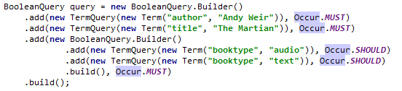
Search
Search is done via an instance of IndexSearcher
Two ways to search:
A query DSL
Programmatic
The query DSL lets you search fields by name for a particular string.
Programmatic search is very similar

Slide 9
Search
Search hits are returned in descending order of their score:
Important stuff:
coord(q, d) – how many of the terms are in my document?
queryNorm(q) – normalization to make queries comparable
tf(t in d) – how many times does each term appear?
idf(t) – inverse frequency, i.e. rarer terms appearing in a document give a higher score
t.getBoost() – is my field boosted?
norm(t, d) – a number of other factors that are dependent on index setup

Slide 10
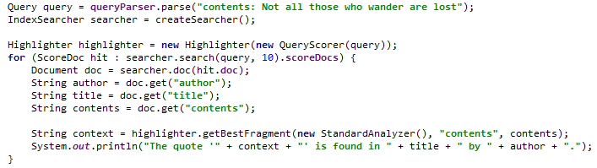
Search
Search results can be post-processed
Example:

Slide 11
Live Demo

Slide 12
Q&A
Code and slides are on my Github
https://github.com/sfaria/lucene-demo

