Slide 1
Triplestores
-or-
Semantic queries and how to use them
Scott Faria, Software Engineer @ Profiler
GDev 2020

Slide 2
So, what is a triplestore, anyway?
Easy. It is data store purpose-built to store triples.
Retrieval of those triples is done via semantic queries.
Easy, right?

Slide 3
Lets break it down a bit more.

Slide 4
Triples
Data entity and basis of the triple store
Consists of three parts, hence the triple designation:
  Subject
  Predicate
  Object
Example: “Scott likes Pizza”
  Subject == Scott
  Predicate == likes
  Object == Pizza

Slide 5
Semantic Queries
Queries over associative and contextual data.
The data is explicity linked in it’s relationship.
  The relationship between triples requires no definition and is encoded into the store.
  Requires zero prior knowledge of the data to discover relationships.
Contrast with Relational Databases:
  Relationships are implicit - they only exist when a query is written by a developer.
  Requires full knowledge of the schema to materialize relationships.

Slide 6
Organization
likes
Scott
Pizza
isA
isA
Person
Food

Slide 7
Organization
“Scott likes Pizza”
“Pizza isA Food”
“Scott isA Person” (allegedly)
The triplestore deals with graphs where the nodes are subjects and/or objects and the vertices are the predicates.

Slide 8
Organization
Like NoSQL databases, triplestores are schema-less.
  Adding new relationships is easy and requires no re-organization of the data or migration.
An Ontology can be used to align data and give some structure to this loosely-structured data.
  Ex: Ontology file aligns two datasets of books by saying the predicates “author” and “creator” should be treated the same.

Slide 9
Advantages
Why a triplestore and not just and RDBMS?
Flexible – no schema (for better and for worse)
Efficient (for the kinds of questions you’d ask)
Easy to import/export.
  RDF (Resource Description Framework) is a standard, textual format used by triplestores.
Easy interoperability with outside systems.
  URI querying for easy interop.
  https://www.pizzabro.org/Scott/likes => “Pizza”
Relationships and discovery.
  Combine with an ontology to understand the data and you can start making a lot of interesting inferences.

Slide 10
Extracting Knowledge
We get how it’s stored, but how do I get something out of it?
Well, you query it!
  URI
  SPARQL
Combine it with an optional ontology for MORE POWER.

Slide 11
URI Query
Very simple
Ex: http://www.example.com/people/scott
<URI-of-alice> a foaf:Person;
foaf:name "Scott";
foaf:email <mailto:scott.faria@gmail.com>;
foaf:homepage <http:/sfaria.net> .

Slide 12
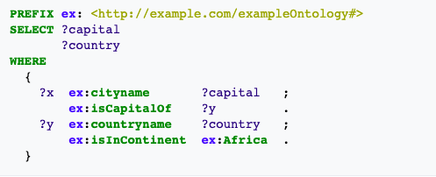
SPARQL
"What are all the country capitals in Africa?"
https://en.wikipedia.org/wiki/SPARQL

Slide 13
Live Demo

Slide 14
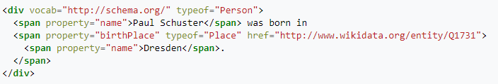
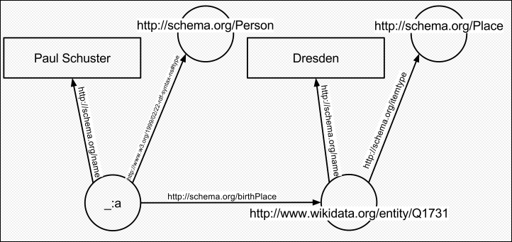
What about this semantic web thing?
Simply put, it’s making the web machine readable.
Using triplestore tech and concepts to build a parseable web.
Wikipedia: The Free Encyclopedia. Wikimedia Foundation, Inc. https://en.wikipedia.org/wiki/Semantic_Web

Slide 15
Thanks!

