Slide 1
MyStudies
Shihab Faruk (VC1C)
sfaruk3131p@gmail.com
Supervisor Razib Ahmed, Razib.ahmed0204@gmail.com

Slide 2
Abstract
MyStudies is a website that helps students prepare for their academics and encourages productivity. MyStudies will allow students to create and review flashcard decks allowing them to curate their studies. The site will also have a bulletin feature that allows students to keep track of important deadlines and tasks. Students will also have the ability to log in and create a personal profile to represent their hobbies and interests. Overall this project will involve creating an intuitive frontend, designing a database to store student information such as decks, bulletin, profile, and creating a backend facilitate.

Slide 3
Tools
Javascript
HTML
CSS
Git
Github
Database (leaning towards MySQL)

Slide 4
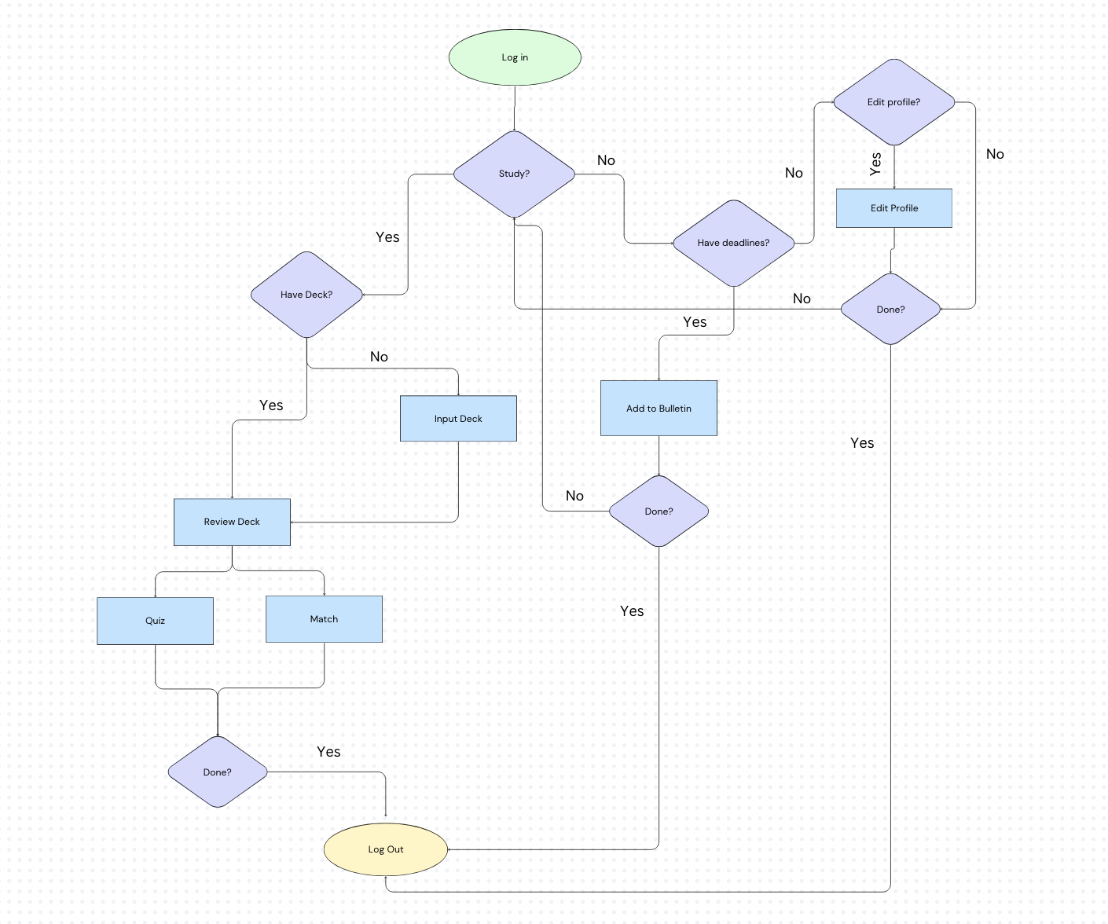
User Flow

Slide 5
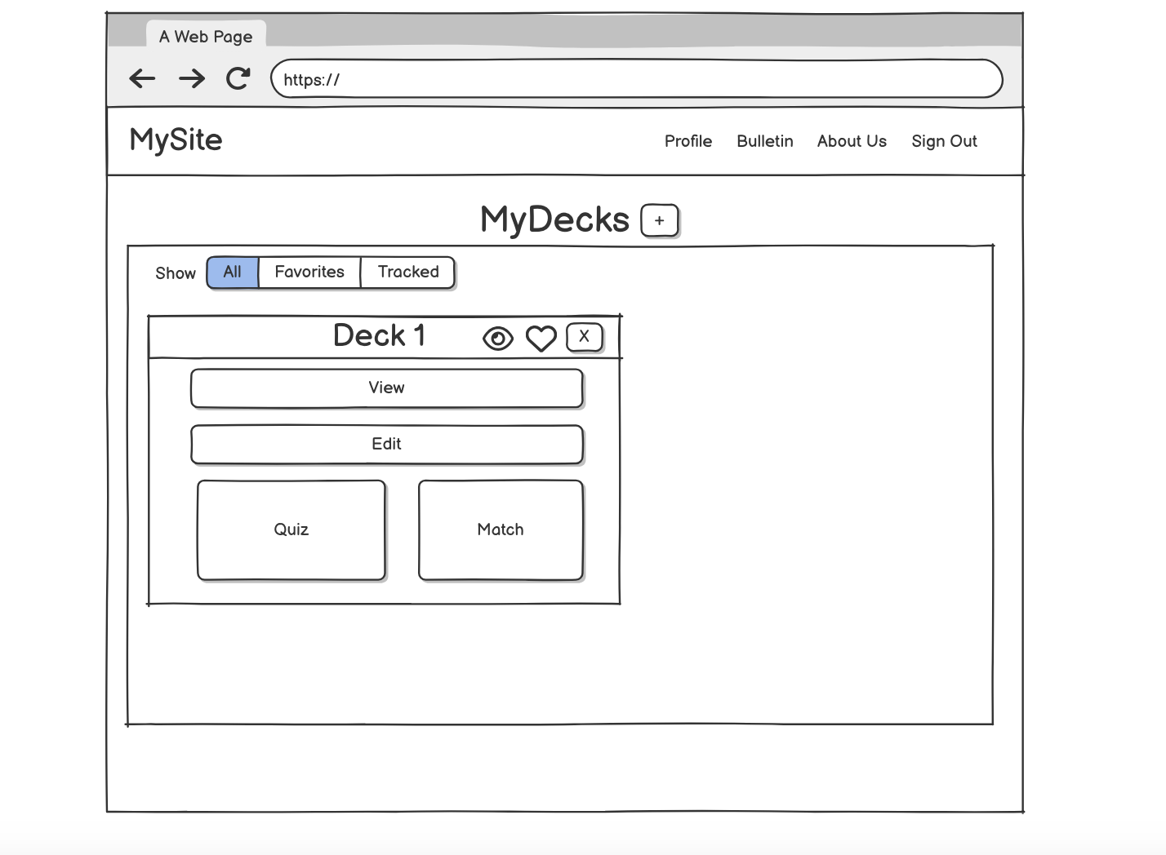
Homepage Wireframe

Slide 6
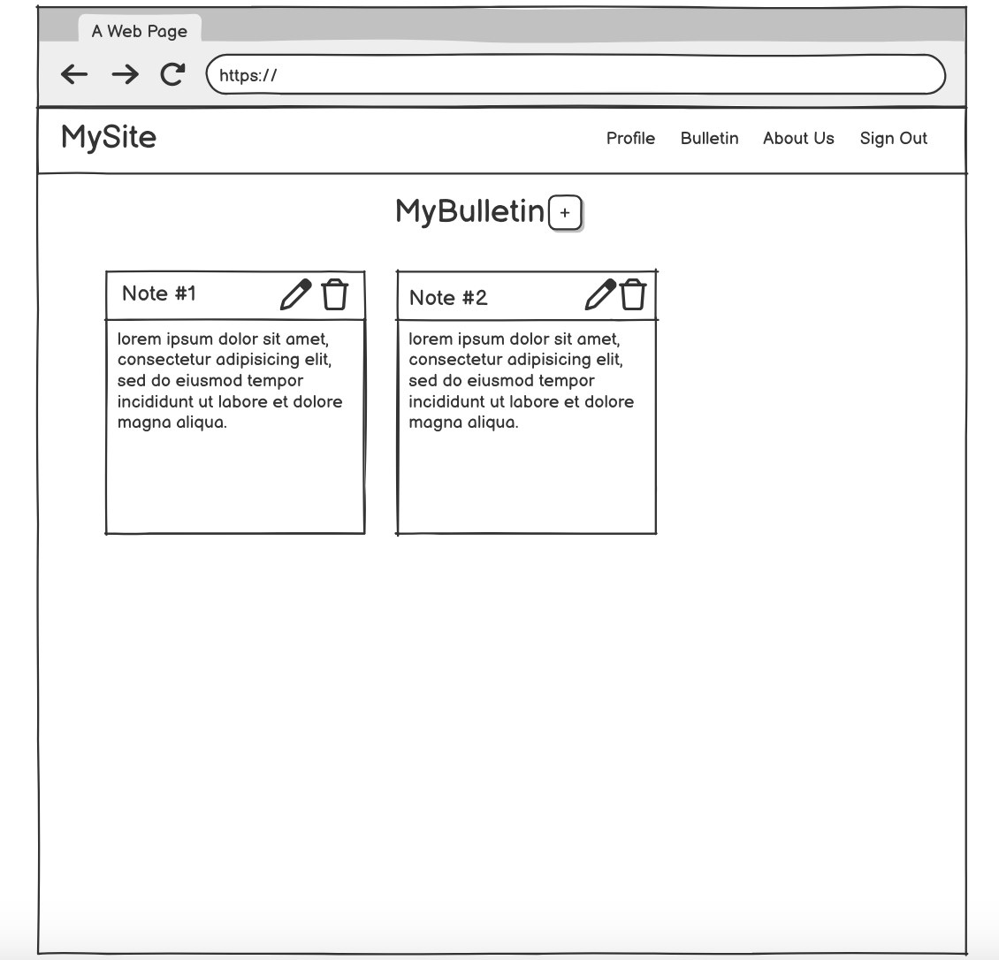
Bulletin Wireframe

Slide 7
Tentative Schedule

Slide 8
Will I use any Datasets?
Most likely no. Most of the data will probably be created by me and inserted into a database.
My database will store dummy users and their flashcard decks, bulletin posts, and profile information.

Slide 9
Use Case #1
Scenario 1: A student will want to review flashcards for a history exam. The student will log in with their proper credentials and in the homepage click the plus button. A modal will pop up and take in definitions and terms inputted from the user in a form. Once submitted a deck object containing the terms will appear on the homepage. The student will click the matching game in the deck container to test themselves.

Slide 10
Use Case #2

Slide 11
Use Case #3

