Slide 1
MyStudies
Shihab Faruk (VC1C)
sfaruk3131p@gmail.com
Supervisor Razib Ahmed, Razib.ahmed0204@gmail.com

Slide 2
Abstract
MyStudies is a website that helps students prepare for their academics and encourages productivity. MyStudies will allow students to create and review flashcard decks allowing them to curate their studies. The site will also have a bulletin feature that allows students to keep track of important deadlines and tasks. Students will also have the ability to log in and create a personal profile to represent their hobbies and interests. Overall this project will involve creating an intuitive frontend, designing a database to store student information such as decks, bulletin, profile, and creating a backend facilitate.

Slide 3
Tools
Javascript
HTML
CSS
Git
Github
Database (leaning towards MySQL)

Slide 4
Project Repository and Board
https://trello.com/b/5IXwlYMt/mystudies
https://github.com/sfaruk2001/MyStudies

Slide 5
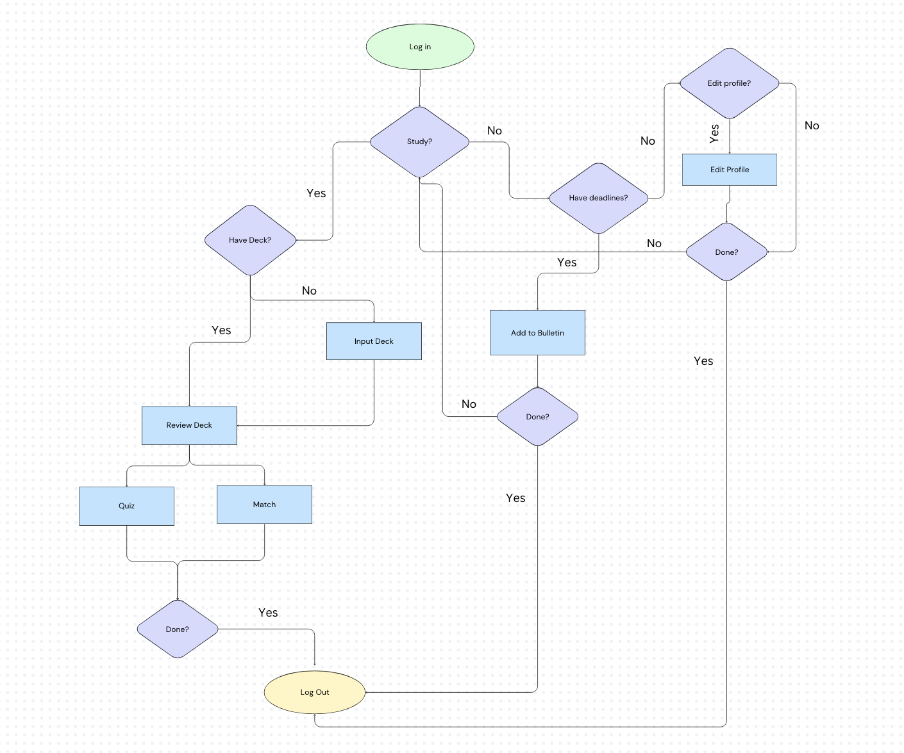
User Flow

Slide 6
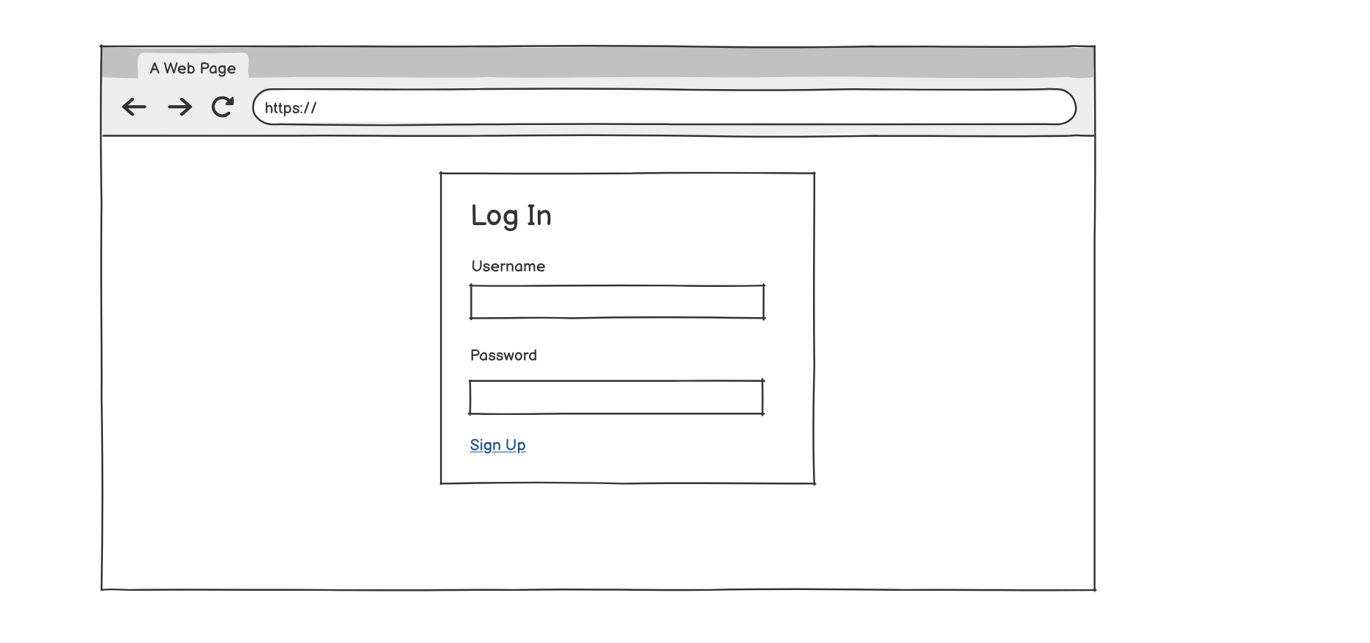
Log In Wireframe

Slide 7
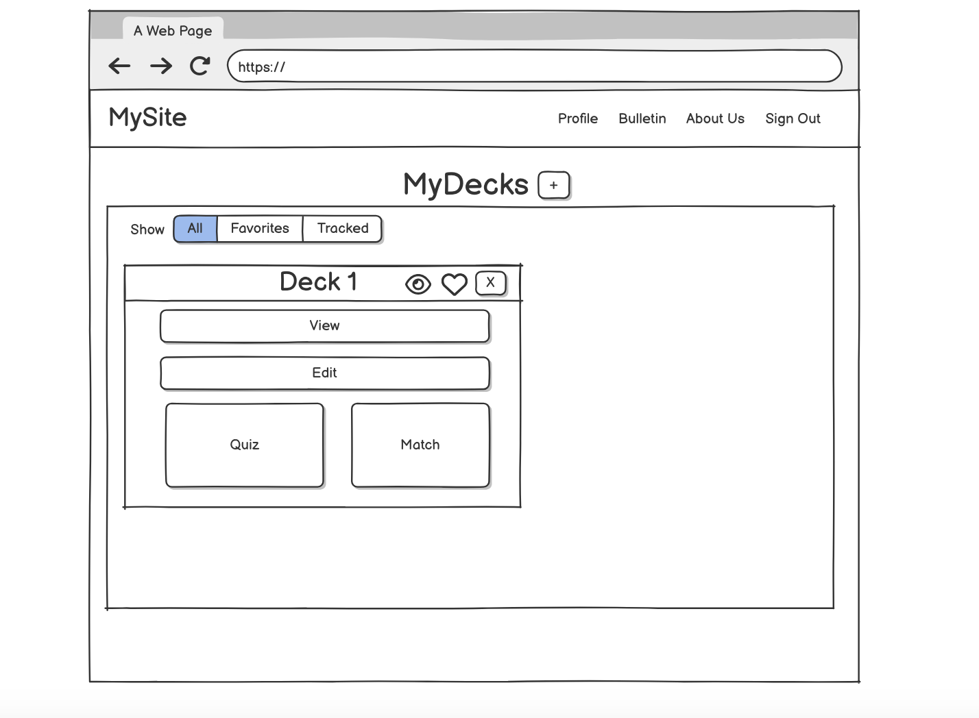
Homepage Wireframe

Slide 8
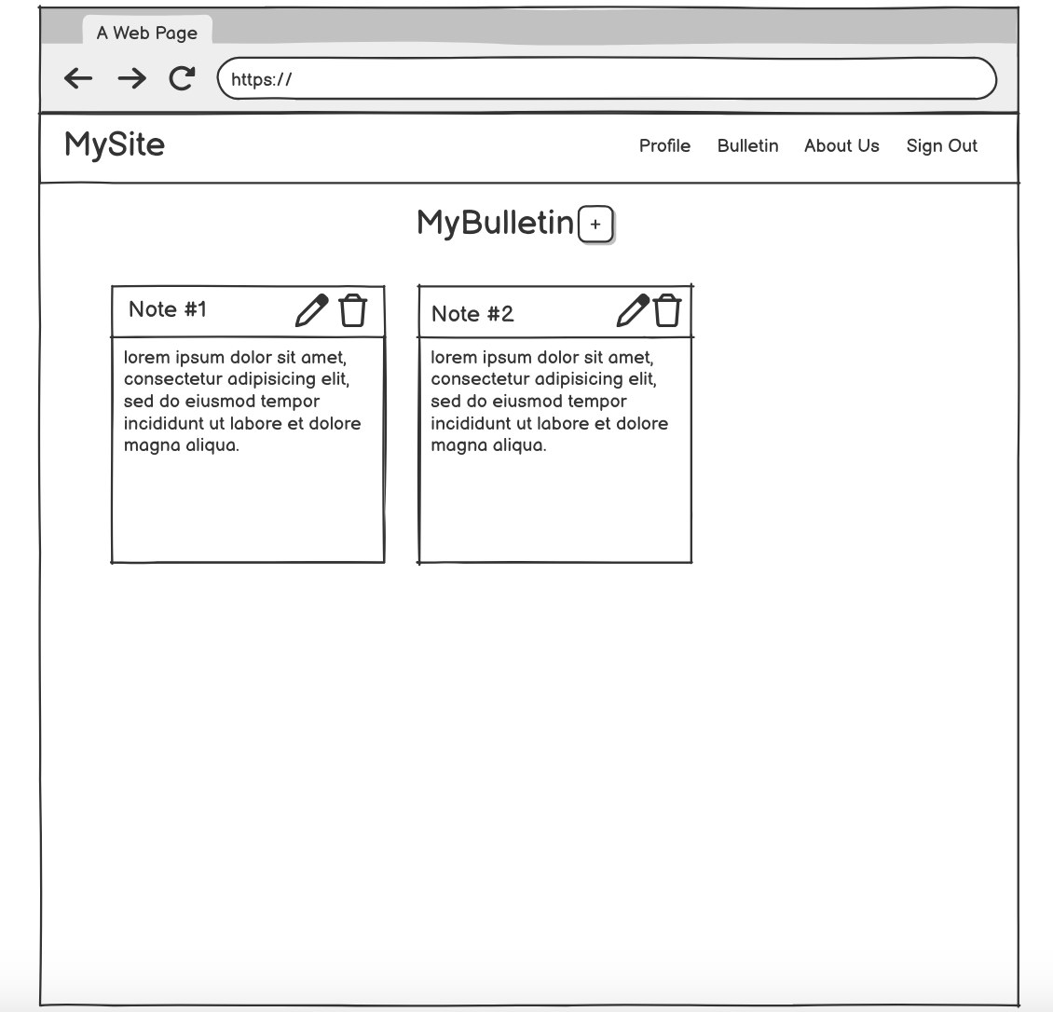
Bulletin Wireframe

Slide 9
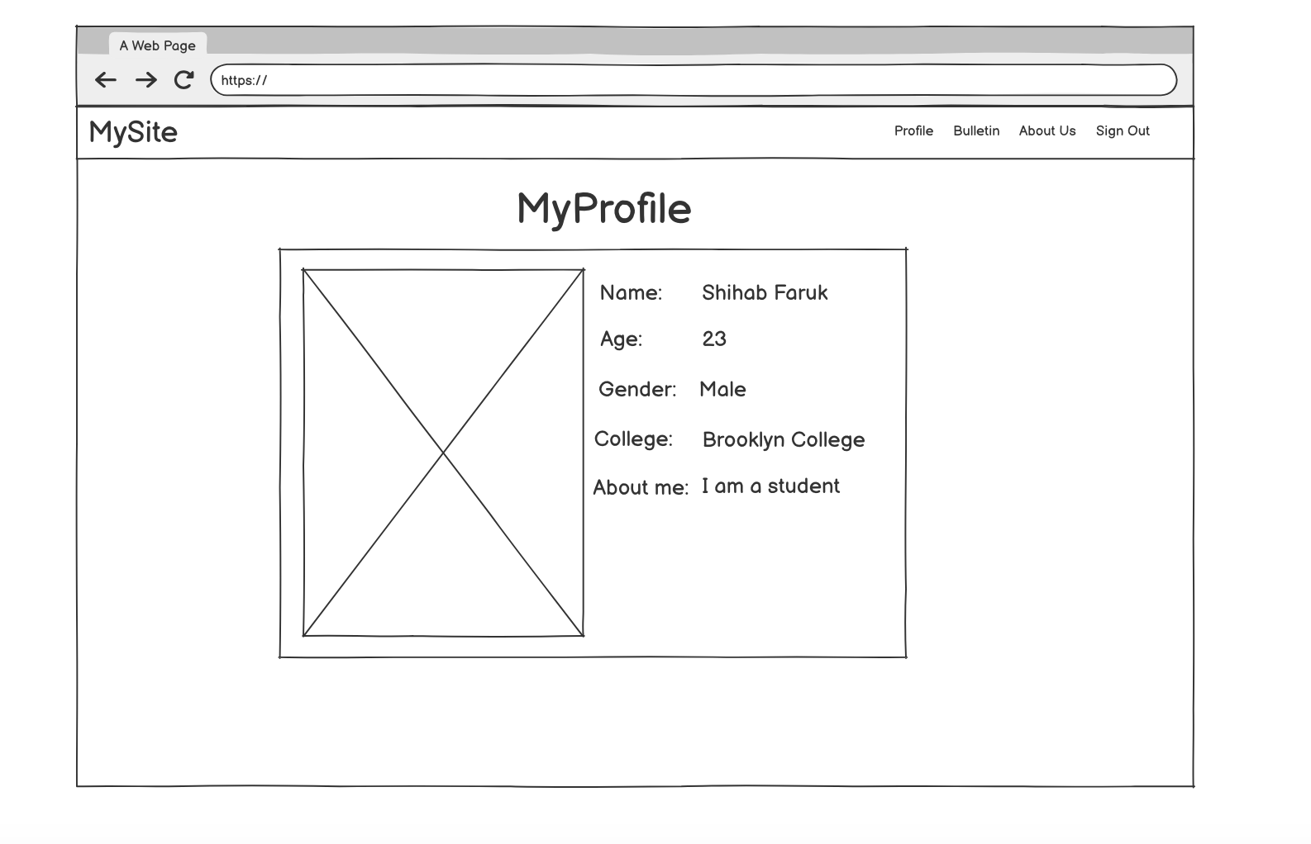
Profile Wireframe

Slide 10
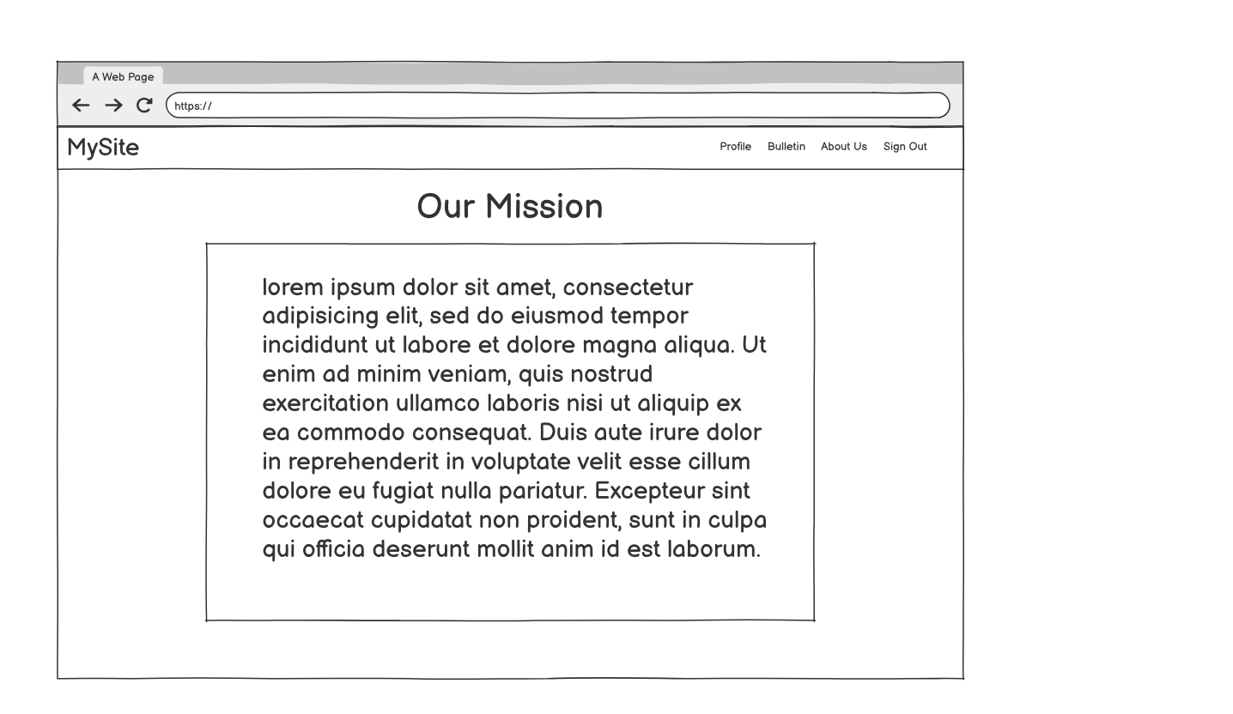
About us Wireframe

Slide 11
Tentative Schedule
Tasks | Timeframe
Planning the project, scope, tools, features | Weeks 1-3. This includes project proposal, project search etc.
Creating the wireframes, working on the UI of the pages. | Weeks 4-5 I will create wireframes on Balsamiq before creating pages in html and css. I will also be researching backend development during this period
Create the demo 1 showing my progress so far | Weeks 6-7
Work on creating the database schema and trying to implement it. | Weeks 7-9
Live Presentation | Week 8
Work on the Backend of the Project. | Week 9-12. This portion of the project I’m more unsure of as I’ve never worked with a backend before.
Demo 2 | Week 11.
Presentation Slides | Week 13-15

Slide 12
Updated Tentative Schedule
Tasks | Timeframe
Live Presentation | Week 8
Bulletin and Profile Functionality | Week 8
Flashdeck Implementation and Features | Week 8-10
NodeJs and Backend Research | Week 8-10
Presentation Slides | Week 10
Demo 2 | Week 11
Backend and Database Implementation | Weeks 11-14
Final Draft Presenation Slides | Weeks 13-15

Slide 13
Will I use any Datasets?
Most likely no. Most of the data will probably be created by me and inserted into a database.
My database will store dummy users and their flashcard decks, bulletin posts, and profile information.

Slide 14
Use Case #1
Scenario 1: A student will want to review flashcards for a history exam. The student will log in with their proper credentials and in the homepage click the plus button. A modal will pop up and take in definitions and terms inputted from the user in a form. Once submitted a deck object containing the terms will appear on the homepage. The student will click the matching game in the deck container to test themselves.

Slide 15
Use Case #2
A student has to keep track of next week’s Data Structures exam, his sister’s birthday, and a networking event in 3 weeks. The student clicks on the bulletin tab at the top of the homepage. The user then clicks the plus button and through a modal creates a “sticky note”. The user does this for the other 2 events as well. The user can log in to the site and know what reminders they have set for themselves.

Slide 16
Use Case #3
A student has just taken his history final exam and got an 85. He created a deck for review a week before the exam. The student is done for the year and decides he doesn’t need his materials for the class anymore. He logs in with his credentials and at the homepage finds the deck titled History Final. He then presses the x at the top right corner of the deck deleting the flashcard deck for that class.

