Slide 1
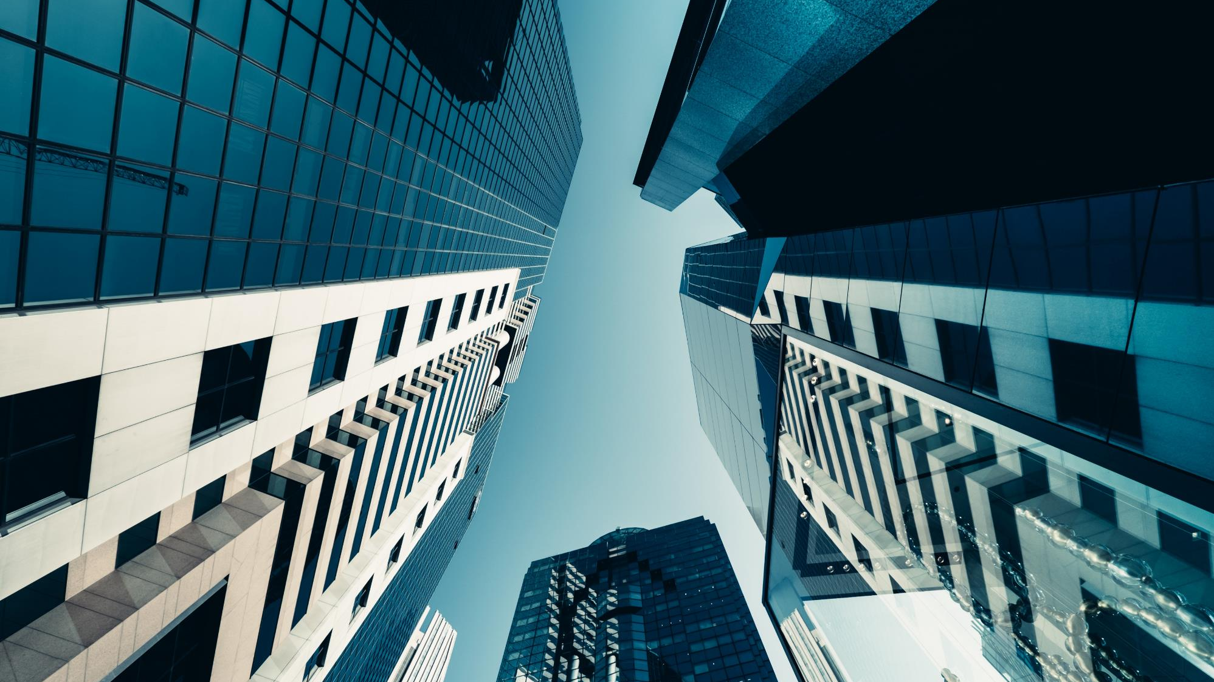
Image Processing and Computer Vision
Automatic licenceplate-detection
SfarzoEl Husseini (0001026293)
Tony Chahoud (0001036076)
Henrike Hummel (1900095402)

Slide 2
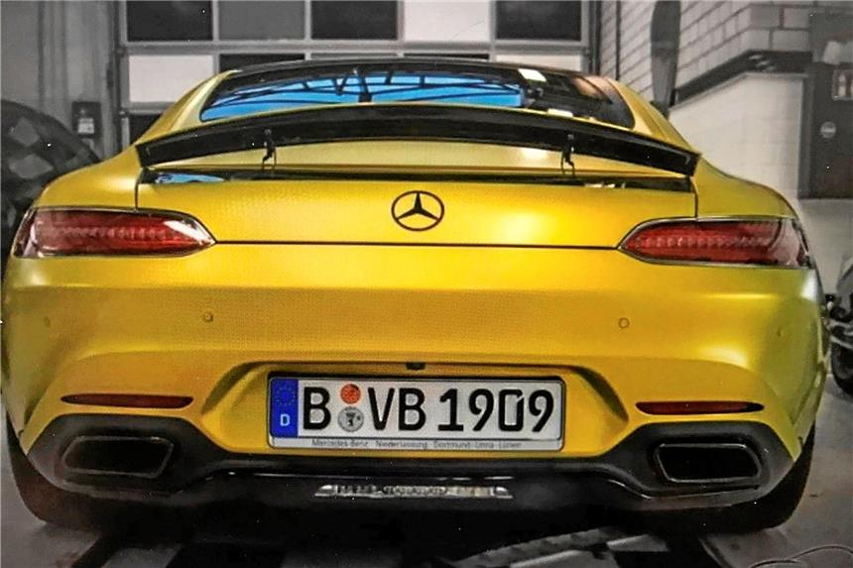


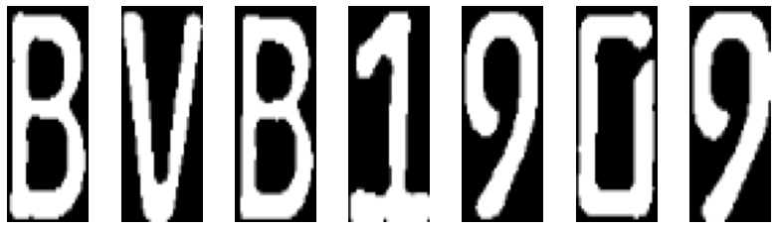
PROJECT - PIPELINE
Step 1:
Plate detection (WPODNET)
Step 2:
Extract characters (OpenCV)
Step 3:
Optical character recognition (MobileNets)
Result
B V B 1 9 0 9
BVB 1909

Slide 3
PROJECT - PIPELINE
Evaluation
Step 1
Step 2
Step 3
Input
Initial photo
Licence Plate
Licence Plate in segments
Step 1: IoU
Adjusting photo size
Gray value picture
Adjust size of characters
Levenstheindistance
Gaussian blur
WPOD-NET
Binarisation with Niblack
MobileNets
Classification of characters
Feature map
Dilation
Finding contures and sorting
Licence Plate and Coordinates
Output
Licence Plate in segments
Final licence plate

Slide 4
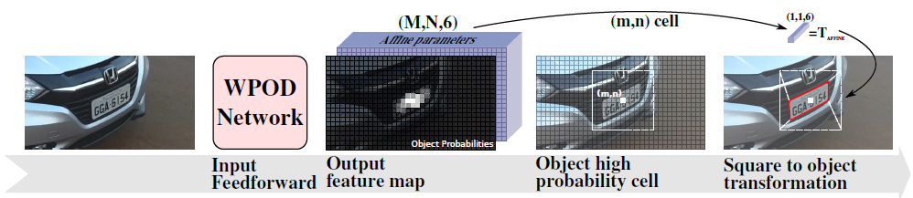
STEP 1: Recognition of the licence plates by means of a neural network
WPOD-NET (CNN): Pre-trained network with 21 convolutional layers, 4 max pooling layers (2×2, stride 2), 1 softmax, 1 linear layer and 1 concatenation layer.
Input: total photo (jpeg)
Output: 8-channel Feature map of total photo, reduced 16 times
Final Output: cut out number plate + coordinates
Python library: keras, TensorFlow
Evaluation : Intersection over Union (IoU)
Image warping
Reference: Taleb Soghadi, Zahra, https://spectrum.library.concordia.ca/id/eprint/986363/

Slide 5
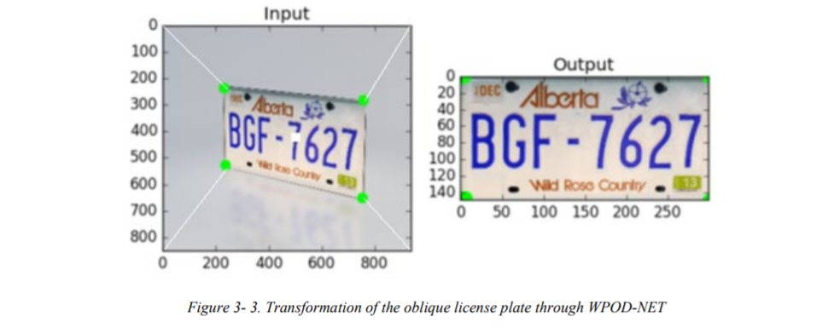
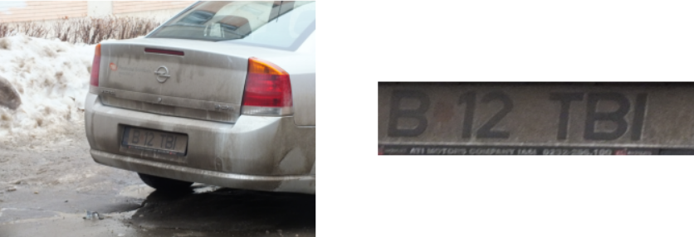
STEP 1: Recognition of the licence plates by means of a neural network
WPOD-NET (CNN)
Quelle: Zahra Taleb Soghadi 2019, p.22

Slide 6
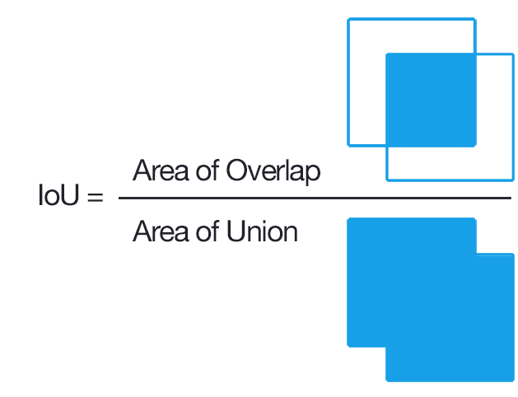
Intersection over Union
Evaluation
Calculation
(x_inter1, y_inter1)
Used for Evaluation of step 1
Cor: [x_inter1, y_inter1, x_inter2, y_inter2 ]
Width_inter = (x_inter2-x_inter1)
Height_inter = (y_inter2-y_inter1)
Area_inter=width_inter*height_inter
(x_inter2, y_inter2)
Reference: https://www.pyimagesearch.com/2016/11/07/intersection-over-union-iou-for-object-detection/

Slide 7
Intersection over Union
Red = licence plate from xml (box2)
Green = predicted plate (box)
1. Reading in coordinates from xml with xml.etree.ElementTree
2. Drawing a box in red with the new coordinates
3. Calculate IoU
In Step 1

Slide 8
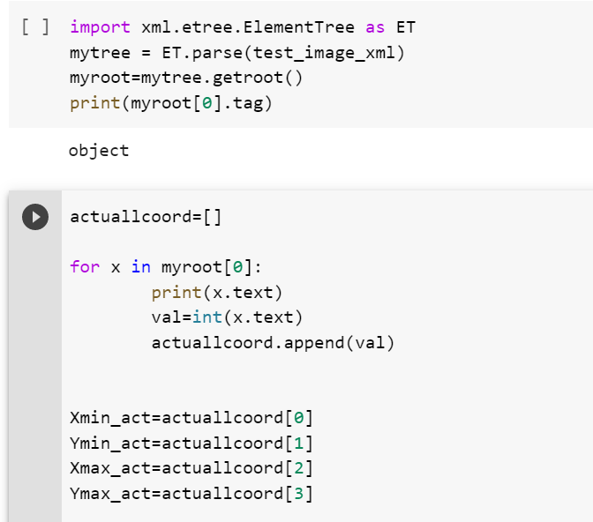
PROJECT - PIPELINE
Used Data:
Data sets of images with cars from EU, Romania and Brasil
Xml-files with the coordinates and content of the licences plates
How to import the xml as an array (actuallcoords):

Slide 9
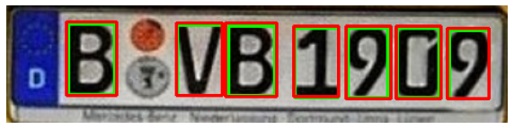
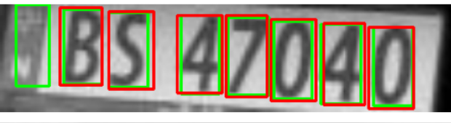
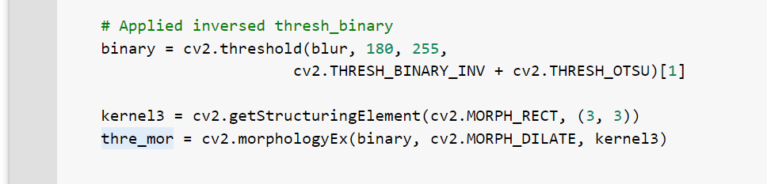
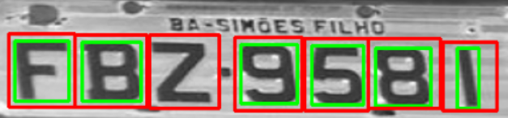
STEP 2: Extracting the characters from the number plate (binarization and labeling)
Image processing:
binarisation according to Niblack (illumination inhomogeneity considered): The threshold value at each pixel is calculated as the sum of the mean and the standard deviation (times a constant, k) of the neighbourhood surrounding the pixel. It is based on applying the following formula to each pixel centred on a n×n neighbourhood surrounding the pixel to derive a local threshold.
For the dark background licence plates: threshold value for black and white pixels: 180 (0-179 background; 181-255 foreground)
Determine contours and split using OpenCV
Evaluation of segmentation (IoU): comparison of labels for each individual character (xml vs. code)
Reference: S. M. Silva und C. R. Jung (2018
https://craftofcoding.wordpress.com/2021/09/30/thresholding-algorithms-niblack-local/)

Slide 10
STEP 2: Extracting the characters from the number plate (binarization and labeling)
Image processing:
Dilation: to enhance the white contour
Determine contours and split using OpenCV
Reference: S. M. Silva und C. R. Jung (2018
https://craftofcoding.wordpress.com/2021/09/30/thresholding-algorithms-niblack-local/)

Slide 11
STEP 3: Extracting the characters from the number plate
MobileNets (CNN): Pretrained net with 27 Convolutional Layers, 1 Average Pooling Layer, 1 Fully Connected Layer and 1 Softmax Layer.
Input: Segmented characters as individual images
Output: Output of classified characters
Python library: keras
https://arxiv.org/abs/1704.04861
B V B 1 9 0 9
Reference: Howard, A. G. et al (ttps://arxiv.org/abs/1704.04861)

Slide 12
OVERALL EVALTUATION TOOLS
Fuzzywuzzy using the Levenstheindistance
Proportion of completely correctly recognized number plates
the Levenshtein distance is a string metric for measuring the difference between two sequences.
the Levenshtein distance between two words is the minimum number of single-character edits (insertions, deletions or substitutions) required to change one word into the other.
Output of fuzzywuzzy: Size of the share of the number plate that was correctly recognised
Taking the mean of the shares for all input images to calculate the overall accuracy
Reference: https://towardsdatascience.com/string-matching-with-fuzzywuzzy-e982c61f8a84

Slide 13
Conclusion and outlook
Ideas to improve model:
At the moment only working for license plates with light background and dark characters
Problem with plates in different ratios that european plates (Dmax, Dmin)
Segmentation using pattern recognition methods leads to problems with characters that do not belong to the number plate (e.g. badges)
https://www.pyimagesearch.com/2016/11/07/intersection-over-union-iou-for-object-detection/

