Slide 1
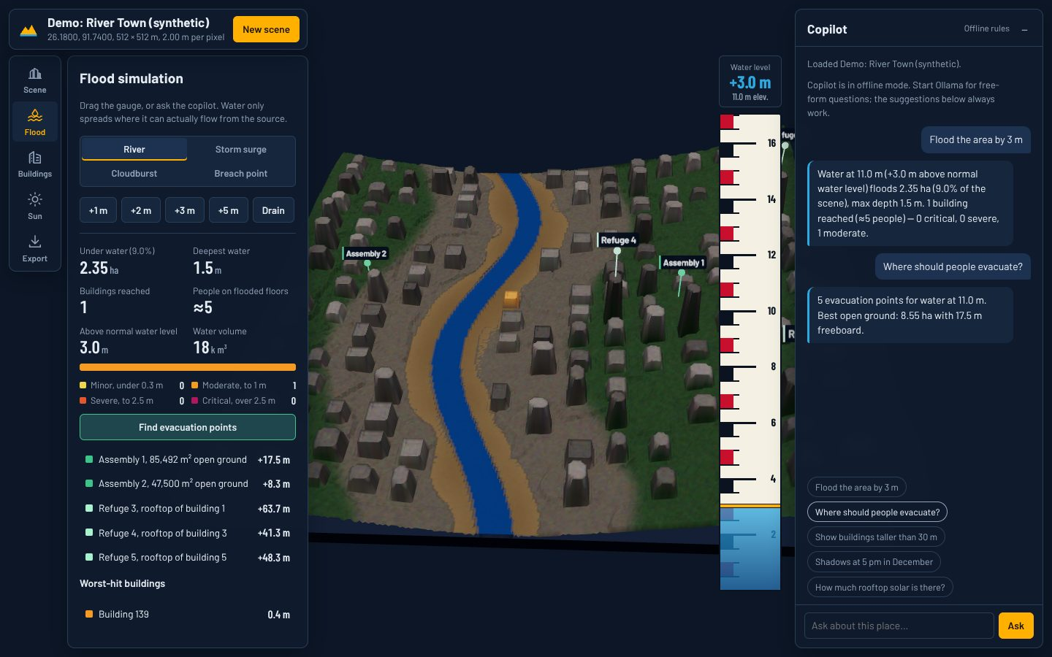
DepthWizard
Category 1: Smart Solutions, Smarter Society
One satellite image in, a measurable 3D twin out. Raise the river, see who floods, send people to safety.
Team Nevermind (IT26-1783)
Mohd Sarfaraz (Team Leader), Prayas Kumarsingh, Yasharth Singh Solanki, Garima Singh, Ayushi Manav
Notes:
Introduce the team and the one-line pitch.

Slide 2
When the river rises, control rooms fly blind
1
Which streets go under water?
Today
3D city models need LiDAR or stereo imagery: costly and slow to commission
Most flood-prone Indian towns have none
Every town does have satellite imagery
2
How many people are in those buildings?
3
Where should they go?
Same gap for planners: no 3D model means no rooftop-solar or building inventory either.

Slide 3
One image to a decision-ready 3D twin
1
2
3
4
Pick any place
→
AI reconstructs 3D
→
Anchor to reality
→
Decide
Map search or upload a drone / satellite image
Depth Anything V2 estimates building shapes
Real terrain (SRTM) + OpenStreetMap heights
Flood impact, evacuation, slopes, solar
All free: Esri imagery, AWS terrain, OpenStreetMap, open-source AI, local LLM. No API keys. Runs on a laptop.

Slide 4
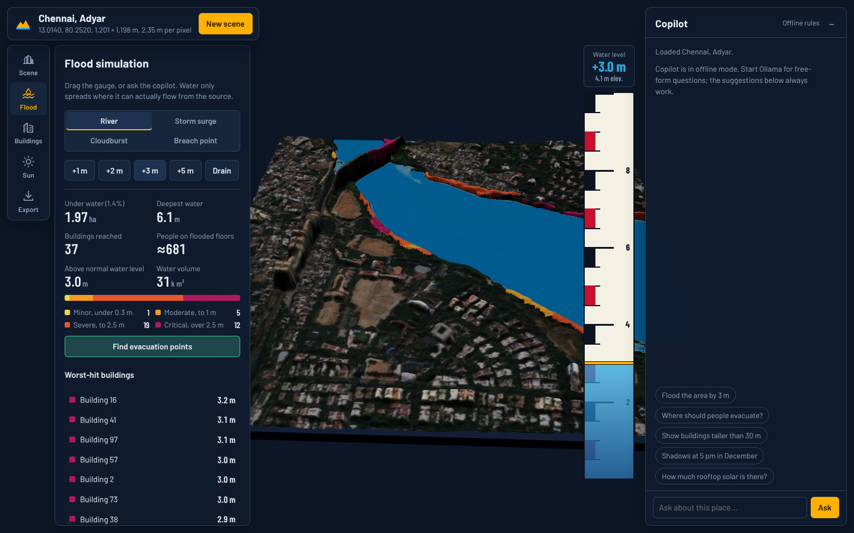
What it does
Flood simulation
River, storm surge, cloudburst or breach; water flows only where it can
Impact report
Buildings reached, depth at each door, people on flooded floors
Evacuation points
Dry open ground and tall rooftops, ranked by height above water
Smart-city tools
Real shadows, rooftop solar per building, slope hazard
AI copilot
Plain English; free local LLM picks actions, code computes numbers
Chennai, Adyar: water raised 3 m. Blue = river, brown = new floodwater
Exports
Printable brief, phone AR, 3D print, GIS data

Slide 5
How it works
Depth AI
Real scale
Depth Anything V2 (PyTorch); fake perspective tilt removed by morphological opening
SRTM terrain + OpenStreetMap height tags, validated on held-out buildings
Water detection
Analytics
Colour, texture, flatness and terrain cues find rivers; they become the flood source
Connected flood fill, watershed building segmentation, NOAA sun, ray-marched shadows
Copilot
Stack
Ollama qwen2.5:3b (free, local); outputs actions only, so no made-up numbers
Python, FastAPI, NumPy/SciPy | Three.js, Leaflet, model-viewer | 37 tests in CI

Slide 6
Measured, not claimed
139/139
36
~1 min
±50%
buildings found on a test town with known heights (1 m error)
buildings and about 660 people flooded at +3 m on the Adyar, Chennai
per 1.2 km scene on a CPU laptop; flood report in 23 ms
honest height error on Manhattan skyscrapers, shown in the app
We validate on OpenStreetMap buildings never used for calibration, so the accuracy number is independent, not circular.

Slide 7
Impact and roadmap
Who uses it
SDMA / DDMA flood control rooms
Municipal planners and solar programmes
Relief NGOs and field teams
Why it scales
Any town with satellite imagery
Zero data or licence cost
Laptop-only, works offline once built
Next steps
1
Land-cover AI to separate trees from roofs
2
ISRO CartoDEM terrain instead of 30 m SRTM
3
Time-based rainfall and runoff model
4
Live river-gauge feeds and WorldPop population

Slide 8
Any town. One image. Today.
Live demo: Chennai flood, evacuation points, copilot, impact brief, phone AR
Thank you. Team Nevermind (IT26-1783)
Mohd Sarfaraz (Team Leader), Prayas Kumarsingh, Yasharth Singh Solanki, Garima Singh, Ayushi Manav

