Slide 1
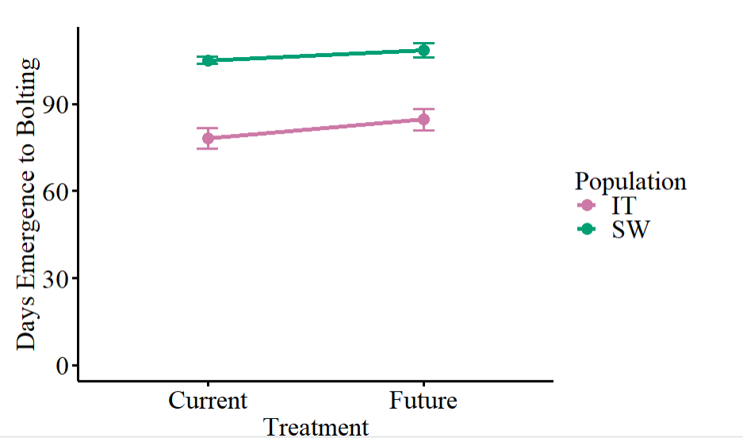
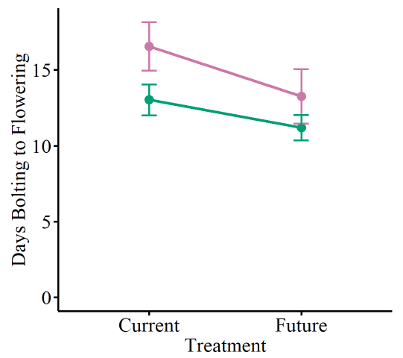
Interpretation: In both experiments, Sweden takes longer to bolt than Italy. However, Italy then takes longer between bolting and flowering. We also see that the future environment takes longer to bolt but less time between bolting and flowering. Only in 2022 was there differentiation for plasticity in days between emergence and bolting, which means?
2021
Pop
Trt
Int
2021
Pop
Trt
Int
Notes:
Phenology - Main

Slide 2
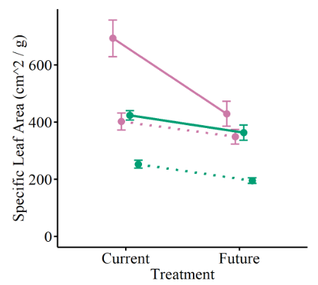
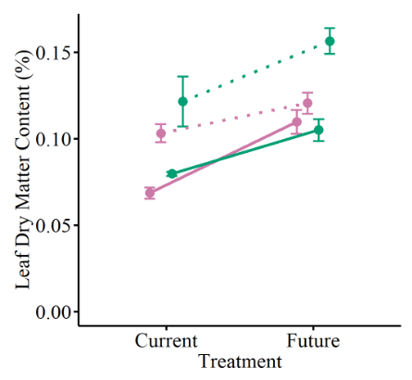
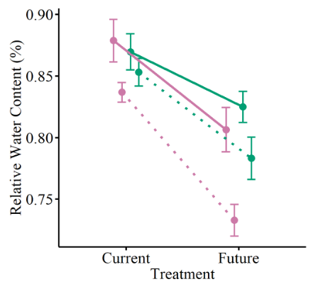
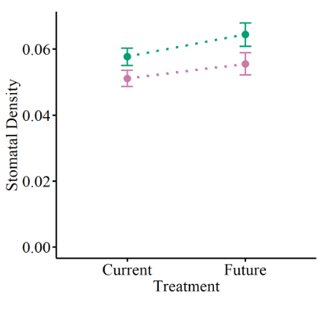
Interpretation in notes
2021
Pop
Trt
Int
2022
Pop
Trt
Int
2021
Pop
Trt
Int
2022
Pop
Trt
Int
2021
Pop
Trt
Int
2022
Pop
Trt
Int
2022
Pop
Trt
Int
Notes:
Leaf traits – Main
Interpretation: RWC – pop dif says maybe some genetic differences or different optimal hydration on leaves?? But trt says we are stressing the leaves out b/c less hydrated in future environment and differentiation for plasticity says we are stressing the leaves out to different degrees – Sweden is better able to maintain higher water content than Italy (Italy more plastic, but in this case plastic might be bad).
Stomatal density – Sweden has more stomata, both have more stomata in future environment. Maybe lean on Tori for what this means, but would guess that there are more stomata in SW b/c historically less stressed (??) but more in future is not what I would expect because I would expect less in future for less water loss through the pore. Need to do some lit searching.
LDMC – SW invests mre in leaves than Italy. Both invest more in future environment. Indicates more leaf investment to make it through stress, but maybe different strategies where SW is always investing more b/c of past selection but IT is not investing unless stressed from beginning of life? This is where some of my escape vs tolerance argument was coming from. SW being more tolerant is supported by RWC
SLA – SW has lower SLA meaning thicker leaves so I think ties in with the escape/tolerance argument
What does the differentiation for plasticity mean here? Not always same pop so hard to say something about which population is generally more plastic, so maybe the conclusion is then that plasticity is really trait dependent – already known – even within traits related to response to the same stress (all drought/heat response, pops responded in different ways and to different extents for different traits)

Slide 3
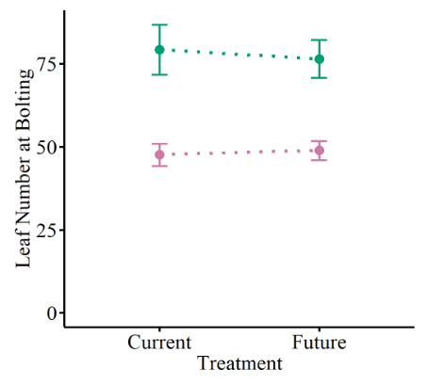
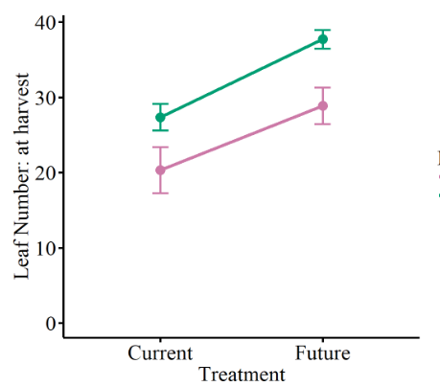
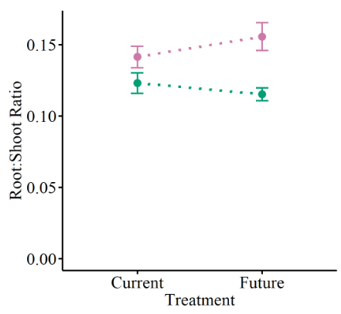
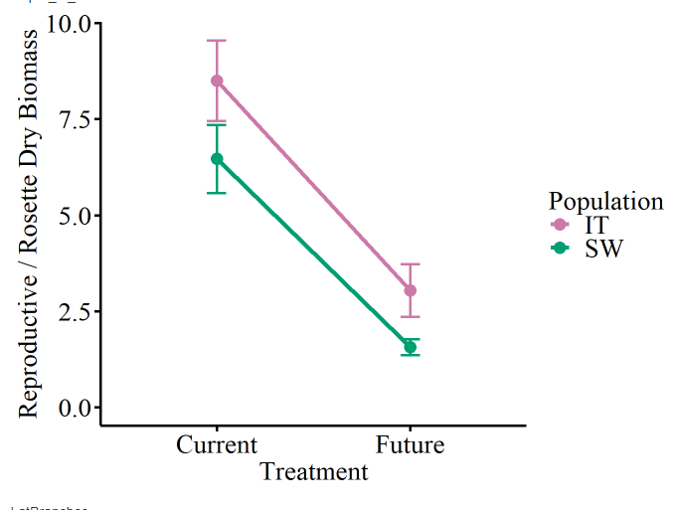
Pop
Trt
Int
Pop
Trt
Int
Pop
Trt
Int
Pop
Trt
Int
Notes:
Biomass – Main
SW has more leaves and more above ground investment compared to Italy, but Italy has more reproductive investment than Sweden. Again maybe is reflective of the same idea where Italy is not investing in leaves, live fast, so more investment in reproductive biomass while Sweden is investing more in leaves (number and carbon content) which translates to less relative root and reproductive investment in terms of mass
The differentiation for plasticity shown here I think is interesting b/c are in different directions and is driven by the above ground investment in SW. SW maintains more above ground investment when stressed but Italy reduces it more.

Slide 4
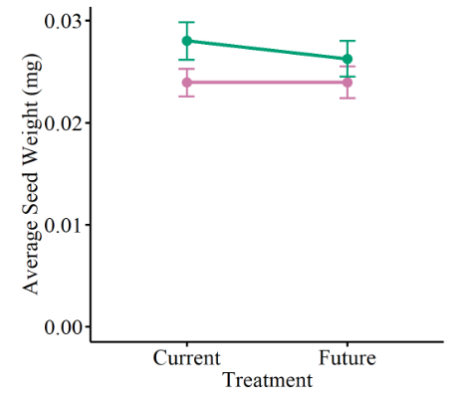
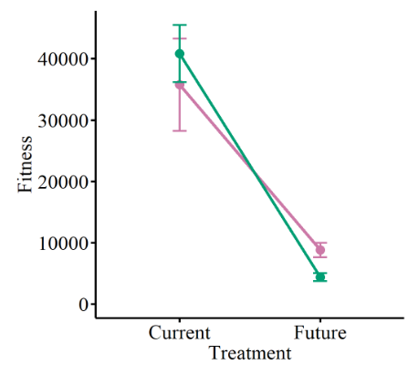
Pop
Trt
Int
Pop
Trt
Int
Notes:
Fitness – Main
Interpretation: Italy does do better in future environment. Sweden invests more in each seed. Note shown but Italy also makes more fruits so seems like a quantity vs quality trade off between populations. Italy does do better in the future environment indicating potential positive role of assisted gene flow

Slide 5
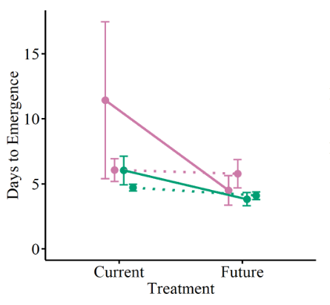
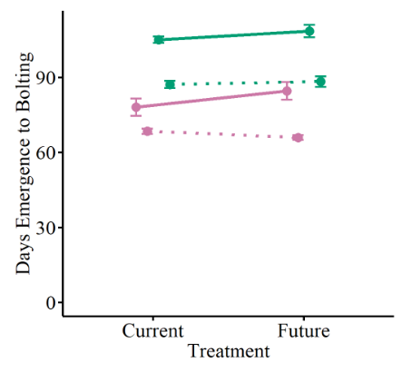
2021
Pop
Trt
Int
2022
Pop
Trt
Int
2021
Pop
Trt
Int
2022
Pop
Trt
Int
Pop
Trt
Int
Notes:
Phenology - Main

Slide 6
2021
Pop
Trt
Int
2022
Pop
Trt
Int
2021
Pop
Trt
Int
2022
Pop
Trt
Int
2021
Pop
Trt
Int
2022
Pop
Trt
Int
Pop
Trt
Int
Notes:
Leaf traits - Main

Slide 7
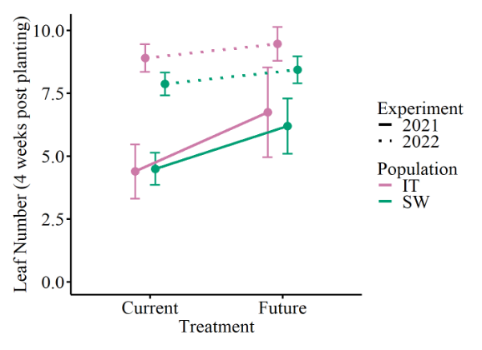
Pop
Trt
Int
Pop
Trt
Int
Pop
Trt
Int
Pop
Trt
Int
Pop
Trt
Int
Pop
Trt
Int
Notes:
Biomass - Main

Slide 8
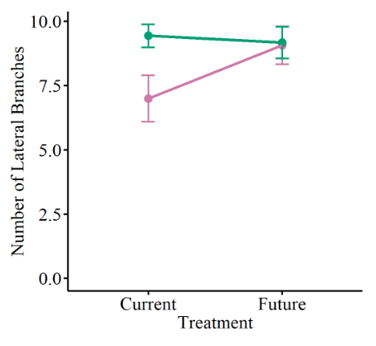
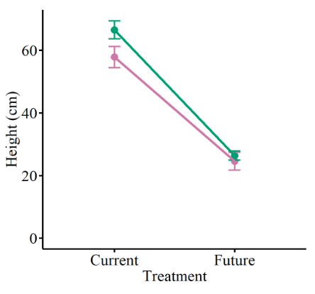
Pop
Trt
Int
Pop
Trt
Int
Pop
Trt
Int
Pop
Trt
Int
Notes:
Fitness - Main

Slide 9
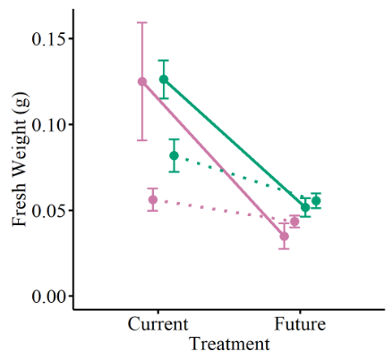
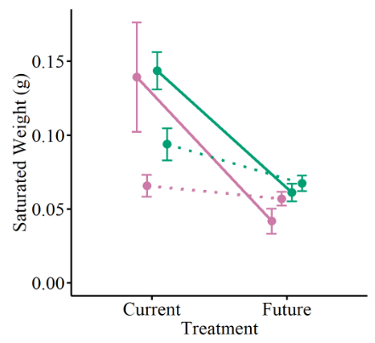
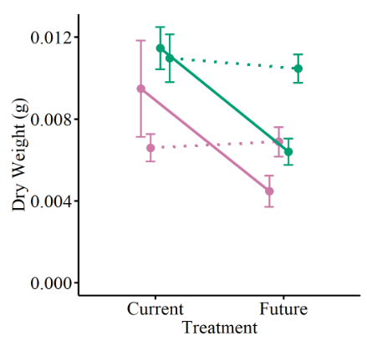
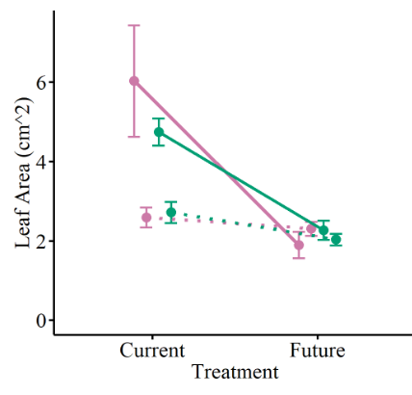
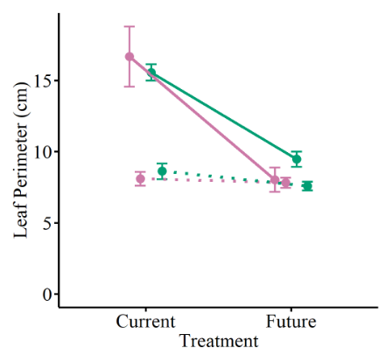
2021
Pop
Trt
Int
2022
Pop
Trt
Int
2021
Pop
Trt
Int
2022
Pop
Trt
Int
2021
Pop
Trt
Int
2022
Pop
Trt
Int
2021
Pop
Trt
Int
2022
Pop
Trt
Int
2021
Pop
Trt
Int
2022
Pop
Trt
Int
Notes:
Supplemental

Slide 10
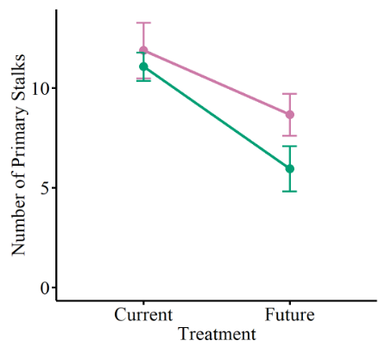
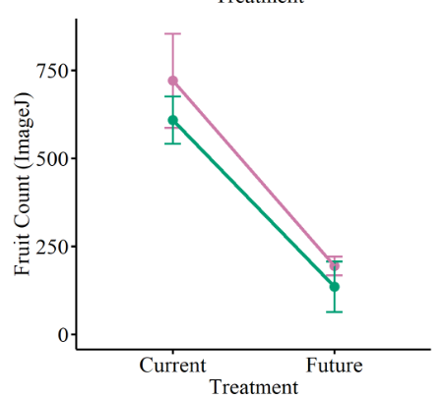
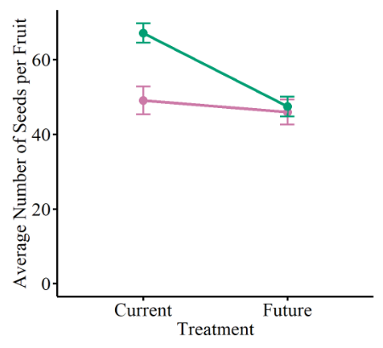
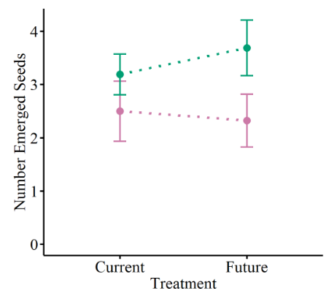
Pop
Trt
Int
Pop
Trt
Int
Pop
Trt
Int
No model
Notes:
Fitness components – Supplemental (don’t think number emerged has a model but it has a figure)

Slide 11
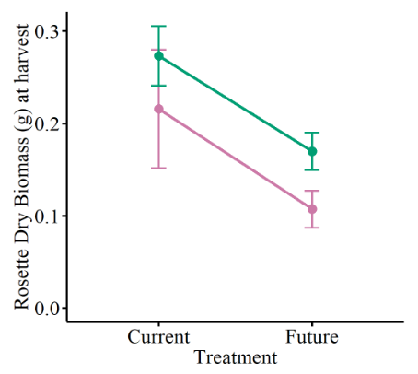
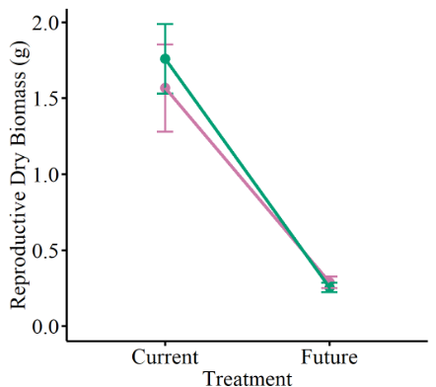
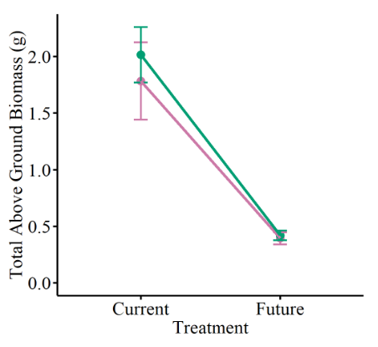
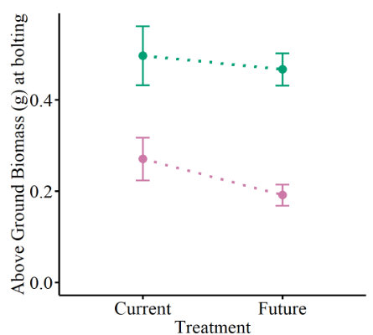
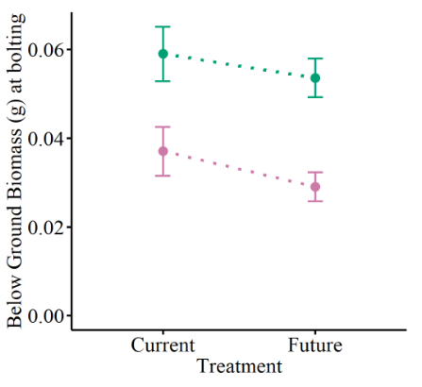
Pop
Trt
Int
Pop
Trt
Int
Pop
Trt
Int
Pop
Trt
Int
Pop
Trt
Int
Notes:
Biomass Supplemental

Slide 12
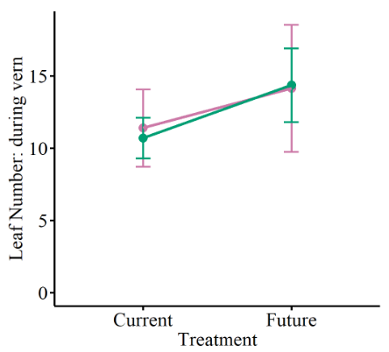
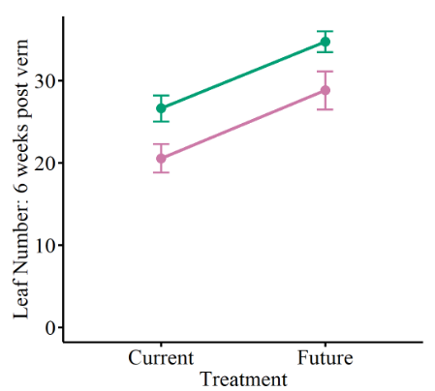
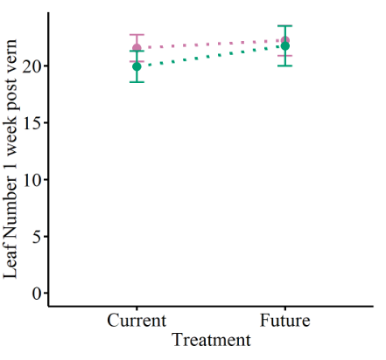
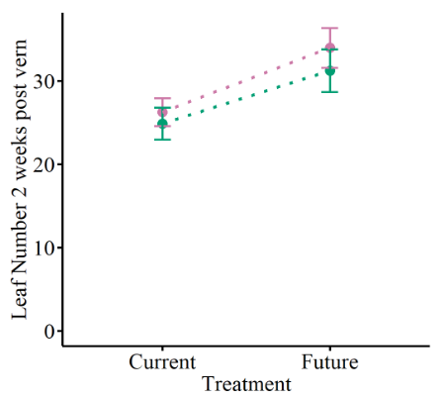
Pop
Trt
Int
Pop
Trt
Int
Pop
Trt
Int
Pop
Trt
Int
Notes:
Additional leaf numbers: Cut from manuscript

