Slide 1
Architecture References for GCP-Snowflake
Contact: ali.khosro@snowflake.com
More Content

Slide 2
One Slider
Independent Slides

Slide 3
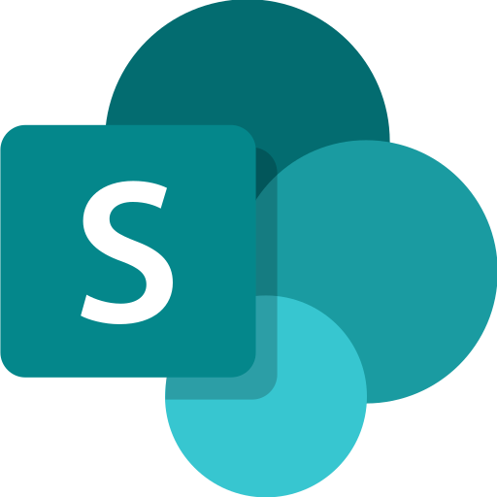
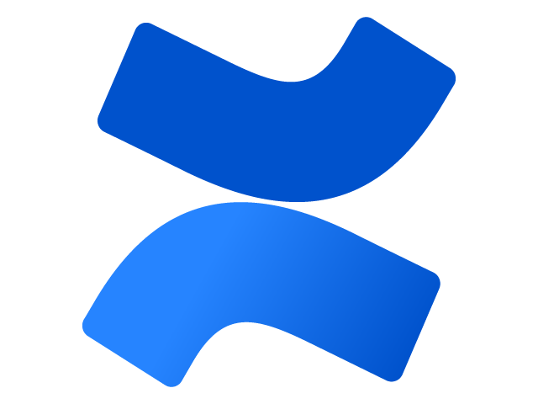
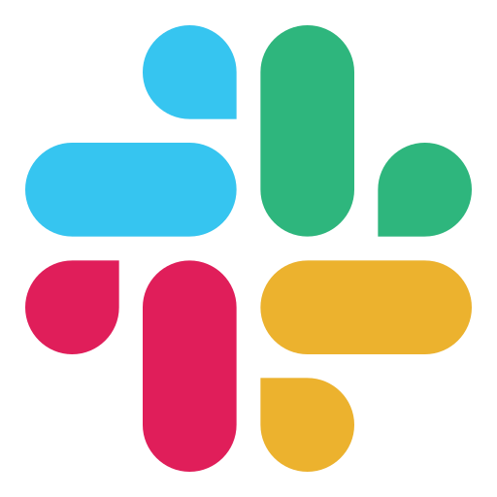
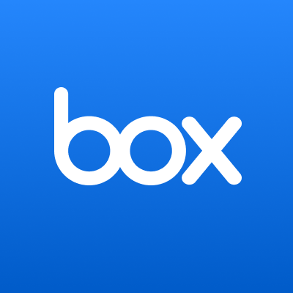
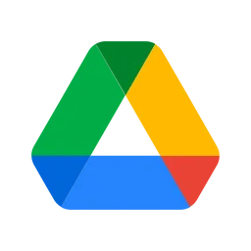
Cortex AI Ecosystem
Source
Data Layer
Semantic Layer
Orchestration
Users
Snowflake Intelligence
Slack/Teams
Cortex Analyst
Cortex Agents
Gemini Enterprise
Data Connectors
Cortex Search
TXT
Chat Bots
Document AI
AI
Workflows
AUDIO

Slide 4
Snowflake-GCP Collaboration Methods and Best Practices
Method | Stack | Consumer Services | Use Case
Direct Connect | Native Connectors (JDBC, Python, ODBC) | Applications Cloud Run, App Engine, Looker, Vertex AI Inference | Fast, two-way R/W access for general applications. Default path. Eliminates Egress.
Move Workload to SF | SnowPark SPCS, SF Feature Store, Model Registry | ML/DS workloads In any of your preferred language Scala, Python, etc. | Using Snowflake MLops platform for building, training, and serving ML workloads.
Interoperability | Iceberg (i, ii) CLD, Polaris, BigLake | BigLake, GCS BigQuery, Vertex AI Training/Ray, DataBricks, Spark | Building Lakehouse (BigLake) to share the same massive data across multiple engines Catalog Federation would be great
Continuous Egress | OpenFlow (NiFi) | GCS or PubSub or Kafka Vertex AI Training/Ray, BigLake, DataBricks, Spark Install Sowpark in Workbench | Granular/streaming delta updates (Egress).
Ingestion/Copy | Snowpipe Dynamic Tables Bulk Copy | GCS | Automated, continuous data loading (Ingress).
Bulk Copy (In/Out) | Copy Into <GCS> | GCS Vertex AI Training | Efficient bulk data unload (Egress).
Recommended Solution:
Iceberg for Shared Data: Iceberg Data Tables in GCP BigLake, Polaris Data Catalog managed by Snowflake, for Bronze and Silver layer data
Direct Connect for Applications: For application through Snowflake native connectors to consume Gold later data in SF native tables.
Polaris for Data Catalog supports many governance features such as time machine, delta updates, etc..
i- Polaris access control is not yet at the level of native Snowflake tables and we recommend direct connector for gold layer data that needs fine-grain access control. ii- Data Types: VARIANT (semi-structured) is currently unsupported by Iceberg.

Slide 5
Snowflake -> GCP
Snowflake Producer, GCP Consumer

Slide 6
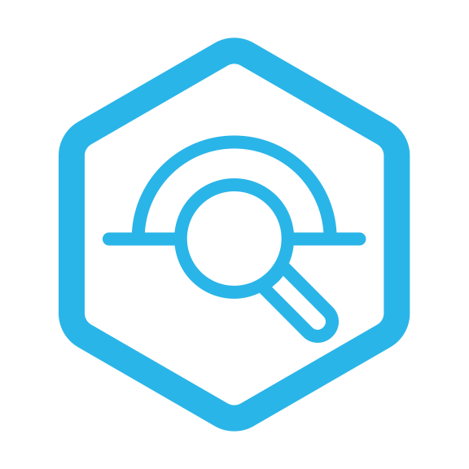
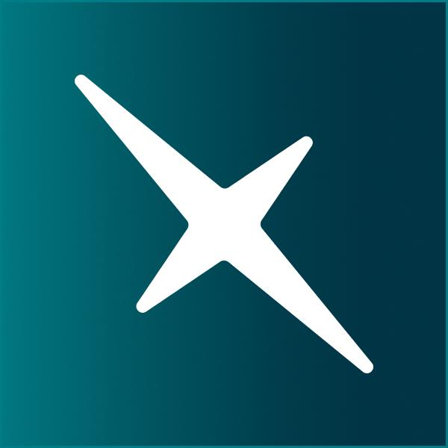
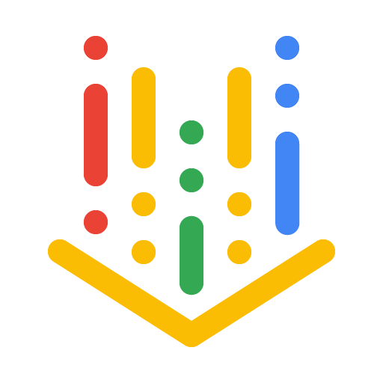
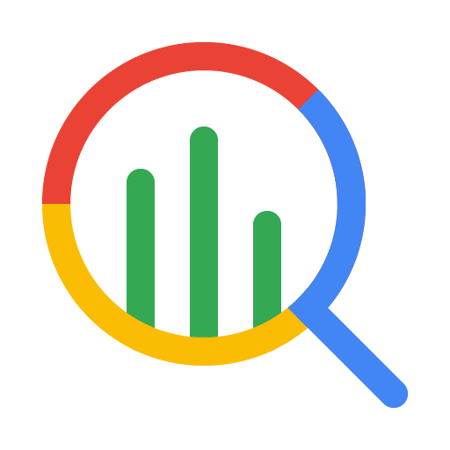
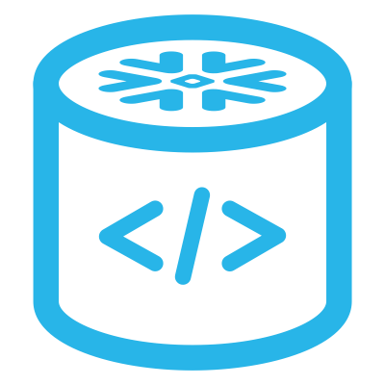
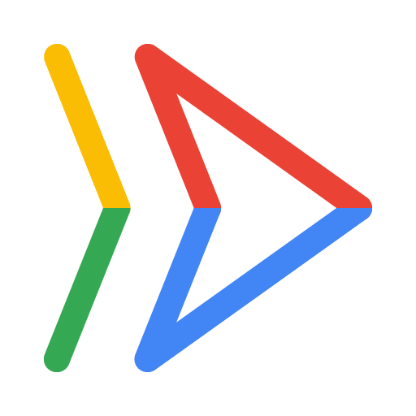
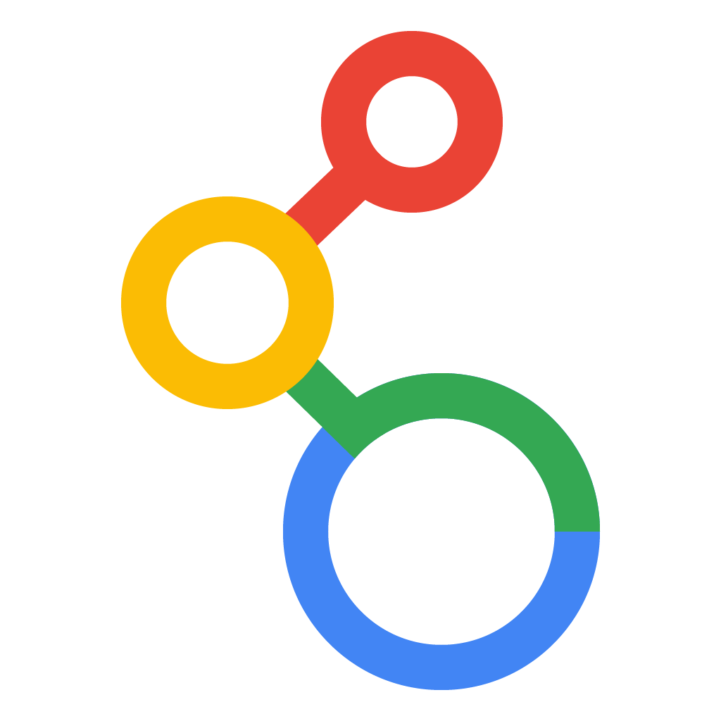
Recommended Architecture for Snowflake + GCP
Snowflake
GCS (Snowflake-Managed)
GCP Services
Horizon Catalog
Polaris Open Catalog
3
BigLake
4
2
Vertex AI Training
Feature Store
Big Query
1
Iceberg Schema Bronze/Silver
Data Layer
PARQUET
Native App / SPCS
Iceberg Tables
API Servers
5
Connectors
Native Tables Gold Data Layer
Looker
1- Native App or SPCS executes standard DML for 1) Iceberg tables to push to BigLake or 2) SF internal tables.
2- Horizon manages RDBC and Iceberg and sync Polaris.
3- BigLake serves as the unified access layer, connecting BigQuery securely to the Polaris-managed Iceberg metadata and the data files in GCS.
4- GCP analytics and AI services (e.g., Vertex AI training) consume the Iceberg tables by querying the integrated BigQuery/BigLake tables.
5- For Gold data layer tables, which granularity is crucial, use Snowflake Connectors to directly connect to Snowflake tables

Slide 7
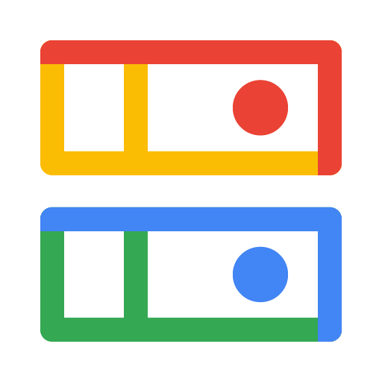
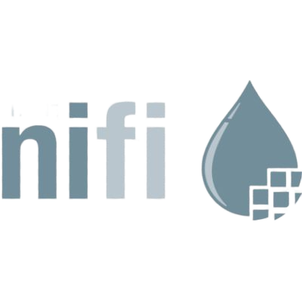
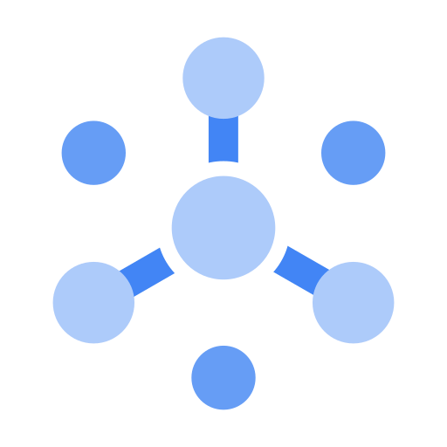
Egress to GCP Services
1- Use External Stages to unload massive datasets to GCS for initial and infrequent loads.
2- Use OpenFlow for delta updates and to manage advanced ETL
3- OpenFlow can output to GCS (microbatch) or PubSub (streaming)
4-Utilize BigLake to enable BigQuery to read Snowflake data in GCS without physical egress
5- Native connectors (JDBC, Python) enable Cloud Run or Compute Engine applications to query Snowflake directly.
Source
Transformation
Consumption*
1
Bulk Update
4
Snowflake
Big Lake
Big Query
External Stages
Copy Into
GCS
SF Streams
PutGCSObject
Vertex AI
2
3
PutGCPubSub
OpenFlow
5
PubSub
Connectors
Cloud Run
JDBC
Looker
* Consumption services can be replaced by similar services such as Kafka for PubSub, Compute Engine for Cloud Run.

Slide 8
GCP -> Snow -> Azure
SF on GCP Producer, Azure Consumer

Slide 9
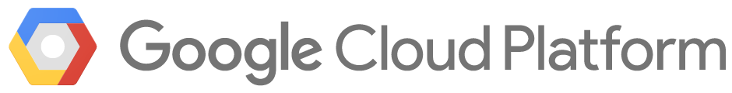



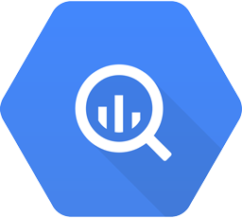

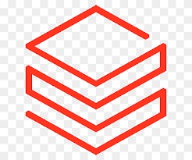

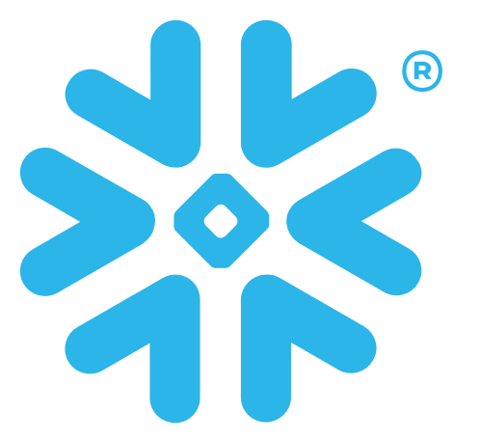

BigQuery to ADSL: Iceberg + Polaris + Snowflake
0- Setup
Create BigQuery Connection to ADSL, Define ADF pipeline, setup Snowflake Polaris
1- Export Data ADF pipeline triggers BigQuery Export Data of Parquet Files
2- Trigger Polaris
ADF triggers Snowflake Merge task that updates Iceberg tables and Polaris catalog
3- Connect Services
Services and databases that support Iceberg use Polaris to access Iceberg Tables
4- Consume The service engines read/write Iceberg tables in ADSL
Azure VPC
ADSL
Enterprise Services
1
4
Upstream Data BigQuery
Pipeline ADF
Data Files Parquet
PARQUET
Other Databases DB
Table Metadata Iceberg
Other Services
Databricks
2
3
Data Catalog Polaris
Data Warehouse
Snowflake

Slide 10
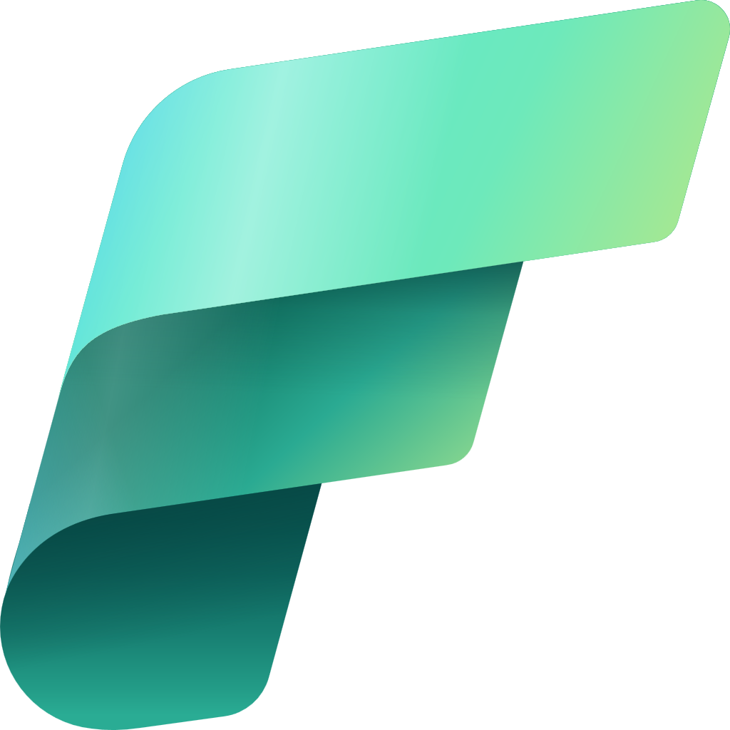

BigQuery to ADSL: Iceberg + Fabric
0- Setup
Create BigQuery Connection to ADSL, Define ADF pipeline, setup Fabric
1- Export Data ADF pipeline triggers BigQuery Export Data of Parquet Files
2- Trigger Polaris
ADF triggers Fabric Spark Merge that updates Iceberg tables and its built-in catalog
3- Connect Services
Services and databases that support OneLake use Fabric metadata visualization
4- Consume The service engines read/write Iceberg tables in OneLake
Azure VPC
Fabric OneLake
Enterprise Services
1
4
Upstream Data BigQuery
Pipeline ADF
Data Files Parquet
Other Databases DB
PARQUET
Table Metadata Iceberg
Data Warehouse
Snowflake
2
Fabric Catalog Fabric
3
Metadata Vis. Fabric
Other Services
Databricks

Slide 11
Architecture Diagrams
Architecture Diagrams

Slide 12
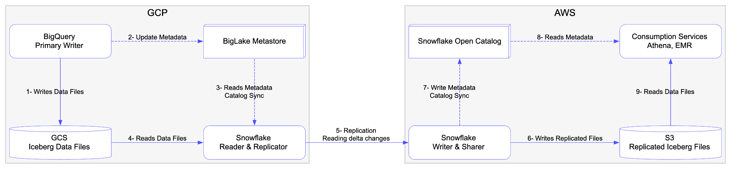
Data Sharing From GCP to AWS

Slide 13
Borrowed Slides
Borrowed Slides

Slide 14

CSP PRODUCT MAPPING TO SNOW WORKLOADS
Product category
Use cases
GCP Products
Data Engineering
Ingestion
Data Fusion, Datastream, Storage Transfer Service
Dataflow, Dataproc
BigLake
Transformation
Interoperable Storage
Business Intelligence
Looker,
BigLake BigQuery
Vertex AI Notebooks, BigQuery ML, Colab
BQ Data Transfer Service, Dataform, Database Migration Service
Analytics
Lakehouse Analytics
Powered By Analytics
Advanced Analytics
Migrations
AI & ML
Unstructured data insights
Vertex AI Studio, AutoML,Document AI, Vertex AI Vector Search
Gemini, Conversational Insight, Conversational Agents
Vertex AI, Model Garden, Colab
Conversational assistants
Model development
Applications Collaboration
Internal Collaboration
Analytics Hub, Cloud Composer, Data Transfer Service, Pub/Sub
Google Workspace, Cloud Run, APIgee, App Engine
Firebase, Cloud Workstations, Application Integration, Cloud Code
GCP Marketplace, BQ Data Marketplace
Business Efficiency
Build
Commercialize
Platform
Compliance, Security, Discovery & Governance
Security Command Center, IAM, Cloud Armor, SecOps, DataPlex
CCP Cost Management
Operation Suite (Logging, Monitoring, Tracing)
Cloud Storage, Firestore, Spanner
Cost Governance
Observability
Storage
GCP MP Features
MP Features drive GCP partner investment and thought leadership
Lack of adoption “Buy with”, Seller Prime, Telemetry, CRM Connectors
Internal Adoption
Internal Adoption of GCP Services
Feature Parity Gap is a main obstacle - Wider region support on GCP needed
Main Services
Notes:
AWS Service integration, some of these we have built DIY solutions but the integrations are not native: AgentCore, Q Business, Bedrock (KnowledgeBases), Sagemaker Unified Studio, S3 Vector Store, S3 Tables (post launch integration). Recent ones we are asking for support on tied to RIV Launches are: IAM delegation, Secret Manager automated secret rotation
Internal Adoption:
Q Dev
Nova

Slide 15


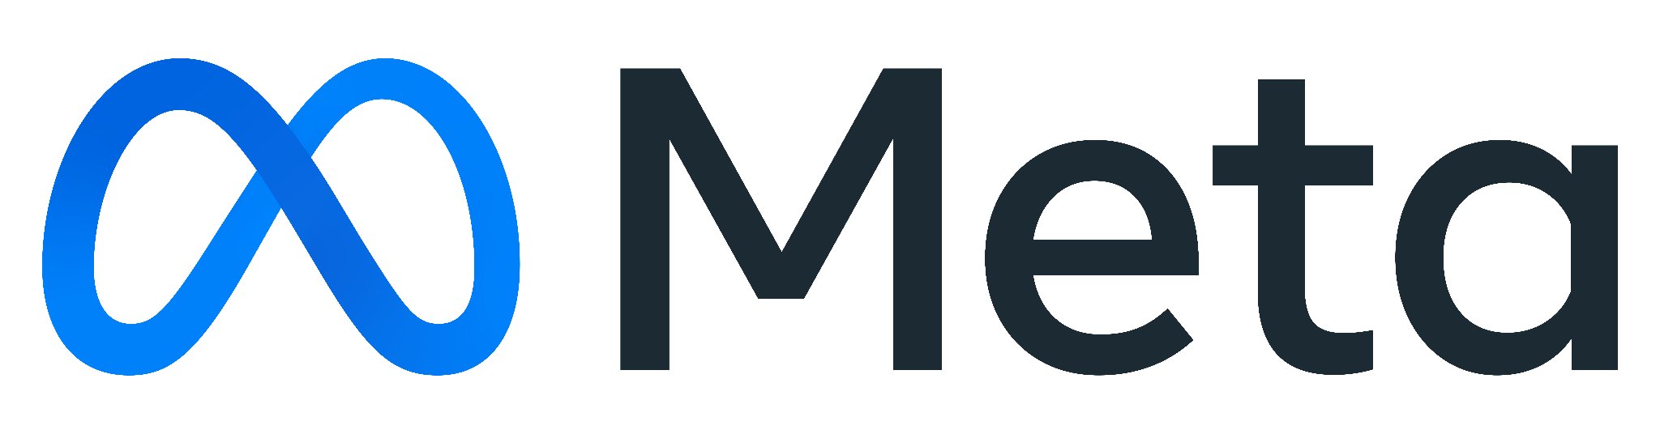



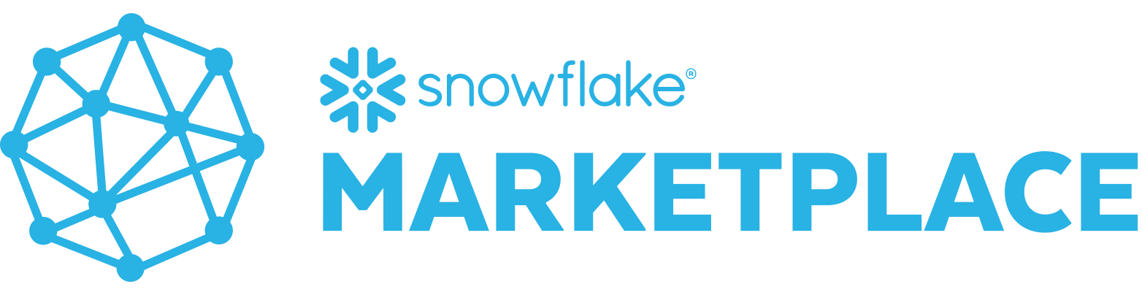
Snowflake Cortex AI Overview
Snowflake Cortex AI
AGENTS & INSIGHTS
MODELS
GOVERNANCE
Agent Apps Snowflake Intelligence
Agent APIs Cortex Agents
Multimodal AI-powered SQL
Cortex AISQL
RBAC
Guardrails
PROCESSING & RETRIEVAL
Unstructured Data Retrieval
Cortex Search
Structured Data Retrieval
Cortex Analyst
Structured Data Retrieval
Cortex Analyst
Document Processing
Document AI, Parse, Embed
Evaluations
Inference & Fine-Tuning APIs
Monitoring
DATA
Data Connectors
Openflow
AI Ready Data & Apps
Snowflake Marketplace
Multimodal Data
Snowflake, Iceberg, External
Embedding Models
AI Gateway
STR
DOC
AUDIO
IMAGE

Slide 16
Example Archs from customers
Example Archs from customers

Slide 17
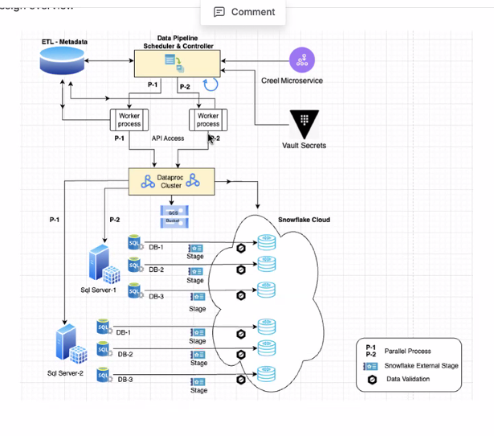
Blackline (financial) use case for Snowflake

Slide 18
BigQuery vs Snowflake
BigQuery vs Snowflake

Slide 19
Architectural Difference: Snowflake vs BigQuery
Big Query
Needs denormalization
Engineers often ignore it
Unpredictable query performance and cost
Migration from other dbs are complicated
One piece in GCP platform
Needs complex ETL to run workloads on Vertex AI, DataProc, Cloud Run, etc
Needs data movement
Needs GCP complex role management
Works mainly with GCP
Complicated Cost structure
Pricing based on data scanned and not compute time
shocking pricing
Snowflake
Zero-Copy data sharing
Across clouds/regions
Enrich your data with most active Marketplace
Unified Data Cloud
Zero-ETL end-to-end workloads
Runs DE, BI, ML, and AI
No data movement needed
Low TCO
True Serverless
Easy to use cost monitoring and tagging
Trusted
Built-in Governance and Security
Centralized Role-Based Data Access
Easy data masking

Slide 20
Snowflake vs BigQuery: It is all about the architecture
Key Aspect | Design Difference | Big Query | Snowflake
Cost and Performance | BQ needs denormalization and cost per data scanned | Unpredictable performance and unexpected costs when denormalization violated | Snowflake means lower TCO and ease of use
Collaboration | Snowflake is multi-cloud platform | Data sharing with Azure and AWS is complex and expensive | Zero-copy cloning and data sharing across clouds/regions without data movement
Migration | BQ needs denormalization | Very complex migration from other databases | Snowconvert makes it easy to migrate
ETL and data movement | BQ is one piece of GCP | Needs complex ETL for end-to-end workflow | Snowflake Zero-ETL runs all your workloads for DE, BI, ML, and AI
Security and Governance | No need to move your data out of Snowflake | Needs complex GCP security and governance to run workloads. | Built-in security and governance with Role-Based Data Access.
Open Standards | Openflow and Iceberg | BigQuery struggles to adapt to open standards cross clouds | Snowflake is pioneering OpenFlow, Iceberg, and Polaris
Data Augmentation | Snowflake has the most active marketplace | BigQuery data market is limited | Buy/sell ready to use dataset in a click with zero-copy to augment and enrich your data
Monitoring | Unified Governance in Snowflake | Need to deal with GCP to monitor costs, tags, and budgets | Built-in and easy to use budgeting, monitoring, and tagging

Slide 21
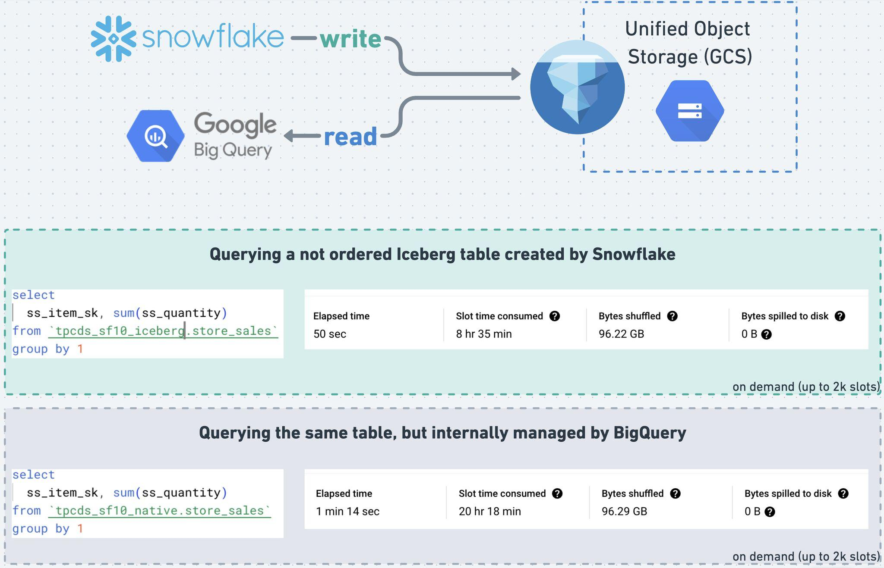
Evidence: Cost Comparison (using Iceberg for neutrality)
$0.22 (Snowflake XL)
$0.85 (GBQ Enterprise Plus)
$0.66 (Snowflake XL)
$2.03 (GBQ Enterprise Plus)

Slide 22
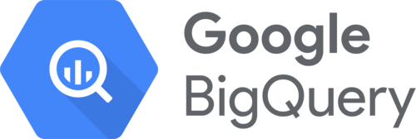
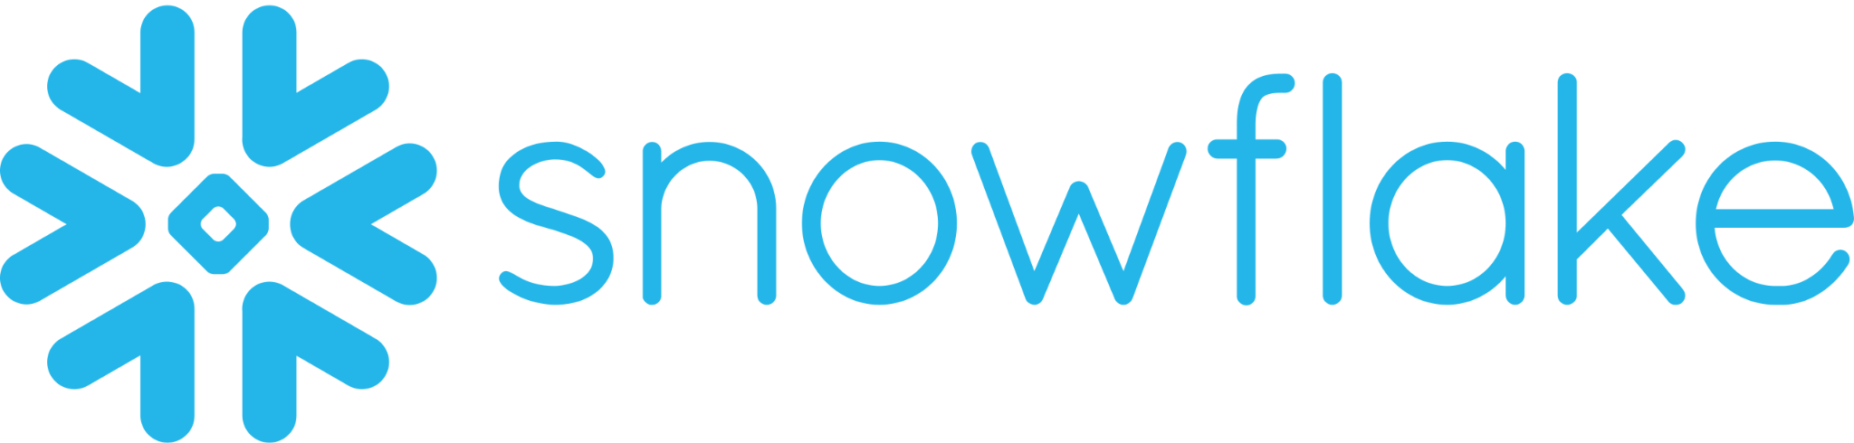
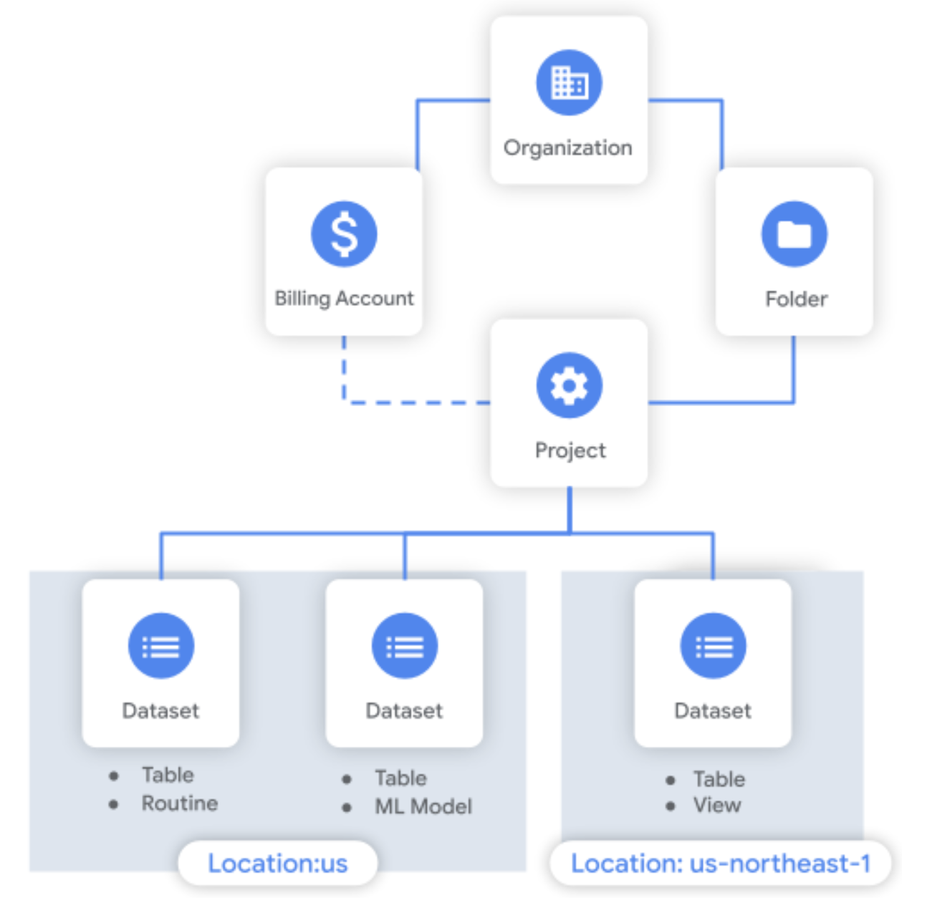
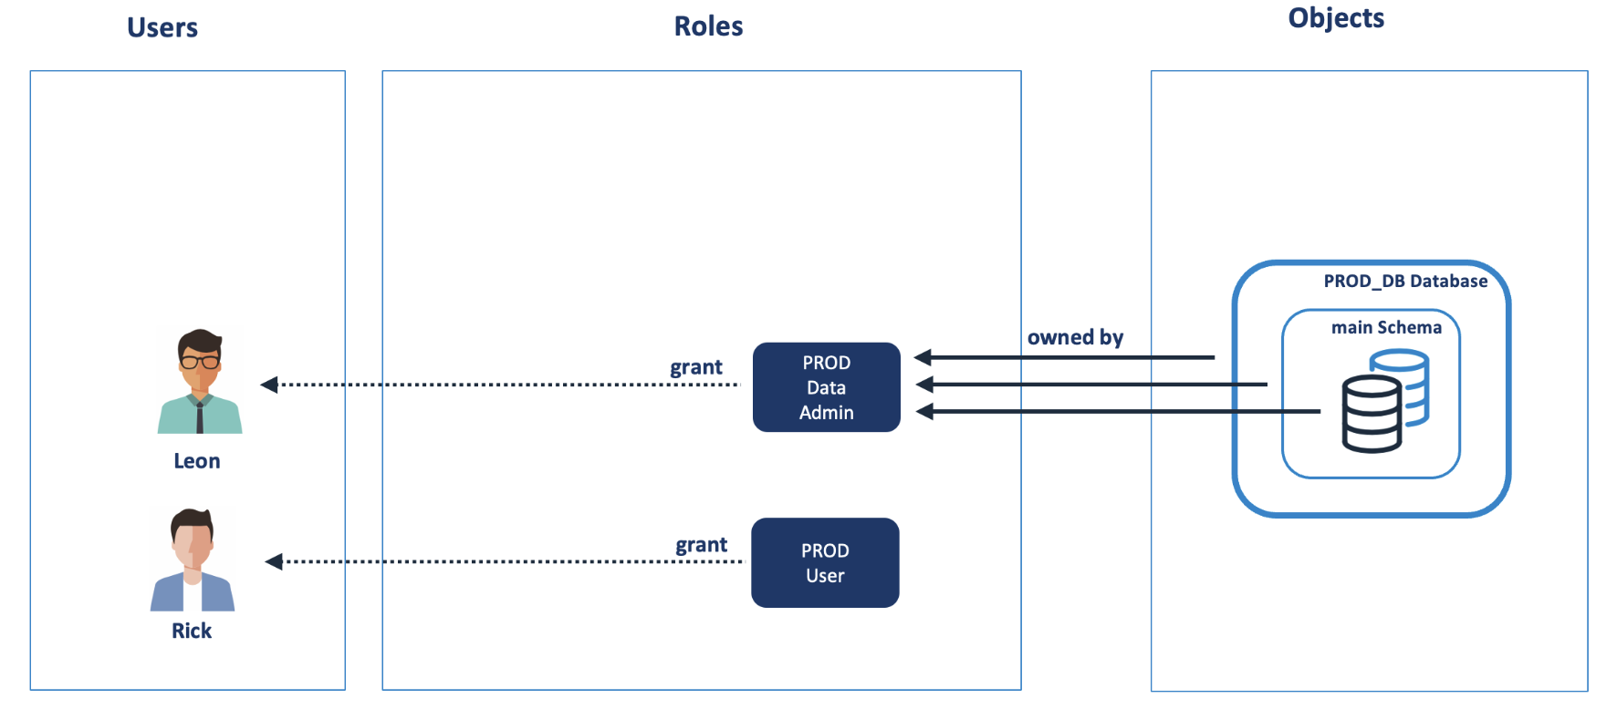
Evidence Security: IAM (Identity and Access Management) in BigQuery is complex
Complexity of IAM in BigQuery requires understanding of the numerous roles and their implications.
Complex : need to understand the overall structure of GCP (projects, resources location, IAM, quotas) before starting | Simple (Database>Schema, Virtual Warehouses, RBAC)
 | Role-Based Access Control (RBAC) : Access privileges are assigned to Roles, which are in turn assigned to Users
IAM Predefined Roles
- BigQuery Admin
- BigQuery Connection Admin
- BigQuery Connection User
- BigQuery Data Editor
- BigQuery Data Owner
- BigQuery Data Viewer
- BigQuery Filtered Data Viewer (if Row Access policy)
- BigQuery Job User
- BigQuery Metadata Viewer
- BigQuery Read Session User
- BigQuery Resource Admin
- BigQuery Resource Editor
- BigQuery Resource Viewer
- BigQuery User
- Masked Reader (if Column Access Policy)
Risks & Impact | Time Consuming : numerous predefined roles and custom roles that can be configured → determining the appropriate set of permissions for each user or entity requires careful consideration and understanding of the available roles and their implications. Integration Complexity with Google Cloud IAM : additional layer of complexity, as BigQuery inherits the IAM features and policies from GCP
Notes:
JADE

Slide 23
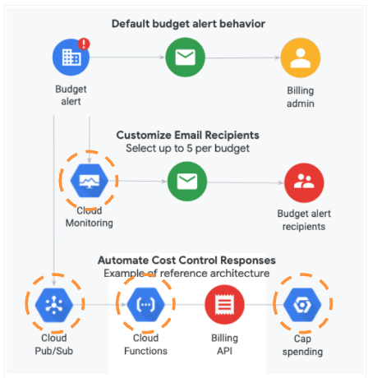
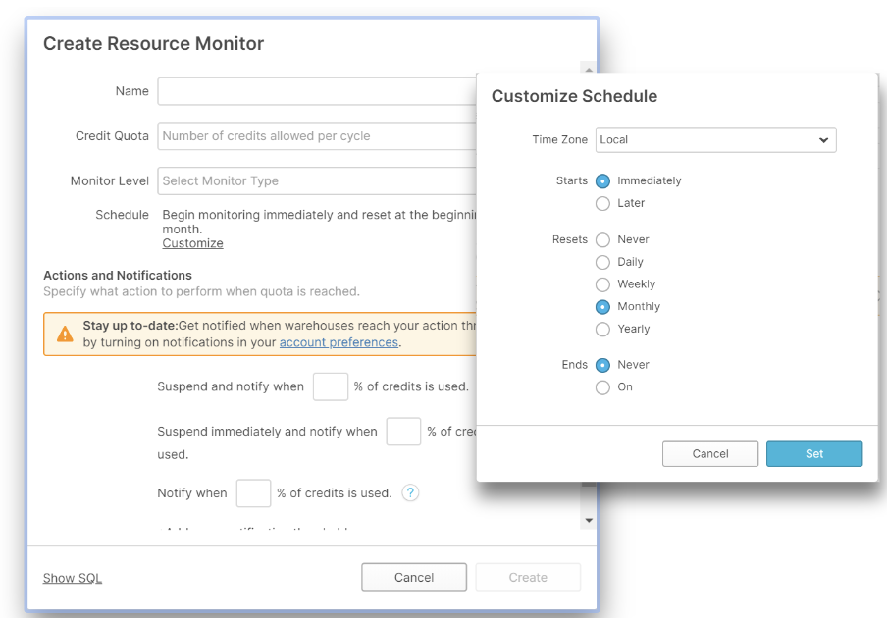
Evidence: FinOps and Cost Monitoring
Snowflake provides built-in tools and features for cost management and monitoring
Complex Monitoring & Alerting | Simple Resource monitoring & Management
 | RESOURCE MONITORS : Create hard limits : don’t overspend or accidentally use up credits A lot of other features: AUTO SUSPEND POLICIES : Turning virtual warehouses off quickly after they go idle saves customers money BI DASHBOARDS : Many of our 3rd party BI vendors offer pre-built dashboards (ex: https://github.com/mattfeks/Snowflake-PowerBI)
Risks & Impact | Custom alerting setup: To set up budget alerts in BigQuery, you often need to rely on custom configurations using third-party monitoring and alerting tools or by integrating with Google Cloud's monitoring and alerting services like Cloud Monitoring and Cloud Pub/Sub. → Additional setup and configuration to monitor BigQuery usage, define budget thresholds, and trigger alerts based on specific conditions.
Notes:
JADE

Slide 24
References and related docs
Service Map (Snowflake, CSP): multi-cloud
Snow vs BQ: BigQuery-Compete

Slide 25
Success stories
Snow vs BigQuery

Slide 26
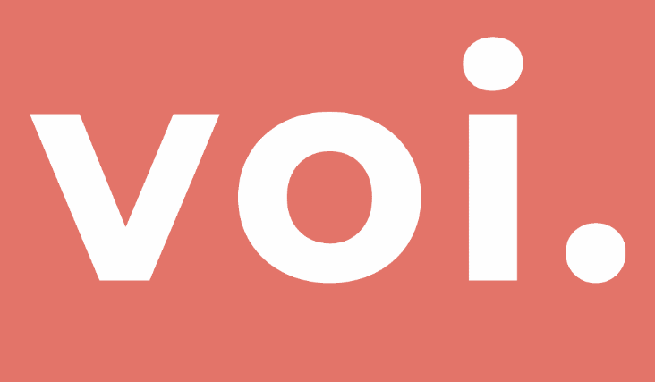
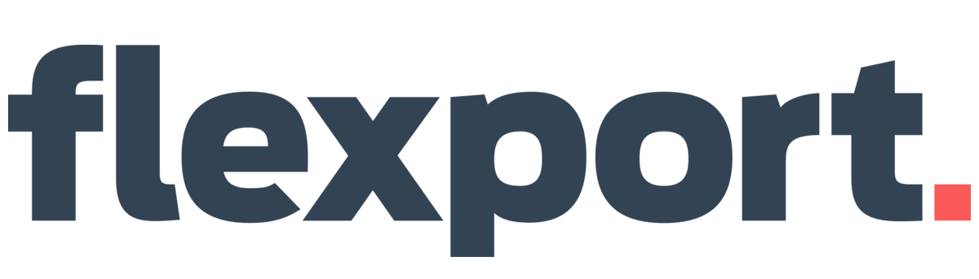


Google BigQuery to Snowflake Migration Proof Points
20-40%
Compute/Storage Cost Reduction
after migration
"As the company and data rapidly grew, BigQuery became a bottleneck. To avoid contention and performance issues, all requests had to pass through the central data engineering team"
40-60%
Productivity Improvements
for Platform Administration
25-40%
Productivity Improvements
for Data Engineers
"Since shifting to data mesh with Snowflake, 5.5x more people are using data across the business on a regular basis.”
5-15%
Productivity Improvements
for Data Scientists
25%+
Time-to-market
improvement for new projects
“Snowflake’s data sharing across clouds is one of its big pros. The gaming industry relies on external partners for faster game development and time to market. Having good data governance to ensure that live data can be shared without movement across cloud providers is key to that model.”
*Metrics gathered through Snowflake customer Value Realization studies

Slide 27


Wargaming Powers Up Player Happiness With Unified Data And Faster Insights
~500K
By migrating from Hadoop and Google BigQuery to Snowflake, Wargaming is saving half a million dollars every year while tapping into data to enhance player experiences and remain on the cutting edge of the gaming industry.
Annual savings with Snowflake
View Full Case Study

Slide 28

BIG FISH GAMES LAUNCHES AND DEVELOPS GAMES FASTER WITH SNOWFLAKE
99%
With the partitioning and allocation of compute resources provided by Snowflake, Big Fish Games provides external developers with a platform they can work autonomously within to analyze, transform, and share data.
Faster time to analytics after releasing new in-game missions and other live-ops content
View Full Case Study

Slide 29


Bumble Scales Up While Keeping Costs Down
200+
With Snowflake as its single platform for its data warehouses, business intelligence, data lake and beyond, Bumble has democratized data, boosted collaboration and fueled innovation.
Users without impact on query performance
View Full Case Study

Slide 30
WARGAMING POWERS UP PLAYER HAPPINESS WITH UNIFIED DATA AND FASTER INSIGHTS
Our analysts are thrilled with the performance improvement. Snowflake is significantly faster than what we had with Hadoop: Data delivery is now up to 40% more efficient.
— ALEX RYABOV Head of Data Services, Wargaming
Wargaming’s original data warehouse, using Hadoop, Oracle, Cloudera, Tableau, and Google BigQuery, couldn’t handle growing data volumes and player base.
On-prem systems and BigQuery became unsustainable due to increasing storage, processing costs, and hardware upgrades.
The old setup required complex ETL workarounds and slow hardware expansion (e.g., adding six new nodes took six months), delaying growth and agility.
Wargaming moved to Snowflake for a more scalable, unified data platform that consolidated multiple data sources and offered high performance for fast-growing data needs.
Snowflake allowed data to be stored anywhere, giving Wargaming the freedom to choose cloud providers and store data in open formats like Iceberg Tables.
Snowflake’s built-in role-based access control (via Horizon Catalog) enabled secure, efficient data access across Wargaming’s global team.
Wargaming saved approximately $500,000 annually by migrating to Snowflake.
Wargaming saw up to a 40% improvement in data delivery speed, allowing product analytics teams to access near real-time insights through Tableau dashboards.
The move to Snowflake alleviated previous performance bottlenecks, enabling faster, more comprehensive insights, and eliminating frustrations like query timeouts.
View Full Case Study

Slide 31
BIG FISH GAMES LAUNCHES AND DEVELOPS GAMES FASTER WITH SNOWFLAKE
The gaming industry relies on external partners for faster game development and time to Market. Having good data governance to ensure that live data can be shared without movement across cloud providers is key to that model.
— GLEN MACKAY,
Senior Manager, Data Engineering
Big Fish Games’ LiveOps team wanted to introduce a game event and quickly measure how engaged the players were by the new content.
Moved from on-premises to Google BigQuery, but the data engineering team was still the central clearinghouse for data requests.
Bottleneck to data access for these downstream users because the data had to be processed first.
Snowflake’s ability to run consistently on multiple clouds allowed Big Fish to both stay on Google Cloud, simplifying their migration from BigQuery, and be on the same platform as key partner organizations, even though those orgs may be on a different cloud platform.
Big Fish Games uses Snowflake to give external partners semi-autonomy to independently work within its organization.
Access to near real-time streaming analytics
Raw event stream is available and users can go in and build tables on top of it.
Improve the gaming experience
Get feedback within hours to fine tune in-game missions and create a great gaming experience.
Quickly activate new games
Standard set of reports through Snowflake allows them to turn on new games in days vs weeks.
Read Case Study
Notes:
https://www.snowflake.com/en/customers/all-customers/case-study/big-fish-games/

Slide 32

Bumble Scales Up While Keeping Costs Down
In the past, we had to run a series of optimizations on our on-premises systems to re-size clusters and reduce storage requirements. With Snowflake, it just works.
— ALEX TOLMACHYOV,
Head Of ETL Team
Bumble’s reporting needs were growing, and its legacy on-premises system couldn’t deliver consistent and timely insights. This was making it difficult to scale.
Limited compute resources also meant the company sometimes had to shut down internal user queries so they wouldn’t interfere with other processes.
As a GCP based company, Bumble initially evaluated Google BigQuery but found it didn’t support all queries and required significant pipeline adaptation.
Bumble adopted Snowflake as it seamlessly integrates with the company’s Google Cloud environment and supports SQL.
It now has a single, scalable platform for its Data Warehouse, BI, and Data Lake and can easily bring in data from external sources.
A single source of truth
The company can run 15 internal products on a single platform with Snowflake.
Better data collaboration
Snowflake’s Collaboration features have given Bumble new, secure ways to share and use its data.
Scalability without bottlenecks
The company can now support 200+ users working on data with no impact on query performance.
View Full Case Study Here

Slide 33
Bumble Scales Up
While Keeping Costs Down
In the past, we had to run a series of optimizations on our on-premises systems to re-size clusters and reduce storage requirements. With Snowflake, it just works.
- ALEX TOLMACHYOV, Head Of ETL Team
Bumble’s reporting needs were growing, and its legacy on-premises system couldn’t deliver consistent and timely insights. This was making it difficult to scale.
Limited compute resources also meant the company sometimes had to shut down internal user queries so they wouldn’t interfere with other processes.
As a GCP based company, Bumble initially evaluated Google BigQuery but found it didn’t support all queries and required significant pipeline adaptation.
Bumble adopted Snowflake as it seamlessly integrates with the company’s Google Cloud environment and supports SQL.
It now has a single, scalable platform for its Data Warehouse, BI, and Data Lake and can easily bring in data from external sources.
A single source of truth The company can run 15 internal products on a single platform with Snowflake.
Better data collaboration Snowflake’s Collaboration features have given Bumble new, secure ways to share and use its data.
Scalability without bottlenecks The company can now support 200+ users working on data with no impact on query performance.

Slide 34
Bumble Scales Up While Keeping Costs Down
Bumble’s reporting needs were growing, and its legacy on-premises system couldn’t deliver consistent and timely insights. This was making it difficult to scale.
Limited compute resources also meant the company sometimes had to shut down internal user queries so they wouldn’t interfere with other processes.
As a GCP based company, Bumble initially evaluated Google BigQuery but found it didn’t support all queries and required significant pipeline adaptation.
Bumble adopted Snowflake as it seamlessly integrates with the company’s Google Cloud environment and supports SQL.
It now has a single, scalable platform for its Data Warehouse, BI, and Data Lake and can easily bring in data from external sources.
A single source of truth The company can run 15 internal products on a single platform with Snowflake.
Better data collaboration Snowflake’s Collaboration features have given Bumble new, secure ways to share and use its data.
Scalability without bottlenecks The company can now support 200+ users working on data with no impact on query performance.
In the past, we had to run a series of optimizations on our on-premises systems to re-size clusters and reduce storage requirements. With Snowflake, it just works.
— ALEX TOLMACHYOV,
Head Of ETL Team

Slide 35
Attachment (in progress slides)

Slide 36
Cortex AI Ecosystem
FRONTEND LAYER
Snowflake Intelligence
Usually Internal-Facing
Slack/Teams
Usually Internal-Facing
Custom Portals
Usually External-Facing
Higher-Level Agents
ChatGPT Desktop/MS Copilot/etc
Agentic Workflows
E.g. Investigate and send an email
Input: Complicated Business Questions
ORCHESTRATION LAYER
E.g. What are the sales of my latest products?
Cortex Agents API
Agent APIs
Output: Directed Questions (Broken Down in Steps)
E.g. What are my latest products? + What are their sales?
SEMANTIC LAYER
Input: English Questions
Cortex Analyst
Structured Data Retrieval
Cortex Search
Unstructured Data Retrieval
Output: SQL Results or Text Search Results
STRUCTURED DATA
TEXT DATA
Document Processing
Document AI, Parse, Embed
TXT
UNSTRUCTURED DATA
Data Connectors
Openflow
PDF
AUDIO
IMAGE

Slide 37
Snowflake-Managed Iceberg on GCS
- CLD is in Public Preview (PuPr); planned GA 10/31/25.
- BigLake write to Polaris IRC is currently in development.
- For Looker, GCP web apps, and Vertex AI Serving, use Snowflake connectors (Rec).
- For Vertex AI Training and Feature Store (large reads), connect via BigLake and Iceberg.
Snowflake
GCS (Snowflake-Managed)
GCP Services
Vertex AI
Horizon Catalog
CLD
Polaris Open Catalog
2
3
4
BigLake
1
Big Query
PARQUET
Native App / SPCS
Iceberg Tables
Cloud Run
1- Native App or SPCS executes standard DML against tables defined within the Catalog Linked Database (CLD) schema. Horizon manages RDBC and Iceberg.
2- CLD acts as the abstraction layer, enabling Snowflake to atomically manage the Iceberg format and sync metadata with the Polaris.
3- BigLake serves as the unified access layer, connecting BigQuery securely to the Polaris-managed Iceberg metadata and the data files in GCS.
4- GCP analytics and AI services (e.g., Vertex AI) consume the Iceberg tables by querying the integrated BigQuery/BigLake tables.

Slide 38
Snowflake-Managed Iceberg on GCS
- CLD is in Public Preview (PuPr); planned GA 10/31/25.
- BigLake write to Polaris IRC is currently in development.
- For Looker, GCP web apps, and Vertex AI Serving, use Snowflake connectors (Rec).
- For Vertex AI Training and Feature Store (large reads), connect via BigLake and Iceberg.
Snowflake
GCS (Snowflake-Managed)
GCP Services
Vertex AI
Horizon Catalog
Polaris Open Catalog
3
BigLake
4
1
2
Big Query
PARQUET
Native App / SPCS
CLD
Cloud Run
Iceberg Tables
1- Native App or SPCS executes standard DML against tables defined within the Catalog Linked Database (CLD) schema. Horizon manages RDBC and Iceberg.
2- CLD acts as the abstraction layer, enabling Snowflake to atomically manage the Iceberg format and sync metadata with the Polaris.
3- BigLake serves as the unified access layer, connecting BigQuery securely to the Polaris-managed Iceberg metadata and the data files in GCS.
4- GCP analytics and AI services (e.g., Vertex AI) consume the Iceberg tables by querying the integrated BigQuery/BigLake tables.

Slide 39
GCP-Managed Iceberg on GCS (Needs changes)
- CLD is in Public Preview (PuPr); planned GA 10/31/25.
- BigLake write to Polaris IRC is currently in development.
- For Looker, GCP web apps, and Vertex AI Serving, use Snowflake connectors (Rec).
- For Vertex AI Training and Feature Store (large reads), connect via BigLake and Iceberg.
Snowflake
GCS (Snowflake-Managed)
GCP Services
Vertex AI
Horizon Catalog
Polaris Open Catalog
3
BigLake
4
1
2
Big Query
PARQUET
Native App / SPCS
CLD
Cloud Run
Iceberg Tables
1- Native App or SPCS executes standard DML against tables defined within the Catalog Linked Database (CLD) schema. Horizon manages RDBC and Iceberg.
2- CLD acts as the abstraction layer, enabling Snowflake to atomically manage the Iceberg format and sync metadata with the Polaris.
3- BigLake serves as the unified access layer, connecting BigQuery securely to the Polaris-managed Iceberg metadata and the data files in GCS.
4- GCP analytics and AI services (e.g., Vertex AI) consume the Iceberg tables by querying the integrated BigQuery/BigLake tables.

Slide 40
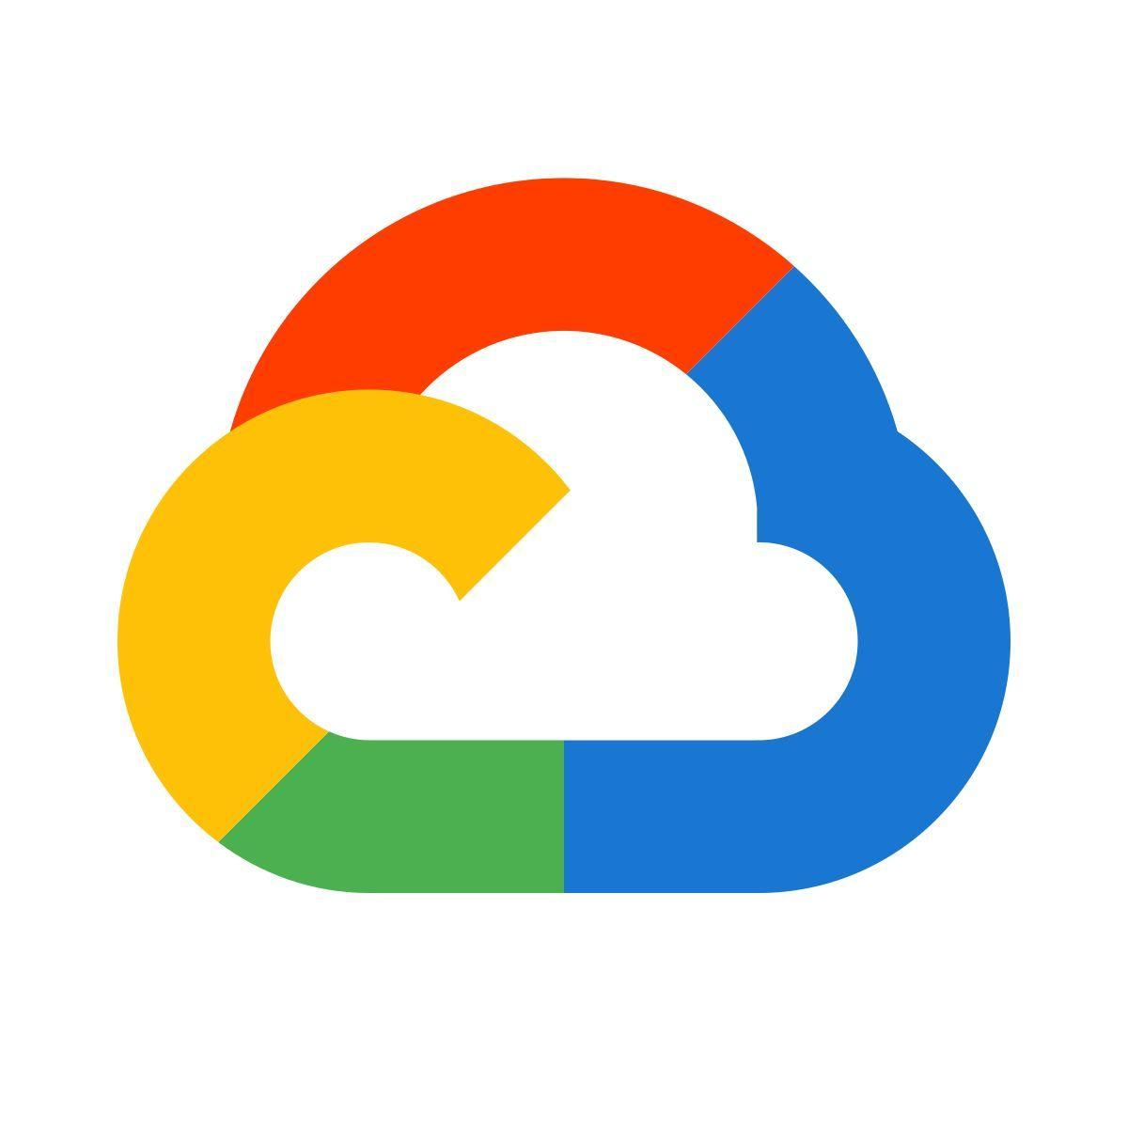
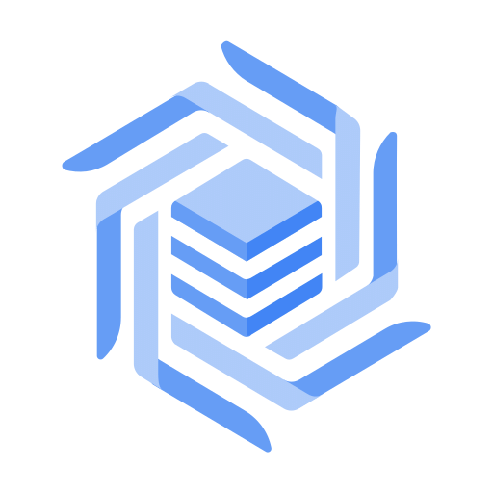
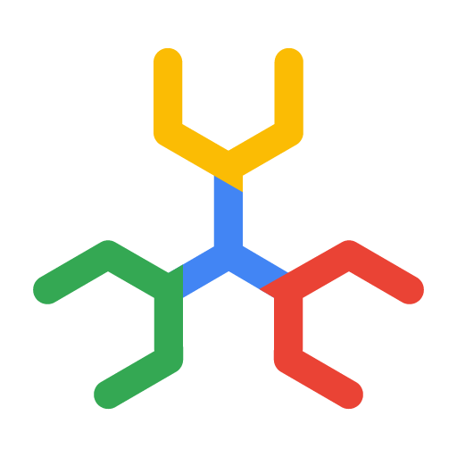

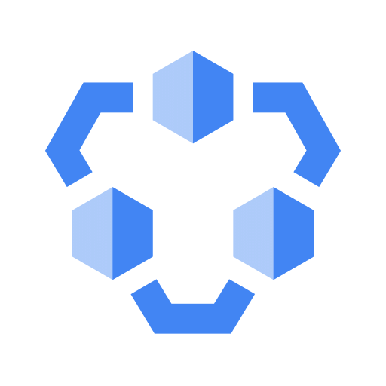
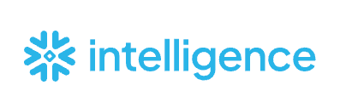
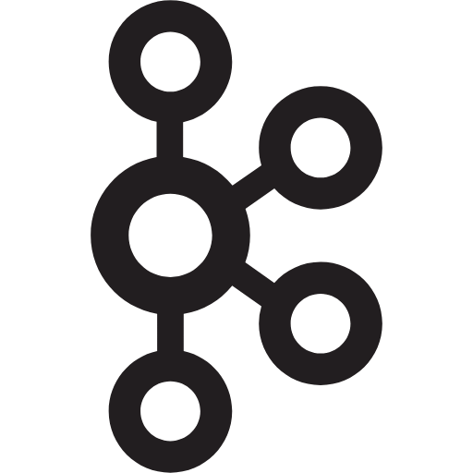
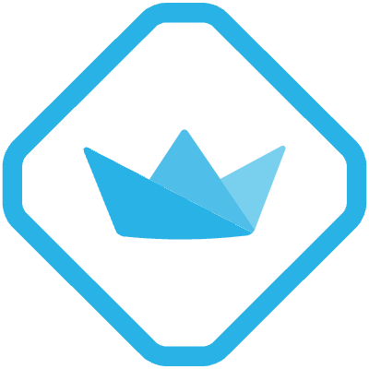
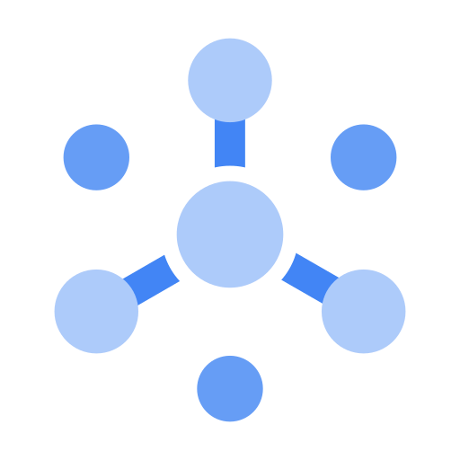

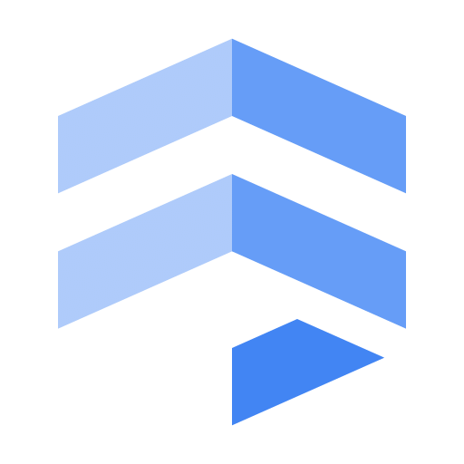

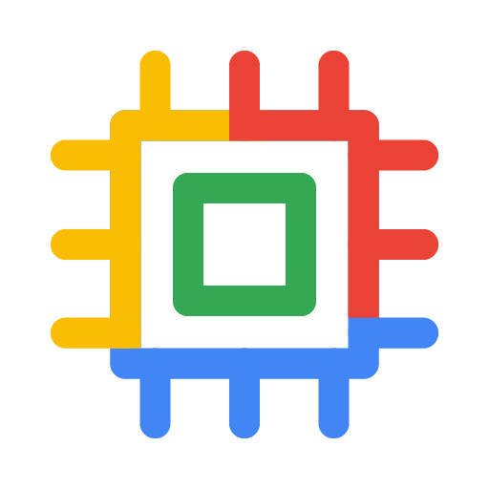
Iceberg Lakehouse with Snowflake and Google Cloud
Google Cloud
OLTP
BigLake
Snowflake
Snowflake Apps
Catalog-Linked Database
MetaStore
Catalog
Horizon
Catalog
Spanner
Snowflake
PostgreSQL
Bronze
Silver
Gold
Semantic Views
Data Products
Processed Tables
RBAC Result Caching
Materialized Views
Optimized Search
Pub/Sub
Streamlit
Cortex
Kafka
Raw Data
Curated
Data
GCP Apps
Processed
Data
GCS
Firestore
Gemini Enterprise
Ingest
IRC
Transformation
Serving
Dataflow
Datastream Openflow
BQ Services Snowpipe
Apache Spark
Dataproc Flink
Trino Big Query
Snowpark Notebooks
dbt Snowflake ML Cortex Workspaces
IRC
Openflow Connectors
Data Sharing SPCS Feature Store
Looker
VertexAI
Cloud Run
Business Apps
Bronze layer includes historical, and unprocessed data from different data sources and OLTP apps. In simpler use cases, Snowflake Horizon, instead of BigLake, might be a better fit.
Snowflake connection to BigLake (without custom header problem) would be available in April 2026.
Silver Layer is where Iceberg is most useful because of heavy transformations that engines (spark, fink, trino, dataproc, snowflake) perform throughout data life cycle.
Snowflake does the heavy transformation through direct sql without IRC overhead while other engines (Spark, Dataproc, Flink, etc) can IRC to read/write to iceberg tables.
Notebooks

Slide 41
Who does what
Catalog (Control Plane)
Authentication and authorization (OAuth2 / PAT)
Credential vending — issues temporary GCS credentials scoped to specific storage paths
Serves table metadata via REST API (current snapshot, schema, partition spec)
Atomic commit — updates the catalog pointer to the new metadata location
Concurrency control — optimistic locking at commit time (rejects stale base snapshots)
Governance and policy enforcement — applied at credential vending and commit time
Engine (Spark, PyIceberg, etc.)
Initiates all operations (auth, table load, reads, writes, commits)
Constructs query plans, applies partition pruning and predicate pushdown
Processes data in memory after reading
GCS — Metadata Storage (Engine writes/reads directly)
Stores Iceberg metadata files: `metadata.json`, manifest lists (Avro), manifest files (Avro)
Engine reads the metadata tree to discover which data files to access
Engine writes new metadata files during write operations (new manifests, manifest lists, metadata.json)
GCS — Data File Storage (Engine writes/reads directly)
Stores the actual data as Parquet files
Engine reads Parquet files directly using vended credentials (after pruning via metadata)
Engine writes new Parquet files directly during write operations using vended credentials

Slide 42
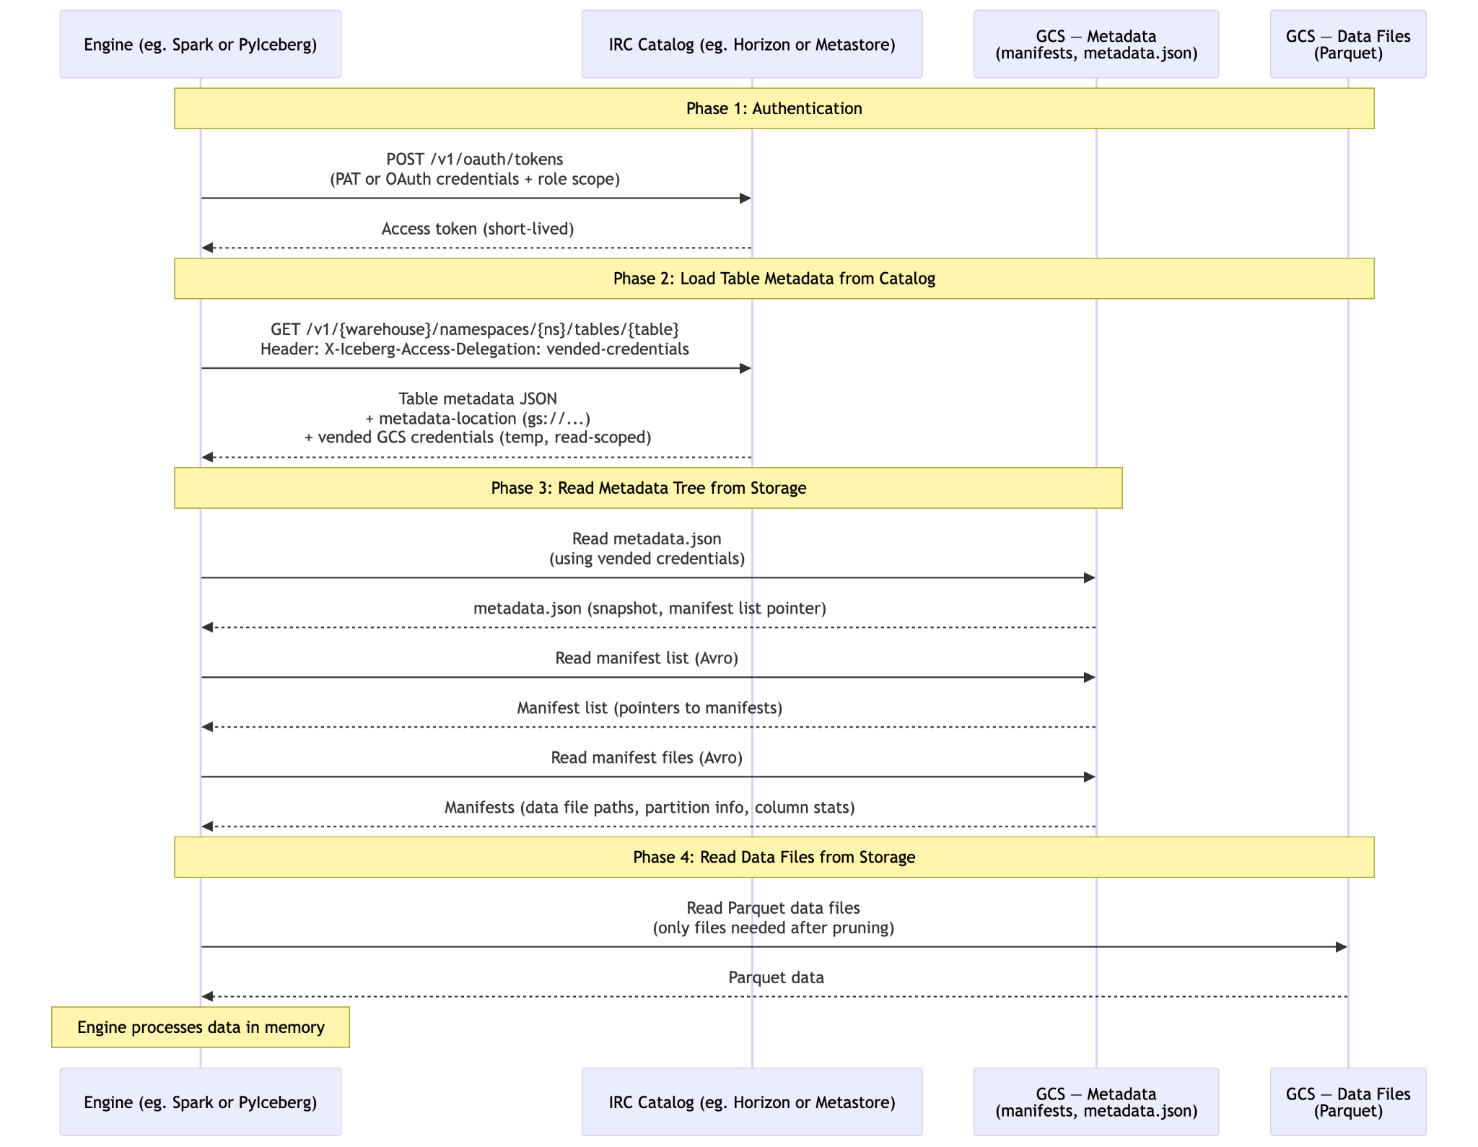
How Iceberg Read Happens: Sequence Diagram

Slide 43
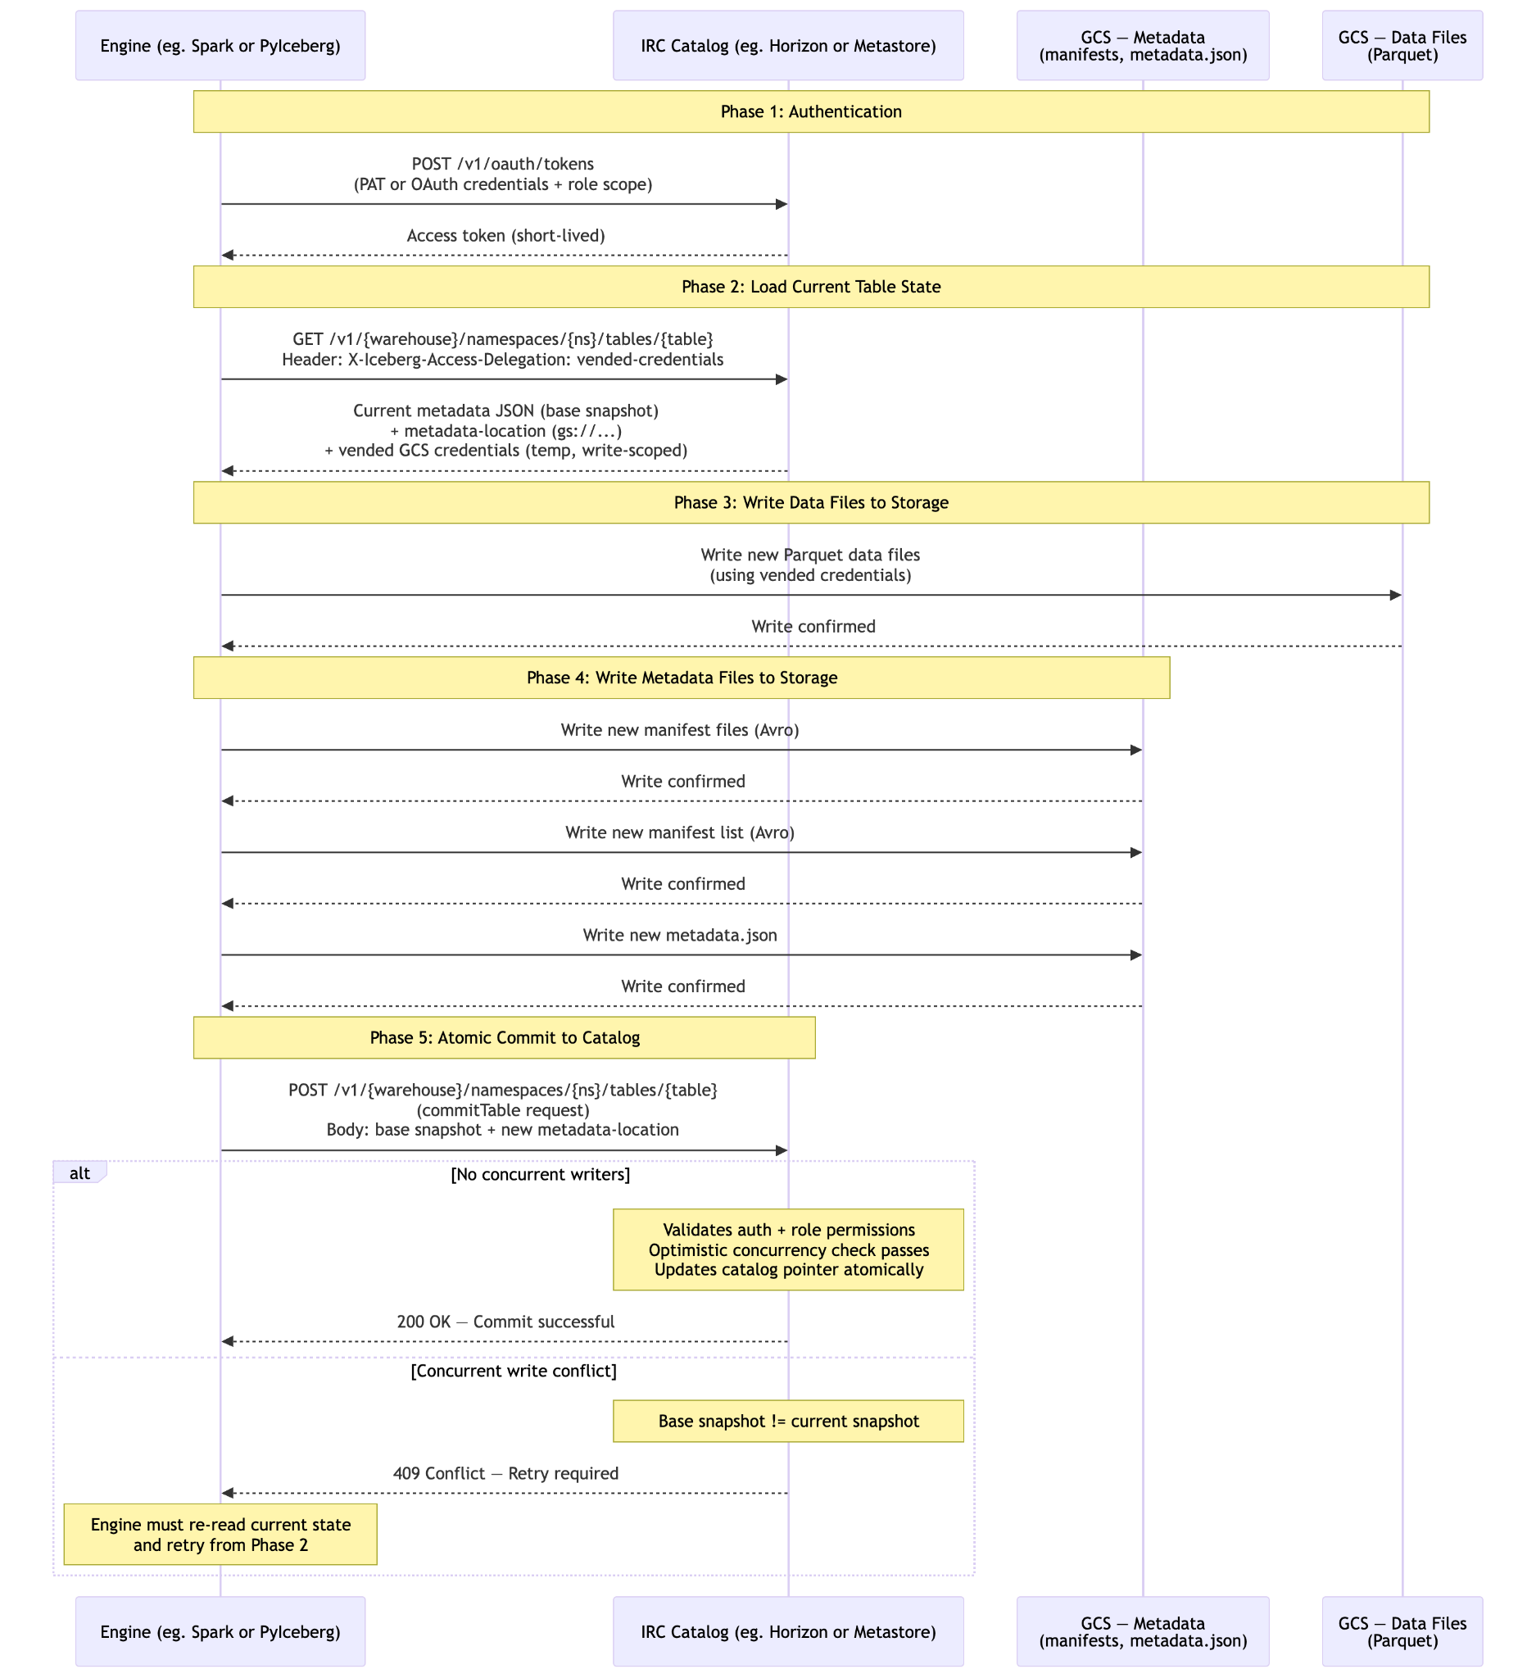
How Iceberg write happens

Slide 44


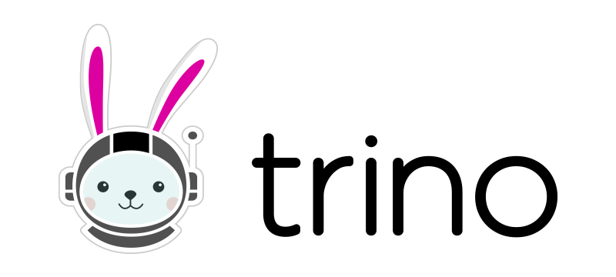
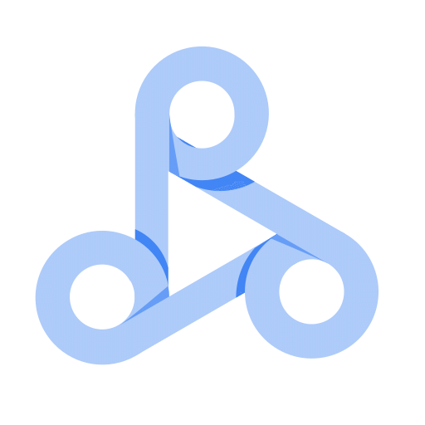
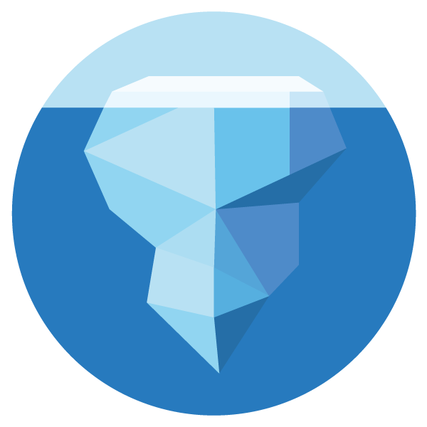


Snowflake-Managed Iceberg on GCP
- Snowflake Horizon Catalog natively implements the Iceberg REST Catalog (IRC) protocol -- Apache Polaris integrated under the hood -- so any engine that supports IRC (Spark, Flink, Trino, PyIceberg, DuckDB, etc.) can read and write Iceberg tables directly through Horizon, using your existing Snowflake authentication, roles, and governance policies.
- VertexAI services (training, inference, workbench) can read/write to iceberg table through python libraries like Spark or PyIceberg.
Google Cloud
Engines
Catalog Manager
IRC
Snowflake Horizon (Polaris-Compatible)
Big Query
Iceberg Tables on GCS
DataProc
Read/Write
Metadata
PyIceberg
PARQUET
Data Files

