Slide 1
INNOVATE AT SCALE WITH CONFIDENCE POWERING A SECURE AND RESILIENT AI ESTATE
Colm Moynihan, Principal Solution Engineer

Slide 2
The World Is Changing
Findings from a Snowflake study shows, 96% still face significant challenges with data quality and quantity, employee skills, integration with legacy systems, and more.¹
Agents don't just answer questions they
Take actions
Access sensitive data
Make decisions
According to Gartnerⓡ by 2027, 80% of large enterprises will have clearly defined, reusable governance and guardrail practices for their conversational AI agents and assistants.²
According to Gartnerⓡ through 2029, over 50% of successful cybersecurity attacks against AI agents will exploit access control issues, using direct or indirect prompt injection as an attack vector.³
Snowflake study: https://www.snowflake.com/en/lp/radical-roi-generative-ai/
Gartner, Practical AI Security: Managing Web-Based AI Assistants,Nader Henein,25, October 2025.
Gartner, Emerging Tech: The Future of AI Security Is in Securing Agent Actions, Not Prompts, Mark Wan and David Senf, 20 February,2026.
GARTNER is the trademark of Gartner Inc and or its affiliates
Notes:
So let's set the scene. The world of AI is shifting fast — and agents are at the centre of that shift.
These aren't just chatbots answering questions anymore. Agents are taking real actions — accessing sensitive data, making decisions, and interacting with systems on behalf of users. And that introduces a fundamentally new category of risk.
A recent Snowflake study found that 96% of organisations still face significant challenges scaling AI — whether that's data quality, skills gaps, or integration with legacy systems. We're very much in the early innings.
And Gartner backs this up. They predict that by 2027, 80% of large enterprises will need clearly defined, reusable governance and guardrail practices for their AI agents and assistants.
Even more striking — Gartner also projects that through 2029, over half of successful cyberattacks against AI agents will exploit access control issues, often through direct or indirect prompt injection.
So the message here is clear: if you're building with agents, security can't be an afterthought. It has to be designed in from day one.

Slide 3
Top Concerns From Security Leaders
Identity and
Access Control
Data Exfiltration and Unauthorized Data Movement
Centralized Visibility
Least privileged access
Access to sensitive data
Single pane of glass
Notes:
Over the past year, we've spoken with dozens of CISOs and security architects. And three themes come up in almost every conversation.
The first is least-privileged access and agent identity. Security leaders want to know: who is this agent? What is it allowed to do? Can I scope its permissions the same way I would for a human user?
The second is data exfiltration and unauthorised data movement. Agents can read data and, without the right controls, they can send it anywhere. That's a real and growing risk — especially as agents become more autonomous.
And the third is centralised visibility. Security teams are telling us they simply don't have a clear picture of how AI is being used across their environment. They need a single pane of glass.
What we're announcing this week directly addresses all three of these concerns. Let me show you how.

Slide 4
Security Investments at a Glance
Proactive enterprise-grade security capabilities for data and AI—built-in, not bolted on
SNOWFLAKE
Cortex AI
Coding Agent
CoCo
Orchestration
Cortex Agent
Business Agent
Snowflake CoWork
Analytics & Predictive Insights
AI Functions & Snowflake ML
Connection
Snowflake Managed MCP Server
Agent Security
Data Security
Platform Security
Prompt Protection
Horizon AI Guardrails
Data Integrity and Encryption
Sensitive Data Protection
Authentication
SSO / Provisioning
Agent Identification
Agent Identity
Data Egress
Data Exfiltration Protection
Authorization
RBAC / ABAC
AI Posture
AI Security Package
Data-Leak Prevention
Ransomware Protection
Secure Boundary
Network Security
Trust Center – Security Posture
Horizon Catalog
Notes:
At Snowflake, our philosophy is straightforward: proactive, enterprise-grade security for data and AI — built in, not bolted on.
Let me walk you through the layers.
At the foundation, you have platform security — authentication, single sign-on, RBAC, network policies. This has been Snowflake's strength for years, and it continues to evolve.
On top of that sits data security — sensitive data protection, encryption, and data integrity. And today, we're extending that layer to include data exfiltration protection and ransomware defence. These are critical capabilities as the threat landscape evolves.
And now, we're introducing a new layer: agent security. These are purpose-built controls designed for the agentic era. This includes Agent Identity — so you can identify and scope what each agent is allowed to do. Horizon AI Guardrails — so you can protect against prompt injection and unsafe outputs. And AI Security Posture Management within Trust Center — so you have full visibility into the security posture of your AI workloads.
This isn't a bolt-on. It's natively integrated into the platform.

Slide 5
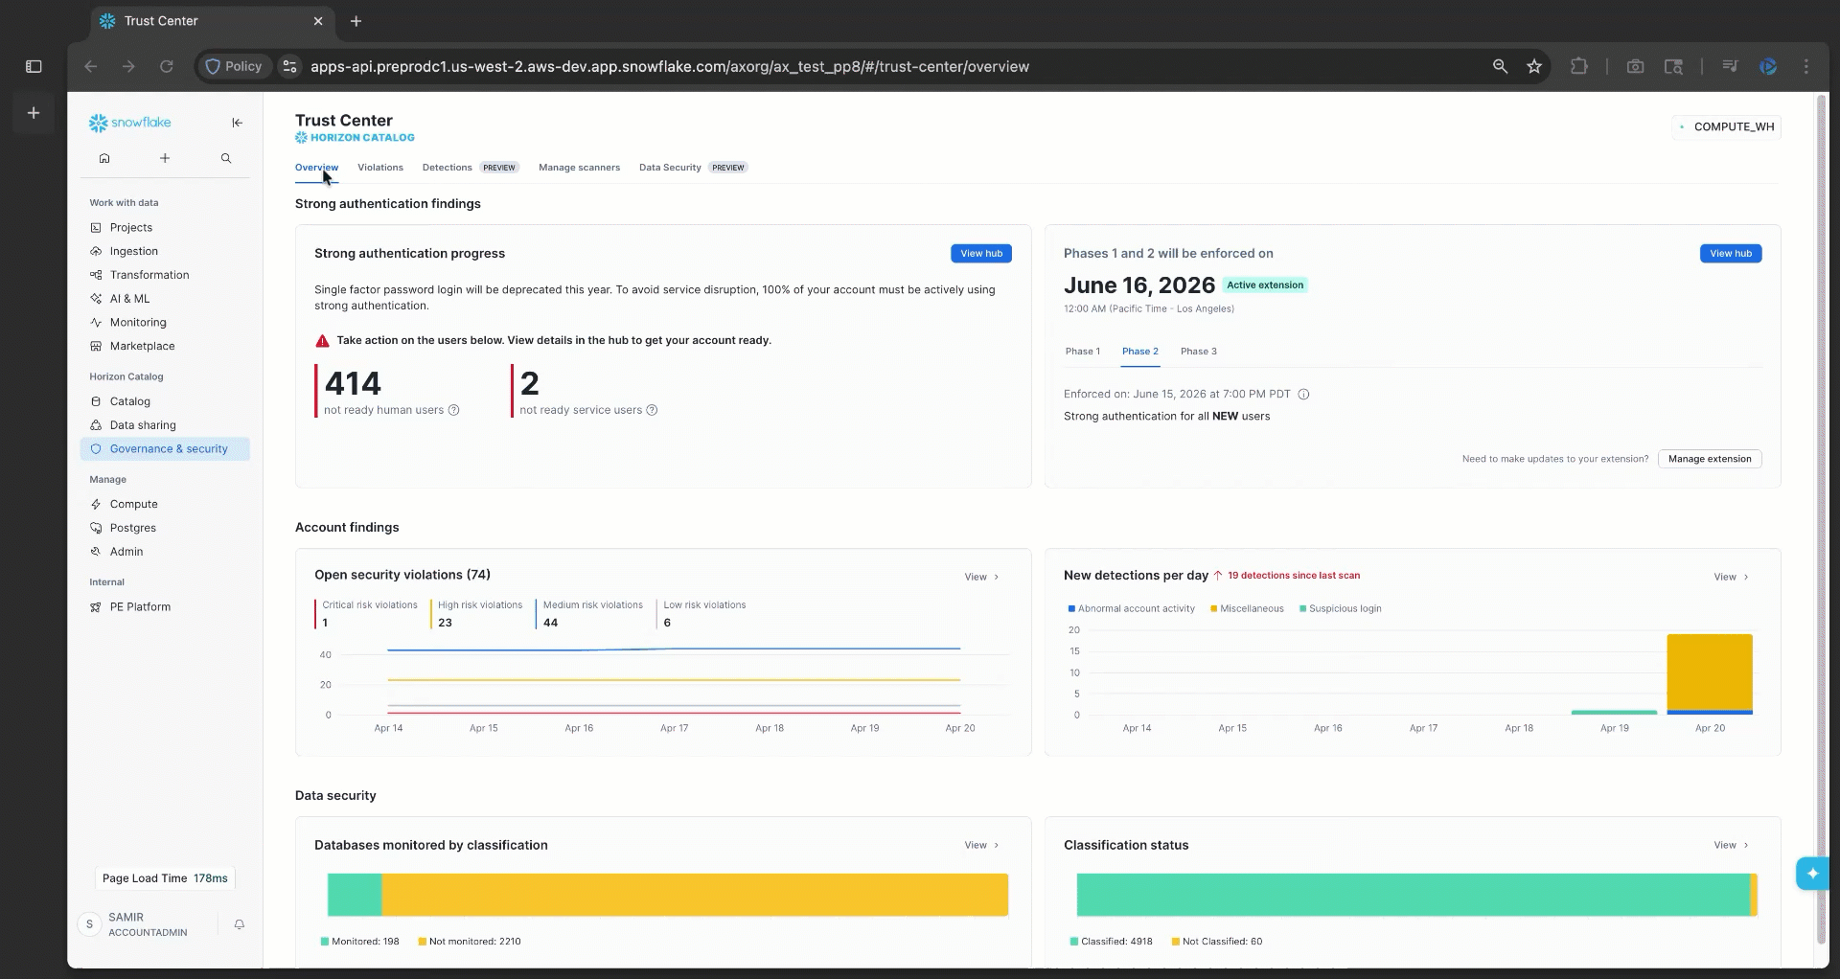
Trust Center
WHAT IS IT
Discover & remediate security, identity, data governance, and compliance risks
Streamline cross-cloud security monitoring in one centralized place Lower TCO and reduce account risks
Scan accounts to detect security violations based on Snowflake CIS Benchmark
WHY USE IT
HOW TO USE IT
Notes:
Now let me talk about Trust Center, because this has been on a real journey.
When we first launched Trust Center, it was focused on surfacing security violations and helping teams remediate them manually. That was a great starting point — but the world has moved on.
Today, we've evolved from violations to near real-time detections. From manual remediation to AI-assisted remediation. From static posture management to AI Security Posture Management and data exfiltration detection. And from a governance-only tool to one that supports full compliance workflows.
Trust Center is now Snowflake's single pane of glass — giving you visibility into security, compliance, and governance across accounts and across clouds.
It scans your accounts against the Snowflake CIS Benchmark — which represents industry best practices for Snowflake security configuration. It surfaces violations. And critically, it tells you exactly what to do about them.
Over the last year, we've significantly expanded Trust Center, and I want to show you what that looks like in practice.

Slide 6
DEMO
Notes:
This is where we bring the slides to life. I'm going to show you Trust Center — Snowflake's single pane of glass for security, compliance, and governance.
The demo has four parts, each mapping to what we just discussed.
First, I'll open Trust Center and show you the dashboard — real findings from this account. Critical issues like missing network policies, tasks running with admin privileges. Trust Center flags these and gives you the exact SQL to fix them.
Second, I'll show you data classification and masking. We'll auto-classify a table with PII — Snowflake identifies emails, names, ages automatically. Then I'll show masking policies in action: same table, same query, different results depending on who's asking. This is how you protect sensitive data from over-privileged access.
Third — and this is the exciting part — I'm going to enable AI Security live. Right now it's disabled. One command turns it on, and suddenly we have scanners checking whether agents are accessing sensitive data, whether prompt injection guardrails are enabled, whether Cortex Search services are owned by privileged roles.
Finally, I'll enable Threat Intelligence — real-time detection scanners for login anomalies, dormant user activity, authentication failures, and sensitive parameter changes.
By the end, all four packages will be active — CIS Benchmarks, Security Essentials, AI Security, and Threat Intelligence — all visible in one place. Built in, not bolted on.

Slide 7
THANK YOU

