Slide 1
Change Data Capture
from SAP BDC Catalog-Linked Shares
A dual-track technical walkthrough
August 2026 | Vendor-neutral community pattern | Apache 2.0

Slide 2
The challenge
- SAP BDC delivers data products into Snowflake as catalog-linked databases
- Consumers report data arriving hours to a day behind business events
- The Gold layer re-reads the entire share on a schedule because nothing signals what changed
- The obvious answers - add a stream, enable change tracking - are all refused
- The objects are Iceberg tables on an SAP-managed external catalog; standard CDC mechanisms do not apply
- Two alternative signals exist, and the right engine is already in Snowflake
sap-bdc-cdc | community pattern | Apache 2.0

Slide 3
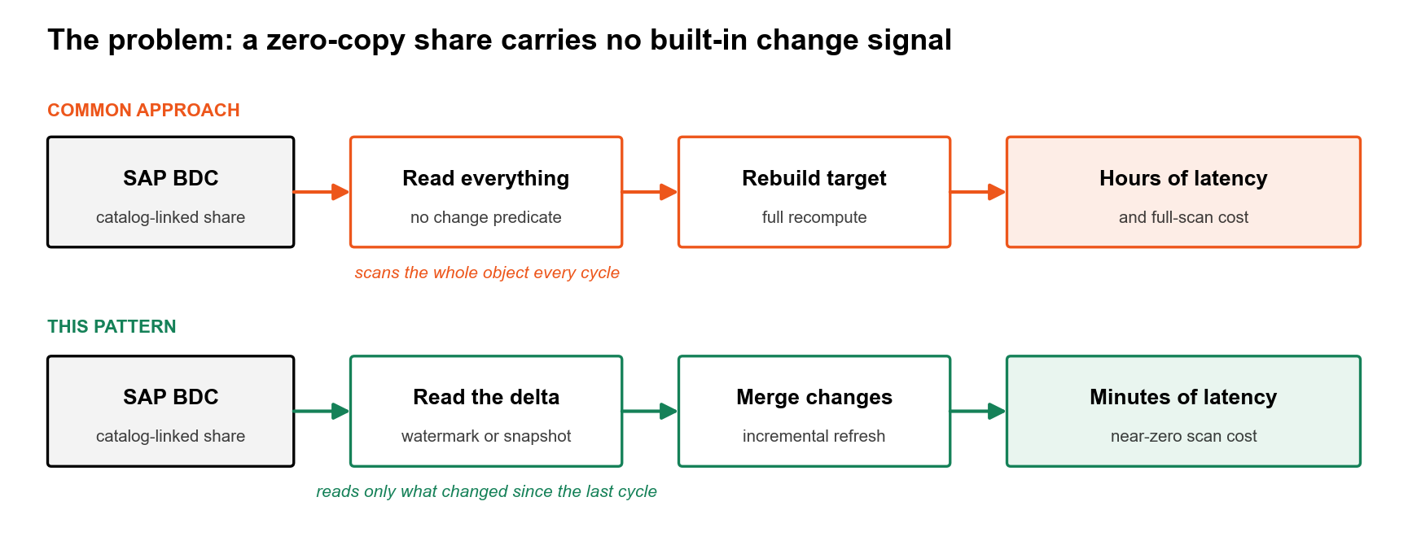
The challenge
The problem capture is asked to solve.

Slide 4
Why standard CDC is refused
- SHOW TABLES reports kind=TABLE, is_external=N - this is misleading
- CREATE STREAM: 'Streams on External Tables or Iceberg tables with an external catalog must have INSERT_ONLY set to true'
- CHANGES() clause: 'not supported on external tables or Iceberg tables with an external catalog'
- ALTER TABLE SET CHANGE_TRACKING: 'cannot be set for Iceberg tables unless they use Snowflake catalog'
- SHOW TABLES reports change_tracking=ON - but both mechanisms are still refused. That ON is misleading.
- INSERT_ONLY streams are permitted but cannot detect physical deletes and expire after 14 days unread
sap-bdc-cdc | community pattern | Apache 2.0

Slide 5
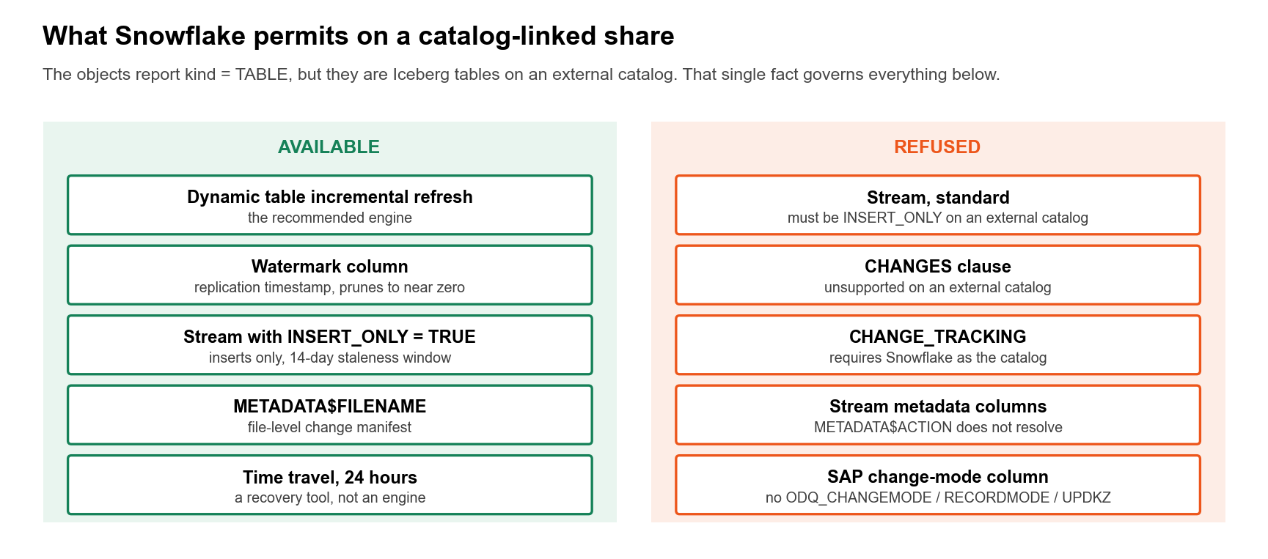
Why standard CDC is refused
What the platform permits on a catalog-linked share.

Slide 6
Two tracks, one engine
- Which signal is available depends on the kind of data product
- Track 1 - Custom: source-system timestamp (e.g. ZZLASTCHGDATE), added by SLT pipeline configuration; 59 objects across reference account
- Track 2 - Standard: four SAP-generated metadata columns (__OPERATION_TYPE, __TIMESTAMP, and two hash-suffixed columns); nothing to configure
- The engine is the same on both tracks: dynamic tables with REFRESH_MODE = INCREMENTAL stated explicitly
- The watermark is the trigger and exception path, not the engine
- Start with the readiness probe: probes/cdc_readiness.py classifies every object and validates the signal before you deploy anything
sap-bdc-cdc | community pattern | Apache 2.0

Slide 7
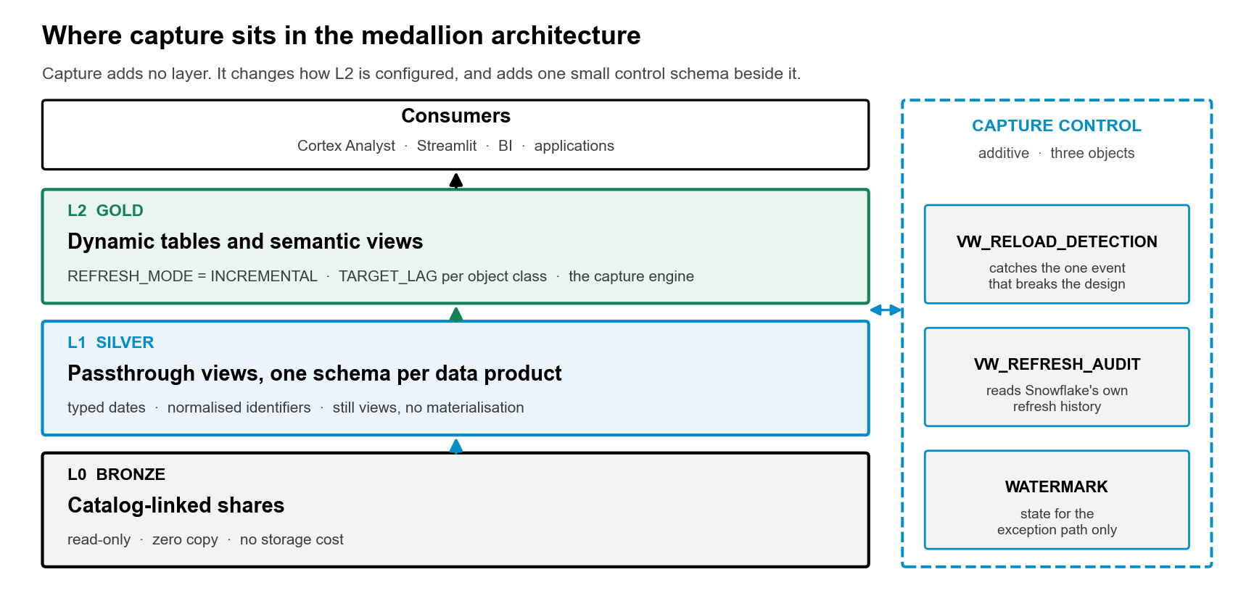
Two tracks, one engine
Where capture sits between the SAP share and the Gold layer.

Slide 8
Track 1 - Custom data products
The connector merges rather than reloads. Historical rows keep their original replication timestamp; new data lands in new Parquet files. Per-file Iceberg statistics span a narrow range, enabling near-total file elimination on a watermark predicate.
- 108M-row GL object: watermark predicate scanned 0.00 MB vs 7,035.80 MB for a full read
- Business-date predicate on the same object: 4,695.75 MB (scattered across all files - the wrong tool)
- Poll cost: 0.00 MB, 47-79 ms
- 10 of 10 Gold dynamic tables confirmed INCREMENTAL once REFRESH_MODE was pinned explicitly
- Initial load: 4,314,292 rows in 18.3 s; no-change refresh: NO_DATA in 984 ms
Note: No operation column on this track. Deletes are invisible. Reconcile row counts on a schedule.
sap-bdc-cdc | community pattern | Apache 2.0

Slide 9
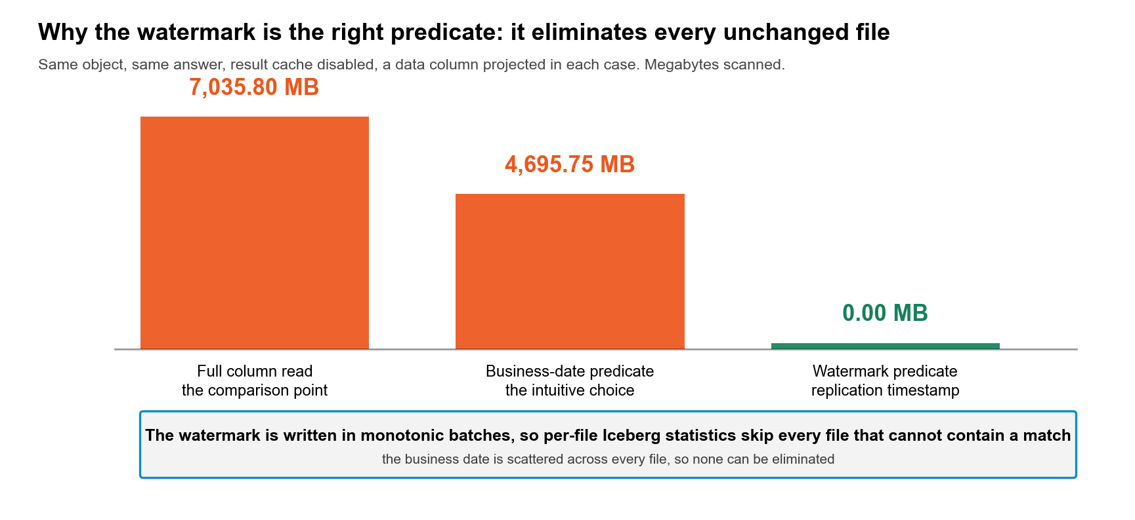
Track 1 - Custom data products
Scan cost: a watermark predicate against a full read.

Slide 10
Track 2 - Standard data products
SAP generates four metadata columns. __TIMESTAMP arrives as TEXT with a comma decimal separator (2026-06-15T09:41:59,6426580Z). TRY_TO_TIMESTAMP_NTZ returns NULL silently on the raw value - an unguarded cast looks like an empty column.
- MAX(__TIMESTAMP) as raw text: 0.000 MB, 2 ms - from manifest statistics
- MAX(parsed expression): 0.310 MB, 45 ms - must scan micropartitions
- Lexicographic order = chronological order (verified on reference data)
- Operations observed: L=67,087 (initial), A=393 (delta); delete code: 0 observed, unverified
- End-to-end: 3,355 rows; INCREMENTAL in 5,241 ms; NO_DATA in 610 ms
- run_id held the SAME value on both initial and delta rows - not a batch discriminator
Note: Predicate pruning NOT demonstrated at scale (single micropartition). Delete code unverified. Use dynamic tables as the engine.
sap-bdc-cdc | community pattern | Apache 2.0

Slide 11
The headline risk: never trust a local copy
The metadata columns were reliable only inside the live catalog-linked database. Every local copy examined had corrupted metadata. None of this fails loudly.
- Copy 1: __OPERATION_TYPE held media titles ('Mission Possible 1', 'About a Girl - Series') + 16,317 NULLs; 17 distinct values up to 33 chars
- Copy 2: __OPERATION_TYPE, __TIMESTAMP, and LOAD_TYPE all held customer identifiers (620 distinct) on 735,305 of 735,305 rows
- Copy 3: same degeneracy on 557,693 of 558,011 rows
- Defect propagated downstream into later medallion layers
- Local copies lose the hash suffix - its absence marks a non-live source
- A downstream filter on __OPERATION_TYPE = 'A' returns zero rows or rows matched on customer IDs, silently
Point capture at the catalog-linked database. Validate metadata before building on it. Treat the hash suffix as a liveness marker.

Slide 12
The engine: dynamic tables
- REFRESH_MODE = INCREMENTAL - stated explicitly, always. Never AUTO.
- AUTO falls back silently to FULL when it cannot support incremental; FULL cascades: it forces everything downstream to FULL as well
- Dynamic tables are the only mechanism that captures physical deletes (they diff consecutive source snapshots)
- Four query shapes verified INCREMENTAL on a live share: flat projection, join, GROUP BY aggregate, left join with CTE
- NO_DATA in 348-610 ms on no-change cycles (Snowflake checks manifest statistics without reading source data)
- Watermark path is the exception: use it for non-deterministic transforms or targets outside Snowflake
sap-bdc-cdc | community pattern | Apache 2.0

Slide 13
Mechanism comparison
Dynamic table
Watermark + MERGE
INSERT_ONLY stream
Inserts
Yes
Yes
Yes
Updates
Yes
Yes
Yes
Physical deletes
Yes
No
No
No-change detection
NO_DATA in <1 s
0 MB poll
Yes
Code required
None
Task + MERGE + control
Task + MERGE
Can feed outside Snowflake
No
Yes
Yes
Goes stale unread
No
No
14 days
Blocked by non-deterministic SQL
Yes
No
No
sap-bdc-cdc | community pattern | Apache 2.0

Slide 14
Decision guide
- Prefer standard data products - only they can represent a delete
- Both tracks: dynamic tables with REFRESH_MODE = INCREMENTAL pinned explicitly
- Point capture at the live catalog-linked database, never a copy
- Validate standard metadata before building - column name is not enough
- Reconcile row counts on a schedule regardless of track
- Watermark path only for: non-deterministic transforms or external (non-Snowflake) targets
- Deploy VW_RELOAD_DETECTION (sql/03_monitoring.sql) - connector switching to reload raises no error
sap-bdc-cdc | community pattern | Apache 2.0

Slide 15
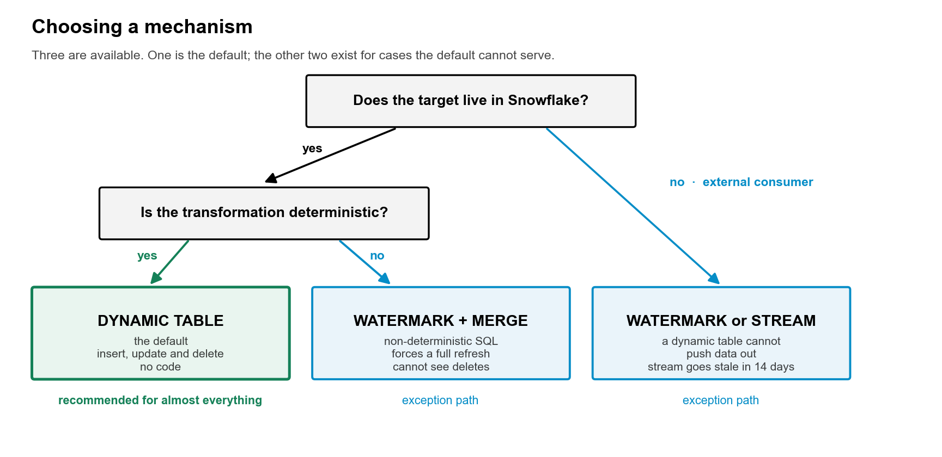
Decision guide
Choosing a mechanism.

Slide 16
The readiness probe
- Run probes/cdc_readiness.py before deploying anything on a new tenant
- Classifies every object: standard track, custom track, or no signal
- Validates standard metadata by checking value distribution, not just column name presence
- Measures poll cost and extraction cost against the live share
- Checks connector merge-versus-reload behaviour
- Returns READY / READY WITH CAVEATS / NOT READY / NOT ASSESSABLE
- Re-run with --with-scratch-tests to prove the dynamic table mechanism directly (creates a table in a scratch database then drops it)
sap-bdc-cdc | community pattern | Apache 2.0

Slide 17
Next steps and open asks to SAP
Next steps
Open asks to SAP
1. Run probes/cdc_readiness.py on your tenant
2. Deploy sql/ scripts in order: 00 through 04
3. Pin REFRESH_MODE = INCREMENTAL on every dynamic table - never AUTO
4. Deploy sql/03_monitoring.sql (VW_RELOAD_DETECTION in particular)
5. Reconcile row counts on a schedule on both tracks
- (a) Authoritative __OPERATION_TYPE contract - does a delete code exist?
- (b) Why __TIMESTAMP is TEXT with comma decimal separator, not a timestamp type
- (c) Whether change_tracking=ON is meaningful when streams are refused
- (d) Declared primary keys per catalog-linked object
- (e) Guidance on uninitialised objects in a share

