Slide 1
Change Data Capture on
SAP Business Data Cloud
How it is done on standard data products, and what to ask for on custom ones
Executive overview | August 2026 | All figures measured on live tenants

Slide 2
The situation
- SAP BDC data products arrive in Snowflake as catalog-linked shares - read-only, zero-copy, no storage cost
- Nothing in the share tells the Gold layer what changed, so the default behaviour is to re-read all of it on a schedule
- Snowflake's three native change mechanisms are all refused on these objects, because they are Iceberg tables on an SAP-managed catalog
- So the change signal has to come from the share itself - and what the share carries depends on which kind of data product it is
- That distinction is the subject of this deck. It decides whether CDC is a procedure to run or a specification to negotiate
sap-bdc-cdc | community pattern | Apache 2.0

Slide 3
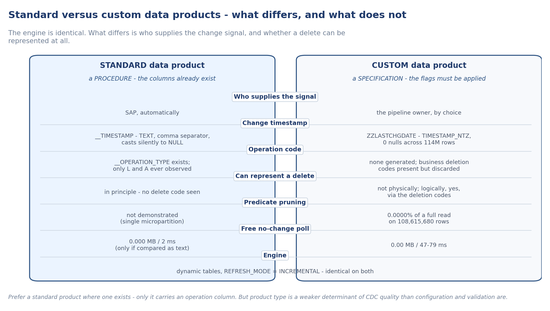
Two kinds of data product, two different jobs
The engine is identical on both. What differs is who supplies the change signal, and whether a delete can be represented at all.

Slide 4
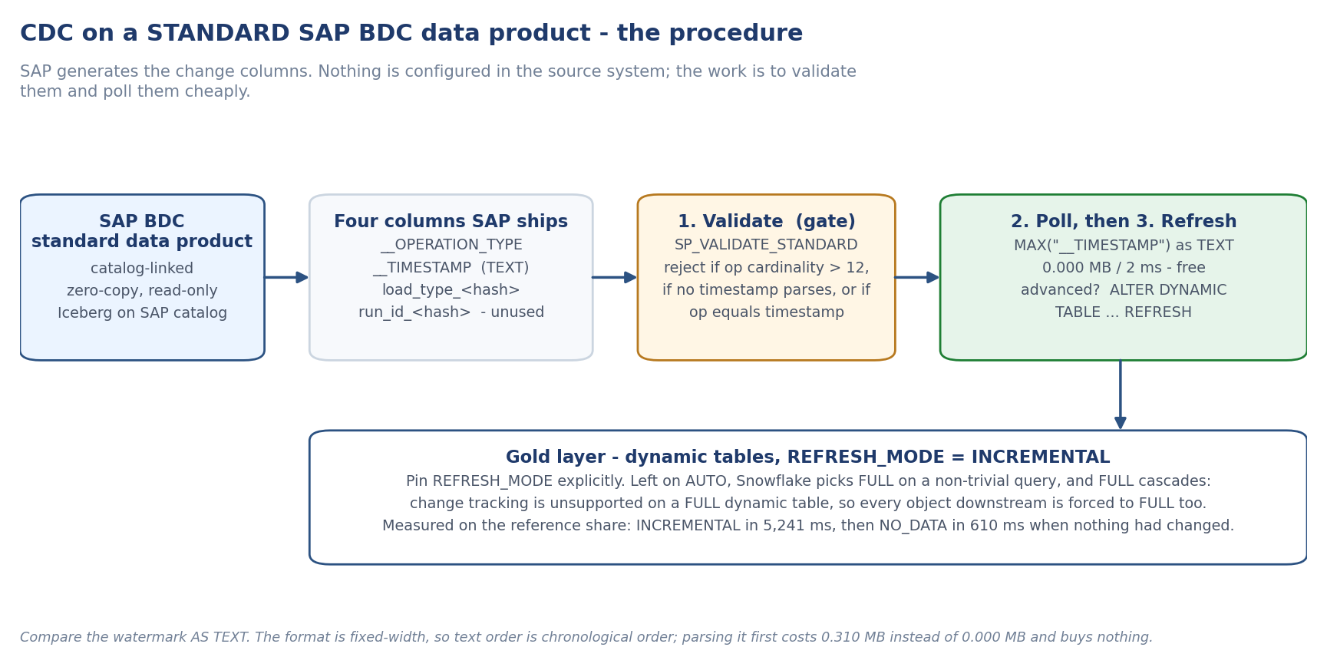
Standard data products - a procedure
SAP generates the change columns. Validate them, then poll them for free. No source-system change is required.

Slide 5
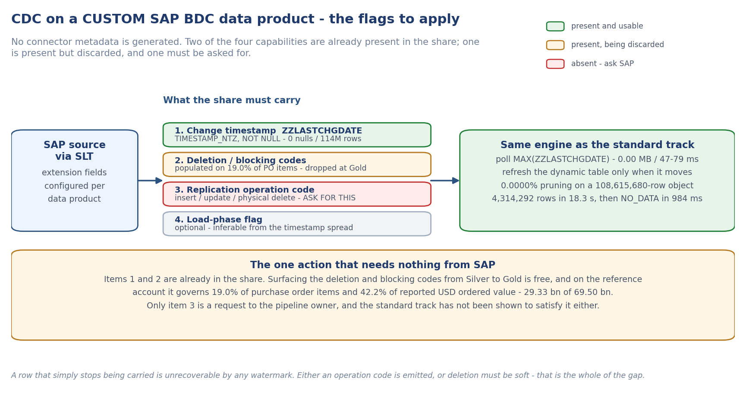
Custom data products - a specification
Nothing is generated. Two capabilities are already in the share, one is present but discarded, and one must be requested.

Slide 6
What it costs, measured
Standard product
Custom product
Detecting no change
0.000 MB in 2 ms - free
0.00 MB in 47-79 ms - free
Reading only the change
not demonstrated at scale
0.0000% of a full read, on 108,615,680 rows
Refresh when nothing moved
NO_DATA in 610 ms
NO_DATA in 984 ms
Refresh with data
INCREMENTAL in 5,241 ms
4,314,292 rows in 18.3 s
Code to write
none - dynamic tables
none - dynamic tables
sap-bdc-cdc | community pattern | Apache 2.0

Slide 7
The risk on standard products: never trust a copy
The connector metadata was reliable inside the live share and corrupted in every local copy of it we examined.
- On one product the operation column held media titles - 17 distinct values, up to 33 characters, plus 16,317 nulls
- On another, three metadata columns all held the same customer identifier across 735,305 of 735,305 rows
- The defect propagated downstream into the layers built on those copies
- None of it raises an error. It produces a wrong incremental result quietly, which is the expensive kind of wrong
Point capture at the catalog-linked share itself, and validate the columns before building on them. Both are one-line checks.

Slide 8
The finding that changed our recommendation
SAP's own deletion and blocking codes are already in the share - and the Gold layer drops them.
- 19.0% of purchase order items carry a deletion or blocking code - 819,745 of 4,314,292
- In USD, where the amounts are additive: 29.33 bn of 69.50 bn of ordered value sits on flagged items - 42.2%
- That 69.50 bn is the same headline ordered-value figure the Gold layer reports today, with no label and no way to filter
- Surfacing those codes costs nothing and requires nothing from SAP
Whether deleted and blocked items belong in spend is a business decision. Carrying them silently is not defensible either way.

Slide 9
The recommendation
In priority order. Only item 3 is a request to SAP.
- 1. Surface the deletion and blocking codes already in the share, so reported value can be labelled or filtered. Free, and worth 42.2% of the headline figure
- 2. Keep the change timestamp strongly typed and never null. The custom track already does this better than the standard one does
- 3. Ask SAP for a replication operation code, or a guarantee that deletion is soft. This is the one genuine capability gap - and it is open on both tracks
- 4. Add a declared load-phase flag. A convenience; inference works today
- 5. Do not copy run_id into a custom product - it carries no change information
Note: Prefer a standard data product where one exists, because only it carries an operation column. But product type matters less than configuration and validation do.
sap-bdc-cdc | community pattern | Apache 2.0

Slide 10
What we do not yet know
- Whether the standard operation column ever emits a delete code - only 'initial load' and 'delta' values were ever observed
- The authoritative list of operation values. SAP's documentation page could not be read, and the nearest published equivalent describes a different target, so we do not cite it
- Whether a change predicate reads only the change at production scale on the standard track - the reference tables were too small to tell
- Until the delete question is answered, row counts must be reconciled on a schedule on both tracks
- These are open asks to SAP, not blockers. Capture works today on both tracks without them
sap-bdc-cdc | community pattern | Apache 2.0

Slide 11
Next steps, and what we are asking SAP
Next steps
Open asks to SAP
1. Run the readiness probe against the account - about a minute, read-only, classifies every object as standard or custom and validates the metadata
2. Surface the deletion and blocking codes from Silver to Gold, so reported value can be labelled or filtered. Free, and worth 42.2% of the headline USD figure
3. Confirm REFRESH_MODE = INCREMENTAL is pinned on every Gold dynamic table, so a silent fall back to FULL cannot cascade
4. Decide, as a business question, whether logically deleted and blocked items belong in spend reporting
5. Schedule row-count reconciliation on both tracks until the delete question is closed
- An authoritative list of operation-code values, and whether a delete code is ever emitted
- Why the standard change timestamp ships as text with a comma decimal separator rather than as a timestamp
- Whether change_tracking = ON means anything on these objects, given streams and CHANGES() are both refused
- Declared primary keys per object, since the merge grain currently comes from source-system knowledge

