Slide 1
SAP WORKING CAPITAL 360
ON SNOWFLAKE
Demo Guide & the Snowflake × SAP Business Data Cloud story
Dave Freriks | Sales Engineering
Notes:
Welcome. Today I'm showing SAP Working Capital 360, a Snowflake Native App built on SAP Business Data Cloud finance data. It mirrors SAP Working Capital Insights and the SAP Taulia early-payment levers. The story: the CFO asks why our cash conversion cycle grew year over year.

Slide 2
Why Snowflake + SAP Business Data Cloud
Two platforms, one governed data foundation
Receivables, payables, cash and inventory live in SAP, but a working capital view needs them together with bank balances and funding programs. That usually means weeks of ETL, and the business context is lost along the way.
SAP BDC Connect shares governed journal entry, invoice and cash data products into Snowflake with zero copy. Snowflake joins non-SAP data and adds AI. No pipelines are needed and the context is preserved.
The Challenge
The Opportunity
Notes:
Set up the problem. DSO, DPO and DIO sit in different SAP modules and the cash position sits at the banks. BDC shares the SAP side zero-copy; Snowflake joins it with non-SAP data and adds AI.

Slide 3
What Is Working Capital 360?
A self-contained Snowflake Native App built on SAP BDC data
9 Working Capital Insights pages: CCC, cash, AR, AP, early payment, inventory and levers.
A Cortex Agent answers plain-English questions over a governed semantic view.
Runs on SPCS with data, semantic view and UI bundled; nothing leaves Snowflake.
Dashboards
Ask the Agent
Runs In Snowflake
Notes:
Tell them what they're about to see: 9 pages spelling out DSO (Days Sales Outstanding), DPO (Days Payables Outstanding), DIO (Days Inventory Outstanding) and CCC, plus a live Cortex agent.

Slide 4
How It’s Built: BDC → Snowflake → App
From SAP data product to a shareable AI app
SAP BDC Connect shares 11 finance data products, including Entry View Journal Entry, Supplier Invoice and Cash Flow, with zero copy and no ETL.
1. BDC Data Products
2. Snowflake Curation
14 L1 views feed L2 dynamic tables with DSO, DPO, DIO and CCC per company and month, plus AR/AP items, inventory and a 13-week cash forecast.
A Native App packages the data, the semantic view and an SPCS React UI with a Cortex agent. It installs in one click.
3. Native App + Cortex
Notes:
Walk the three steps: zero-copy in, curated into Working Capital Insights KPIs with the Taulia levers, and packaged as a one-click app. The dynamic tables refresh daily on their own.

Slide 5
DEMOING WORKING CAPITAL 360
THE 10-MINUTE FLOW
Notes:
Transition: 'Let me show you the app. The CFO wants to know why our cash conversion cycle grew year over year.'

Slide 6
The Demo Flow
Open the app: no setup, the data is already inside
Overview: CCC 54.0 → 58.7 days year over year
AP and Early Payment: DPO fell 50.0 → 44.5 days
AR and Inventory: overdue, disputes, DIO vs target
WC Opportunities: USD 3.0M cash release by lever
Ask the Agent why CCC rose in Japan Operations
Recap: zero-ETL, governed, AI-ready
Notes:
Roadmap for the live demo; don't read it aloud. Focus most on AP and Early Payment & SCF: shorter DPO is the main reason CCC grew, and the Taulia levers fix it.

Slide 7
Demo Act 1: The Dashboards
Answer the CFO: why did CCC grow?
CCC (DSO + DIO − DPO) rose 4.7 days to 58.7; Japan Operations is highest at 66.0 days.
DPO fell from 50.0 to 44.5 days; USD 30.1K of discounts were lost last month.
Dynamic discounting (APR 10.2%) and supply chain finance are the Taulia levers.
USD 3.0M cash release identified; SCF-extended DPO is the largest lever.
Overview
Payables
Early Payment
Opportunities
Notes:
Click through and narrate outcomes: 'CCC is up 4.7 days, and the driver is DPO: we pay suppliers earlier and still lose discounts.' Then show the SCF and dynamic discounting levers.

Slide 8
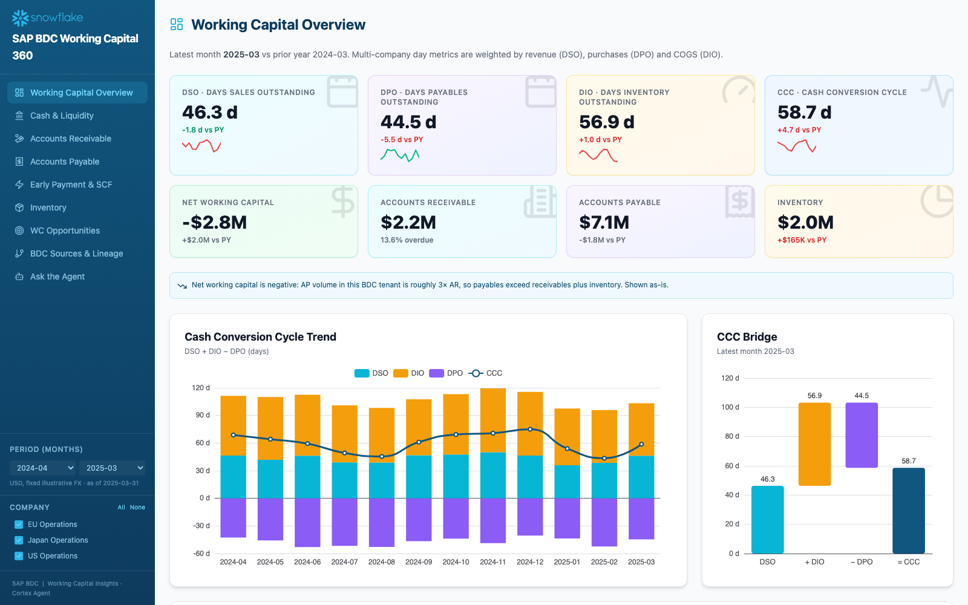
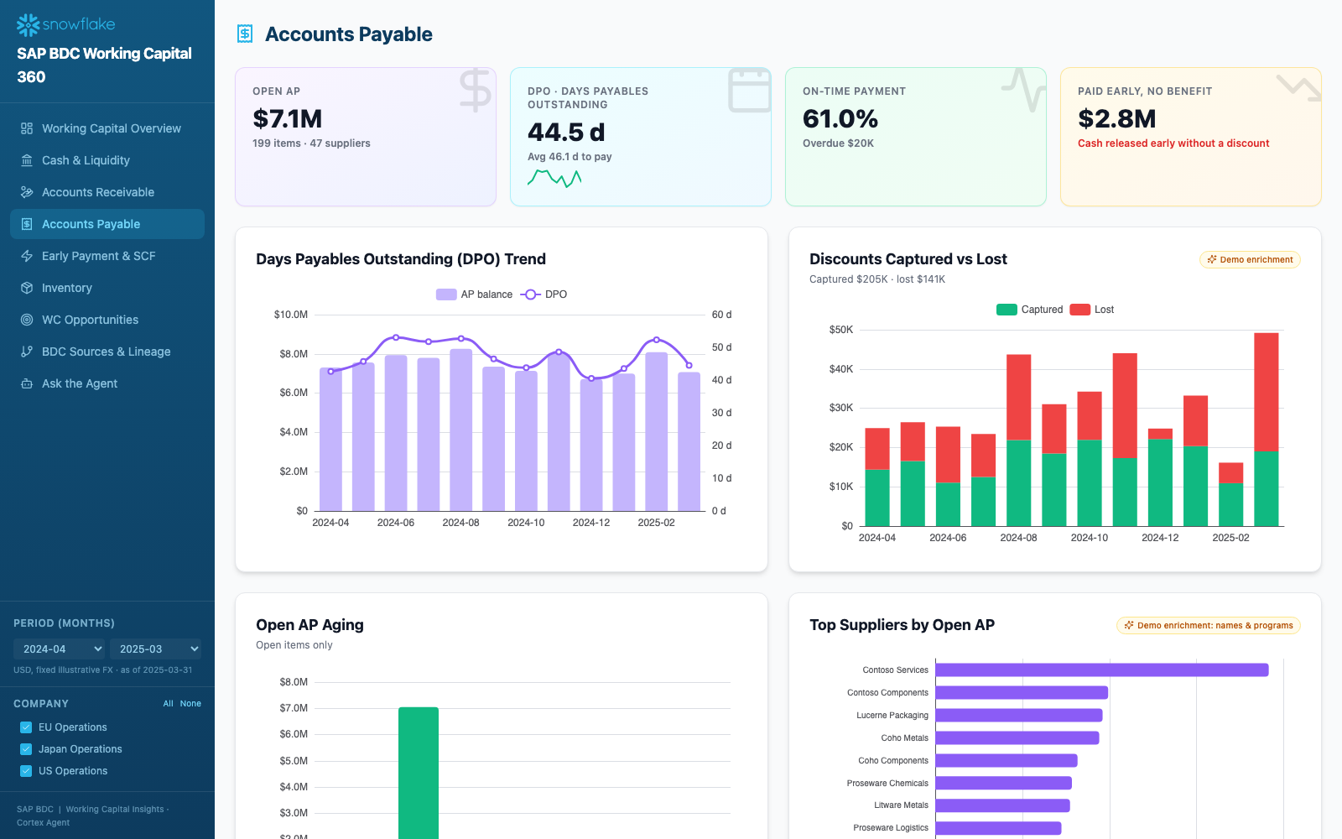
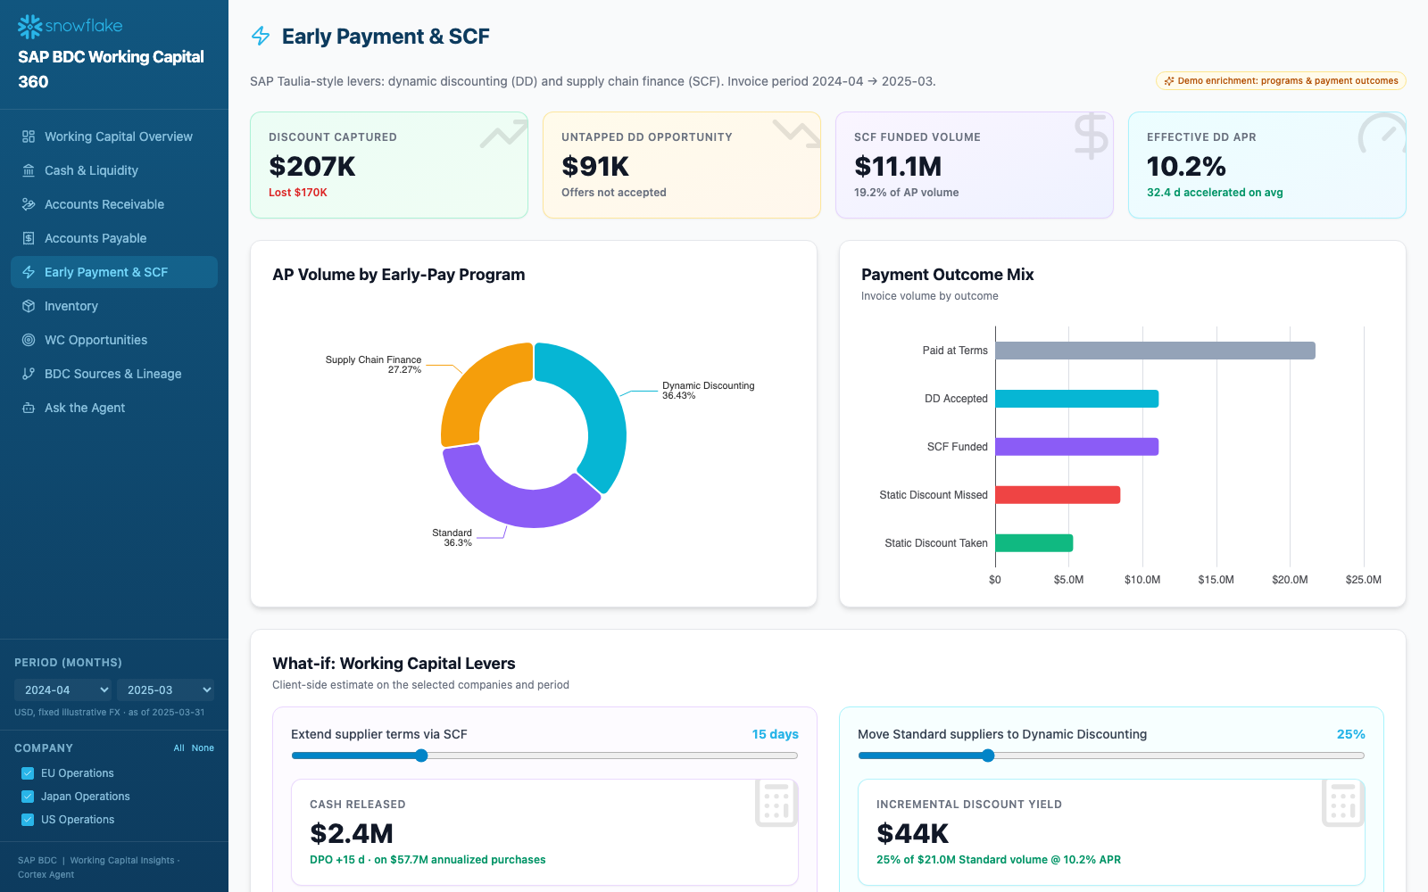
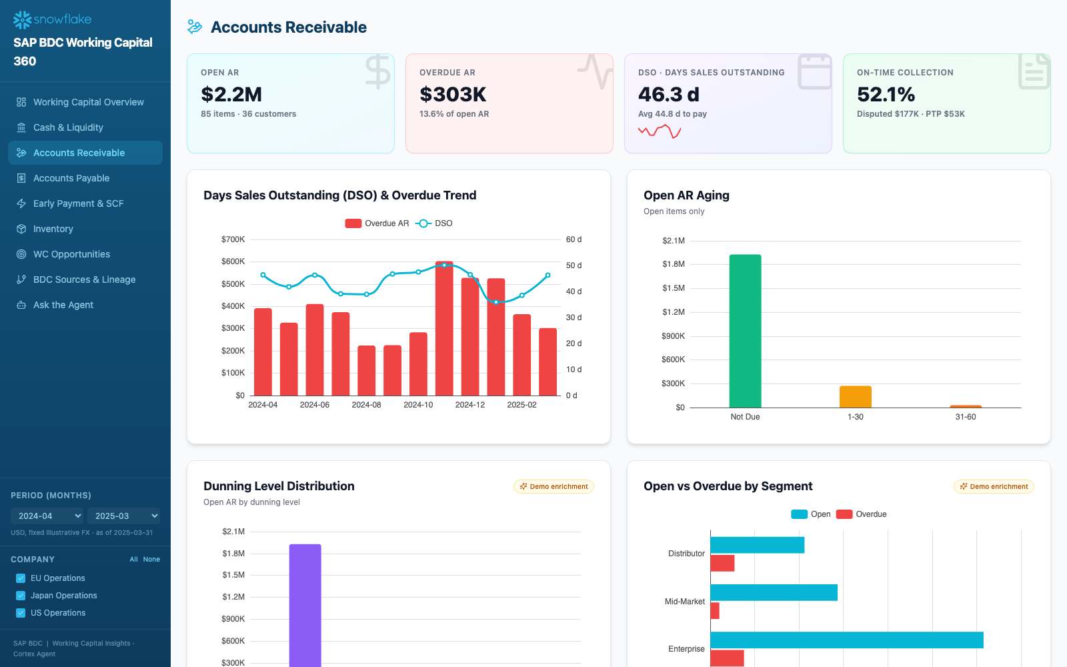
The Dashboards: CCC, Payables & Early Payment
Notes:
Screens for Act 1: Working Capital Overview, Accounts Payable, Early Payment & SCF, Accounts Receivable.

Slide 9
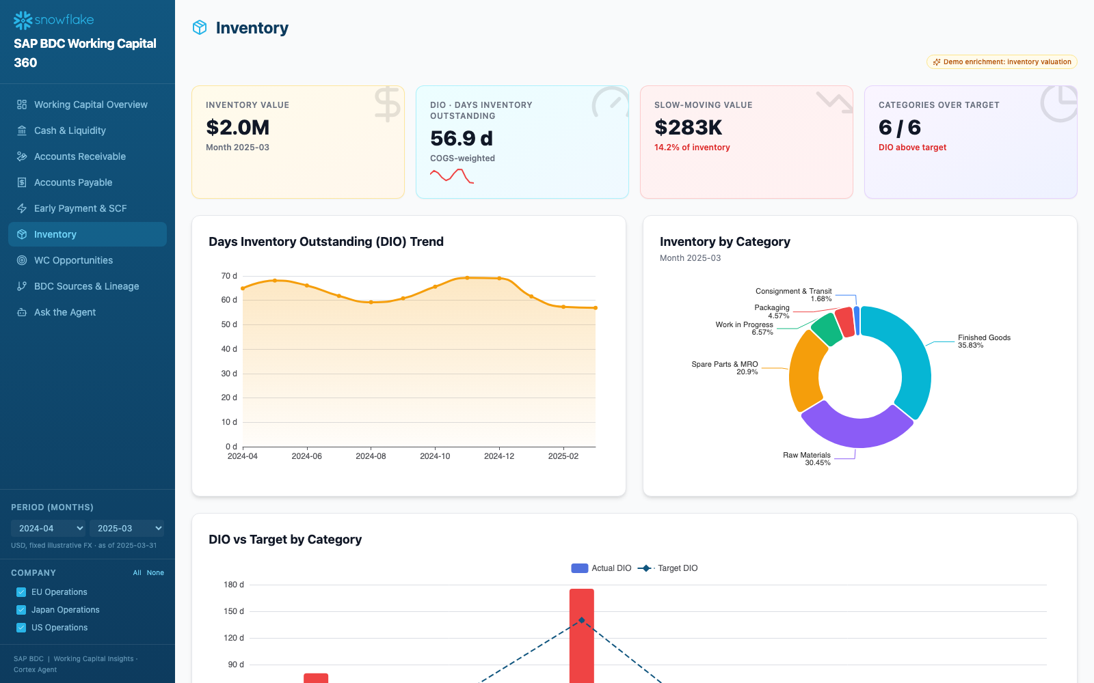
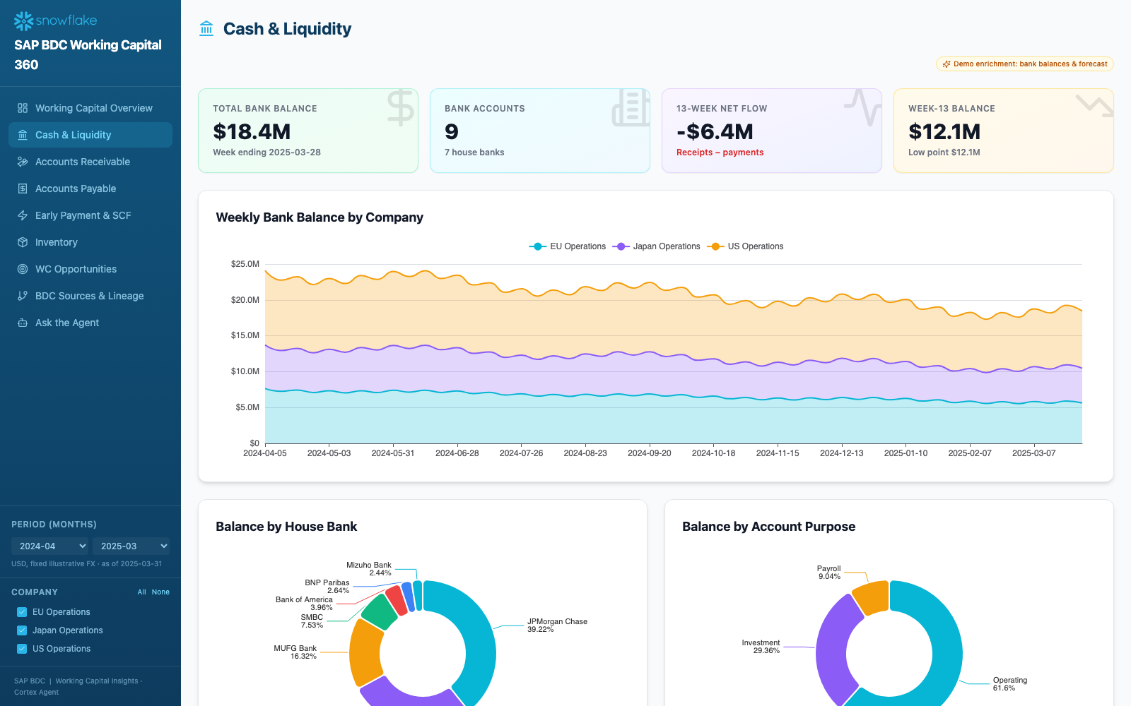
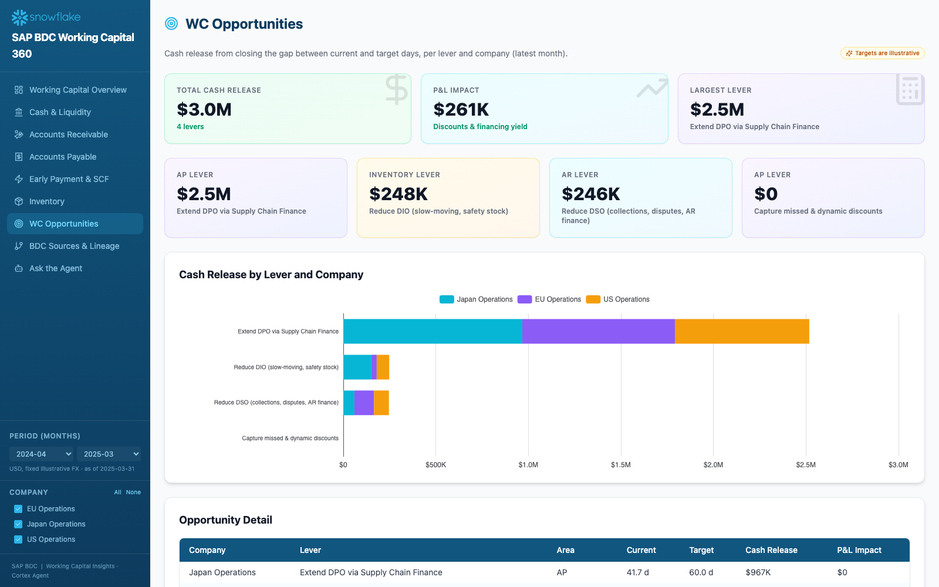
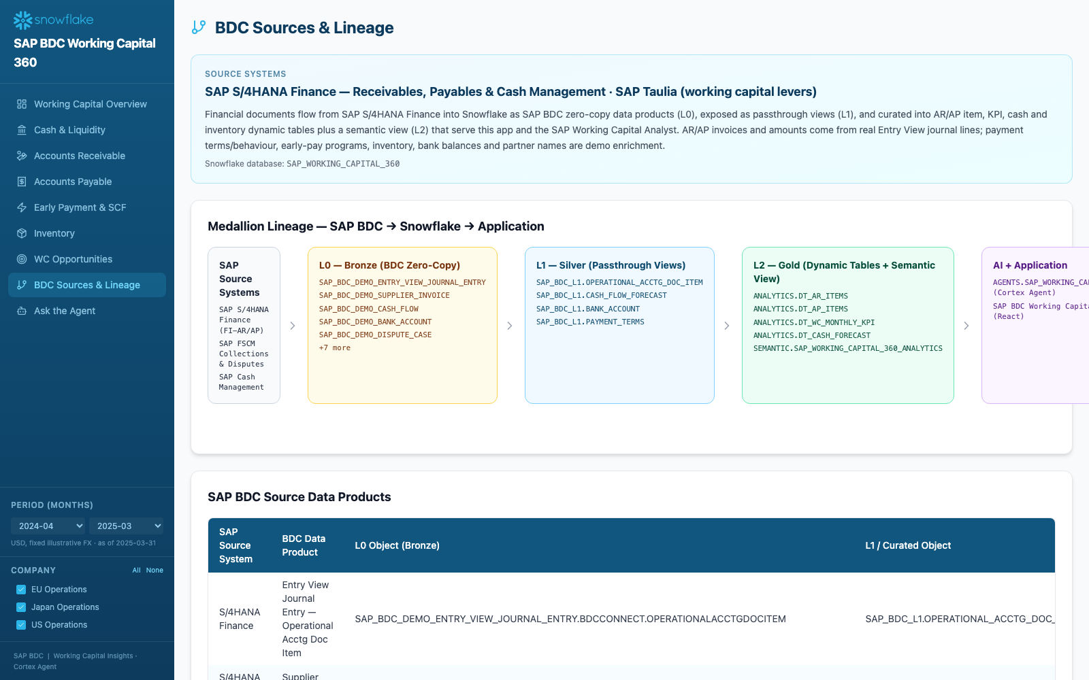
The Dashboards: Inventory, Cash & Opportunities
Notes:
Inventory DIO vs target, Cash & Liquidity with the 13-week forecast, WC Opportunities, and BDC Sources & Lineage.

Slide 10
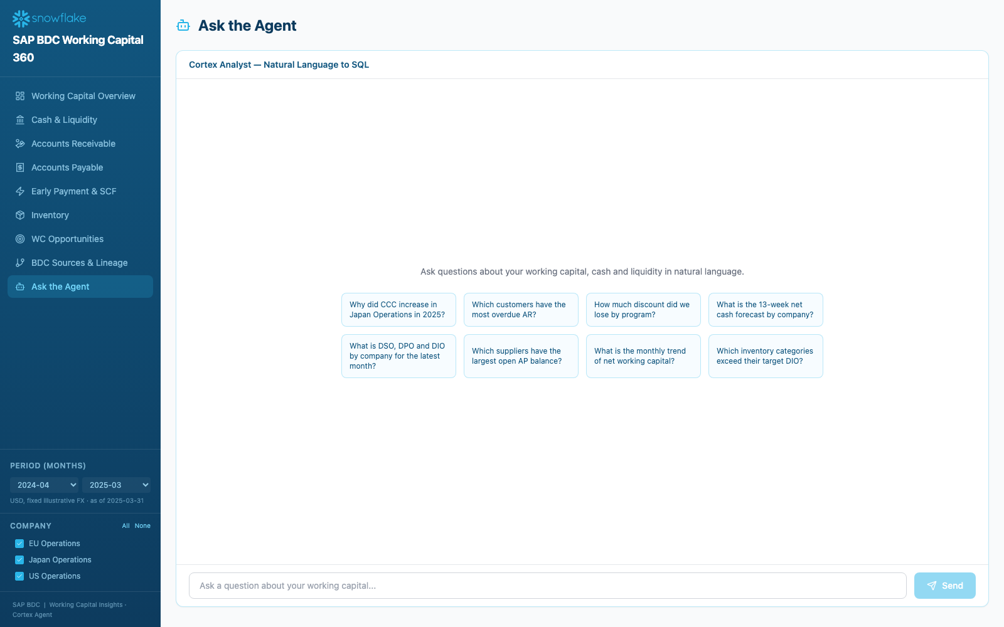
Ask the Agent
Notes:
The Ask the Agent page. Ask a live question and expand the SQL.

Slide 11
Demo Act 2: Ask the Agent
Cortex Agent over a governed semantic view
Ask in plain English: “Why did CCC increase in Japan Operations in 2025?”, “How much discount did we lose by program?” or “Which customers have the most overdue AR?”
SAP_WORKING_CAPITAL_ANALYST maps the question to the bundled semantic view, generates governed SQL and returns a chart with the exact query, so the answer is explainable.
Notes:
The highlight. Type a question live; do NOT pre-load it. Expand the generated SQL to show the answer is governed and explainable.

Slide 12
Key Points to Land During the Demo
Say these out loud
Lead with the CFO question, not architecture. AR/AP invoices are real BDC journal lines; terms, early-pay programs, inventory, bank balances and partner names are demo enrichment. USD at fixed FX (EUR 1.08, JPY 0.0067); NWC is negative as AP is ~3x AR.
Notes:
Reinforce: no ETL, Working Capital Insights plus Taulia levers, AI-ready and governed. Always state the data honesty line; it builds trust with finance audiences.

Slide 13
The Snowflake × SAP BDC Value
Why this partnership matters
BDC Connect zero-copy sharing means no pipelines; journal entry data is live in Snowflake.
SAP semantics are preserved and joined with non-SAP bank and funding data.
A Cortex Agent brings natural-language analytics directly to SAP working capital data.
Native Apps package data + AI + UI into a one-click, distributable product.
Zero-ETL
Governed
AI-Ready
Global Apps
Notes:
Zoom out to the partnership value. Cover each of the four pillars in one sentence.

Slide 14
Takeaways by the Numbers
What this demo proves
0
11
4.7
$3M
ETL pipelines to build: BDC Connect shares data zero-copy.
BDC finance data products composed into one app.
Days of CCC growth explained, down to the driver.
Cash release identified across the SAP Taulia levers.
Notes:
Make it concrete: zero pipelines, 11 BDC data products, a 4.7-day CCC increase explained, and USD 3.0M of cash release identified.

Slide 15



One App. US Live. EMEA & APAC Next.
‹#›
Notes:
The app is live in US (AWS_US_WEST_2) as ORGDATACLOUD$INTERNAL$WORKING_CAPITAL_360_ORG. EMEA and APAC use the same scripts with --target dfreriks_eu_demo / dfreriks_apac_demo; each region is its own governed install.

Slide 16
Demo Do’s and Don’ts
Keep it crisp and outcome-focused
Lead with the CFO question. Show the app already has data. Focus on AP and Early Payment & SCF. Ask SAP_WORKING_CAPITAL_ANALYST a real question live.
Don’t pre-load canned answers or dwell on SQL. Don’t present enriched terms, programs, inventory or bank balances as real tenant data. Don't hide the negative NWC; explain it.
Do
Don’t
Notes:
Presenter coaching. AR/AP invoices, amounts and dates are real BDC Entry View Journal Entry lines; payment terms and behaviour, early-pay programs, inventory, bank balances and partner names are demo enrichment (IS_DEMO_ENRICHMENT). USD at fixed illustrative FX (EUR 1.08, JPY 0.0067). NWC is negative because AP is ~3x AR in the demo tenant.

Slide 17
Next Steps
Take the story forward
For SEs: install from the internal marketplace (or use the public demo) and rehearse the 10-minute flow.
For customers: map SAP finance data products in BDC and pick the first working capital lever to size.
For partners: co-build Native Apps on BDC data with SAP Taulia levers to reach every Snowflake region.
Notes:
Close with a clear ask per audience. Public demo: https://sfc-gh-dfreriks.github.io/working-capital-360-public/

Slide 18
THANK
YOU
Notes:
Thank the audience. Share the listing locator ORGDATACLOUD$INTERNAL$WORKING_CAPITAL_360_ORG (role WORKING_CAPITAL_360_APP_USERS) so they can install Working Capital 360.

