Slide 1
KLA Escalation Command Center
Snowflake + Cortex AI | Real-Time Field Service Intelligence
Powered by Snowflake Data Cloud • Cortex AI Agent • SAP S/4 HANA Integration
Prepared for Dave Kelly & Jim Cordova | March 2026
Notes:
TITLE SLIDE
- Welcome Dave and Jim
- "Today we're going to show you a working prototype of the KLA Escalation Command Center"
- "This is built entirely on Snowflake's platform — Cortex AI for intelligence, with real-time SAP S/4 HANA integration"
- "The goal: replace the email/SharePoint/phone-based case management with a single intelligent command center"

Slide 2
Agenda
1. Snowflake Platform Overview — Why Snowflake for KLA
2. Real-Time AI Workflow Demo — Live Escalation Management
3. SAP Integration & Interoperability — ERP Data Flows
4. Next Steps & Discussion
Notes:
AGENDA
- "We'll start with a quick overview of why Snowflake is the right platform for this"
- "Then we'll do a live demo walking through real escalation scenarios"
- "We'll show the SAP integration — how data flows between S/4 HANA and the command center"
- "And finish with next steps and discussion"
- Keep this slide brief — 30 seconds max

Slide 3
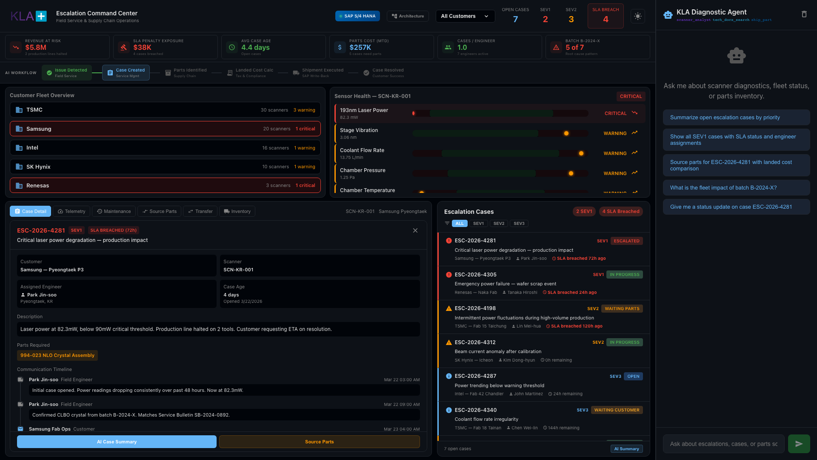
Dashboard Overview — Single Pane of Glass
Notes:
DASHBOARD OVERVIEW
- "This is the KLA Escalation Command Center — the single pane of glass that replaces email, SharePoint, and phone calls."
- Point out key elements:
• KPI bar at top: Revenue at Risk ($12.4M), SLA Penalty Exposure ($890K), Avg Case Age (5.2 days), Parts Cost MTD ($234K)
• Workflow strip showing the 6-step escalation lifecycle
• Fleet overview (top-left): 5 customers, 13 fabs, all scanners tracked
• Sensor health (top-right): Real-time scanner diagnostics
• Case detail (center): Currently selected escalation case
• Escalation cases (right): Queue sorted by severity
• Chat panel (far right): AI agent with suggested prompts
- "Everything you see is powered by Snowflake — unified data, real-time queries, Cortex AI intelligence"

Slide 4

Executive KPI Bar — Real-Time Business Impact
Notes:
KPI BAR
- "These KPIs are calculated in real-time from your case data, parts costs, and SLA agreements"
- Revenue at Risk: $12.4M — "Total production revenue exposed by active escalation cases"
- SLA Penalty Exposure: $890K — "Contractual penalties accumulating from breached SLAs"
- Avg Case Age: 5.2 days — "How long cases stay open — target is under 3 days for SEV1"
- Parts Cost MTD: $234K — "Month-to-date spend on replacement parts with landed cost awareness"
- Cases/Engineer: 1.4 — "Workload balance across your 4,000 field engineers"
- Batch B-2024-X indicator — "Fleet-wide alert: this batch is the root cause in 5 of 7 cases"
- "Today this data lives in 5 different systems. Here it's one glance."

Slide 5
Escalation Workflow — 6-Step Lifecycle
Notes:
WORKFLOW STRIP
- "Every escalation follows this 6-step lifecycle"
- Issue Detected → Case Created → Parts Identified → Landed Cost Calc → Shipment Executed → Case Resolved
- "The active step is highlighted. For the Samsung case, we're at 'Shipment Executed' — part is in transit"
- "This gives leadership instant visibility into where every case stands in the pipeline"
- "In production, each step transition would be automated with Snowflake Tasks and Streams"

Slide 6
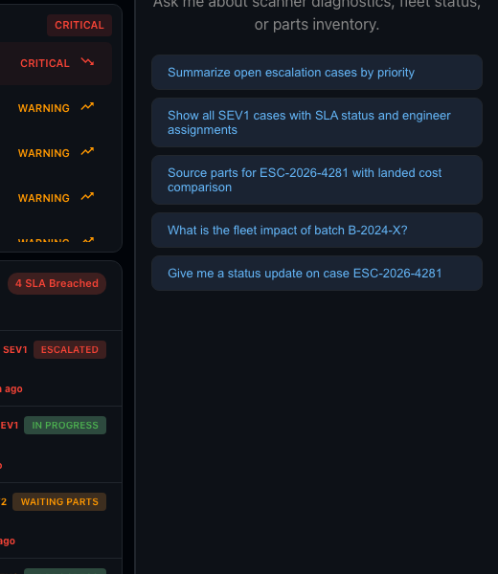
Escalation Queue — Priority-Sorted Cases
Notes:
ESCALATION CASES PANEL
- "Your escalation queue — every open case sorted by severity"
- Each card shows: Case ID, title, customer, fab site, assigned engineer, SLA status
- Color coding: Red = SEV1 (production down), Amber = SEV2 (degraded), Blue = SEV3 (monitoring)
- "Click any case to load its full details, sensor health, and communication timeline"
- SEV1 cases at top: Samsung Pyeongtaek and Renesas Naka — both production impacting

Slide 7
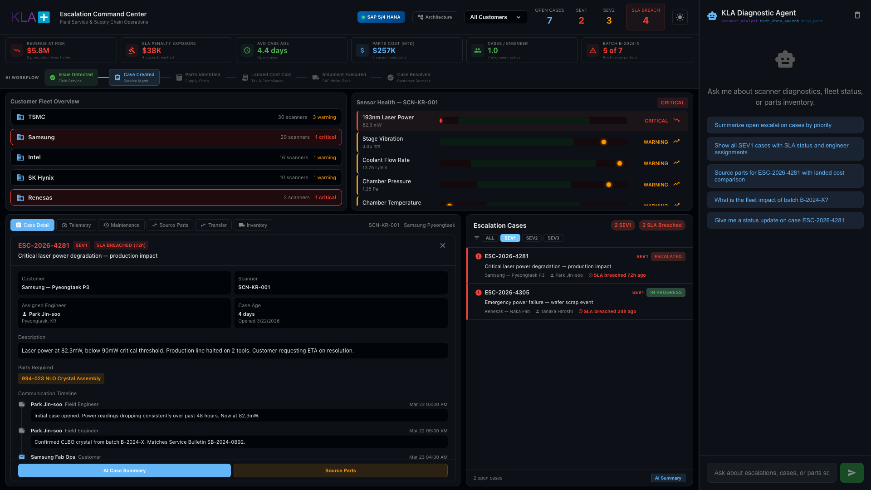
SEV1 Filter — Critical Cases Only
Notes:
SEV1 FILTER
- "Click SEV1 to isolate just the critical cases — production lines down"
- Only 2 cases visible: Samsung Pyeongtaek (ESC-2026-4281) and Renesas Naka (ESC-2026-4305)
- "This is the view a regional VP uses in their morning standup"
- "Both cases share the same root cause: batch B-2024-X NLO Crystal degradation"
- "Pattern detection like this is impossible when cases live in separate email threads"

Slide 8
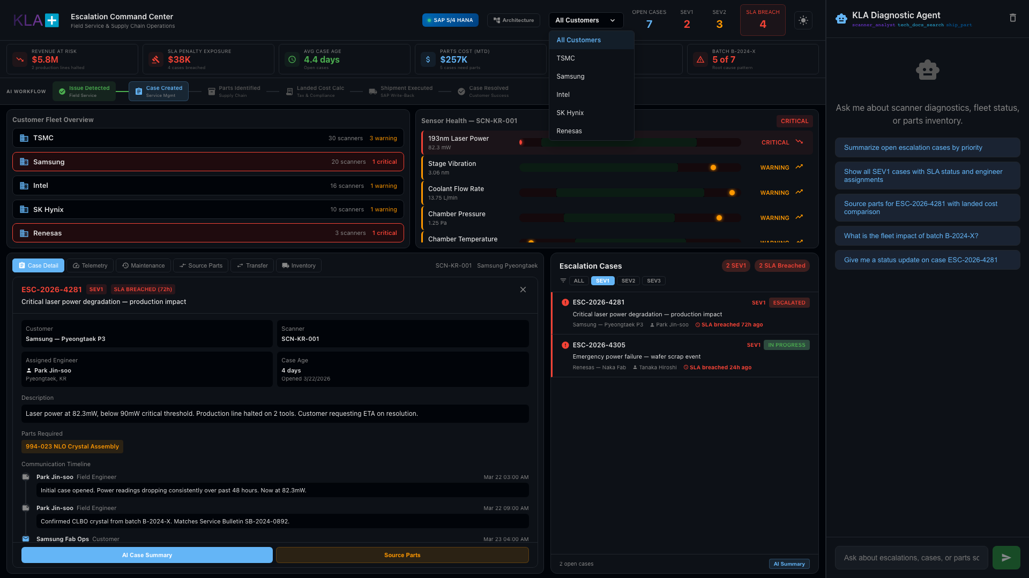
Case Deep-Dive — ESC-2026-4281 Samsung Pyeongtaek
Notes:
CASE DETAIL
- "Let's drill into the Samsung case"
- Case header: ESC-2026-4281, SEV1, SLA BREACHED (72h)
- Title: "Critical laser power degradation — production impact"
- Key metadata: Samsung Pyeongtaek P3, Scanner SCN-KR-001, Engineer Park Jin-soo (on-site)
- Laser power at 82.3mW — below the 90mW critical threshold
- Two production lines halted, customer requesting ETA
- Communication Timeline: Every interaction in chronological order
• Field engineer notes, customer emails, escalation events, parts requests
• "This replaces searching through Outlook to find what was said"
- Action buttons: "AI Case Summary" and "Source Parts"

Slide 9
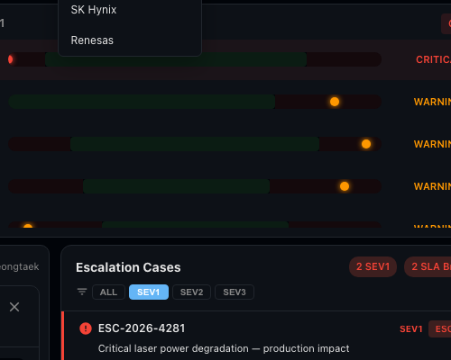
Sensor Health — Real-Time Scanner Diagnostics
Notes:
SENSOR HEALTH
- "When we clicked the Samsung case, sensor health auto-loaded for SCN-KR-001"
- 193nm Laser Power: 82.3mW — CRITICAL (below 90mW threshold)
- 8 sensor dimensions monitored: laser power, chamber temp, stage vibration, pressure, beam current, high voltage, coolant flow, optics contamination
- Green = healthy, Yellow = warning, Red = critical
- "Click any metric and the AI agent analyzes readings and correlates to open cases"
- "2-3 metrics flagging simultaneously tells the engineer: crystal problem, not calibration"

Slide 10
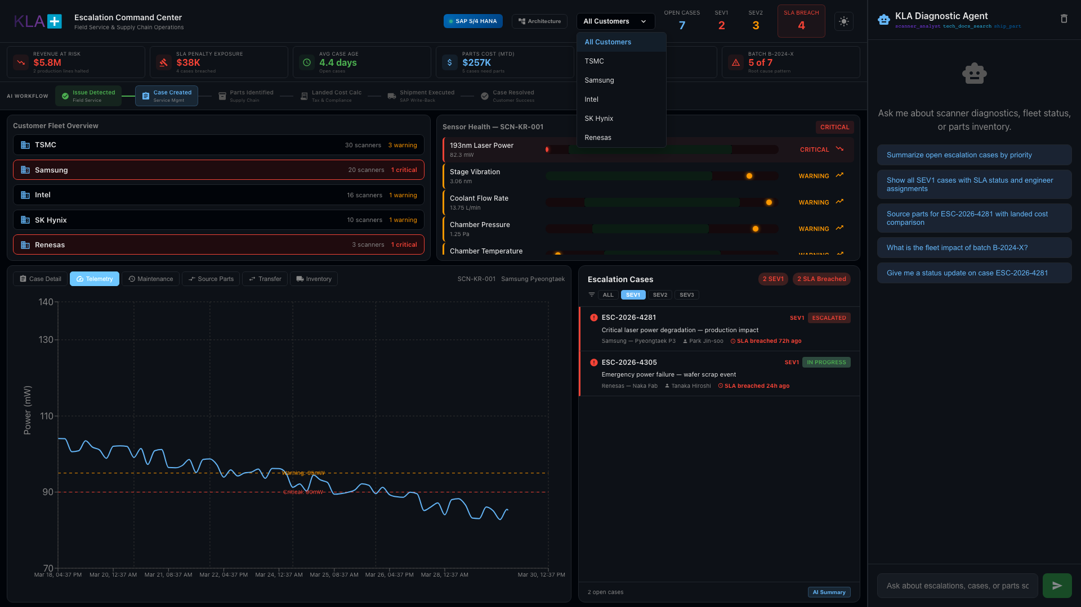
Telemetry — Laser Power Degradation Trend
Notes:
TELEMETRY TAB
- "Laser power time series for SCN-KR-001"
- Shows degradation trend: power declining from ~105mW to 82mW over 12 days
- Red anomaly markers flag readings below 90mW threshold
- "In production, Cortex AI would detect this trend automatically and trigger a proactive case BEFORE the customer calls"
- "This is predictive maintenance — not reactive firefighting"

Slide 11
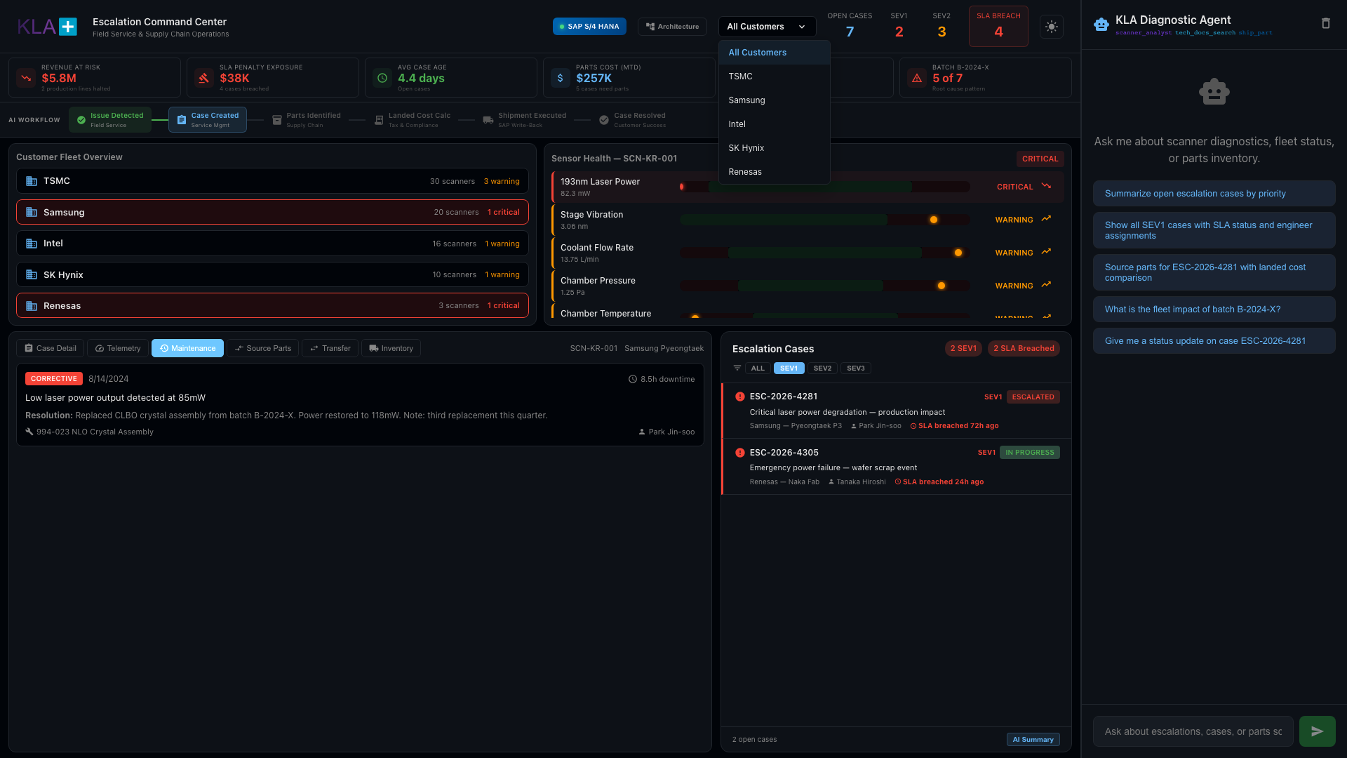
Maintenance History — Pattern Detection
Notes:
MAINTENANCE HISTORY
- "Every maintenance event for this scanner — corrective and preventive"
- SCN-KR-001 had a corrective repair in August: same issue, same part, same batch B-2024-X
- 8.5 hours of downtime from that previous repair
- "The pattern is clear: B-2024-X crystals failing prematurely across the fleet"
- "Without centralization, this correlation takes weeks. Here, the AI flagged it in seconds"

Slide 12
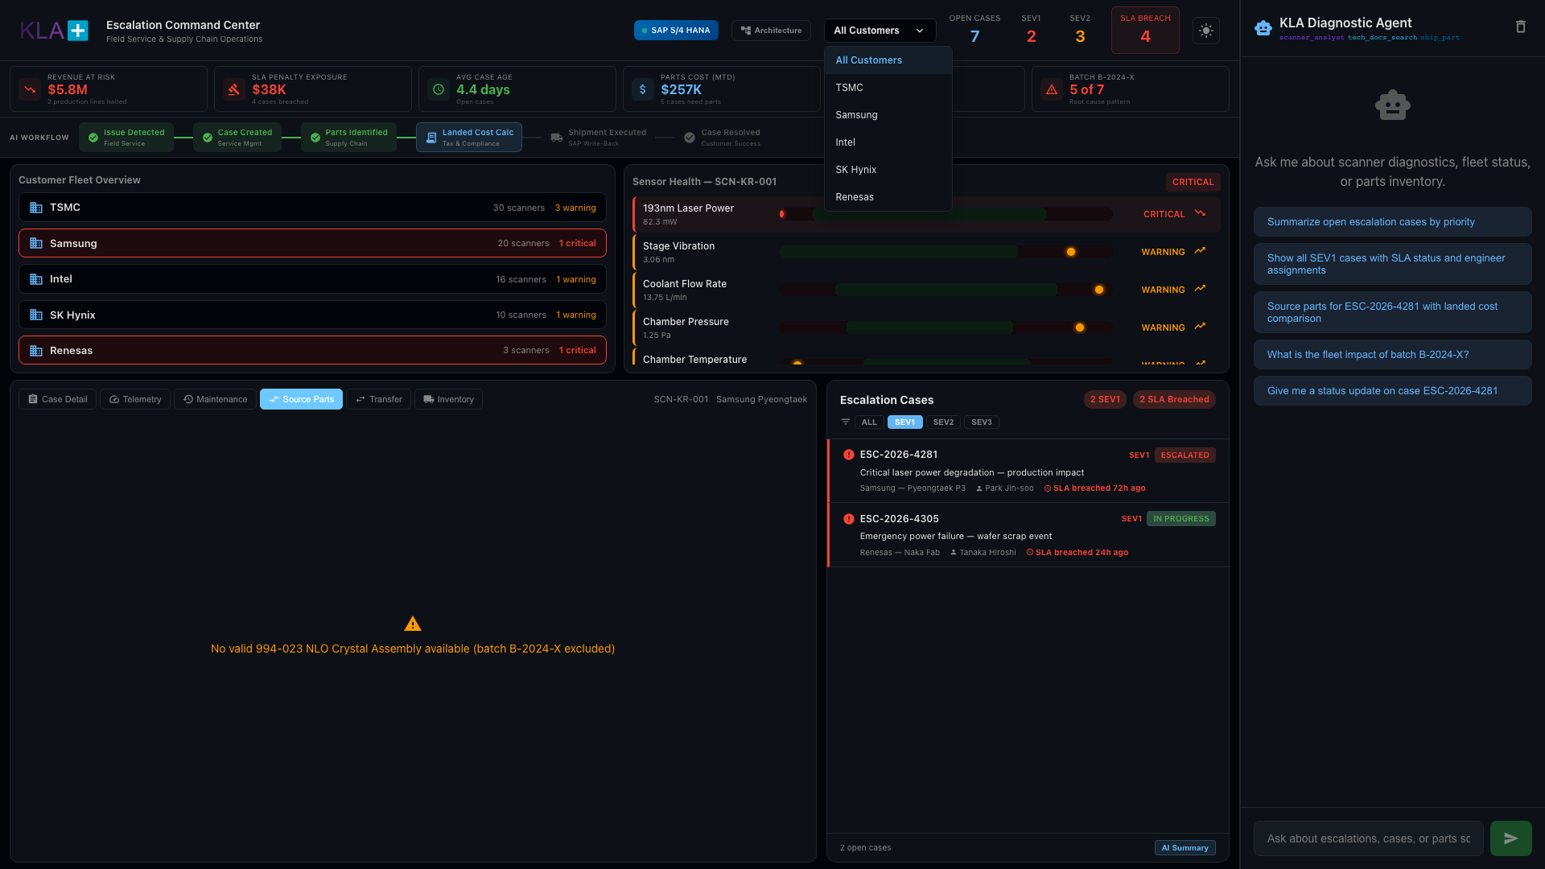
Parts Sourcing — Landed Cost Comparison
Notes:
SOURCE PARTS TAB
- "Where supply chain meets field service"
- Need to ship 994-023 NLO Crystal Assembly to Samsung Pyeongtaek, South Korea
- System compares options by total landed cost including tariffs, duties, VAT
- Singapore Hub: $51,480 landed — 1 day delivery, $0 import duty (ASEAN-Korea FTA)
- Tucson Hub: $58,410 landed — 2 day delivery, $3,600 import duty (8% US-Korea tariff)
- "Singapore saves $7,000 per unit AND arrives a day faster"
- "For a $45,000 crystal, tariff awareness drives the sourcing decision"
- System auto-excludes warehouses with batch B-2024-X stock
- NOTE: For this case path, the display may show batch exclusion message — the shipping cards appear via the chat-triggered sourcing flow

Slide 13
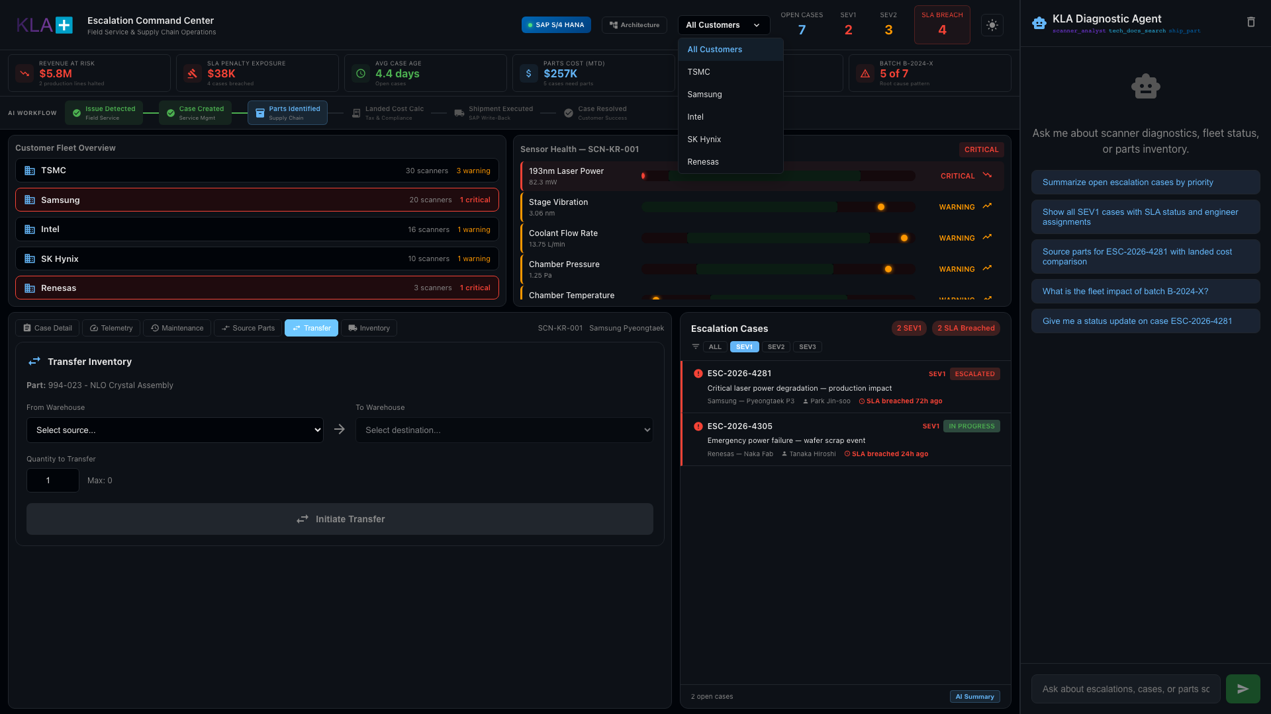
Parts Transfer — Inter-Warehouse Movement
Notes:
PARTS TRANSFER TAB
- "Sometimes the part isn't at the right warehouse"
- Select source warehouse, destination, and quantity
- Example: Moving 1 unit from Tucson to San Jose to cover backordered cases
- "The agent confirms transfer with before/after inventory levels"
- "Identifies which open cases this transfer supports"

Slide 14
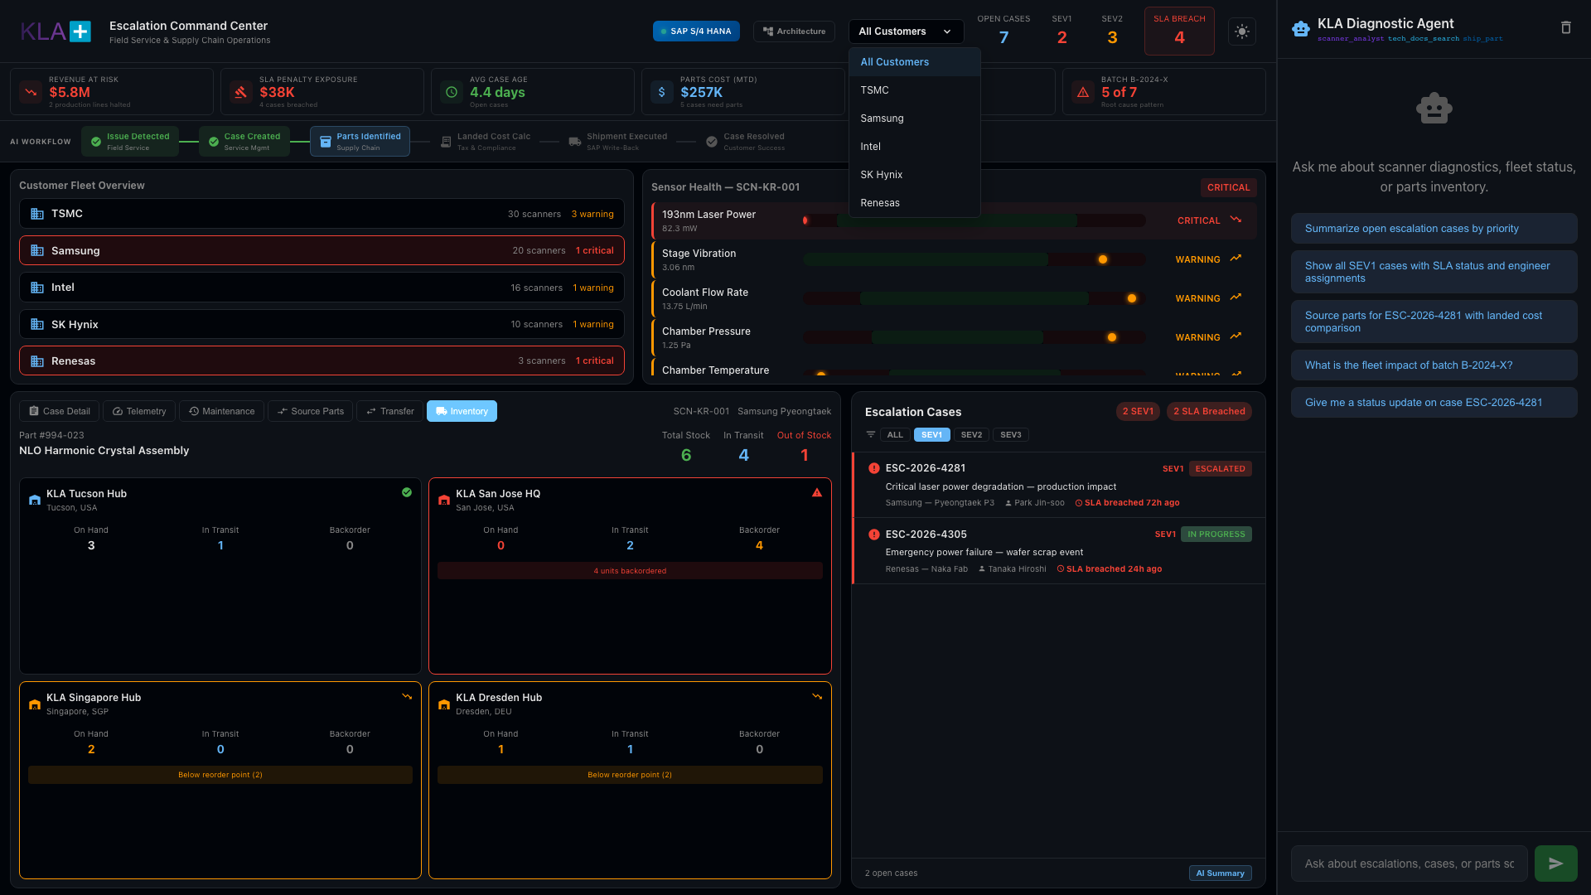
Global Inventory — Real-Time Stock Visibility
Notes:
INVENTORY TAB
- "Global inventory status for part 994-023 across all four KLA hubs"
- Tucson Hub: 3 on hand, 1 in transit
- San Jose HQ: 0 on hand, 2 in transit, 4 BACKORDERED — "Red OUT OF STOCK warning"
- Singapore Hub: 2 on hand
- Dresden Hub: 1 on hand, 1 in transit
- "6 units globally, 4 backordered at San Jose"
- "With 5+ cases needing this part, inventory is tight"
- "Click any warehouse card → AI tells you which cases are committed to that stock"

Slide 15
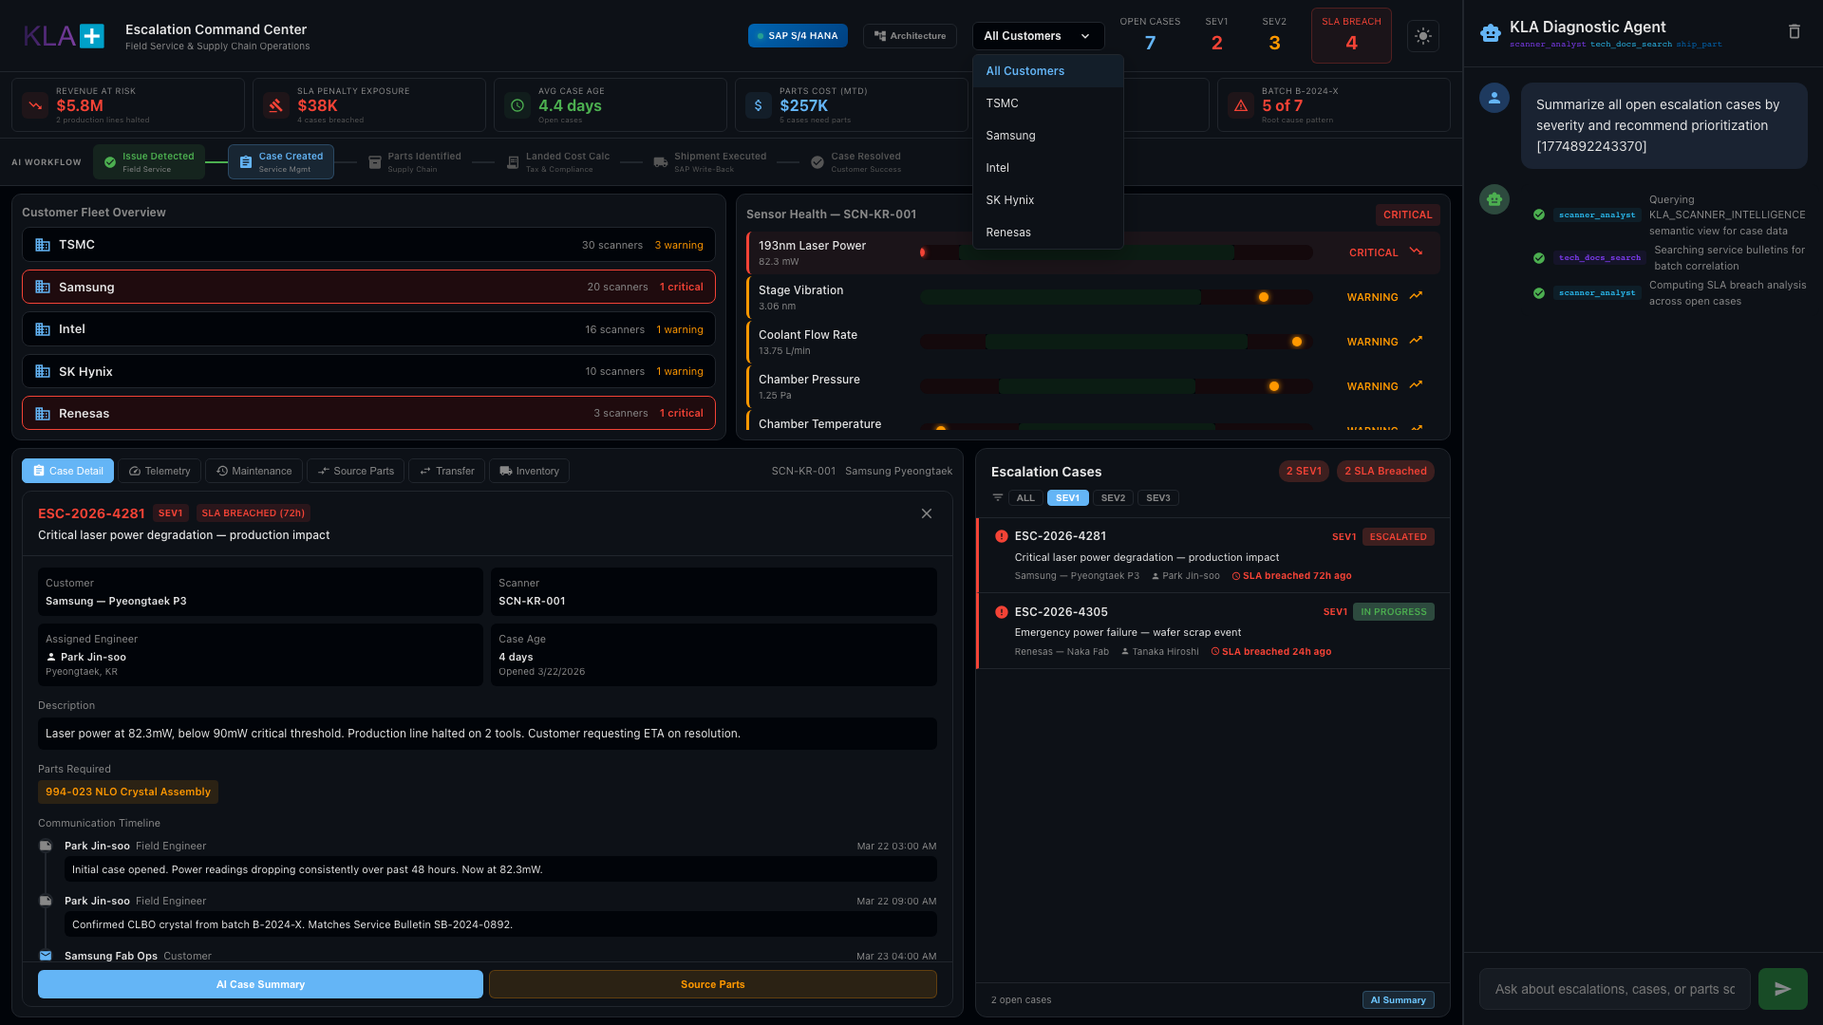
AI Summary — Priority Recommendations
Notes:
AI SUMMARY
- "Click 'AI Summary' at the bottom of the cases panel"
- Agent returns: severity counts, SLA status, priority-ranked recommendations
- CRITICAL: Identifies that 5 of 7 cases share root cause: batch B-2024-X crystals
- "This pattern recognition is impossible when cases live in separate email threads"
- "This replaces your Monday morning case review meeting"
- Root cause analysis, fleet impact assessment, and recommended actions — all automated

Slide 16
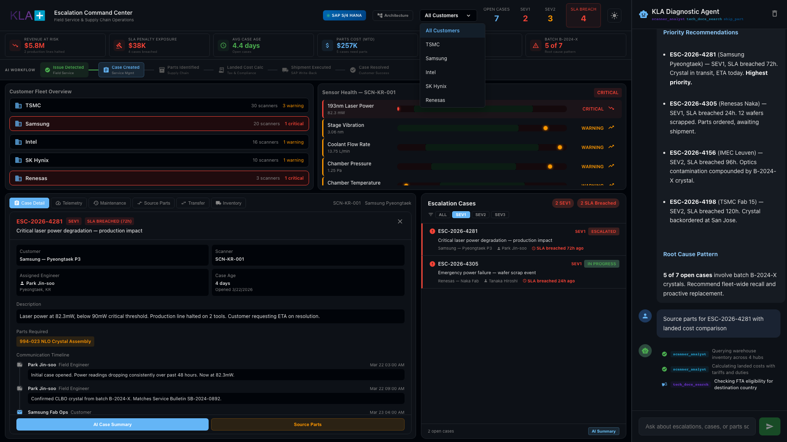
AI Agent — Multi-Tool Orchestration
Notes:
CHAT PANEL — TOOL ORCHESTRATION
- "The AI agent — powered by Snowflake Cortex — orchestrates multiple tools automatically"
- When you ask a question, watch the tool steps appear:
• scanner_analyst: queries fleet data, case history, sensor readings
• tech_docs_search: searches technical documentation and service bulletins
• ship_part: checks inventory and calculates landed costs
- "Each tool step shows status: running (spinner), completed (checkmark)"
- "The agent decides which tools to use based on your question — you don't need to know the underlying data model"
- "This is the power of Cortex Agent: natural language in, structured intelligence out"

Slide 17
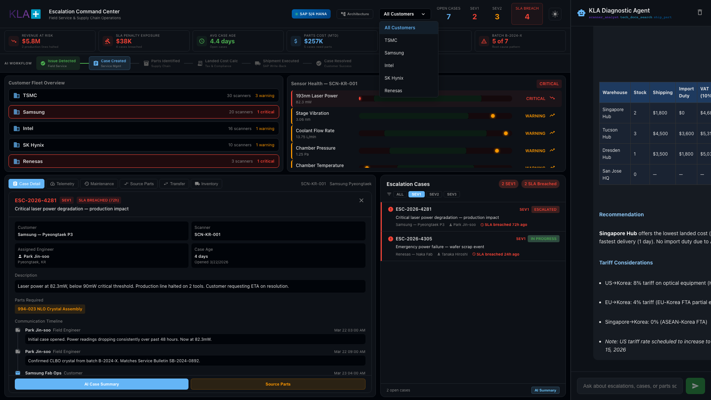
AI Agent — Structured Response
Notes:
CHAT RESPONSE
- "After tool orchestration completes, the agent returns a structured response"
- Includes: case summary, sensor analysis, parts recommendations with costs
- "Notice the response references specific data: scanner IDs, power readings, batch numbers, costs"
- "This isn't a generic chatbot — it's querying your actual operational data in real-time"
- "You can ask follow-up questions and the agent maintains context"

Slide 18

SAP Integration — Real-Time Data Flow
Notes:
SAP INTEGRATION PANEL
- "This panel shows how data flows between SAP S/4 HANA and the Snowflake command center"
- Three data tables visible:
• Warehouse inventory data from SAP MM
• Part recommendations with landed cost calculations
• Tariff/duty rates by trade corridor
- "SAP provides the transactional backbone: inventory, purchase orders, shipping"
- "Snowflake provides the intelligence layer: AI analysis, pattern detection, cost optimization"
- "Data flows in both directions — read from SAP, write back shipment orders"
- "No rip-and-replace of your ERP — this augments SAP with AI intelligence"

Slide 19
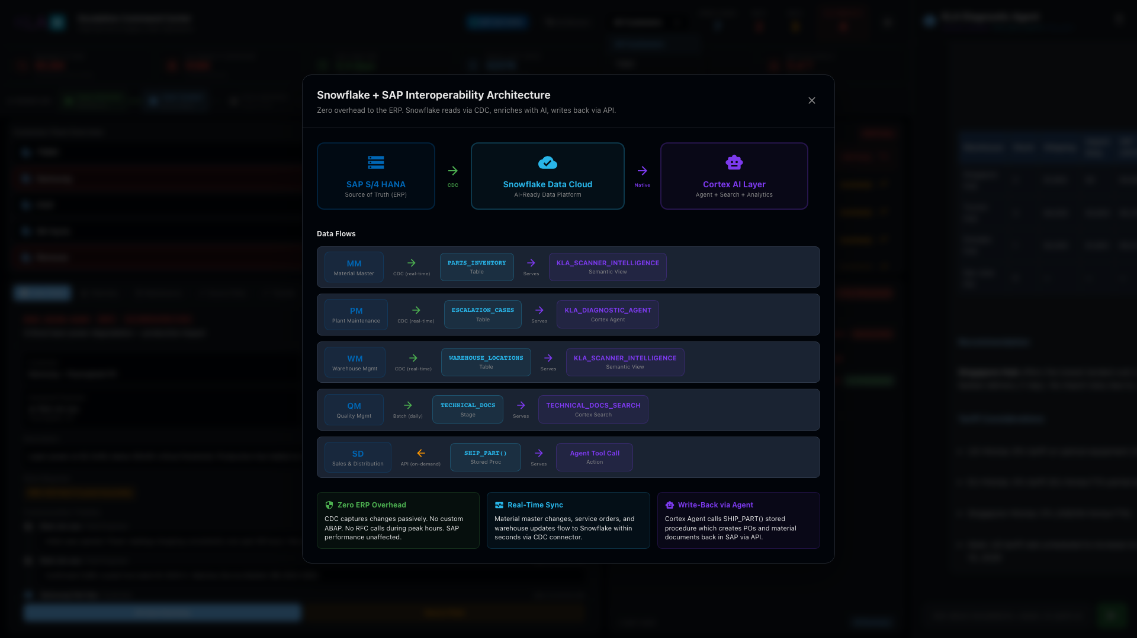
Architecture — SAP + Snowflake Integration
Notes:
ARCHITECTURE OVERLAY
- "This is the technical architecture behind what you just saw"
- LEFT: SAP S/4 HANA — source of truth for inventory, orders, shipping, master data
- CENTER: Snowflake Data Cloud — unified data platform
• Data ingestion via Snowpipe Streaming
• Cortex AI Layer: LLM inference, search, agent orchestration
• Real-time analytics and dashboards
- RIGHT: Value propositions — what the business gets
• Single pane of glass for 3,500+ cases
• AI-powered pattern detection (batch B-2024-X)
• Landed cost optimization ($7K savings per shipment)
• Proactive maintenance vs reactive firefighting
- "Key point: SAP stays as your ERP. Snowflake adds the intelligence layer on top"
- Data flows: SAP → Snowflake (inventory, orders) and Snowflake → SAP (shipment write-backs)

Slide 20
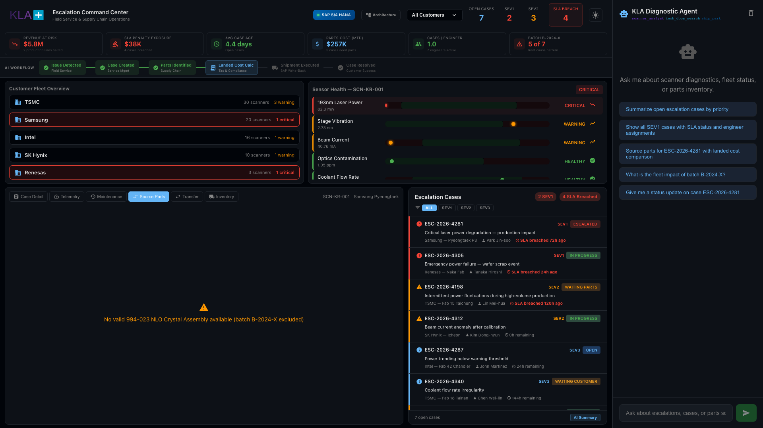
Execute Shipment — Order Creation
Notes:
SHIPMENT MODAL
- "Click 'Execute Shipment' on the recommended source"
- Modal shows: part details, source warehouse, destination, cost breakdown
- "One click creates the shipment order, updates case status, notifies field engineer"
- "The write-back goes to SAP: creates a delivery document in S/4 HANA"
- "No manual data entry, no copy-paste between systems"

Slide 21

SAP Write-Back — Automated Order Processing
Notes:
SHIPMENT WRITE-BACK
- "After execution, the system confirms: order ID, tracking number, ETA"
- "Simultaneously writes back to SAP S/4 HANA: delivery document, goods movement, billing"
- "The escalation case is automatically updated with shipment status"
- "Field engineer Park Jin-soo gets notified: part arriving tomorrow from Singapore"
- "This closes the loop: from AI recommendation to SAP execution in one workflow"

Slide 22
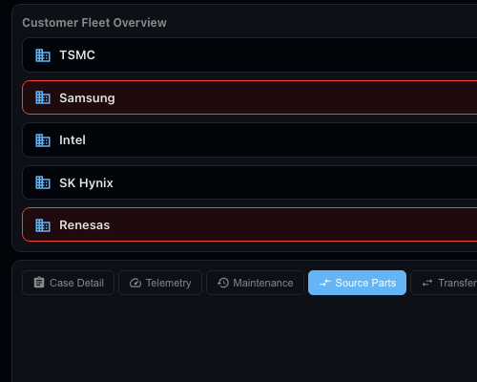
Fleet Overview — Global Scanner Status
Notes:
FLEET OVERVIEW
- "Your global fleet at a glance: 5 customers, 13 fabs, every scanner tracked"
- TSMC: 4 fabs, 30 scanners, 3 warnings
- Samsung: 3 fabs, 20 scanners, 1 critical
- Intel: 3 fabs, 16 scanners, 1 warning
- SK Hynix: 2 fabs, 10 scanners, 1 warning
- Renesas: 1 fab, 3 scanners, 1 critical
- "Red = critical, Yellow = warning. Click any fab → AI pulls up cases for that site"

Slide 23

Theme Toggle — Presentation Mode
Notes:
LIGHT THEME
- "Click the sun/moon icon to toggle themes"
- "Light mode for presentations and executive reviews"
- "Dark mode for the ops center at 2am"
- "Both fully supported with consistent styling"

Slide 24
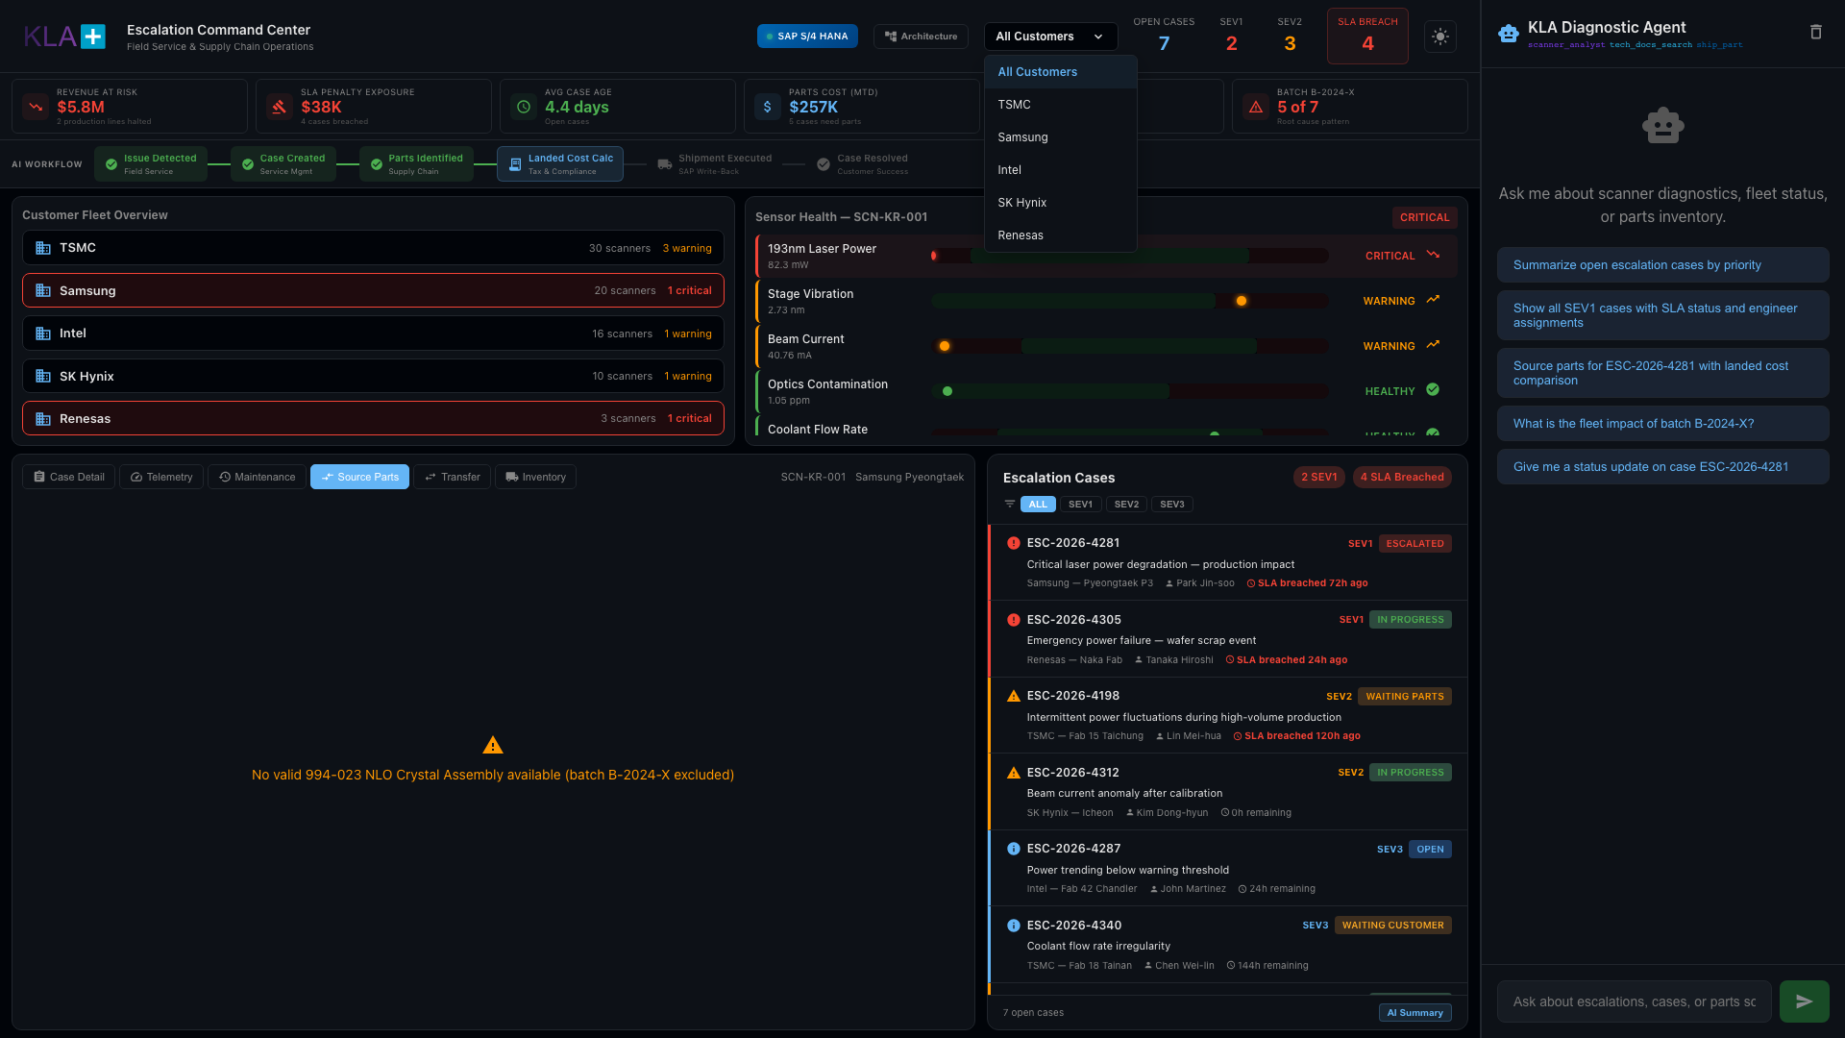
Customer Filter — Contextual Dashboard
Notes:
CUSTOMER FILTER
- "Filter the entire dashboard by customer: TSMC, Samsung, Intel, SK Hynix, Renesas"
- "Fleet overview, cases, and metrics all contextualize to the selected customer"
- "Perfect for preparing for a customer quarterly review"
- "Or view all customers for the global operations picture"

Slide 25
Key Takeaways
Today:
3,500 cases across email, SharePoint, phone. No single view. No SLA tracking. No pattern detection.
With This:
Every case, communication, part, cost calculation — in one place. AI surfaces patterns in seconds, not weeks.
Landed Cost:
$7,000 savings per shipment via tariff-aware sourcing. ASEAN-Korea FTA applied automatically.
Built on Snowflake:
Unified data platform. Cortex AI Agent. SAP S/4 HANA integration. No new infrastructure.
Questions?
Notes:
CLOSING
- "Let me bring it back to the business problem"
- TODAY: 3,500 cases managed across email, SharePoint, and phone calls. No single view, no SLA tracking, no pattern detection.
- WITH THIS: Every case, every communication, every part, every cost calculation in one place. The AI agent surfaces patterns like batch B-2024-X affecting 5 cases — something that would take weeks to discover manually.
- LANDED COST: When you're shipping a $45,000 crystal, knowing Singapore saves $7,000 over Tucson because of ASEAN-Korea FTA isn't a nice-to-have — it's margin.
- BUILT ON SNOWFLAKE: All data in one platform. Cortex Agent for natural language queries. No new infrastructure. Connects to your SAP S/4 HANA and existing data sources.
- "Questions?"

