Slide 1
KLA Scanner Intelligence
Global Supply Chain Tower
Powered by Snowflake + SAP S/4 HANA

Slide 2
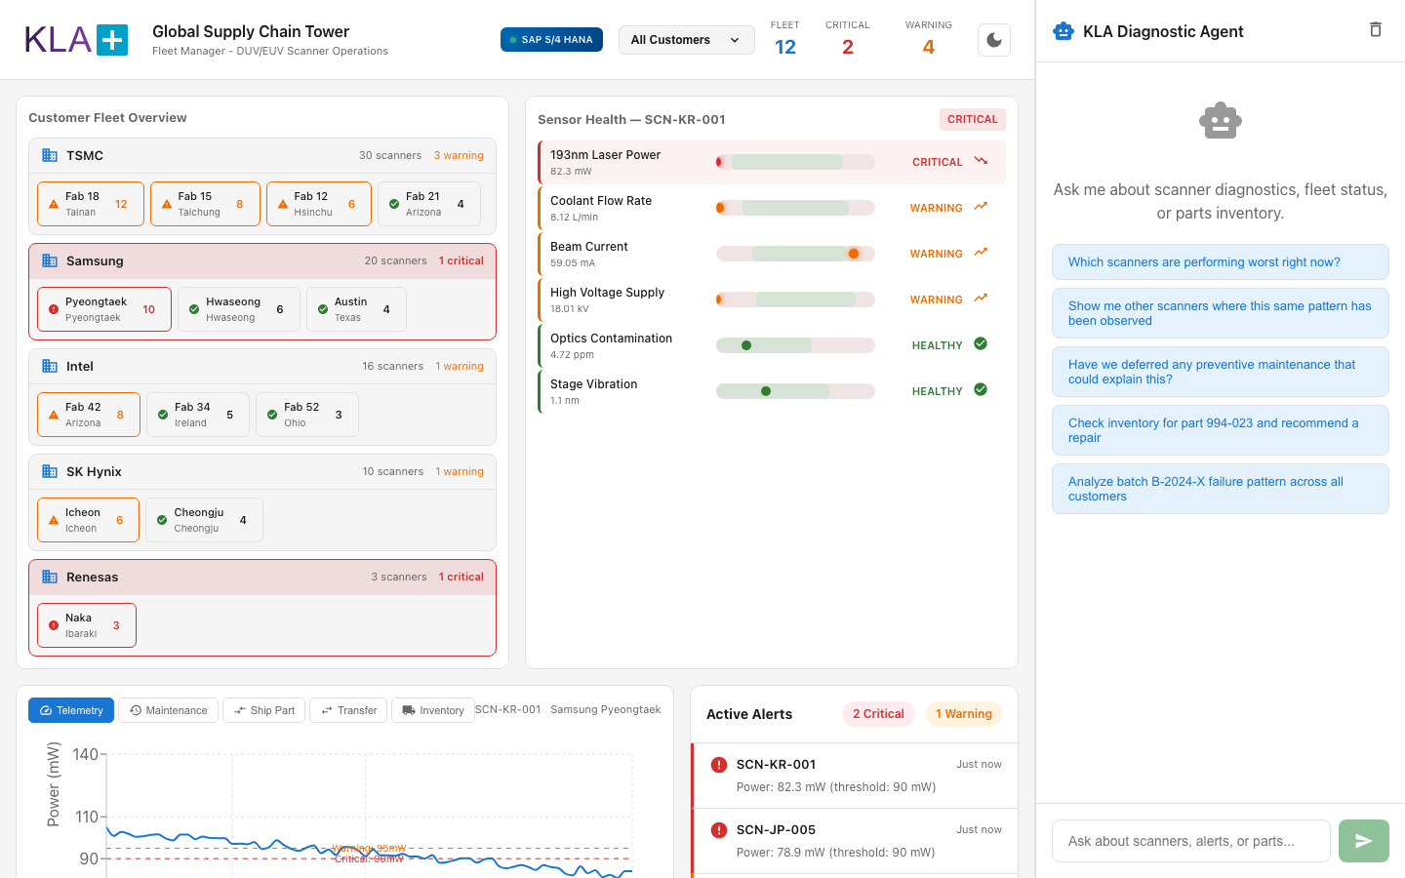
The Problem & The Dashboard
[0:00 - 0:40]
Notes:
What you're looking at is a Global Supply Chain Tower for KLA's scanner fleet. This connects directly to SAP S/4 HANA - you can see the live indicator in the header - and gives our field service and supply chain teams a single pane of glass across all customers.
Today we're managing a fleet of 12 fabs across 5 major customers - TSMC, Samsung, Intel, SK Hynix, and Renesas. Right away in the header you can see we have 2 critical scanners and 4 warnings that need attention.

Slide 3
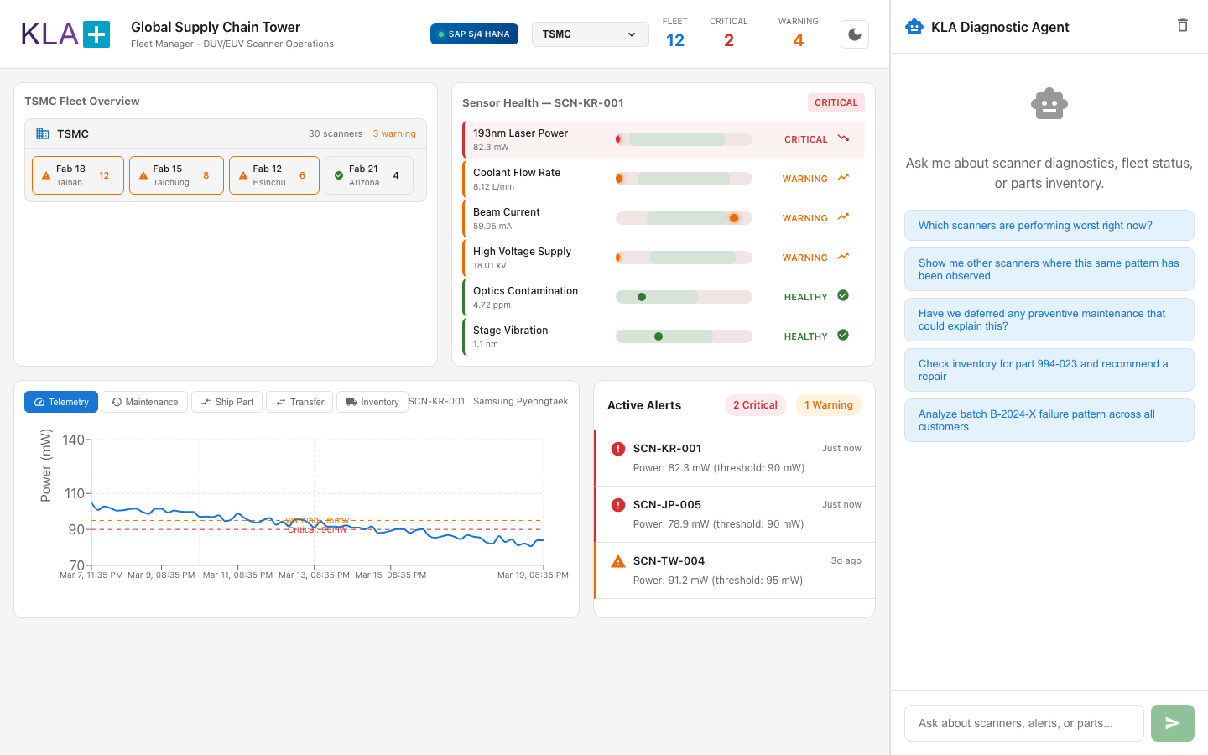
Customer Fleet Overview
[0:40 - 1:20] Navigate by Customer
Notes:
The first thing a fleet manager does is pick their customer. Let me filter down to TSMC - they're about 50% of our revenue.
Now I'm looking at TSMC's 30 scanners across 4 fabs - Tainan, Taichung, Hsinchu, and Arizona. I can immediately see Fab 18 in Tainan has the most scanners and some warnings. The color coding - red for critical, orange for warning, green for healthy - tells me where to focus.

Slide 4
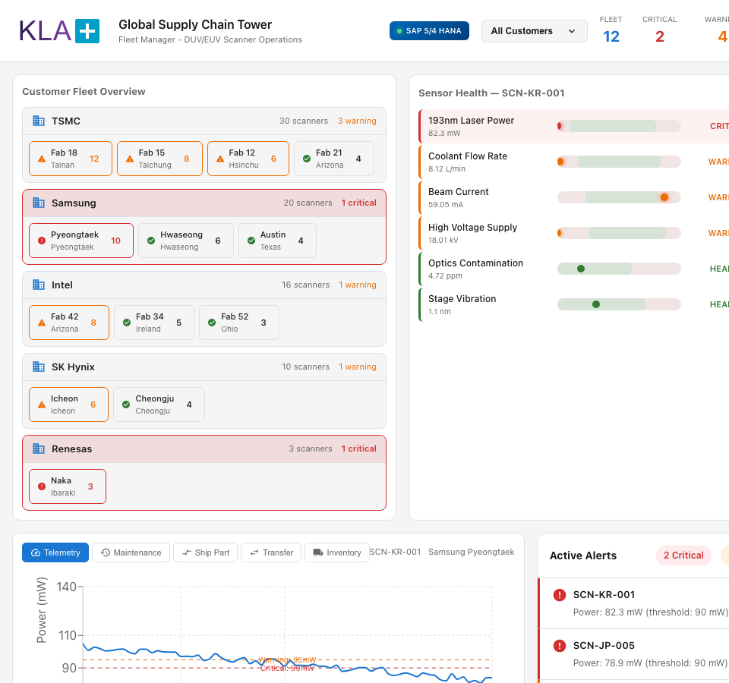
Sensor Health - Multi-Sensor Diagnostics
[1:20 - 2:10] SCN-KR-001 Critical Scanner
Notes:
This is where it gets powerful. Scanner SCN-KR-001 in Korea is flagged critical, and instead of just seeing one number, we see ALL the sensor metrics sorted worst-to-best.
At the top - 193nm Laser Power at 82.3 milliwatts. That's well below our 90 milliwatt critical threshold. But look - it's not just the laser. Stage Vibration is in warning territory at 3.14 nanometers, Chamber Pressure is low at 0.81 Pascals, and Beam Current is borderline.
This strip plot visualization shows the healthy range in green, and the dot shows exactly where the current reading sits. When multiple sensors degrade together like this, that's a pattern - and that's where our AI agent comes in.

Slide 5
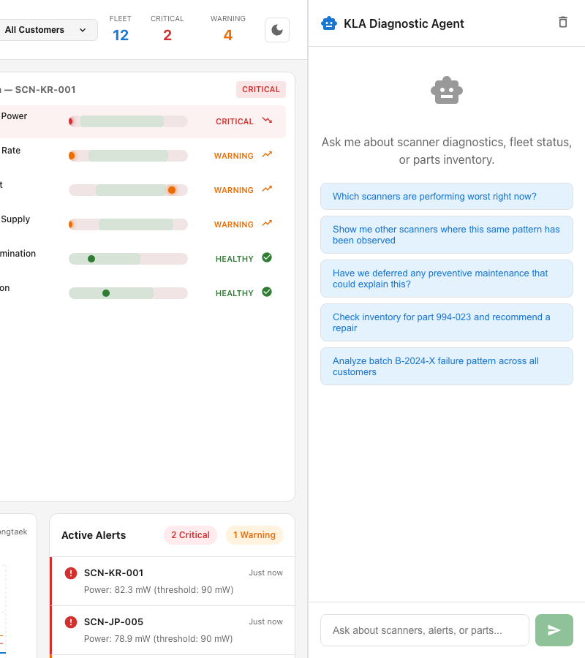
AI Diagnostic Agent
[2:10 - 3:10] Pattern Recognition
Notes:
Let me ask our KLA Diagnostic Agent about this. I'll click directly on the 193nm Laser Power metric.
That automatically triggers an AI analysis. The agent looks at this scanner's telemetry history, compares it against the full fleet, and identifies root causes.
I can ask: 'show me other scanners where this same pattern has been observed.' The agent can correlate degradation patterns across the entire fleet and identify if this is an isolated issue or a systemic batch problem.
And I can check if any deferred maintenance could be the root cause. This connects maintenance history to current sensor readings - something that typically requires a field engineer to manually cross-reference.

Slide 6

Telemetry & Maintenance
[3:10 - 3:50] The Evidence
Notes:
Below the fleet overview, we have the telemetry trend for this scanner - you can see the laser power degrading over the past two weeks.
Switching to Maintenance history, I can see the full repair log - previous part replacements, calibrations, and importantly, any deferred preventive maintenance that might explain what we're seeing.

Slide 7
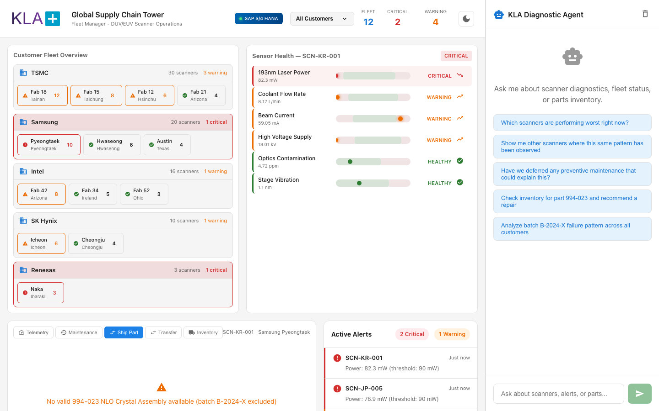
Supply Chain Action
[3:50 - 4:30] Ship Part & Transfers
Notes:
Here's where diagnostics meets supply chain execution. Once we've identified the issue, I need to get a replacement part to the customer. This view shows me shipping options from different warehouses - cost, transit time, and tax implications side by side.
I can compare shipping from our US warehouse versus our APAC warehouse, see the landed cost breakdown, and choose the best option.
And if the part isn't in the nearest warehouse, I can initiate a warehouse-to-warehouse transfer to pre-position inventory closer to customers who might need it next.
The inventory view gives me real-time stock levels across all our warehouses, so I know exactly what's available before I commit to a repair plan.

Slide 8

The Value
[4:30 - 5:00] Closing
Notes:
So to recap - in one unified view, we went from a fleet-level overview, to customer-specific diagnostics, to multi-sensor pattern analysis, to AI-powered root cause identification, to supply chain execution.
What used to take a field engineer hours of cross-referencing spreadsheets and SAP transactions now happens in seconds. This is KLA Scanner Intelligence - connecting diagnostics to action, powered by Snowflake and SAP S/4 HANA.

Slide 9
Architecture
Data Layer: Snowflake (KLA_SUPPLY_CHAIN database)
- SCANNERS: 46 scanners across 12 fabs
- TELEMETRY_READINGS: 6,258 sensor readings
- ALERTS: Active critical/warning alerts
- PARTS_INVENTORY: 14 parts across warehouses
AI Layer: Snowflake Cortex
- Cortex Agent: KLA_DIAGNOSTIC_AGENT
- Semantic View: KLA_SCANNER_INTELLIGENCE
- Search Service: TECHNICAL_DOCS_SEARCH
ERP Layer: SAP S/4 HANA
- Live inventory & shipping data
- Part transfer & logistics
Frontend: React + TypeScript + Vite
- Recharts for telemetry visualization
- Real-time sensor health strip plots
Notes:
The solution is built on:
- Snowflake Cortex Agent for AI diagnostics
- Snowflake Cortex Analyst (Semantic View) for natural language to SQL
- Cortex Search for technical documentation retrieval
- SAP S/4 HANA integration for live ERP data
- React dashboard with real-time sensor telemetry

