Slide 1
DEAL REVIEW [CLIENT]
SERVICES DELIVERY
[AUTHOR] | [DATE]
This deck is for internal use only

Slide 2
Agenda
Executive Summary
Our Understanding
Methodology & Engagement Approach
Scope
Timeline with Key Milestones
Detailed RACI
Governance Cadence
Commercials
Assumptions & Risks

Slide 3
Executive Summary
This deck is for internal use only
Content from Proposal Generator Agent - REVIEW BEFORE USING!!!
{{exec_summary}}
Current Challenges
{{exec_challenges}}
Snowflake Solution
{{exec_solution}}
Expected Outcomes
{{exec_outcomes}}

Slide 4
Our Understanding
This deck is for internal use only
Content from Proposal Generator Agent - REVIEW BEFORE USING!!!
{{our_understanding}}
Current State
{{our_understanding_current_state}}
Engagement Objectives
{{our_understanding_engagement_objectives}}

Slide 5
Methodology & Framework
This deck is for internal use only
Content from Proposal Generator Agent - REVIEW BEFORE USING!!!
{{meth_summary}}
Phase | Est. Duration | Activities
{{meth_phases}} | {{meth_phase_duration}} | {{meth_phase_activities}}

Slide 6
Content from Proposal Generator Agent - REVIEW BEFORE USING!!!
Engagement Model
HIGH
Data Team Interested but Resource-Constrained {{low_engage_high_own}} | Data Team Owned {{high_engage_high_own}}
Core Team Neutral {{low_engage_low_own}} | Data Team Cares About {{high_engage_low_own}}
{{engage_summary}}
Ownership
LOW
Engagement
HIGH

Slide 7
Scope
This deck is for internal use only
Content from Proposal Generator Agent - REVIEW BEFORE USING!!!
In Scope
Assessment & Analysis
{{scope_assessment}}
Architecture & Design
{{scope_architecture}}
Implementation & Migration
{{scope_implementation}}
Out of Scope
{{scope_out}}

Slide 8
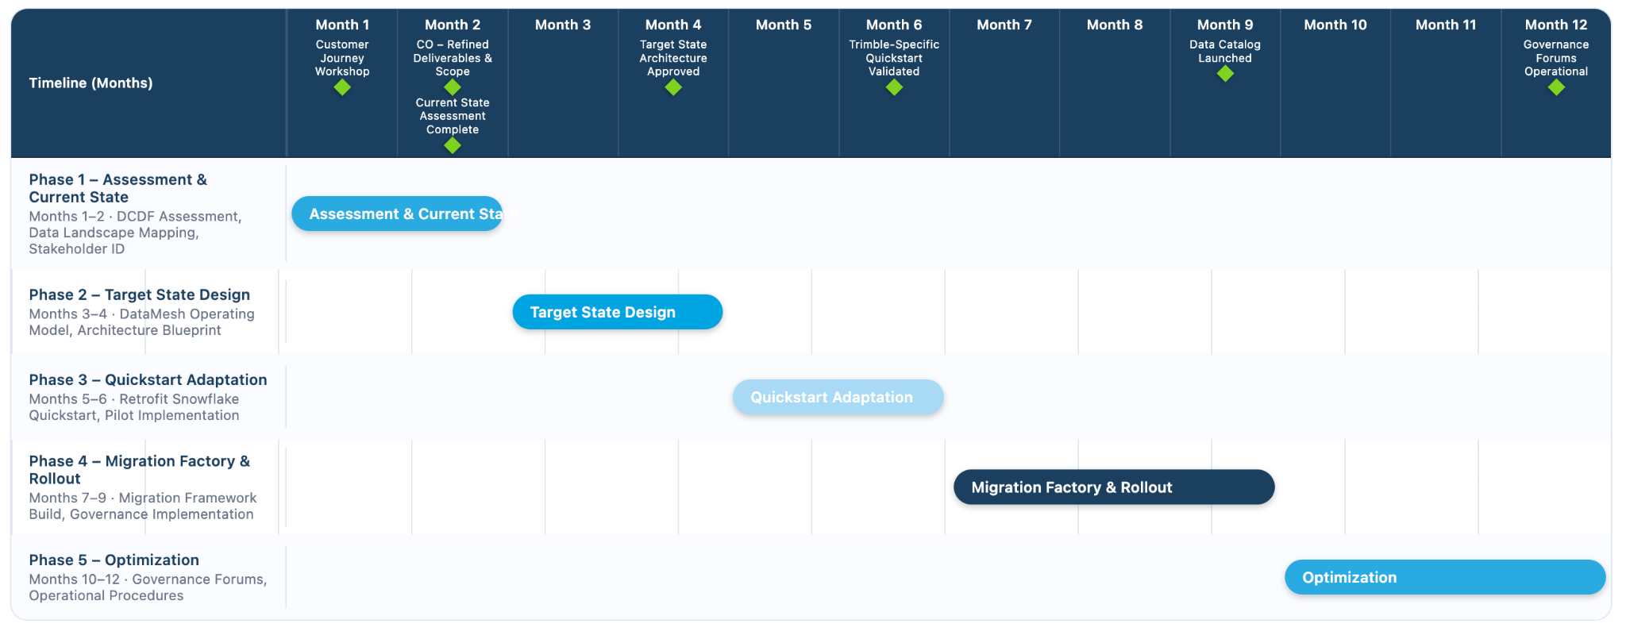
Tentative High-level Program Schedule
UPDATE MANUALLY
This represents the tentative program schedule as we understand it today. Within 60 days of contract start, and following the Customer Journey Workshop and subsequent Change Order, this will be refined to reflect more accurate timelines and activities.

Slide 9
Dependencies - To be completed before Kickoff
This deck is for internal use only
Content from Proposal Generator Agent - REVIEW BEFORE USING!!!
{{dependencies}}

Slide 10
Detailed RACI
This deck is for internal use only
UPDATE MANUALLY
Include in IC slides
Functional Activity | R (Responsible) | A (Accountable) | C (Consulted) | I (Informed)
PMO / Planning / Program Ownership | Snowflake | [CUSTOMER] | [CUSTOMER] | [CUSTOMER]
Detailed Architecture Analysis & Recommendations | Snowflake | Snowflake | [CUSTOMER] | [CUSTOMER]
Target Operating Model - DataMesh/DataOps | Snowflake | Snowflake | [CUSTOMER] | [CUSTOMER]
Quick Start Framework | Snowflake | Snowflake | [CUSTOMER] | [CUSTOMER]
Data Migration Factory Framework | Snowflake | Snowflake | [CUSTOMER] | [CUSTOMER]
Network Setup and Security | [CUSTOMER] | [CUSTOMER] | Snowflake | Snowflake
Env Setup at Customer (Snowflake) | [CUSTOMER] | [CUSTOMER] | Snowflake | Snowflake
Security Model & DCDF Setup (RBAC, Governance, etc) | Snowflake | [CUSTOMER] | [CUSTOMER] | [CUSTOMER]
Data Migration & Code Conversion Oversight | Snowflake | [CUSTOMER] | [CUSTOMER] | [CUSTOMER]
QA and Testing Plan | [CUSTOMER] | [CUSTOMER] | Snowflake | [CUSTOMER]
Unit Testing - Compilation of Code | [CUSTOMER] | [CUSTOMER] | Snowflake | [CUSTOMER]
Historical Data Migration Ingestion & Orchestration | [CUSTOMER] | [CUSTOMER] | Snowflake | [CUSTOMER]
Data Consumption Repointing (Reporting Tools) | [CUSTOMER] | [CUSTOMER] | Snowflake | Snowflake
Data Verification (Integration Testing) Oversight | Snowflake | [CUSTOMER] | [CUSTOMER] | [CUSTOMER]
User Acceptance Testing | [CUSTOMER] | [CUSTOMER] | Snowflake | Snowflake
Deployment to Production | [CUSTOMER] | [CUSTOMER] | Snowflake | Snowflake
Snowflake Performance Optimization | Snowflake | [CUSTOMER] | [CUSTOMER] | [CUSTOMER]

Slide 11
Governance Cadence
UPDATE MANUALLY
Forum | Cadence | Participation By Role | Responsibility | Materials or Collateral
{{gov_forum}} | {{gov_cadence}} | {{gov_roles}} | {{gov_responsibility}} | {{gov_material}}

Slide 12
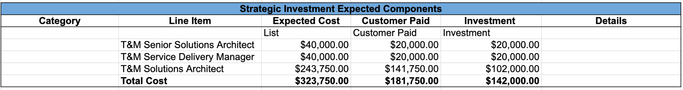
Commercials / Pricing
UPDATE MANUALLY
 | Expected Hours | Snowflake Rate | Price
T&M Senior Solution Architect | 100 | $400 | $40,000
T&M Solution Architect | 750 | $325 | $243,750
T&M Service Delivery Manager | 160 | $250 | $40,000
Sub-total | $323,750
Less Snowflake Investment | ($142,000)
Trimble Total | $181,750
Deal Pricing Sheet link

Slide 13
Assumptions & Commitments
This deck is for internal use only
Content from Proposal Generator Agent - REVIEW BEFORE USING!!!
{{assum_commitments}}
Access Requirements
{{assum_access}}
Roles & Responsibilities
{{assum_roles}}
Out-of-Scope Clarifications
{{assum_clarification}}

Slide 14
Risks and Mitigation
This deck is for internal use only
Content from Proposal Generator Agent - REVIEW BEFORE USING!!!
Risk Category | Risk Description | Impact | Mitigation Strategy
Organizational | {{risks_org}} | {{impact_org}} | {{mitigation_org}}
Governance | {{risks_gov}} | {{impact_gov}} | {{mitigation_gov}}
Technical | {{risks_tech}} | {{impact_tech}} | {{mitigation_tech}}
Resource | {{risks_resource}} | {{impact_resource}} | {{mitigation_resource}}
Scope | {{risks_scope}} | {{impact_scope}} | {{mitigation_scope}}
Timeline | {{risks_timeline}} | {{impact_timeline}} | {{mitigation_timeline}}
Adoption | {{risks_adopt}} | {{impact_adopt}} | {{mitigation_adoption}}
Additional Risk Considerations
{{additional_risk_considerations}}

Slide 15
Next Steps / Close Plan
This deck is for internal use only
Content from Proposal Generator Agent - REVIEW BEFORE USING!!!
Immediate Next Actions
{{next_actions}}

Slide 16
THANK YOU

