Slide 1
|
Jun 2025

Slide 2


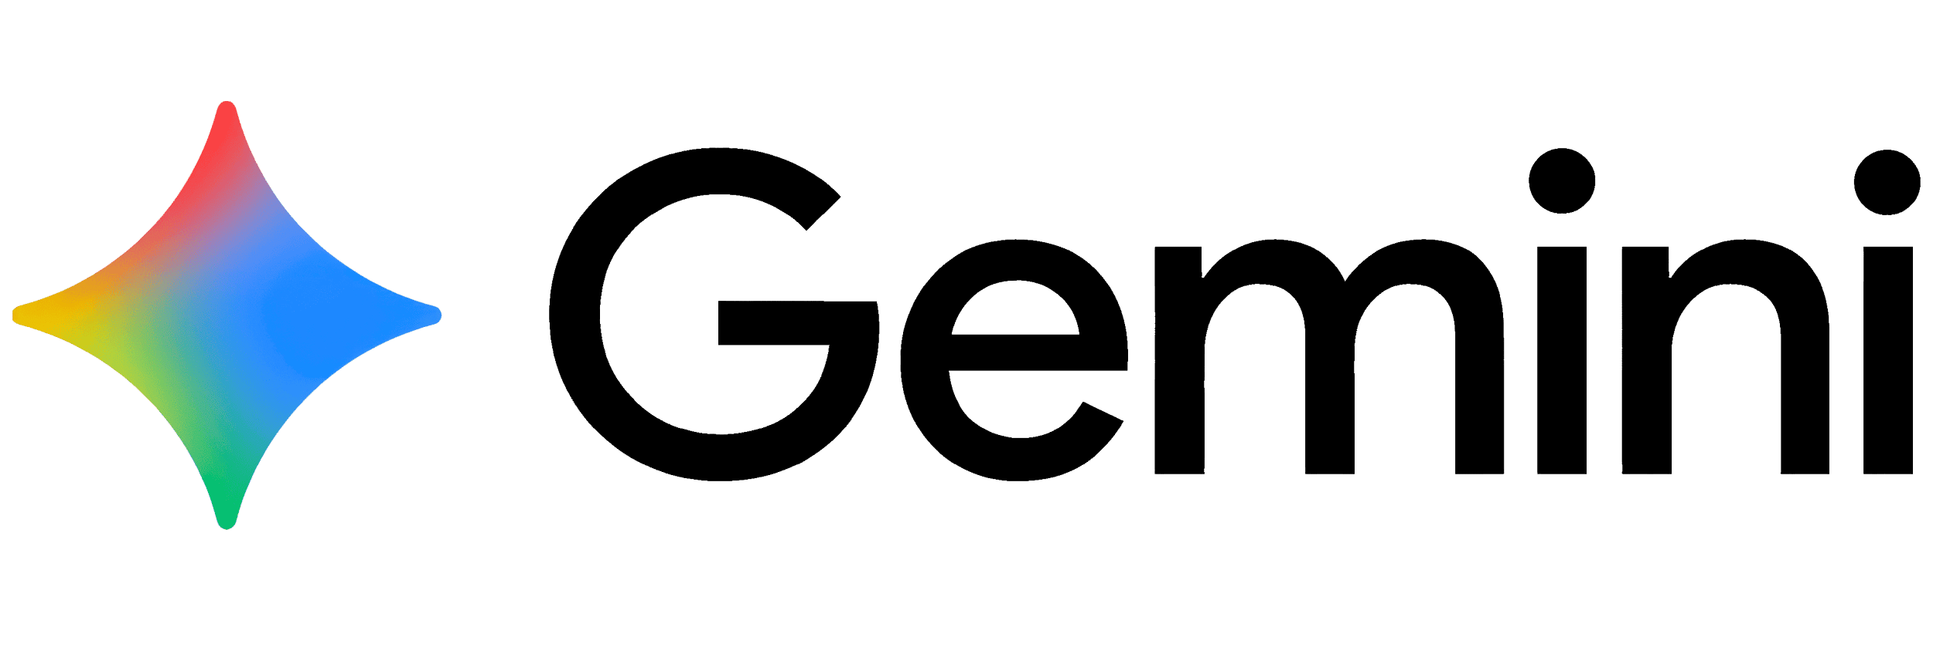




Snowflake Cortex AI is Easy, Connected, Trusted
Trusted AI needs governance and context, both are possible only by being close to data
SNOWFLAKE CORTEX AI
INTERFACES
MODEL CATALOG
GOVERNANCE
Business Agent Snowflake Intelligence
Coding Agent Cortex Code
Dev Experience Agent Studio
RBAC
DECISION INTELLIGENCE
Guardrails
Data Retrieval
Cortex Analyst / Search
Analytics & Predictive Insights
AI Functions & Snowflake ML
Orchestration & Quality
Cortex Agents
Evaluations
CONTEXT
All Data, No Silos
Snowflake, Iceberg, Openflow, MCP
Workflows, Procedures
Skills, Plugins
Business Knowledge
Semantic Views
Monitoring
Cost Gov.
SCALABLE AI INFERENCE
Multimodal AI-powered SQL
Cortex AISQL
Notes:
Snowflake native & Apache Iceberg = OPEN DATA FORMATS
Efficiency, ease of use and trust benefits of the full platform also apply to generative AI.
At its foundation we have fully managed set of models which are great to do things like process text at scale, sentiment analysis, or custom summaries using Snowflake models like Arctic or other leading models from companies like Mistral.
Now a common goal among enterprises is to enable everyone to talk to the data, to do this we have two fully managed services that make that easy whether its structured data used for analytics or unstructured data like documents
Getting access to all of this is easy using multiple code interfaces like SQL and Python, we are also introducing Snowflake Studio for no-code development
And because we trust the reliability of Cortex AI, we’ve built a few products on top of it like Snowflake Copilot and Document AI.
Note: Audience may have questions about specific features immediately, but be sure to use the use case flow to make each feature more tangible
Snowflake AI & ML Studio: Enable users of all technical levels to utilize AI with no-code development interface in addition to the already supported SQL, Python and REST API interfaces
Chat with your data
Cortex Analyst: Enable business users to interact with analytical data stored in tables using natural language, enabling them to find answers faster, self-serve insights and save valuable time.
Cortex Search: Quickly and securely find information by using fully managed search and retrieval within a given set of enterprise documents.
Models
Foundation models: Access pre-trained models from leading providers such as Mistral, Reka and Meta all inside Snowflake.
Cortex Fine-Tuning: Serverless customization and management of LLMs inside Snowflake
Task Specific and embed models: Summarize, translate or embed text with task specific functions
AI experiences built on Cortex:
Snowflake Copilot: Boost productivity of analysts, data engineers and other SQL developers with AI that understand the context of your data to turn questions into SQL queries.
Document AI: extract content like invoice amounts or contract terms from documents using Arctic TILT, a state-of-the-art built-in, multimodal L

Slide 3
Cortex
Notes:
That was from data architecture now the data governance operation models most fo the time follow the data architecture and we have three of those

Slide 4
Cortex Architecture in Same Region
Self Hosted Models
Snowflake Security Boundary
SELECT SNOWFLAKE.CORTEX.COMPLETE('model_name', 'What are large language models?');
API and Drivers/Connectors
CSP Snowflake Region
Cortex Proxy
Cortex Services
Cloud Services
TLS
SF Compute Network
Call Cortex
NLB
VWH
(Compute)
VWH
(Compute)
VWH
(Compute)
Self Hosted models run on Snowflake GPUs
Snowflake Internal Network
Large Result Set
SF Inference Network
Large Result Set
CSP Snowflake Private Network
Customer Internal Stage
Customer Fine Tuned Models
Results
Notes:
Client side ciphers: For all these routes into cortex inference running off of k8s clusters (aka internal Istio load balancer), we use these cipher suites for mtls - ["ECDHE-ECDSA-AES256-GCM-SHA384", "ECDHE-ECDSA-AES128-GCM-SHA256", "ECDHE-RSA-AES256-GCM-SHA384", "ECDHE-RSA-AES128-GCM-SHA256"]
We do not use egress proxy
PrPr AWS and Azure when are we planning for pupr and ga
GPU dedicated per customer or multiplexed ?
inter service communication is mtls ?
caching VWH caching is as usual but the inference results are not cached anywhere
Data encrypted in transit TLS - mtls ?
We use external functions to call Cortex services
Cloning and replication is NOT supported between DB and Schemas..
Model Updates :
major Llama 2 to Llma 3 for example we go via BCR with customers can opt-in in one month and opt out for another month
minor updates are directly .. if there is a model name change we will inform the customers
can one GPU be shared between multiple customers or we we allow on GPU per customer during execution then we clear , zero and restart ? before assign to other customer ? or we multiplex between customers on the GPU
Today, we do not share GPU memory space during execution between customers in prod. https://docs.google.com/document/d/1z90NijFcq26LKy-rd1_cqfErYsutvdUmiVwVCUoOKKE/edit#heading=h.38tk0926xr38
However, we are aiming to roll out vLLM with continuous, cross-customer batching in the coming weeks. Once we do that, data from different customers will share GPU memory space concurrently. We guarantee isolation at the software level
19:28
what are the roles needed to use Cortex functions the docs does not mention anything (edited)
Today, there is no role required -- see docs here, it is an account-level parameter that one must opt into for the time being.
In the next couple months, we will roll out RBAC on the function level, but it doesn't exist yet
G Suite Document

