Slide 1


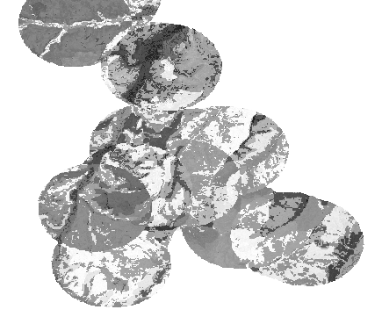

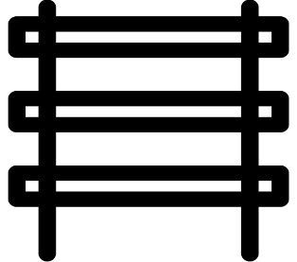
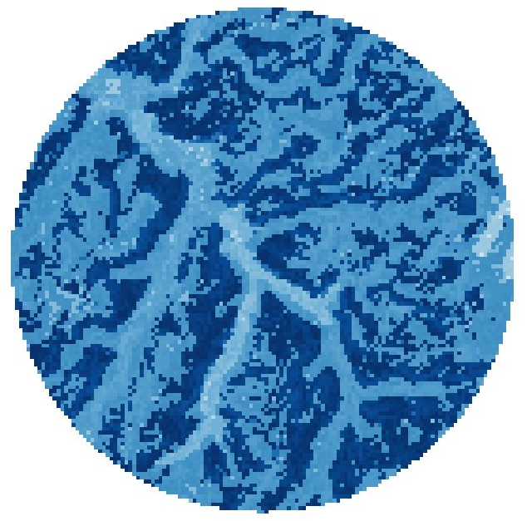

Automated Reference Toolset: : CHEAT SHEET
Spatial Inputs
Raster Stack
Stacking Overlapping Buffers
The Automated Reference Toolset (ART) predicts similarity between 2 locations based on:
CODE:
NOTE:
raster.stack <- raster : : stack(psc, wetness.index, soil)
Since points are closer than buffer size, the similarity values overlap making it impossible to assess the similarity of some points.
Soil Texture
Topography
Geology
Make sure all rasters are the same extent
Predicted similarity is a continuous variable from 0 to 1.
0 means the 2 points are NOT similar and 1 means that they’re completely similar.
Each band is like an empty shelf for a buffer.
Soil texture values have to come from a particle size class (PSC) map. Refer to Nauman and Duniway 2016 for how to calculate PSC (doi:10.2136/sssaj2016.05.0151).
Gower’s Similarity Index
CODE:
1. Create an empty raster with the same number of bands as input points.
clhs::similarity_buffer(covs = raster.stack,
pts = spatial.points,
fac = c(1,3)
buffer = 2000,
metric = "gower")
Topography values from a NED digital elevation model (DEM) should be used to create a wetness index. This index describes where water is most likely to collect. The wetness index can be created in SAGA GIS or in R. Either way, SAGA must be installed.
I recommend using a minimum of a 2 km buffer
CODE:
raster.empty = r # r is the similarity raster for all points together
raster.empty[] <- NA
raster.point.stack <- stack(mget(rep("raster.empty", length(csamp)))) # csamp is the input point layer
Sometimes I’ve had issues with this function so if you would like the raw code go here: https://github.com/sfdistefano/ART-model-verification/blob/master/Code/cLHS_GowersExample.r
CODE:
2. For() loop that creates a raster stack where each point buffer has it's own layer so that the similarity buffers don't overlap each other
DEM.sgrd <- RSAGA : : rsaga.import.gdal(in.grid = DEM.tif)
RSAGA : : rsaga.wetness.index(in.dem = DEM.sgrd)
Output: a buffer of 2km where the similarity of each pixel has been calculated to the central pixel (point of interest)
CODE:
Make sure DEM is a SAGA grid file (.sgrd)
# similarL is where the buffers are being stored
for(i in 1:length(similarL)){
# Convert list of cell numbers and similarity values to a dataframe
similarity.point <- as.data.frame(similarL[[i]]) names(similarity.point) <- c('CellNum', 'Similar’)
# Index each raster layer and insert corresponding similarity values
raster.point.stack[[i]][similarity.point$CellNum] <- similarity.point$Similar
}
NOTE:
Dissimilarity = 0
I would recommend doing this in SAGA GIS since the RSAGA package isn’t always up to date with the latest SAGA version
Geology values should come from soil map units. These data can be obtained from USDA NRCS web soil survey.
You can only do this for 1 “shelf” at a time
Reference Site Selection
ALL DATA SHOULD BE IN RASTER FORMAT
MINUMUM RESOLUTION: 30 M
Similarity = 1
CODE:
raster : : sampleRandom(x = raster.point.stack [[1]], size = 1)
RStudio® is a trademark of RStudio, Inc. • CC BY SA Sean Di Stéfano• sfdistefano@uidaho.edu • https://github.com/sfdistefano • Updated: 2019-05-01
stack and shelf icons made by www.freepik.com

