Slide 1
Calculus
Dr Milan Joshi

Slide 2
Agenda
Numbers
Number Line
Intervals
Functions(single variable)
Graphs of functions
Limits of functions
Continuity of function
Differentiation of functions
Convexity of functions

Slide 3
Agenda
Maxima Minima of single variable functions (optimization)

Slide 4
Agenda
Functions of Several variables
Graphs
Limits and continuity
Partial derivatives
Jacobian
Hessian

Slide 5
Agenda
Maxima Minima for several variable (optimization)
Gradient descent

Slide 6
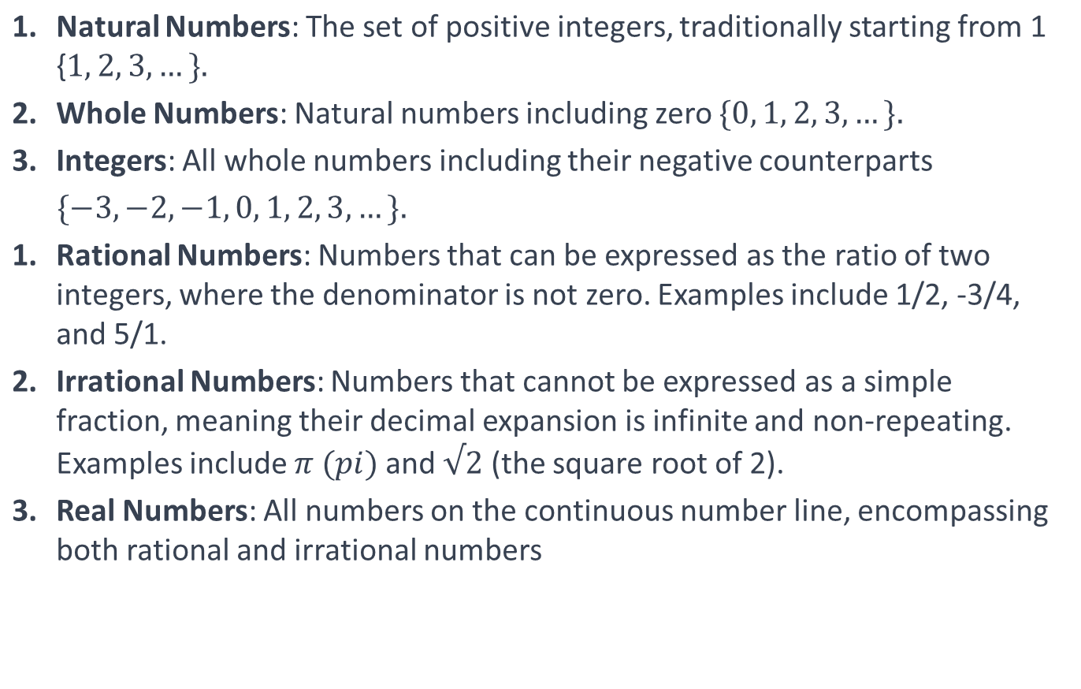
Numbers

Slide 7
Real Numbers
5 (a natural number and also an integer)
0 (a whole number)
-8 (an integer)
3/4 (a rational number)
-2/3 (a rational number)
π (an irrational number, approximately 3.14159)
√2 (an irrational number, the square root of 2)
-√3 (an irrational number, the negative square root of 3)
e (an irrational number, Euler's number, approximately 2.71828)
1.41421356 (a decimal expansion, rational approximation of √2)
-5.5 (a negative decimal number)
2.3333 (a repeating decimal, equivalent to 7/3, a rational number)
22/7 (a rational approximation of π)
0.1010010001... (a non-repeating, non-terminating decimal, an irrational number)
-π (a negative irrational number)
19.99 (a decimal number)
1.61803398875 (a decimal approximation of the golden ratio, an irrational number)
-6/5 (a negative rational number)
10^3 (a power of an integer, equals 1000)
-e^2 (a negative irrational number, square of Euler's number)

Slide 8
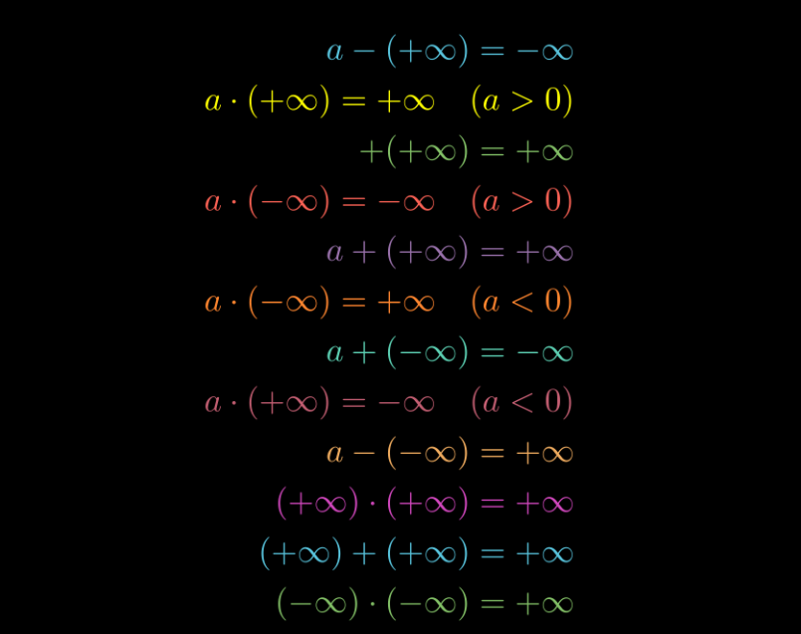
Infinity
a quantity without bound or end. Infinity is not a number in the traditional sense; it is an idea that in some sense is larger than any natural number and represents the concept of an unending quantity.

Slide 9
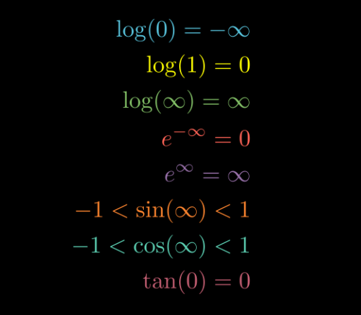
Computations

Slide 10

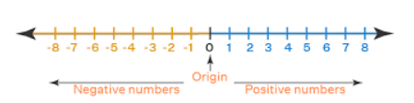
Number Line

Slide 11
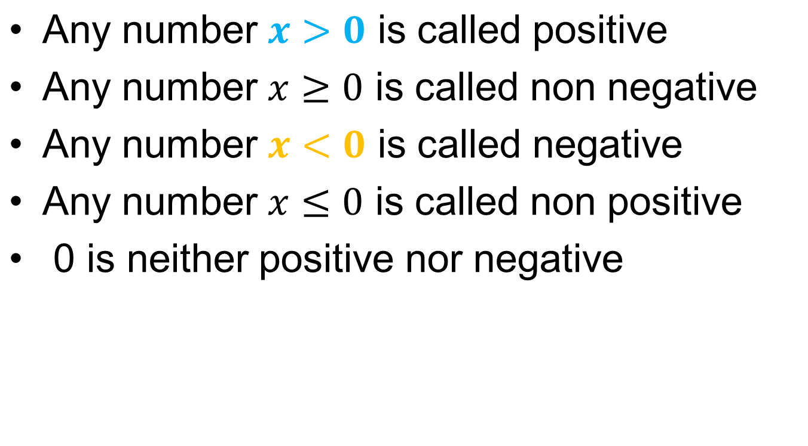
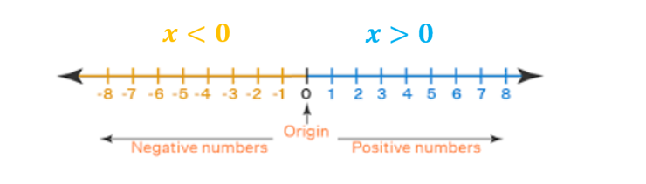
Number Line

Slide 12

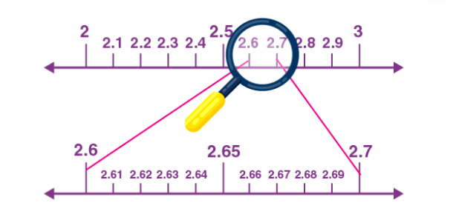
Number Lines

Slide 13
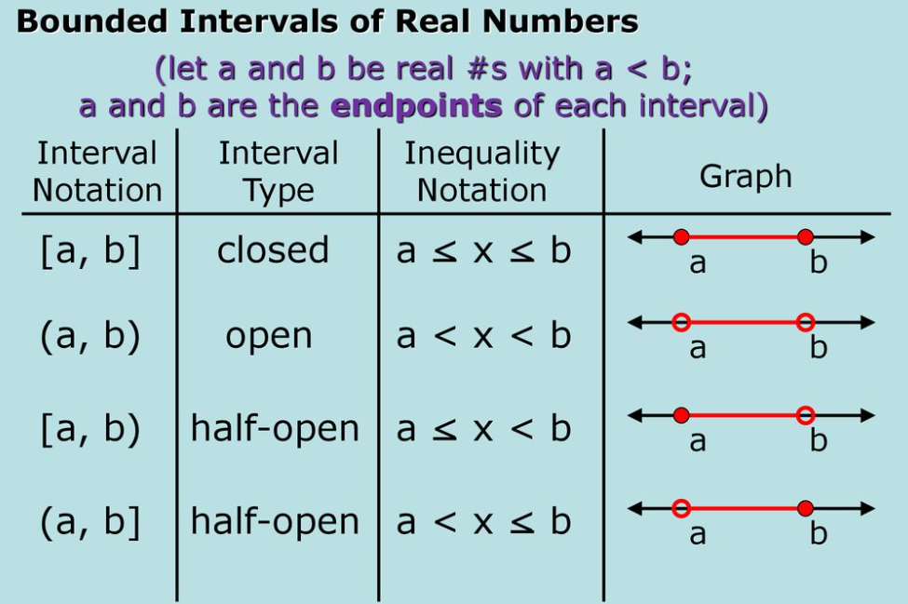
Intervals

Slide 14
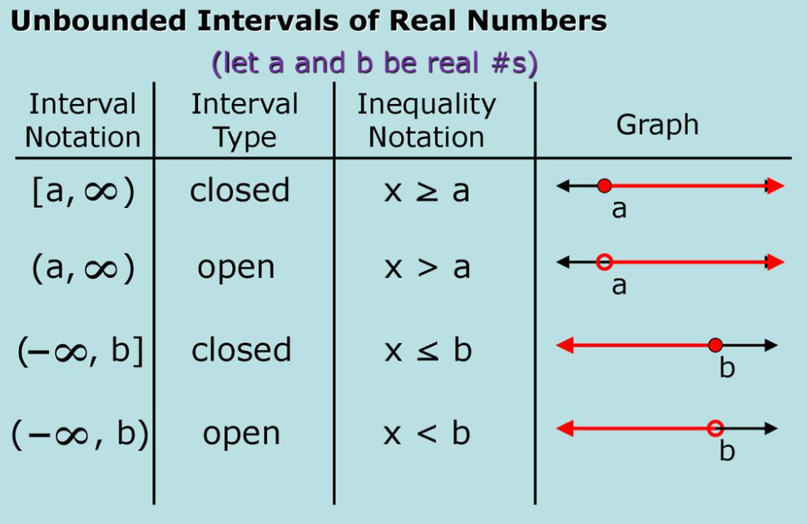
Intervals

Slide 15
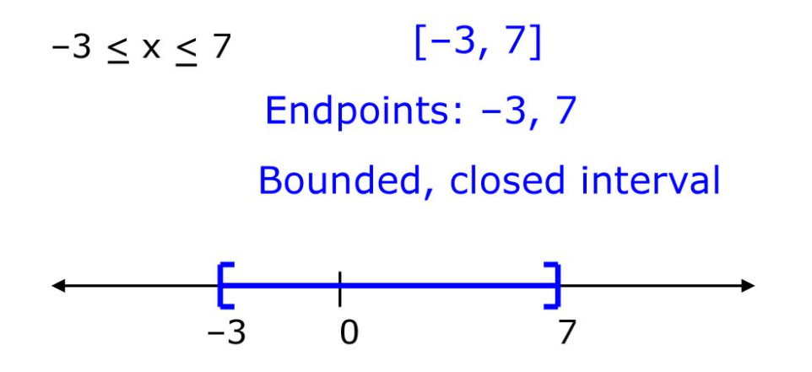
Intervals

Slide 16
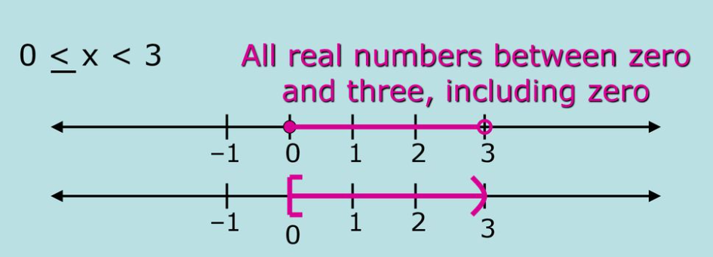
Intervals

Slide 17
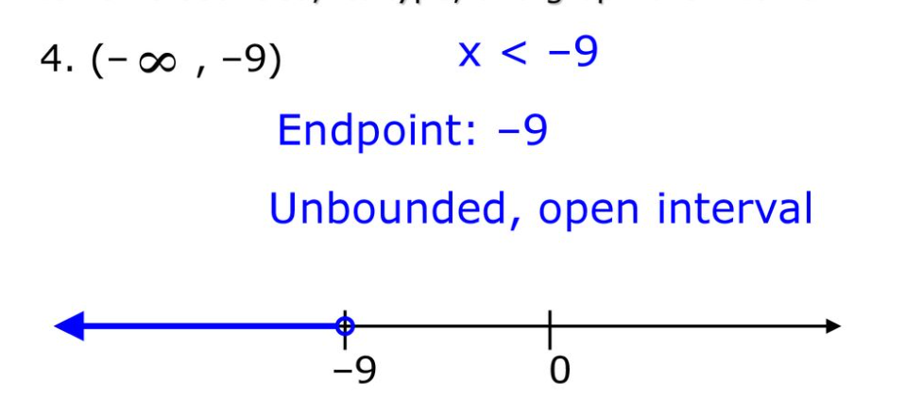
Intervals

Slide 18
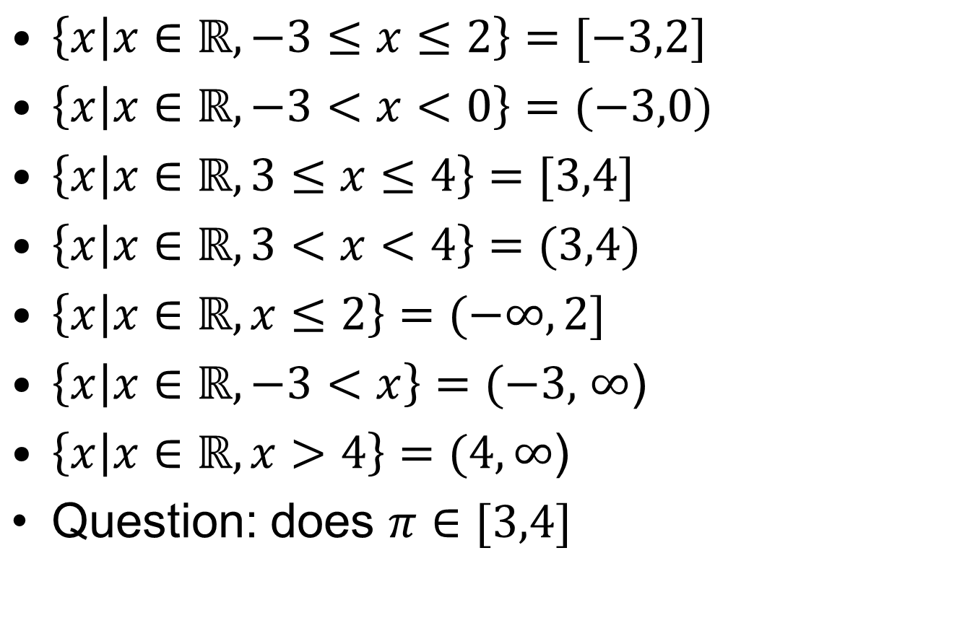
Set As Interval

Slide 19
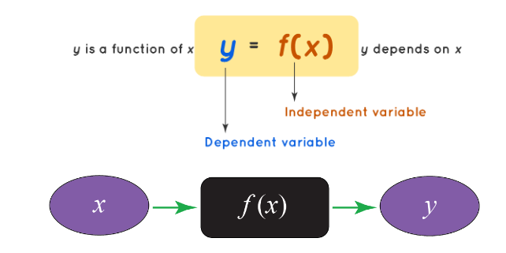
Functions( Single variable)
Functions in calculus represent the relationship between two variables, which are the independent variable and the dependent variable.

Slide 20

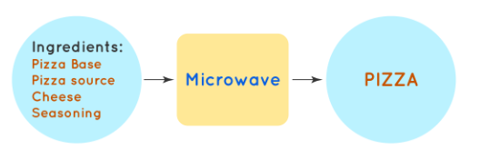
Functions

Slide 21
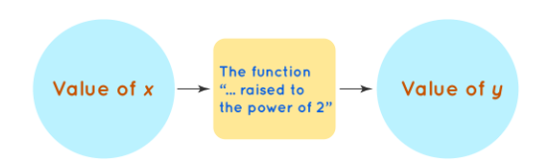
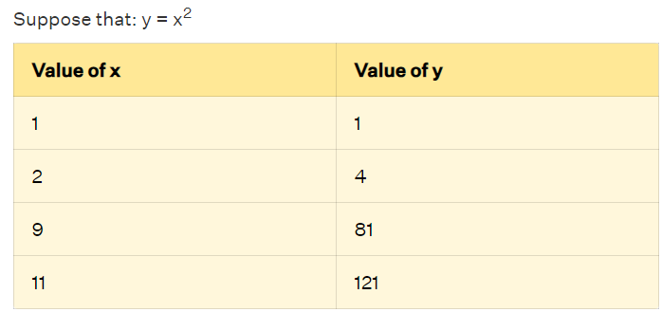
Functions
INPUT (x) is independent of the OUTPUT (y)
OUTPUT depends on the INPUT
f(x) is responsible for the transformation of the INPUT to the OUTPUT and is called a "function"

Slide 22
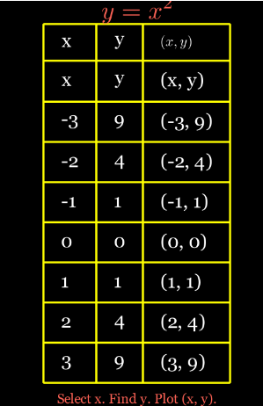

Slide 23
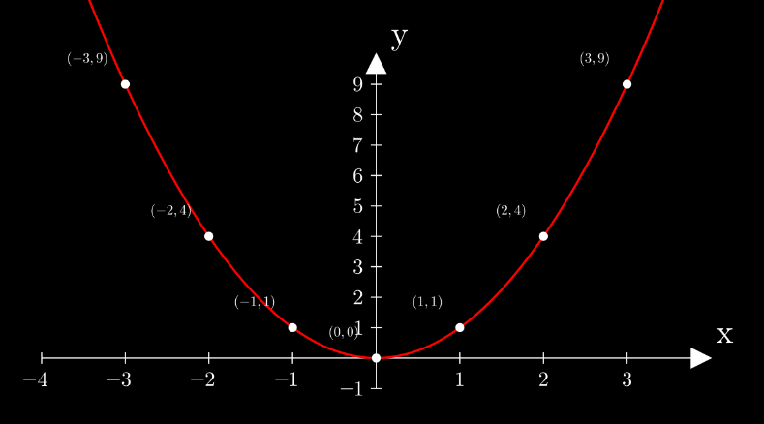
Functions of coordinate axis

Slide 24
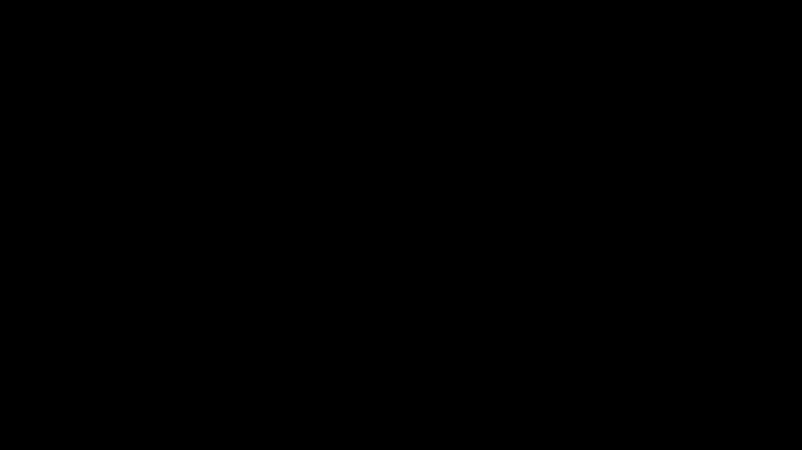

Slide 25
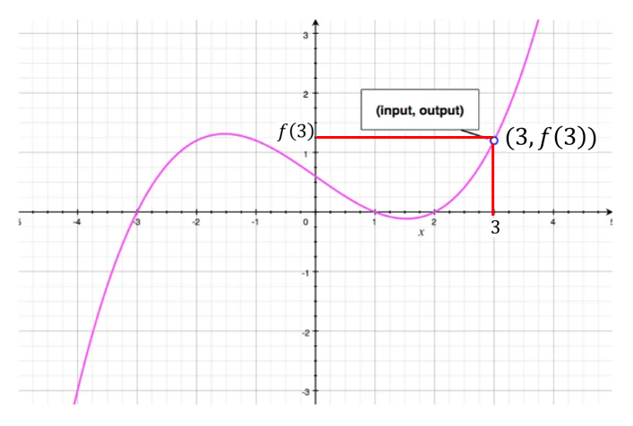
Functions of coordinate axis

Slide 26
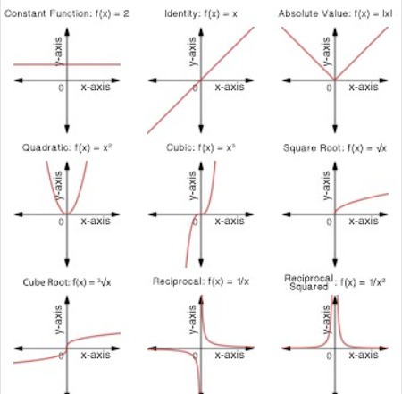
Graphs

Slide 27
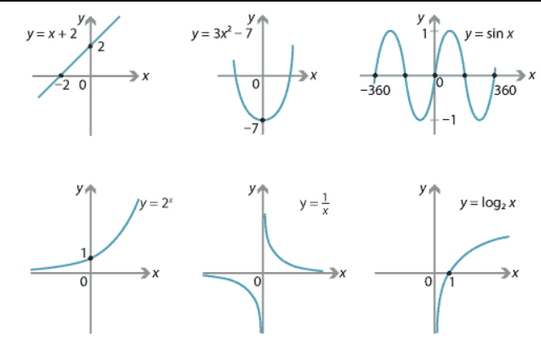
Graphs

Slide 28
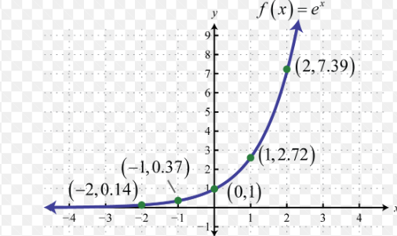
Graphs

Slide 29
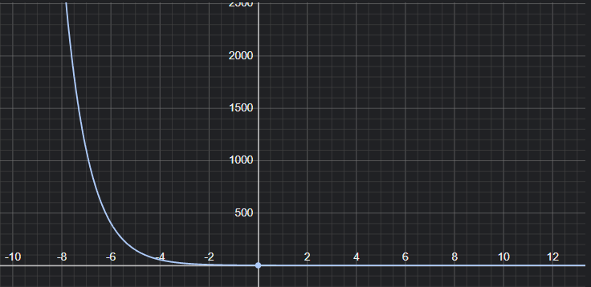
Graphs

Slide 30
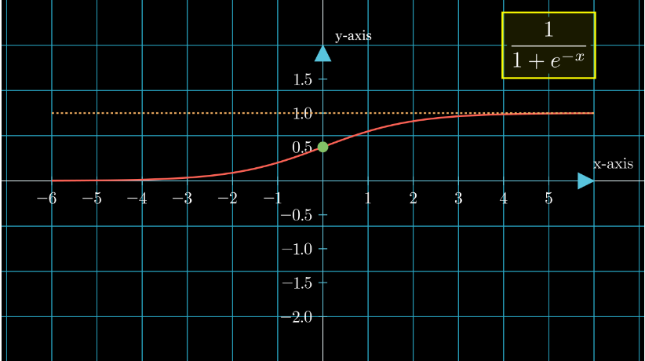
Sigmoid function

Slide 31
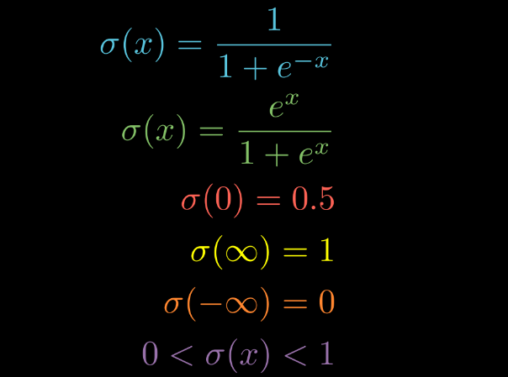
Sigmoid function

Slide 32
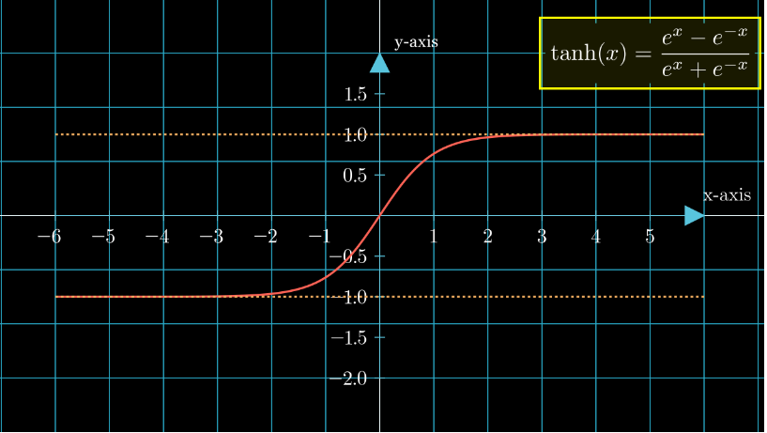
Tan Hyperbolic functions

Slide 33
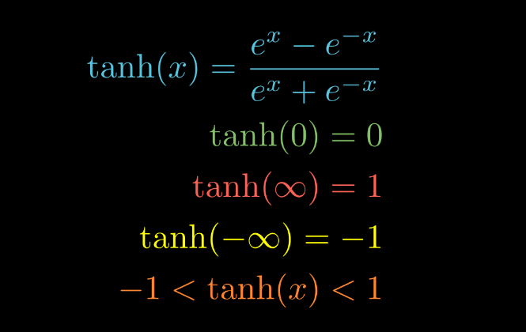
Tan Hyperbolic functions

Slide 34
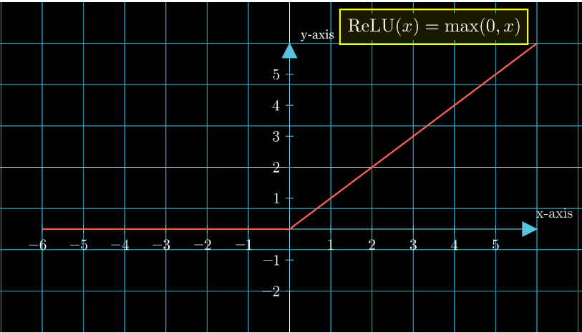
ReLU function

Slide 35
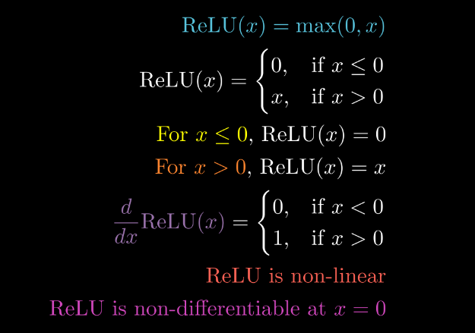
ReLU function

Slide 36
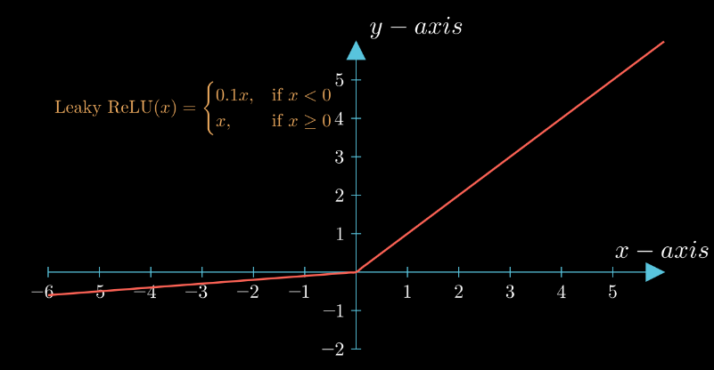
Leaky ReLU

Slide 37
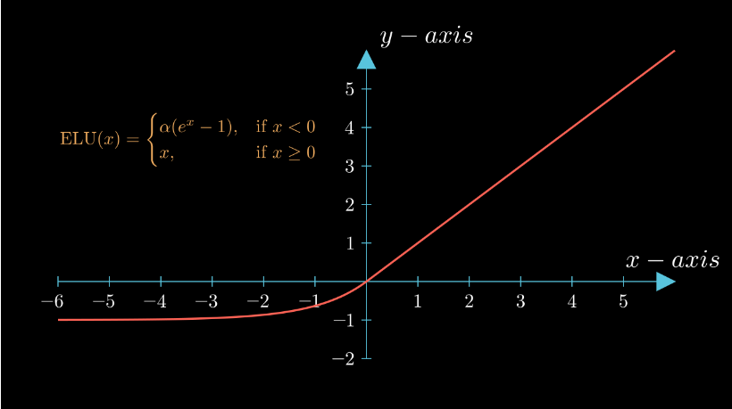
ELU

Slide 38
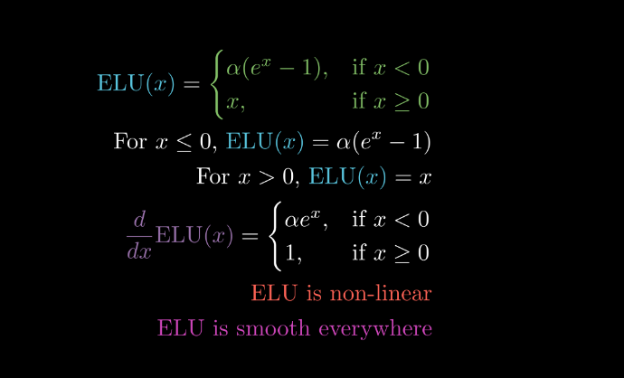
ELU

Slide 39
Limits

Slide 45


