Slide 1
MISSION ONE
Operation Halftime Stampede
Answer Deck — Falcon Football Academy Halftime Snack Preorder
Prepared for Baba By the problem-solver assigned to this mission
60 players. One table. Ten minutes. Zero system.

Slide 2
MISSION BRIEFING
What happened last Saturday
!
!
!
A shin pad ended up in the drinks box
Two players were hurt in the crowd
A player missed second-half kickoff
Gear went flying in the crush around the snack table.
Pushed and stepped on scrambling for a bag.
Still stuck in the crowd when the whistle blew.
The mission: figure out what's really going wrong, break the mess into pieces, and build a simple preorder app so halftime becomes grab-and-go — no stampede, no flying shin pads.
Operation Halftime Stampede
2

Slide 3
QUESTION 1
Is it the snacks, the queue, or something else?
✕
✕
Not the snacks
Not really “the queue”
There's enough food and drink for every player.
A queue is orderly. This is a crowd — there's no line at all.
THE REAL PROBLEM
Deciding and collecting are forced into the same tiny window
60 players choosing their snack AND grabbing it, at one table, in about 10 minutes. That collision — not the food, not a lineup — is what turns halftime into a crowd instead of a line.
Operation Halftime Stampede
3

Slide 4
QUESTION 2
The three biggest causes of the chaos
01
02
03
Decisions made under pressure
No system for who gets what
One point, one window, no order
Every player chooses their snack and drink in the same rushed minute, right at the table — slow by nature.
Nothing is sorted or named ahead of time, so staff work out each order live while a crowd builds.
60 players, one table, ~10 minutes, no lineup or spacing — the exact setup for crowding and injuries.
Operation Halftime Stampede
4

Slide 5
QUESTION 3
Who is affected, and what do they need?
WHO
THE MESS, FROM THEIR SIDE
WHAT THEY ACTUALLY NEED
Players
Get pushed in a crowd, risk injury
Grab their bag fast, no on-the-spot decisions
Coaches
A player still stuck when 2nd half starts
Everyone back in position, no incidents to manage
Parents / snack volunteers
60 kids asking at once, no idea who ordered what
A simple list — match a name, don't take an order
Injured players
Physically caught in the crush
An orderly pickup with no crowd to be caught in
Operation Halftime Stampede
5

Slide 6
QUESTION 4
What the app fixes — and what could still go wrong
✓
FIXED
!
STILL AT RISK
Deciding no longer happens at the table
Orders don't sync across devices yet
Players preorder their snack and drink before the match. By halftime, every bag already has a name on it — staff just match a name and hand it over. That removes causes #1 and #2: no more live decisions, no more guessing who gets what.
This version saves orders on one device (the snack table's tablet). A parent preordering from home on a different device won't show up there without a shared backend. Walk-ups with no preorder also still need an on-the-spot decision — the next fix to build.
Operation Halftime Stampede
6

Slide 7
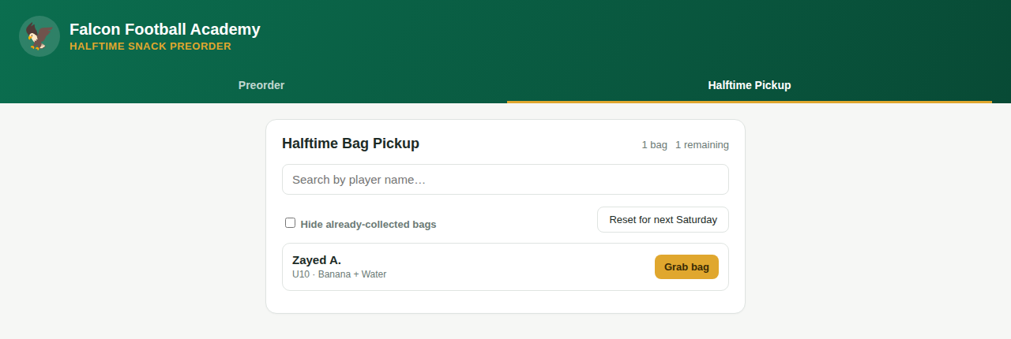
THE BUILD
Halftime Snack Preorder
A two-tab web app, built with Claude — no installation needed.
1
Preorder tab
2
Halftime Pickup tab
Name, team, one snack, one drink, optional allergy note — filled out any time before the match.
Every order sorted A–Z with search, a “Grab bag” button, and a live count of bags remaining.
Live test: one bag reserved and ready — no queue.
7

Slide 8
MISSION STATUS
Chaos diagnosed. Fix built and tested.
✓
Real problem identified
✓
Three causes isolated
✓
App built and tested
✓
Honest risk called out
Ready for review, Baba.

