Slide 1
VERITAS tracking system
  Stephen Fegan (UCLA)
  VERITAS Basecamp Tech-Talk Series
  February 2008

Slide 2
Overview
The problem:
  Interesting targets are scattered throughout the sky and telescopes must be pointed at them
  Unavoidable rotation and motion of the Earth through the heavens must be compensated for
The solution:
  Positioner – safety, motors, encoders, feedback, C&C
  Tracking software – safety, astronomy, GUI, logging

Slide 3
Positioner
Rotating Precision Mechanisms model PG4003 (www.rpm-psi.com)
Dual axis – elevation over azimuth (Alt/Az)
Two drives per axis with integral brakes – Cleveland Motion Control model BMR4000, brushless DC motors (www.cmccontrols.com)
Gear boxes – 3 stages – 25308:1 (Az) 25650:1 (El)
Absolute encoders, tachometers, limits switches
Control system

Slide 4
Motion control introduction
The essential problem of motion control is: how much power to apply to achieve required motion?
For example: in your car's cruise control – how wide should the throttle be opened to maintain correct speed. How much should it change as a function of road inclination, weather etc.
People solve this kind of problem instinctively through feedback – “closed loop” system.
Same with motion control systems.

Slide 5
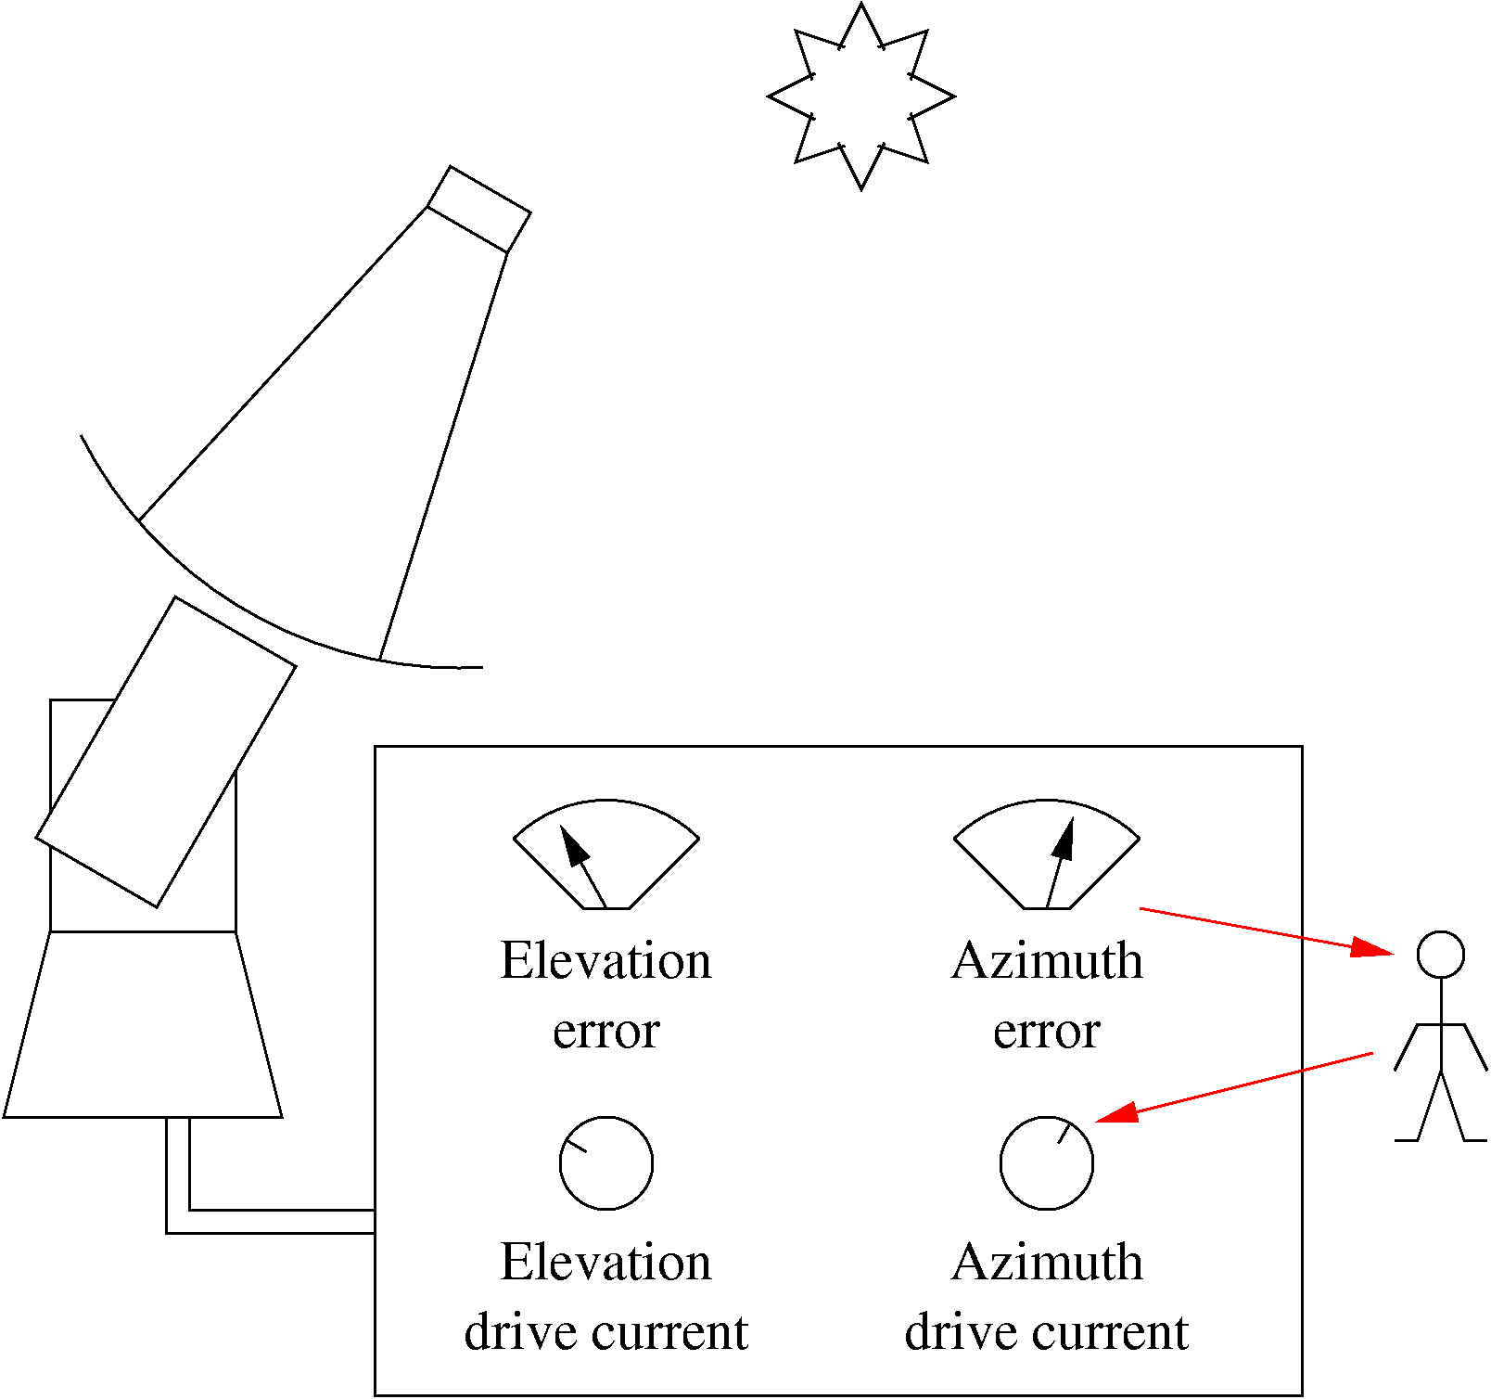
Closed loop control
Far from target?
  Go faster
Always lagging behind when tracking?
  Go faster
Target moving away from you?
  Go faster

Slide 6
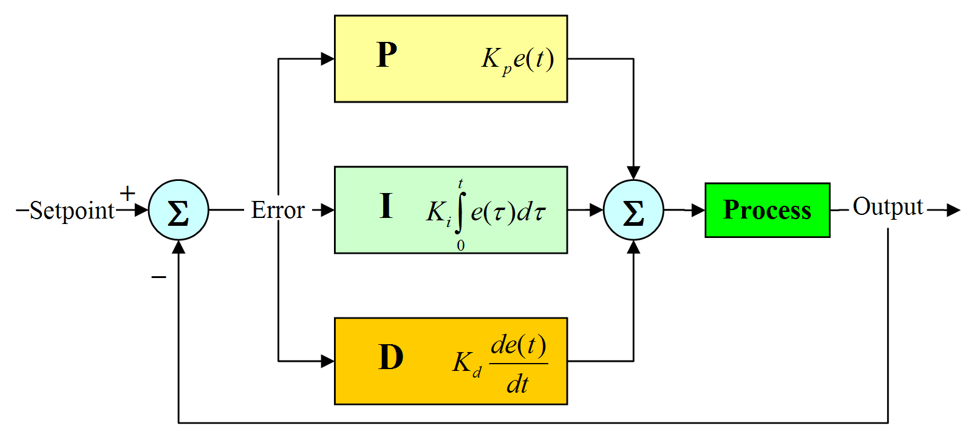
PID loop
The power to drive the system comes from the “error”
No error = no motion!!
Figure: wikipedia
Parameters: Kp, Ki, Kd, and usually something to limit integral component, which can become very large and cause serious overshoot. Gains chosen to compromise between having responsive system and having serious over-shoot and oscillation.

Slide 7
Many nested loops
Output of “position loop” is a signal that system should try to move to minimize position error:
  Large output – system should try to move quickly
  Small output – system should try to move slowly
Output could be amplified and sent directly to motors.. better to interpret as a “velocity request”
Use as input (set-point) of “velocity loop” which compares to motor speed (tachometer).
O/P of velocity loop is a “torque request” - used in a “torque loop” (A/K/A “current loop”).

Slide 8
What set-point?
Imagine you have a telescope system that must track within 0.1deg, and needed 1Amp to move at sidereal rate.
So PID loop must generate signal for 1Amp with an error on scale of 0.1deg.
What happens when you want to slew to target 100deg away – PID system would try to generate 1000Amp!
Better to increment set-point in a controlled way.

Slide 9
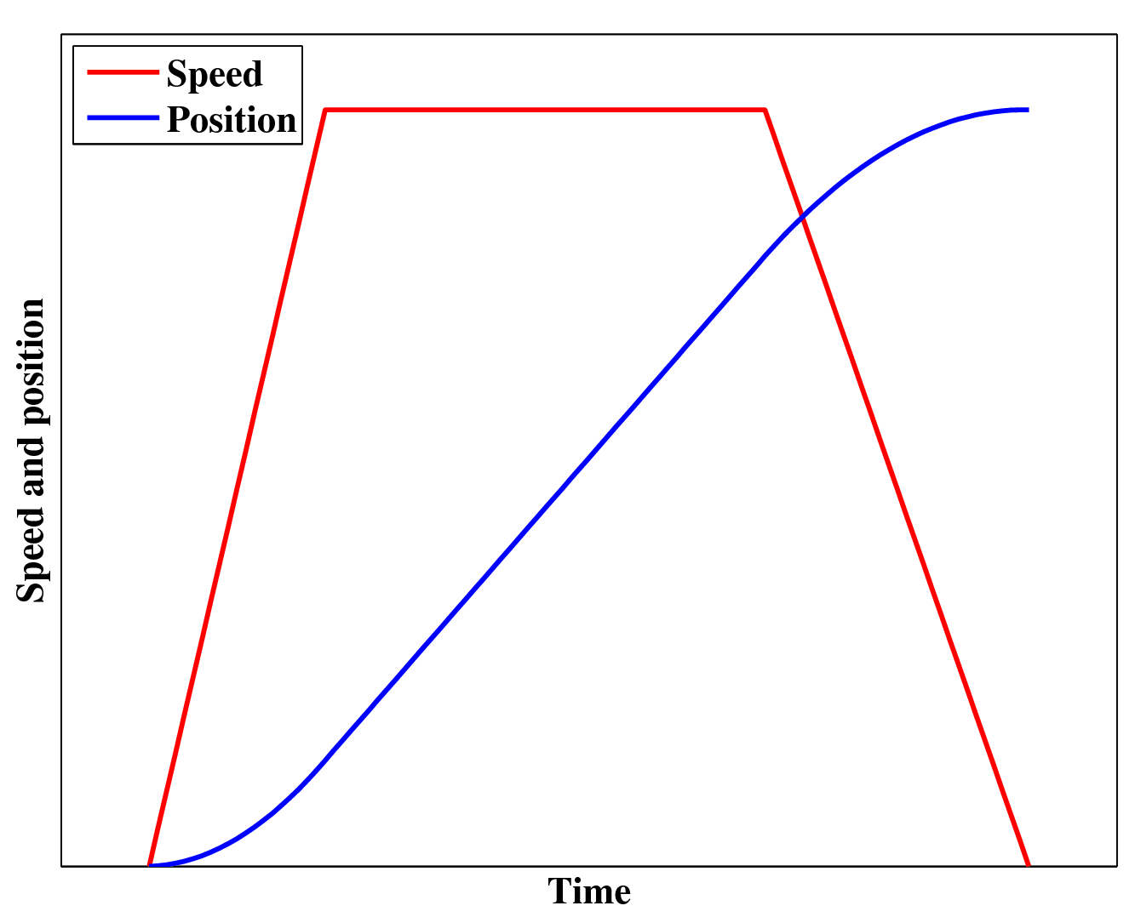
Trajectory generator
Define trajectory of set-points including:
  Acceleration phase
  Constant speed
  Deceleration
Trapezoidal trajectory generator
PID loop responsible for following the trajectory
Parameters: Acceleration rate, maximum speed, deceleration rate.

Slide 10
VERITAS control system
Electronic stack – PC/104 bus
  Single board computer (Micro/sys – SBC1491)
  Interface and control software (RPM sub-contractor)
  Digital motion control (ACSTech80 - 595x Series)
  Power supply board
  Pedestal interface board + firmware (RPM – custom)
Dual-drive board (RPM - custom)
Servo amplifiers (Advanced Motion Control B25A20AC)

Slide 11
Simplified command flow
VERITAS tracking software on PCS computer in trailer
Pedestal i/f
RPM software running on SBC in mount
Encoders
Digital motion control board (position loop)
Tachometers
RPM dual-drive board (velocity loop)
Current sensor
Servo amplifiers (current or torque loop)
Motors

Slide 12
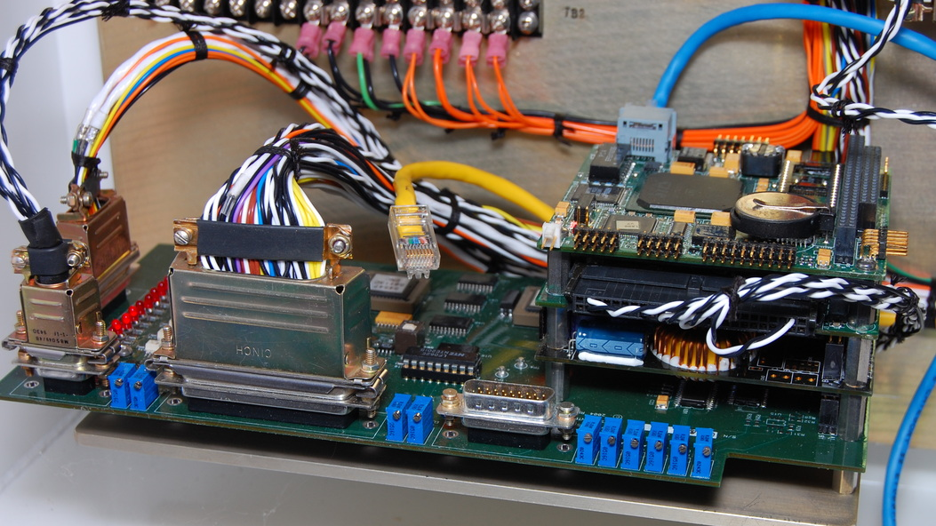
Pedestal interface board
Connectors to motors, interlocks, encoders, etc..
PC/104 stack
Pedestal interface board

Slide 13
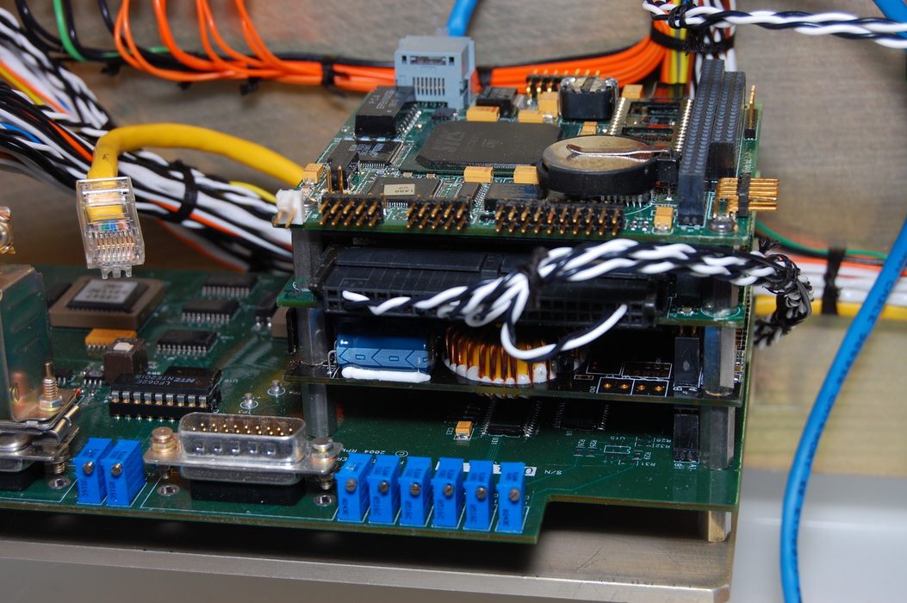
PC/104 stack
Ethernet cable to PCS computer
Single board computer
Motion control board
Power supply board
Pedestal interface board

Slide 14
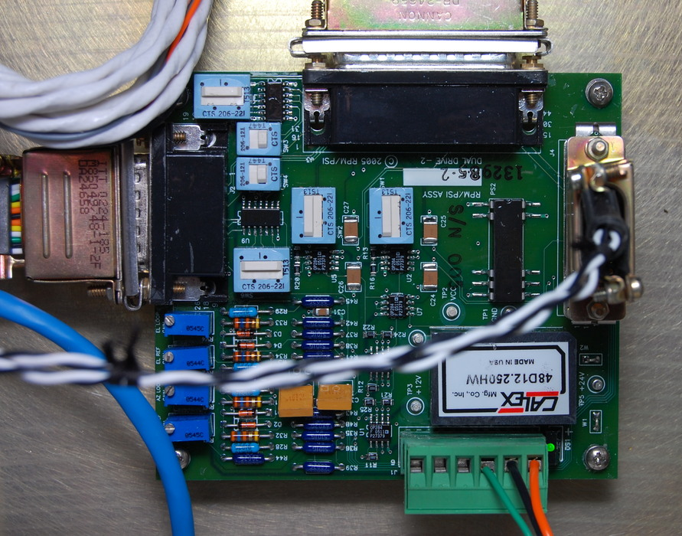
Dual-drive board
Two drives per axis
  Better for high wind
  Faster slewing
  Eliminate backlash
Stationary: drives push a different directions at 10% of max. torque
Moving fast: work together (1% cur. diff.)
Velocity loop
Inputs: (1) output from position loop and (2) motor tachometers
Output: current set-points for servo amps

Slide 15
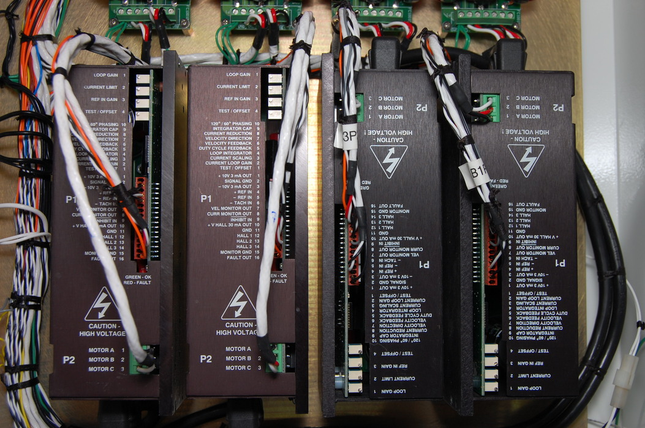
Servo amplifiers
Servo amplifiers generate high currents for brushless motors
In our system they operate in current feedback mode
Current loop
Inputs: (1) current/torque request from dual-drive board and (2) motor shaft positions from hall probes
Output: 3 phase currents to motors

Slide 16
SBC + interface software
Commands/responses sent over UDP/IP & Ethernet (A0058IF_RevD_ENET.doc) e.g.:
SEND: [? 0x0D
RECV: [?3027F92478F3005300552200004100 0x0D
Primary commands:
  Get status: get the position and status of instrument
  Point: point telescope to given position
  Standby: immediately stop telescope and apply brakes
Relays commands to RPM system via PC/104 interface.

Slide 17
Hardware safety
Interlock loop controls AC power flow to servo amplifiers through relays (K1 and K3) – opening loop removes AC power from amplifiers
  Run/Safe
  Stow switches (2x2): on Az/El stow pins
  Failsafe limit switches (2x2): up, down, CW, CCW
  Hatch switches (2+1): two to El area, 1 to Az
  Drill adapter: El and Az drill adapter must be in place
  Az pull cord: 270 degree rotation pull-cord in Az area

Slide 18
Motion control parameters
Digital motion control board:
  Kp – position loop proportional gain
  Ki – position loop integral gain
  Kd – position loop derivative gain
  Ilim – position loop integral limit
  Max A – trajectory maximum acceleration
  Max V – trajectory maximum speed
Dual drive board:
  Velocity loop gain (analog – potentiometer)
Servo amplifiers: read manual!!

Slide 19
Tracking software (features)
Array, single telescope and failsafe interfaces
Client-server architecture means that tracking server is monitoring telescope regardless of CORBA failure, GUI slowness, etc...
Well integrated with database (commands, positions, targets, corrections)
Support for taking star measurements and calculating corrections with on-board solver
Safety layer enforces limits on motion

Slide 20
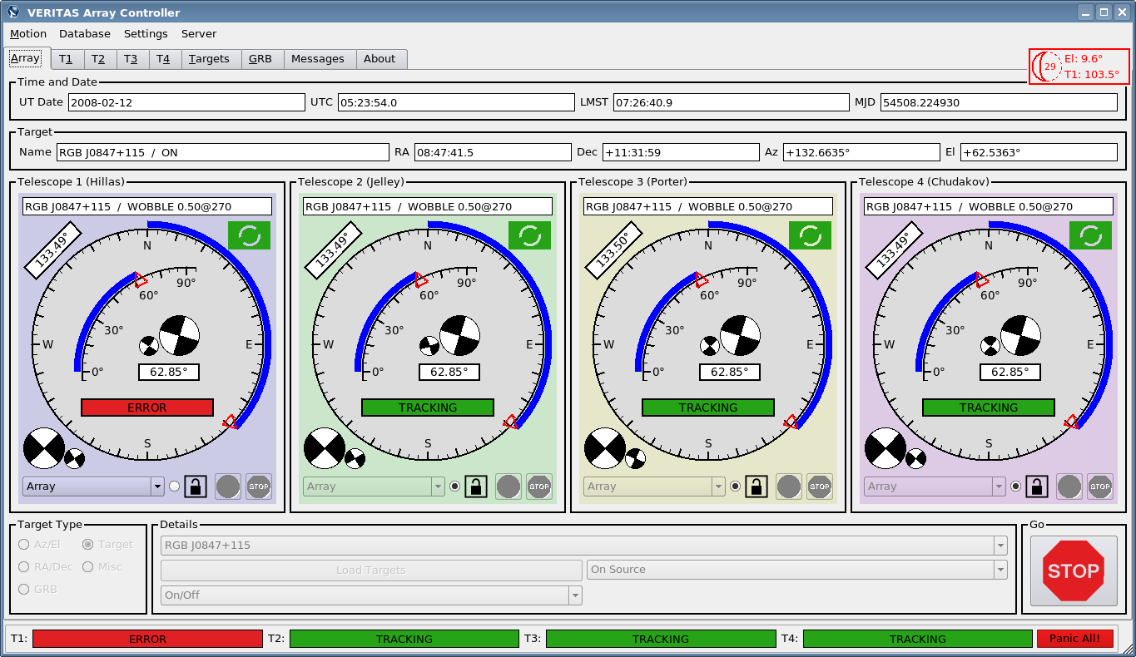
Array GUI

Slide 21
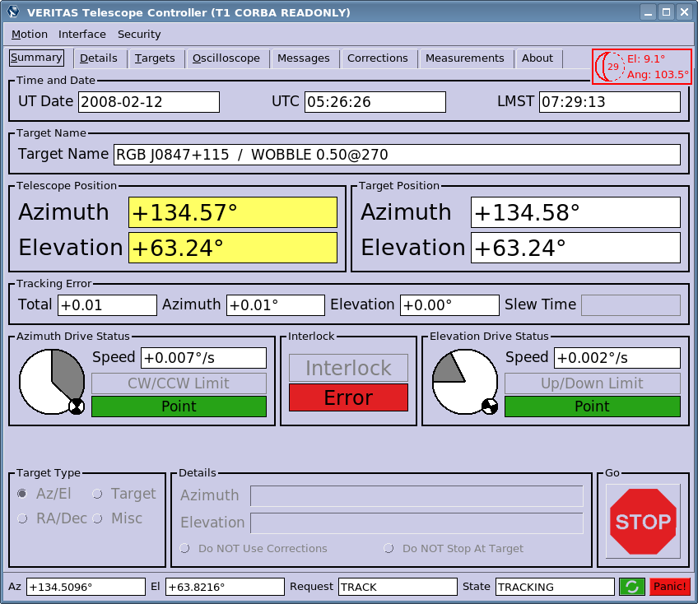
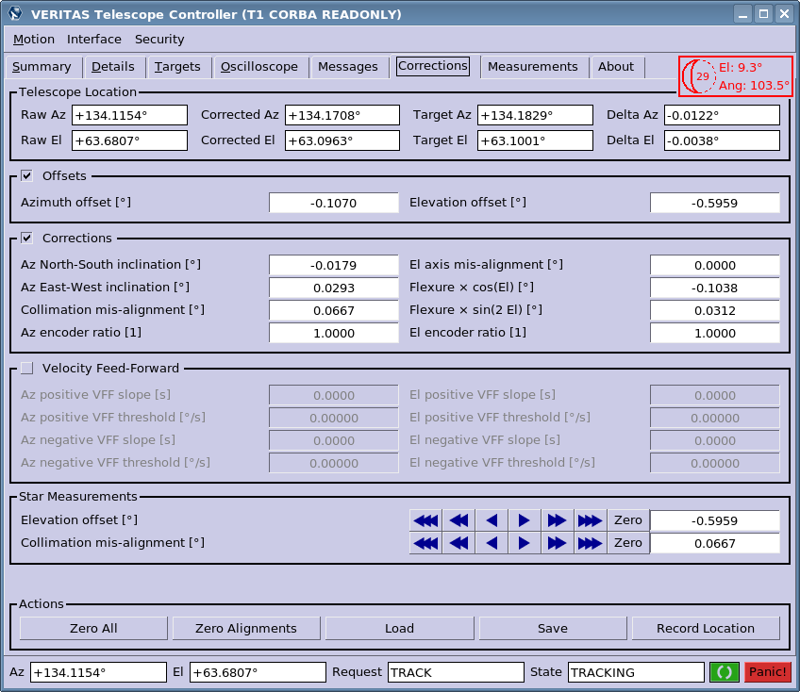
Single telescope GUI

Slide 22
Network neighborhood
Telescope
Private network between each
telescope and its PCS computer
VPM
CORBA
Array Control
Tracking server
Tracking server
Tracking server
Tracking server
L3
Array GUI
Positions
Positions
Commands
Corrections
HV
Database
Targets

Slide 23
Tracking software (internals)
Scope API – send/receive commands from scope
Failsafe UI – text interface to Scope API - CAUTION
Telescope controller (Local)
  Loop to monitor pedestal and send target position commands to telescope and log to database
Single telescope GUI – old interface
Telescope controller (Remote)
  Proxy for Telescope Controller (Local) using CORBA
Array GUI – talk to multiple telescopes

Slide 24
Operating modes
Text based failsafe UI directly to telescope. Like using RPM TCU but with less feedback. No limits.
Single telescope GUI on PCS computer directly to telescope (./serial_tracking)
Tracking server on PCS computer directly to telescope (./tracking_server)
Single telescope GUI to tracking server with CORBA (./one_tracking_t1)
Array GUI with CORBA (./array_tracking)

Slide 25
Telescope contoller loop
Get positioner status
Calculate target position
Apply corrections
Test limits
Apply Vff
Restrict motion (key)
Enforce slew direction
Update state machine
Send command
Log position to DB
Sleep for up to 250ms

Slide 26
Corrections
10 parameter model of Alt/Az behavior
  Azimuth and Elevation offsets (2)
  Azimuth N/S and E/W inclination (2)
  Elevation axis mis-alignment (1)
  Collimation mis-alignment (1)
  Flexure of focus box (2)
  Encoder ratios (2)
Can control 2 drive axes – but 3 Euler angles required to describe orientation of rigid bodies.
8 parameter “Velocity feed-forward” - not used
Every telescope orientation corresponds to somewhere in sky. Not every sky position has a corresponding telescope orientation.

Slide 27
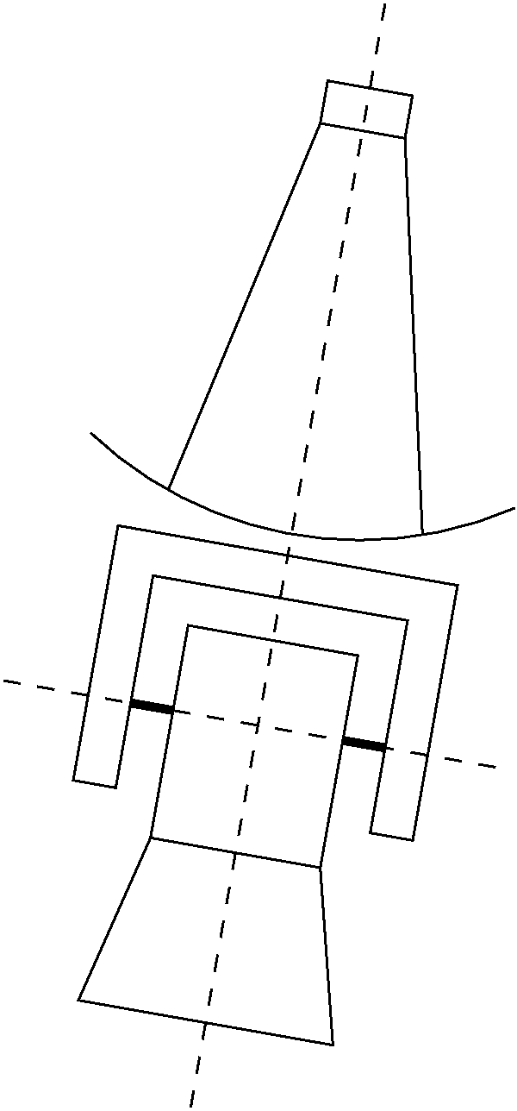
Azimuth N/S, E/W inclination
Describes angles of inclination of an axis perpendicular to the azimuth bearing with respect to the zenith
N/S and E/W angles
T1 angles today:
  NS: -0.0081°
  EW: 0.0276°

Slide 28
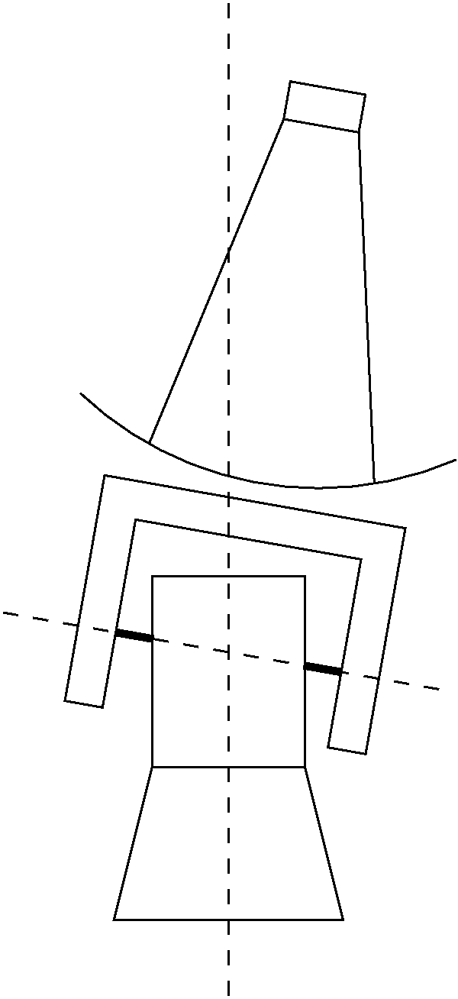
Elevation axis mis-alignment
Ideally elevation axis is perpendicular to azimuth axis.
In real telescope this is not necessarily so.
We have never needed this correction for VERITAS telescopes.

Slide 29
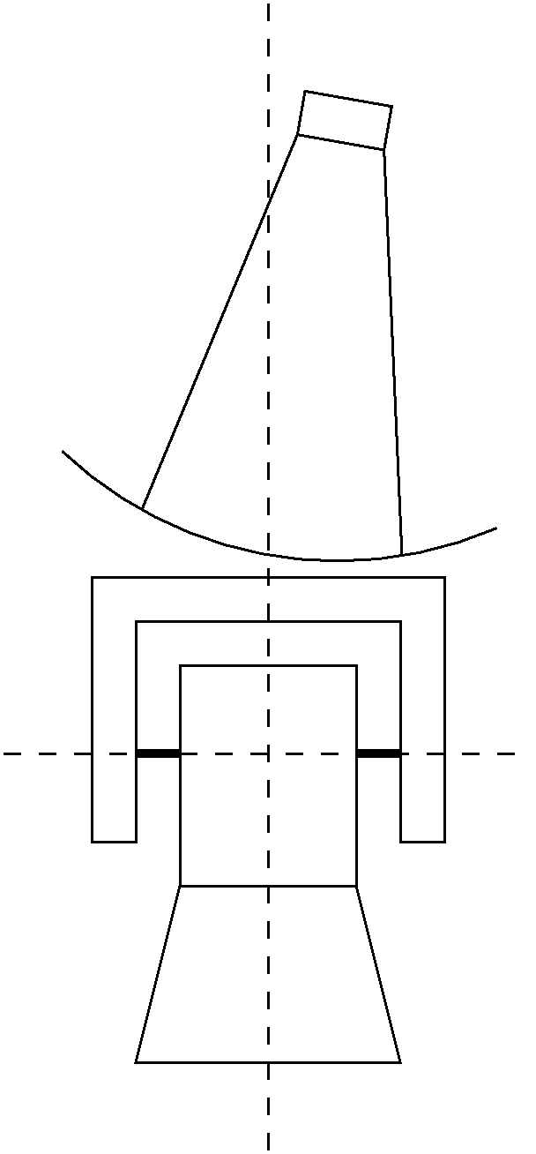
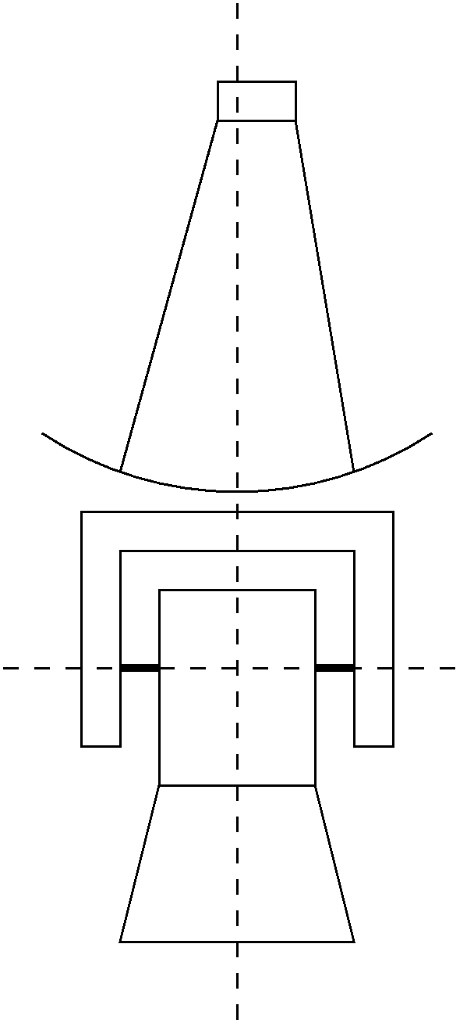
Focal plane collimation
Ideally light from a distant target lying in plane defined by the elevation axis is reflected into the center PMT
Out of plane error is mis-collimation
T1: 0.0667°

Slide 30
Offsets and flexure
Elevation and azimuth offsets describe “zero” point of encoders. The exact definition of the parameters are surprisingly difficult. For example the correction equivalent to “FP collimation”, but Up/Down in the camera is folded into El offset.
Flexure – anomalous motion of camera has some functional form. Define it to be zero at zenith. Function can be expanded as Fourier series. First two non zero terms are A*cos(el) and B*sin(2el).
  T1: A=-0.1038°, B=0.0312°

Slide 31
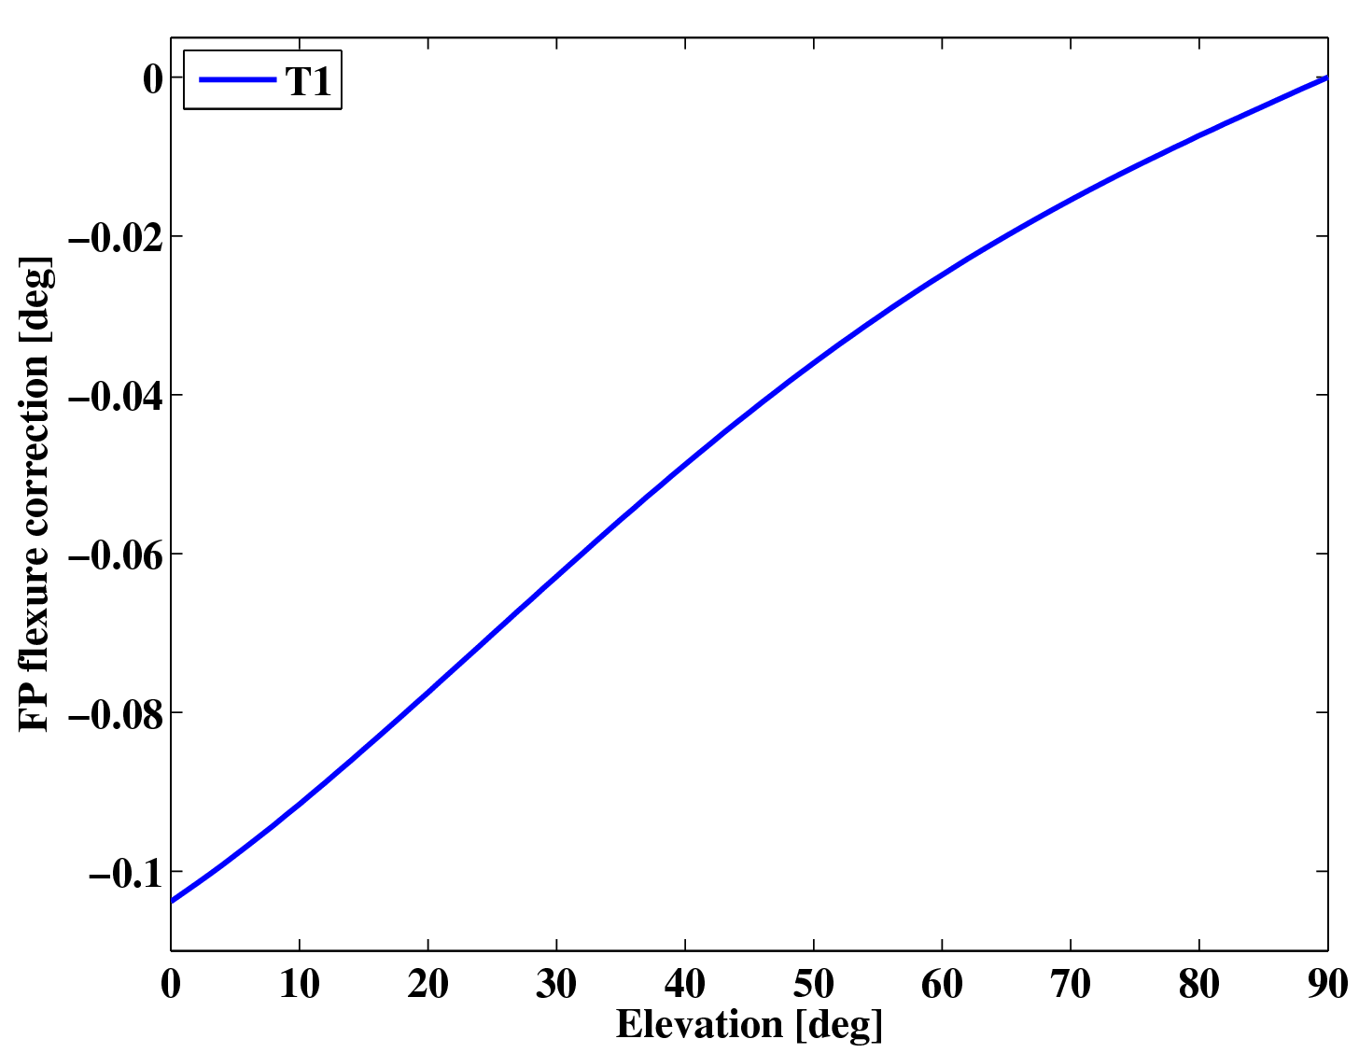
T1 flexure correction

Slide 32
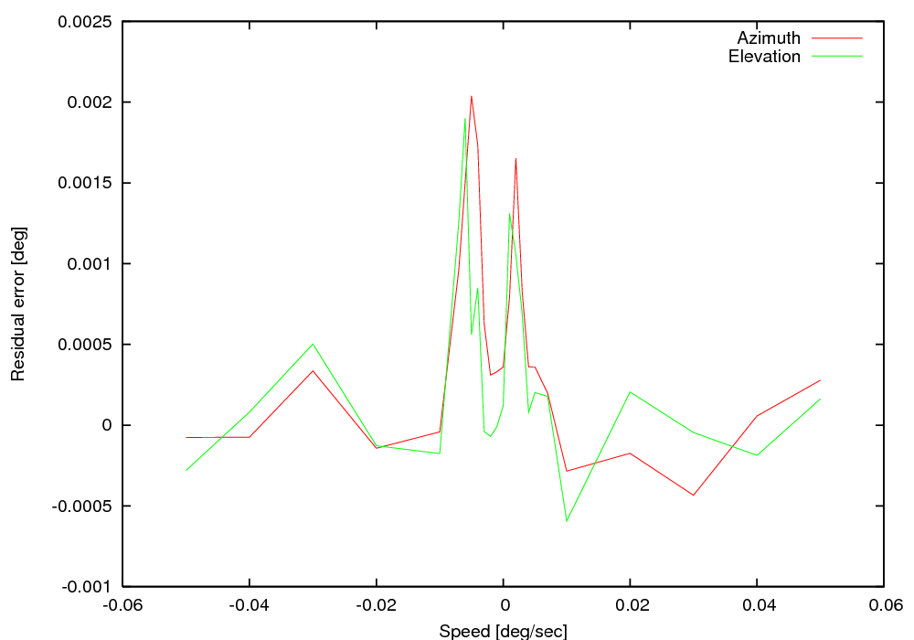
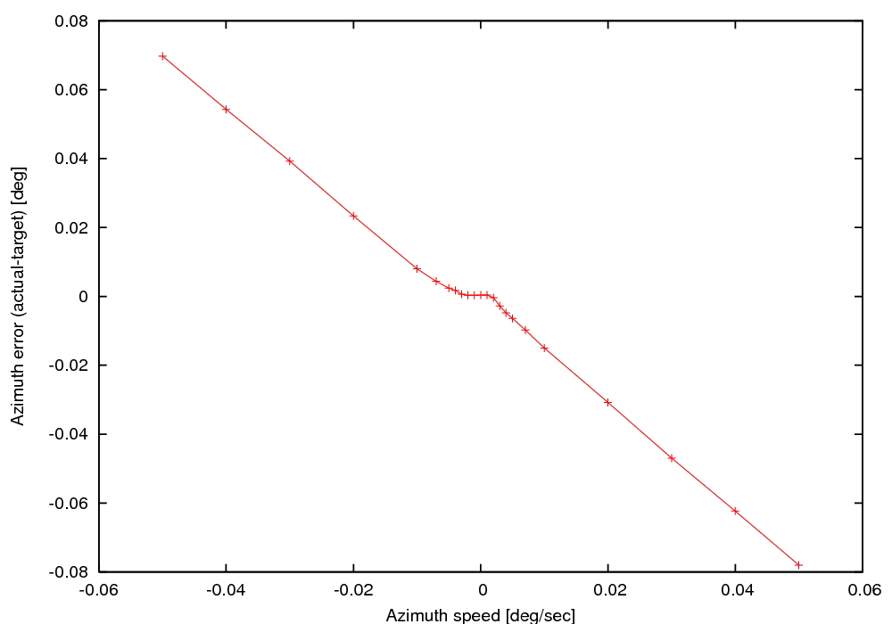
Velocity feed-forward
As mentioned earlier, current to drive motors derives from position error. No error mean there will be no motion! Plotted is error vs. speed of target.
Vff corrections consists of two linear fits to speed-error curve for each axis. When applied tracking program leads target, depending on its speed to minimize error.

Slide 33
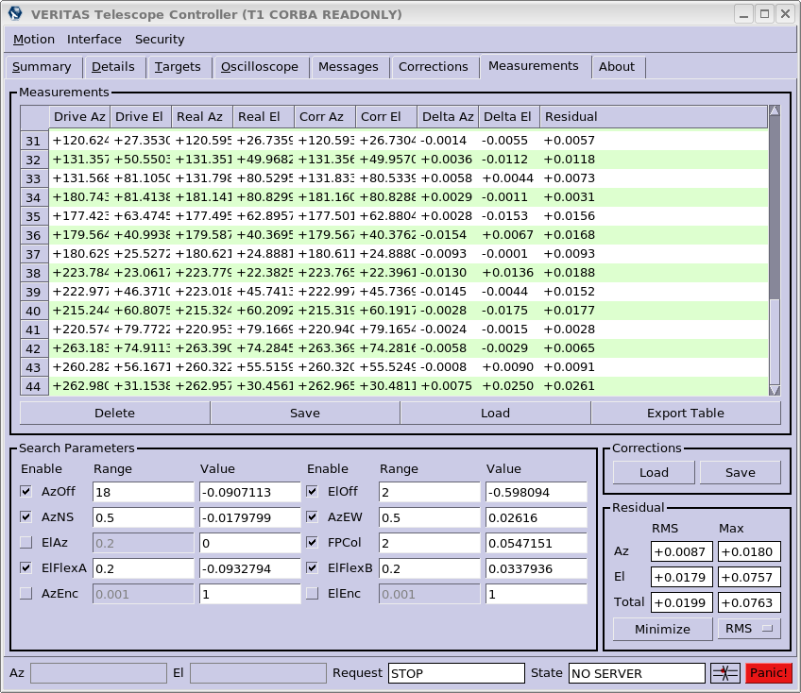
Corrections fitting
Fitting can be done from within single telescope GUI
Be conservative with number of parameters
Start with Az/ElOff and AzNS/EW.
Add param and check solution improves.
Never use AzEl or Az/ElEnc
0.010-0.025 good!

Slide 34
Software safety
Motion below 20° forbidden.
  Two windows for low elevation motion open: platform and stow.
  Override option was previously available – not any longer after a few mishaps.
Control loop is pretty simple and runs as a separate thread. Should not hang for any reason.
Panic! buttons instantly stop motion and terminate control loop, so tracking servers would need to be restarted to resume motion.

Slide 35
Problems
T1 control system sometime will not reach target, needs to be “reset” by pressing stop and start
T2 has noticeable oscillations during regular observations
T3 has violent oscillations when slewing downward at 0.06deg/sec – not usual during observation
T4 has no problems at this time :-)

Slide 36
Further reading
In “Specs” directory of tracking software:
  MA4065_redux.pdf – Pedestal manual – lots of information (RPM)
  PG4003_A4065_SAO.doc – Pedestal specifications – old (RPM)
  A0058IF_RevD_ENET.doc – Control message specification (RPM)
  acstech80_595x.pdf – Digital motion control board specs (ACS/Tech80)
  pmd_HW_v101.pdf – Digital motion control manual (ACS/Tech80)
  b25a-ac.pdf – Servo amplifier manual (AMC)
  AMC_sectionG.pdf – Engineering notes from servo amp. Manufacturer (AMC)
  bmr4000.pdf – Motor manual (CMC)
  microsys_sbc1491_datasheet.pdf – SBC datasheet (Microsys)

