Slide 1
TRATAMIENTO DE DATASET, ANÁLISIS Y GRÁFICOS
_
Sofía Feilbogen - L. 61889

Slide 2
Elección de la base

Slide 3


Notes:
En los casos que el banco sospeche de si puede cumplir con los plazos de devolucion de los prestamos, (casos raros) puede analizar con el siguiente modelo si es fiable o no

Slide 4


Extracción del censo de 1994 por Barry Becker.
Objetivo de clasificación: determinar si la persona puede ganar más de 50k por año.
Variables: 15
Registros: 32560

Slide 5
VARIABLES
Ages (int) | WorkClass (chr) | TargetPopulation (int) | Bachelors (chr) | BachelorYear (int) | MaritalStatus (chr) | Occupation (chr)
Family(chr) | Ethnicity(chr) | Gender(chr) | CapitalGain (int) | CapitalLoss (int) | HoursPerweek (int) | Country (chr) | Result (cht)
Extraída con las siguientes condiciones:
Ages mayor a 16 años
AGI adjusted gross income (ingreso bruto ajustado) mayor a 100
FNLWGT (TargetPopulation) mayor a 1
HRSWK (HoursPerWeek) mayor a 0

Slide 6
FNLWGT
"Recuentos ponderados" de cualquier característica socioeconómica específica de la población.
Las personas con características demográficas similares deberían tener pesos similares.
Una estimación de una sola celda de la población mayor de 16 años para cada estado.
Controles de Origen Hispano por edad y sexo.
Controles por Raza, edad y sexo.

Slide 7
Variables categóricas

Slide 8
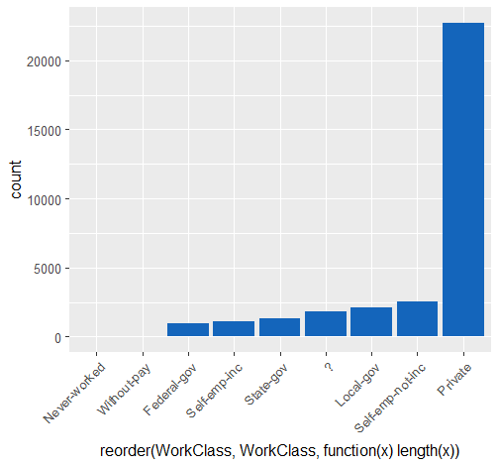
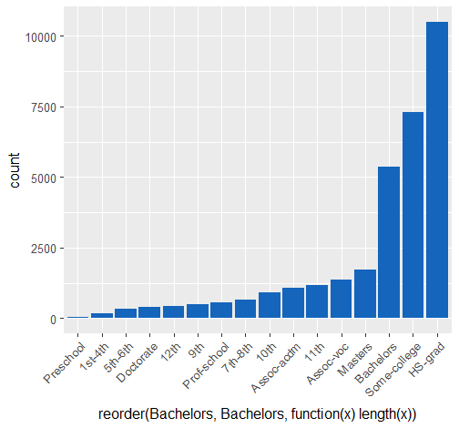
Preschool < 1st-4th < 5th-6th < 7th-8th < 9th < 10th < 11th < 12th < HS-grad < Prof-school < Assoc-acdm < Assoc-voc < Some-college < Bachelors < Masters < Doctorate.
WorkClass
Bachelors

Slide 9
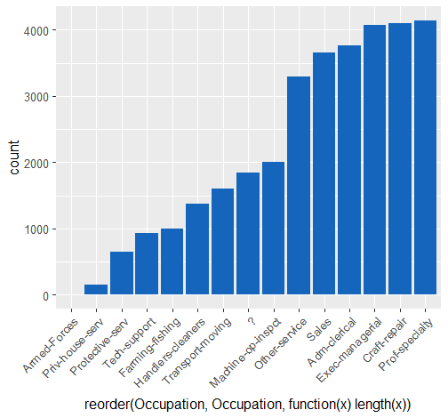
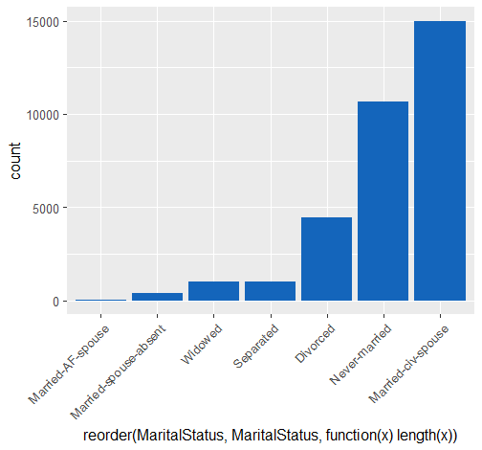
MaritalStatus
Occupation
Divorced | Married-AF-spouse | Married-civ-spouse
4443 | 23 | 14976
Married-spouse-absent | Never-married | Separated
418 | 10682 | 1025
Widowed
993

Slide 10
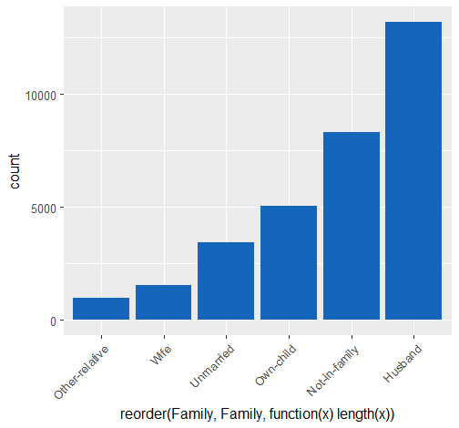
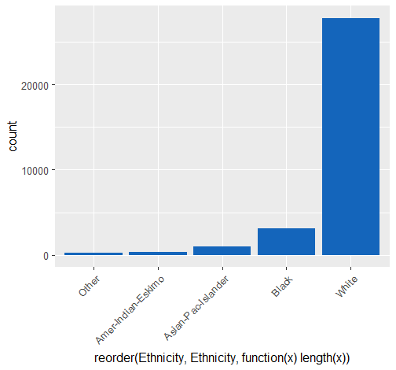
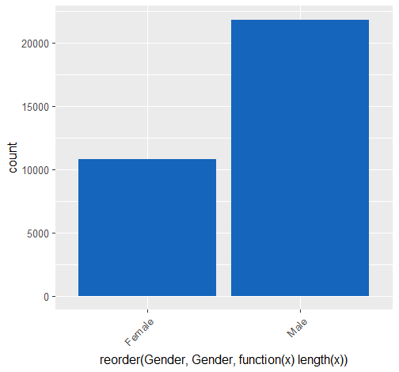
Family
Ethnicity
Gender

Slide 11
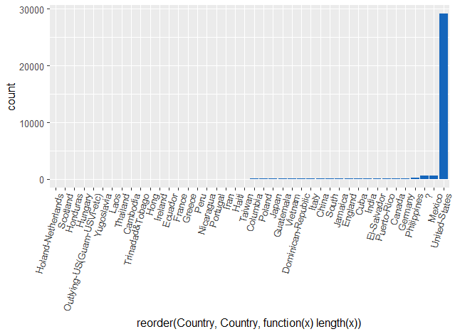
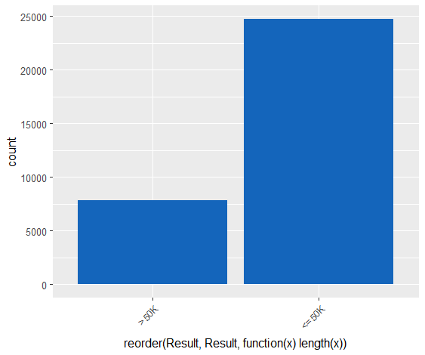
Country
Result

Slide 12
Variables numéricas

Slide 13
Cuantiles
Ages
BachelorYear
 | 0% | 25% | 50% | 75% | 100%
 | 1 | 9 | 10 | 12 | 16
0% | 25% | 50% | 75% | 100%
17 | 28 | 37 | 48 | 90
TargetPopulation
CapitalGain
 | 0% | 25% | 50% | 75% | 100%
 | 0 | 0 | 0 | 0 | 99999
0% | 25% | 50% | 75% | 100%
12285.0 | 117831.5 | 178363.0 | 237054.5 | 1484705.0
HoursPerWeek
CapitalLoss
 | 0% | 25% | 50% | 75% | 100%
 | 0 | 0 | 0 | 0 | 4356
0% | 25% | 50% | 75% | 100%
1 | 40 | 40 | 45 | 99

Slide 14
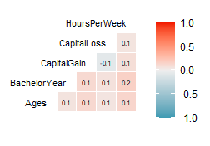
Relación entre las variables
Var1 | Var2 | corr
HoursPerWeek | BachelorYear | 0.1672209
HoursPerWeek | Ages | 0.1429096
CapitalGain | Ages | 0.1249498
CapitalGain | BachelorYear | 0.1190456
HoursPerWeek | CapitalGain | 0.0933443
CapitalLoss | BachelorYear | 0.0747574
CapitalLoss | CapitalGain | -0.0665583
BachelorYear | Ages | 0.0663372
HoursPerWeek | CapitalLoss | 0.0598518
CapitalLoss | Ages | 0.0584850
Quitamos TargetPopulation

Slide 15

Quitamos datos atípicos
Quitamos la variable TargetPopulation
Le pedimos los datos al cliente
Predecimos en que categoría entra el cliente

Slide 16
Tendencias

Slide 17
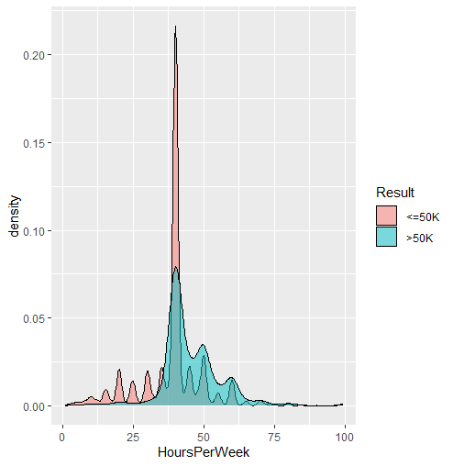
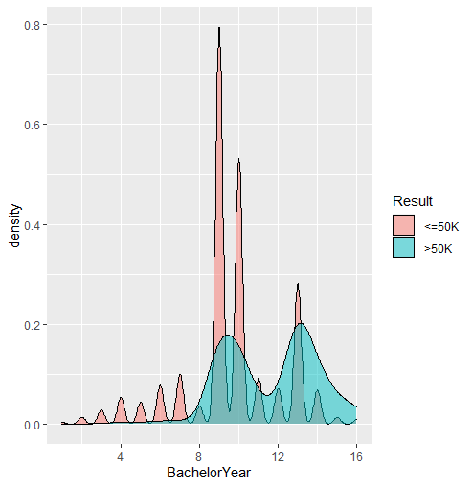

Slide 18
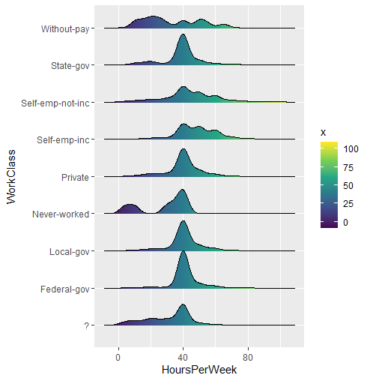

Slide 19
WorkClass
 | ? | Federal-gov | Local-gov | Never-worked | Private | Self-emp-inc | Self-emp-not-inc | State-gov | Without-pay
<=50K | 1645 | 589 | 1476 | 7 | 17733 | 494 | 1817 | 944 | 14
>50K | 191 | 371 | 617 | 0 | 4963 | 622 | 724 | 353 | 0

Slide 20
Bachelors
Preschool < 1st-4th < 5th-6th < 7th-8th < 9th < 10th < 11th < 12th < HS-grad < Prof-school < Assoc-acdm < Assoc-voc < Some-college < Bachelors < Masters < Doctorate.
 | 10th | 11th | 12th | 1st-4th | 5th-6th | 7th-8th | 9th | Assoc-acdm
<=50K | 871 | 1115 | 400 | 162 | 317 | 606 | 487 | 802
>50K | 62 | 60 | 33 | 6 | 16 | 40 | 27 | 265
 | Assoc-voc | Bachelors | Doctorate | HS-grad | Masters | Preschool | Prof-school | Some-college
<=50K | 1021 | 3133 | 107 | 8826 | 764 | 51 | 153 | 5904
>50K | 361 | 2221 | 306 | 1675 | 959 | 0 | 423 | 1387

Slide 21
Occupation
 | ? | Adm-clerical | Armed-Forces | Craft-repair | Exec-managerial | Farming-fishing | Handlers-cleaners | Machine-op-inspct
<=50K | 1652 | 3262 | 8 | 3170 | 2098 | 879 | 1284 | 1752
>50K | 191 | 507 | 1 | 929 | 1968 | 115 | 86 | 250
 | Other-service | Priv-house-serv | Prof-specialty | Protective-serv | Sales | Tech-support | Transport-moving
<=50K | 3158 | 148 | 2281 | 438 | 2667 | 645 | 1277
>50K | 137 | 1 | 1859 | 211 | 983 | 283 | 320

Slide 22
Estadísticas descriptivas principales

Slide 23
Ages
Min. | :17.00
1st Qu. | :28.00
Median | :37.00
Mean | :38.58
3rd Qu. | :48.00
Max. | :90.00
Bachelors
Length:32560
Class | :character
Mode | :character
WorkClass
Length:32560
Class | :character
Mode | :character
TargetPopulation
Min. | :12285
1st Qu. | :117832
Median | :178363
Mean | :189782
3rd Qu. | :237055
Max. | :1484705

Slide 24
BachelorYear
Min. | :1.00
1st Qu. | :9.00
Median | :10.00
Mean | :10.08
3rd Qu. | :12.00
Max. | :16.00
Not.in.family
Length:32560
Class | :character
Mode | :character
Male
Length:32560
Class | :character
Mode | :character
Adm.clerical
Length:32560
Class | :character
Mode | :character
White
Length:32560
Class | :character
Mode | :character
HoursPerWeek
Min. | :1.00
1st Qu. | :40.00
Median | :40.00
Mean | :40.44
3rd Qu. | :45.00
Max. | :99.00
Never.married
Length:32560
Class | :character
Mode | :character

Slide 25
CapitalGain |  |  | CapitalLoss
Min. | :0 |  | Min. | :0.00
1st Qu. | :0 |  | 1st Qu. | :0.00
Median | :0 |  | Median | :0.00
Mean | :1078 |  | Mean | :87.31
3rd Qu. | :0 |  | 3rd Qu. | :0.00
Max. | :99999 |  | Max. | :4356.00
Result
Length | :32560
Class | :character
Mode | :character
United.States
Length | :32560
Class | :character
Mode | :character

Slide 26
Missings

Slide 27
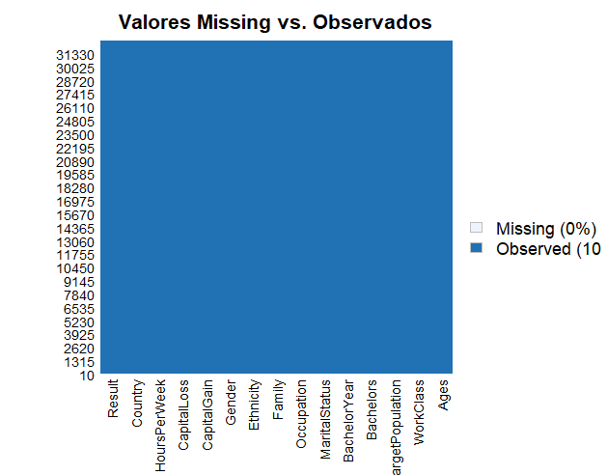
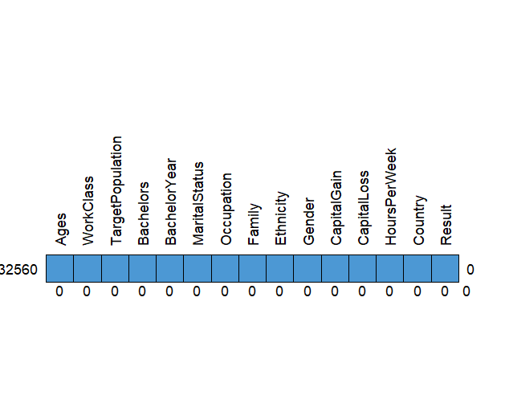

Slide 28
Outliers

Slide 29
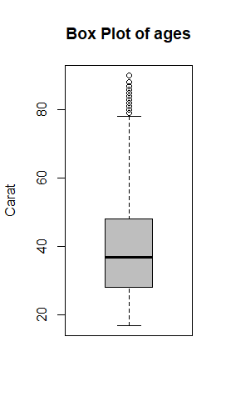
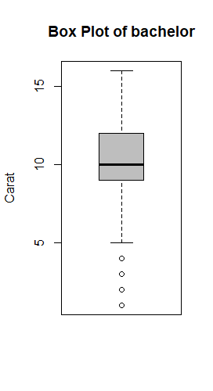
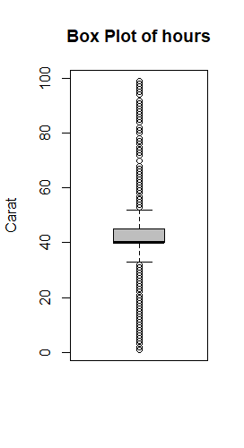
Tomamos los menores a 75 años; los que sus años de bachelors sean menores a 5; en función de las horas laborales tomamos aquellas que sean mayores a 36 y menores a 50

Slide 30
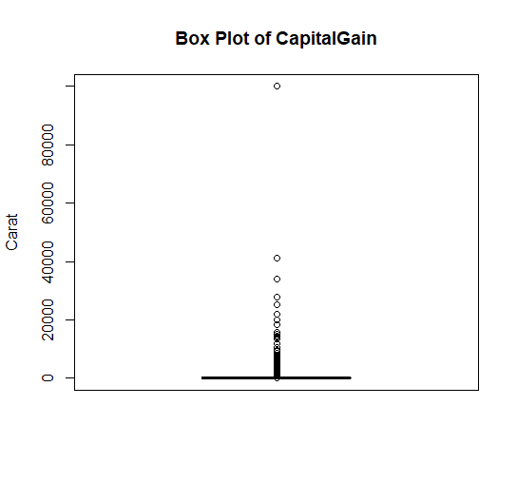
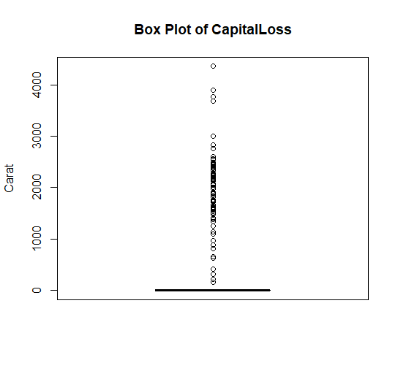
Tomamos los que su CapitalGain sea diferente a 99999

Slide 31
Predecimos

Slide 32
Limpiamos la base
Convertimos a binaria la variable Result
0.80% → Entrenamiento
0.20 % → Testeo

Slide 33
Regresión logística
Matriz de confusión
 | 0 | 1
0 | 659 | 463
1 | 233 | 2867
TP | FP
FN | TN
Accuracy (exactitud) = (659 +2867)/(659 +463+233 +2867)= 0.8351
Ratio de Error = (463 +233 )/(659 +463+233 +2867) = 0.1648

Slide 34
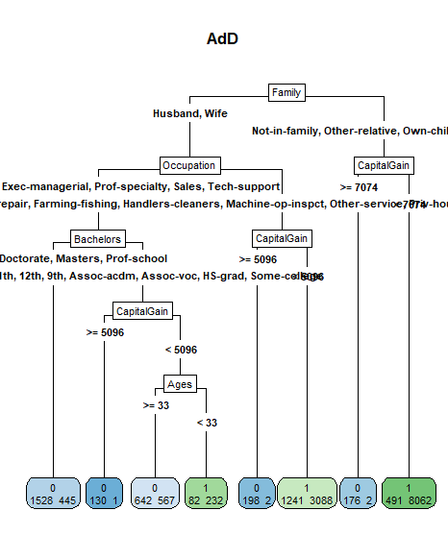
Árboles
Reference
Prediction 0 1
0 660 237
1 461 2862
Accuracy : 0.8346

Slide 35
Muchas gracias

