Slide 1
TRATAMIENTO DE DATASET, ANÁLISIS Y GRÁFICOS
_
Sofía Feilbogen - L. 61889

Slide 2




Notes:
barry becker 1994

Slide 3
VARIABLES
Ages (int) | WorkClass (chr) | TargetPopulation (int) | Bachelors (chr) | BachelorYear (int) | MaritalStatus (chr) | Occupation (chr)
Family(chr) | Ethnicity(chr) | Gender(chr) | CapitalGain (int) | CapitalLoss (int) | HoursPerweek (int) | Country (chr) | Result (cht)
Extraída con las siguientes condiciones:
Ages mayor a 16 años
AGI adjusted gross income (ingreso bruto ajustado) mayor a 100
FNLWGT (TargetPopulation) mayor a 1
HRSWK (HoursPerWeek) mayor a 0
Una estimación de una sola celda de la población mayor de 16 años para cada estado.
Controles de Origen Hispano por edad y sexo.
Controles por Raza, edad y sexo.
Notes:
"Recuentos ponderados" de cualquier característica socioeconómica específica de la población.
Las personas con características demográficas similares deberían tener pesos similares.

Slide 4
Variables categóricas
Variables numéricas
Tendencias
Estadísticas descriptivas principales
Missings
Outliers
Predecimos
ÍNDICE

Slide 5
Variables categóricas

Slide 6
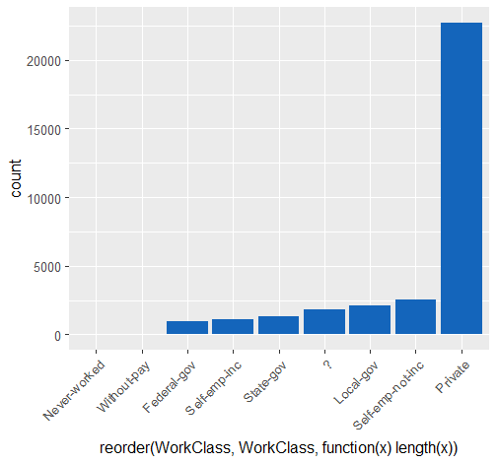
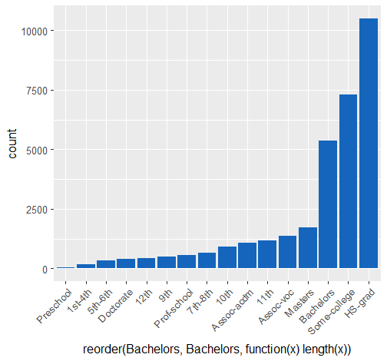
Preschool < 1st-4th < 5th-6th < 7th-8th < 9th < 10th < 11th < 12th < HS-grad < Prof-school < Assoc-acdm < Assoc-voc < Some-college < Bachelors < Masters < Doctorate.
WorkClass
Bachelors

Slide 7
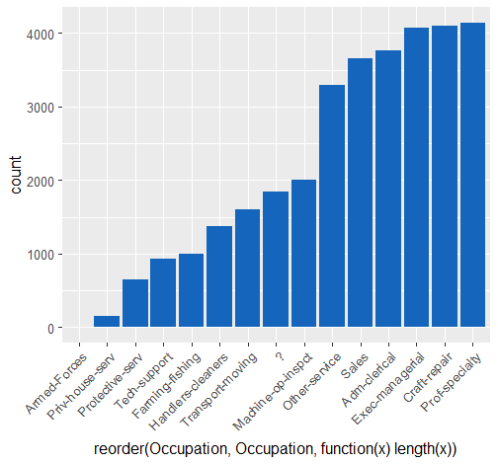
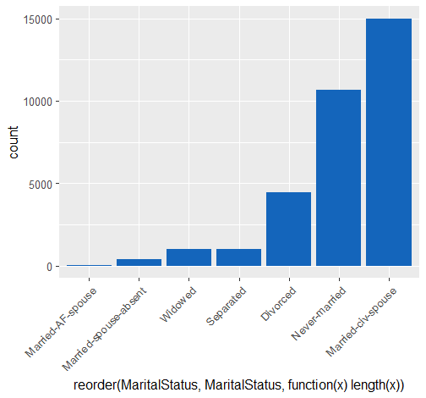
MaritalStatus
Occupation

Slide 8
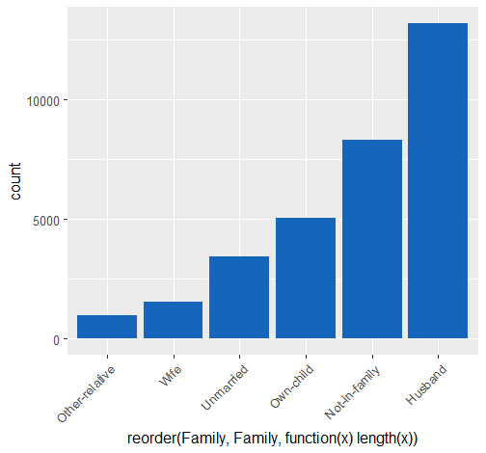
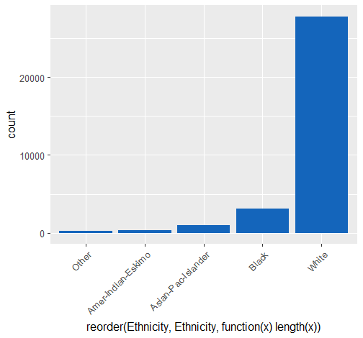
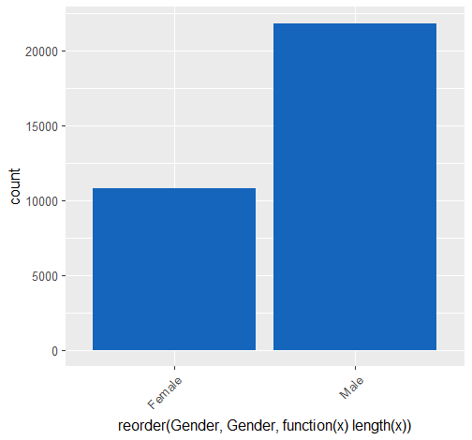
Family
Ethnicity
Gender

Slide 9
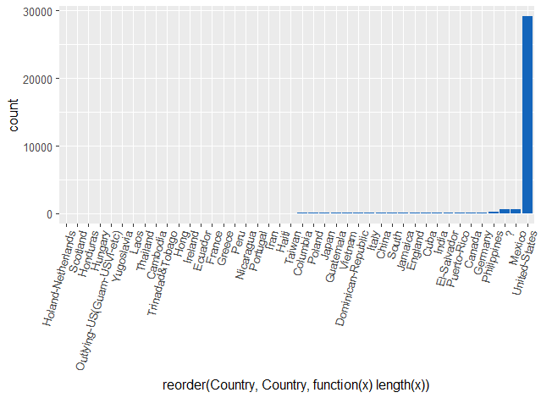
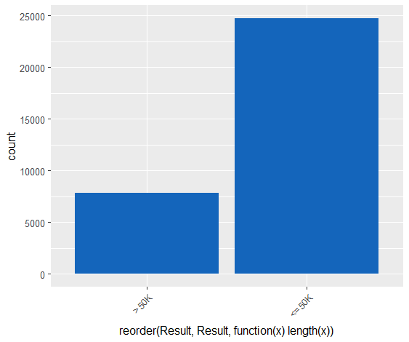
Country
Result

Slide 10
Variables numéricas

Slide 11
Cuantiles
Ages
BachelorYear
 | 0% | 25% | 50% | 75% | 100%
 | 1 | 9 | 10 | 12 | 16
0% | 25% | 50% | 75% | 100%
17 | 28 | 37 | 48 | 90
TargetPopulation
CapitalGain
 | 0% | 25% | 50% | 75% | 100%
 | 0 | 0 | 0 | 0 | 99999
0% | 25% | 50% | 75% | 100%
12285.0 | 117831.5 | 178363.0 | 237054.5 | 1484705.0
HoursPerWeek
CapitalLoss
 | 0% | 25% | 50% | 75% | 100%
 | 0 | 0 | 0 | 0 | 4356
0% | 25% | 50% | 75% | 100%
1 | 40 | 40 | 45 | 99

Slide 12
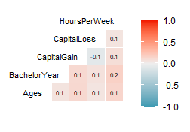
Relación entre las variables
Var1 | Var2 | corr
HoursPerWeek | BachelorYear | 0.1672209
HoursPerWeek | Ages | 0.1429096
CapitalGain | Ages | 0.1249498
CapitalGain | BachelorYear | 0.1190456
HoursPerWeek | CapitalGain | 0.0933443
CapitalLoss | BachelorYear | 0.0747574
CapitalLoss | CapitalGain | -0.0665583
BachelorYear | Ages | 0.0663372
HoursPerWeek | CapitalLoss | 0.0598518
CapitalLoss | Ages | 0.0584850
Quitamos TargetPopulation

Slide 13
Tendencias

Slide 14
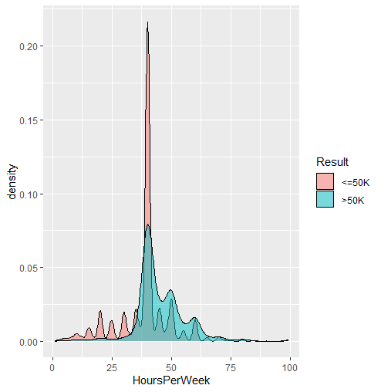
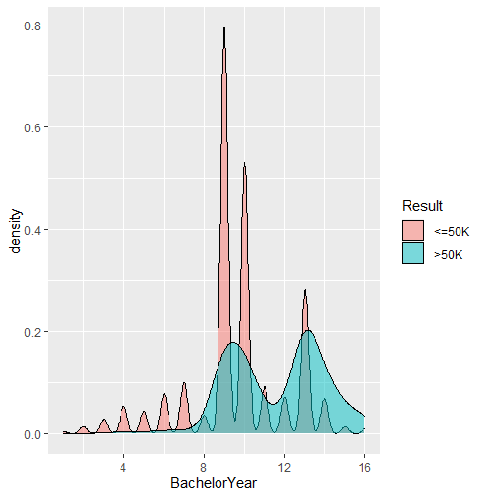
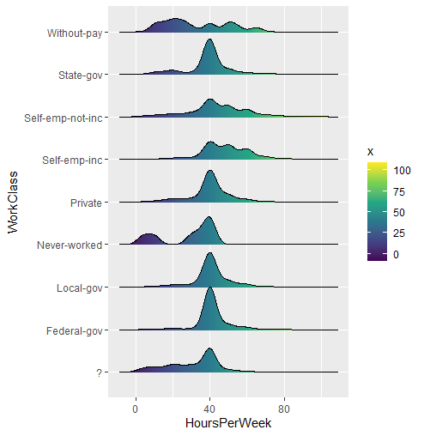

Slide 15
WorkClass
 | ? | Federal-gov | Local-gov | Never-worked | Private | Self-emp-inc | Self-emp-not-inc | State-gov | Without-pay
<=50K | 1645 | 589 | 1476 | 7 | 17733 | 494 | 1817 | 944 | 14
>50K | 191 | 371 | 617 | 0 | 4963 | 622 | 724 | 353 | 0

Slide 16
Bachelors
Preschool < 1st-4th < 5th-6th < 7th-8th < 9th < 10th < 11th < 12th < HS-grad < Prof-school < Assoc-acdm < Assoc-voc < Some-college < Bachelors < Masters < Doctorate.
 | 10th | 11th | 12th | 1st-4th | 5th-6th | 7th-8th | 9th | Assoc-acdm
<=50K | 871 | 1115 | 400 | 162 | 317 | 606 | 487 | 802
>50K | 62 | 60 | 33 | 6 | 16 | 40 | 27 | 265
 | Assoc-voc | Bachelors | Doctorate | HS-grad | Masters | Preschool | Prof-school | Some-college
<=50K | 1021 | 3133 | 107 | 8826 | 764 | 51 | 153 | 5904
>50K | 361 | 2221 | 306 | 1675 | 959 | 0 | 423 | 1387

Slide 17
Occupation
 | ? | Adm-clerical | Armed-Forces | Craft-repair | Exec-managerial | Farming-fishing | Handlers-cleaners | Machine-op-inspct
<=50K | 1652 | 3262 | 8 | 3170 | 2098 | 879 | 1284 | 1752
>50K | 191 | 507 | 1 | 929 | 1968 | 115 | 86 | 250
 | Other-service | Priv-house-serv | Prof-specialty | Protective-serv | Sales | Tech-support | Transport-moving
<=50K | 3158 | 148 | 2281 | 438 | 2667 | 645 | 1277
>50K | 137 | 1 | 1859 | 211 | 983 | 283 | 320

Slide 18
Estadísticas descriptivas principales

Slide 19
Ages
Min. | :17.00
1st Qu. | :28.00
Median | :37.00
Mean | :38.58
3rd Qu. | :48.00
Max. | :90.00
TargetPopulation
Min. | :12285
1st Qu. | :117832
Median | :178363
Mean | :189782
3rd Qu. | :237055
Max. | :1484705
BachelorYear
Min. | :1.00
1st Qu. | :9.00
Median | :10.00
Mean | :10.08
3rd Qu. | :12.00
Max. | :16.00
CapitalGain
Min. | :0
1st Qu. | :0
Median | :0
Mean | :1078
3rd Qu. | :0
Max. | :99999
CapitalLoss
Min. | :0.00
1st Qu. | :0.00
Median | :0.00
Mean | :87.31
3rd Qu. | :0.00
Max. | :4356.00
HoursPerWeek
Min. | :1.00
1st Qu. | :40.00
Median | :40.00
Mean | :40.44
3rd Qu. | :45.00
Max. | :99.00

Slide 20
Missings

Slide 21
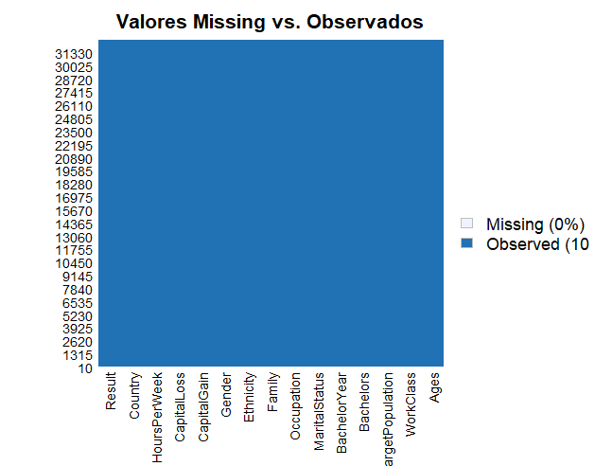
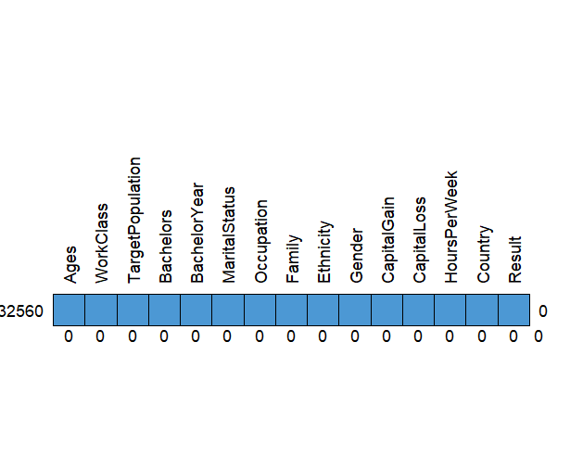

Slide 22
Outliers

Slide 23
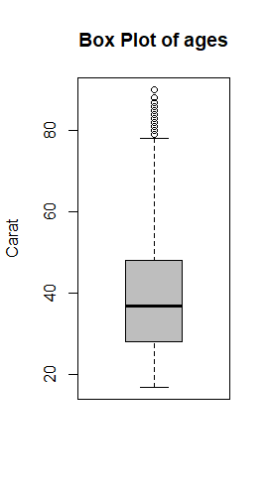
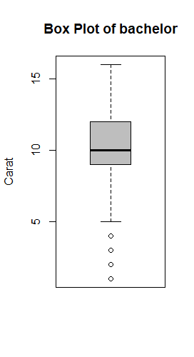
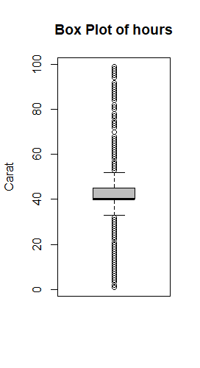
Tomamos los menores a 75 años; los que sus años de bachelors sean menores a 5; en función de las horas laborales tomamos aquellas que sean mayores a 36 y menores a 50

Slide 24
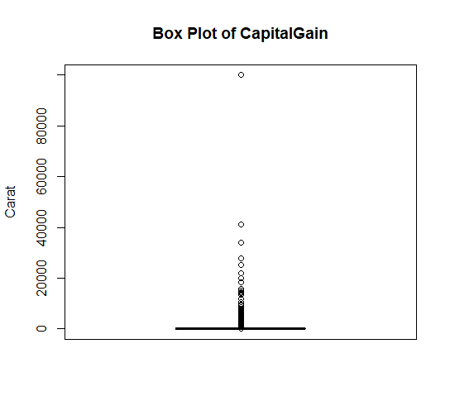
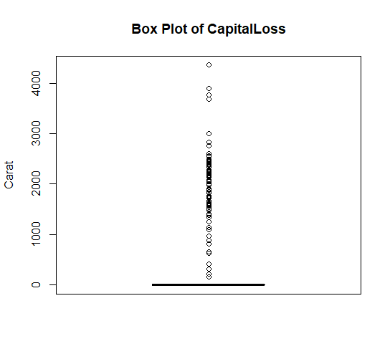
Tomamos los que su CapitalGain sea diferente a 99999

Slide 25
Predecimos
Limpiamos la base
Convertimos a binaria la variable Result
0.80% → Entrenamiento
0.20 % → Testeo

Slide 26
Regresión logística
Matriz de confusión
 | 0 | 1
0 | 659 | 463
1 | 233 | 2867
TP | FP
FN | TN
Accuracy (exactitud) = (659 +2867)/(659 +463+233 +2867) = 0.8351
Ratio de Error = (463 +233 )/(659 +463+233 +2867) = 0.1648

Slide 27
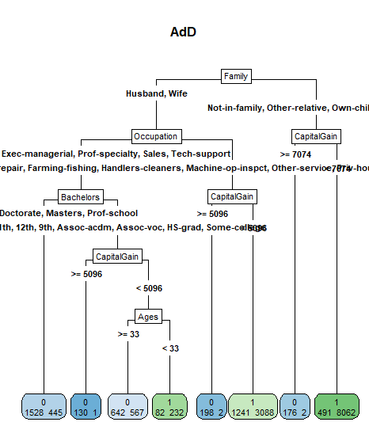
Árboles
Reference
Prediction 0 1
0 660 237
1 461 2862
Accuracy : 0.8346
Resultado menor o igual a 50mil dólares anuales: 1
Resultado mayor o igual a 50mil dólares anuales: 0

Slide 28
Muchas gracias

