Slide 1

Machine Learning
Facultatea de Inginerie Herrmann Oberth
Master-Program „Embedded Systems“
Professor: Student:
Prof. dr. ing. Volovici Daniel Stefan Feilmeier Sef l. dr. Creţulescu Radu Conf. dr. ing. Morariu Daniel
- 27.05.2014 -

Slide 2
Text classification for German and Romanian language

Slide 3
Agenda
What is text classification?
What is the general approach?
Why this project?
Generate example data
Train and test Naïve Bayes algorithm
Performance and results
Conclusions

Slide 4
1. What is text classification?

Slide 5
What is text classification?
Find out, which category a given text belongs to?
Used in
news aggregators,
libraries,
text mining,
document management,
…
Text 1
Text 2
Text 3
Category

Slide 6
2. What is the general approach?

Slide 7
What is a general approach?
Prepare text
Example:
Wikipedia article about „art“

Slide 8
What is a general approach?
Prepare text
Remove markup code and punctuation
'''Art''' is a diverse range of [[human behavior|human activities]]
Art is a diverse range of human activities

Slide 9
What is a general approach?
Prepare text
Remove markup code and punctuation
Handle each word separately
is
Art
a
diverse
of
range
human
activities

Slide 10
What is a general approach?
Prepare text
Remove markup code and punctuation
Handle each word separately
Convert to lower case
is
art
a
diverse
of
range
human
activities

Slide 11
What is a general approach?
Prepare text
Remove markup code and punctuation
Handle each word separately
Convert to lower case
Remove stop-words
is
art
a
diverse
of
range
human
activities

Slide 12
What is a general approach?
Prepare text
Remove markup code and punctuation
Handle each word separately
Convert to lower case
Remove stop-words
Apply stemming algorithm
is
art
a
diverse
of
range
human
activities

Slide 13
What is a general approach?
Prepare text
Remove markup code and punctuation
Handle each word separately
Convert to lower case
Remove stop-words
Apply stemming algorithm
Create word counter list
Word | Count
art | 1
divers | 1
range | 1
human | 1
activ | 1

Slide 14
What is a general approach?
Prepare text
Remove markup code and punctuation
Handle each word separately
Convert to lower case
Remove stop-words
Apply stemming algorithm
Create word counter list
Train text classification algorithm (Naïve Bayes)
Category: Science
systemat
science
Category: Arts
activ
divers
art

Slide 15
What is a general approach?
Prepare text
Remove markup code and punctuation
Handle each word separately
Convert to lower case
Remove stop-words
Apply stemming algorithm
Create word counter list
Train text classification algorithm (Naïve Bayes)
Apply learnt algorithm (using test data)
art
divers
activ
Category: Arts

Slide 16
3. Why this project?

Slide 17

Text classification for German and Romanian language. Why?
Based on Lab @ Dr. MORARIU:
MACHINE LEARNING – Advanced group
Topic 2: Text Document classification using Naïve Bayes
Well researched for English language, but not for German and Romanian

Slide 18
4. Generate example data

Slide 19

Generate example data: a supervised learning problem
In the Lab: Reuters dataset of English language texts
Requirements for project:
Example dataset of classified texts
Available in German and Romanian language
Similar data structure
Decent number of examples

Slide 20

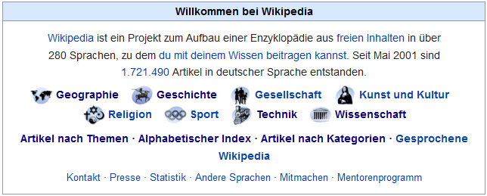
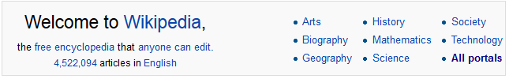
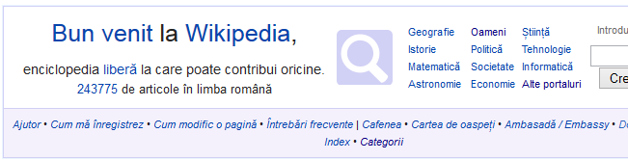
Generate example data. Idea: Wikipedia articles and categories
Example dataset of classified texts ✔
Available in German and Romanian language ✔
Similar data structure ✔
Decent number of examples ✔

Slide 21
Wikipedia dump data structure (and size)
category.sql
categorylinks.sql
pages-articles.xml
Category-id, number of pages within a category
M:N relation between categories and pages/sub-directories
XML file with page-ids and all page contents

Slide 22
Generate example data Pseudo code
Define top categories "Geographie, Geschichte, Gesellschaft,…/ Geografie, Istorie, Societate,…“
Read meta data about categories from category.sql-file
Read matching page-ids from categorylinks.sql Remove markup code and punctuation Handle each word separately Convert to lower case Remove stop-words Apply stemming algorithm Create word counter list
Write arff-file(s) Standardized format to be read by Naïve Bayes algorithm developed in Machine Learning lab

Slide 23
5. Train and test Naïve Bayes algorithm

Slide 24
Train and test Naïve Bayes algorithm Pseudo code
Read arff-files with training and testing examples
For training examples:
Apply word-counter list
Reduce features using feature selection algorithm keep only features („words“) with high „mutual information“
For testing examples:
Calculate probability for each category
Category with highest probability = prediction

Slide 25
6. Performance and results

Slide 26
Performance and results Test 1: German language
Parameters:
Categories: 6 Geographie, Geschichte, Gesellschaft, Religion, Sport, Technik
Pages per Category: 100
Training documents: 450
Testing documents: 150
Statistics
Total number of distinct words: 79.905

Slide 27
Performance and results Test 1: German language

Slide 28
Performance and results Test 2: Romanian language
Parameters:
Categories: 6 Artă, Cultură, Geografie, Istorie, Religie, Știință
Pages per Category: 100
Training documents: 450
Testing documents: 150
Statistics
Total number of distinct words: 34.538

Slide 29
Performance and results Test 2: Romanian language

Slide 30
7. Conclusions

Slide 31
Prediction Accuracy
Higher than random guessing
➔ works in principle
Still not satisfying

Slide 32
Problems with text classification approach
Ignore word position in text
Lost negations („not“) „I do not love you, I hate you“ = „I do not hate you, I love you“
Different meanings of words „Jaguar“: Car? Animal?
Stemming not perfect (➔ better: dictionary-based) In German: long, compound words („Donauschifffahrtsgesellschaft“)

Slide 33
Sources and more information
Machine Learning by Tom M. Mitchell issued on 1st March 1997, chapter 6 „Bayesian Learning“, pages 154 to 200 ISBN: 0070428077
Text classification and Naïve Bayes Paper by Cambridge University Press issued on 1st April 2009, chapter 13, pages 253 to 287 Download: http://nlp.stanford.edu/IR-book/pdf/13bayes.pdf
Snowball-Stemmer and stop-word lists OpenSource library mainly by Martin Porter and Richard Boulton Download: http://snowball.tartarus.org
Source code and this presentation https://github.com/sfeilmeier/TextClassification

Slide 34
Questions?

