Slide 1
Using Tour Length Estimators to Improve Vehicle Routing Problem Solutions
Stephen Feldman

Slide 2
Agenda
Introduction
Literature Review
Creating/Selecting Tour Length Estimators
Heuristics for Assignment-Routing Formulation
Conclusion

Slide 3

Introduction
Problem Statement
Motivation
Existing Solution Approaches?
Our Approach

Slide 4
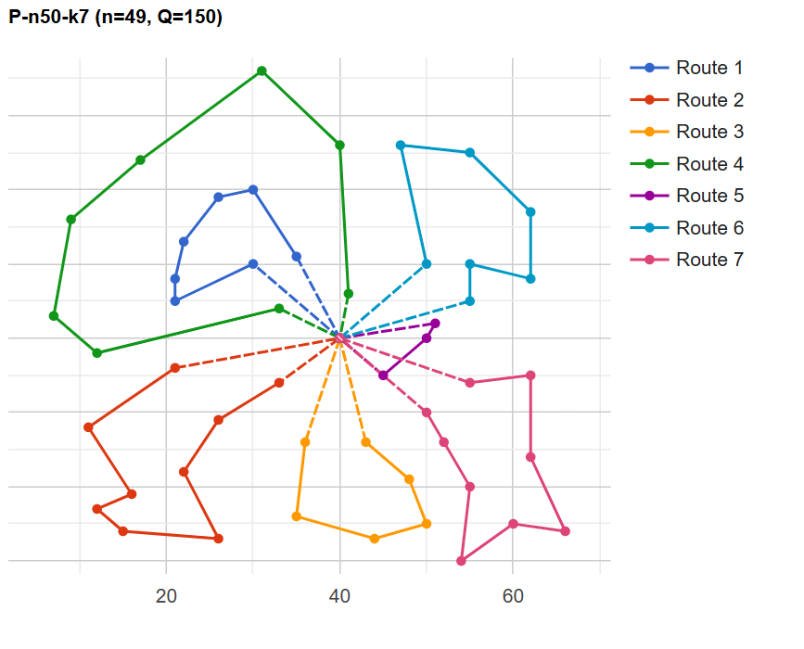
Problem Statement
Classical VRP (Euclidean Space)– Minimize total distance traveled for a homogenous fleet of vehicles of fixed capacity and each customer requiring unitary demand.
Objective: Efficiently find high quality solutions to the VRP
CVRPLIB Example Solution

Slide 5


Motivation
Practical Applications:
5 – 20% savings routinely yielded by routing optimization in supply chains
Improve customer satisfaction (ex: last mile delivery, ridesharing)
Complexity (NP-hard):
Exact methods become intractable for realistic problem sizes
Continuous development of new heuristics and metaheuristics

Slide 6
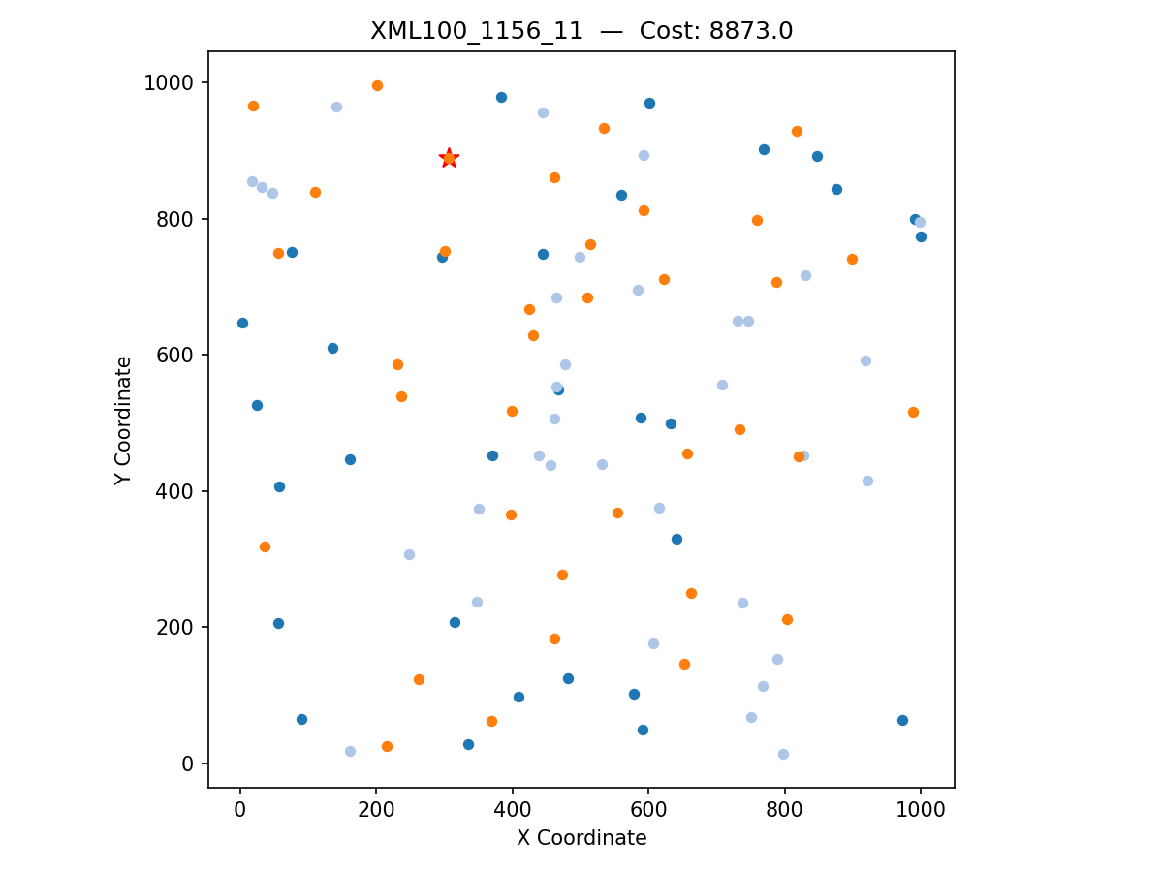
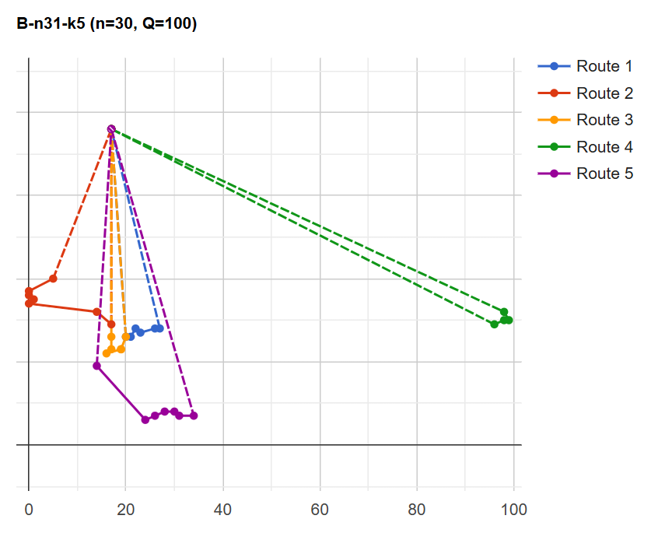
Contribution: Proof of Concept for the Assignment – Routing Formulation
Develop a proxy objective function to enable the Assignment-Routing formulation using TSP tour length estimators
Test an optimizer for the proxy objective function
1. Assign Customers to Vehicles
2.Solve for the best route in each vehicle
CVRPLIB Example Optimal Solution
XML100 Example Optimal Assignment
Notes:
Add 2-Stage mathematical formulation to slides. For contribution.
Revise images to simplify example. Fewer nodes direct relationship.

Slide 7
Literature Review
Heuristic Approaches to the VRP
Tour Length Estimation for the TSP

Slide 8
Heuristic Approaches to the VRP
Constructive Heuristics:
Clark & Wright – merges routes if doing so yields savings (cannot specify number of vehicles).
Insertion heuristics: nearest-neighbor, Regret-k.
Improvement Heuristics & Metaheuristics
Begin with feasible solution and iteratively apply ‘operators’ (moves) to improve solution.
Inter-route operators: pairwise exchange, relocate, CROSS-exchange, ejection-chain, and cycling exchanges.
Metaheuristics: Tabu Search, Large Neighborhood Search, Variable Neighborhood Search

Slide 9
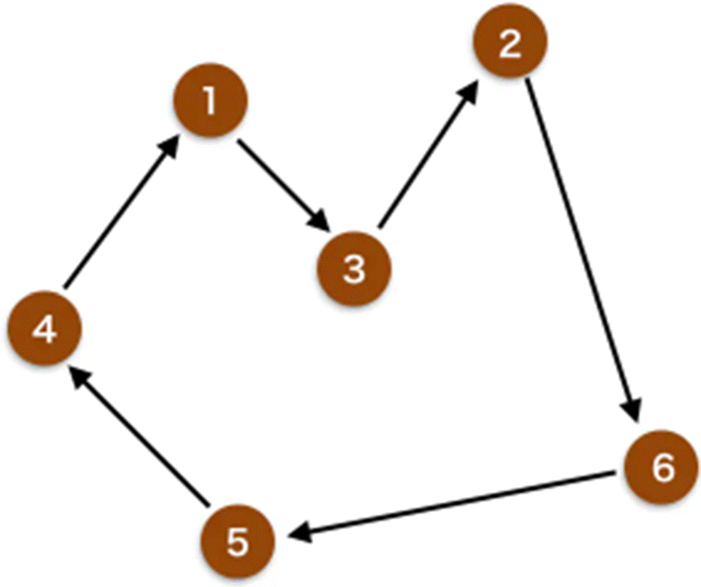
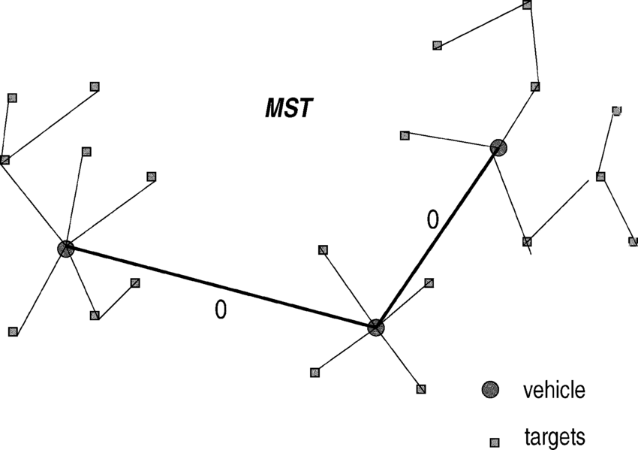
Tour Length Estimators for TSP
Simple TSP
Spatial Estimators utilize spatial properties of graph to predict tour length
Machine Learning-Based Estimators utilize graphical knowledge and features (Neural Networks common)
Minimum Spanning Tree provides tight bounds on the TSP and additional features

Slide 10
Creating/Selecting Tour Length Estimators
Available TSP Tour Length Estimators
GART – Geometrically Assisted Regression Tree
Comparative Benchmarking

Slide 11
Creating/Selecting Tour Length Estimators
Estimators Available in Literature
GART – Geometrically Assisted Regression Tree
Estimator Comparison

Slide 12
Heuristics for Assignment Routing Formulation
Simple 2-Opt Tabu Search
Multi-Campaign Search XML100 Results
Multi-Campaign Search XML1000 Results

Slide 13
Conclusion
Key Findings
Implications
Limitations and Future Research

Slide 14
Sources:

Slide 15
THANK YOU
Stephen Feldman
732-354-5379
feldms5@rpi.edu
RIN: 662047892

Slide 16
Overcoming nervousness
Confidence-building strategies

Slide 17

Engaging the audience
Make eye contact with your audience to create a sense of intimacy and involvement
Weave relatable stories into your presentation using narratives that make your message memorable and impactful
Encourage questions and provide thoughtful responses to enhance audience participation
Use live polls or surveys to gather audience opinions, promoting engagement and making sure the audience feel involved

Slide 18
Effective delivery techniques
Voice modulation is a powerful tool in public speaking. It involves varying pitch, tone, and volume to convey emotion, emphasize points, and maintain interest:
Pitch variation
Tone inflection
Volume control
Effective body language enhances your message, making it more impactful and memorable:
Meaningful eye contact
Purposeful gestures
Maintain good posture
Control your expressions

Slide 19
Navigating Q&A sessions
Maintaining composure during the Q&A session is essential for projecting confidence and authority. Consider the following tips for staying composed:
Stay calm
Actively listen
Pause and reflect
Maintain eye contact
Know your material in advance
Anticipate common questions
Rehearse your responses

Slide 20
Speaking impact
Your ability to communicate effectively will leave a lasting impact on your audience
Effectively communicating involves not only delivering a message but also resonating with the experiences, values, and emotions of those listening

Slide 21
Dynamic delivery
Learn to infuse energy into your delivery to leave a lasting impression
One of the goals of effective communication is to motivate your audience
Metric | Measurement | Target | Actual
Audience attendance | # of attendees | 150 | 120
Engagement duration | Minutes | 60 | 75
Q&A interaction | # of questions | 10 | 15
Positive feedback | Percentage (%) | 90 | 95

Slide 22
Speaking engagement metrics
Impact factor | Measurement | Target | Achieved
Audience interaction | Percentage (%) | 85 | 88
Knowledge retention | Percentage (%) | 75 | 80
Post-presentation surveys | Average rating | 4.2 | 4.5
Referral rate | Percentage (%) | 10 | 12
Collaboration opportunities | # of opportunities | 8 | 10

