Slide 1


ecs36b Spring 2020: Software Development & Object-Oriented Programming midterm
Abstraction
Encapsulation
Polymorphism
Inheritance
Dr. S. Felix Wu
sfwu@ucdavis.edu

Slide 2
Midterm

Slide 3




Slide 4
Which one should “it” hit?

Slide 5

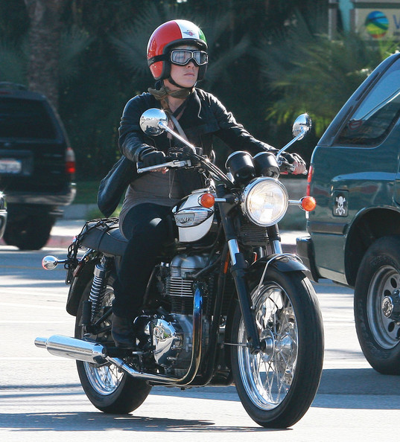

Slide 6


Slide 7
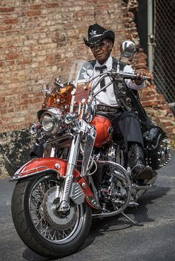

Slide 8


Slide 9
Autonomous Driving
How to define classes and objects?
And, how will objects interact with each other?

Slide 10
Inter-AV Communication
Cars talking to Motercycles

Slide 11
Inter-AV Communication
Cars talking to Motorcycles
Requirement #1: Class Hierarchy (is-a)
Auto V
Car
Motorcycle

Slide 12
Inter-AV Communication
Cars talking to Motorcycles
Requirement #2: Containment Hierarchy (has-a)
Class Motorcycle : public Auto_V
Object Person Rider;
Object Person Passenger;
Object Hybrid RobotC;
…
Methods/Interfaces

Slide 13
Inter-AV Communication
Cars talking to Motorcycles
Requirement #3: Inter-Object Communications
Motorcycle Right
Motorcycle Left
Car
Alert (…)
My Situation (…)

Slide 14
Part 2
How to communicate among the objects proactively to avoid the possible collisions in advance?

