Slide 1

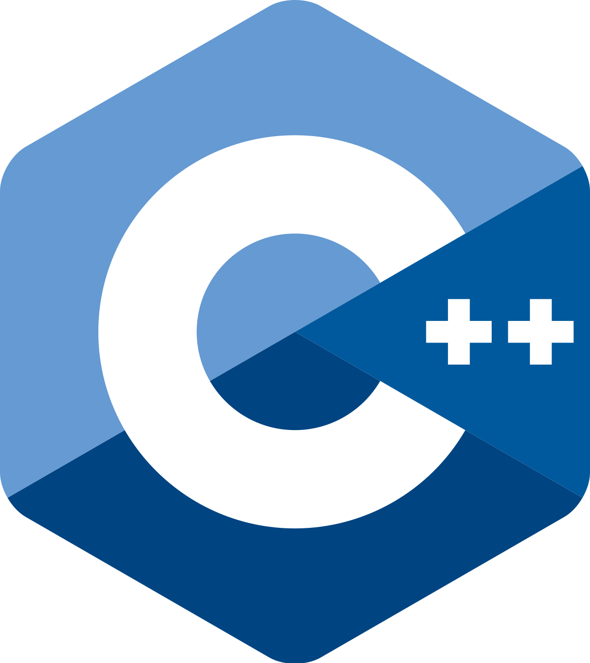
ecs36b Spring 2023: Software Development & Object-Oriented Programming #05: Inheritance and Polymorphism (5/5)
Abstraction
Encapsulation
Polymorphism
Inheritance
Dr. S. Felix Wu
sfwu@ucdavis.edu

Slide 2
Chapter 13, Inheritance Chapter 14, Polymorphism

Slide 3
Chapter 13, Inheritance Chapter 14, Polymorphism
Important topics but not covered by most textbooks
JSON Representation of Objects
(and how it might interfere with Polymorphism)
Run-time versus Compiler-Time
Memory-Layout

Slide 4
Memory Layout in C/C++
Single Inheritance ⬅
Multiple Inheritance
Virtual Inheritance
class Planet
{
public:
Planet() {}
std::string name;
double diameter;
int moons;
double orbit_time;
double rotation_time;
};
http://www.vishalchovatiya.com/memory-layout-of-cpp-object/

Slide 5
Pointers
The instructor at this point assumes that you are familiar with the concept of C pointers, which is related to (in C/C++) memory addresses, C array, unsigned long/integers, and casting.
If you are like to review these concepts, you may view the following lecture I provided a few months ago (the same link I shared via a Canvas announcement) --
https://www.youtube.com/watch?v=2rJoGp3kbnc
For our final exam (s2023), the concept covered in the above lecture will be included.

Slide 6
class Account
{
public:
Account() {}
unsigned long A1;
};
class Employee : public Account
{
public:
Employee() {}
unsigned long E1;
};
class Student : public Account
{
public:
Student() {}
unsigned long S1;
};
class Work_Study : public Employee, public Student
{
public:
Work_Study() {}
unsigned long W1;
};

Slide 7
class Account
{
public:
Account() {}
unsigned long A1;
};
class Employee : public Account
{
public:
Employee() {}
unsigned long E1;
};
class Student : public Account
{
public:
Student() {}
unsigned long S1;
};
class Work_Study : public Employee, public Student
{
public:
Work_Study() {}
unsigned long W1;
};
Account
Employee
Student
Work_Study

Slide 8
Account
Account
class Account
{
public:
Account() {}
unsigned long A1;
};
class Employee : public Account
{
public:
Employee() {}
unsigned long E1;
};
class Student : public Account
{
public:
Student() {}
unsigned long S1;
};
class Work_Study : public Employee, public Student
{
public:
Work_Study() {}
unsigned long W1;
};
Employee
Student
Work_Study
Account
Employee
Student
Work_Study

Slide 9
Multiple Inheritance
Account
Account
class Account
{
public:
Account() {}
unsigned long A1;
};
class Employee : public Account
{
public:
Employee() {}
unsigned long E1;
};
class Student : public Account
{
public:
Student() {}
unsigned long S1;
};
class Work_Study : public Employee, public Student
{
public:
Work_Study() {}
unsigned long W1;
};
Employee
Student
Work_Study
Account
Employee
Student
Work_Study

Slide 10
class Account
{
public:
Account() {}
unsigned long A1;
};
class Employee : public virtual Account
{
public:
Employee() {}
unsigned long E1;
};
class Student : public virtual Account
{
public:
Student() {}
unsigned long S1;
};
class Work_Study : public Employee, public Student
{
public:
Work_Study() {}
unsigned long W1;
};
Virtual Inheritance
Account
Employee
Student
Work_Study

Slide 11
Memory Layout in C/C++
Single Inheritance
Multiple Inheritance ⬅
Virtual Inheritance ⬅
Different Memory Layouts
class Account
{
public:
Account() {}
unsigned long A1;
};
class Employee : public virtual Account
{
public:
Employee() {}
unsigned long E1;
};
class Student : public virtual Account
{
public:
Student() {}
unsigned long S1;
};
class Work_Study : public Employee, public Student
{
public:
Work_Study() {}
unsigned long W1;
};
Account
Employee
Student
Work_Study

Slide 12
AccountE
AccountS
Employee
Student
A1
E1
A1
S1
W1
Multiple Inheritance
Work_Study
Work_Study * ws_ptr
(Employee *) ws_ptr
(Student *) ws_ptr
AccountE
Employee
AccountS
Student
Work_Study

Slide 13
Core
Thing
Core
IOT_Thing
Person
Thing
IOT_Thing

Slide 14
Memory Layout
How does an object (of a particular class), including its parents, reside in the memory when we create this object at run-time?
Core
Thing
IOT_Thing

Slide 15
*** Dumping AST Record Layout
0 | class IOT_Thing
0 | class Thing (base)
0 | class Core (base)
0 | unsigned int class_id
4 | unsigned int model
8 | unsigned int sequence_num
16 | class GPS_DD location
16 | double latitude
24 | double longitude
32 | class IP_Address connected
32 | unsigned int addr
| [sizeof=40, dsize=36, align=8,
| nvsize=36, nvalign=8]

Slide 16
*** Dumping AST Record Layout
0 | class IOT_Thing
0 | class Thing (base)
0 | class Core (base)
0 | unsigned int class_id
4 | unsigned int model
8 | unsigned int sequence_num
16 | class GPS_DD location
16 | double latitude
24 | double longitude
32 | class IP_Address connected
32 | unsigned int addr
| [sizeof=40, dsize=36, align=8,
| nvsize=36, nvalign=8]

Slide 17
*** Dumping AST Record Layout
0 | class IOT_Thing
0 | (IOT_Thing vtable pointer)
8 | class IP_Address connected
8 | unsigned int addr
48 | class Core (virtual base)
48 | unsigned int class_id
16 | class Thing (virtual base)
16 | (Thing vtable pointer)
24 | unsigned int model
28 | unsigned int sequence_num
32 | class GPS_DD location
32 | double latitude
40 | double longitude
| [sizeof=56, dsize=52, align=8,
| nvsize=12, nvalign=8]

Slide 18
*** Dumping AST Record Layout
0 | class IOT_Thing
0 | (IOT_Thing vtable pointer)
8 | class IP_Address connected
8 | unsigned int addr
48 | class Core (virtual base)
48 | unsigned int class_id
16 | class Thing (virtual base)
16 | (Thing vtable pointer)
24 | unsigned int model
28 | unsigned int sequence_num
32 | class GPS_DD location
32 | double latitude
40 | double longitude
| [sizeof=56, dsize=52, align=8,
| nvsize=12, nvalign=8]

Slide 19
*** Dumping AST Record Layout
0 | class IOT_Thing
0 | (IOT_Thing vtable pointer)
8 | class IP_Address connected
8 | unsigned int addr
48 | class Core (virtual base)
48 | (Core vtable pointer)
56 | unsigned int class_id
16 | class Thing (virtual base)
16 | (Thing vtable pointer)
24 | unsigned int model
28 | unsigned int sequence_num
32 | class GPS_DD location
32 | double latitude
40 | double longitude
| [sizeof=64, dsize=60, align=8,
| nvsize=12, nvalign=8]

Slide 20
((long) ( &((IOT_Thing *) 0)->connected ) )
0x00000000
0x00001000

Slide 21
Account
AccountE
AccountS
Employee
Student
Employee
Student
Virtual Inheritance
Multiple Inheritance
Work_Study
Work_Study
Work_Study * ws_ptr
(Employee *) ws_ptr
Lower Addresses
vTable Ptr
Work_Study * ws_ptr
(Employee *) ws_ptr
(Acc *) ((Emp *) ws)
(Student *) ws_ptr
(Acc *) ((Stu *) ws)
AccountE
Employee
(Student *) ws_ptr
Employee
vTable Ptr
AccountS
Student
Student
Work_Study
(Account *) ws_ptr
Work_Study
Account

Slide 22
Can we accomplish this with Single Inheritance?
Class Role { Student, Employee …}
Class Member
{
std::vector<Role> myRoles;
}

Slide 23
vTable Ptr
Account
Account
Employee
Employee
Student
vTable Ptr
vTable Ptr
Student
Student
Work_Study
Work_Study
Account
vTable Ptr
Employee
Account *acc_ptr;
Work_study *ws_ptr;
Account

Slide 24
Question: possible midterm
Why do we need Virtual Pointer for Virtual Inheritance?

Slide 25
Lower Addresses
Work_Study * ws_ptr
(Employee *) ws_ptr
vTable Ptr
Memory Layout for the Objects
Account
Employee
Student
Work_study
Memory address for the member variables
Employee
(Student *) ws_ptr
vTable Ptr
Student
Work_Study
(Account *) ws_ptr
5/10/23
Account

Slide 26
Memory Layout for the Objects
Account
Employee
Student
Work_study
Memory address for the member variables
Vt ptr
E1 (&(WS.E1))
Vt ptr
S1
W1
A1 (&(WS.A1)) ==
((Account *) (&WS))
Lower Addresses
Work_Study * ws_ptr
(Employee *) ws_ptr
vTable Ptr
Employee
8
(Student *) ws_ptr
vTable Ptr
Student
8
Work_Study
8
(Account *) ws_ptr
5/10/23
Account
8

Slide 27
Account
AccountE
AccountS
Employee
Student
Employee
Student
Virtual Inheritance
Multiple Inheritance
Work_Study
Work_Study
(Account *) ((Employee *) ws_ptr)
Work_Study * ws_ptr
(Employee *) ws_ptr
vTable Ptr
Work_Study * ws_ptr
(Employee *) ws_ptr
(Student *) ws_ptr
AccountE
Employee
(Student *) ws_ptr
Employee
vTable Ptr
AccountS
Student
Student
Work_Study
(Account *) ws_ptr
Work_Study
Account

Slide 28
Core
Thing
Core
IOT_Thing
Proxy_IOT_Thing
Person
Thing
Shadow_Person
IOT_Thing
Memory Layout in C/C++
Single Inheritance
Proxy_IOT_Thing

Slide 29
Midterm

Slide 30




Slide 31
Which one should “it” hit?

Slide 32

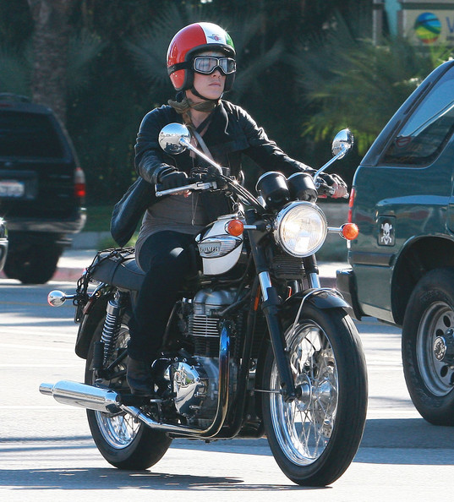

Slide 33


Slide 34


Slide 35


Slide 36
Autonomous Driving
How to define classes and objects?
And, how will objects interact with each other?

Slide 37
Inter-AV Communication
Cars talking to Motercycles

Slide 38
Inter-AV Communication
Cars talking to Motorcycles
Requirement #1: Class Hierarchy (is-a)
Auto V
Car
Motorcycle

Slide 39
Inter-AV Communication
Cars talking to Motorcycles
Requirement #2: Containment Hierarchy (has-a)
Class Motorcycle : public Auto_V
Object Person Rider;
Object Person Passenger;
Object Hybrid RobotC;
…
Methods/Interfaces

Slide 40
Inter-AV Communication
Cars talking to Motorcycles
Requirement #3: Inter-Object Communications
Motorcycle Right
Motorcycle Left
Car
Alert (…)
My Situation (…)

