Slide 1


ecs36b Spring 2020: Software Development & Object-Oriented Programming #05: Inheritance and Polymorphism (1/3)
Abstraction
Encapsulation
Polymorphism
Inheritance
Dr. S. Felix Wu
sfwu@ucdavis.edu

Slide 2
Chapter 13, Inheritance Chapter 14, Polymorphism

Slide 3







// Box.h
class Box {
private:
…
public:
mb_func(…);
};
// Box.cpp
#include “Box.h”
Box::mb_func(…)
{
// implementation
…
}
class Box;
class Person;
g++ -std=c++17 -c Box.cpp
digital twin
object Box
Box.o
Object-
Oriented
Modeling
compiler
linker
executable
main.o
g++ -std=c++17 -c main.cpp
// main.cpp
#include “Box.h”
int
main (…)
{
Box firstBox {…};
…
}
a complex system

Slide 4
class Box;
class Person;
Object-
Oriented
Modeling
a complex system
10/10/22
ecs36b, Spring 2020

Slide 5
class Box
{
protected:
double length {1.0};
double width {1.0};
double height {1.0};
public:
// Constructors
Box(double lv, double wv, double hv) : length {lv}, width {wv}, height {hv}
{ std::cout << "Box(double, double, double) called.\n"; }
Box(double side) : Box {side, side, side} {std::cout << "Box(double) called.\n";}
Box() { std::cout << "Box() called.\n"; } // No-arg constructor
double volume() const { return length*width*height; }
double getLength() const { return length; }
double getWidth() const { return width; }
double getHeight() const { return height; }
};
class Box
inherit/is-a
Carton is a Box
class Carton : public Box
{
private:
std::string material {"Cardboard"};
public:
Carton(double lv, double wv, double hv, const std::string desc)
: Box {lv, wv, hv}, material {desc}
{ std::cout << "Carton(double,double,double,std::string) called.\n"; }
Carton(const std::string desc) : material {desc}
{ std::cout << "Carton(string) called.\n"; }
…
};
class Carton

Slide 6
class Box
{
protected:
double length {1.0};
double width {1.0};
double height {1.0};
public:
// Constructors
Box(double lv, double wv, double hv) : length {lv}, width {wv}, height {hv}
{ std::cout << "Box(double, double, double) called.\n"; }
Box(double side) : Box {side, side, side} {std::cout << "Box(double) called.\n";}
Box() { std::cout << "Box() called.\n"; } // No-arg constructor
double volume() const { return length*width*height; }
double getLength() const { return length; }
double getWidth() const { return width; }
double getHeight() const { return height; }
};
Base class
inherit/is-a
class Carton : public Box
{
private:
std::string material {"Cardboard"};
public:
Carton(double lv, double wv, double hv, const std::string desc)
: Box {lv, wv, hv}, material {desc}
{ std::cout << "Carton(double,double,double,std::string) called.\n"; }
Carton(const std::string desc) : material {desc}
{ std::cout << "Carton(string) called.\n"; }
…
};
Derived class

Slide 7
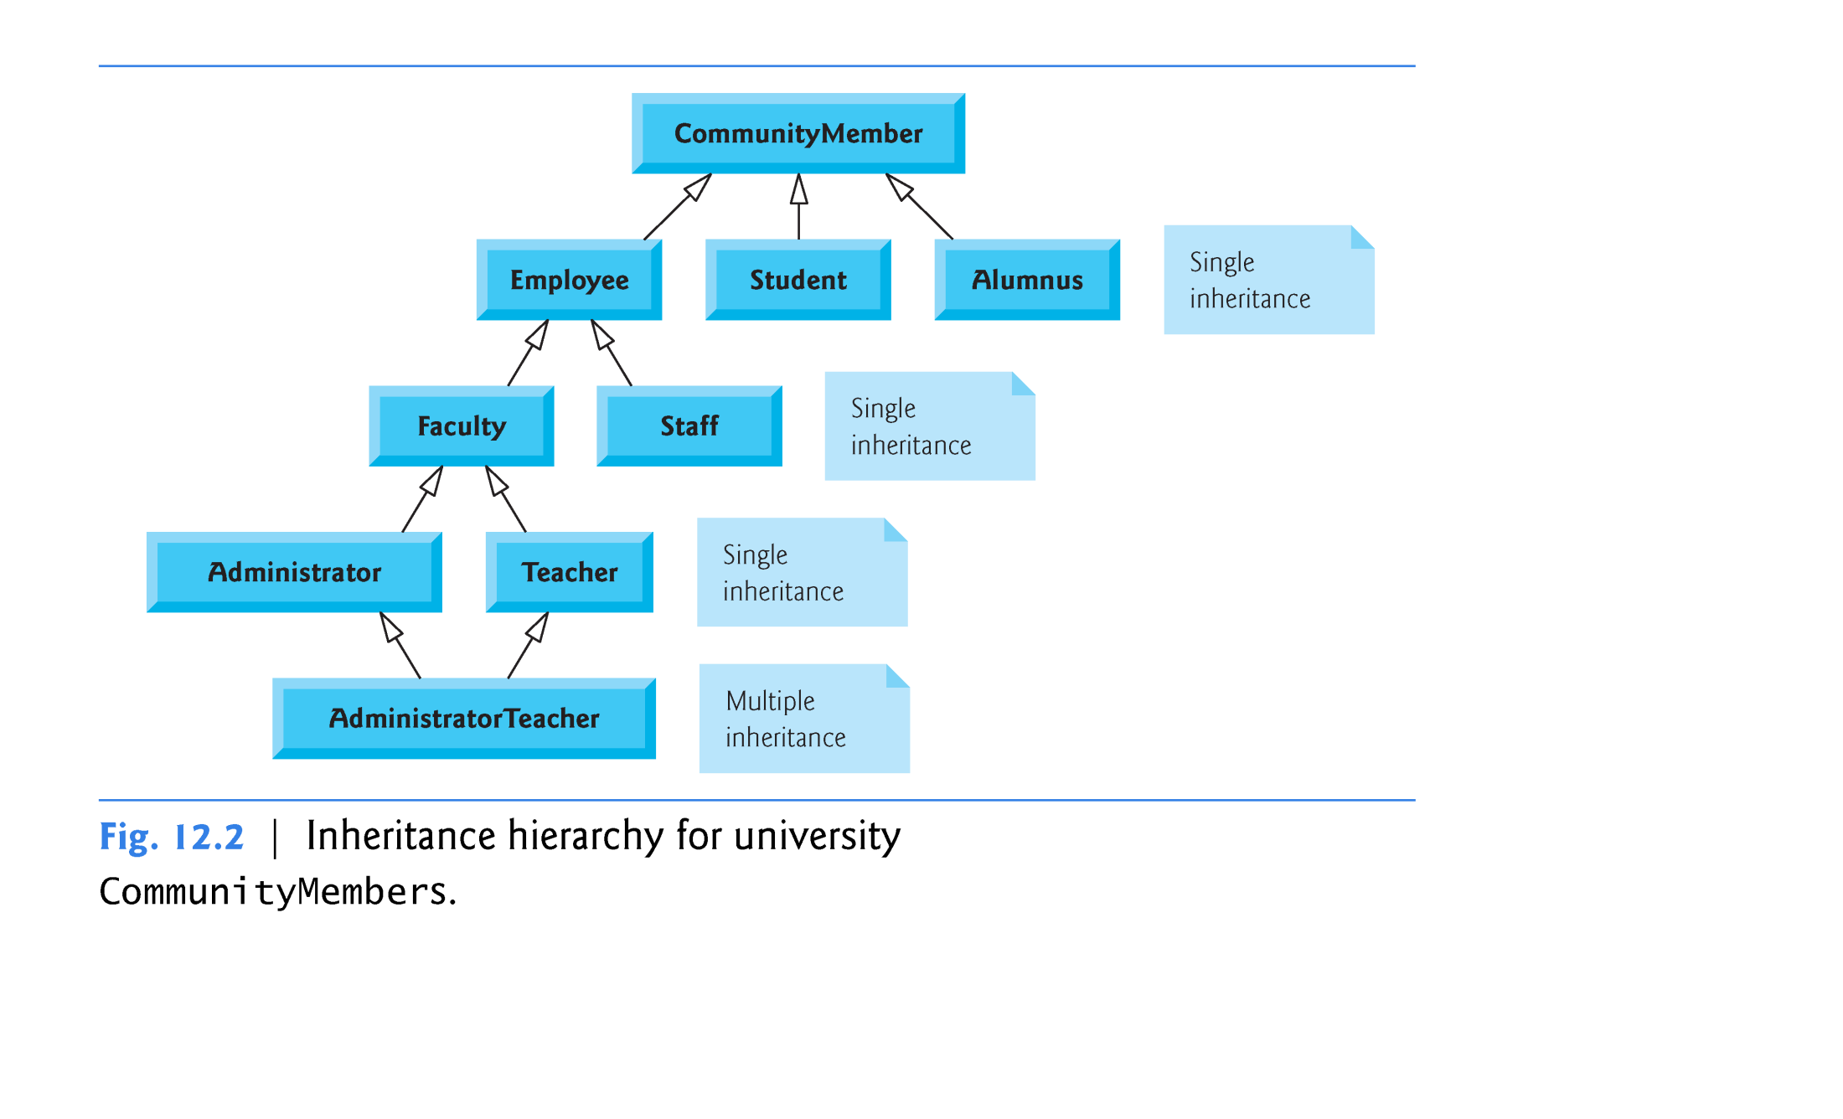

Slide 8
Base class
Capture the Relationships
inherit/is-a
Reusability and Extensibility
for OOSD
Derived class

Slide 9
https://isocpp.org/wiki/faq/strange-inheritance
Base class
Capture the Relationships
inherit/is-a
Reusability and Extensibility
for OOSD
Derived class
How to define/create a Derived class and its objects?
How to access the Parent class from the Derived?
How to interface with objects under the Class hierarchy?

Slide 10
Constructor
Base
Constructor
Derived

Slide 11


class Parent/Base
{
private:
protected:
public:
};
Constructor
Base
“public”
“private”
“protected”
class Child/Derived
{
private:
public:
};
Constructor
Derived
{…}
“private”

Slide 12
class Base
{
private:
protected:
public:
};
Constructor
Base
“public”
“private”
“protected”
class Derived : <mode> Base
{
private:
protected:
public:
};
Constructor
Derived
{…}
modes:
public prot → prot, pub → pub
protected prot, pub → prot
private prot, pub → priv
“private”

Slide 13
Who are you, really?
You are both the Base and the Derived, aren’t you?
Then, do you want to be seen/treated as a pure Base or a Derived?
And, how can such multiple views of you be managed or controlled?
Constructor
Base
Constructor
Derived

Slide 14
class Transaction
{
private:
static unsigned int transaction_count;
unsigned int tr_type;
std::string tr_description;
unsigned int tr_status;
time_t tr_when;
protected:
Person tr_agent;
GPS_DD tr_where;
IP_Address tr_srcIP;
void *tr_data;
public:
Transaction(unsigned int _tr_type, std::string _desc,
Person& _agent, GPS_DD& _where, IP_Address& _src, time_t _when) :
tr_type { _tr_type }, tr_description { _desc }, tr_agent { _agent },
tr_where { _where }, tr_srcIP { _src }, tr_when { _when } { }
void setData(void *);
void *getData();
virtual std::string getDescription();
};

Slide 15
class Flight: public Transaction
{
private:
static unsigned int fl_count;
Person fl_passenger;
Airline fl_airline;
public:
Flight(unsigned int _tr_type, std::string _desc, Person& _agent,
GPS_DD& _where, IP_Address& _src, time_t _when, Person& _passenger,
Airline& _airline, std::string _ticket) : Transaction { _tr_type,
_desc, _agent, _where, _src, _when }, fl_passenger { _passenger },
fl_airline { _airline }, fl_ticket_number { _ticket } { }
double getDistance();
bool Conflict_of_Interest()
{ return (this->tr_agent == this->fl_passenger); }
std::string fl_ticket_number;
virtual std::string getDescription() { return "Flying"; }
};

Slide 16
Person p1 {"Lion King", "123456789123456789"};
Person p2 {”Nemo", "223456789123456789"};
Transaction f1 {TR_TYPE_FLIGHT, "desc", p1, gps_Davis, IP_Davis,
time(NULL)};
Flight f2 {TR_TYPE_FLIGHT, "desc", p1, gps_Davis, IP_Davis,
time(NULL), p2, United, "1234567890"};
Flight f3 {TR_TYPE_FLIGHT, "desc", p1, gps_Davis, IP_Davis,
time(NULL), p1, United, "9999999999"};
std::cout << flight_one.getDescription() << std::endl;
std::cout << flight_two.getDescription() << std::endl;
std::cout << ((Transaction&) flight_two).getDescription() << std::endl;
if (f3.Conflict_of_Interest())
std::cout << "CoI for " << f2.fl_ticket_number << std::endl;

Slide 17
Who are you, really?
You are both the Base and the Derived, aren’t you?
Then, do you want to be seen/treated as a pure Base or a Derived?
And, how can such multiple views of you be managed or controlled?
Constructor
Base
getDescript
Constructor
Derived
getDescript
Virtual Function, the power of Polymorphism in C++

Slide 18
https://isocpp.org/wiki/faq/strange-inheritance
Base class
Capture the Relationships
inherit/is-a
Reusability and Extensibility
for OOSD
Derived class
How to define/create a Derived class and its objects?
How to access the Parent class from the Derived?
How to interface with objects under the Class hierarchy?

Slide 19
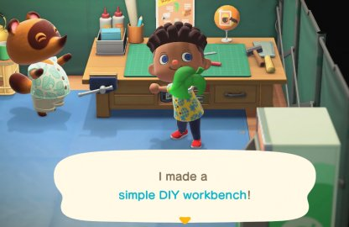
https://isocpp.org/wiki/faq/strange-inheritance
Base class
inherit/is-a
program in ecs36b running!!
Derived class
How to define/create a Derived class and its objects?
How to access the Parent class from the Derived?
How to interface with objects under the Class hierarchy?

