Slide 1


ecs36b Spring 2020: Software Development & Object-Oriented Programming #05: Inheritance and Polymorphism (1/3)
Abstraction
Encapsulation
Polymorphism
Inheritance
Dr. S. Felix Wu
sfwu@ucdavis.edu

Slide 2
Chapter 13, Inheritance Chapter 14, Polymorphism

Slide 3







// Box.h
class Box {
private:
…
public:
mb_func(…);
};
// Box.cpp
#include “Box.h”
Box::mb_func(…)
{
// implementation
…
}
class Box;
class Person;
g++ -std=c++17 -c Box.cpp
digital twin
object Box
Box.o
Object-
Oriented
Modeling
compiler
linker
executable
main.o
g++ -std=c++17 -c main.cpp
// main.cpp
#include “Box.h”
int
main (…)
{
Box firstBox {…};
…
}
a complex system

Slide 4
class Box;
class Person;
Object-
Oriented
Modeling
a complex system
10/19/22
ecs36b, Spring 2020

Slide 5
class Box
{
protected:
double length {1.0};
double width {1.0};
double height {1.0};
public:
// Constructors
Box(double lv, double wv, double hv) : length {lv}, width {wv}, height {hv}
{ std::cout << "Box(double, double, double) called.\n"; }
Box(double side) : Box {side, side, side} {std::cout << "Box(double) called.\n";}
Box() { std::cout << "Box() called.\n"; } // No-arg constructor
double volume() const { return length*width*height; }
double getLength() const { return length; }
double getWidth() const { return width; }
double getHeight() const { return height; }
};
class Box
inherit/is-a
Carton is a Box
class Carton : public Box
{
private:
std::string material {"Cardboard"};
public:
Carton(double lv, double wv, double hv, const std::string desc)
: Box {lv, wv, hv}, material {desc}
{ std::cout << "Carton(double,double,double,std::string) called.\n"; }
Carton(const std::string desc) : material {desc}
{ std::cout << "Carton(string) called.\n"; }
…
};
class Carton

Slide 6
class Box
{
protected:
double length {1.0};
double width {1.0};
double height {1.0};
public:
// Constructors
Box(double lv, double wv, double hv) : length {lv}, width {wv}, height {hv}
{ std::cout << "Box(double, double, double) called.\n"; }
Box(double side) : Box {side, side, side} {std::cout << "Box(double) called.\n";}
Box() { std::cout << "Box() called.\n"; } // No-arg constructor
double volume() const { return length*width*height; }
double getLength() const { return length; }
double getWidth() const { return width; }
double getHeight() const { return height; }
};
Base class
inherit/is-a
class Carton : public Box
{
private:
std::string material {"Cardboard"};
public:
Carton(double lv, double wv, double hv, const std::string desc)
: Box {lv, wv, hv}, material {desc}
{ std::cout << "Carton(double,double,double,std::string) called.\n"; }
Carton(const std::string desc) : material {desc}
{ std::cout << "Carton(string) called.\n"; }
…
};
Derived class

Slide 7
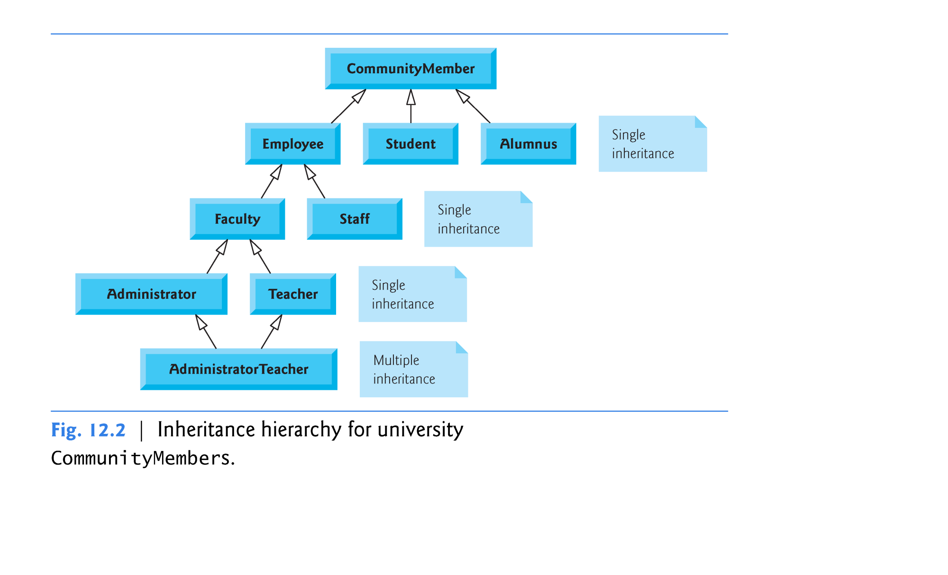

Slide 8
Base class
Capture the Relationships
inherit/is-a
Reusability and Extensibility
for OOSD
Derived class

Slide 9
https://isocpp.org/wiki/faq/strange-inheritance
Base class
Capture the Relationships
inherit/is-a
Reusability and Extensibility
for OOSD
Derived class
How to define/create a Derived class and its objects?
How to access the Parent class from the Derived?
How to interface with objects under the Class hierarchy?

Slide 10
Constructor
Base
Constructor
Derived

Slide 11


class Parent/Base
{
private:
protected:
public:
};
Constructor
Base
“public”
“private”
“protected”
class Child/Derived
{
private:
public:
};
Constructor
Derived
{…}
“private”

Slide 12
class Base
{
private:
protected:
public:
};
Constructor
Base
“public”
“private”
“protected”
class Derived : <mode> Base
{
private:
protected:
public:
};
Constructor
Derived
{…}
modes:
public prot → prot, pub → pub
protected prot, pub → prot
private prot, pub → priv
“private”

Slide 13
Constructor
Base
Who are you, really?
You are both the Base and the Derived, aren’t you?
Then, do you want to be seen/treated as a pure Base or a Derived?
And, how can such multiple views of you be managed or controlled?
Constructor
Derived

Slide 14
class Transaction
{
private:
static unsigned int transaction_count;
unsigned int tr_type;
std::string tr_description;
unsigned int tr_status;
time_t tr_when;
protected:
Person tr_agent;
GPS_DD tr_where;
IP_Address tr_srcIP;
void *tr_data;
public:
Transaction(unsigned int _tr_type, std::string _desc,
Person& _agent, GPS_DD& _where, IP_Address& _src, time_t _when) :
tr_type { _tr_type }, tr_description { _desc }, tr_agent { _agent },
tr_where { _where }, tr_srcIP { _src }, tr_when { _when } { }
void setData(void *);
void *getData();
virtual std::string getDescription();
};

Slide 15
class Flight: public Transaction
{
private:
static unsigned int fl_count;
Person fl_passenger;
Airline fl_airline;
public:
Flight(unsigned int _tr_type, std::string _desc, Person& _agent,
GPS_DD& _where, IP_Address& _src, time_t _when, Person& _passenger,
Airline& _airline, std::string _ticket) : Transaction { _tr_type,
_desc, _agent, _where, _src, _when }, fl_passenger { _passenger },
fl_airline { _airline }, fl_ticket_number { _ticket } { }
double getDistance();
bool Conflict_of_Interest()
{ return (this->tr_agent == this->fl_passenger); }
std::string fl_ticket_number;
virtual std::string getDescription() { return "Flying"; }
};

Slide 16
Person p1 {"Lion King", "123456789123456789"};
Person p2 {”Nemo", "223456789123456789"};
Transaction f1 {TR_TYPE_FLIGHT, "desc", p1, gps_Davis, IP_Davis,
time(NULL)};
Flight f2 {TR_TYPE_FLIGHT, "desc", p1, gps_Davis, IP_Davis,
time(NULL), p2, United, "1234567890"};
Flight f3 {TR_TYPE_FLIGHT, "desc", p1, gps_Davis, IP_Davis,
time(NULL), p1, United, "9999999999"};
std::cout << flight_one.getDescription() << std::endl;
std::cout << flight_two.getDescription() << std::endl;
std::cout << ((Transaction&) flight_two).getDescription() << std::endl;
if (f3.Conflict_of_Interest())
std::cout << "CoI for " << f2.fl_ticket_number << std::endl;

Slide 17
Who are you, really?
You are both the Base and the Derived, aren’t you?
Then, do you want to be seen/treated as a pure Base or a Derived?
And, how can such multiple views of you be managed or controlled?
Constructor
Base
getDescript
Constructor
Derived
getDescript
Virtual Function, the power of Polymorphism in C++

Slide 18
https://isocpp.org/wiki/faq/strange-inheritance
Base class
Capture the Relationships
inherit/is-a
Reusability and Extensibility
for OOSD
Derived class
How to define/create a Derived class and its objects?
How to access the Parent class from the Derived?
How to interface with objects under the Class hierarchy?

Slide 19
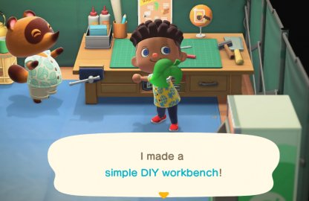
https://isocpp.org/wiki/faq/strange-inheritance
Base class
inherit/is-a
program in ecs36b running!!
Derived class
How to define/create a Derived class and its objects?
How to access the Parent class from the Derived?
How to interface with objects under the Class hierarchy?

Slide 20
Base class
inherit/is-a
Derived class

Slide 21
member function foo(…)
Base class
virtual member function foo(…)
How to specify a virtual member function?
What is the difference?
inherit/is-a
member function foo(…)
Derived class
virtual member function foo(…)

Slide 22
void foo(void);
member function foo(…)
class myBase
inherit/is-a
member function foo(…)
class myDeriv

Slide 23
void foo(void);
member function foo(…)
class myBase
myBase obj1;
myDeriv obj2;
obj1.foo();
obj2.foo();
((myBase&) obj2).foo();
Which foo( ) will be invoked?
inherit/is-a
member function foo(…)
class myDeriv

Slide 24
void foo(void);
member function foo(…)
class myBase
myBase obj1;
myDeriv obj2;
obj1.foo();
obj2.foo();
((myBase&) obj2).foo();
inherit/is-a
member function foo(…)
class myDeriv

Slide 25
virtual void foo(void);
virtual member function foo(…)
class myBase
myBase obj1;
myDeriv obj2;
obj1.foo();
obj2.foo();
((myBase&) obj2).foo();
Which foo( ) will be invoked?
inherit/is-a
virtual member function foo(…)
class myDeriv

Slide 26
virtual void foo(void);
virtual member function foo(…)
class myBase
myBase obj1;
myDeriv obj2;
obj1.foo();
obj2.foo();
((myBase&) obj2).foo();
inherit/is-a
virtual member function foo(…)
class myDeriv
void myDeriv::foo(void) { … }

Slide 27
myBase obj1;
myDeriv obj2; ➔ 0x71141346
obj1.foo();
obj2.foo();
((myBase&) obj2).foo();
myBase *obj3_ptr = (myBase *) 0x71141346;
(*obj3_ptr).foo();

Slide 28
void foo(void);
member function foo(…)
class myBase
myBase obj1;
myDeriv obj2;
obj1.foo();
obj2.foo();
((myBase&) obj2).foo();
inherit/is-a
member function foo(…)
class myDeriv
The reference class type of the object at the time of the call!!

Slide 29
virtual void foo(void);
virtual member function foo(…)
class myBase
myBase obj1;
myDeriv obj2;
obj1.foo();
obj2.foo();
((myBase&) obj2).foo();
inherit/is-a
virtual member function foo(…)
class myDeriv
The reference class type of the object at the time of the creation !!

Slide 30
member function foo(…)
Base class
virtual member function foo(…)
inherit/is-a
reference class membership at the time of call
member function foo(…)
Derived class
virtual member function foo(…)
original class membership at the time of creation

Slide 31
virtual member function dump2JSON( )
Thing
Thing.h/cpp
Thing t1;
IOT_Thing t2;
IOT_Thing t3;
Thing& something_object;
something_object.dump2JSON();
inherit/is-a
virtual member function dump2JSON ( )
IOT_Thing
IOT_Thing.h/cpp

Slide 32
Chapter 13, Inheritance Chapter 14, Polymorphism
Chapter 6, Pointers & References

Slide 33
Warning!!
The following 20+ slides might be the hardest or the 2nd hardest content of ecs36b!!!
The other hard concept is Proxy Object

Slide 34
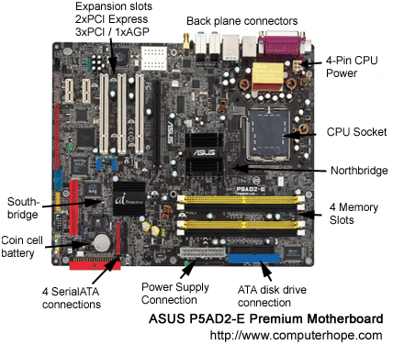
Do I need to know exactly where to store/save the variable?

Slide 35
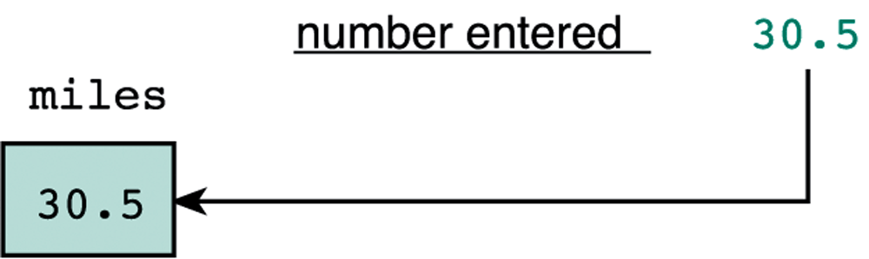
“Address”
Linguistics in C/C++
Where is THIS really located on my device?
Then, we need a way to represent “address”!

Slide 36
scanf(“%lf”, &miles);
“Format String” -- I am going to take a Long Float # (double) from the stdin (Standard Input device)”

Slide 37
“Address”
32 bits or 64 bits address
01101001 10110001 11100000 10100111
0x69b1e0a7

Slide 38
scanf(“%lf”, &miles);
0x 7014ae00
0x 7014ae01
0x 7014ae02
0x 7014ae03
0x 7014ae04
0x 7014ae05
0x 7014ae06
0x 7014ae07
8 bytes
scanf(“%lf”, 0x7014ae00);

Slide 39
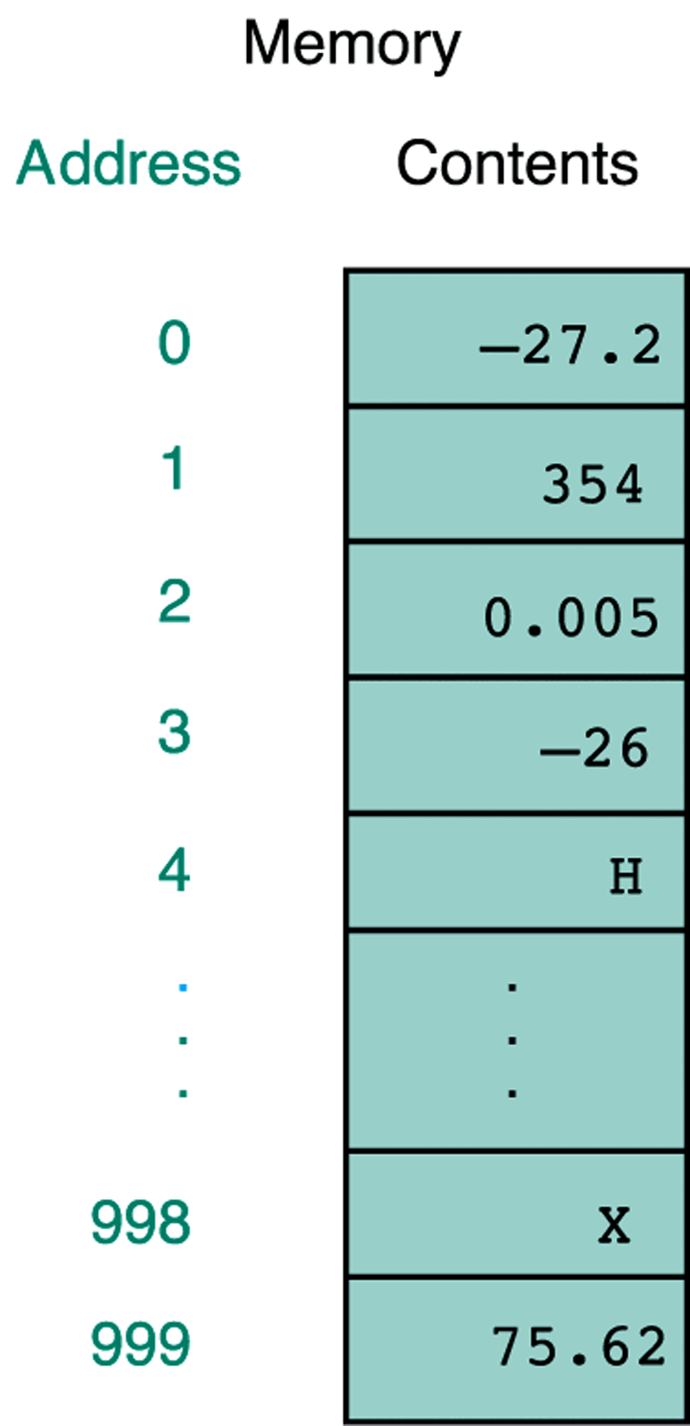
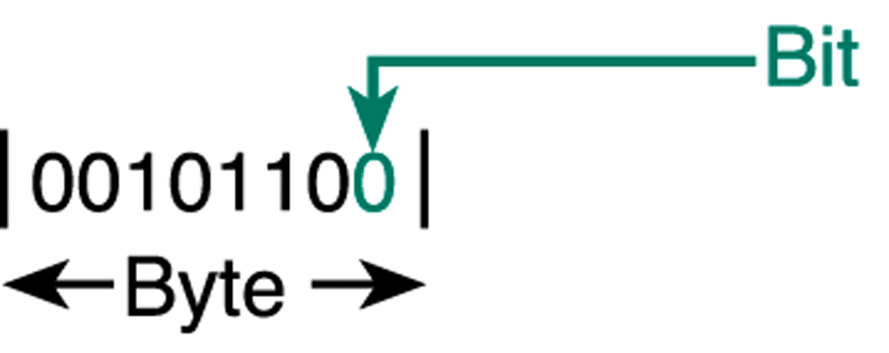
“Memory Box”
Each “address-able” box is ONE Byte
1 byte = 8 bits
1 bit is 0 or 1
Binary representation

Slide 40
Basic data types
/* an example program for the sizeof operator in C */
#include <stdio.h>
int
main(void)
{
printf("The size of an integer is %d.\n", sizeof(int));
printf("The size of a float is %d.\n", sizeof(float));
printf("The size of a double is %d.\n", sizeof(double));
printf("The size of a character is %d.\n", sizeof(char));
}
Output:
The size of an integer is 4.
The size of a float is 4.
The size of a double is 8.
The size of a character is 1.

Slide 41
“Memory Box”
00000000
00000000
00000000
00000001
00000000
12312345
01236712
12190562
Each “address-able” box is ONE Byte
1 byte = 8 bits
1 bit is 0 or 1
Binary representation

Slide 42
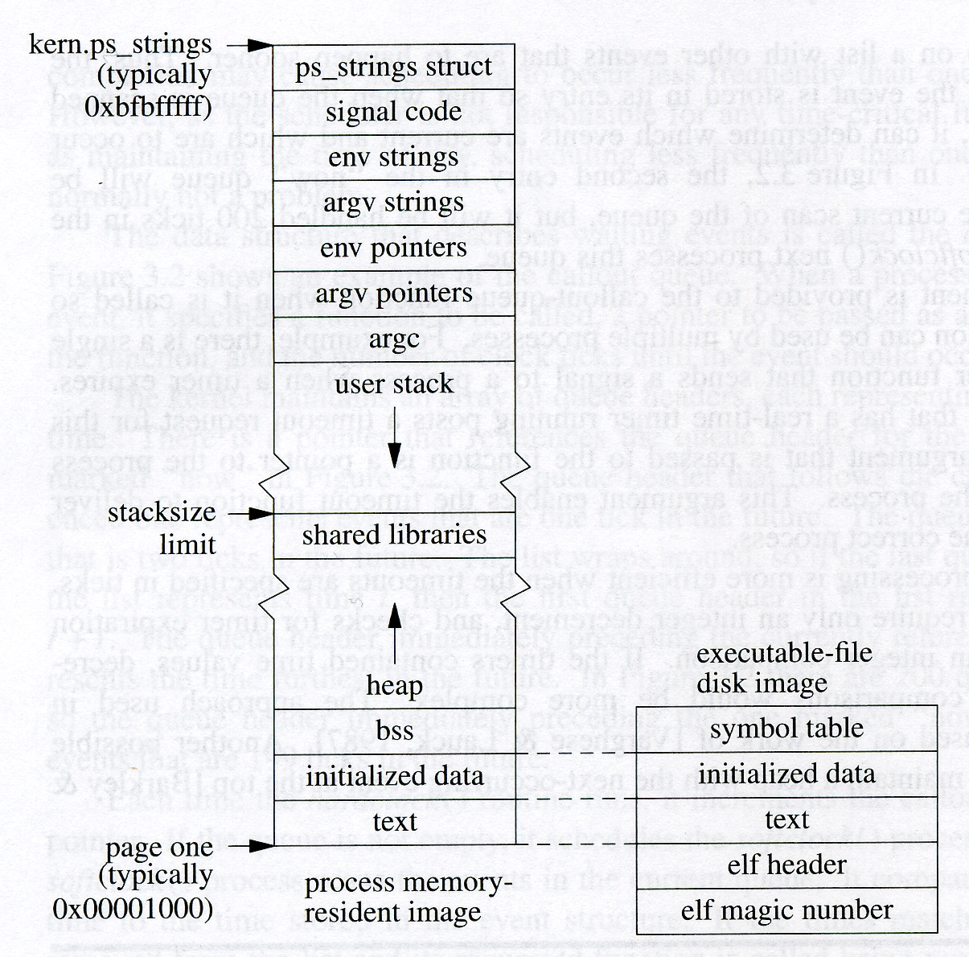
Memory Cell Layout
main
scan_address
scanf
malloc/free
new/delete
a.out

Slide 43
<type> * <variable name>;
I declare a variable xp such that xp is an address containing a type-T object.
int x; // declaration of an integer x
int * xp; // declaration of a pointer
xp = &x; // assign address to the pointer
&xp == 0x34ef5d00
34ef5f12
0x34ef5d00
xp
xp = &x;
&x == 0x34ef5f12
T(int) = 222
0x34ef5f12
x
x == 222
*xp == 222

Slide 44
int num3D[8][6][4];
struct chess_board piece[8][8];

Slide 45
Declare the array
<type> <array_name>[size]([]…[]);
Access the array
<array_name>[index] ([]…[])
Memory Cell models for the array
(low level implementation)
*(num+i) == num[i]
m[x][y] ~ *(m + x*columns + y)

Slide 46
0,0
0,1
0,2
0,3
char m[4][4];
1,0
1,1
1,2
1,3
void
printMatrix
(char m[][4])
{
m[2][1]
…
}
2,0
2,1
2,2
2,3
3,0
3,1
3,2
3,3
m == &(m[0][0])
“Cache miss”
m[x][y] ~ *((char *) m + x*columns + y)
0,0
0,1
0,2
0,3
1,0
1,1
1,2
1,3
2,0
2,1
2,2
2,3
3,0
3,1
3,2
3,3
How many rows I should skip?

Slide 47
0,0
0,1
0,2
0,3
char m[4][4];
1,0
1,1
1,2
1,3
void
printMatrix
(char m[][4])
{
m[2][1]
…
}
2,0
2,1
2,2
2,3
3,0
3,1
3,2
3,3
m == &(m[0][0])
&(m[x][y]) ~ ((char *) m + x*columns + y)
0,0
0,1
0,2
0,3
1,0
1,1
1,2
1,3
2,0
2,1
2,2
2,3
3,0
3,1
3,2
3,3
How many rows I should skip?

Slide 48
m[x][y] ~ *((char *) m + x*columns + y)
((int) m) + ((x*columns) + y) * sizeof(char)
m[x][y] ~ *((int *) m + x*columns + y)
((int) m) + ((x*columns) + y) * sizeof(int)

Slide 49
#define MSize 2048
void copyij(long int src[MSize][MSize],
long int dst[MSize][MSize])
{
long int i,j;
for (i = 0; i < MSize; i++)
for (j = 0; j < MSize; j++)
dst[i][j] = src[i][j];
}
void copyji(long int src[MSize][MSize],
long int dst[MSize][MSize])
{
long int i,j;
for (j = 0; j < MSize; j++)
for (i = 0; i < MSize; i++)
dst[i][j] = src[i][j];
}
0,0
0,1
0,2
0,3
1,0
1,1
1,2
1,3
2,0
2,1
2,2
2,3
3,0
3,1
3,2
3,3
m == &(m[0][0])
0,0
0,1
0,2
0,3
1,0
1,1
1,2
1,3
2,0
2,1
2,2
2,3
3,0
3,1
3,2
3,3

Slide 50
Memory Cell Model
With different data types
Address &x
Pointer xp
Array x_array[]

Slide 51
malloc & free
malloc:
Input: the size of the memory cells
return: the address of the first memory cell
#include <stdlib.h>
void *xp;
xp = malloc(sizeof(planet_t));

Slide 52
malloc & free
** Chapter 6: C++ smart pointers **
malloc:
Input: the size of the memory cells
return: the address of the first memory cell
#include <stdlib.h>
void *xp;
xp = malloc(sizeof(planet_t));

Slide 53
#define STRSIZ 10
typedef struct {
char name[STRSIZ]; // 10
double diameter; // 8
int moons; // 4
double orbit_time, // 8
rotation_time; // 8
} planet_t; // 38 ➔ 40

Slide 54
#define STRSIZ 10
typedef struct {
char name[STRSIZ]; // 10
double diameter; // 8
int moons; // 4
double orbit_time, // 8
rotation_time; // 8
} planet_t; // 38 ➔ 40
planet_t *ptp;
ptp = (planet_t *) malloc(sizeof(planet_t));

Slide 55
I386 architecture
typedef struct {
char name[10];
double diameter;
int moons;
double orbit_time,
rotation_time;
} planet_t;

Slide 56
Memory Layout in C/C++
Single Inheritance ⬅
Multiple Inheritance
Virtual Inheritance
class Planet
{
public:
Planet() {}
std::string name;
double diameter;
int moons;
double orbit_time;
double rotation_time;
};
http://www.vishalchovatiya.com/memory-layout-of-cpp-object/

Slide 57
Core
Thing
Core
IOT_Thing
Proxy_IOT_Thing
Person
Thing
Shadow_Person
IOT_Thing
Proxy_IOT_Thing

Slide 58
class Account
{
public:
Account() {}
unsigned long A1;
};
class Employee : public Account
{
public:
Employee() {}
unsigned long E1;
};
class Student : public Account
{
public:
Student() {}
unsigned long S1;
};
class Work_Study : public Employee, public Student
{
public:
Work_Study() {}
unsigned long W1;
};

Slide 59
class Account
{
public:
Account() {}
unsigned long A1;
};
class Employee : public Account
{
public:
Employee() {}
unsigned long E1;
};
class Student : public Account
{
public:
Student() {}
unsigned long S1;
};
class Work_Study : public Employee, public Student
{
public:
Work_Study() {}
unsigned long W1;
};
Account
Employee
Student
Work_Study

Slide 60
Account
Account
class Account
{
public:
Account() {}
unsigned long A1;
};
class Employee : public Account
{
public:
Employee() {}
unsigned long E1;
};
class Student : public Account
{
public:
Student() {}
unsigned long S1;
};
class Work_Study : public Employee, public Student
{
public:
Work_Study() {}
unsigned long W1;
};
Employee
Student
Work_Study
Account
Employee
Student
Work_Study

Slide 61
Multiple Inheritance
Account
Account
class Account
{
public:
Account() {}
unsigned long A1;
};
class Employee : public Account
{
public:
Employee() {}
unsigned long E1;
};
class Student : public Account
{
public:
Student() {}
unsigned long S1;
};
class Work_Study : public Employee, public Student
{
public:
Work_Study() {}
unsigned long W1;
};
Employee
Student
Work_Study
Account
Employee
Student
Work_Study

Slide 62
class Account
{
public:
Account() {}
unsigned long A1;
};
class Employee : public virtual Account
{
public:
Employee() {}
unsigned long E1;
};
class Student : public virtual Account
{
public:
Student() {}
unsigned long S1;
};
class Work_Study : public Employee, public Student
{
public:
Work_Study() {}
unsigned long W1;
};
Virtual Inheritance
Account
Employee
Student
Work_Study

Slide 63
Memory Layout in C/C++
Single Inheritance
Multiple Inheritance ⬅
Virtual Inheritance ⬅
Different Memory Layouts
class Account
{
public:
Account() {}
unsigned long A1;
};
class Employee : public virtual Account
{
public:
Employee() {}
unsigned long E1;
};
class Student : public virtual Account
{
public:
Student() {}
unsigned long S1;
};
class Work_Study : public Employee, public Student
{
public:
Work_Study() {}
unsigned long W1;
};
Account
Employee
Student
Work_Study

Slide 64
AccountE
AccountS
Employee
Student
A1
E1
A1
S1
W1
Multiple Inheritance
Work_Study
Work_Study * ws_ptr
(Employee *) ws_ptr
(Student *) ws_ptr
AccountE
Employee
AccountS
Student
Work_Study

Slide 65
Work_Study Obj_WS;
(Employee *)(&Obj_WS)
Work_Study Obj_WS2;
Work_Study *obj_ptr = &Obj_WS;
&(Obj_WS.w1)
&(obj_ptr->w1)
Obj_WS2.w1
Obj_WS.w1 == this->w1
std::cout << Obj_WS.w1;

Slide 66
Account
AccountE
AccountS
Employee
Student
Employee
Student
Virtual Inheritance
Multiple Inheritance
Work_Study
Work_Study
Work_Study * ws_ptr
(Employee *) ws_ptr
Lower Addresses
vTable Ptr
Work_Study * ws_ptr
(Employee *) ws_ptr
(Acc *) ((Emp *) ws)
(Student *) ws_ptr
(Acc *) ((Stu *) ws)
AccountE
Employee
(Student *) ws_ptr
Employee
vTable Ptr
AccountS
Student
Student
Work_Study
(Account *) ws_ptr
Work_Study
Account

Slide 67
vTable Ptr
Account
Account
Employee
Employee
Student
vTable Ptr
vTable Ptr
Student
Student
Work_Study
Work_Study
Account
vTable Ptr
Employee
Account *acc_ptr;
Work_study *ws_ptr;
Account

Slide 68
Question: possible midterm
Why do we need Virtual Pointer for Virtual Inheritance?

Slide 69
Lower Addresses
Work_Study * ws_ptr
(Employee *) ws_ptr
vTable Ptr
Memory Layout for the Objects
Account
Employee
Student
Work_study
Memory address for the member variables
Employee
(Student *) ws_ptr
vTable Ptr
Student
Work_Study
(Account *) ws_ptr
10/19/22
Account

Slide 70
Memory Layout for the Objects
Account
Employee
Student
Work_study
Memory address for the member variables
Vt ptr
E1 (&(WS.E1))
Vt ptr
S1
W1
A1 (&(WS.A1)) ==
((Account *) (&WS))
Lower Addresses
Work_Study * ws_ptr
(Employee *) ws_ptr
vTable Ptr
Employee
8
(Student *) ws_ptr
vTable Ptr
Student
8
Work_Study
8
(Account *) ws_ptr
10/19/22
Account
8

Slide 71
Account
AccountE
AccountS
Employee
Student
Employee
Student
Virtual Inheritance
Multiple Inheritance
Work_Study
Work_Study
(Account *) ((Employee *) ws_ptr)
Work_Study * ws_ptr
(Employee *) ws_ptr
vTable Ptr
Work_Study * ws_ptr
(Employee *) ws_ptr
(Student *) ws_ptr
AccountE
Employee
(Student *) ws_ptr
Employee
vTable Ptr
AccountS
Student
Student
Work_Study
(Account *) ws_ptr
Work_Study
Account

Slide 72
Core
Thing
Core
IOT_Thing
Proxy_IOT_Thing
Person
Thing
Shadow_Person
IOT_Thing
Memory Layout in C/C++
Single Inheritance
Proxy_IOT_Thing

Slide 73
Midterm

Slide 74
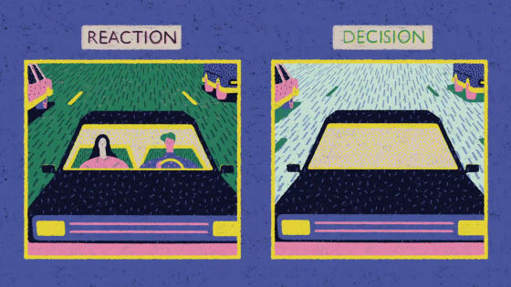



Slide 75
Which one should “it” hit?

Slide 76

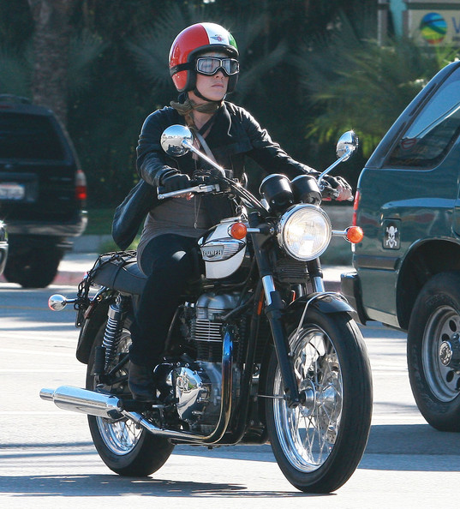

Slide 77


Slide 78


Slide 79


Slide 80
Autonomous Driving
How to define classes and objects?
And, how will objects interact with each other?

Slide 81
Inter-AV Communication
Cars talking to Motercycles

Slide 82
Inter-AV Communication
Cars talking to Motorcycles
Requirement #1: Class Hierarchy (is-a)
Auto V
Car
Motorcycle

Slide 83
Inter-AV Communication
Cars talking to Motorcycles
Requirement #2: Containment Hierarchy (has-a)
Class Motorcycle : public Auto_V
Object Person Rider;
Object Person Passenger;
Object Hybrid RobotC;
…
Methods/Interfaces

Slide 84
Inter-AV Communication
Cars talking to Motorcycles
Requirement #3: Inter-Object Communications
Motorcycle Right
Motorcycle Left
Car
Alert (…)
My Situation (…)

