Slide 1


ecs36b Spring 2020: Software Development & Object-Oriented Programming midterm
Abstraction
Encapsulation
Polymorphism
Inheritance
Dr. S. Felix Wu
sfwu@ucdavis.edu

Slide 2
Midterm

Slide 3




Slide 4
Which one should “it” hit?

Slide 5

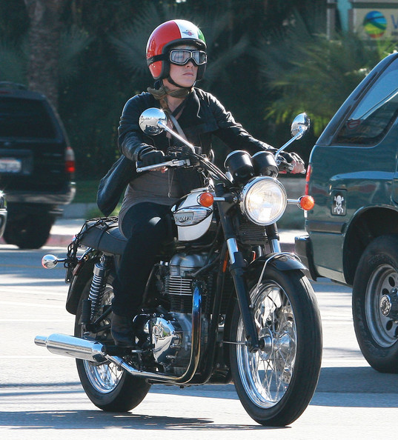

Slide 6


Slide 7
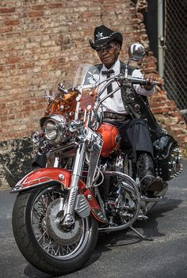

Slide 8


Slide 9
Autonomous Driving
How to define classes and objects?
And, how will objects interact with each other?

Slide 10
Inter-AV Communication
Cars talking to Motercycles

Slide 11
Inter-AV Communication
Cars talking to Motorcycles
Requirement #1: Class Hierarchy (is-a)
Auto V
Person
Car
Motorcycle

Slide 12
Inter-AV Communication
Cars talking to Motorcycles
Requirement #2: Containment Hierarchy (has-a)
Class Motorcycle : public Auto_V
Person& Rider;
Person& Passenger;
Hybrid& RobotC;
…
Methods/Interfaces

Slide 13
Inter-AV Communication
Cars talking to Motorcycles
Requirement #3: Inter-Object Communications
Motorcycle Right
Motorcycle Left
Car
Alert (…)
My Situation (…)

Slide 14
Motorcycle ml
Car me
Motorcycle mr
Alert (…)
My Situation (…)
Decide(ml)
notify (…)

Slide 15
Part 2
How to communicate among the objects proactively to avoid the possible collisions in advance?

