Slide 1


ecs36b Fall 2022: Software Development & Object-Oriented Programming #07: Smart Pointer and Pure Virtual
Abstraction
Encapsulation
Polymorphism
Inheritance
Dr. S. Felix Wu
sfwu@ucdavis.edu

Slide 2
Chapter 13, Inheritance Chapter 14, Polymorphism
Chapter 5, Arrays & Loops
Chapter 6, Pointers & References

Slide 3
Pointers
Address, Pointer, Reference, and Array
Casting
Memory Layout
malloc/free, new/delete (⬅ tracking)
Segmentation Fault
Syntax, Run-time, Logical errors

Slide 4
Smart Pointers
Unique Pointer
Shared Pointer
Weak Pointer

Slide 5
Raw Pointers
&xp == 0x34ef5d00
34ef5f12
0x34ef5d00
xp
xp = &x;
&x == 0x34ef5f12
T(int) = 222
0x34ef5f12
x
x == 222
*xp == 222

Slide 6
Smart Pointers
std::unique_ptr<int> xp = {new int {222}};
Unique Pointer
Shared Pointer
Weak Pointer
1
&xp == 0x34ef5d00
34ef5f12
0x34ef5d00
xp
xp = &x;
&x == 0x34ef5f12
T(int) = 222
0x34ef5f12
x
x == 222
*xp == 222

Slide 7
#include <memory>
#include <iostream>
int
main(void)
{
std::unique_ptr<int> xp { new int {222} };
std::cout << xp << std::endl;
std::cout << &xp << std::endl;
return 0;
}
(base) ecs36b sfwu$ g++ -std=c++17 smart_ptr.cpp
(base) ecs36b sfwu$ ./a.out
0x7fb0d0c00680
0x7ffeecd809d0

Slide 8
Smart Pointers
std::shared_ptr<int> xp = {new int {222}};
Unique Pointer
Shared Pointer
Weak Pointer
+1
&xp == 0x34ef5d00
34ef5f12
0x34ef5d00
xp
xp = &x;
+1
&x == 0x34ef5f12
T(int) = 222
0x34ef5f12
x
x == 222
*xp == 222
Reference_Count

Slide 9
#include <memory>
#include <iostream>
int
main(void)
{
std::shared_ptr<int> xp { new int {222} };
std::cout << xp << std::endl;
std::cout << &xp << std::endl;
std::shared_ptr<int> xp2 = xp;
std::cout << xp2 << std::endl;
std::cout << &xp2 << std::endl;
return 0;
}
0x7ff736400680
0x7ffee896c9c8
0x7ff736400680
0x7ffee896c9a0

Slide 10
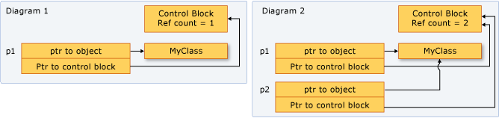
Reference Count
Source –
https://docs.microsoft.com/en-us/cpp/cpp/how-to-create-and-use-shared-ptr-instances?view=vs-2019

Slide 11
#include <memory>
#include <iostream>
int
main(void)
{
std::shared_ptr<int> xp { new int {222} };
std::cout << xp << std::endl;
std::cout << &xp << std::endl;
std::cout << xp.use_count() << std::endl;
std::shared_ptr<int> xp2 = xp;
std::cout << xp2 << std::endl;
std::cout << &xp2 << std::endl;
std::cout << xp.use_count() << std::endl;
std::cout << xp2.use_count() << std::endl;
return 0;
}

Slide 12
Smart Pointers
std::weak_ptr<int> xp = {new int {222}};
Unique Pointer
Shared Pointer
Weak Pointer
+1
&xp == 0x34ef5d00
34ef5f12
0x34ef5d00
xp
xp = &x;
+1
&x == 0x34ef5f12
T(int) = 222
0x34ef5f12
x
x == 222
*xp == 222
Reference_Count

Slide 13
std::shared_ptr<int> xp { new int {222} };
std::cout << xp.use_count() << std::endl;
std::shared_ptr<int> xp2 = xp;
std::cout << xp2 << std::endl;
std::cout << &xp2 << std::endl;
std::cout << xp.use_count() << std::endl;
std::cout << xp2.use_count() << std::endl;
std::weak_ptr<int> wxp = xp;
std::cout << xp.use_count() << std::endl;
std::cout << xp2.use_count() << std::endl;
std::cout << wxp.use_count() << std::endl;
xp = nullptr;
std::cout << xp.use_count() << std::endl;
std::cout << xp2.use_count() << std::endl;
std::cout << wxp.use_count() << std::endl;

Slide 14
Account
AccountE
AccountS
Employee
Student
Employee
Student
Virtual Inheritance
Multiple Inheritance
Work_Study
Work_Study
Work_Study * ws_ptr
(Employee *) ws_ptr
vTable Ptr
Work_Study * ws_ptr
(Employee *) ws_ptr
(Student *) ws_ptr
AccountE
Employee
(Student *) ws_ptr
Employee
vTable Ptr
AccountS
Student
Student
Work_Study
(Account *) ws_ptr
Work_Study
Account

Slide 15
WS_Ptr
E_WS_ptr
A_E_WS_ptr
Work_Study * ws_ptr
(Employee *) ws_ptr
(Student *) ws_ptr
AccountE
E_A1
E1
S_A1
S1
W1
Employee
AccountS
S_WS_ptr
A_S_WS_ptr
Student
Work_Study
15

Slide 16
WS_Ptr
E_WS_ptr
Work_Study * ws_ptr
(Employee *) ws_ptr
E1
S1
W1
A1
vTable Ptr
S_WS_ptr
Employee
(Student *) ws_ptr
vTable Ptr
Student
Acc_WS_ptr
Work_Study
(Account *) ws_ptr
11/18/22
Account

Slide 17
Account
AccountE
AccountS
Employee
Student
Employee
Student
Virtual Inheritance
Multiple Inheritance
Work_Study
Work_Study
Members AS1, AE1, S1, E1, W1
Work_Study * ws_ptr
(Employee *) ws_ptr
vTable Ptr
a8
Work_Study * ws_ptr
(Employee *) ws_ptr
(Student *) ws_ptr
AccountE
Employee
(Student *) ws_ptr
Employee
vTable Ptr
b8
AccountS
Student
Student
Work_Study
(Account *) ws_ptr
Work_Study
Account

Slide 18
Pure Virtual Functions
Abstract Class
No implementation of Virtual Functions
Only at the Derived Class
Just the Interface
Not to be instantiated

Slide 19
// Vessel.h Abstract class defining a vessel
#ifndef VESSEL_H
#define VESSEL_H
class Vessel
{
public:
virtual double volume() = 0;
};
#endif

Slide 20
// Box.h
#ifndef BOX_H
#define BOX_H
#include "vessel.h"
class Box : public Vessel
{
protected:
double length {1.0};
double width {1.0};
double height {1.0};
public:
Box(double lv, double wv, double hv)
: length {lv}, width {wv}, height {hv} { }
virtual double volume() { return length*width*height; }
};
#endif

Slide 21
// Box.h
#ifndef BOX_H
#define BOX_H
#include "vessel.h"
class Box : public Vessel
{
protected:
double length {1.0};
double width {1.0};
double height {1.0};
public:
Box(double lv, double wv, double hv)
: length {lv}, width {wv}, height {hv} { }
virtual double volume() { return length*width*height; }
};
#endif
Vessel
virtual double volume( ) = 0;
Box
virtual double volume( );

Slide 22
// Box.h
#ifndef BOX_H
#define BOX_H
#include "vessel.h"
class Box : public Vessel
{
protected:
double length {1.0};
double width {1.0};
double height {1.0};
public:
Box(double lv, double wv, double hv)
: length {lv}, width {wv}, height {hv} { }
// virtual double volume() { return length*width*height; }
};
#endif
Vessel
virtual double volume( ) = 0;
Box
virtual double volume( );

Slide 23
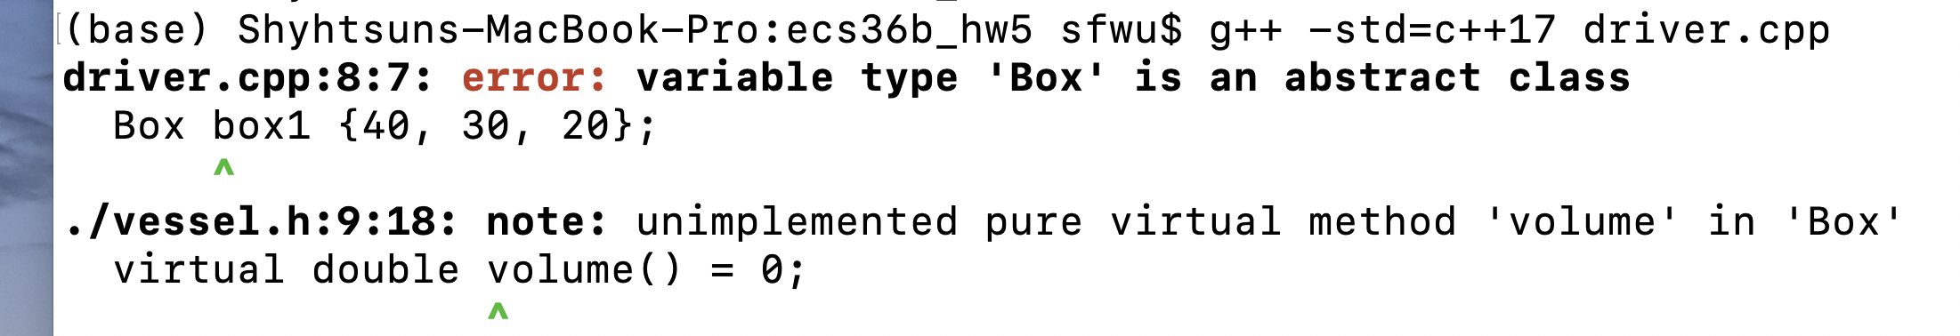

Slide 24
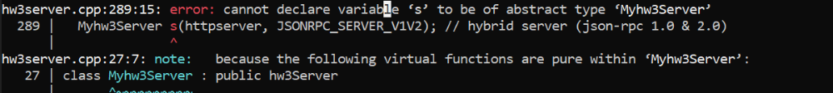

Slide 25
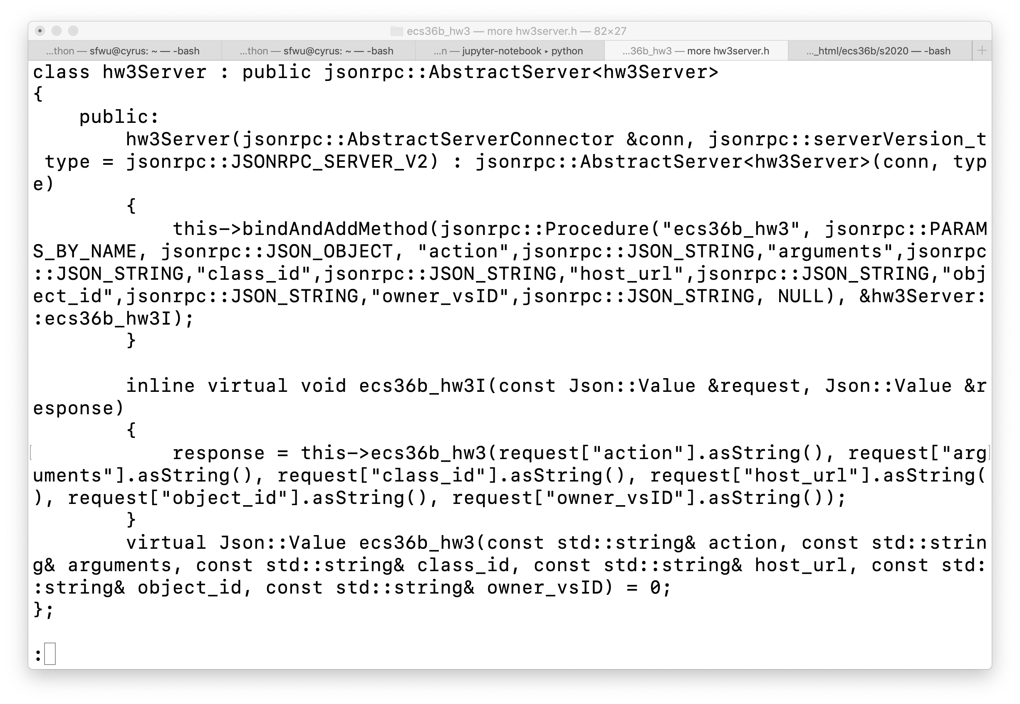

Slide 26
class Myhw3Server : public hw3Server
{
public:
Myhw3Server(AbstractServerConnector &connector,
serverVersion_t type);
virtual Json::Value ecs36b_hw3(const std::string& action,
const std::string& arguments,
const std::string& class_id,
const std::string& host_url,
const std::string& object_id,
const std::string& owner_vsID);
};

Slide 27
Pure Virtual Functions
Abstract Class
No implementation of Virtual Functions
Only at the Derived Class
Just the Interface
Not to be instantiated

Slide 28
Compiler
Does/should Compiler know where (i.e., the entrance point as an address) is the function to call?

Slide 29
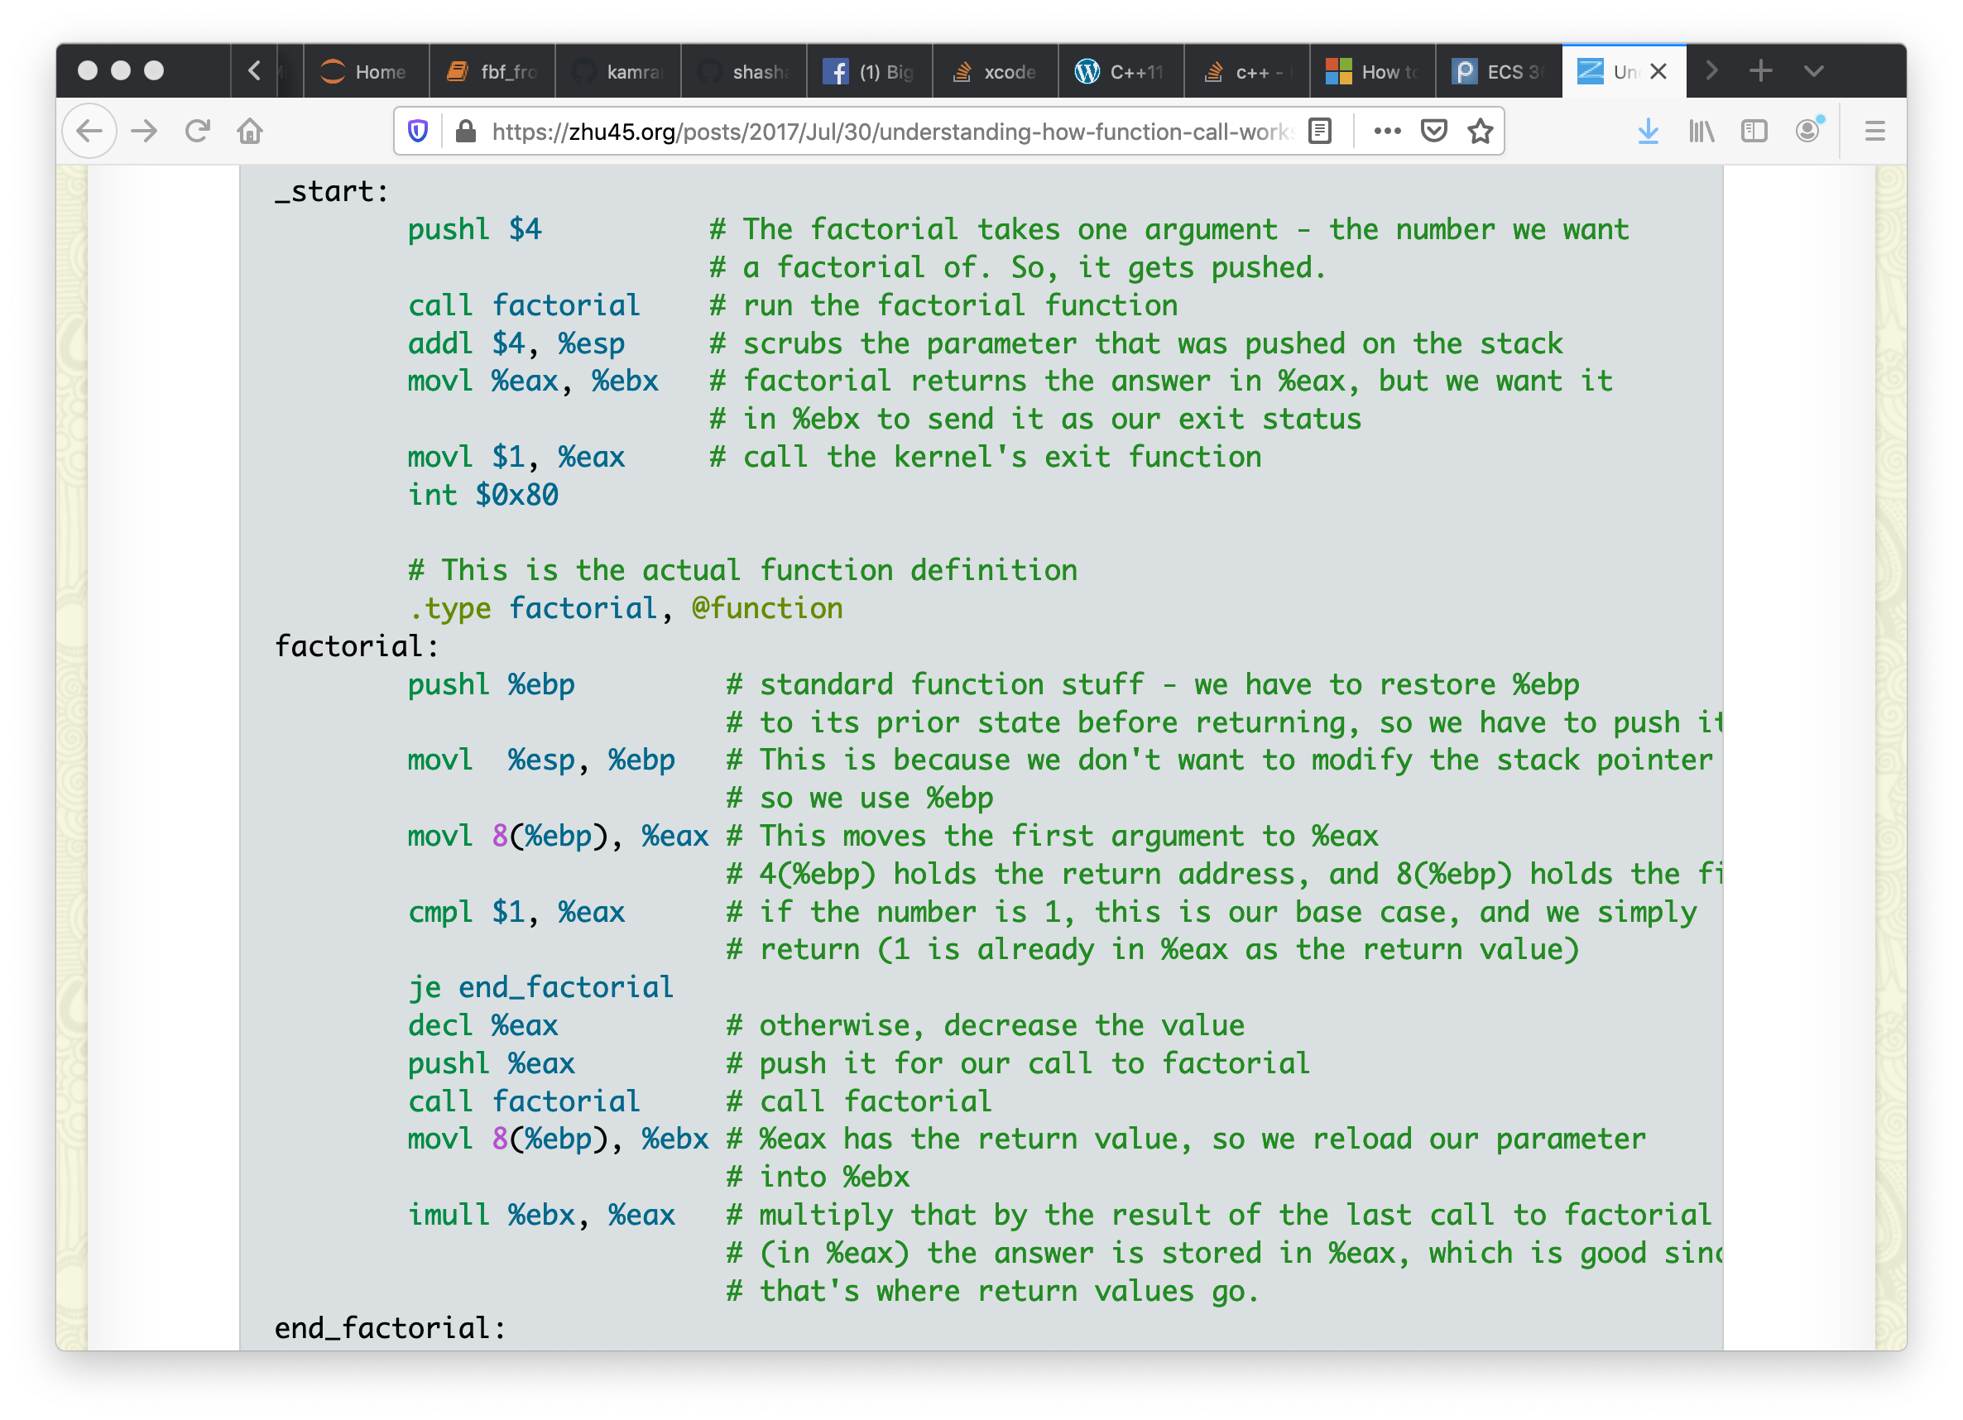
Code Generation

Slide 30
Code Generation

Slide 31
Core
0x34ef5d00
← sp_ptr
Person
std::string host_url;
std::string owner_vsID;
std::string class_id;
std::string object_id;
Core
Shadow_Person
virtual bool operator==(Person&);
virtual str::string getVsID();
Person
server
Transaction
std::string vsID;
virtual double getDistance();
virtual bool Conflict_of_Interest();
virtual bool operator==(Person&);
virtual str::string getVsID();
client
Flight
Shadow_Person
server
call operatorEqEq(…)
call this→callMethod(…)
virtual double getDistance();
virtual bool Conflict_of_Interest();
call getVsID(…)
call this→callMethod(…)
Shadow_Flight
client

Slide 32
Compiler
Does/should Compiler know where (i.e., the entrance point as an address) is the function to call?
Not for Polymorphism/VFs because a (Person&) could really be (Shadow_Person&) due to casting.

Slide 33
Account
Account
Account
Employee
Student
Employee
Student
Student
Employee
Virtual Inheritance
Work_Study
Pointer to vTable for the “Original” class
Work_Study * ws_ptr
(Employee *) ws_ptr
vTable Ptr
Employee
[ 0] 0x10f2f4048
[ 1] 0x2
[ 2] 0x10f2f4060
[ 3] 0x3
[ 4] 0x1
[ 5] 0x5
(Student *) ws_ptr
vTable Ptr
Student
Work_Study
(Account *) ws_ptr
11/18/22
Account

Slide 34
https://thispointer.com/how-virtual-functions-works-internally-using-vtable-and-vpointer/
for every object of a class that has a vTable associated with it, contains a vPointer in first 4 bytes. This vPointer points to the vTable of that class.
Steps are as follows,
vpointer hidden in first 4 bytes of the object will be fetched
vTable of this class is accessed through the fetched vPointer
Now from the vTable corresponding function’s address will be fetched
Function will be executed from that function pointer

Slide 35
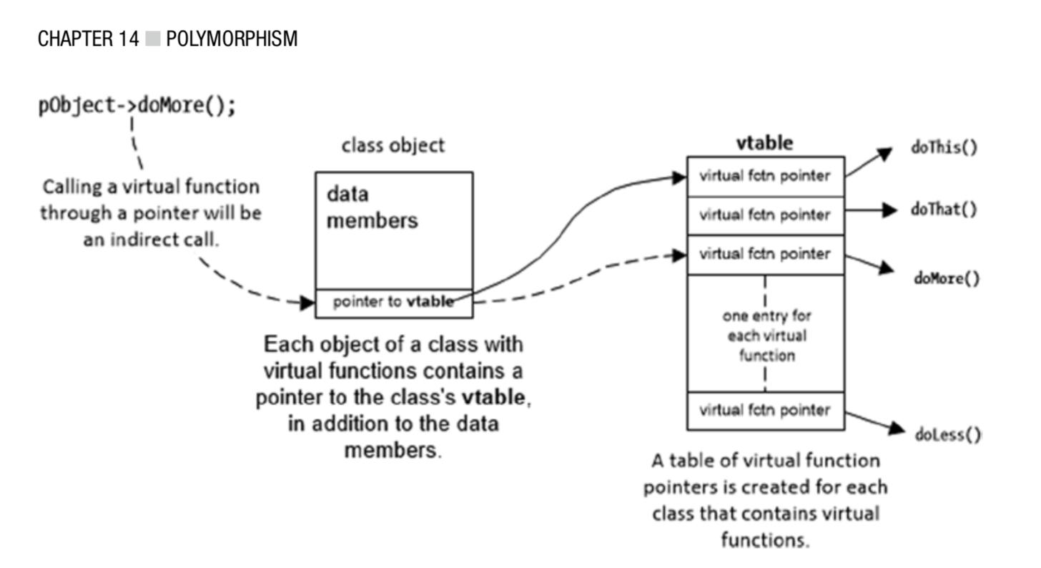

Slide 36
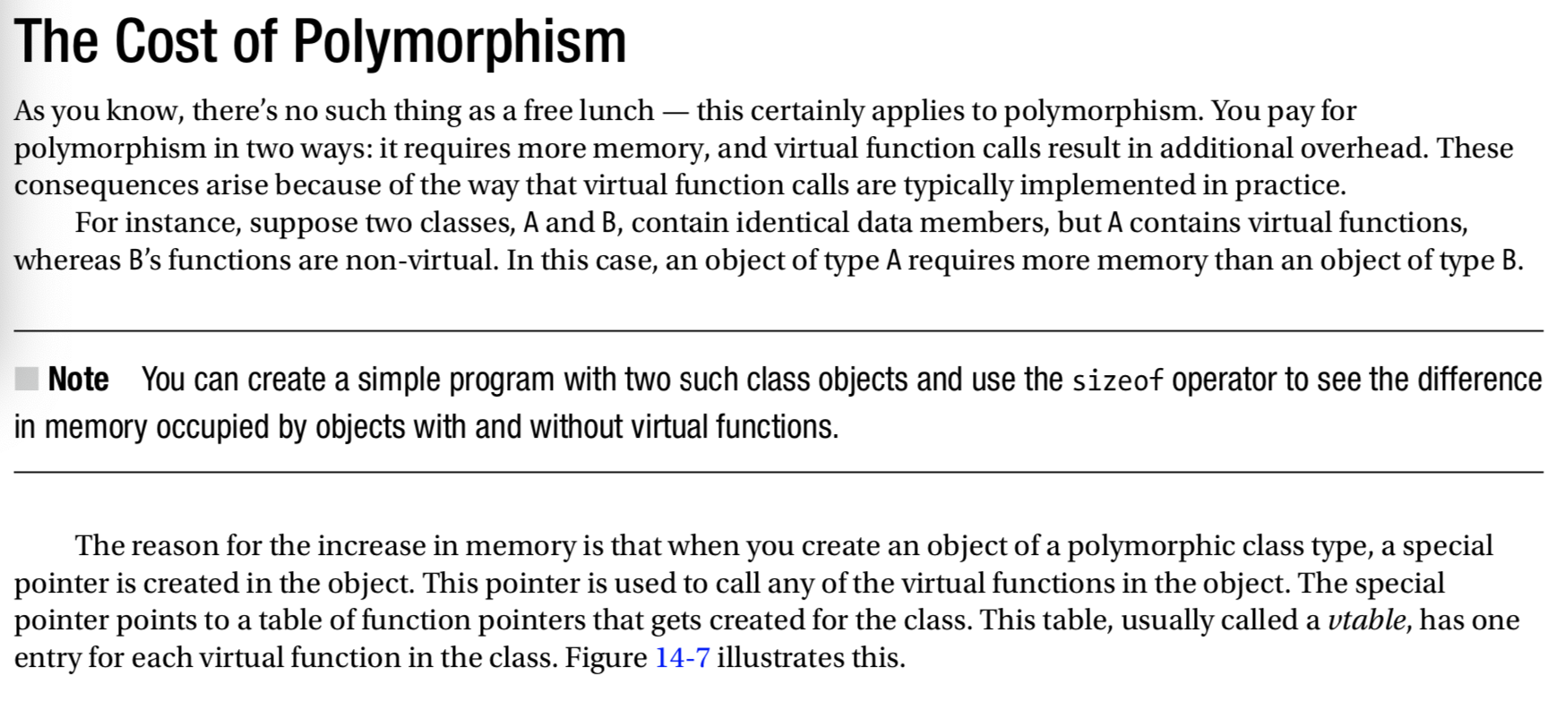
pp. 451-458

Slide 37
Common issues for HW#3
{ {…}, {“returns”: “xyz”, }…}…}
Makefile
<target>: <dependency>
<fired command>
CFLAGS = -c –I/usr/include/jsoncpp (for Ubuntu)
Find, grep
Matching member function declaration and definition/implementation
Reading the error/warning messages
Debugging ➔ cout/printf (seeing the partial results)
Hw3server (pr/pr) ➔ getVsID( ) ➔ hw3another (pr)

Slide 38
Plan
HW#4 – memory
HW#5 – JSON (Post, vsID)
Post, content, comment, reactions (TS)
“old JSON” ➔ parse ➔ C++ Classes/Objects
“actions on C++ Objects” (e.g., add a comment, add a reaction to a comment)
C++ Classes/Objects ➔ “newer JSON”
Model (2) implementation (3) actions
HW#6 (HW#3+HW#5) => send Post to vsID

