Slide 1


ecs36b Spring 2020: Software Development & Object-Oriented Programming #08: Exceptions
Abstraction
Encapsulation
Polymorphism
Inheritance
Dr. S. Felix Wu
sfwu@ucdavis.edu

Slide 2
JSON C++ Library
Chapter 15, Run time errors and exceptions

Slide 3
Exception Handling in C++
try
{
…
throw <typed something>
…
}
catch (<type> <something>)
{
…
}

Slide 4
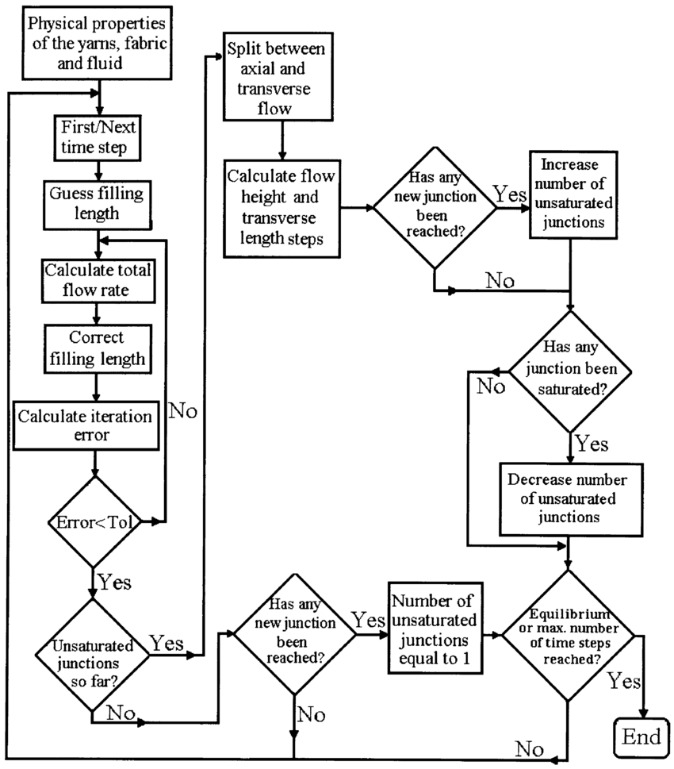
Detection
Control Flow Transfer
Passing the Argument
throw
Information about the exception
catch

Slide 5
int tag_index;
Work_Study *obj_ptr;
...
try
{
if (obj_ptr == NULL)
throw “Null Pointer”; ...
if (tag_index < 0)
throw tag_index;
... }
catch (int n)
{
...
}
catch (const char * str_ptr)
{
...
}
// the remaining code

Slide 6
int tag_index;
Work_Study *obj_ptr;
...
try
{
if (obj_ptr == NULL)
throw “Null Pointer”; ...
if (tag_index < 0)
throw tag_index;
... }
catch (int n)
{
...
}
catch (const char * str_ptr)
{
...
}
// the remaining code

Slide 7
int tag_index;
Work_Study *obj_ptr;
...
try
{
if (obj_ptr == NULL)
throw “Null Pointer”; ...
if (tag_index < 0)
throw tag_index;
... }
catch (int n)
{
...
}
catch (const char * str_ptr)
{
...
}
// the remaining code

Slide 8
int tag_index;
Work_Study *obj_ptr;
...
try
{
if (obj_ptr == NULL)
throw “Null Pointer”; ...
if (tag_index < 0). // assert(tag_index < 0);
throw tag_index;
... }
catch (int n)
{
...
}
catch (const char * str_ptr)
{
...
}
// the remaining code
Assert ➔ quit/trap/killed

Slide 9
Detection
Control Flow Transfer
Passing the Argument as
“object” or class exception
throw
Information about the exception
catch

Slide 10
// bad_alloc standard exception
#include <iostream>
#include <exception>
using namespace std;
int main
(void)
{
try
{
int* myarray= new int[1000];
}
catch (exception& e)
{
cout << "Standard exception: " << e.what() << endl;
}
return 0;
}

Slide 11
// bad_alloc standard exception
#include <iostream>
#include <exception>
using namespace std;
int main
(void)
{
try
{
int* myarray= new int[1000];
}
catch (exception& e)
{
cout << "Standard exception: " << e.what() << endl;
}
return 0;
}
Any library

Slide 12
class exception
{
public:
exception() noexcept;
exception(const exception&) noexcept;
virtual ~exception() noexcept;
virtual const char * what() const noexcept;
};

Slide 13
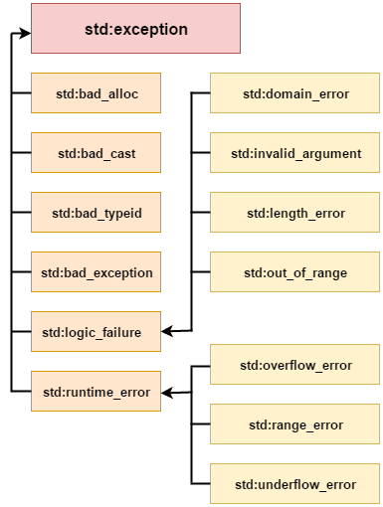
class exception
{
public:
exception() noexcept;
exception(const exception&) noexcept;
virtual ~exception() noexcept;
virtual const char * what() const noexcept;
};

Slide 14
// MyTroubles.h Exception class definition
#ifndef MYTROUBLES_H
#define MYTROUBLES_H
#include <string>
using std::string;
class Trouble
{
private:
string message;
public:
Trouble(string str = "There's a problem") : message {str} {}
string what() const { return message; }
};
#endif

Slide 15
// Ex15_03.cpp
// Throw an exception object
#include <iostream>
#include "MyTroubles.h”
int main()
{
for (int i {}; i < 2; ++i)
{
try
{
if (i == 0)
throw Trouble {}; // i == 0
else // i == 1
throw Trouble {"Nobody knows the trouble I've seen..."};
}
catch(const Trouble& t)
{
std::cout << "Exception: " << t.what() << std::endl;
}
}
}

Slide 16
class hw3Client : public jsonrpc::Client
{
public:
hw3Client(jsonrpc::IClientConnector &conn,
jsonrpc::clientVersion_t type jsonrpc::JSONRPC_CLIENT_V2)
: jsonrpc::Client(conn, type) {}
Json::Value GetDistance(const std::string& action,
const std::string& arguments,
const std::string& class_id,
const std::string& host_url,
const std::string& object_id,
const std::string& owner_vsID)
{
Json::Value p;
p["action"] = action;
p["arguments"] = arguments;
p["class_id"] = class_id;
p["host_url"] = host_url;
p["object_id"] = object_id;
p["owner_vsID"] = owner_vsID;
Json::Value result = this->CallMethod("GetDistance",p);
if (result.isObject())
return result;
else
throw jsonrpc::JsonRpcException
(jsonrpc::Errors::ERROR_CLIENT_INVALID_RESPONSE,
result.toStyledString());
}

Slide 17
/usr/local/include/jsonrpccpp/common/exception.h
class JsonRpcException: public std::exception
{
public:
JsonRpcException(int code);
JsonRpcException(int code, const std::string& message);
JsonRpcException(int code, const std::string& message, const Json::Value &data);
JsonRpcException(const std::string& message);
virtual ~JsonRpcException() throw ();
int GetCode() const;
const std::string& GetMessage() const;
const Json::Value& GetData() const;
virtual const char* what() const throw ();
private:
int code;
std::string message;
std::string whatString;
Json::Value data;
void setWhatMessage();
};

Slide 18
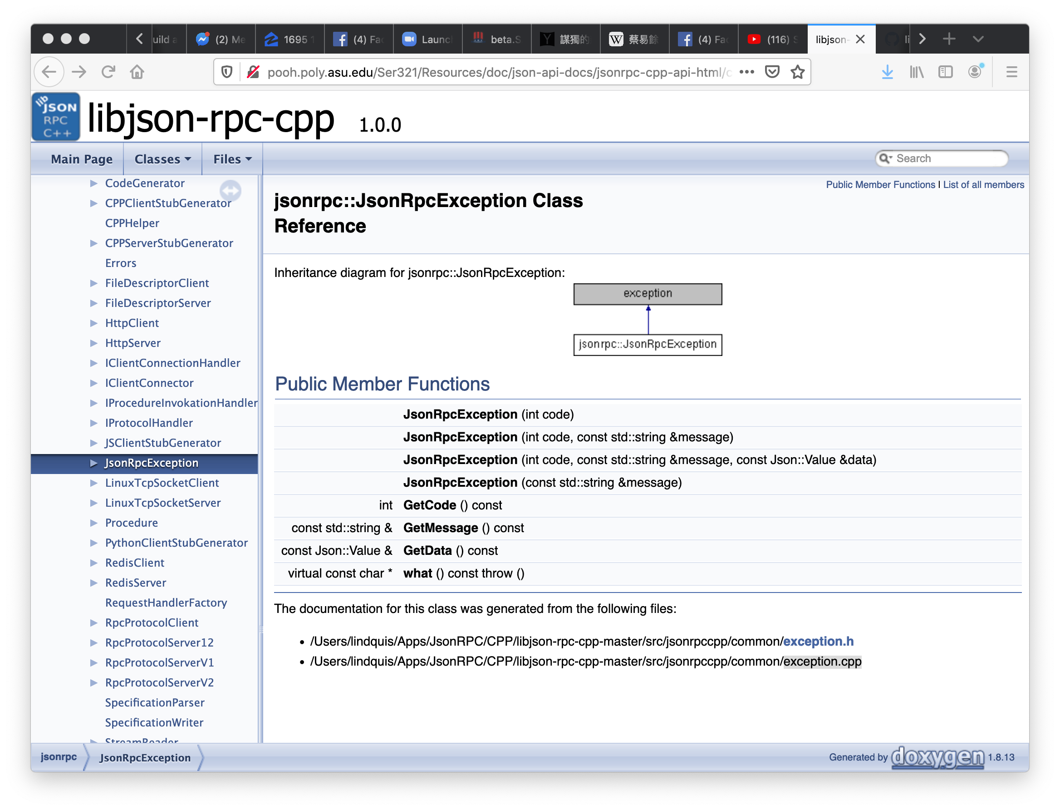

Slide 19
Exception Handling in C++
try
{
…
throw <typed something> // possibly inner
…
}
catch (<type> <something>)
{
…
}

Slide 20
Exception Handling in C++
try
{
…
throw <typed something> // possibly inner
…
}
catch (exception& <something>)
{
…
}

Slide 21
class exception
{
public:
exception() noexcept;
exception(const exception&) noexcept;
virtual ~exception() noexcept;
virtual const char * what() const noexcept;
};

Slide 22
Base-class exception
Contains virtual function what for storing error messages
Exception classes derived from exception
bad_alloc – thrown by new
bad_cast – thrown by dynamic_cast
bad_typeid – thrown by typeid
bad_exception – thrown by unexpected
Instead of terminating the program or calling the function specified by set_unexpected
Used only if bad_exception is in the function’s throw list

Slide 23
try
{
std::cout << "MSize = " << MSize << std::endl;
long int * m1 = (long int *) new long int[MSize * MSize];
long int * m2 = (long int *) new long int[MSize * MSize];
std::cout << "memory allocated\n";
fflush(stdout);
...
}
catch (exception& e)
{
std::cout << "inside the exception\n";
std::cout << "standard exception: " << e.what() << endl;
std::cout << typeid(e).name() << std::endl;
}

Slide 24
try
{
std::cout << "MSize = " << MSize << std::endl;
long int * m1 = (long int *) new long int[MSize * MSize];
long int * m2 = (long int *) new long int[MSize * MSize];
std::cout << "memory allocated\n";
fflush(stdout);
...
}
catch (exception& e)
{
std::cout << "inside the exception\n";
std::cout << "standard exception: " << e.what() << endl;
std::cout << typeid(e).name() << std::endl;
}
(base) Shyhtsuns-MacBook-Pro:exception sfwu$ ./hw4ex 4200000
MSize = 4200000
hw4ex(24215,0x1059915c0) malloc: can't allocate region
*** mach_vm_map(size=141120000000000) failed (error code=3)
hw4ex(24215,0x1059915c0) malloc: *** set a breakpoint in malloc_error_break to debug
inside the exception
standard exception: std::bad_alloc
St9bad_alloc
**Re-throw**?

Slide 25
try
{
std::cout << "MSize = " << MSize << std::endl;
long int * m1 = (long int *) new long int[MSize * MSize];
long int * m2 = (long int *) new long int[MSize * MSize];
std::cout << "memory allocated\n";
fflush(stdout);
...
}
catch (exception& e)
{
std::cout << "inside the exception\n";
std::cout << "standard exception: " << e.what() << endl;
std::cout << typeid(e).name() << std::endl;
}
(base) Shyhtsuns-MacBook-Pro:exception sfwu$ ./hw4ex 4200000
MSize = 4200000
hw4ex(24215,0x1059915c0) malloc: can't allocate region
*** mach_vm_map(size=141120000000000) failed (error code=3)
hw4ex(24215,0x1059915c0) malloc: *** set a breakpoint in malloc_error_break to debug
inside the exception
standard exception: std::bad_alloc
St9bad_alloc

Slide 26
try
{
std::cout << "MSize = " << MSize << std::endl;
long int * m1 = (long int *) new long int[MSize * MSize];
long int * m2 = (long int *) new long int[MSize * MSize];
std::cout << "memory allocated\n";
fflush(stdout);
...
}
catch (exception& e)
{
std::cout << "inside the exception\n";
std::cout << "standard exception: " << e.what() << endl;
std::cout << typeid(e).name() << std::endl;
}
(base) Shyhtsuns-MacBook-Pro:exception sfwu$ ./hw4ex 4200000
MSize = 4200000
hw4ex(24215,0x1059915c0) malloc: can't allocate region
*** mach_vm_map(size=141120000000000) failed (error code=3)
hw4ex(24215,0x1059915c0) malloc: *** set a breakpoint in malloc_error_break to debug
inside the exception
standard exception: std::bad_alloc
St9bad_alloc
“e” has to be from a polymorphic class

Slide 27
Interference with MI and VI
class MyException : public MyAnother, exception
{
private:
protected:
public:
virtual ~MyException() throw () {};
virtual const char* what() const throw () { return "Mine"; };
};
class MyException : public exception, MyAnother
{
private:
protected:
public:
virtual ~MyException() throw () {};
virtual const char* what() const throw () { return "Mine"; };
};

Slide 28
Interference with MI and VI
class MyException : public MyAnother, exception
{
private:
protected:
public:
virtual ~MyException() throw () {};
virtual const char* what() const throw () { return "Mine"; };
};
libc++abi.dylib: terminating with uncaught exception of type MyException
Abort trap: 6

Slide 29
for MI and VI, exception (or any types to be caught by “catch”) needs to come first
class MyException : public exception, MyAnother
{
private:
protected:
public:
virtual ~MyException() throw () {};
virtual const char* what() const throw () { return "Mine"; };
};

Slide 30
Detection (versus assert( ))
Control Flow Transfer
Passing the Argument as
“object” or class exception
throw
Information about the exception
catch

Slide 31
Detection (versus assert( ))
Control Flow Transfer
Passing the Argument as
“object” or class exception
throw
Information about the exception
catch
software development w/ multi-platforms
readability and cleaner debugging
interaction better with other’s code

Slide 32
http://cyrus.cs.ucdavis.edu/sfelixwu/ecs36b/s2020/check_status.txt

Slide 33
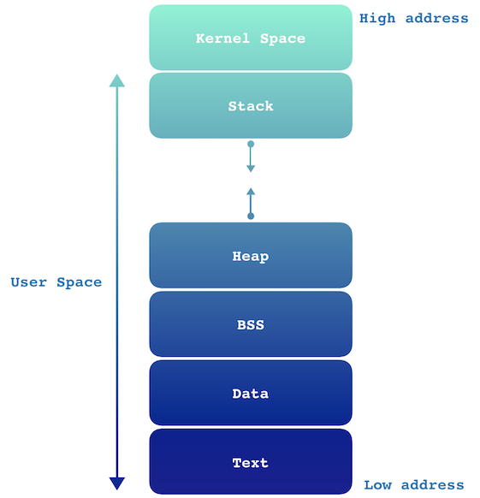
Segmentation Fault
Memory Layout
Stack
Heap
Static Allocated Memory

Slide 34
Comment *comment_ptr;
std::vector<Comment *> *comment_vector_ptr;
Comment_ptr = new Comment(,,…,);
Question: error: no matching constructor for initialization of 'Comment' Comment * comment_ptr = new Comment(react_p_ptr, ^ ~~~~~~~~~~~~ ./Comment.h:29:3: note: candidate constructor not viable: requires 6 arguments, but 4 were provided I got this error in the hwproduce and don’t know how to fix it?
Question: error: no matching constructor for initialization of 'Comment' Comment * comment_ptr = new Comment(react_p_ptr, ^ ~~~~~~~~~~~~ ./Comment.h:29:3: note: candidate constructor not viable: requires 6 arguments, but 4 were provided I got this error in the hwproduce and don’t know how to fix it?
Comment::Comment
(std::string arg_profile_id, std::string arg_post_id, std::string arg_comment_id,
Person * arg_author, Message * arg_msg, JvTime * arg_created)
{
this->profile_id = arg_profile_id;
this->post_id = arg_post_id;
this->comment_id = arg_comment_id;
this->author = arg_author;
this->msg = arg_msg;
this->created = arg_created;
}
<profile>_<post>_<comment>

Slide 35
// <profile>_<post>_<comment>
sscanf(idstr, “%[^_]_%[^_]_%s”, buf_profile_id, buf_post_id,
buffer_comment_id);
// <profile>_<post>_<comment>
sscanf(idstr, “%[^_]_%[^_]_%s”, buf_profile_id, buf_post_id,
buffer_comment_id);
// <profile>_<post>
sscanf(idstr, “%[^_]_%s”, buf_profile_id, buf_post_id);

Slide 36
Comment *comment_ptr;
std::vector<Comment *> *comment_vector_ptr;
JvTime *jv_ptr; // NULL
Comment_ptr = new Comment(,,…,);
jv_ptr->x;
((JvTime *) 0)->x;
// parsing JSON time
…
jv_ptr = new JvTime(…);
(vec_c_reactions_ptr)->push_back(…);
(*vec_c_reactions_ptr).push_back(…);
Question: error: no matching constructor for initialization of 'Comment' Comment * comment_ptr = new Comment(react_p_ptr, ^ ~~~~~~~~~~~~ ./Comment.h:29:3: note: candidate constructor not viable: requires 6 arguments, but 4 were provided I got this error in the hwproduce and don’t know how to fix it?
Question: error: no matching constructor for initialization of 'Comment' Comment * comment_ptr = new Comment(react_p_ptr, ^ ~~~~~~~~~~~~ ./Comment.h:29:3: note: candidate constructor not viable: requires 6 arguments, but 4 were provided I got this error in the hwproduce and don’t know how to fix it?

Slide 37
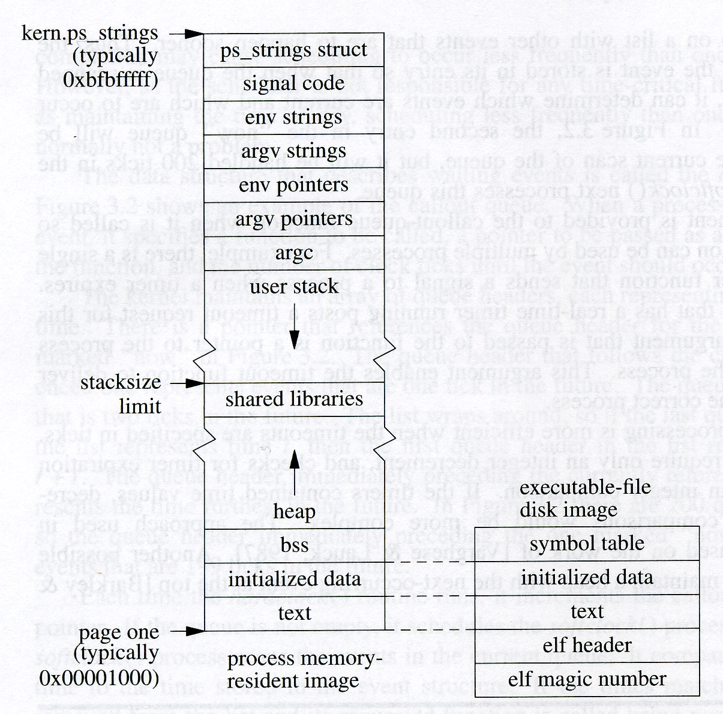
Memory Cell Layout
main()
mypost.dumpJ()
comment.dumpJ()
malloc/free
new/delete
Static variables
a.out

Slide 38
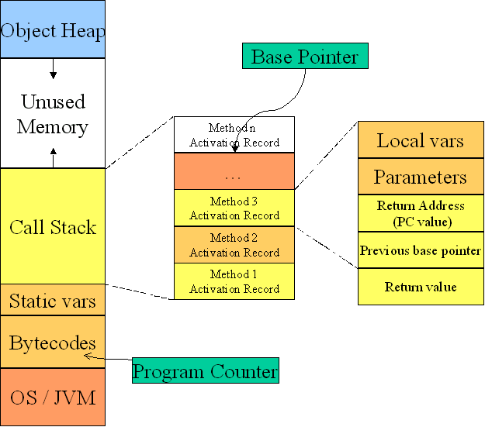

Slide 39
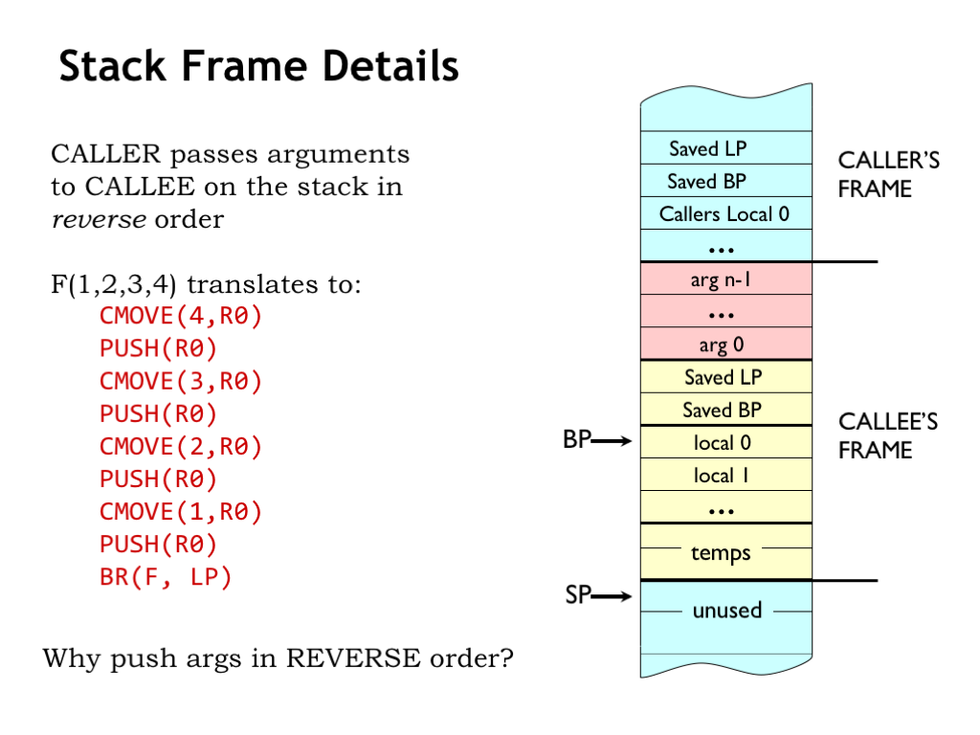

Slide 40
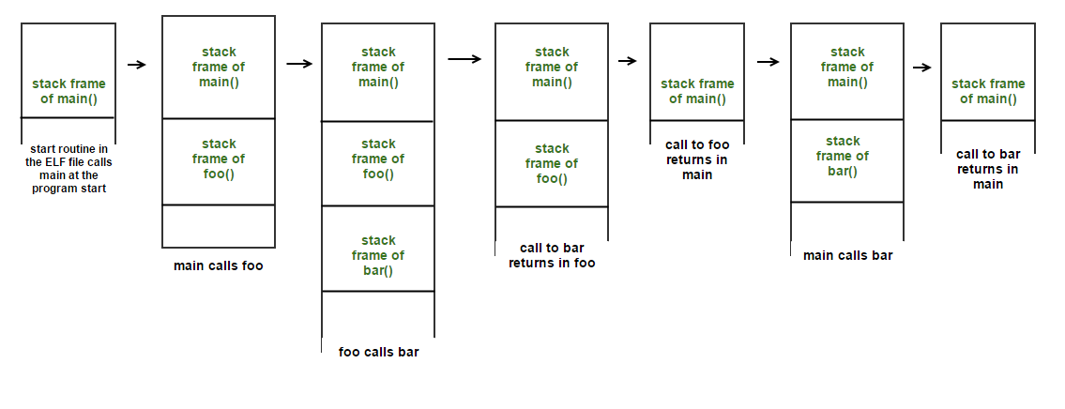
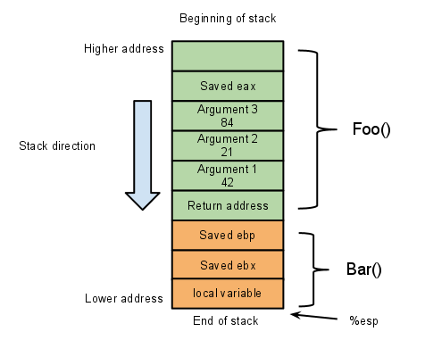
Main()

Slide 41
A Simple OO Server
RPCs
Exception Handling
Error Messages
Distributed Debugging
Logging
Non-Structure JSON format

Slide 42
Remote Procedure Call (RPC)
https://en.wikipedia.org/wiki/External_Data_Representation
Specification of the Interface
e.g., XDR or JSON
rpcgen or jsonrpcstub
client.h used as it is
client.cpp provide the hook or template
server.h
server.cpp
#include “client.h”
f = foo(…)
#include “server.h”
double *foo(…)

Slide 43
Distributed Wordle
./hw6client
https://github.com/sfelixwu/1123_2022
Set_name
Obtain
Guess
Submit
./hw6server
https://5f43-2601-200-c001-9ff0-d5cd-ca2a-e2c4-2fcc.ngrok.io

Slide 44
./hw7client
./hw7server
./hw7another
./hw3server

