Slide 1

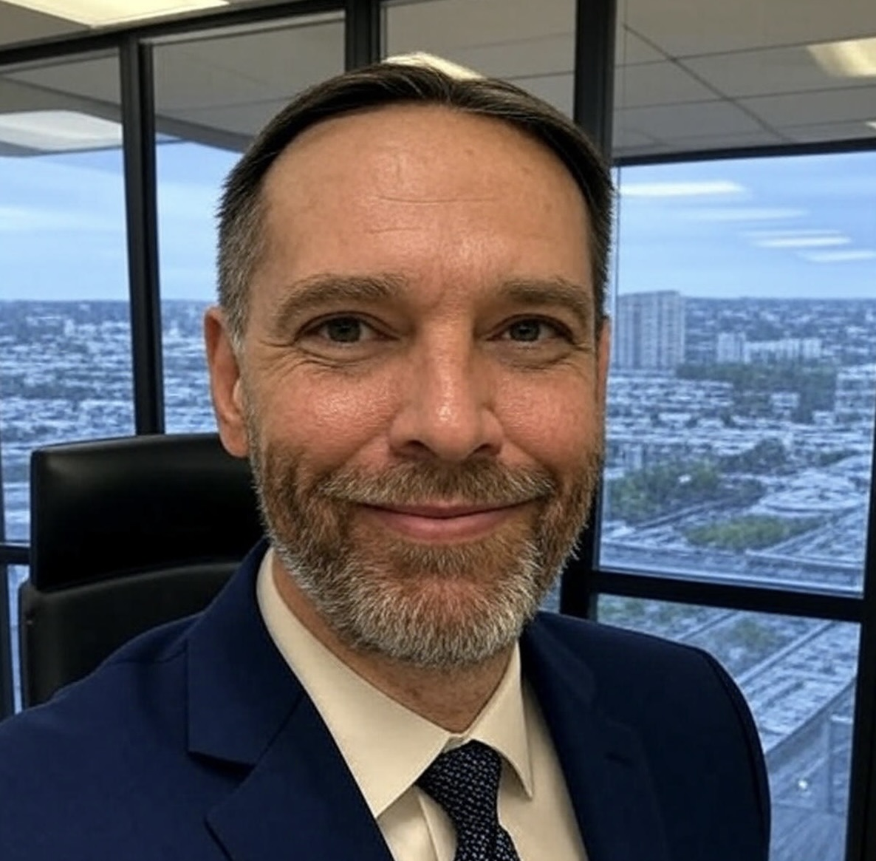

Steven Festenstein
Syracuse NY
Software Engineer – Lockheed Martin, 29 years!
C++, Qt, RF Systems
▸ Experienced in embedded systems & real-time apps
▸ Open-source contributor & Technical trainer
▸ Building software-defined radio tools
▸ Advocate for modern C++ best practices
Drag your profile
photo here

Slide 2
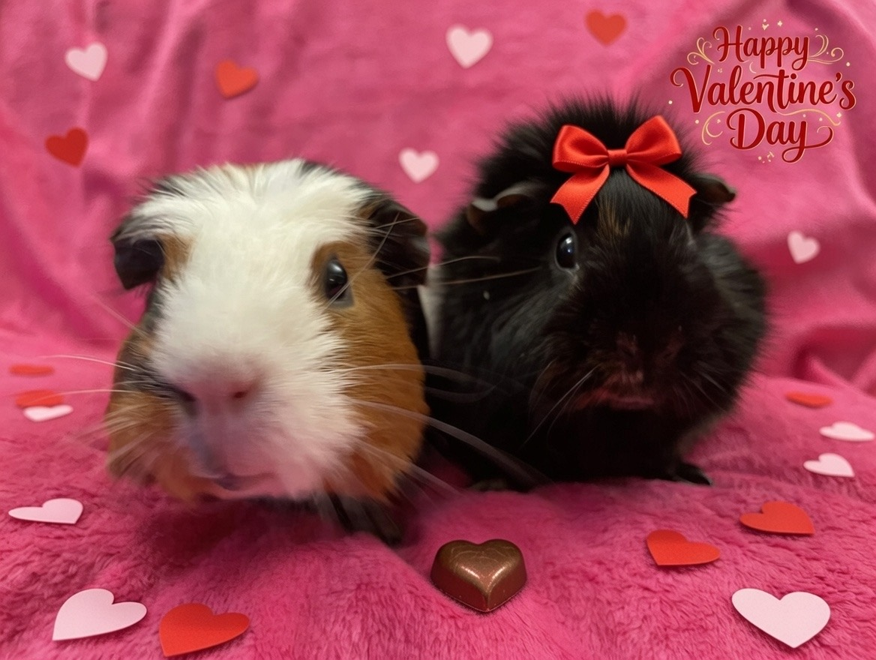
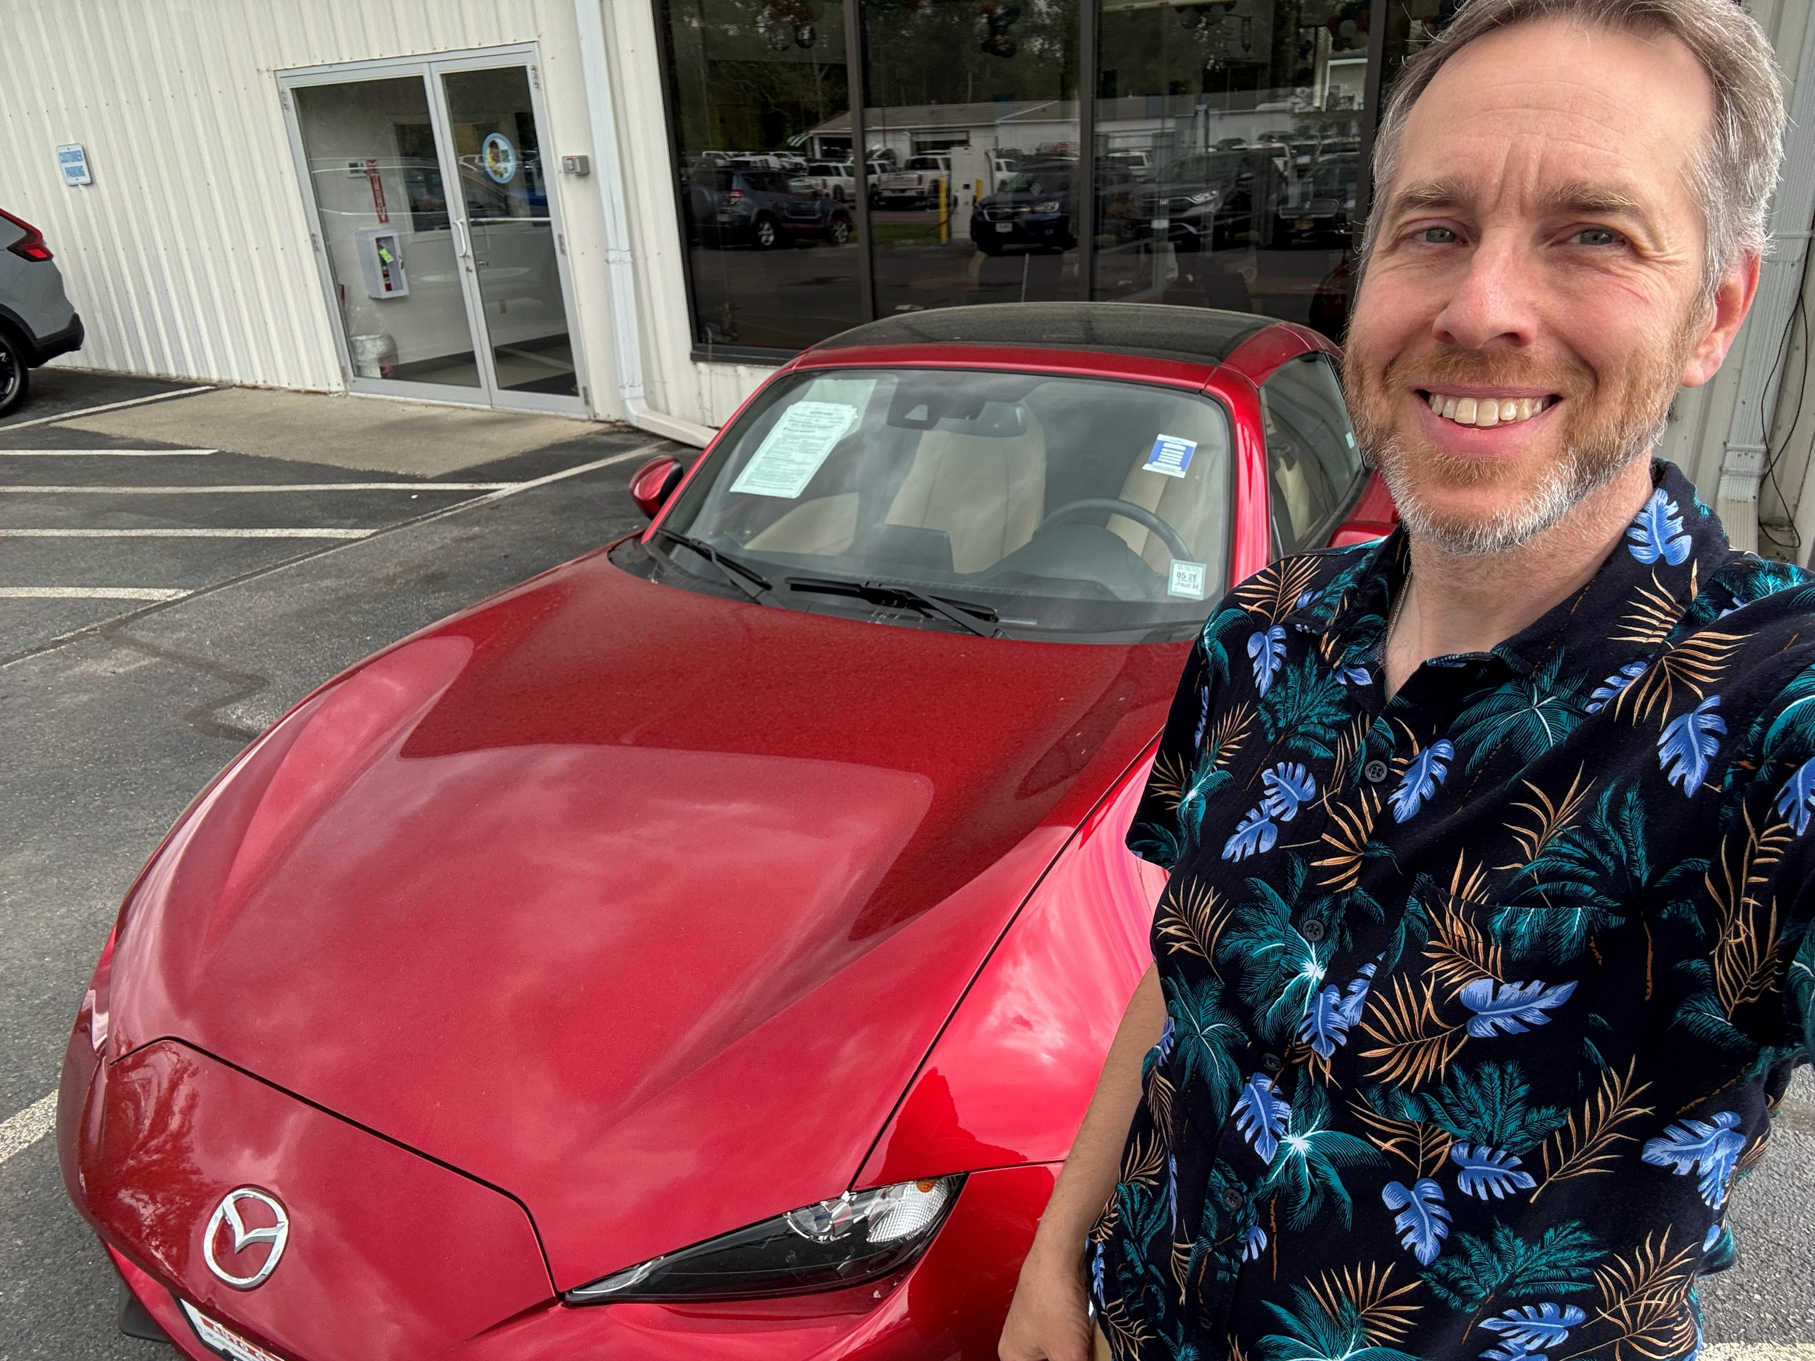
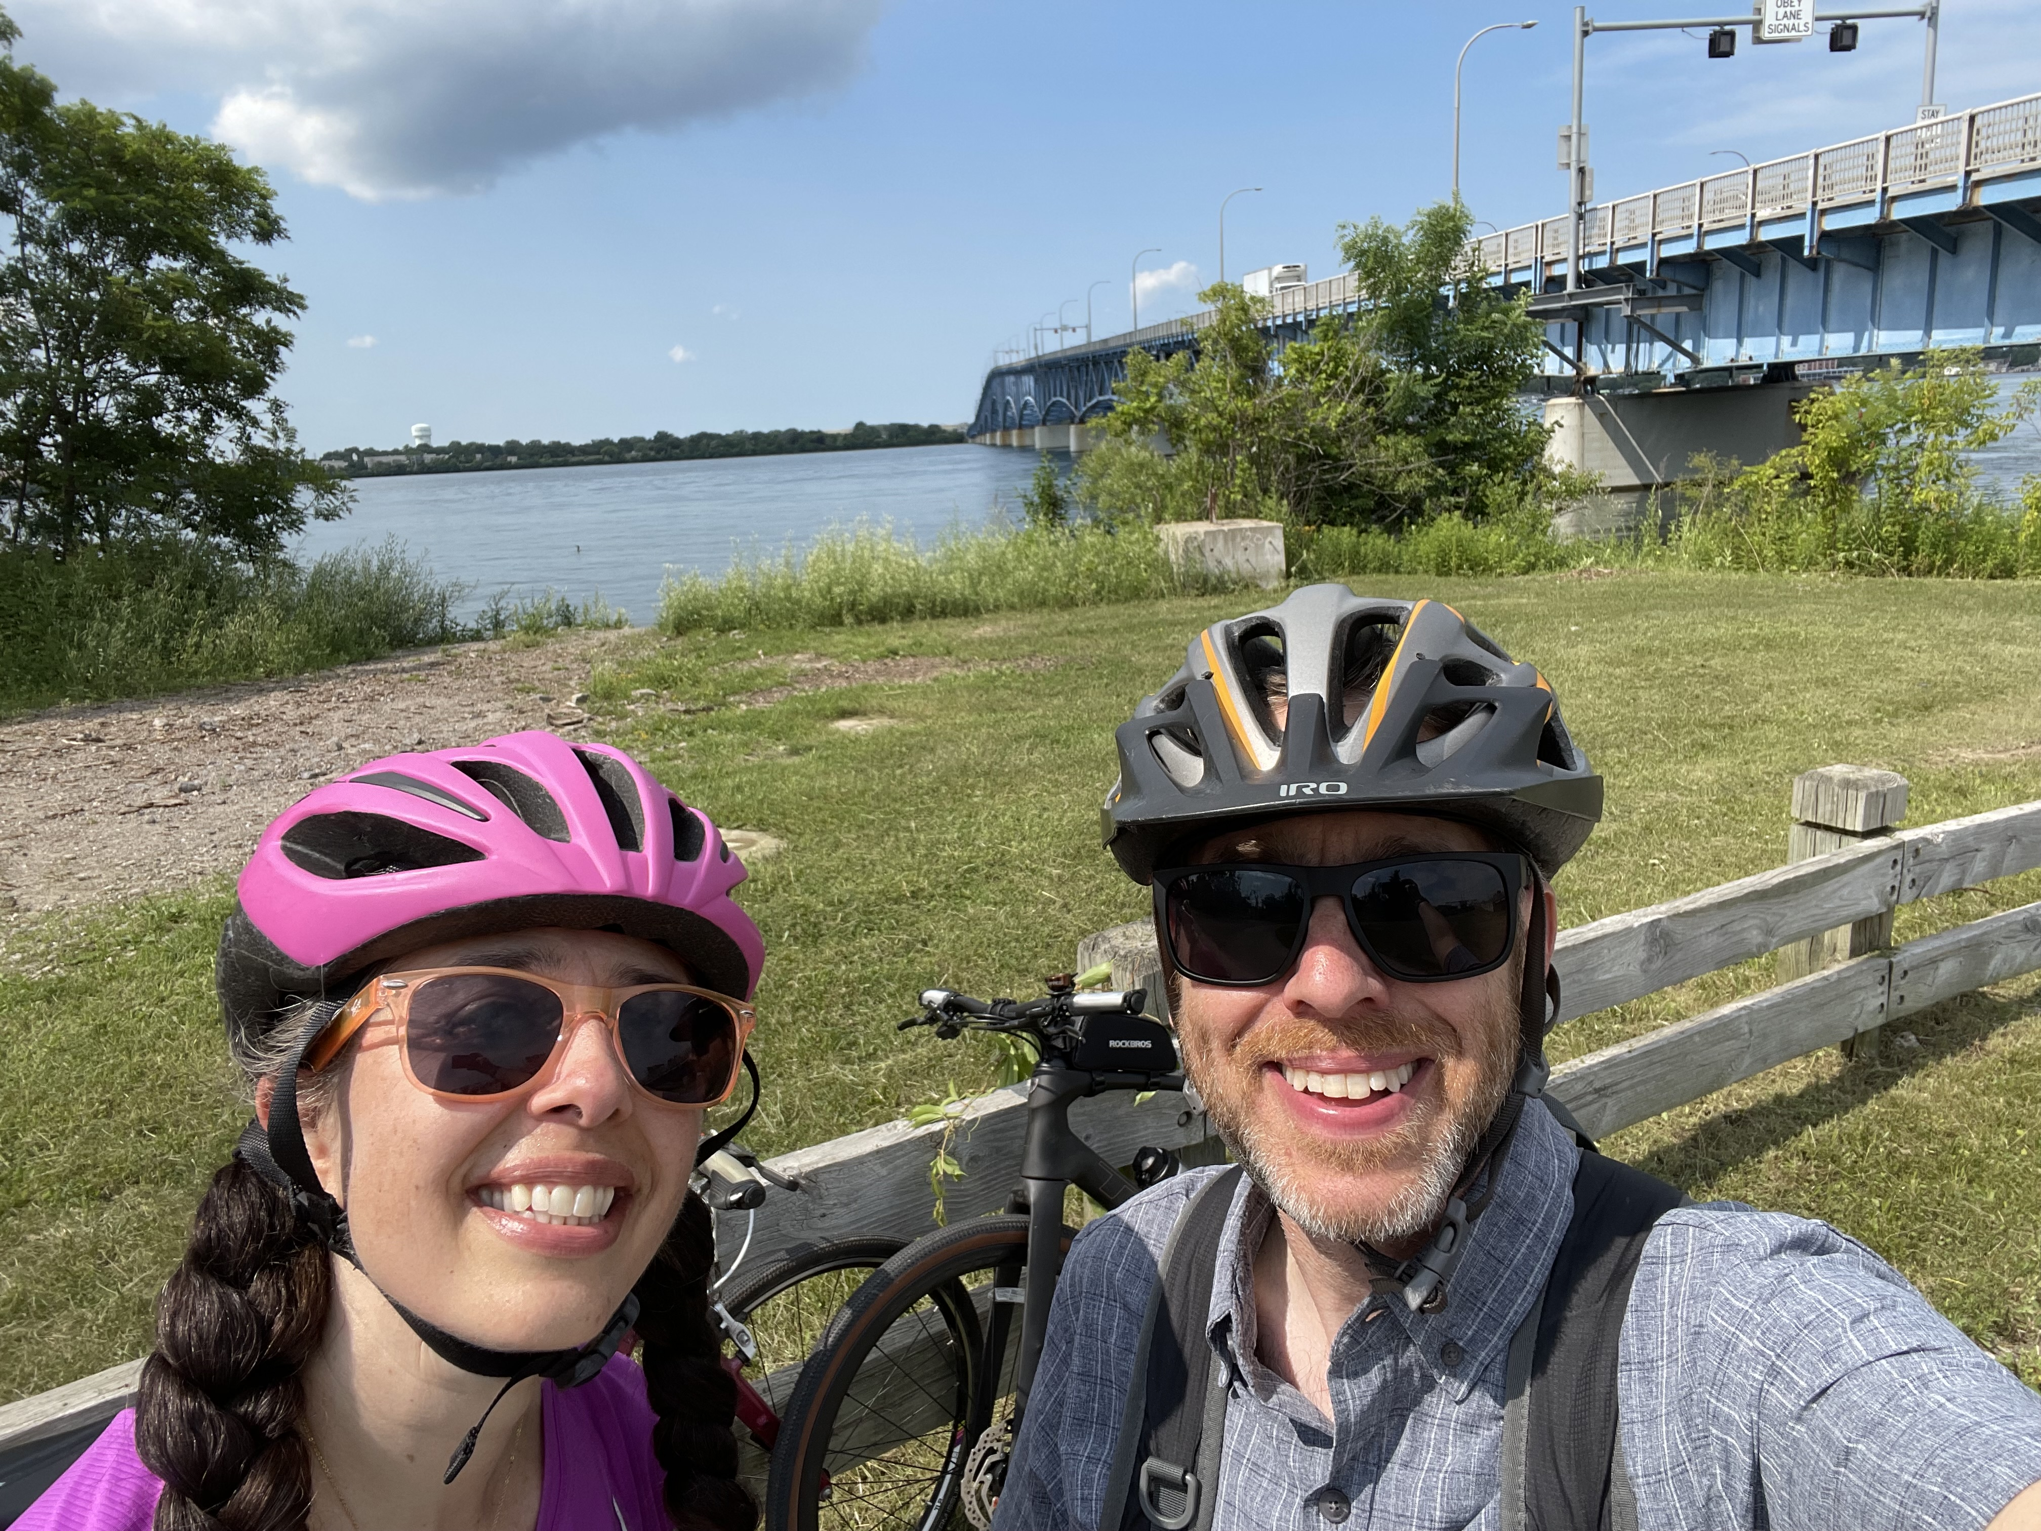
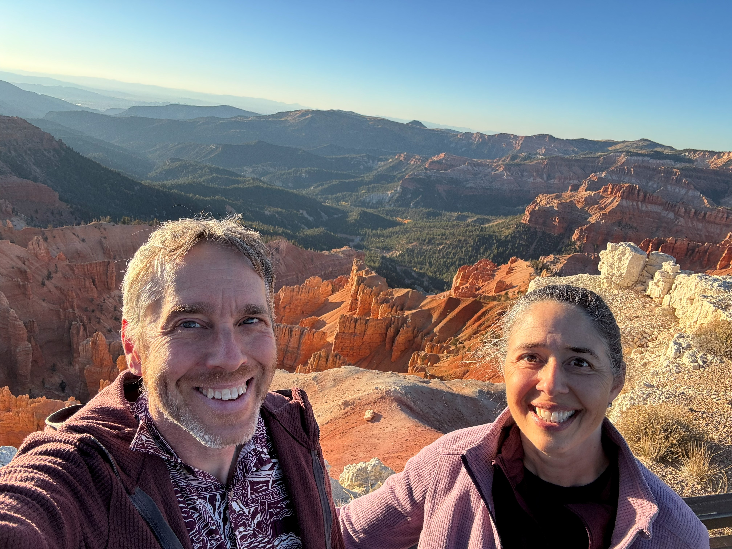
MY WORLD
Beyond the Office
Outdoors
Adventures

Slide 3
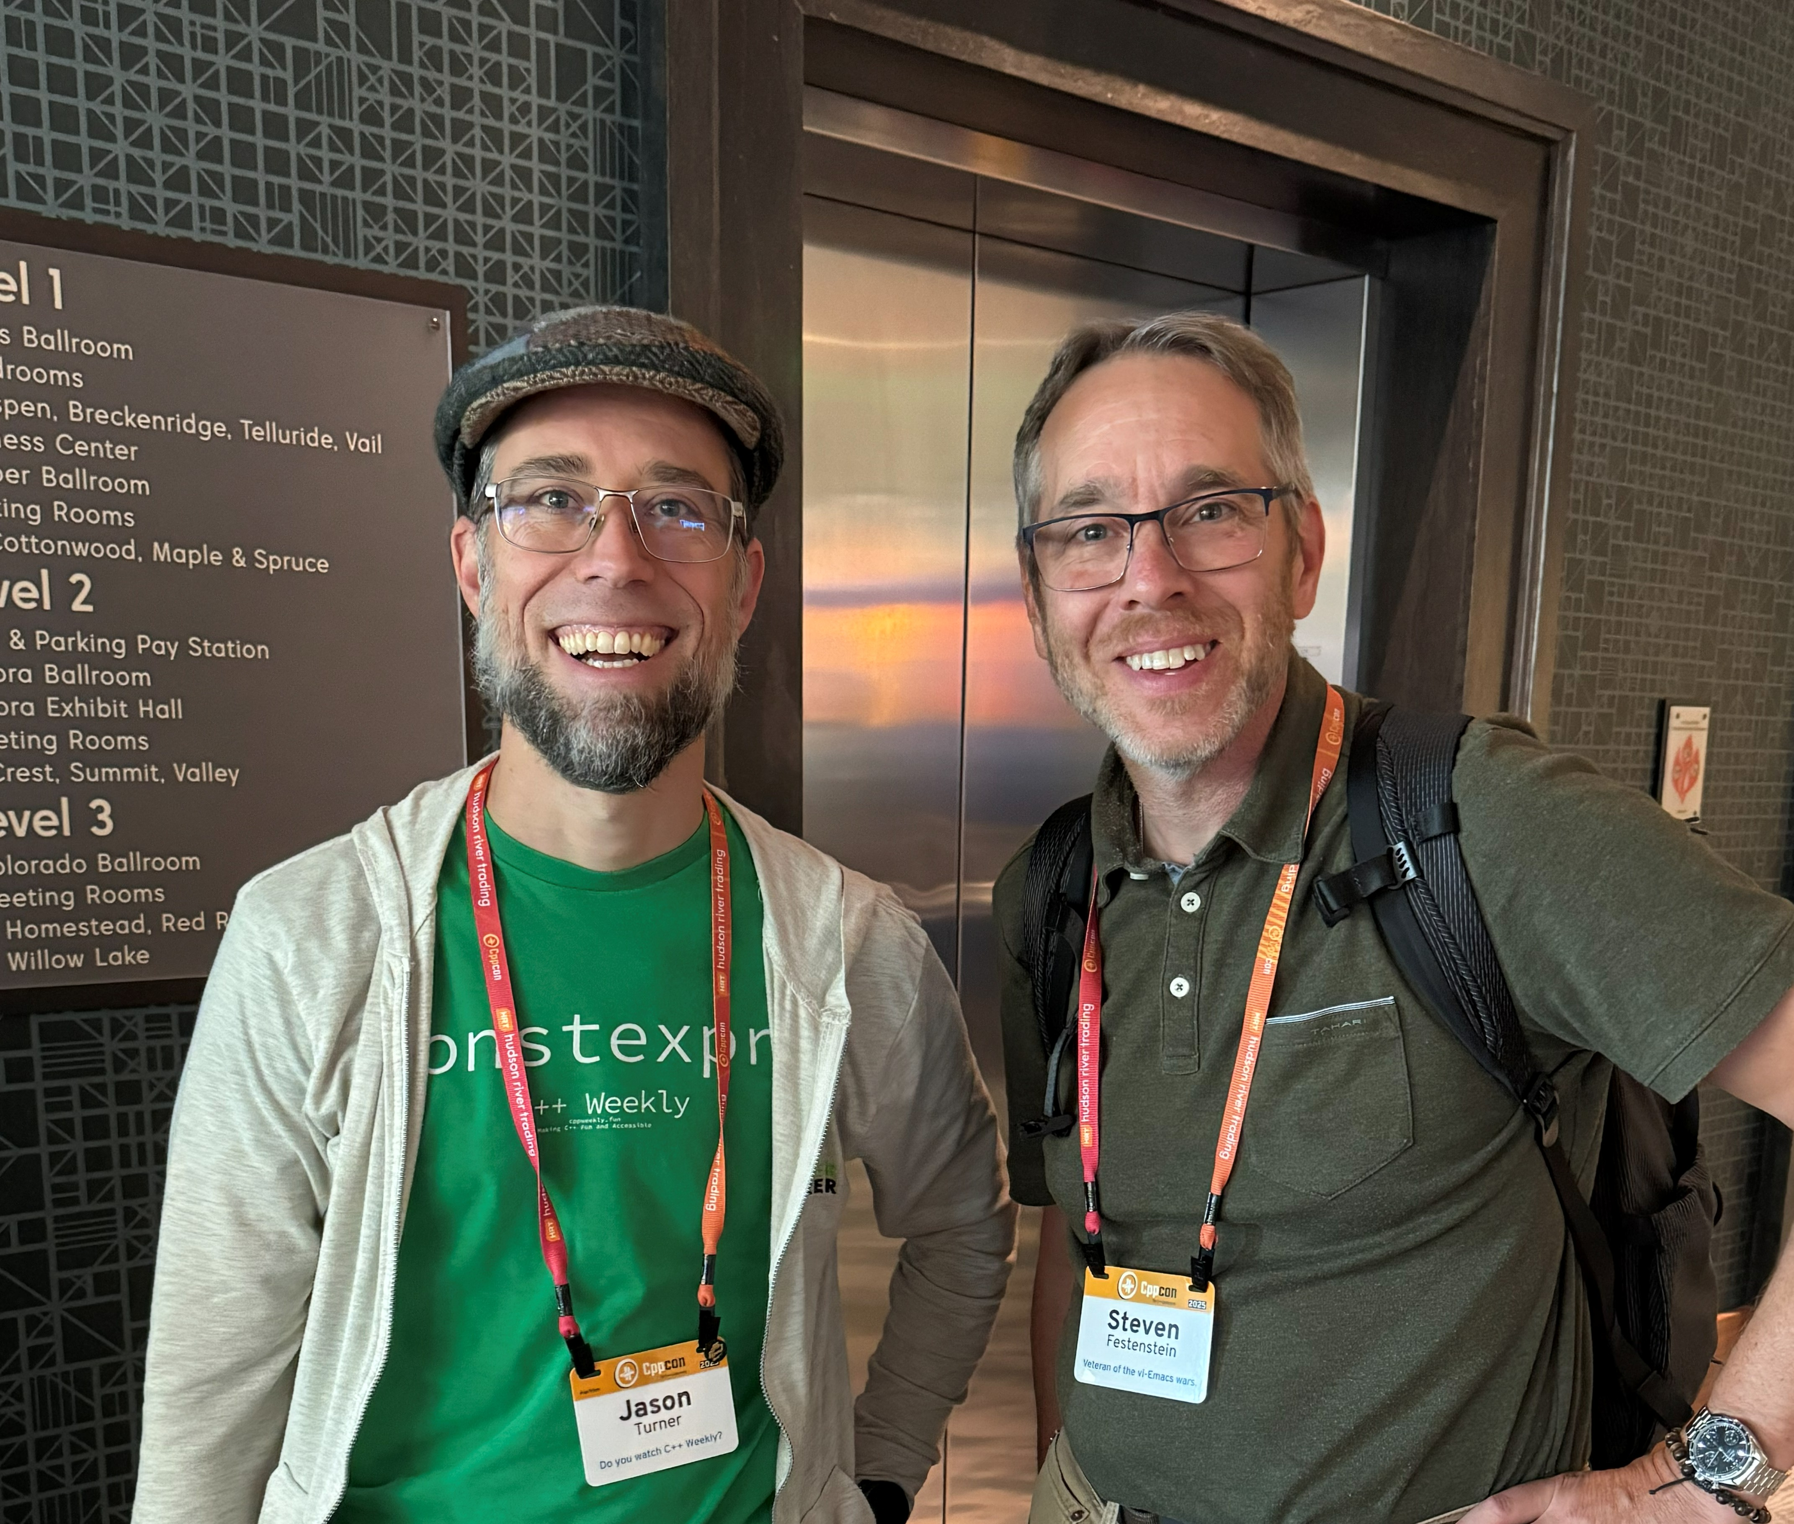
CPPCON 2025
The premier C++ conference experience
Meeting the Stars of C++
One of the highlights of attending CppCon was meeting incredible people in the C++ community, including Jason Turner!
The conference featured cutting-edge talks on modern C++ techniques, concurrency, and performance optimization.
Key Takeaways:
▸ Latest C++ standards & proposals
▸ Networking with top engineers
▸ Hands-on workshops & lightning talks

Slide 4

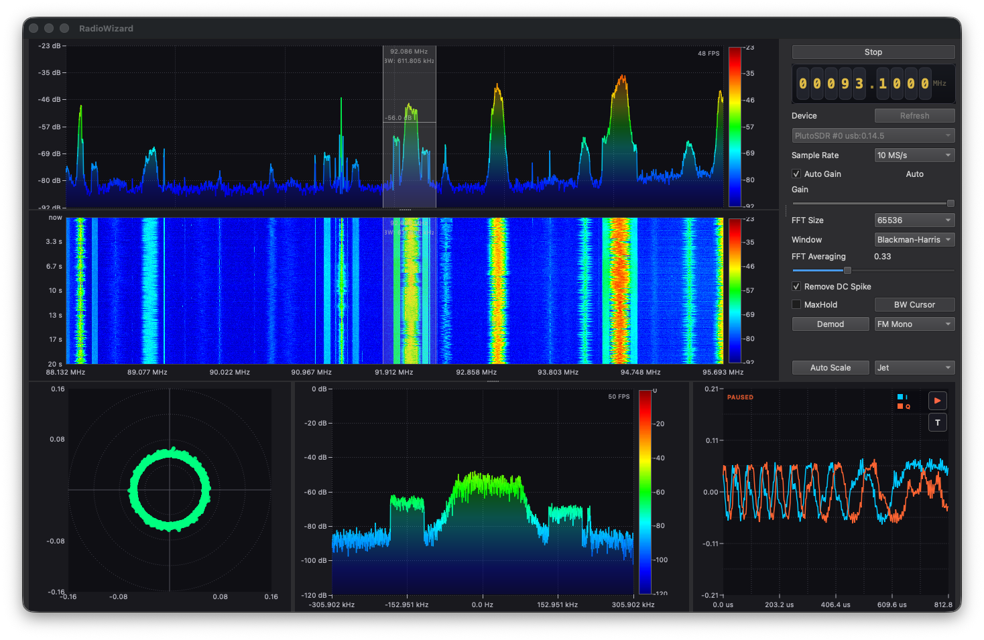
RADIO WIZARD
Software Defined Radio Controller
A passion project that brings the power of software-defined radio to an intuitive interface.
▸ Real-time signal processing & visualization
▸ Multi-band frequency scanning
▸ Custom demodulation pipelines
▸ Built with modern C++ & DSP libraries
C++20
< 10ms
SDR
Language Standard
Latency
Architecture

