Slide 1
Robot Platform
Tech Challenge Presentation
Feifan Sun

Slide 2
Robot Platform
A cloud-native application designed to manage and monitor robots
Frontend Layer (Visualization) - Dashboard UI
Backend Layer (Business Logic) - Robot Service API
Observability Layer (Monitoring & Logging) - Prometheus, Loki, Promtail

Slide 3
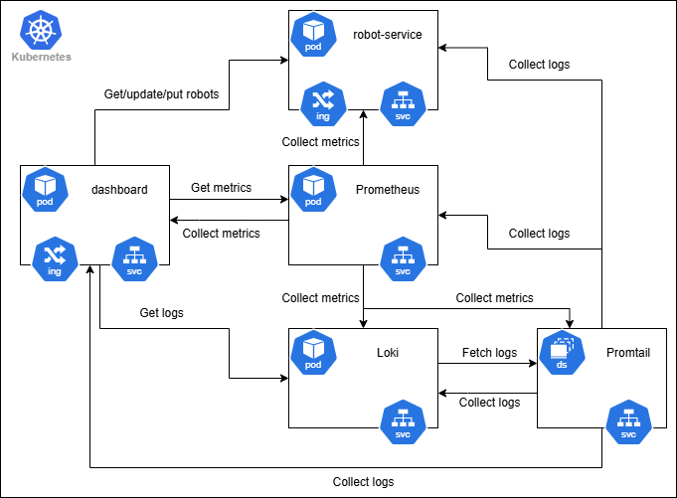
Architecture

Slide 4
Backend Layer - Robot Service
REST API (FastAPI) endpoints for managing robots
GET /robots - Get all robots with their status
POST /robots - Add a new robot
PATCH /robot - Update robot data for a specific robot
Prometheus metrics endpoint
GET /metrics
Logging
Unit tests
Docker support

Slide 5
FastAPI
High performance, async-first Python framework
Automatic OpenAPI/Swagger documentation
Built-in data validation with Pydantic
Easy to test and maintain with dependency injection
Great developer experience with type hints and modern Python features

Slide 6
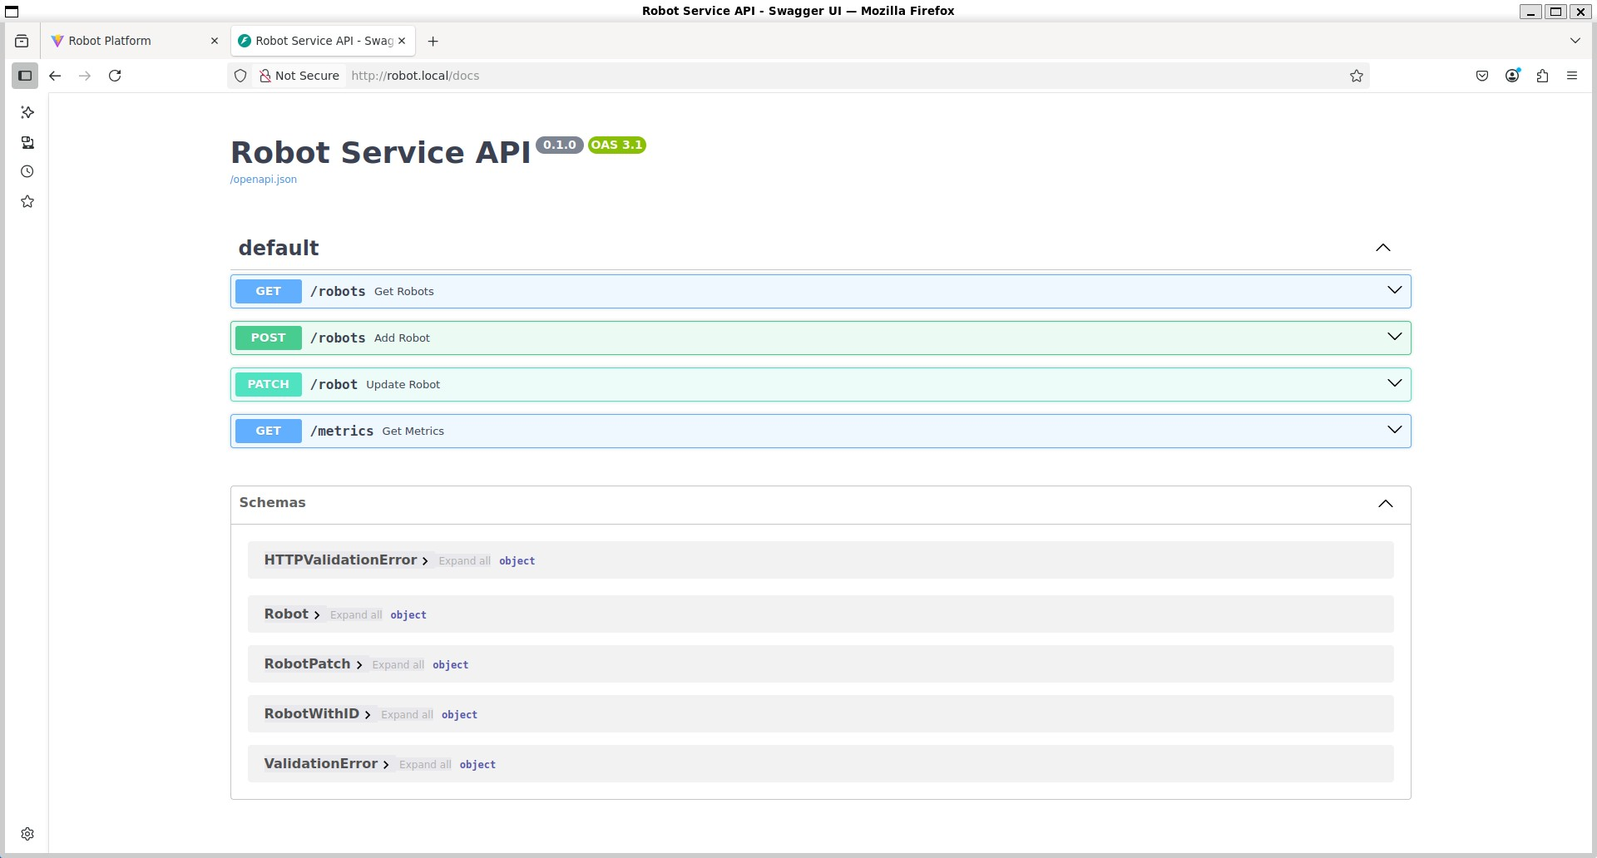
Backend Layer - Robot Service

Slide 7
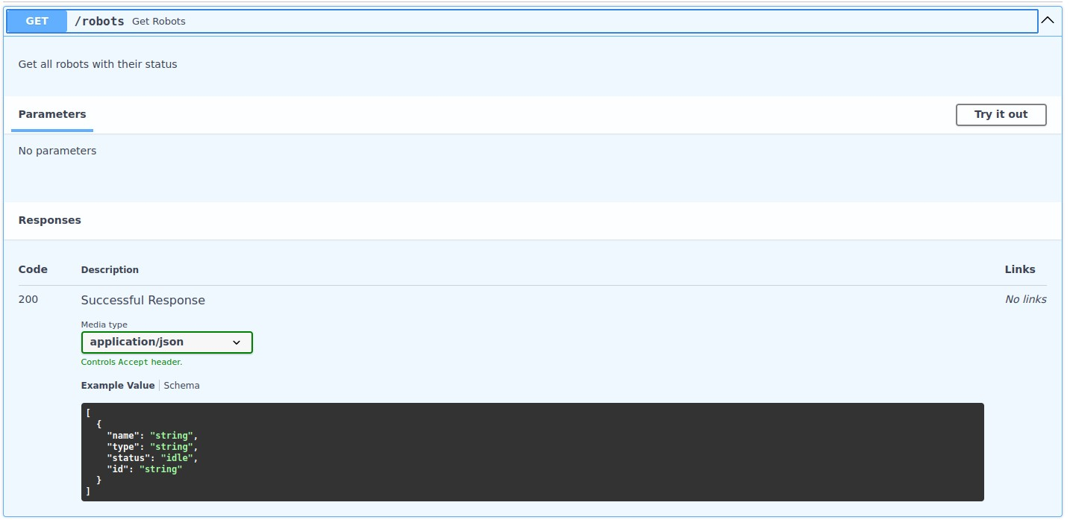
Backend Layer - Robot Service

Slide 8
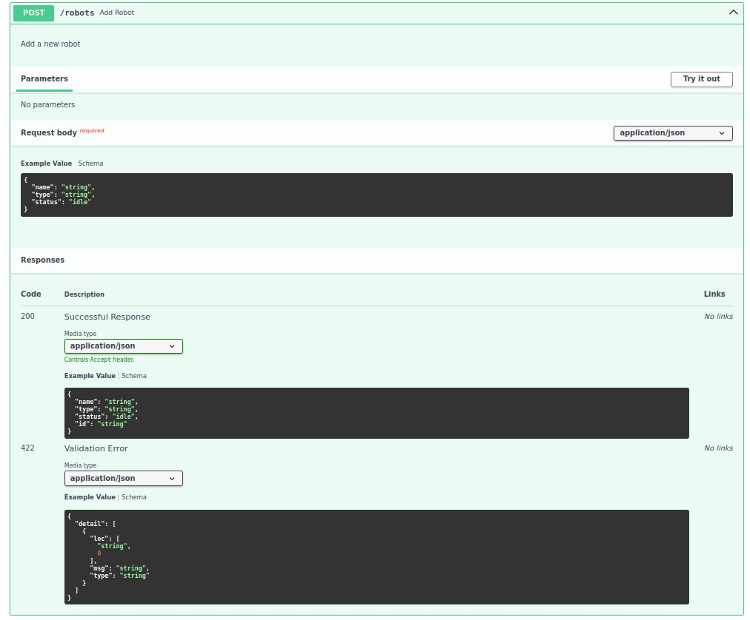
Backend Layer - Robot Service

Slide 9
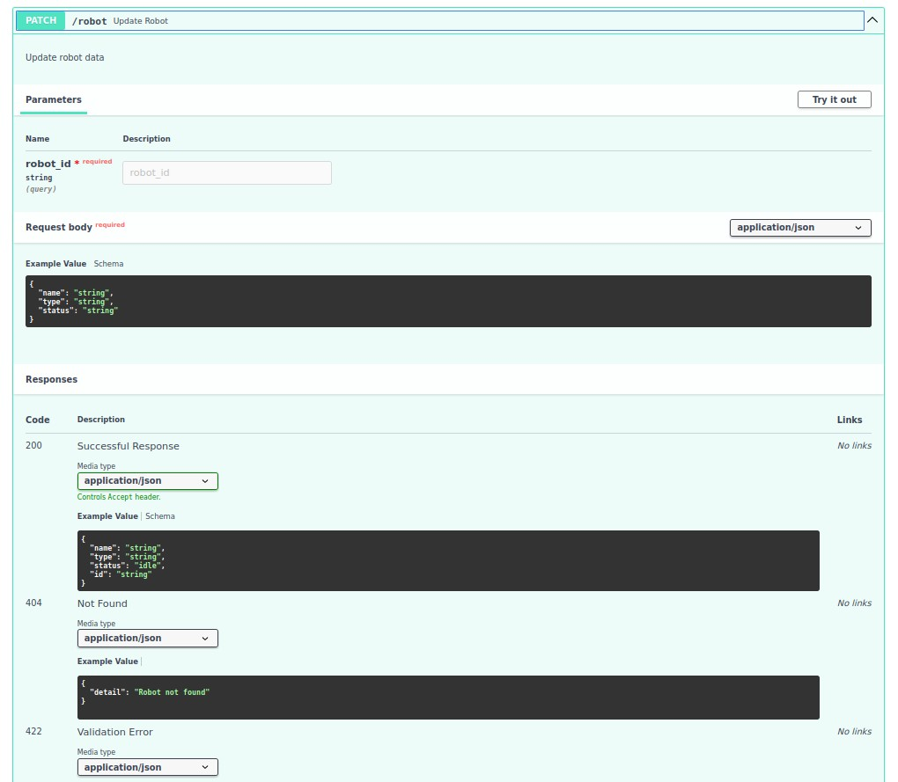
Backend Layer - Robot Service

Slide 10
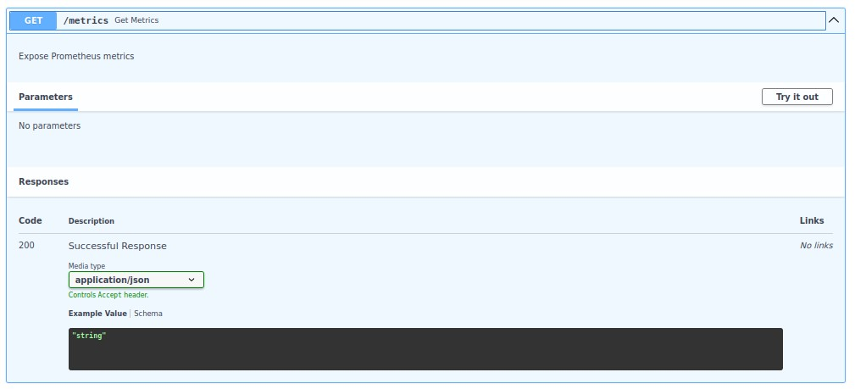
Backend Layer - Robot Service

Slide 11
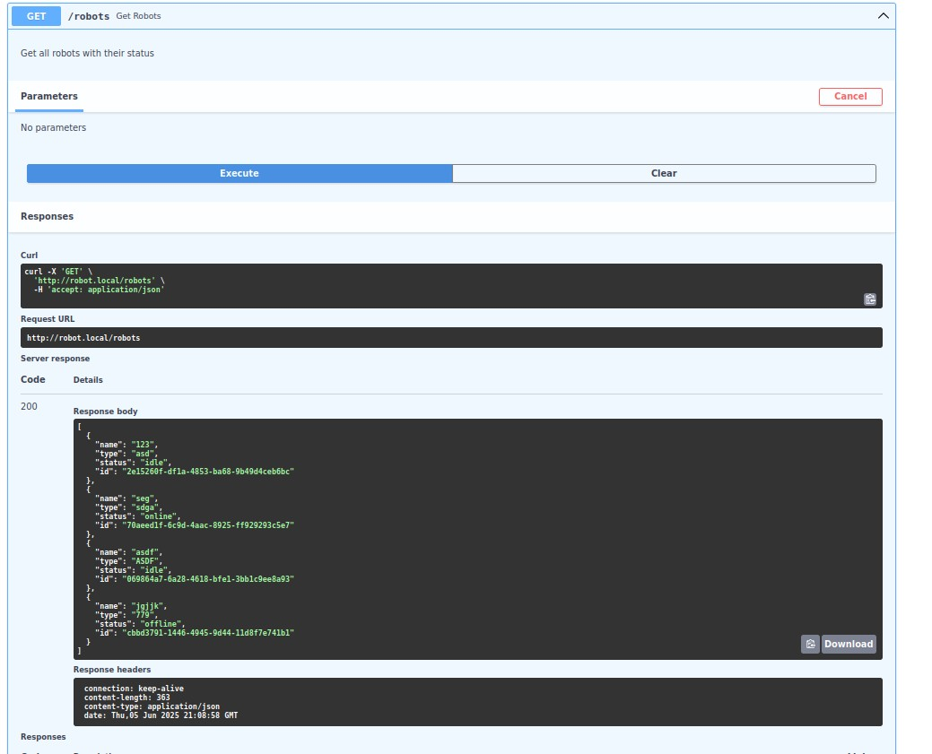
Backend Layer - Robot Service

Slide 12
Frontend Layer - Dashboard
Key Features
Robot management interface
Real-time metrics visualization
Log viewing and filtering
Key Tech Stack:
React for UI rendering
TypeScript for type safety
Material-UI for component library

Slide 13
React + TypeScript
Strong type safety and better developer experience with TypeScript
Large ecosystem of libraries and tools
Component-based architecture for reusability
Material-UI for consistent, modern UI components
React Query for efficient server state management

Slide 14
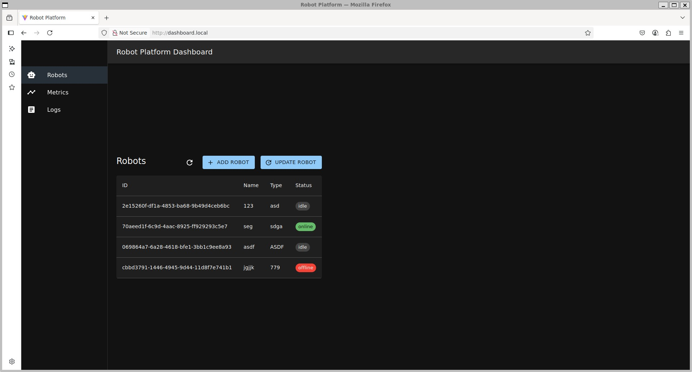
Frontend Layer - Dashboard

Slide 15
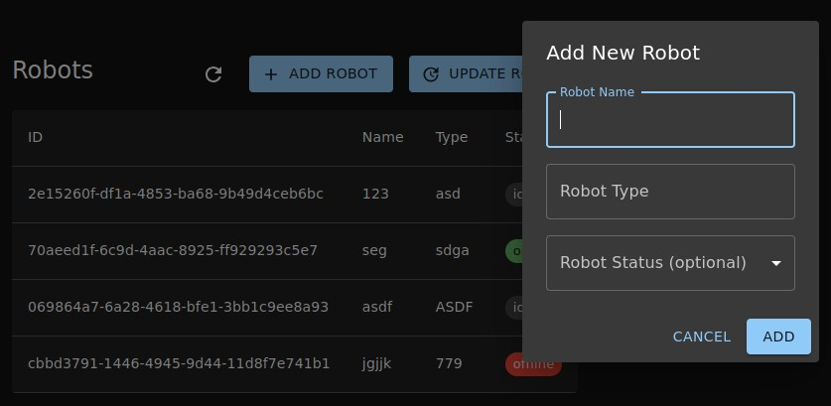
Frontend Layer - Dashboard

Slide 16
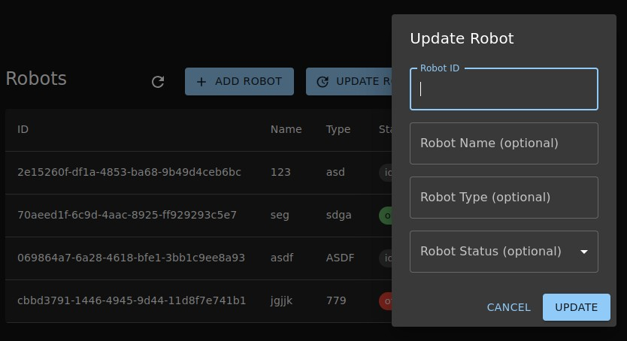
Frontend Layer - Dashboard

Slide 17
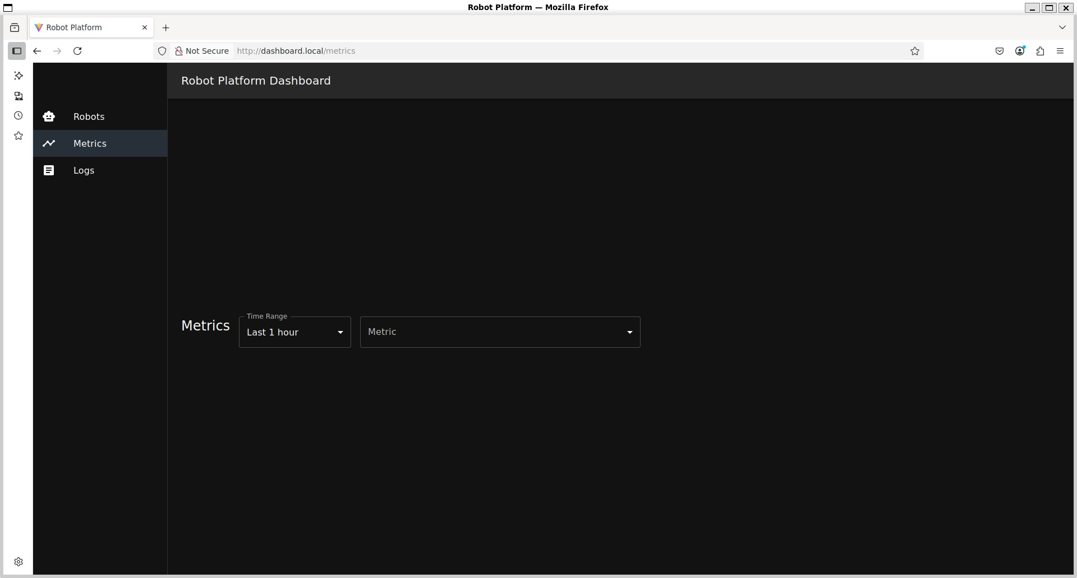
Frontend Layer - Dashboard

Slide 18
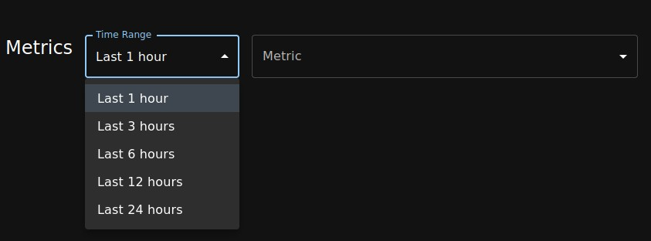
Frontend Layer - Dashboard

Slide 19
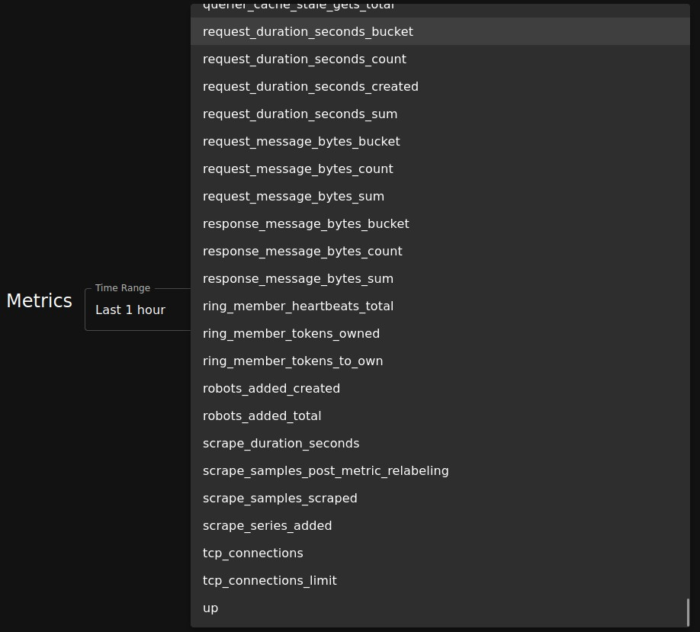
Frontend Layer - Dashboard

Slide 20
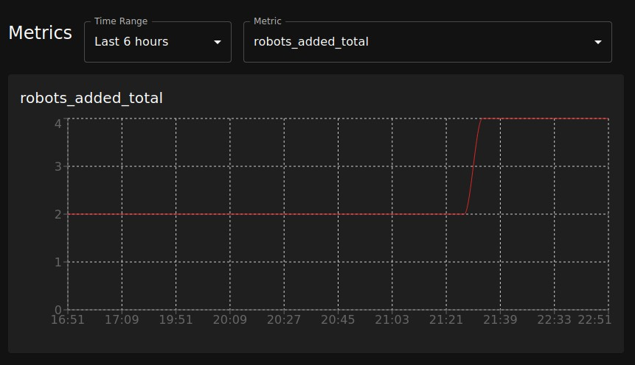
Frontend Layer - Dashboard

Slide 21
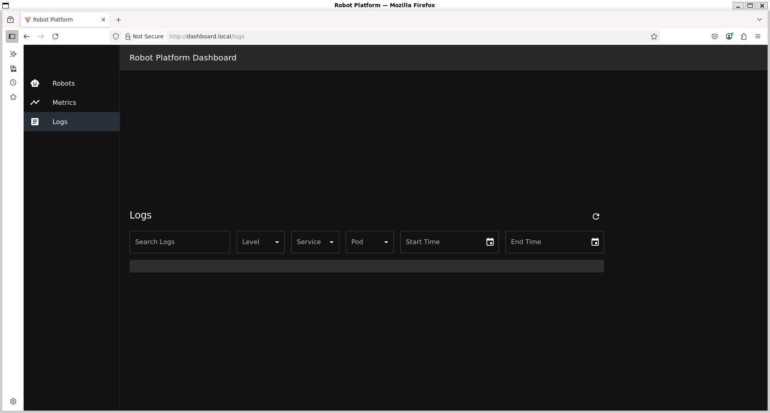
Frontend Layer - Dashboard

Slide 22
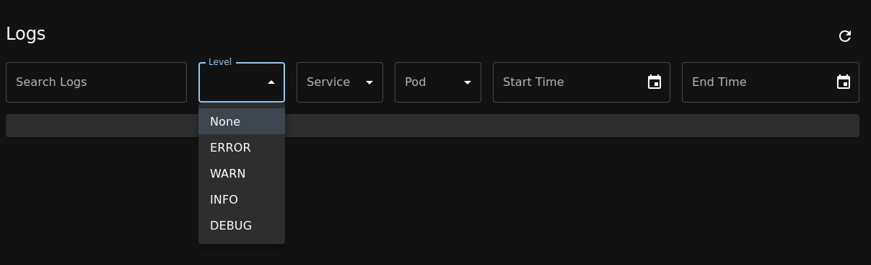
Frontend Layer - Dashboard

Slide 23
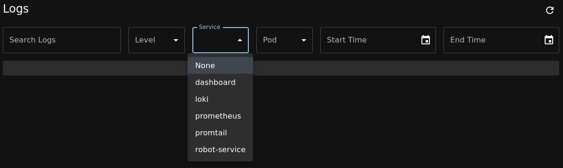
Frontend Layer - Dashboard

Slide 24
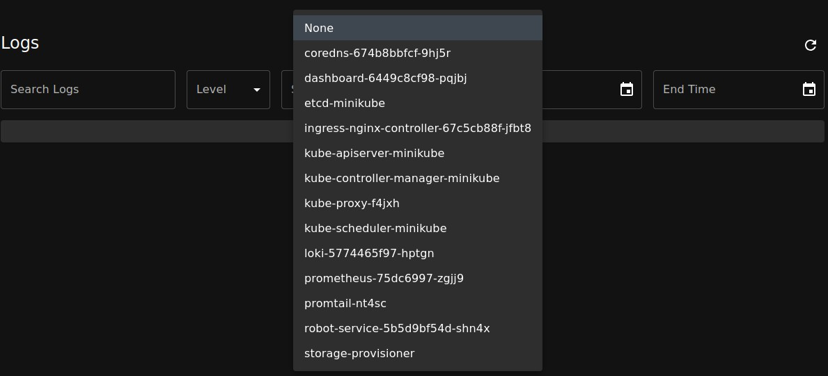
Frontend Layer - Dashboard

Slide 25
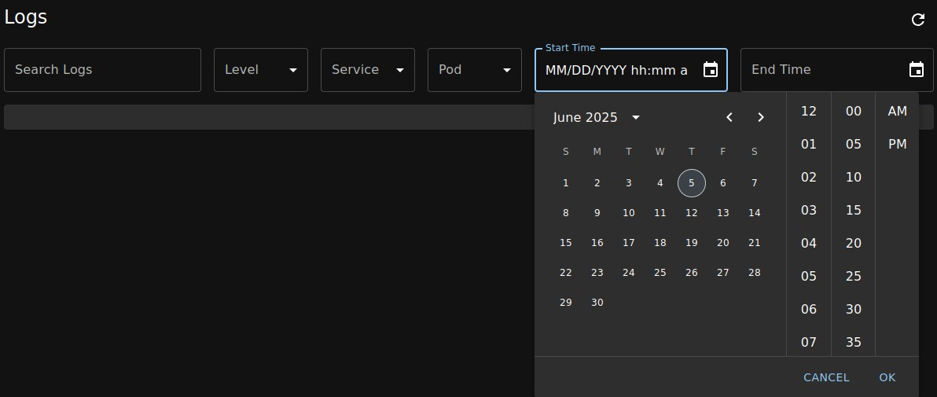
Frontend Layer - Dashboard

Slide 26
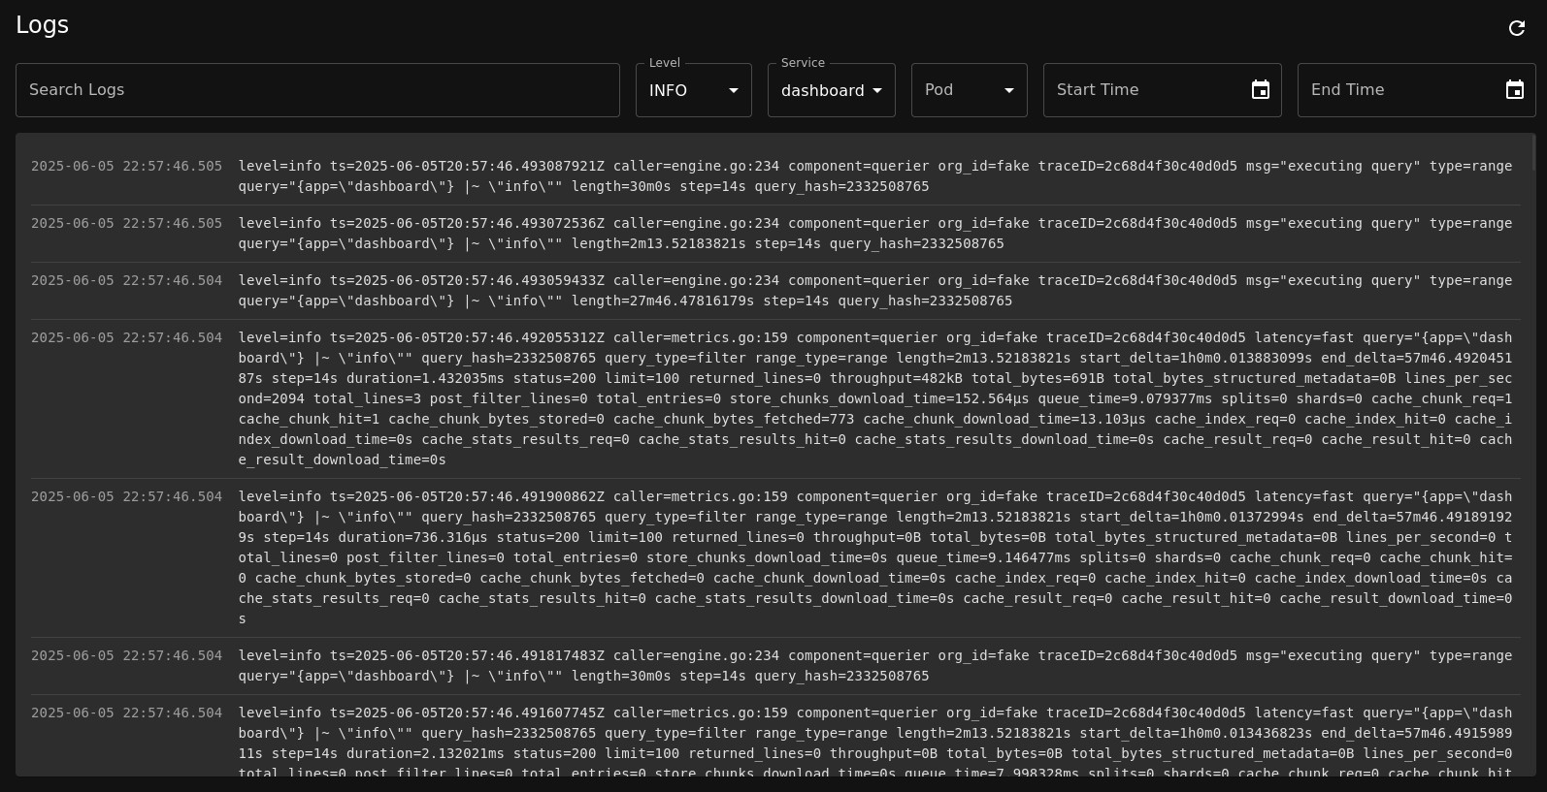
Frontend Layer - Dashboard

Slide 27
Observability Layer - Monitoring
Prometheus Server v2.45.0
Service Discovery via Kubernetes
Pull-based metrics collection
Key Metrics:
HTTP request metrices
Robot service metrics
Monitoring and logging service metrices

Slide 28
Prometheus
De facto standard for metrics in cloud-native applications
Pull-based architecture with native Kubernetes integration
Powerful PromQL query language
Rich ecosystem of exporters and integrations
Built-in alerting capabilities

Slide 29
Observability Layer - Logging
Loki v2.9.0 for log aggregation
Promtail v2.9.3 for log collection
Label-based indexing
Log streaming support

Slide 30
Loki + Promtail
Native Kubernetes integration
Label-based log aggregation (similar to Prometheus)
Efficient log storage with index separation
Strong LogQL query language
Easy integration with Grafana for visualization

Slide 31
Demo (if available)
http://dashboard.local
http://robot.local/docs

Slide 32
Code Go-through
https://github.com/sff0219/robot-platform

Slide 33
Assumptions and Tradeoffs Architecture Decisions
Monolithic backend -> modular backend
In-memory storage -> database
Metric and log Visualization -> use Grafana

Slide 34
Assumptions and Tradeoffs Scalability and Availability
Single replica deployment -> auto-scaling
Monitoring alerts
Backup and disaster recovery
Single node cluster

Slide 35
Assumptions and Tradeoffs Security
No authentication/authorization -> proper auth (OAuth2/JWT)
Plain HTTP -> HTTPS with TLS termination
Secrets management -> Kubernetes Secrets
Network policies

Slide 36
Assumptions and Tradeoffs Observability
Metrics with more business logic
Log aggregation with more features
Log filtering and search

Slide 37
Assumptions and Tradeoffs CI/CD Workflow
Development environment matches production
Build and use images directly -> use registry
More tests of different levels

Slide 38
Thanks for your attention! Any questions?

