Slide 1
研究プロジェクト結果
16B13360
Hana Hoshino

Slide 2
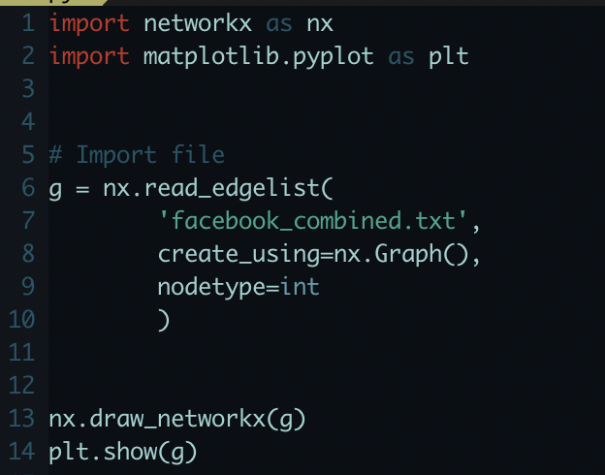
Tool
Name: Networkx
Written by pure Python → Easy to install
Demo on the right
Notes:
Calculating centrality takes time

Slide 3
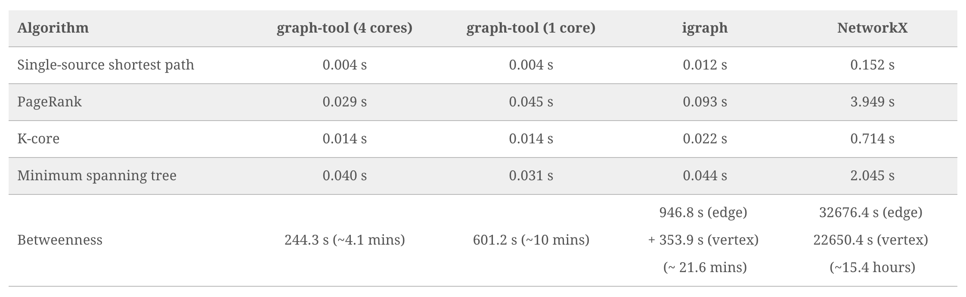
Tool
N=39,796 vertices and E=301,498 edges
20 to 170 times slower
https://graph-tool.skewed.de/performance
Notes:
What I found out: Bigger datasets tend to take time on networkx
Calculating centrality takes time
O(n^2) if fully connected

Slide 4
Data
Name：Social circles: Facebook
File Format: text file
About: A dataset of ‘friends list’ from Facebook 2012
Nodes: 4039
Edges: 88234
Person A’s ID Friend α’s ID
Person A’s ID Friend β’s ID
Person B’s ID Friend γ’s ID
Notes:
Snap (Stanford’s dataset)

Slide 5
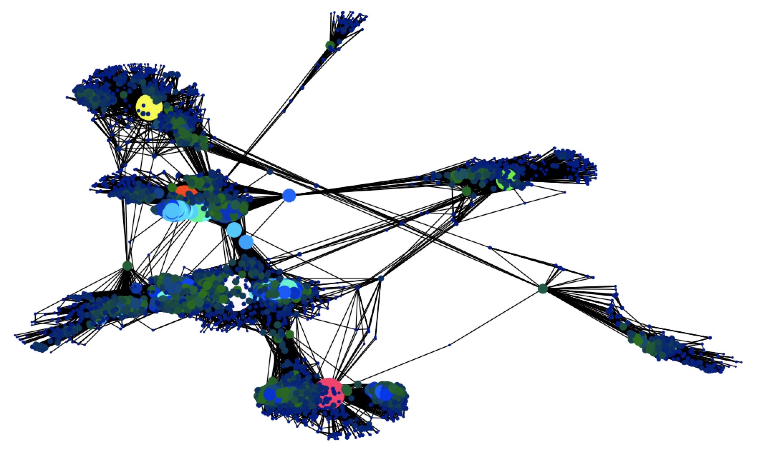
Output
Notes:
ノード間の反発力と、エッジのweightの大きさによる吸引力でノードの位置が決定されます。

Slide 6
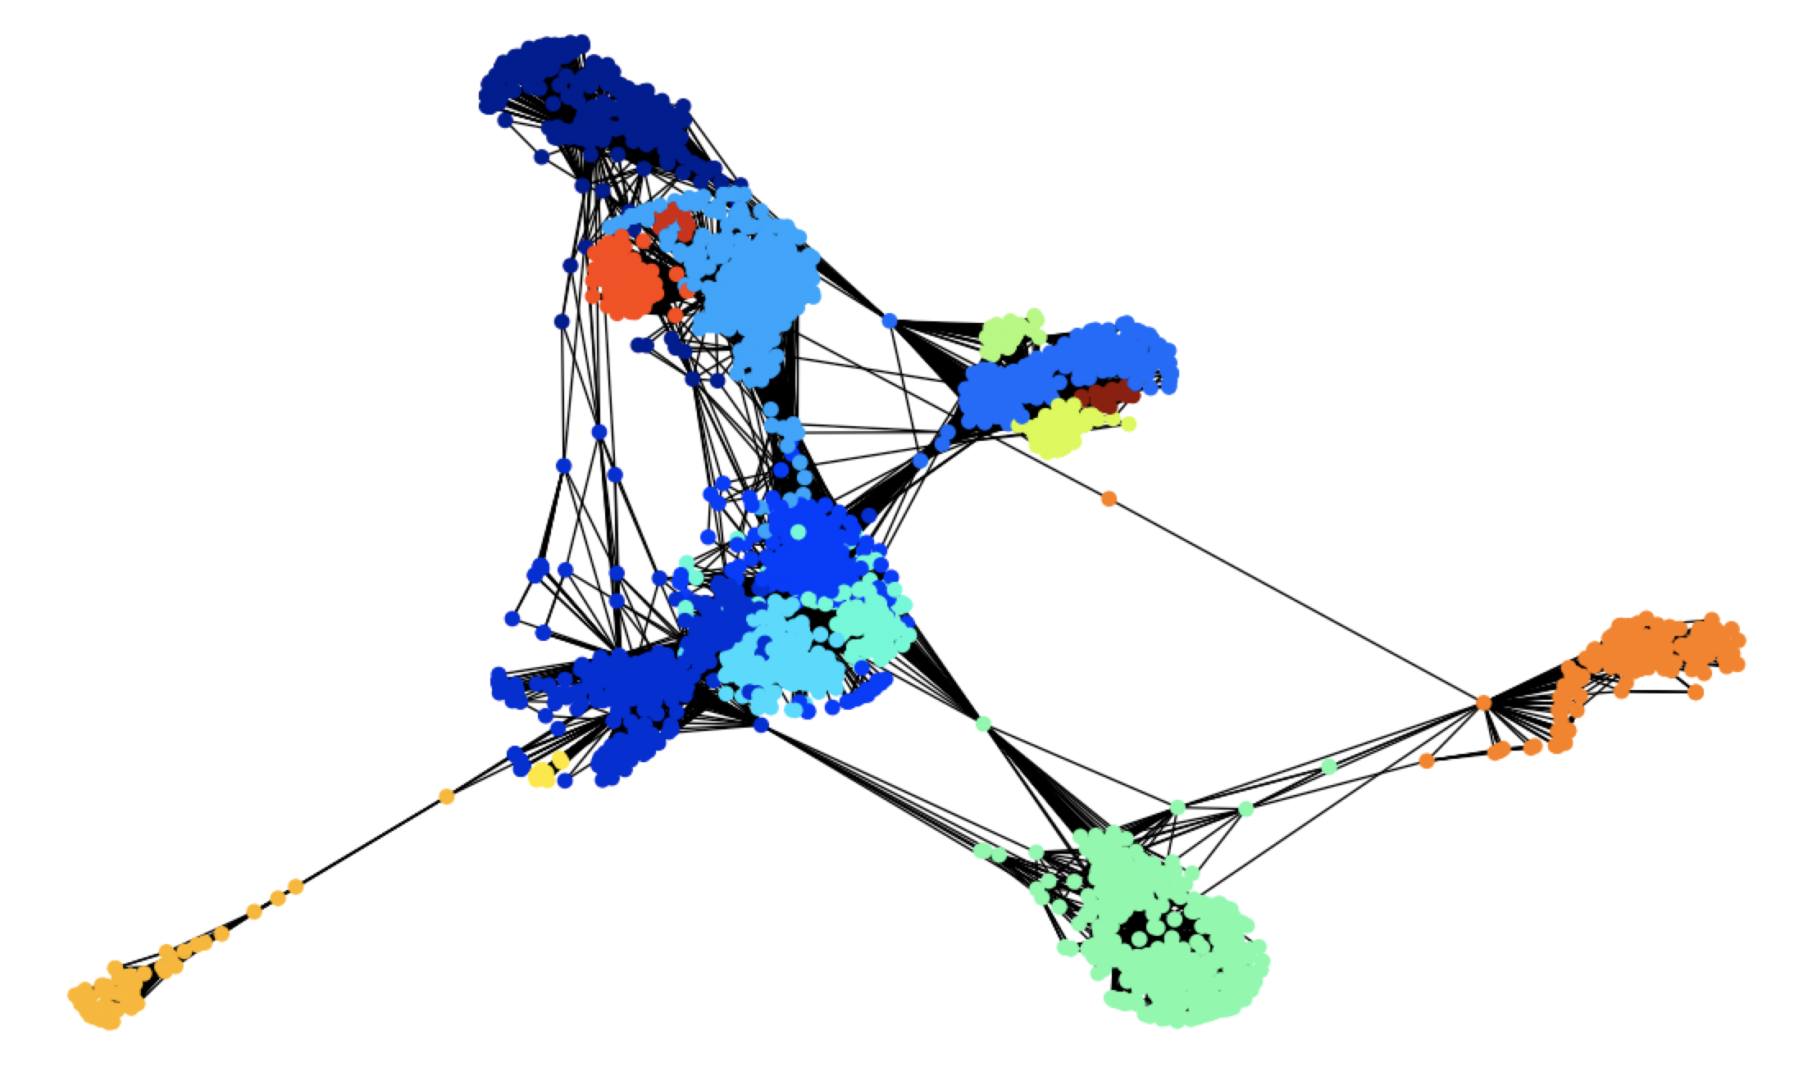
Output
With the help
of module ‘community’

Slide 7
Result
Average Degree: 43.6910
Average Shortest Path: 3.6923
Community: 16
Max Degree: 1045
Min Degree: 1
Max Degree Centrality: 0.258791480931154
Min Degree Centrality: 0.00024764735017335313
Notes:
Average friends per person is 43.6910
Community: 16

Slide 8
Future works
Add more node attributes (ex: age, education, country, etc.) and analyze each community
Look at each community in more details

Slide 9
Reference
https://blog.dominodatalab.com/social-network-analysis-with-networkx/
https://matplotlib.org/mpl_examples/color/colormaps_reference_05.png
https://snap.stanford.edu/data/ego-Facebook.html

Slide 10
THANK YOU FOR LISTENING

