Slide 1


Cheap Energy
Might Not Be Enough
A Trade Model of AI Compute Services
Michael Lokshin
March 2026

Slide 2
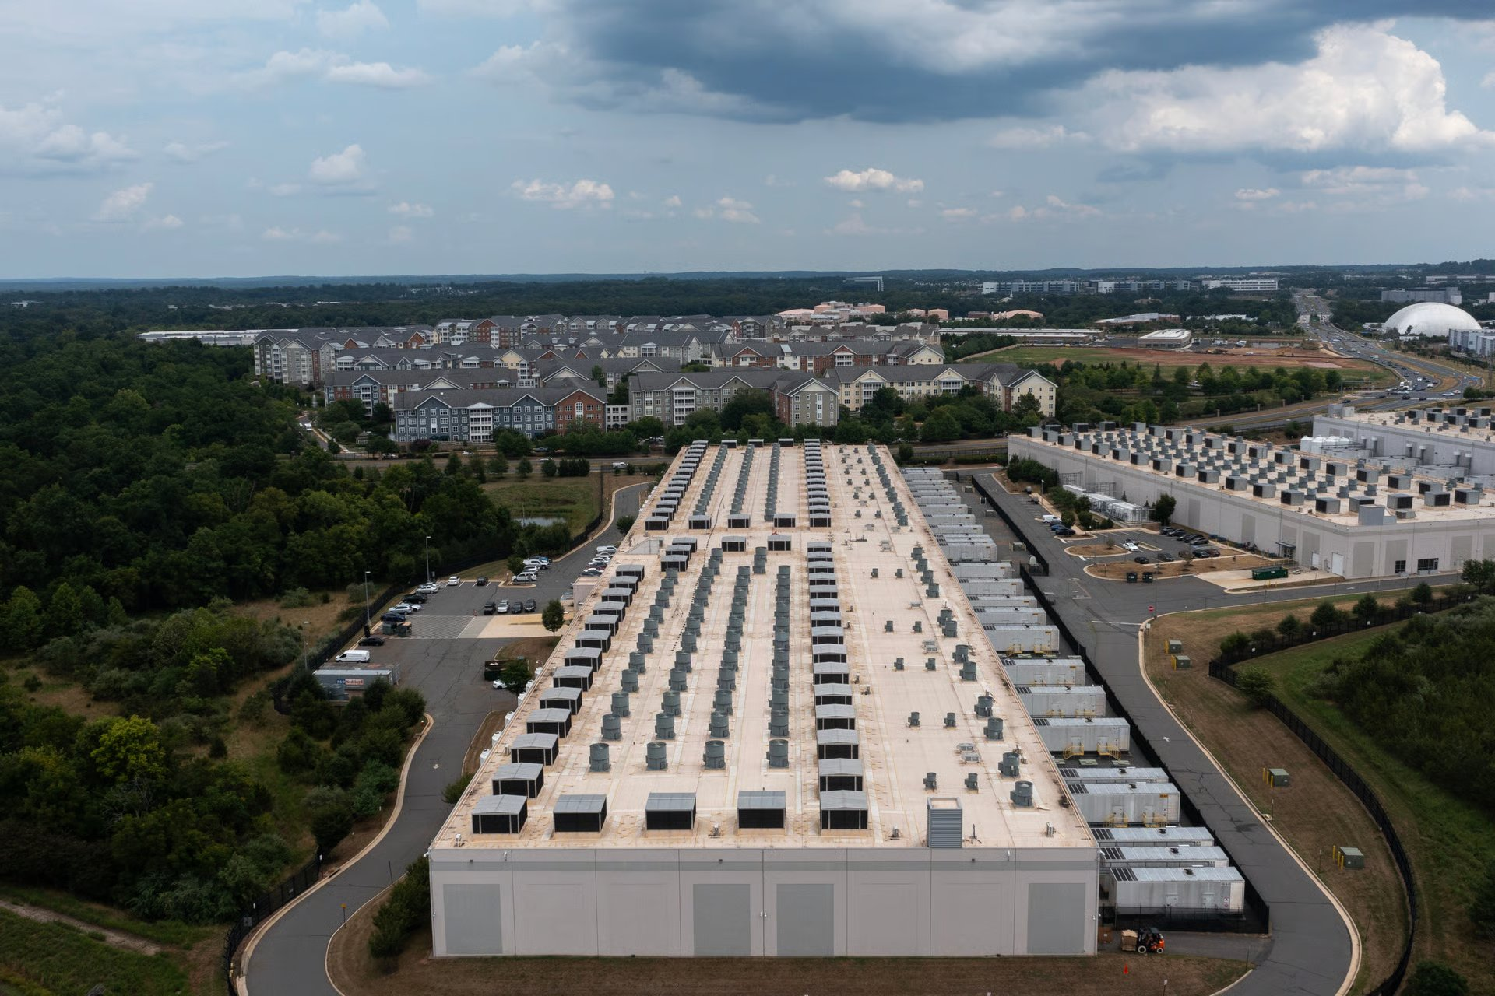




How FLOPs Are Produced
A data center converts electricity into floating-point operations — the raw commodity of AI
Electricity
→
Cooling
→
GPU Hardware
→
FLOPs Output
Grid power (pⱼᴱ)
Local price — only
country-varying input
PUE overhead
Climate-dependent
(θⱼ → cooling cost)
H100/B200 racks
Globally priced
(~90% of unit cost)
Compute services
Training (batch)
Inference (real-time)
Unit cost: cⱼ = electricity (~8%) + hardware (~90%) + networking + construction (~2%)

Slide 3
Developing Countries Are Joining the Race
Billion-dollar data center commitments are no longer confined to the US, Europe, and China
ARMENIA
SAUDI ARABIA
UAE
Firebird / NVIDIA AI Factory
HUMAIN / NEOM / DataVolt
OpenAI–G42 Abu Dhabi
$4B total (Phase 1: $500M) · 100 MW
50,000 NVIDIA GPUs · US-approved chip transfer
PM Pashinyan lobbied Trump directly
$23B+ in AI partnerships · 11 data centers
200 MW each · NEOM pivoting to DC hub
PIF goal: 3rd-largest AI provider globally
5 GW campus · largest single AI site globally
Stargate international expansion
Khazna 100 MW AI facility in Ajman
INDONESIA
KENYA
MALAYSIA
Jakarta / Batam DC corridor
Africa Data Centres / IXAfrica
Johor corridor (Microsoft / NTT)
Princeton Digital: $1B Jakarta campus
Microsoft & Google cloud regions
Largest SE Asian market by demand
East Africa's DC hub · 1 GW pipeline
Cheap geothermal power (~$0.07/kWh)
Microsoft & Google African cloud regions
$34B investment boom · $6B market by 2031
Microsoft 2nd cloud region (SE Asia 3)
Cyberjaya: 22 existing + 9 upcoming DCs
Key question: These countries have cheap energy and political will. Can they overcome sovereignty frictions and institutional gaps to capture AI compute demand?

Slide 4

The Opportunity: FLOP Exporting
2×
AI compute demand is doubling every six months. Data centers already consume 1.5% of global electricity — projected to more than double by 2030.
Countries can convert cheap electricity into high-value AI compute exports — moving up the value chain from raw resources to digital services.
Energy-rich developing countries — with cheap electricity, growing grid capacity, and political will — have a rare opportunity to leapfrog into high-value digital exports without the traditional industrialization path.
compute demand
doubling rate
85
countries
calibrated
$9B+
cloud exports
annually

Slide 5



This Paper's Contributions
1
Model
Capacity-constrained Ricardian model of compute trade with iceberg latency costs and bilateral sovereignty premia
Distinguishes training (latency-insensitive) from inference (latency-sensitive) — five equilibrium regimes emerge
2
Calibration
85-country calibration correcting for energy subsidies that distort headline cost rankings
Cost-recovery pricing replaces subsidized tariffs with LRMC for 13 countries; bilateral sovereignty premium from UNGA voting, data adequacy, and sanctions
3
Welfare & Policy
Characterize trade regimes and quantify the welfare cost of sovereignty premia
Welfare cost is 1.5% of compute spending (~$1.3B/yr) — small enough that domestic production can be rational for sovereign workloads

Slide 6



Related Literature
Existing work examines AI governance, digital trade, and data center geography — but no formal trade model of compute exists
AI & Comparative Advantage
IT Services Offshoring
Goldfarb & Trefler (2018)
Korinek & Stiglitz (2021)
Blinder (2006)
Brainard (1997), Helpman et al. (2004)
AI shifts advantage to data & human capital; developing countries risk being left behind
Labor-intensive and skill-biased — a different set of exporters than compute
Data Center Geography
Compute Governance
Flucker et al. (2013), Liu et al. (2023)
Lehdonvirta et al. (2024), Pilz et al. (2025)
Sastry et al. (2024)
World Bank (2025), Biglaiser et al. (2024)
Climate affects cooling costs; 'Compute North' holds 77% of capacity
Compute is well-suited for regulation but lacks a cost-to-trade framework
Gap: No formal model linking production costs → trade patterns → welfare costs for compute services

Slide 7
Model Architecture
A capacity-constrained Ricardian model with three innovations
Cost Structure
Trade Costs
Sovereignty Premium
Country-specific production costs from electricity, hardware (globally priced), and construction. PUE varies with climate.
Training is latency-insensitive (freely offshorable). Inference degrades with distance — localized markets.
Bilateral friction from geopolitical distance, regulatory gaps, and sanctions. Trust deficits as trade barriers.

Slide 8


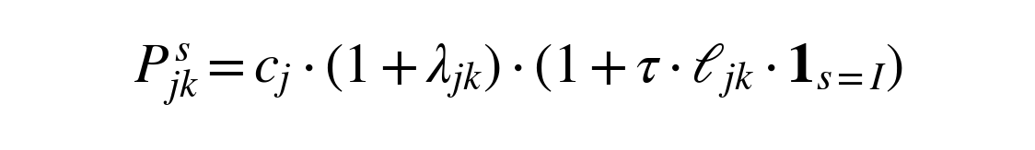
Model: Cost Structure & Trade Costs
(1) Production Cost
γ = GPU power draw (kW)
pⱼᴱ = electricity price ($/kWh)
PUE(θⱼ) = cooling overhead (θ = temp.)
ρ = hardware amortization (global, ~90%)
η = networking (global)
κⱼ/(Lf·H) = construction / (lifetime × hrs/yr)
(2) Bilateral Sovereignty Premium
dⱼₖ = geopolitical distance (UNGA voting)
Rⱼₖ = data-adequacy agreement (0/1)
Sⱼₖ = sanctions indicator → λ = ∞
(3) Delivered Cost
τ = latency degradation rate
ℓⱼₖ = round-trip latency (ms)
Training (s=T):
τ = 0 → no latency cost
Inference (s=I):
τ > 0 → cost rises with distance

Slide 9




Model: Equilibrium & Welfare
(4) Demand
ωₖ = share of installed DC capacity (MW)
Splits: Dᵀ = αΩωₖ (training), Dᴵ = (1−α)Ωωₖ (inference)
(5) Sourcing & Capacity Constraint
Each buyer picks cheapest delivered source
GPU-hours allocated to highest-margin use
Subject to grid capacity ceiling k̄ⱼ
(6) Training Market Clearing
Price = marginal exporter's cost
Infra-marginal exporters earn rents
Welfare:
Import markup + allocative inefficiency
from domestic production

Slide 10
Demand & Capacity Constraints
How demand is defined
How capacity constraints work
1
Global spending Ω
Total cloud compute market (~$90B/yr)
Each country has a capacity ceiling k̄ⱼ
(grid power + permitting + connectivity)
Without constraints: cheapest country serves all demand, pᵀ = c₁, zero rents
With constraints: cheapest fills up → price rises to marginal entrant's cost → infra-marginal exporters earn rents
2
Country shares ωₖ = k̄ₖ / Σk̄ₖ'
Proxied by installed DC capacity (MW)
US ~33%, China ~16%, EU ~15%, RoW ~36%
3
Training / inference split
Dᵀ = α · Ω · ωₖ (latency-insensitive)
Dᴵ = (1−α) · Ω · ωₖ (latency-sensitive)
Baseline: α = 40% training, 60% inference
$1.65+
pᵀ = marginal entrant
$1.60
$1.61
$1.59
$1.58
↕ rents
Key: demand shares are fixed — the model determines who supplies each country's demand, not how much each country demands.
KGZ
CAN
KOS
FIN
...
← cumulative capacity (GPU-hours) →

Slide 11
Why the Cost Spread Is Narrow
~90%
of unit cost is hardware
— identical across countries
12–20%
total cross-country cost spread
— narrower than virtually any
other tradable sector

Slide 12
Two Markets, Two Geographies
TRAINING
INFERENCE
Latency-Insensitive
Latency-Sensitive
Model training, fine-tuning, batch processing
No distance penalty — freely offshorable
Global market: cheapest producer wins
Weeks to months of compute time
Highly concentrated: 1–2 exporters serve most demand
Chatbots, autonomous systems, real-time agents
Quality degrades with distance (latency)
Regional market: proximity matters
Millisecond response required
More dispersed: regional hubs serve nearby demand

Slide 13
Five Equilibrium Regimes
Of nine possible combinations, only five arise in equilibrium (Proposition 1)
Regime | Training | Inference | Description
EE | Export | Export | Cheapest producers — global training + regional inference
IE | Import | Export | Regional inference hubs — not cheap enough for global training
ID | Import | Domestic | Import training, produce inference domestically
DD | Domestic | Domestic | High sovereignty premium — produce both domestically
II | Import | Import | High-cost countries — import both services
The remaining four combinations (e.g., training exporter + inference importer) are ruled out by cost ordering.

Slide 14
Training Exporters ⊂ Inference Exporters
Proposition 4: every training exporter also exports inference — but not vice versa
Inference Exporters
Why nesting holds
Training has no distance penalty (τ = 0), so a training exporter wins the global cost competition.
That same cost advantage dominates the latency markup for nearby buyers → it also wins inference locally.
Training
Exporters
Canada
Kyrgyzstan†
Kosovo†
Norway
But not vice versa
EE
Finland
UK
An inference exporter only needs to beat neighbors within the latency threshold.
It may not be cheap enough to win the global training market, where every country competes head-to-head on cost alone.
IE
Implication: regimes EI, ED, and DE cannot arise — the five equilibrium regimes in Proposition 1 are the only ones possible

Slide 15
Raw Tariffs vs Cost-Recovery (Table 3)
Subsidized tariffs replaced with long-run marginal cost — 13 countries adjusted, 40 change trade regimes
# | (1) Raw Tariffs | $/hr | Type |  | (2) Cost-Recovery | $/hr | Type
1 | Iran | $1.56 | DD* | → | Kyrgyzstan | $1.58 | EE†
2 | Turkmenistan | $1.57 | DD* | → | Canada | $1.59 | EE
3 | Ethiopia | $1.58 | EE† | → | Ethiopia | $1.59 | II
4 | Kyrgyzstan | $1.58 | EE† | → | Kosovo | $1.60 | IE†
5 | Egypt | $1.58 | EE† | → | Tajikistan | $1.60 | II
6 | Algeria | $1.59 | EE† | → | Montenegro | $1.60 | IE†
7 | Canada | $1.59 | EE | → | China | $1.61 | II
8 | Russia | $1.59 | DD* | → | Ukraine | $1.61 | IE†
9 | South Africa | $1.60 | II | → | Argentina | $1.61 | II
10 | Kosovo | $1.60 | IE† | → | Colombia | $1.61 | II
EE = training + inference exporter IE = inference exporter DD = domestic II = full importer * = sanctioned † = developing

Slide 16
Sovereignty Reshapes Everything (Table 3)
Bilateral sovereignty premia shift most developing countries from exporters to domestic producers
Country | (1) Raw Rank | Type |  | (2) Cost-Rec. Rank | Type |  | (3) Bilateral Rank | Type
Canada | 7 | EE | ▲ | 2 | EE | ▲ | 1 | EE
Kyrgyzstan | 4 | EE† | ▲ | 1 | EE† | ▼ | 4 | EE†
Iran | 1 | DD* | ▼ | 24 | DD* | — | — | DD*
Ethiopia | 3 | EE† | — | 3 | II | ▼ | 8 | DD
Kosovo | 10 | IE† | ▲ | 4 | IE† | ▼ | 9 | DD
Finland | 24 | IE | ▲ | 16 | IE | ▲ | 6 | IE
USA | — | II | — | — | II | ▲ | 2 | DD
Turkmenistan | 2 | DD* | ▼ | 19 | DD* | — | — | DD*
Norway | 21 | IE | ▲ | 14 | IE | ▲ | 5 | DD
— = not in top 25 (USA high-cost importer) or no bilateral rank (Iran, Turkmenistan sanctioned → forced domestic)
Only Canada + Kyrgyzstan remain exporters under bilateral spec
Trusted advanced economies rise as developing exporters fall

Slide 17

The Central Finding
Countries best positioned to export compute on cost grounds are precisely those excluded by bilateral trust deficits.
Cost advantage exists
Trust deficits eliminate it
Welfare cost: ~1.5%
Developing countries with cheap energy rank among the lowest-cost producers under cost-recovery pricing.
Bilateral sovereignty premia shift nearly all developing countries to domestic production or importing.
Demand-weighted welfare loss from sovereignty premia is 1.5% of compute spending — modest but nontrivial.

Slide 18
A Dual Implication
The narrow cost spread cuts both ways
Easiest Sector to Enter
Most Vulnerable to Frictions
Because hardware is globally priced and dominates costs, the absolute barrier to cost-competitiveness is low. Countries with cheap electricity and favorable cooling face a small gap to close.
The same narrowness means even modest frictions — a sovereignty premium, a governance penalty, or a higher cost of capital — are sufficient to alter a country's trade regime entirely.

Slide 19
Robustness: Sensitivity Analysis
Cost rankings are stable across plausible parameter variation
Hardware cost share (ρ ± 4%)
Higher ρ compresses the locally-penalized share → governance penalties muted → developing countries gain competitiveness.
Lower ρ widens the electricity and construction share → cold-climate, low-cost countries strengthen their advantage.
Uniform sovereignty premium (λ = 10%)
Most countries produce domestically under either bilateral or uniform specification — regime assignments are similar.
Only 2 countries (Canada, Kyrgyzstan) remain exporters under both. The narrow cost spread means 10% is enough to flip regimes.
Sovereignty tiers (3 workload segments)
Sovereign workloads (10% of demand): domestic only. Regulated (20%): higher compatibility weight. Commercial (70%): standard.
Tiered approach more realistic than uniform — governments rarely apply the same standard to classified vs. commercial AI.
Core result stable: the binding constraint is institutional credibility, not energy cost, across all specifications

Slide 20
Caveats & Extensions
Factors outside the current model that would further narrow the set of viable exporters
GPU Export Controls
Endogenous Electricity Prices
US restrictions bar Iran, Russia, Belarus, and (partially) China from acquiring frontier GPUs. Model's cost advantage for sanctioned countries is moot without hardware access.
A 100 MW data center in Kyrgyzstan would consume ~10% of national generation. At scale, marginal cost pricing would push electricity above the current average tariff.
Cost of Capital
Next-Gen GPUs (B200+)
Calibration assumes uniform WACC. In practice, an OECD hyperscaler at 8% faces $1.58/hr; a developing-country entrant at 15% faces $1.62/hr — erasing cost advantage from cheap energy.
Successor GPUs deliver ~4× training throughput at ~1 kW. Higher power draw widens the absolute electricity gap, modestly strengthening developing-country advantage on energy costs.
Direction of bias: all four factors narrow the set of viable exporters beyond the baseline calibration. GPU controls and capital costs work against developing countries; endogenous prices work against small countries; GPU upgrades slightly favor energy-rich ones.

Slide 21
Policy Implications
Training vs Inference
Institutional Credibility
Restricting training imports raises costs without offsetting proximity gains. Inference has a genuine latency-based case for domestic production.
The binding constraint is not energy cost but institutional trust: non-sanctioned status, credible contracts, network connectivity, regulatory stability.
Data Localization Risk
Resource Curse Parallels
Broad data localization requirements risk foreclosing both import savings and regional export opportunities — the very gains the model predicts.
Concentrated compute export revenues could trigger Dutch disease dynamics. Revenue-sharing models (sovereign wealth fund vs elite capture) determine outcomes.

Slide 22

Key Takeaway
Compute is the easiest sector for developing countries to enter on cost grounds — and the most vulnerable to the small frictions that keep them out.
Hardware dominance compresses cross-country cost spread to 12–20%
Cost-recovery pricing reveals genuine comparative advantage in energy-rich countries
Bilateral sovereignty premia eliminate developing-country exports
Institutional credibility, not energy cost, is the binding constraint
Michael Lokshin • March 2026 • michael.lokshin@gmail.com

