Slide 1

Sentimental Analysis on COVID-19 Vaccine Tweets
MSBA 305 – Data Processing Framework
Done By:
Maryam Ahmed Ali
Ibrahim Al-Bahri
Mazen Hajj Diab
Samer Haidar

Slide 2
Problem Statement
There are 72.3 million confirmed COVID-19 cases in the world
COVID- 19 caused a total of 1.63 million deaths worldwide
COVID-19 has spread to 218 Countries and Territories around the world
The virus caused a major economic shock and affected the lives of millions of people
COVID-19
The United Kingdom started vaccinating citizens a few days ago
The United States has just authorized the vaccine a few days ago
Many countries have already started to acquire the vaccine and will start distributing it soon
The public opinion is still hesitant to take the vaccine
A lot of people around the world are doubting the effectiveness and safety of the vaccine
Vaccine
In order to investigate the public’s opinion regarding the Covid-19 vaccine, we will analyze people tweets on Twitter
We will examine their overall opinion towards the vaccine using sentimental analysis
Additionally, we will visualize some statistical measurements considering countries, source of tweets, number of followers, number of likes, etc.
Analysis

Slide 3
A huge amount of data is being generated everyday on Twitter.
More than 500 million tweets are posted per day.
Twitter’s tweets are public and accessible to everyone.
Twitter’s API allows you to filter the tweets by specifying a date and topic for your search.
We can use twitter data to keep track of peoples’ concerns and opinions regarding certain issues
Why Twitter

Slide 4
Workflow
First, we signed up for Twitter developer account, created a project and an app.
Next, we extracted 4000 tweets having the following hashtag #Covid19Vaccine and saved them to a csv file
After, we cleaned and organized the data
We analyzed and visualized the data and performed a sentimental analysis to examine peoples’ opinions on the vaccine.
We established a connection with MySQL and inserted the dataframe to our database

Slide 5
Analysis

Slide 6
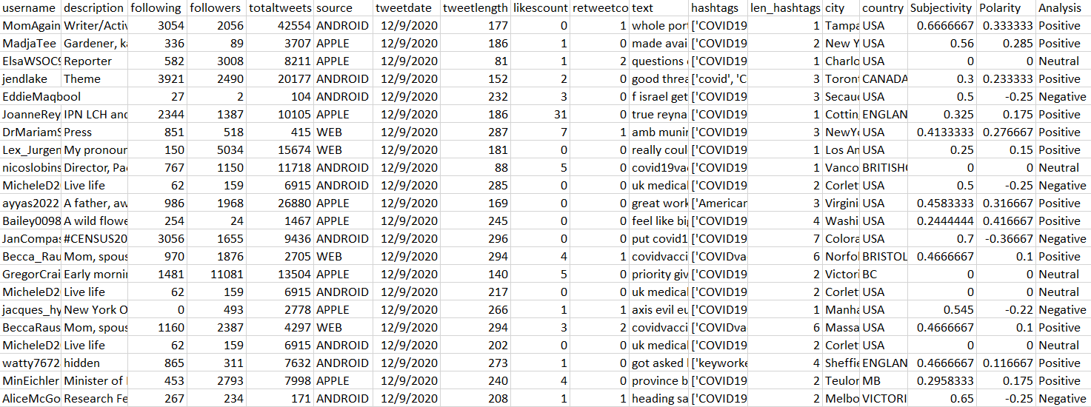
Question 1: What are the total number cleaned data points (tweets) used?
Total Tweets: 4000
Cleaned Dataset: 1918 Tweets

Slide 7
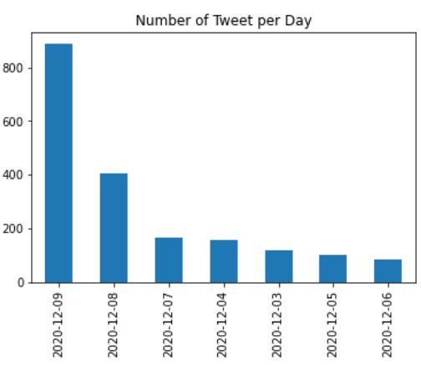
Question 2: What is the date range of these tweets?

Slide 8
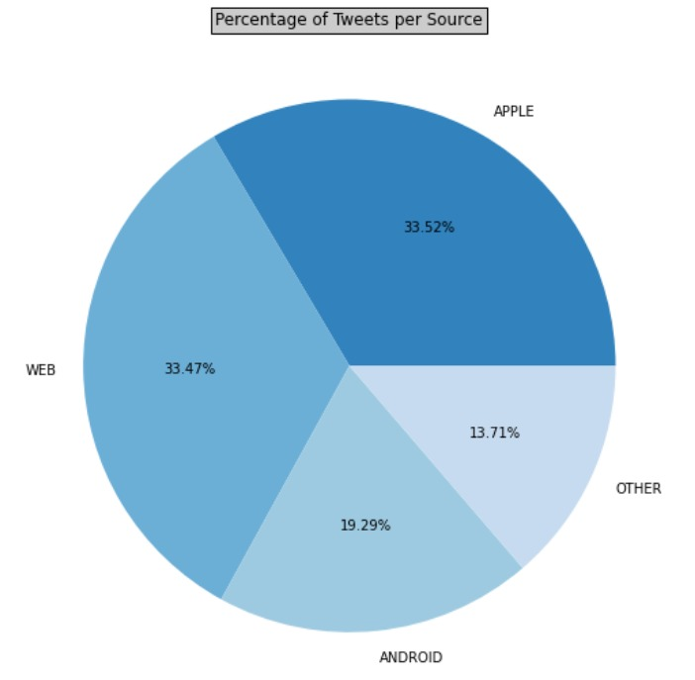
Question 3: From where are these users tweeting?

Slide 9
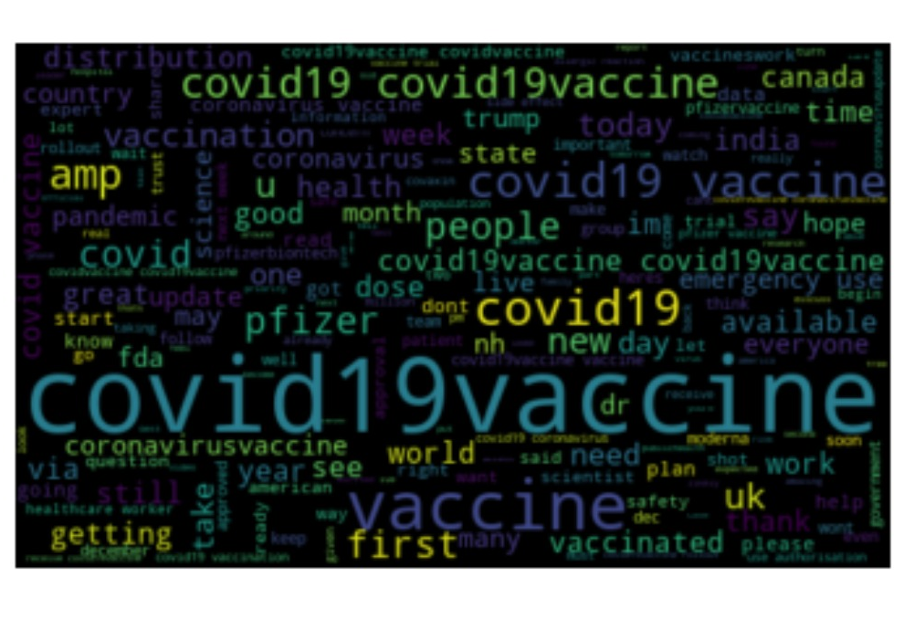
Question 4: What are the most used words in these tweets?

Slide 10
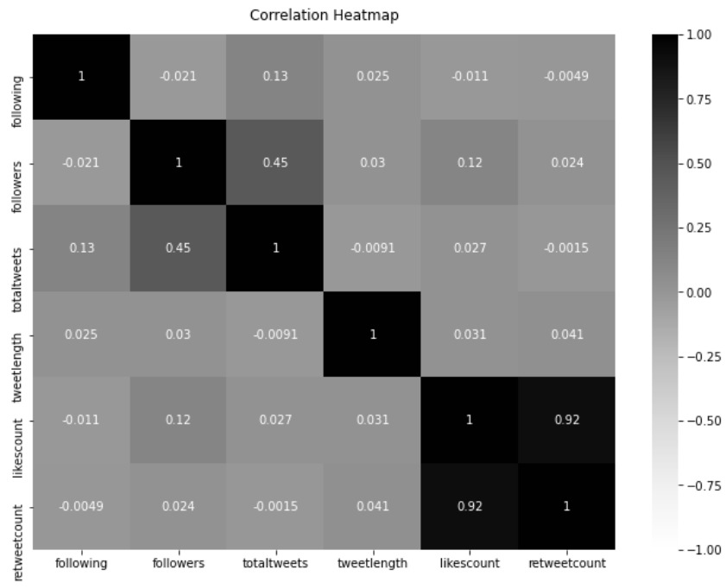
Question 5: What is the correlation between the different numerical variables?

Slide 11
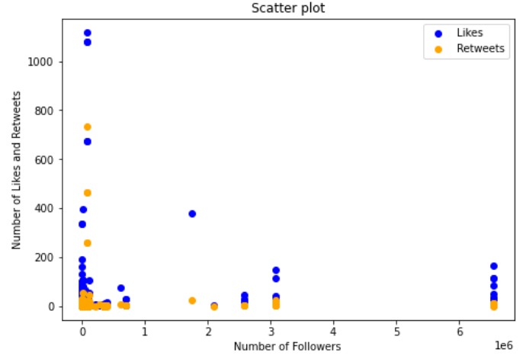
Question 6: What is the correlation between number of likes, and retweets and the number of hashtags used?

Slide 12
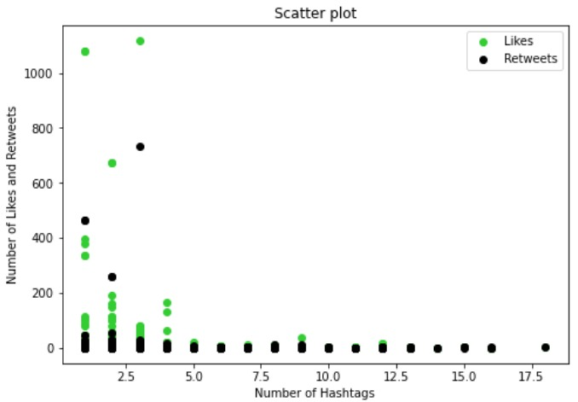
Question 7: What is the correlation between number of likes and the number of hashtags used?

Slide 13
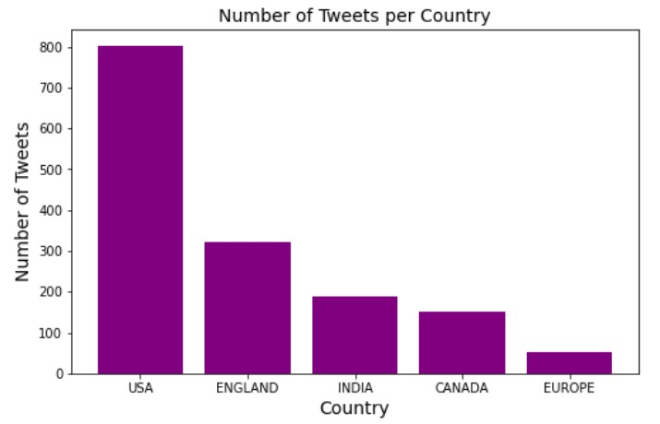
Question 8: What are top 5 countries that tweeted the most?

Slide 14
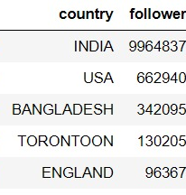
Question 9: What are top 5 countries where the users have the most reach ?

Slide 15
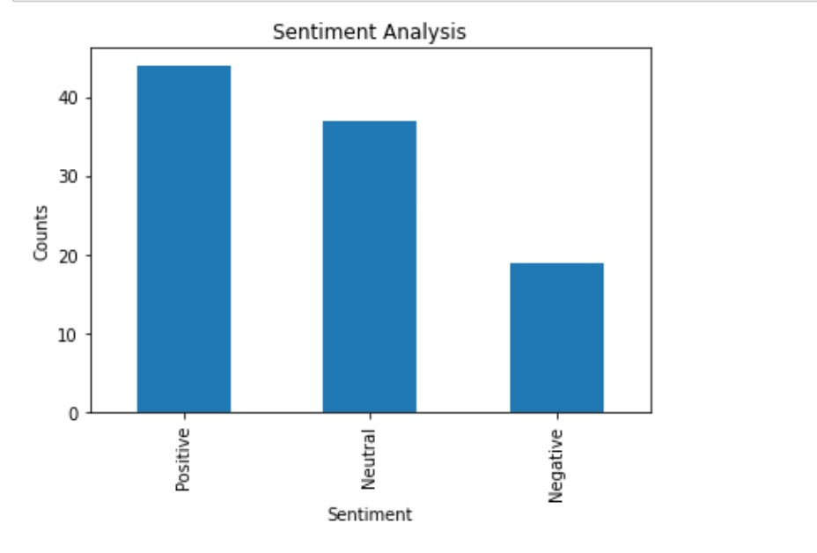
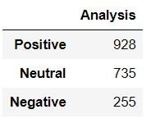
Question 10: What is the number of tweets for each Analysis Category?

Slide 16
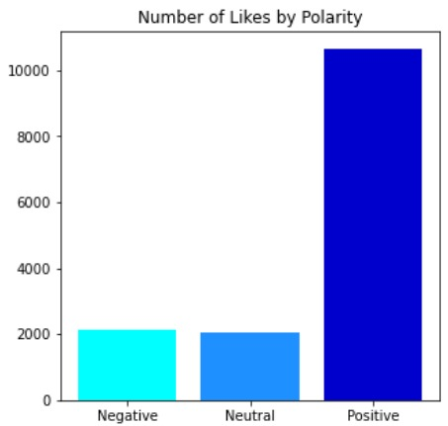
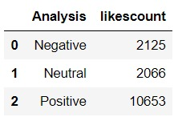
Question 11: What is the number of likes for each Analysis Category?

Slide 17
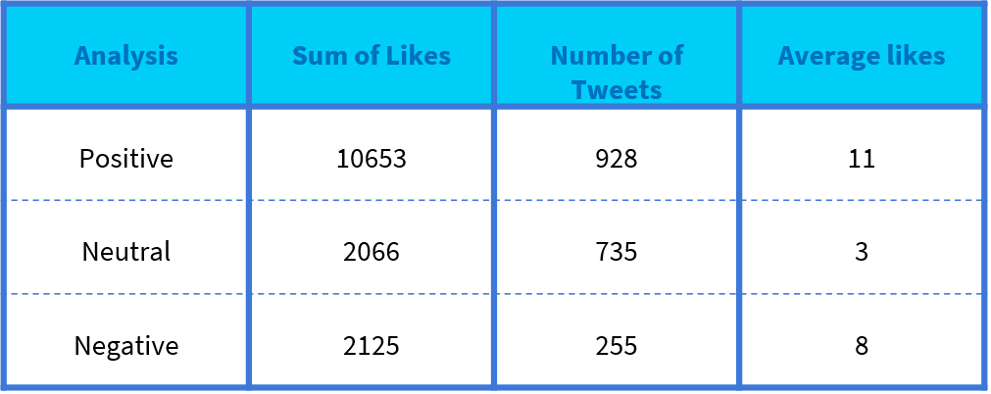
Question 12: What is the average likes per tweet for each Analysis Category?

Slide 18
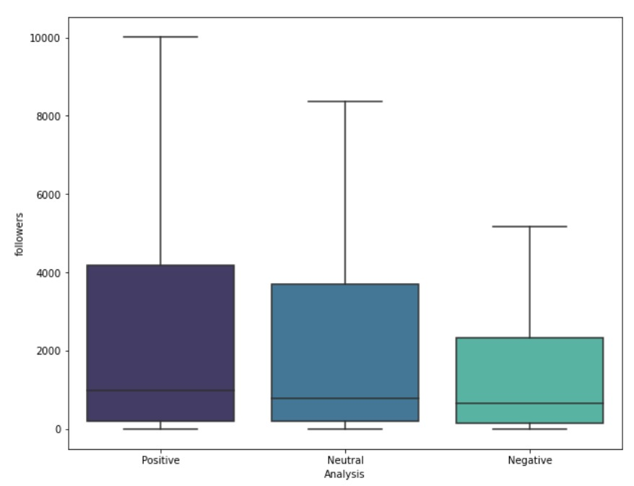
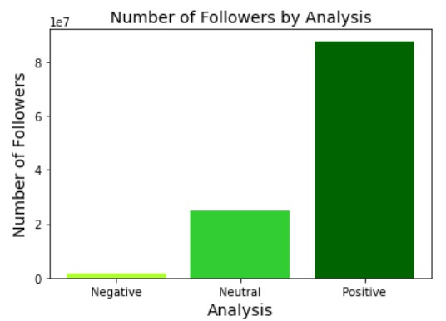
Question 13: What is the reach of tweets for each Analysis category

Slide 19
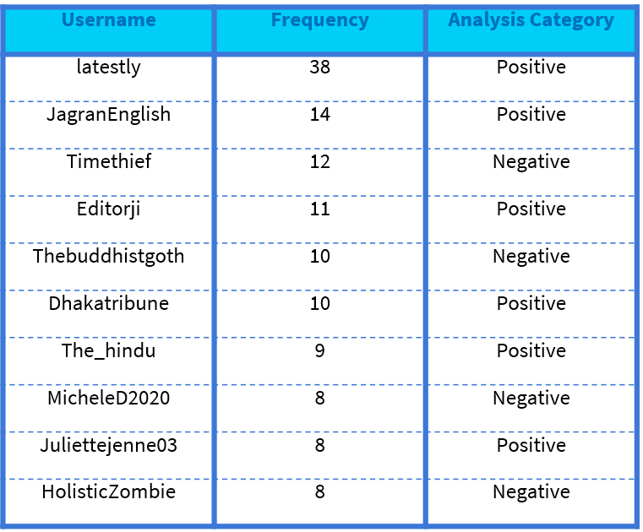
Question 14: Who are the top 10 users of frequency of tweets and what is their analysis category?

Slide 20
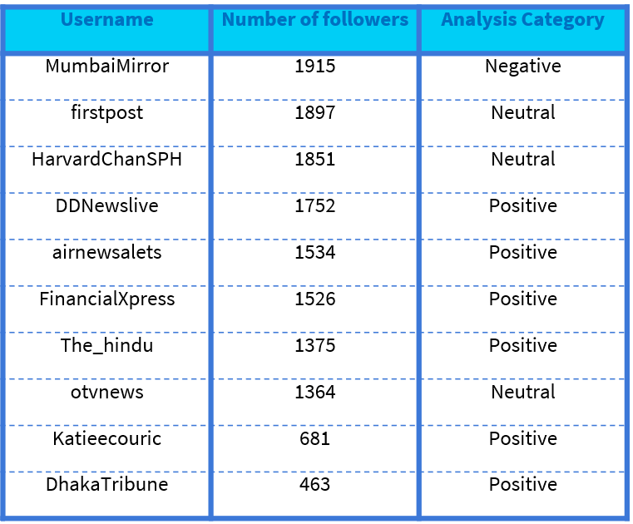
Question 15: Who are the top 10 users with the highest number of followers and what is their analysis category?

Slide 21
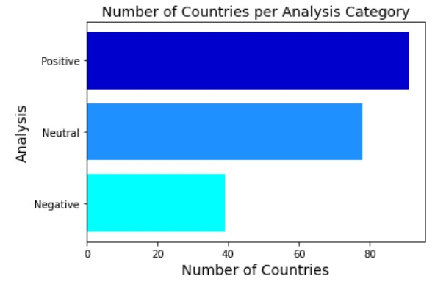
Question 16: What is the number of countries per Analysis category

Slide 22
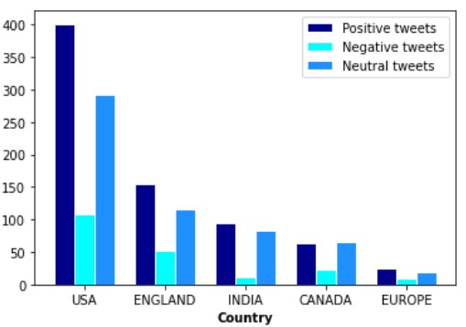
Question 17: Number of tweets per each analysis category for the top 5 countries

Slide 23
Conclusion
Although a significant portion of tweets is negative, most of them are positive
Most citizens support taking the COVID-19 vaccine
Some countries’ citizens are more accepting to taking the vaccine than others

Slide 24
Thank You

