Slide 1

Basic Java
Notes:
Introducción
Primer parte
Define el rol de un diseñador de experiencia de usuario (diseñador de interfaz de usuario)
Segunda parte
Presentación de herramientas técnicas, definición de HTML

Slide 2
What’s the goal of this practice?
Let’s start programming!
Goals:
Familiarize yourself with programs.
Begin to apply what we saw in class.

Slide 3
What do we know so far?
We still do not know JAVA, but we learned minimal programming concepts from previous classes:
Basic structure of a program.
Variables and constants.
Logical operations.
Programs can do mathematical calculations.
Notes:
Introducción
Primer parte
Define el rol de un diseñador de experiencia de usuario (diseñador de interfaz de usuario)
Segunda parte
Presentación de herramientas técnicas, definición de HTML

Slide 4
What do we know so far?
However, we still do not know how to write a JAVA program for the computer to understand us, and that will take several classes more.
So we are going to see some things that we need to know to do this Practice, but we are not interested yet to understand what we are doing at the JAVA level or how, just to understand the program in the same way we saw it in the previous classes.

Slide 5
What do we know so far?
In this Practice we will focus on the problem / algorithm we want to solve.

Slide 6
What are we using?
To run a JAVA program on our computer, we need to first install a set of programs and tools.
As this is complex and time consuming, in order to test our first simple programs, we will run everything on an online site where we can write our Java code directly and try it without worrying about installing anything.
The site is:
http://www.tutorialspoint.com/compile_java_online.php

Slide 7
Basic java structure
public class HelloWorld {
public static void main(String []args) {
System.out.println("Hello World");
}
}

Slide 8
Basic java structure
public class HelloWorld {
public static void main(String []args) {
System.out.println("Hello World");
}
}
CLASS DECLARATION: WE ALWAYS WRITE THIS LINE AS IS AT THE BEGINNING OF ANY PROGRAM
FOR NOW WE DON’T CARE WHAT IT MEANS!

Slide 9
Basic java structure
public class HelloWorld {
public static void main(String []args) {
System.out.println("Hello World");
}
}
METHOD DECLARATION : THE SECOND LINE WILL ALWAYS BE LIKE THIS
WE DO NOT CARE WHAT IT MEANS FOR NOW!

Slide 10
Basic java structure
public class HelloWorld {
public static void main(String []args) {
System.out.println("Hello World");
.
.
.
.
}
}
WITHIN THE BRACKETS WE’LL HAVE OUR ALGORITHMS
BODY

Slide 11
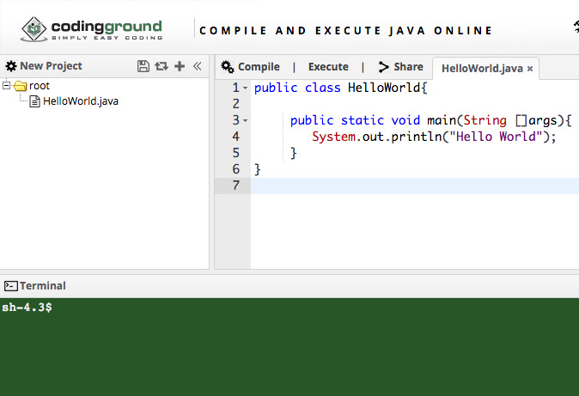
Our environment

Slide 12
Our environment
COMPILE: CLICK HERE BEFORE EXECUTE

Slide 13
Our environment
EXECUTE: CLICK HERE

Slide 14
How to write our program?
Declare a numeric variable x
var Number: x
In Java:
int x;

Slide 15
How to write our program?
Declare a text variable x
var Text: y
In Java:
String y;

Slide 16
How to write our program?
Print “Hello”
print “Hello”
In Java:
System.out.println(”Hello");

Slide 17
How to write our program?
Print a variable on screen
Pseudo code:
var Number: x
X = 2
print x

Slide 18
How to write our program?
JAVA:
int x;
x = 2; System.out.println(x);

Slide 19
How to write our program?
IMPORTANT: In Java, lowercase and uppercase matter
Not the same
int x;
than
INT x;
DOESN’T WORK

Slide 20
How to write our program?
Every line ends in semicolon
;
Example
int x;

Slide 21
Practice 1
LET’S DO IT!

Slide 22
Practice 1
1 - Declare a variable that contains your name. Then show your name on the console. For example: if your name is John, the console output should say ”John".

Slide 23
Practice 1
2 – Modify the previous application to show a welcome message in the console, as follows: if your name is John, the console output should say "Welcome John."

Slide 24
Practice 1
3 – Declares two variables of numeric type. Assign a value to each variable. Then display the sum of the two variables on screen.

Slide 25
Practice 1
5 – Declare a numeric variable and assign a value to it. Then write the statements to
A- Increase the variable by 77.
B- Decrease it by 3.
C- Duplicate its value.

Slide 26
Practice 1
6 – Declare four numeric variables a, b, c, and d, and assign values to them. Then do what is necessary so that
B takes the value of C.
C takes the value of A.
A takes the value of D.
D takes the value of B.
Display the values in console.
Hint: Is it enough to use 4 variables?

