Slide 1

INTRODUCTION to Computing

Slide 2
THE TOPICS
Computing and Informatics
Programming
Program
Language
Translation

Slide 3
IT AND COMPUTING
Informatics is the science that studies everything related to the processing of information in electronic devices known as computers.
It is the product of an increasingly frequent need in the human being, to be informed.

Slide 4
COMPUTING
¿And computing?
In general terms, several authors agree that, at present, it
refers to the same thing.
If you insist on a definition: you can reserve the word
computing for science that covers more formal issues related
to the processing of a computer.
Programming Languages Theory
Graphic Computing
Operative Systems
Computational Complexity

Slide 5
INFORMATICS
Computer Science is based on the fundamentals of:
Programming
Software development methodologies
Computers’ architecture
Networking
AI
Some parts of electronics
Even the social impact of computer systems
It is possible to understand by computer science the synergic union of all this set of disciplines.

Slide 6
COMPUTER
It is a programmable machine, which can perform different jobs depending on the preparation given.
It has numerical and logical calculation capacity.
It works like a robot, that is, it is totally conditioned to the orders of man.
It doesn’t work stand alone
The computer does not reason or create solutions, but executes a series of commands that are provided.

Slide 7
PURPOSE OF THE COMPUTER
The purpose of the computer is to help man solve problems.
Through programming, we get a computer to solve a specific problem.
Just to think a little bit:
Can every problem be solved by a computer?

Slide 8
PROGRAMMING
The preparation that is done to a computer so that it does what we want.
The purpose of programming is to create programs.

Slide 9
PROGRAM
It is an orderly sequence of instructions that carried out by the computer meet a purpose.
Develop a program implies that we have to "talk" with the computer a language, which serves as a means of communication with the computer to indicate what we want to do.

Slide 10
PROGRAMMING LANGUAGE
It is the language we use to communicate with the computer in order to tell what we want to do.
There are different types:
Machine language (1101 1001 0110..)
Assembler language Assembler
High-level language Java, .Net, C, etc.

Slide 11
TRANSLATION
The computer can only understand machine language (its natural language).
To understand another language requires a translation process.
From other language to machine language.

Slide 12

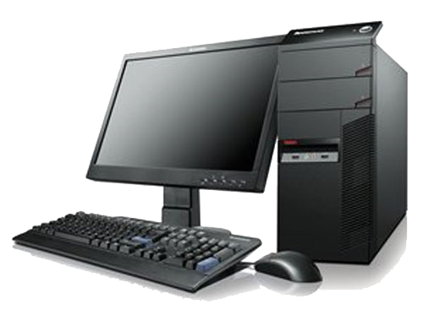


TRANSLATION
PROGRAMMING
LANGUAGE
TRANSLATION
MACHINE
LANGUAGE

Slide 13
WHAT IS A PROGRAMMER?
Person who makes computer programs.
A programmer, computer programmer, developer, dev, coder, or software engineer is a person who writes computer software. The term computer programmer can refer to a specialist in one area of computer programming or to a generalist who writes code for many kinds of software. (Wikipedia)

Slide 14
THE END
QUESTIONS?

