Slide 1
Features and Unification
Chapter 15
Lecture #10
October 2012

Slide 2
Context Free Grammars
We have been introduced to the notion of a context free grammar for capturing English constructions.
  Context Free rules, have a single non-terminal on the left hand side, and a list of terminals and/or non-terminals on the right hand side.
We have seen a very simple example of a context free grammar for English
We have seen that we can parse using context free grammars fairly easily.

Slide 3
English Constituent Problems for Context Free Grammars
Agreement
Subcategorization
Movement (for want of a better term)

Slide 4
Agreement
Determiner/Noun Agreement
This dog
Those dogs
Subject/Verb Agreement
This dog eats
Those dogs eat
Our grammar also generates
*This dogs
*Those dog
Our grammar also generates
*This dog eat
*Those dogs eats

Slide 5
Handing Number Agreement in CFGs
To handle, would need to expand the grammar with multiple sets of rules. We must have a different word class for each kind of determiner and noun.
NP_sg → Det_sg N_sg
NP_pl → Det_pl N_pl
…..
VP_sg → V_sg NP_sg
VP_sg → V_sg NP_pl
VP_pl → V_pl NP_sg
VP_pl → V_pl NP_pl

Slide 6
Subcategorization
Sneeze: John sneezed
*John sneezed [the book]_{NP}
Find: Please find [a flight to NY]_{NP}
*Please find
Give: Give [me]_{NP}[a cheaper fare]_{NP}
*Give [with a flight]_{PP}
Help: Can you help [me]_{NP}[with a flight]_{PP}
Prefer: I prefer [to leave earlier]_{TO-VP}
*I prefer [United has a flight]_{S}
Told: I was told [United has a flight]_{S}
…

Slide 7
Subcategorization
Subcat expresses the constraints that a predicate (verb for now) places on the number and type of the argument it wants to take

Slide 8
So?
So the various rules for VPs overgenerate.
  They permit the presence of strings containing verbs and arguments that don’t go together
  For example
  VP -> V NP therefore
  Sneezed the book is a VP since “sneeze” is a verb and “the book” is a valid NP

Slide 9
Possible CFG Solution
VP -> V
VP -> V NP
VP -> V NP PP
…
VP -> IntransV
VP -> TransV NP
VP -> TransPP NP PP
…

Slide 10
Movement
Core example
  My travel agent booked the flight

Slide 11
Movement
Core example
  [[My travel agent]_{NP} [booked [the flight]_{NP}]_{VP}]_{S}
I.e. “book” is a straightforward transitive verb. It expects a single NP arg within the VP as one of its arguments, and a single NP arg as the subject.

Slide 12
Movement
What about?
  Which flight do you want me to have the travel agent book_?
The direct object argument to “book” isn’t appearing in the right place. It is in fact a long way from where its supposed to appear.

Slide 13
Movement
What about?
  Which flight do you want me to have the travel agent book_?
The direct object argument to “book” isn’t appearing in the right place. It is in fact a long way from where its supposed to appear.
And note that its separated from its verb by 2 other verbs.

Slide 14
The Point
CFGs appear to be just about what we need to account for a lot of basic syntactic structure in English.
But there are problems
  That can be dealt with adequately, although not elegantly, by staying within the CFG framework.
There are simpler, more elegant, solutions that take us out of the CFG framework (beyond its formal power)
We will use feature structures and the constraint-based unification formalism

Slide 15
Features
Go back to subject verb agreement case
An alternative is to rethink the terminal and non-terminals as complex objects with associated properties (called features) that can be manipulated.
Features take on different values
The application of grammar rules is constrained by testing on these features

Slide 16
Subject-Verb Agreement
We could use features that allow us to code rules such as the following:
S → NP VP
Only if the number of the NP is equal to the number of the VP (that is, the NP and VP agree in number).
This allows us to have the best of both worlds.

Slide 17
Features and Feature Structures
We can encode these properties by associating what are called Feature Structures with grammatical constituents.
Feature structures are sets of feature-value pairs where:
  The features are atomic symbols and
  The values are either atomic symbols or feature structures
Feature₁ Value₁
Feature₂ Value₂
. .
. .
. .
Feature_{n} Value_{n}

Slide 18
Example Feature Structures
Number SG
Number SG
Person 3
Cat NP
Number SG
Person 3
Notes:
First start with a number feature whose value can be either sg or pl. Next add an additional feature to capture the person feature. Finally encode the grammatical category of the constituent. This structure can be used to represent a third person singular NP.

Slide 19
Bundles of Features
Feature Values can be feature structures themselves.
This is useful when certain features commonly co-occur, as number and person.
Cat NP
Number SG
Agreement
Person 3
Notes:
Having feature structures as values leads to the notion of a feature path. Hence an alternative graphical structure for viewing them.

Slide 20
Feature Structures as DAGs
Notes:
Features appear as labeled edges; values as nodes.

Slide 21
Reentrant Structure
We’ll allow multiple features in a feature structure to share the same values. By this we mean that they share the same structure, not just that they have the same value.
Numerical indices indicate the shared value.
Cat S
Number SG
Agreement Person 3
Head
Subject Agreement
1
1

Slide 22
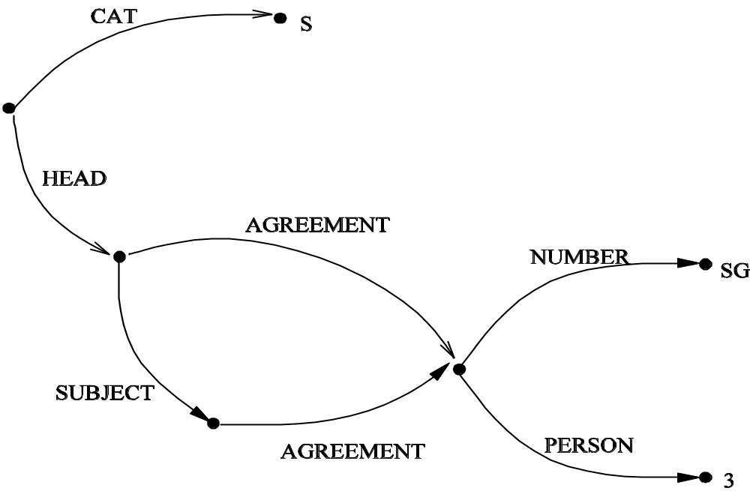
Reentrant DAGs

Slide 23
Reentrant Structure
It will also be useful to talk about paths through feature structures. As in the paths
<HEAD AGREEMENT NUMBER>
<HEAD SUBJECT AGREEMENT NUMBER>
Cat S
Number SG
Agreement Person 3
Head
Subject Agreement
1
1

Slide 24
The Unification Operation
So what do we want to do with these things...
check the compatibility of two structures
merge the information in two structures
We can do both with an operation called Unification.
Merging two feature structures produces a new feature structure that is more specific (has more information) than, or is identical to, each of the input feature structures.

Slide 25
The Unification Operation
We say two feature structures can be unified if the component features that make them up are compatible.
[number sg] U [number sg] = [number sg]
[number sg] U [number pl] = fails!
Structures are compatible if they contain no features that are incompatible.
If so, unification returns the union of all feature/value pairs.

Slide 26
The Unification Operation
[number sg] U [number [] ] =

Slide 27
The Unification Operation
[number sg] U [number [] ] = [number sg]
[number sg] U [person 3] =

Slide 28
The Unification Operation
[number sg] U [number [] ] = [number sg]
[number sg] U [person 3] =
number sg
person 3

Slide 29
Unification Operation
Agreement [Number sg]
Subject [Agreement [Number sg]]
U
[Subject [Agreement [Person 3]]]
=
Agreement [Number sg]
Number sg
Subject Agreement
Person 3

Slide 30
The Unification Operation
[Head [Subject [Agreement [Number PL]]]]
U
Cat S
Number SG
Agreement Person 3
Head
Subject Agreement
1
1
= Fail!

Slide 31
Properties of Unification
Monotonic: if some description is true of a feature structure, it will still be true after unifying it with another feature structure.
Order independent: given a set of feature structures to unify, we can unify them in any order and we’ll get the same result.

Slide 32
Features, Unification, and Grammars
We’ll incorporate all this into our grammars in two ways:
We’ll assume that constituents are objects which have feature-structures associated with them
We’ll associate sets of unification constraints with grammar rules that must be satisfied for the rule to be satisfied.

Slide 33
Unification Constraints
β₀ → β₁ … β_{n}
{ set of constraints }
< β_{i} feature path > = atomic value
< β_{i} feature path > = < β_{k} feature path >

Slide 34
Agreement
NP → Det Nominal
< Det AGREEMENT > = < Nominal AGREEMENT >
< NP AGREEMENT > = < Nominal AGREEMENT >
Noun → flight
< Noun AGREEMENT NUMBER > = SG
Noun → flights
< Noun AGREEMENT NUMBER > = PL
Nominal → Noun
< Nominal AGREEMENT > = < Noun AGREEMENT >
Det → this
< Det AGREEMENT NUMBER > = SG

Slide 35
Unification and Parsing
OK, let’s assume we’ve augmented our grammar with sets of path-like unification constraints.
What changes do we need to make to a parser to make use of them?
  Building feature structures and associating them with a subtree
  Unifying feature structures as subtrees are created
  Blocking ill-formed constituents

Slide 36
Building Feature Structures
Features of most grammatical categories are copied from head child to parent (e.g., from V to VP, Nom to NP, N to Nom)
VP → V NP
  < VP HEAD > = < V HEAD >
S → NP VP
  < NP HEAD AGREEMENT > = < VP HEAD AGREEMENT>
  < S HEAD > = < VP HEAD >
S [head ]
NP [head [agreement ]]
VP [head [agreement ]]
1
2
1
2

