Slide 1
Introduction to Partial Least Squares Discriminant Analysis (PLS-DA)

Slide 2
What is PLS-DA?
Partial Least Squares Discriminant Analysis (PLS-DA) is a supervised classification method.
Combines features of Partial Least Squares (PLS) regression with discriminant analysis.
Useful for handling multicollinearity and high-dimensional data.

Slide 3
Applications of PLS-DA
Datasets with correlated and noisy variables.
Fields: Chemometrics, Bioinformatics, Metabolomics, and Sensory Data.
Ideal for high-dimensional datasets where other classification methods struggle.

Slide 4
Basic Workflow of PLS-DA
1. Input: Predictor matrix X and response vector y.
2. Latent Variable Extraction: PLS-DA aims to Maximize covariance between Predictor matrix X and response vector y.
3. Dimensionality Reduction: Summarize X into latent variables.
4. Discriminant Analysis: Classify samples using latent variables. The idea is to project the data into a lower-dimensional space (formed by the latent variables) where the separation between the classes is maximized.

Slide 5
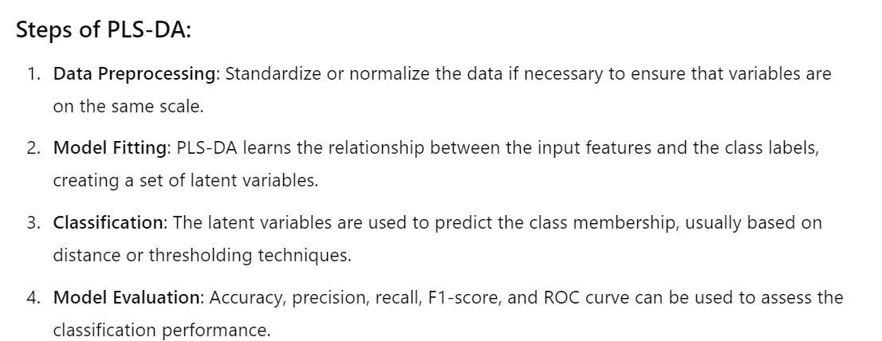

Slide 6
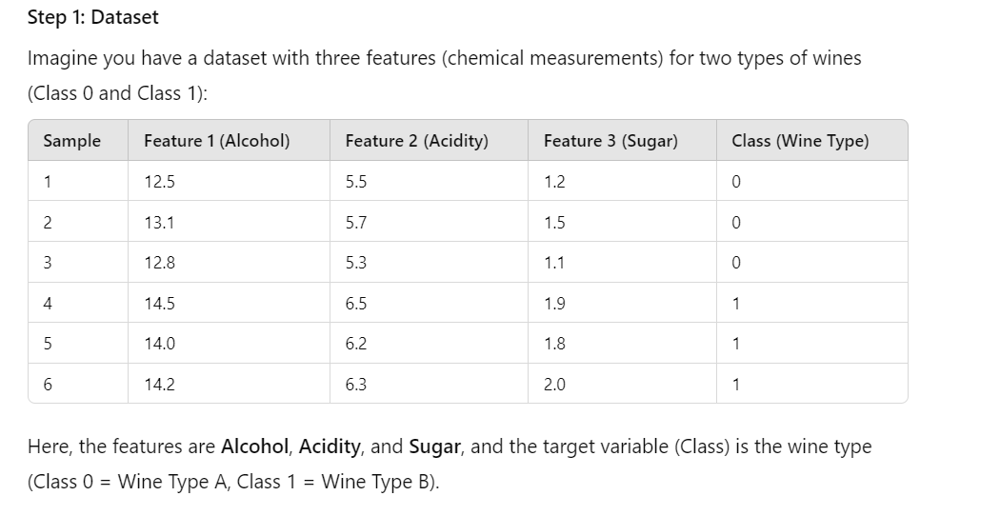
Wine Classification Example

Slide 7
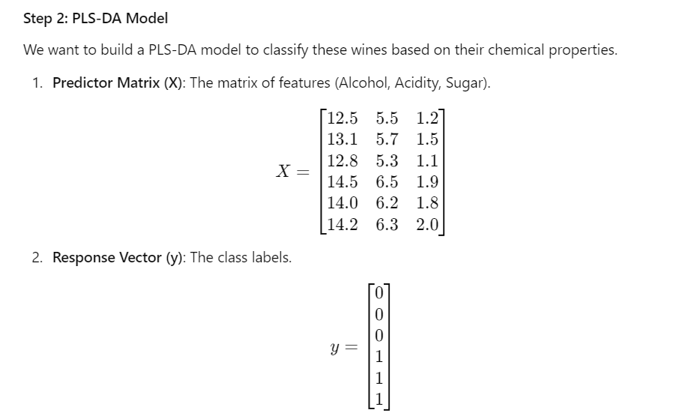

Slide 8
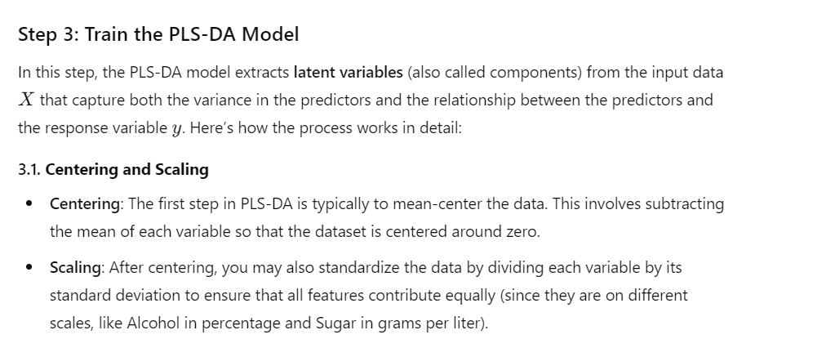

Slide 9
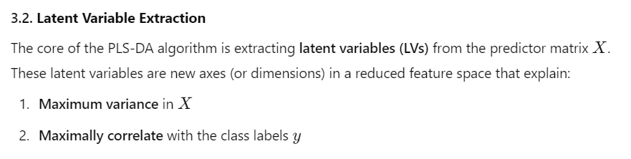
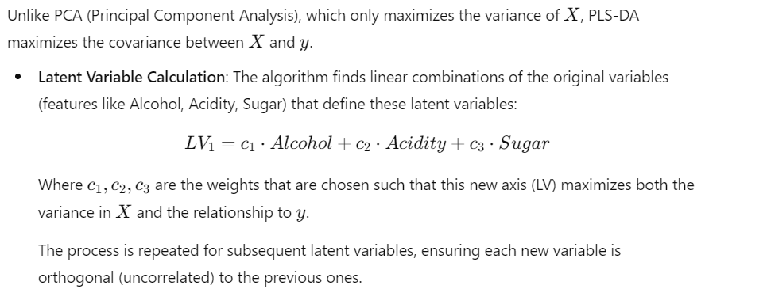

Slide 10
What Are Latent Variables?
Linear combinations of original features (e.g., LV₁ = c₁ × Alcohol + c₂ × Acidity + c₃ × Sugar).
Latent variables maximize both the variance in X and the correlation with y.
PLS-DA extracts a few important latent variables to separate classes.

Slide 11
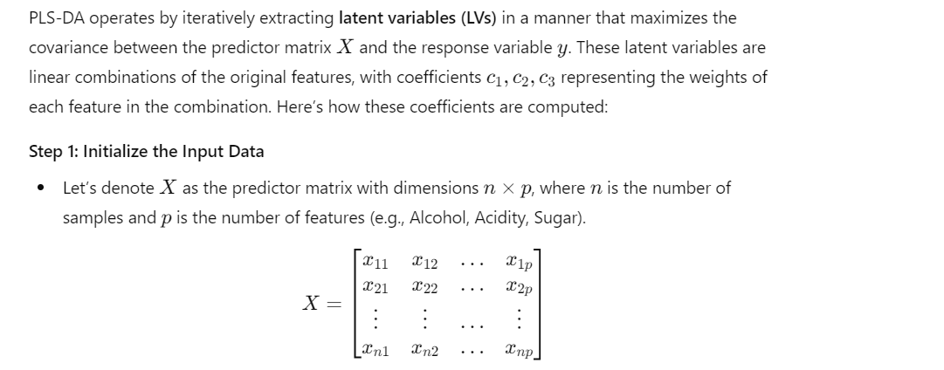
How Coefficients c₁, c₂, c₃ Are Calculated

Slide 12

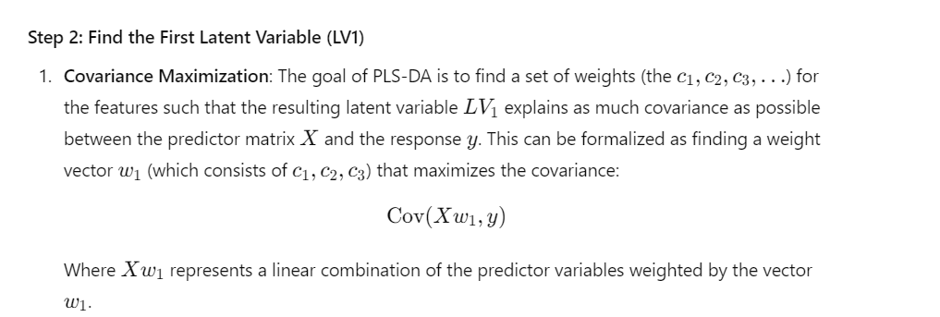

Slide 13
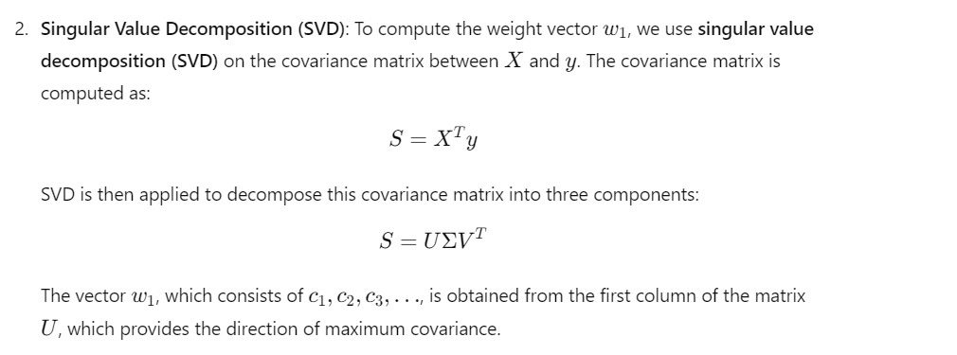

Slide 14
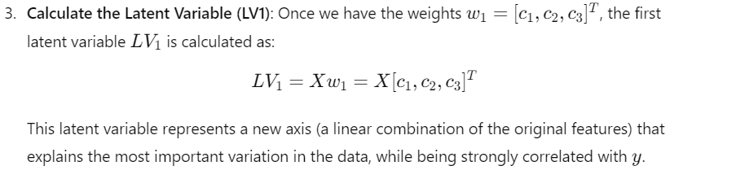

Slide 15
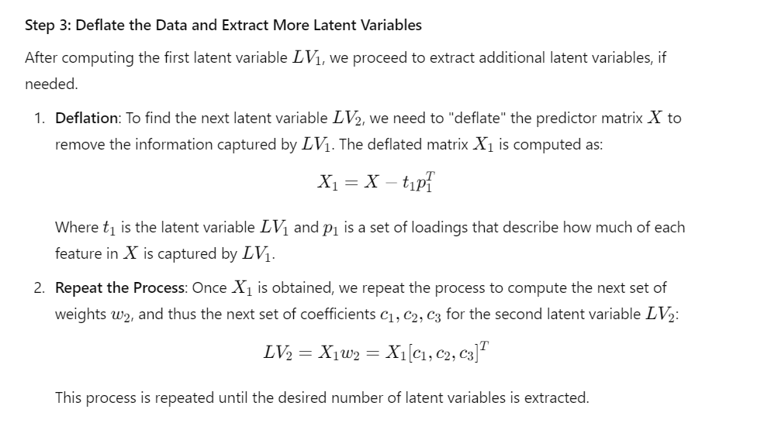

Slide 16
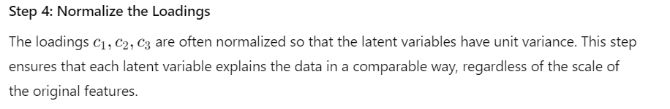
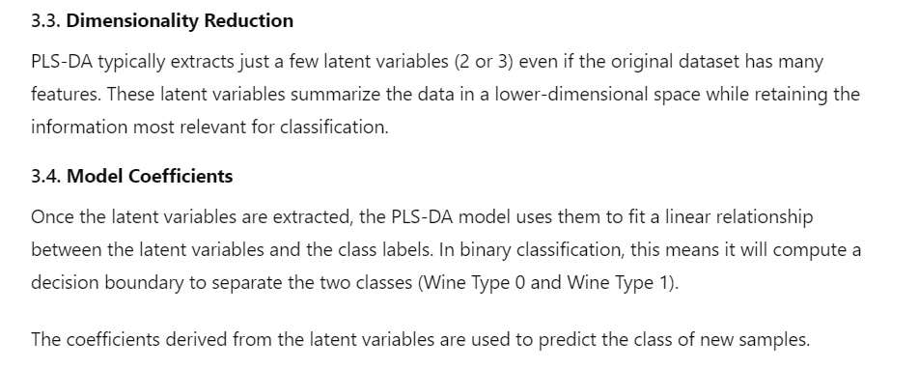

Slide 17
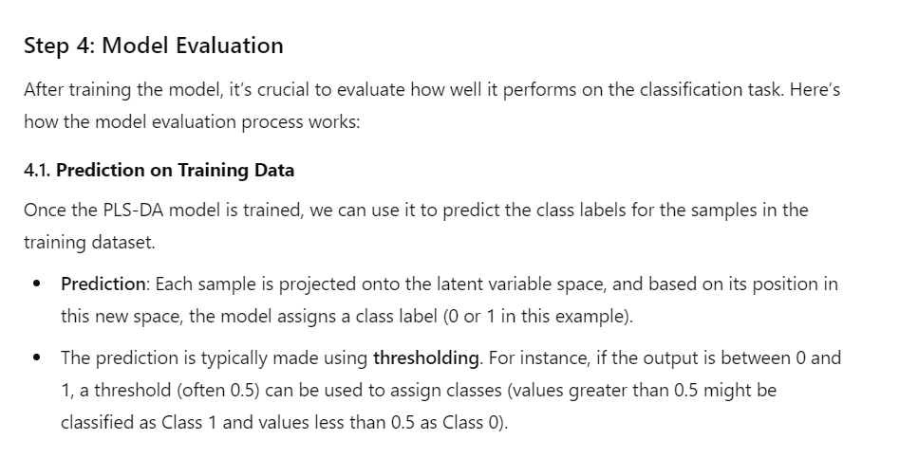

Slide 18
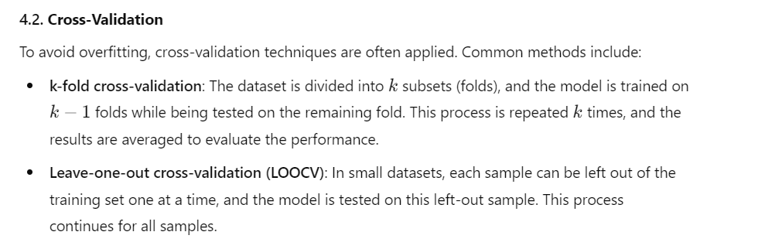

Slide 19
Evaluating PLS-DA Performance
Metrics: Accuracy, Precision, Recall, F1-Score, and AUC-ROC curve.
Confusion Matrix to evaluate classification performance.
Cross-validation: k-fold, LOOCV to prevent overfitting.

Slide 20
Why Use PLS-DA?
Handles multicollinearity in data.
Effective for high-dimensional datasets.
Provides interpretable results (VIP scores for feature importance).

Slide 21
Real-World Use Cases
Chemometrics: Chemical properties for product quality control.
Bioinformatics: Gene expression and metabolomics data.
Sensory Science: Food and beverage classification based on chemical attributes.

Slide 22
Summary
PLS-DA is a powerful classification tool for complex, multivariate datasets.
Combines dimensionality reduction with classification, making it useful in several scientific and industrial fields.
Provides both predictive accuracy and insight into important features.

