Slide 1
4. N-Grams
Oldest & most broadly used practical tool in language processing

Slide 2
N-Grams
An n-gram is a contiguous sequence of n items from a given sample of text or speech.
The items can be phonemes, syllables, letters, words, or base pairs according to the application

Slide 3
Types of n-grams:
Unigram (1-gram): Single items. In text processing, these are single words.
  Example: "I", "love", "reading".
Bigram (2-gram): Pairs of items. In text processing, these are pairs of consecutive words.
  Example: "I love", "love reading".

Slide 4
Trigram (3-gram): Triplets of items. In text processing, these are triplets of consecutive words.
  Example: "I love reading".
Higher-order n-grams: Sequences with n > 3. For example, a 4-gram (quadgram) would be four consecutive items.
  Example: "I love reading books".

Slide 5
Example:
Consider the sentence: "I love reading books."
Unigrams: "I", "love", "reading", "books"
Bigrams: "I love", "love reading", "reading books"
Trigrams: "I love reading", "love reading books"
4-gram: "I love reading books"

Slide 6
Applications of n-grams:
Natural Language Processing (NLP): N-grams are used in various NLP tasks such as text classification, machine translation, and speech recognition.
Text Prediction: Predictive text input systems (like those on smartphones) often use n-gram models to suggest the next word.

Slide 7
Spelling Correction: N-gram models help in identifying and correcting spelling errors.
Language Modeling: N-grams are used to create statistical models of language, which can predict the likelihood of a sequence of words.

Slide 8
Word Prediction
Guess the next word...
  I noticed three guys standing on the ……???
    Orange, floor, fan, pen
  I am going …….??
    (she, to, the, him)
There are many sources of knowledge that could be helpful, including world knowledge.
But we can do pretty well by simply looking at the preceding words and keeping track of simple counts.

Slide 9
Word Prediction
Formalize this task using N-gram models.
N-grams are token sequences of length N.
Given N-grams counts, we can guess likely next words in a sequence.

Slide 10
Applications
Being able to predict the next word (or any linguistic unit) in a sequence is very significant
It lies at the core of the following applications
  Automatic speech recognition
  Handwriting and character recognition
  Spelling correction
  Machine translation
  Word similarity, generation, POS tagging, etc.

Slide 11
Language Modeling
Assess the conditional probability of a word given the previous words in the sequence
  P(w_{n}|w₁,w₂…w_{n-1})
We’ll call a statistical model that can assess this a Language Model

Slide 12
Language Modeling
One way to calculate them is to use the definition of conditional probabilities, and get the counts from a large corpus
  Counts are used to estimate the probabilities

Slide 13
Language Modeling
How to compute the probability of a complete string of words
P(w₁,w₂,…w_{n},w_{n-1} )
We’ll use the chain rule of probability

Slide 14
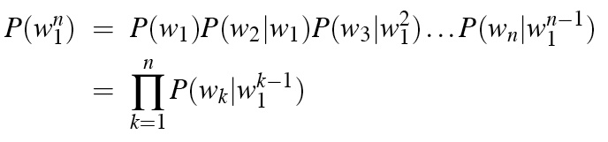
The Chain Rule
P(its water was so transparent)=
P(its)*
P(water|its)*
P(was|its water)*
P(so|its water was)*
P(transparent|its water was so)

Slide 15
Independence Assumption each word occurring in its correct location is an independent event
Make the simplifying assumption
  P(lizard|the,other,day,I,was,walking,along,and,saw,a) = P(lizard|a)
Or maybe
  P(lizard|the,other,day,I,was,walking,along,and,saw,a) = P(lizard|saw,a)

Slide 16
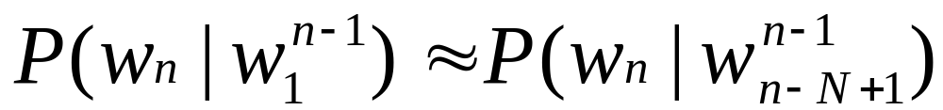
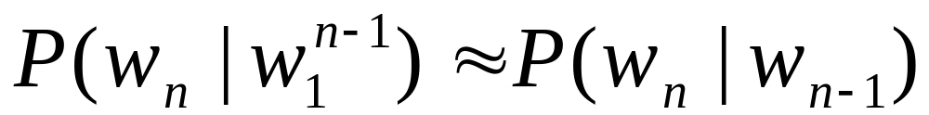
Markov Assumption
The probability of a word depends only on the previous word is called Markov assumption
For each component in the product replace with the approximation (assuming a prefix of N)
P(it/was)? P(it/how was)??
Bigram version

Slide 17
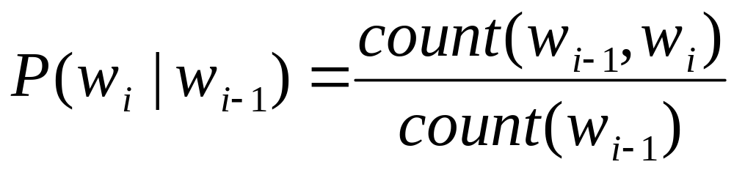
Estimating Bigram Probabilities
The Maximum Likelihood Estimate (MLE)
P (am | I) = count (I am)/ count (I)

Slide 18

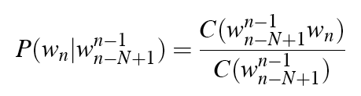
An Example
<s> I am Sam </s>
<s> Sam I am </s>
<s> I do not like green eggs and ham </s>

Slide 19
Maximum Likelihood Estimates
The maximum likelihood estimate of some parameter of a model M from a training set T
  Is the estimate that maximizes the likelihood of the training set T given the model M
Suppose the word Chinese occurs 400 times in a corpus of a million words (Brown corpus)
What is the probability that a random word from some other text from the same distribution will be “Chinese”
MLE estimate is 400/1000000 = .004
  This may be a bad estimate for some other corpus

Slide 20
Berkeley Restaurant Project (is a speech-understanding consultant) Sentences
can you tell me about any good cantonese restaurants close by
mid priced thai food is what i’m looking for
tell me about chez panisse
can you give me a listing of the kinds of food that are available
i’m looking for a good place to eat breakfast
when is caffe venezia open during the day

Slide 21
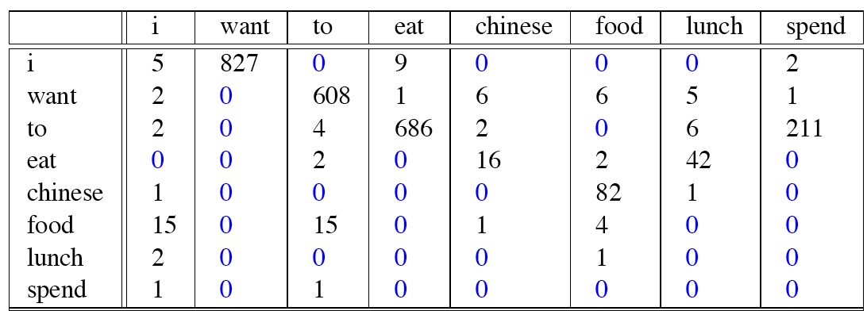
Bigram Counts
Out of 9222 sentences
  Eg. “I want” occurred 827 times

Slide 22
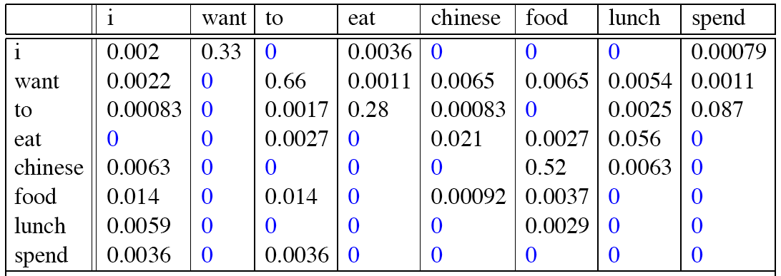
Bigram Probabilities
Divide bigram counts by prefix unigram counts to get probabilities.

Slide 23
P(want/I)=count(I, want)/count(I)
827/2533= 0.3267

Slide 24
Bigram Estimates of Sentence Probabilities
P(<s> I want english food </s>) =
P(i|<s>)*
P(want|I)*
P(english|want)*
P(food|english)*
P(</s>|food)*
=.000031

Slide 25
Kinds of Knowledge
As crude as they are, N-gram probabilities capture a range of interesting facts about language.
P(english|food) = .00001
P(chinese|want) = .0065
P(to|want) = .66
P(eat | to) = .28
P(food | to) = 0
P(want | spend) = 0
P (i | <s>) = .25
World knowledge
Syntax
Discourse

Slide 26
Evaluation
How do we know if one model is better than another?
Shannon’s game gives us an intuition.
  The generated texts from the higher order models sound more like the text the model was obtained from.

Slide 27
Evaluation
Standard method
  Train parameters of our model on a training set.
  Look at the model’s performance on some new data: a test set. A dataset which is different than our training set, but is drawn from the same source
  Then we need an evaluation metric to tell us how well our model is doing on the test set.
    One such metric is perplexity (to be introduced below)

Slide 28
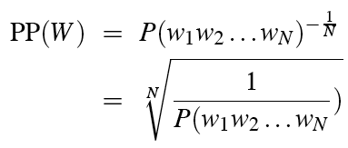
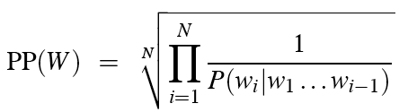
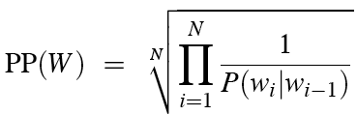
Perplexity
Perplexity is the probability of the test set (assigned by the language model), normalized by the number of words:
Chain rule:
For bigrams:
Minimizing perplexity is the same as maximizing probability
  The best language model is one that best predicts an unseen test set
  You do not need to memorize this formula

Slide 29

Lower perplexity means a better model
Training 38 million words, test 1.5 million words, WSJ

Slide 30
Evaluating N-Gram Models
Best evaluation for a language model
  Put model A into an application
    For example, a speech recognizer
  Evaluate the performance of the application with model A
  Put model B into the application and evaluate
  Compare performance of the application with the two models
  Extrinsic evaluation

Slide 31
Difficulty of extrinsic (in-vivo) evaluation of N-gram models
Extrinsic evaluation
  This is really time-consuming
  Can take days to run an experiment
So
  As a temporary solution, in order to run experiments
  To evaluate N-grams we often use an intrinsic evaluation, an approximation called perplexity
  But perplexity is a poor approximation unless the test data looks just like the training data
  So is generally only useful in pilot experiments (generally is not sufficient to publish)
  But is helpful to think about.

