Slide 1
Linear Discriminant Analysis (LDA)
Overview, Concepts, and Applications

Slide 2
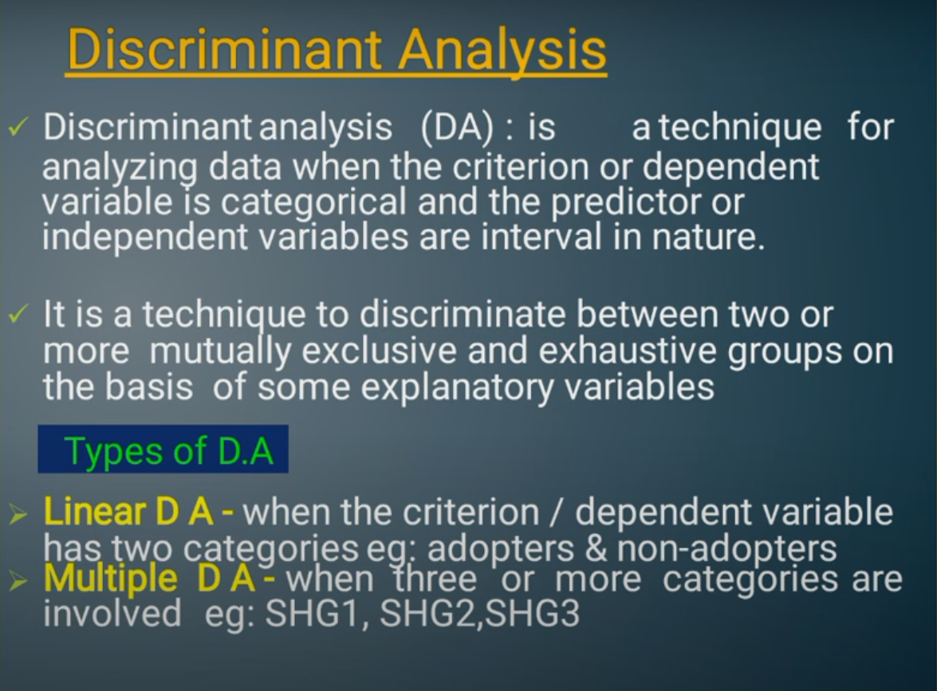

Slide 3
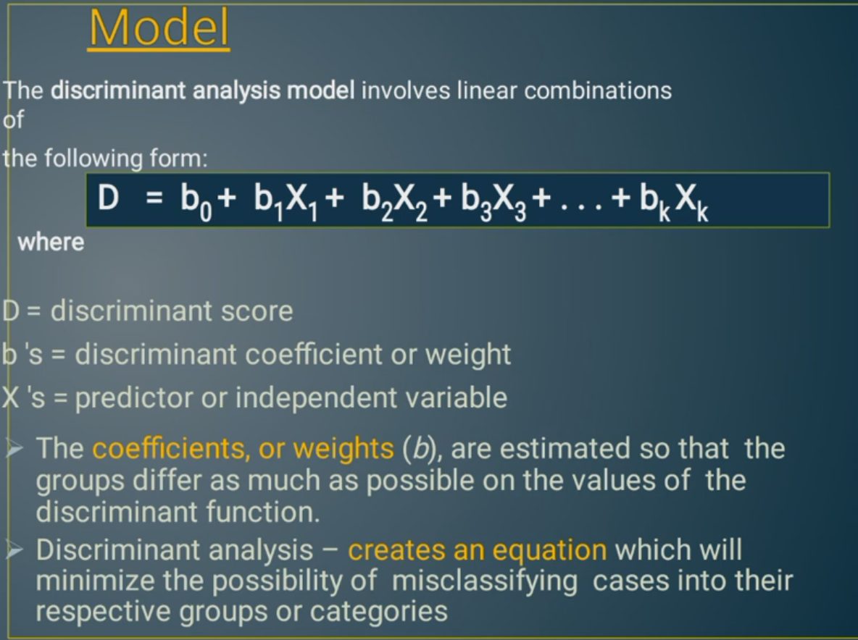

Slide 4
Introduction to LDA
Linear Discriminant Analysis (LDA) is a supervised classification technique that finds a linear combination of features to separate two or more classes.
Used for dimensionality reduction, pattern recognition, and classification tasks.

Slide 5
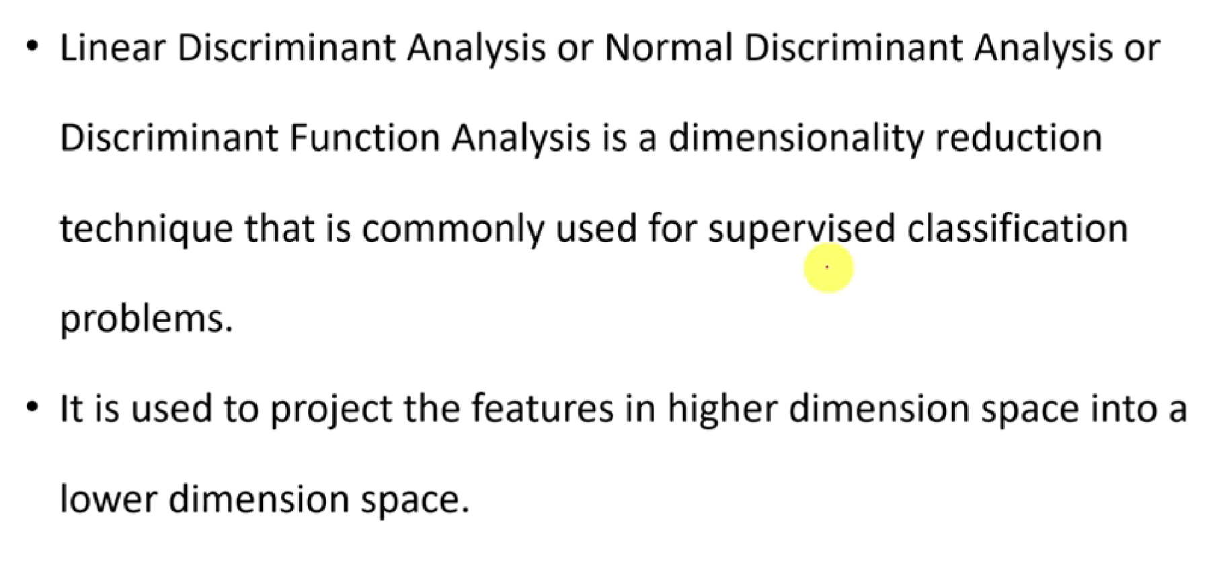

Slide 6
Objective and Assumptions of LDA
Objective: Project data to a lower-dimensional space to maximize separation between classes.
Assumptions:
1. Data is normally distributed.
2. Equal covariance for different classes.
3. Classes are linearly separable.

Slide 7
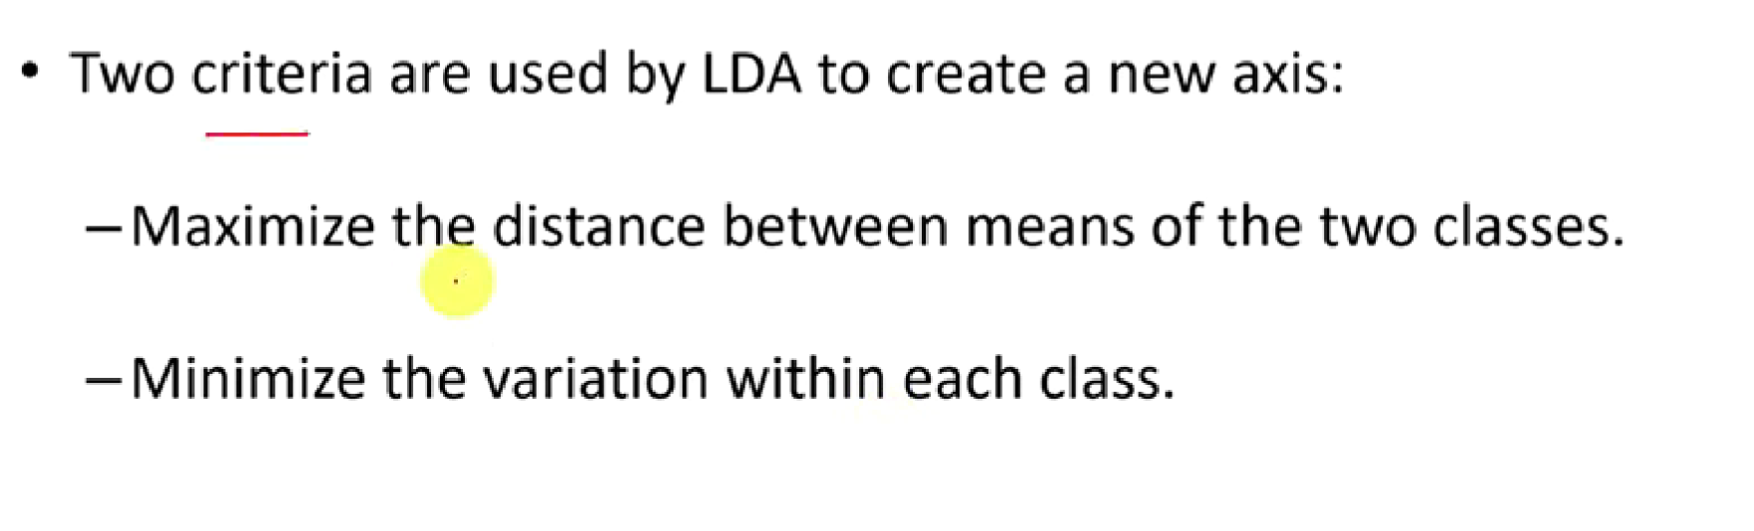

Slide 8
How LDA Works
LDA maximizes the ratio of between-class variance to within-class variance to find the best separating axes.
Scatter Matrices:
1. Between-class scatter matrix (S_B): Measures distance between class means.
2. Within-class scatter matrix (S_W): Measures variance within each class.

Slide 9
Steps in LDA
1. Compute the mean vectors for each class.
2. Compute within-class and between-class scatter matrices.
3. Solve the eigenvalue problem for optimal discriminant directions.
4. Project the data onto the new axes.
5. Classify based on linear decision boundary.

Slide 10
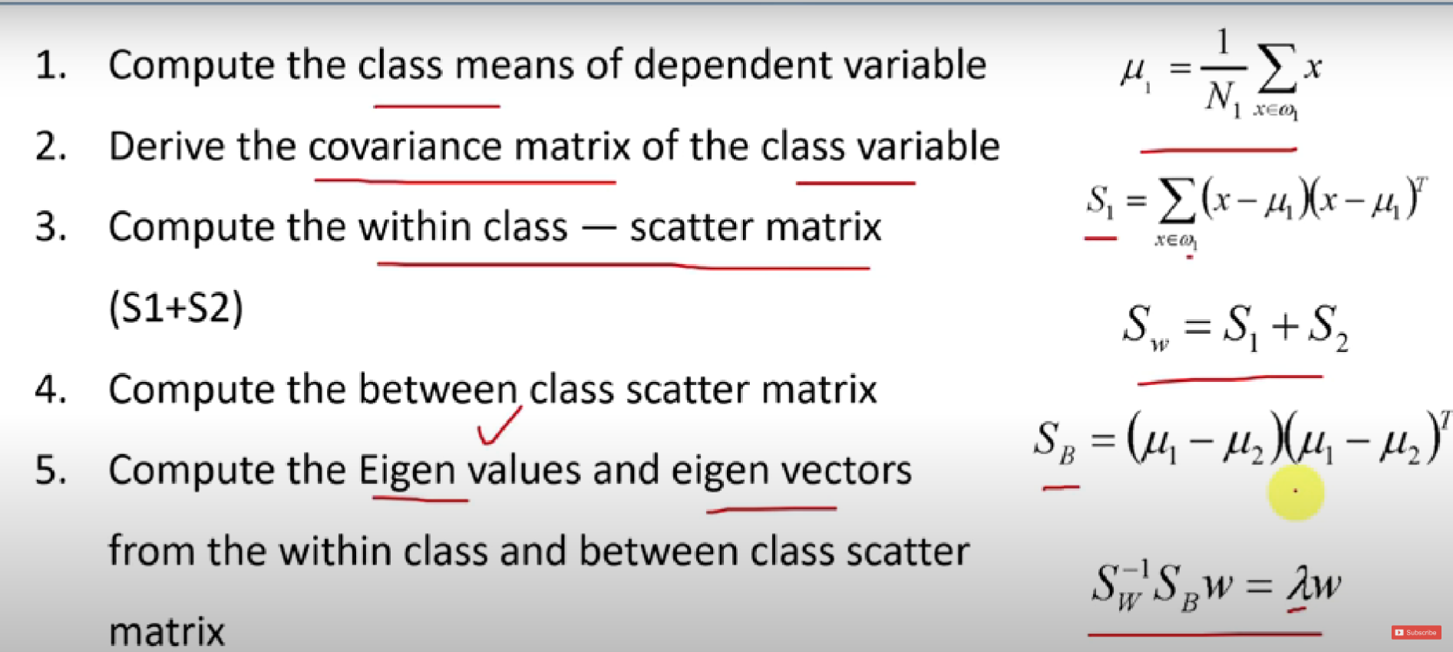

Slide 11
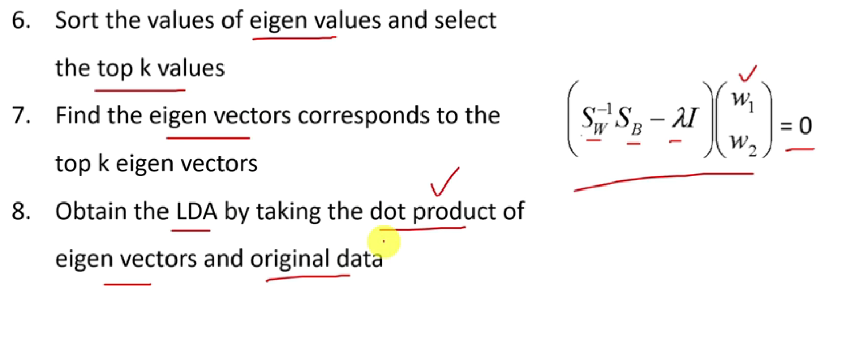

Slide 12
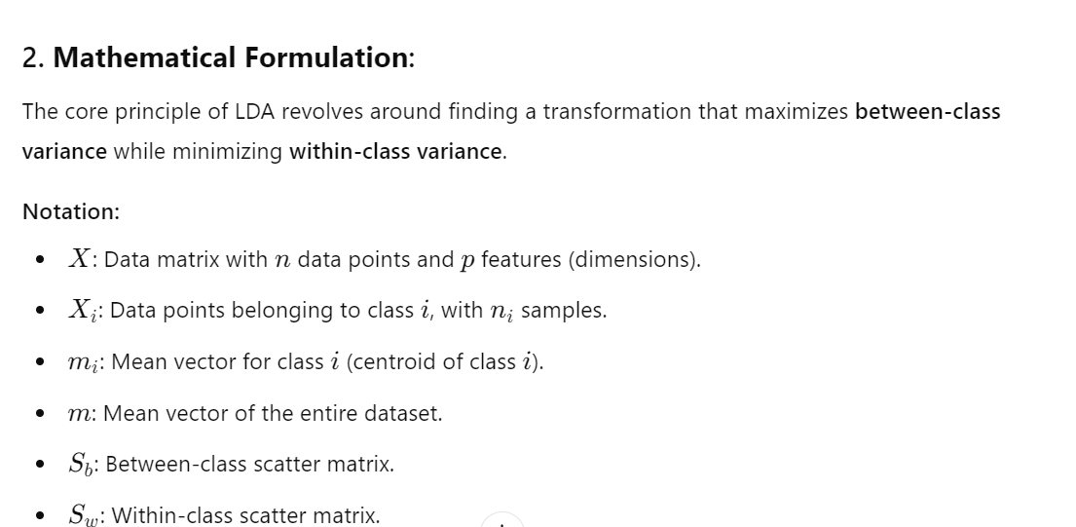

Slide 13
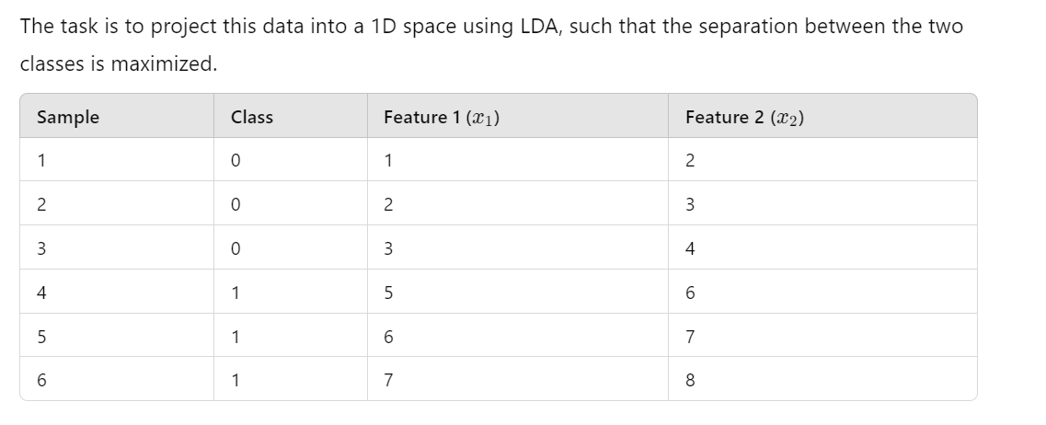

Slide 14
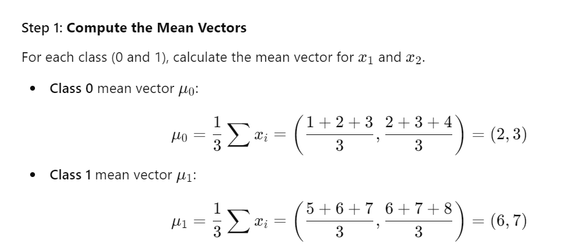

Slide 15
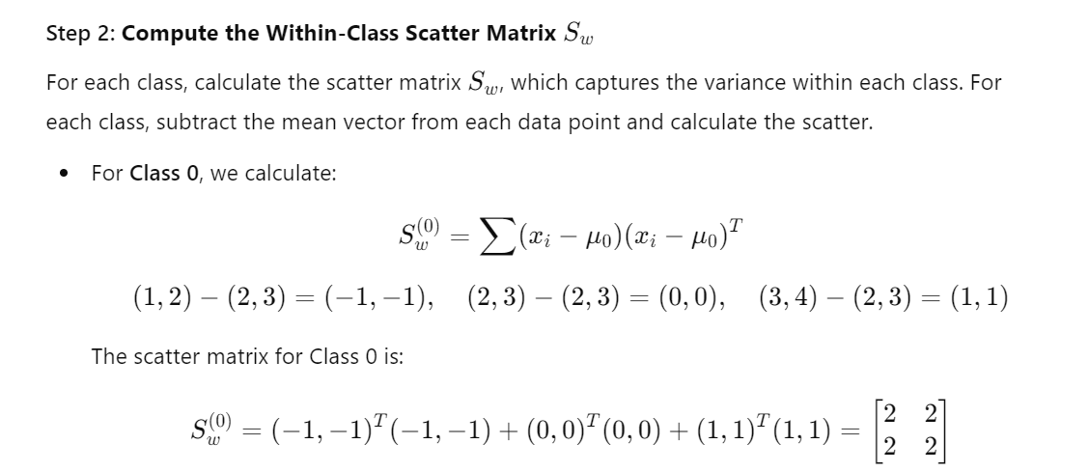

Slide 16
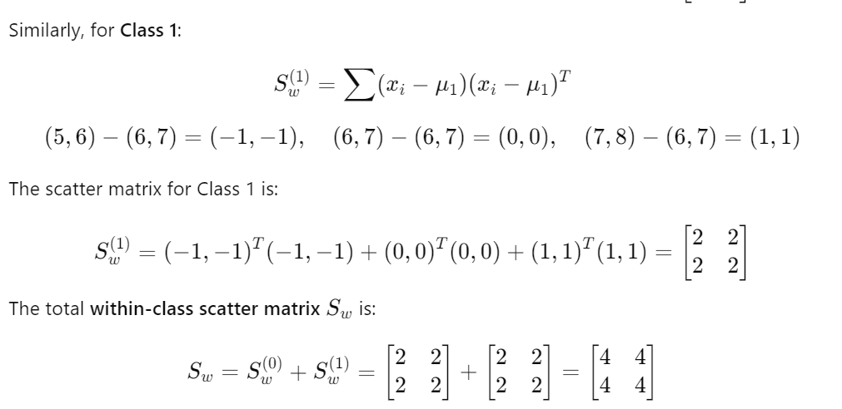

Slide 17
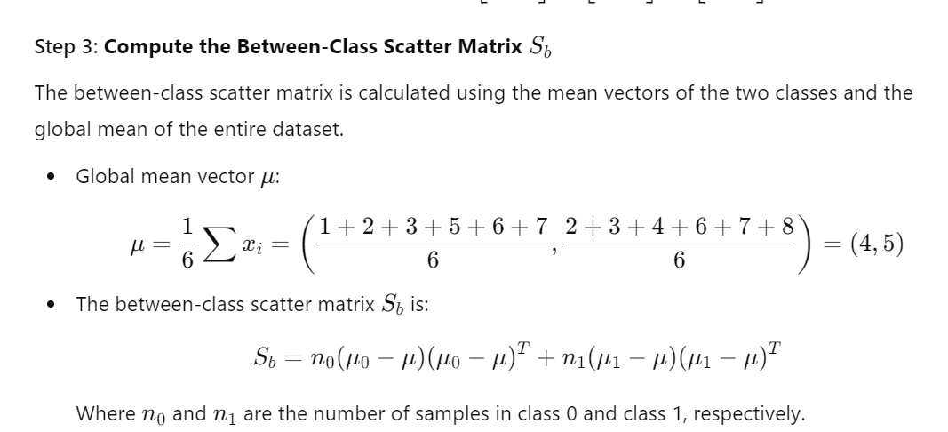

Slide 18
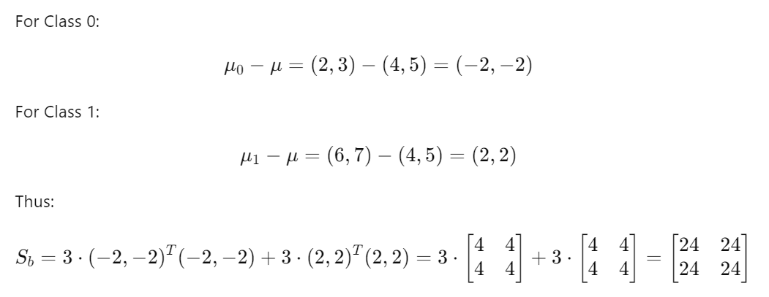

Slide 19
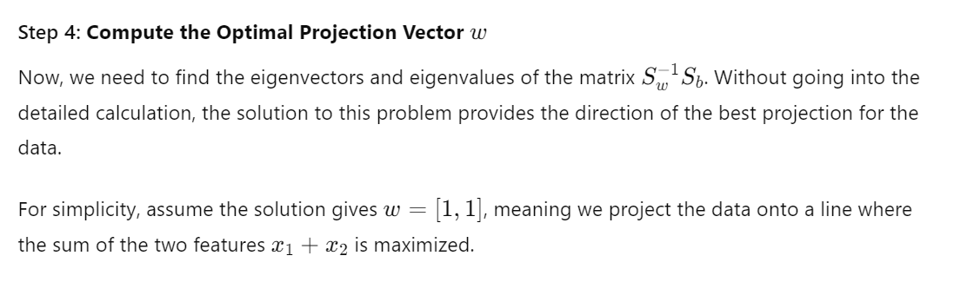

Slide 20
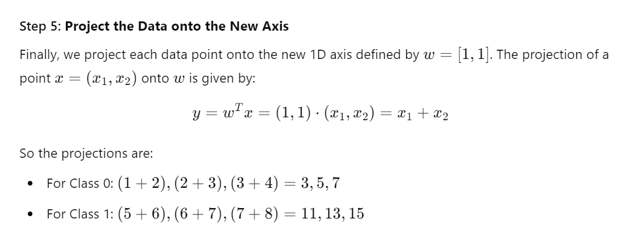

Slide 21
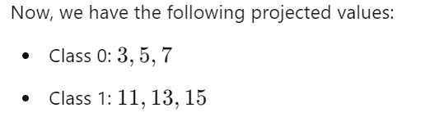

Slide 22
Applications of LDA
1. Face Recognition: LDA is used to reduce dimensionality while retaining discriminatory information.
2. Speech Recognition: LDA enhances class separation in speech signal classification.
3. Medical Diagnosis: Helps in classifying patients based on their medical data.
4. Text Classification: Used to categorize documents into spam or non-spam, etc.

Slide 23
LDA vs PCA
1. LDA is supervised, uses class labels, and maximizes class separability.
2. PCA is unsupervised, focuses on variance, and doesn't consider class labels.
3. LDA reduces dimensions to C-1 (where C is the number of classes).

Slide 24
Conclusion
LDA is a powerful technique for classification and dimensionality reduction, especially when data is normally distributed and linearly separable.
It maximizes the separation between different classes by projecting data onto a lower-dimensional space.

