Slide 1
Migrating to Cloud Computing: Options and challenges
Module 1
Dr. Bijoy A Jose

Slide 2
Challenges to solve in Cloud computing
Service quality: Terms of service.
Availability, Reliability, Scalability: SLA.
Interoperability: Compatibility with other platforms, data pipelines.
Cloud integration: on-prem to on-cloud interfacing
Portability: Migration to other vendors

Slide 3
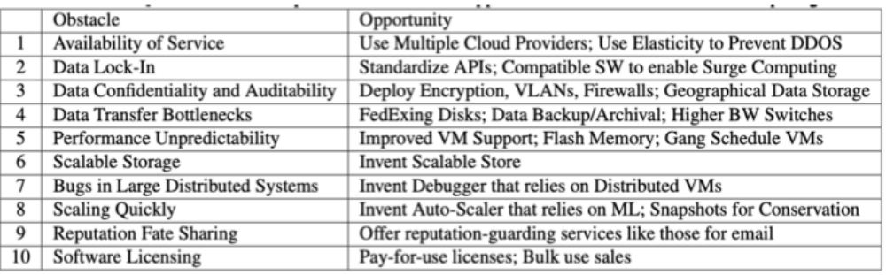
Challenges to solve in Cloud computing

Slide 4
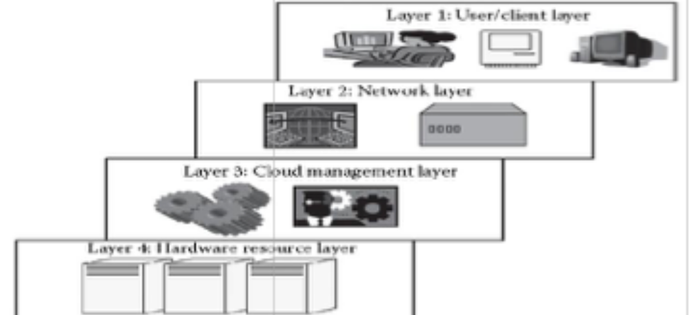
Layered architecture

Slide 5
Layered architecture
Layer 2
layer allows the users to connect to the cloud. This is primarily the Internet in the case of a public cloud. The public cloud usually exists in a specific location and the user would not know the location as it is abstract.
Layer 3:
Software that are used in managing the cloud. The software can be a cloud OS, a software that acts as an interface between the data center (actual resources) and the user, or a management software that allows managing resources.
This software usually allow resource management (scheduling, provisioning, etc.), optimization (server consolidation, storage workload consolidation), and internal cloud governance.

Slide 6
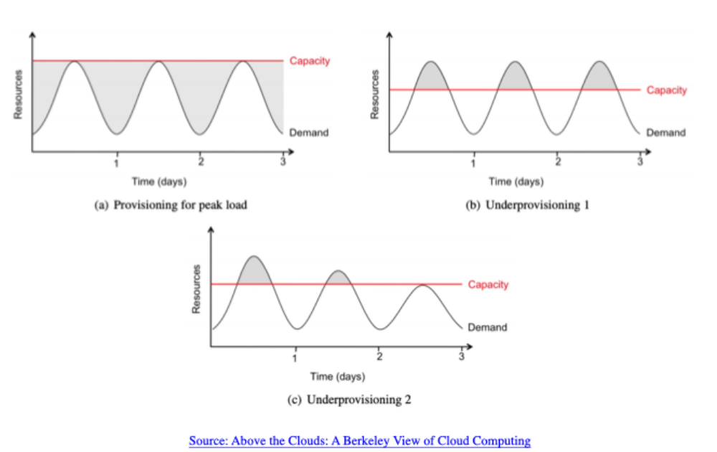
Provisioning cloud computing

Slide 7
Cloud storage
Unmanaged Cloud Storage: Unmanaged cloud storage means that the storage is preconfigured for the consumer. The consumer cannot format nor the consumer can install own file system or change drive properties
Managed Cloud Storage: Managed cloud storage offers online storage space on demand. Managed cloud storage system presents what appears to the user to be a raw disk that the user can partition and format.

Slide 8
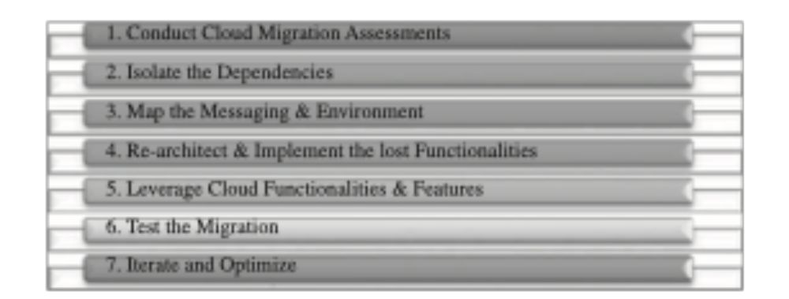
Migration to cloud
Seven step approach (Infosys)

Slide 9
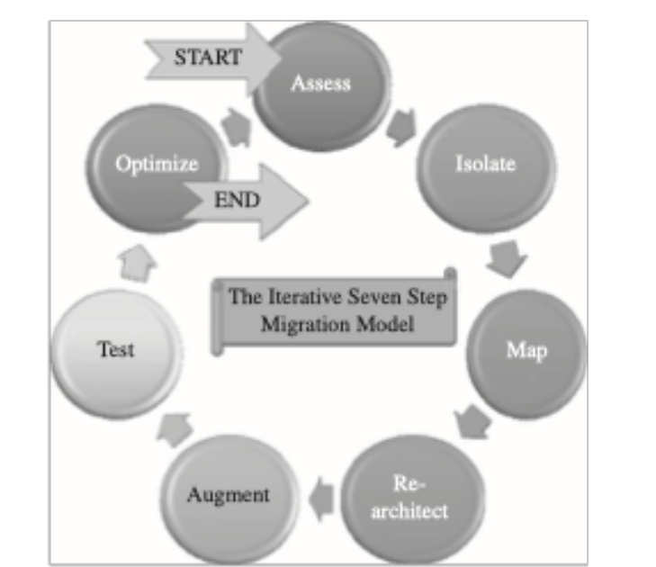
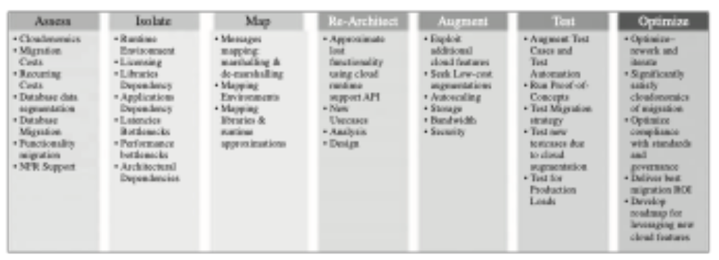
Migration to cloud

Slide 10
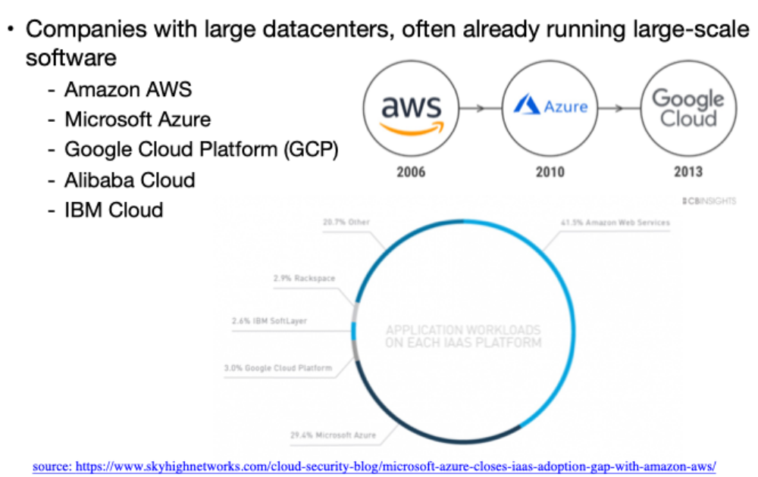
Cloud providers

