Slide 1
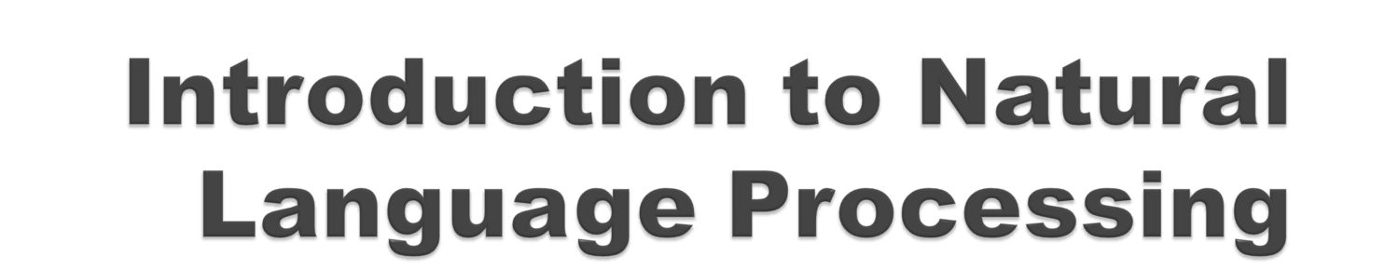
Dr. Ajees A P
Assistant Professor
Department of Computer Science
CUSAT

Slide 2
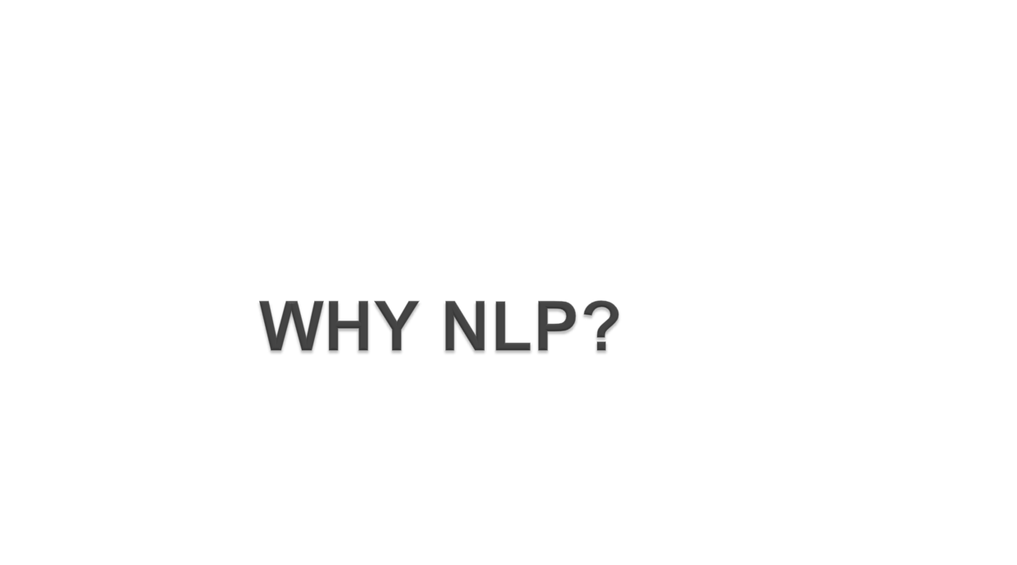

Slide 3

Age of big data
In 2019, there were 3.4 billion active social media users in the world
In 2024, how much is it?
On average, Google now processes more than 40,000 searches every second (3.5 billion searches per day)!

Slide 4
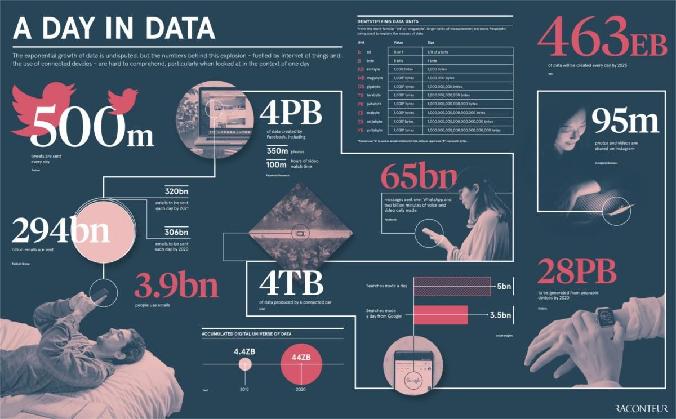

Slide 5

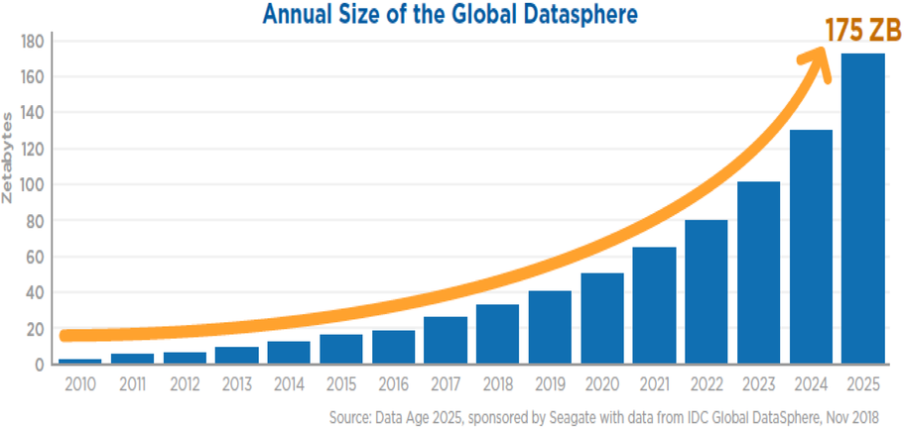

Slide 6

There is simply too much data for you to review manually.
That is why, even the big organizations are using data analysis tools and natural language processing.

Slide 7

Auto complete feature in Gmail and whatsapp.
Spam filters in Gmail.
Language translation
Customer service chat bots
Voice assistants such as Alexa and Google Assistant
Question answering (BERT-Google)
Automated news generation.

Slide 8
What is NLP?

Slide 9

What is a language?
The origin of language goes back to the beginning of human species on earth.
There are two forms in which languages can be expressed- spoken and written forms.
Linguistics is the scientific study of language .

Slide 10
The techniques of computer science that are applied to the analysis and synthesis of language and speech (CL)
Linguist is someone who is engaged in the study of languages.
They study every aspect of language, including vocabulary, grammar, the sound of language, and how words evolve over time
Linguistics can be theoretical or applied

Slide 11

Theoretical Linguistics are concerned with finding and describing generalities both within particular languages and among all languages.
It includes study of
  Grammar, Semantics and Pragmatics

Slide 12

Grammar is the study of language structures
It includes
  – Morphology (study of internal structure of words)- Inflectional and Derivational
  - Syntax (study of how words combine to form grammatically correct sentences and phrases)
  - Phonology (study of sound units that distinguishes meaning)

Slide 13

Semantics is the study of the meanings of linguistic expressions (as opposed to their sound, spelling, etc.).
  Eg. Colorless green ideas sleep furiously.(Doesn’t make sense)
Pragmatics has to do with context-dependent features of language.
  Eg. Suzy is one of the best two students in the class.
  (Said in a letter of recommendation; in fact, unmentioned in the letter, there are only two students in the class)

Slide 14

Applied linguistics take the results of findings of theoretical linguistics applies them in areas like
  Machine translation
  Computer assisted language teachings
  Man-machine interfaces
  Question answering systems etc

Slide 15

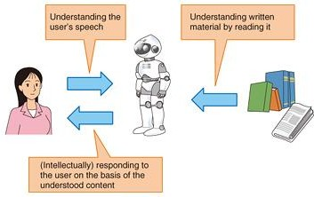
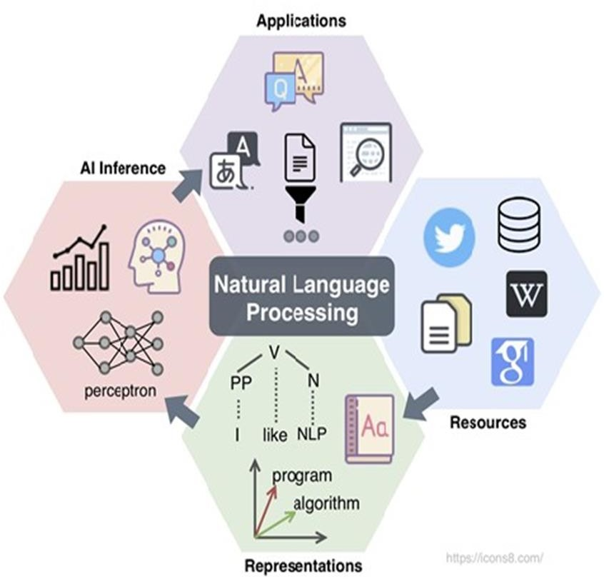


Slide 16
Natural language processing (NLP) refers to the branch of computer science concerned with giving computers the ability to understand text and spoken words in the same way human beings can.
NLP is broadly defined as the automatic manipulation of natural language forms, like speech and text, by software.
Always required when you want an intelligent system like robot to perform as per your instructions
The input and output of an NLP system can be −
  Speech
  Text

Slide 17

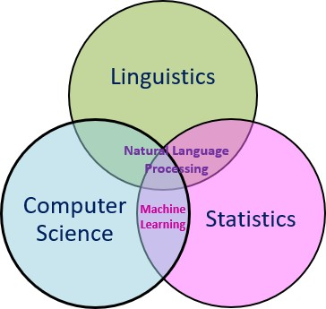
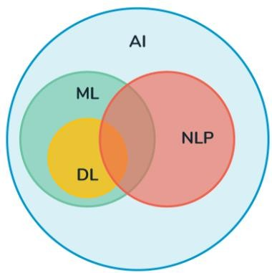
9

Slide 18

Ultimate goal
  Building computer systems that handle natural languages as humans do
Immediate goal
  Building computer systems that can handle speech and text intelligently

Slide 19




















Lexical ambiguity
NLU
Syntactic Ambiguity
Referential ambiguity
Text Planning
NLG
Sentence Planning
Text Realization

Slide 20

Word-level ambiguity.
A single word can have ambiguous meaning in terms of its internal structure and its syntactic class.
Examples:
She won three silver medals. Here, silver is a noun.
She made silver speech. Here, silver is a adjective.
His stress had silvered his hair. Here, silvered is a verb.

Slide 21

Syntactic/structural/grammatical ambiguity is the presence of two or more possible meanings within a single sentence.
Examples:
I saw a man on a hill with a telescope.
There’s a man on a hill, and I’m watching him with my telescope.
There’s a man on a hill, who I’m seeing, and he has a telescope.
I’m on a hill, and I saw a man using a telescope.
There’s a man on a hill, and I’m sawing him with a telescope.

Slide 22

This type of ambiguity is typically related to the context of the sentence.
Context can be observed from preceding and succeeding sentences.
Example:
Raghu went to Kumar’s house. He was very tired.

Slide 23

Natural Language Understanding (NLU) involves the following tasks −
  Mapping the given input in natural language into useful representations.
  Analyzing different aspects of the language.
  Uses algorithms to reduce human speech into a structural ontology.

Slide 24
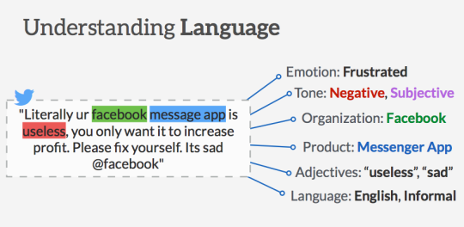

Slide 25

Ontology in artificial intelligence is a structured framework that define and categorize concepts and relationships within a specific domain.
They serve as the backbone for intelligent systems to understand, process, and interpret complex data.
They help us to share common understanding of the structure of information among people

Slide 26
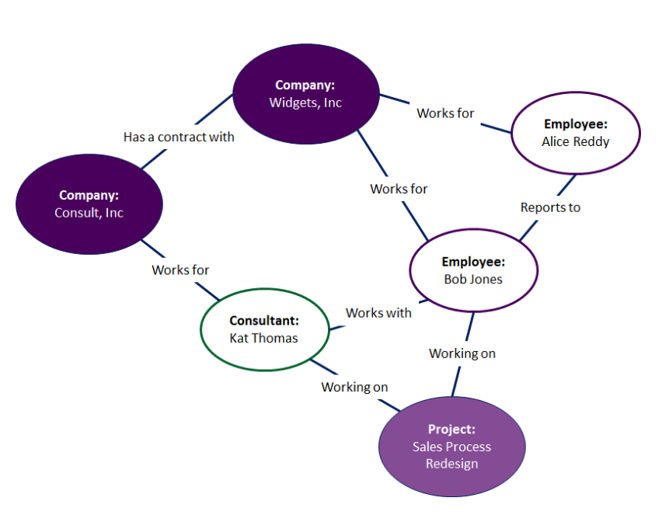

Slide 27

Natural language generation is a software process that produces natural language output.
This enables the computers to produce the output after understanding the input given by the user in natural languages like English, Hindi etc.
Applications of NLG are Chatbots, Voice assistants etc.

Slide 28

Document planning: deciding what is to be said and creating an abstract document that outlines the structure of the information.
Micro planning: generation of referring expressions, word choice, and aggregation to flesh out the document specifications.
Realization: converting the abstract document specifications to a real text, using domain knowledge about syntax, morphology, etc.

Slide 29

Lexical Analysis
  Lexical analysis is breaking down the whole chunk of text into paragraphs, sentences, and words.
  It also deals with the study of lexical meaning and part-of-speech.
  Lexicon of a language means the collection of words and phrases in a language.
  It involves identifying and analyzing the structure of words.

Slide 30
Syntactic Analysis (Parsing)
  The process of determining the syntactic structure of a text by analyzing its constituent words based on an underlying grammar (of the language).
  It involves analysis of words in the sentence for grammar and arranging words in a manner that shows the relationship among the words.
  The sentence such as “The boy will went to school” is rejected by English syntactic analyzer.

Slide 31

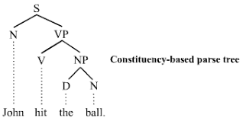

Slide 32
Semantic Analysis
  Semantic analysis is the process of drawing meaning from text
  It allows the machines to understand and interpret sentences rather than words. Involves WSD.
  It is done by analyzing their grammatical structure, and identifying relationships between individual words in a particular context.
  The semantic analyzer disregards sentence such as “hot ice-cream”.

Slide 33
Discourse Analysis
  Discourse is a coherent structured group of sentences.
  Discourse analysis may be defined as the process of determining contextual information that is useful for performing other tasks, such as anaphora resolution, NER, and so on.
  The meaning of any sentence depends upon the meaning of the sentence just before it.

Slide 34

Discourse structure is concerned primarily with how the text is structured – from start to finish.
Let us consider the following phrases and serially number them.
  S1: Rahul went to the bank to deposit money.
  S2: He then went to Rohan's shop.
  S3 : He wanted a phone.
  S4 : He did not have a phone.
  S5: He also wanted to buy a laptop from Rohan's shop.

Slide 35

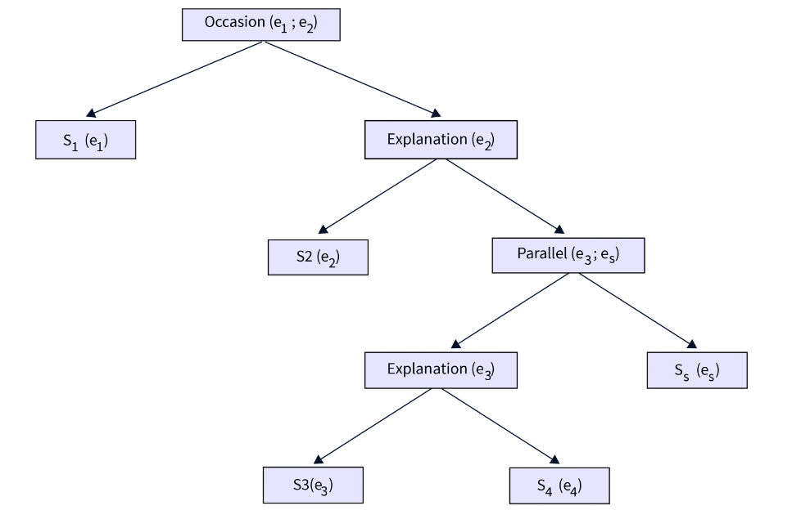

Slide 36
Pragmatic Analysis
  Reinterpretation of actual meaning.
  It involves deriving those aspects of language which require real world knowledge.
  Example: Do you know what time is it?

Slide 37

Yes/No

Slide 38

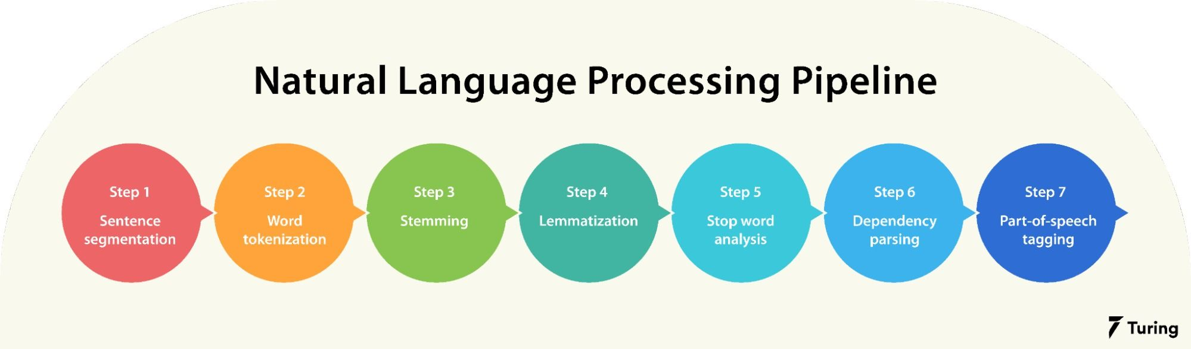

Slide 39

Text data derived from natural language is unstructured and noisy.
Text preprocessing involves transforming text into a clean and consistent format that can then be fed into a model for further analysis and learning.
This include steps like segmentation, tokenization, spell correction, stop word removal, stemming etc.

Slide 40

Segmentation involves breaking up text into corresponding sentences.
While this may seem like a trivial task, it has a few challenges.
For example, in the English language, a period normally indicates the end of a sentence, but many abbreviations, including “Inc.,” “Calif.,” “Mr.,” and “Ms.,” and all fractional numbers contain periods and introduce uncertainty unless the end-of-sentence rules accommodate those exceptions.

Slide 41

The tokenization stage involves converting a sentence into a stream of words, also called “tokens.”
Tokens are the basic building blocks upon which analysis and other methods are built.
For example, you can use a whitespace or punctuation to determine if one word has ended and the next one has started.
Example: “Hello everyone. Welcome to Delhi.”
  [‘Hello’, ‘everyone’, ‘.’, ‘Welcome’, ‘to’, ‘Delhi’, ‘.’]

Slide 42

Changing the case involves converting all text to lowercase or uppercase so that all word strings follow a consistent format.
Lowercasing is a more frequent choice in NLP.

Slide 43

Many NLP applications include a step to correct the spelling of all words in the text.

Slide 44

Stop words are those words in the text which does not add any meaning to the sentence and their removal will not affect the processing of text for the defined purpose.
They carry very little useful information
They are removed from the vocabulary to reduce noise and to reduce the dimension of the feature set.
Examples of stop words in English are “a”, “the”, “is”, “are” and etc.

Slide 45
Normalization is the process of converting a token into its base form.
In the normalization process, the inflectional form of a word is removed so that the base form can be obtained.
This helps us to improve the efficiency.
The different normalization techniques in NLP are stemming and lemmatization.

Slide 46

Text normalization is the preprocessing stage that converts text to a canonical representation.
For example, hello might be written as hellooo or something might appear as smth, and different people might choose to write real time, real-time, or realtime.
In the last example, all three forms would be converted to realtime.

Slide 47
Stemming is the process of reducing the words to their word stem or root form.
The objective of stemming is to reduce related words to the same stem even if the stem is not a dictionary word.
Example: ‘children’ -> ‘child’, ‘playing’ -> ‘play’ , ‘whom’ -> ‘who’, etc.
The most common algorithm for stemming English is Porter’s algorithm.

Slide 48
There are mainly two errors in stemming:
Over-stemming: where a much larger part of a word is chopped off than what is required.
For example, the words “university” and “universe” that get reduced to “univers”.
Under-stemming: occurs when two or more words could be wrongly reduced to more than one root word when they actually should be reduced to the same root word.
For example, the words “data” and “datum” that get reduced to “dat” and “datu” respectively (instead of the same stem “dat”).

Slide 49
Unlike stemming, lemmatization reduces words to their base word, reducing the inflected words properly and ensuring that the root word belongs to the language.
It’s usually more sophisticated than stemming, since stemmers works on an individual word without knowledge of the context.
In lemmatization, a root word is called lemma.
  A lemma is the canonical form, dictionary form, or citation form of a set of words. Example: better -> good

Slide 50

Lemmatization is a more advanced form of stemming and involves converting all words to their corresponding root form, called “lemma.”
Stemming reduces all words to their stem via a lookup table
It does not employ any knowledge of the parts of speech or the context of the word.
This means stemming can’t distinguish which meaning of the word right is intended in the sentences
Eg. “Please turn right at the next light” and “She is always right.”

Slide 51

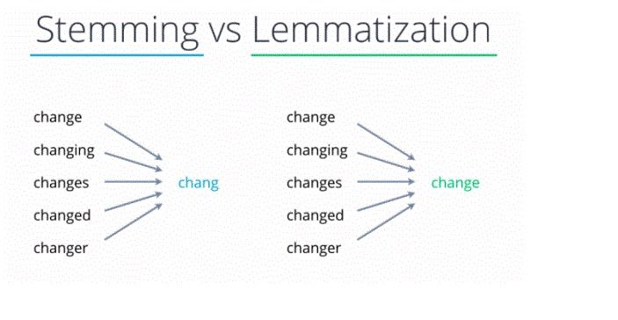

Slide 52

One of the more advanced text preprocessing techniques is parts of speech (POS) tagging.
This step augments the input text with additional information about the sentence’s grammatical structure.
Each word is, therefore, inserted into one of the predefined categories such as a noun, verb, adjective, etc. This step is also sometimes referred to as grammatical tagging.

Slide 53

Topic Modeling & Text Classification
  At the document level, one of the most useful ways to understand text is by analyzing its topics.
  The process of learning, identifying and extracting these topics across a collection of documents is called topic modeling
  Existing algorithms used to perform the topic modeling are:
    Latent semantic analysis
    Latent Dirichlet allocation
    Non-negative matrix factorisation etc

Slide 54
Sentiment Analysis
  Sentiment analysis refers to identifying sentiment orientation (positive, neutral, and negative) of natural language text.
  Today, businesses want to know what buyers say about their brand and how they feel about their products.
  However, with all of the “noise” filling our email, social and other communication channels, listening to customers has become a difficult task.

Slide 55
Named Entity Recognition
  Named Entity Recognition is the process of recognizing information units like names, including person, organization and location names, etc from unstructured text.
  NER is probably the first step towards information extraction that seeks to locate and classify named entities in a text.
  It can help answering many real-world questions

Slide 56
Part-of-Speech Tagging (POS)
  It is the process of marking up a word in a text (corpus) as corresponding to a particular part of speech based on both its definition and its context
  Finds applications in:
    Information retrieval,
    Parsing,
    Text to Speech (TTS) applications,
    Question answering
    Word sense disambiguation etc

Slide 57
Relationship Extraction & Textual Similarity
  This technique identifies the relationships present between pairs of named entities previously identified in the given text.
  Semantic textual similarity deals with determining how similar two pieces of texts are.
  This can take, for example, the form of assigning a score or of a classification (similar vs. different)

Slide 58
Content Analytics for Video Broadcasting
  Content analytics is an NLP-driven approach to cluster videos (e.g. YouTube) into relevant topics based on the user comments.
  The most frequently used technique is topic modeling LDA using bag of words
  It is actually an unsupervised learning technique that treat documents as bags of words.

Slide 59
Automatic Summarization
  Summarization is the task of condensing a piece of text to a shorter version, reducing the size of the initial text while at the same time preserving key informational elements and the meaning of content.
  Manual text summarization is a time expensive and generally laborious task.
  The automatization of the task is gaining increasing popularity and therefore constitutes a strong motivation for academic research.
  There are two different approaches for automatic summarization: extraction and abstraction.

Slide 60

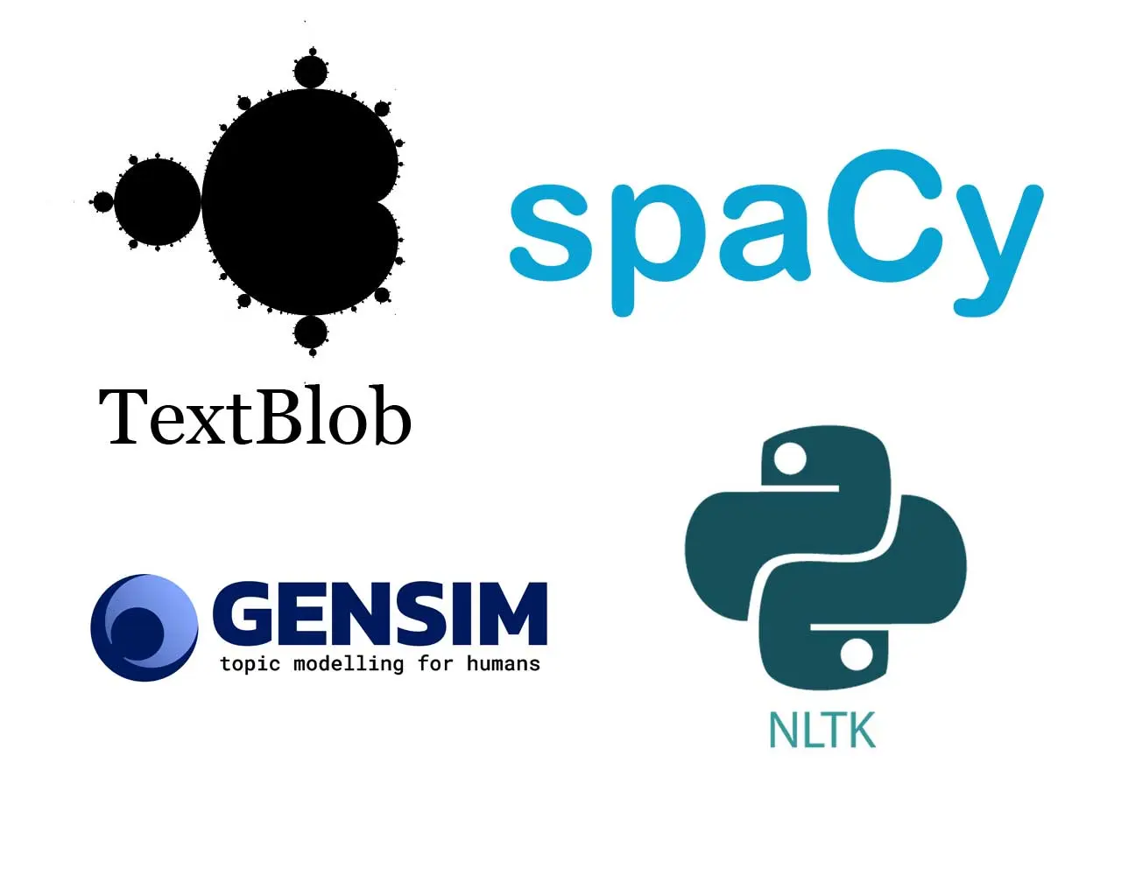

Slide 61
Thank you

