Slide 1
MODULE 1

Slide 2
Every day people are faced with questions such as
“What route should I take to work today?”
“Should I switch to a different cell phone carrier?”
“How should I invest my money?” or “Will I get cancer?”
These questions indicate our desire to know future events, and we earnestly want to make the best decisions towards that future.
To aid in our decision-making processes, we now turn to tools like Google to filter billions of web pages to find the most appropriate information for our queries.
WebMD to diagnose our illnesses based on our symptoms
E*TRADE to screen thousands of stocks and identify the best investments for our portfolios.

Slide 3
Predictive modeling: the process of developing a mathematical tool or model that generates an accurate prediction.
While the primary interest of predictive modeling is to generate accurate predictions.
A secondary interest may be to interpret the model and understand why it works.
The unfortunate reality is that as we push towards higher accuracy, models become more complex and their interpretability becomes more difficult.
This is almost always the trade-off we make when prediction accuracy is the primary goal.

Slide 4
PREDICTION VS INTERPRETATION
Predictive modeling: the process of developing a mathematical tool or model that generates an accurate prediction.
While the primary interest of predictive modeling is to generate accurate predictions.
A secondary interest may be to interpret the model and understand why it works.
The unfortunate reality is that as we push towards higher accuracy, models become more complex and their interpretability becomes more difficult.
This is almost always the trade-off we make when prediction accuracy is the primary goal

Slide 5
Key Ingredients of Predictive Models
Relevant data for the desired research objectives.
Irrelevant information can drive down predictive performance of many models.
Predictive modeling is not a substitute for intuition, but rather a complement”.
The foundation of an effective predictive model is laid with intuition and deep knowledge of the problem context, which are entirely vital for driving decisions about model development.
The third ingredient is a versatile computational toolbox which includes techniques for data pre-processing and visualization as well as a suite of modeling tools for handling a range of possible scenarios.

Slide 6
Terminology
The terms sample, data point, observation, or instance refer to a single, independent unit of data, such as a customer, patient, or compound.
The term sample can also refer to a subset of data points, such as the training set sample.
The training set consists of the data used to develop models while the test or validation sets are used solely for evaluating the performance of a final set of candidate models.
The predictors, independent variables, attributes, or descriptors are the data used as input for the prediction equation.
Independent variable are variables that we change.
Outcome, dependent variable, target, class, or response refer to the outcome event or quantity that is being predicted.
Dependent Variable is what you measure.
Control variables are that don’t change that keep the results accurate.
Continuous data have natural, numeric scales. Blood pressure, the cost of an item, are all continuous.
Categorical data, otherwise known as nominal, attribute, or discrete data, take on specific values that have no scale. Credit status (“good” or “bad”) or color (“red,”“blue,” etc.) are examples of these data..

Slide 7
7-Steps Predictive Modeling Process
Step 1: Understand Business Objective
Step 2: Define Modeling Goals
Step 3: Select/Get Data
Step 4: Prepare Data
Step 5: Analyze and Transform Variables. Random Sampling
Step 6: Model Selection and Develop Models (Training)
Step 7: Validate Models (Testing), Optimize and Profitability

Slide 8
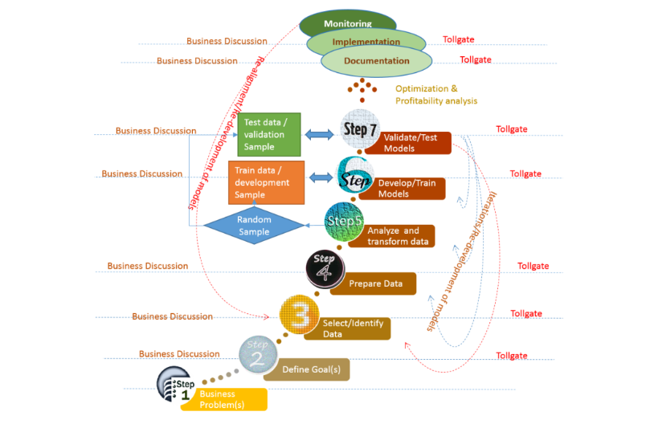

Slide 9
Step 1: Business Objective(s)
Target Marketing
Risk & Fraud Management
Strategy Implementation and Change Management
Operational Efficiency
Increase Customer Experience
Manage Marketing Campaigns
Forecast Revenue or Loss
Workforce Management
Financial Modeling
Churn Management
Social Media Influencers

Slide 10
Step 1.1: Business Objectives - Asking Right Questions!
It is very important to clearly define the goals based on business objective.
Do you want to understand the characteristics of customers?
Do you want to make unprofitable customers profitable?
Do you want to understand what driving sales?
Do you want to win-back lost customers?
Do you want to increase sales?
Do you want to reduce customer churn?
Do you want to reduce cost of production or operation?
Do you want to target new customers?
Do you want to identify probable credit default customers?
Do you want to know X-sell/Upsell opportunities?
Businesses want to find answers all such important questions and make decisions based on data

Slide 11
Step 2: Define Goals - translate business objective into analytics goal
Based on the business questions we want to answer, translate the business objective into Analytic terms
Profile Analysis
Segmentations
Response Modeling
Risk Modeling
Activation
Cross-Sell and Upsell
Attrition/Churn Modeling
Net Present Value(NPV)
Customer Life Time Value (CLTV)

Slide 12
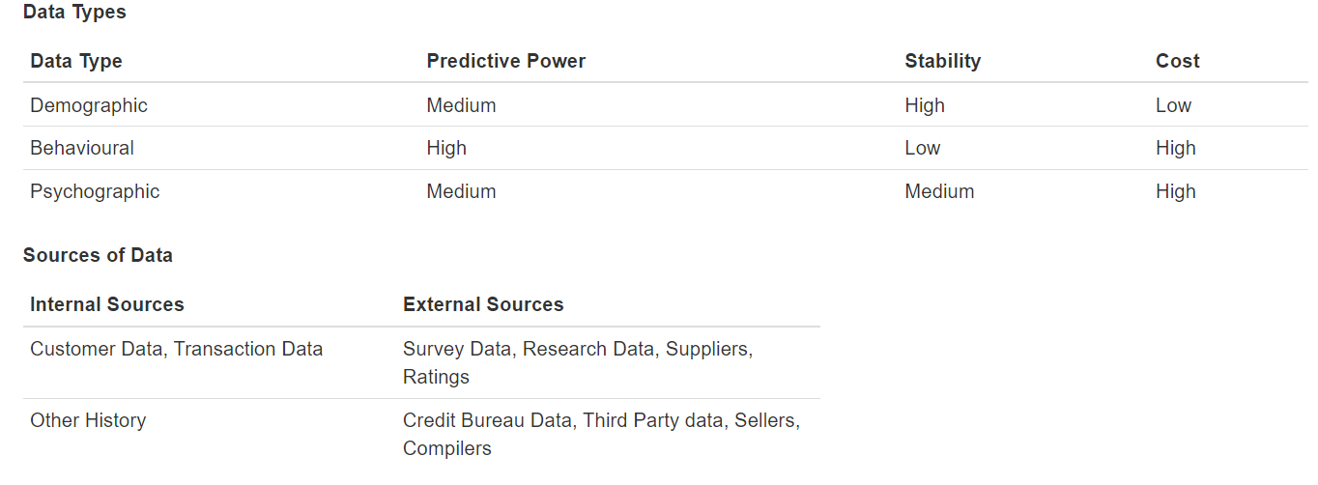
Step 3: Selecting Data for Modeling
Selecting best data for target modeling requires thorough understanding of the market, business and the objective. The model is only as good and relevant as the underlying data:

Slide 13
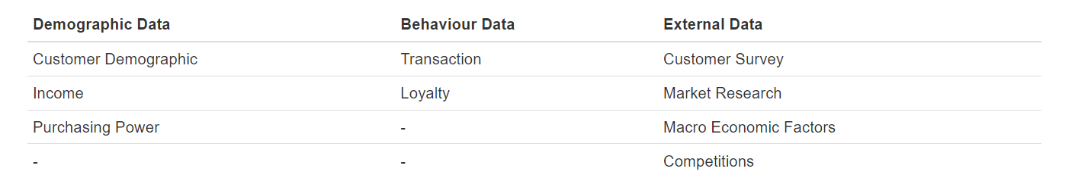
Step3.1: A Case Study - Target Marketing
Typical data required for Target Marketing

Slide 14
Step 4: Prepare Data
In this step we need prepare data into right format for analysis and the tool you may want use.
Do initial cleaning up
Define Variables and Create Data Dictionary
Joining/Appending multiple datasets
Validate for correctness
Produce Basic Summary Reports

Slide 15
Step 5: Analyze and Transform Variables
Once data is in right shape and perform
univariate analysis: to check the distribution of each of the variables and features
multivariate analyses: to check relationships with other variables and with dependent variables
Based on type of model you are going to use, you may need to transform the variables using one of the approaches
Bining approach: create distinct groups
Transformation:
Logarithmic, Polynomial
Square Root, Inverse, Square
Extreme value (outlier) treatments
Missing Value Treatment
Dimension Reduction - Information Value(IV) and Weight of Evidence(WoE), Variable Clustering, PCA, Factor Analysis, etc.

Slide 16
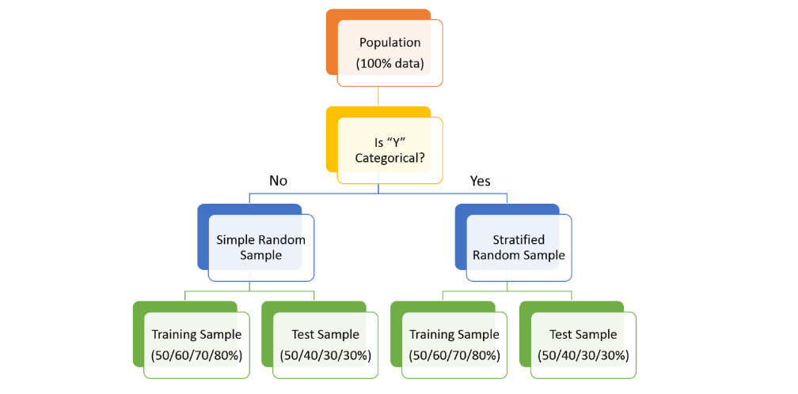
Step 5.1: Random Sampling (Train and Test)
Training Sample: Model will be developed on this sample. Typically 50%, 60%, 70% or 80% of the data goes here.
Test Sample: Model performances will be validated on this sample. Typically 50%, 40%, 30% or 20% of the data goes here

Slide 17
Step 6.1: Model Selection
General linear model
Non-Linear Regression
Linear Regression
Lasso Regression
Ridge Regression
Non-Negative Garrotte Regression
Percentage Regression
Quantile Regression
Non-parametric regression
Logistic Regression
Tobit Regression
Probit Regression
Classification/Decision Trees

Slide 18
Random Forest
Support Vector Machine (SVM)
Distance metric learning
Bayesian methods
Graphical Models
Neural Networks
Genetic Algorithm
The Hazard and Survival Functions
Time Series Models
Signal Processing
Clustering Techniques
Market Basket Analysis
Frequent Itemset Mining
Association Rule Mining etc.

Slide 19
Step 6.2: Build/Develop/Train Models
Validate the assumptions of the chosen algorithm
Check for Multicollinearity and Redundancies of Independent Variables (Features). Sometime in Machine Learning, we are keen on accuracies of the models and hence we may not perform these checks!
Develop/Train Model on Training Sample, which is 80%/70%/60%/50% of the available data(Population)
Check Model performance - Error, Accuracy

Slide 20
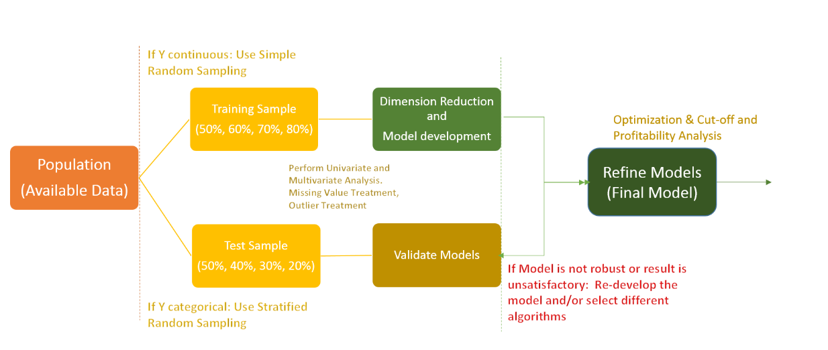

Slide 21
Step 7: Validate/Test Models
Score and Predict using Test Sample
Check for the robustness and stability of the model
Check Model Performance: Accuracy, ROC, AUC, KS, GINI etc.
Perform Cross Validation to increase accuracy/performance of the models

