Slide 1
Encrypting Data
Module 4
Dr Bijoy A Jose

Slide 2
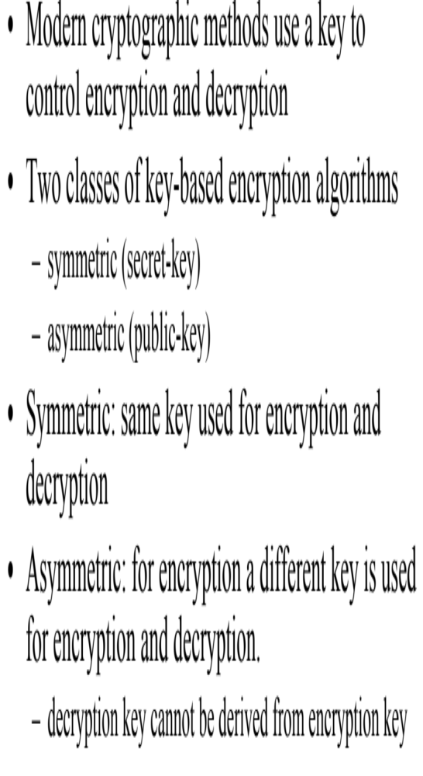
Symmetric and Asymmetric cryptography

Slide 3
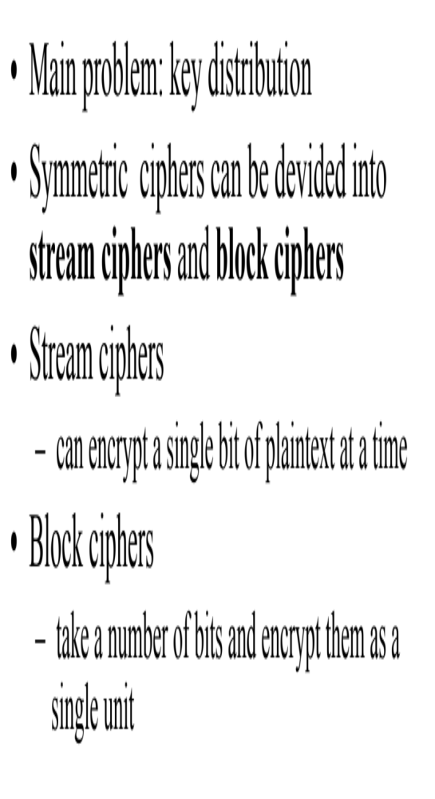
Symmetric ciphers

Slide 4
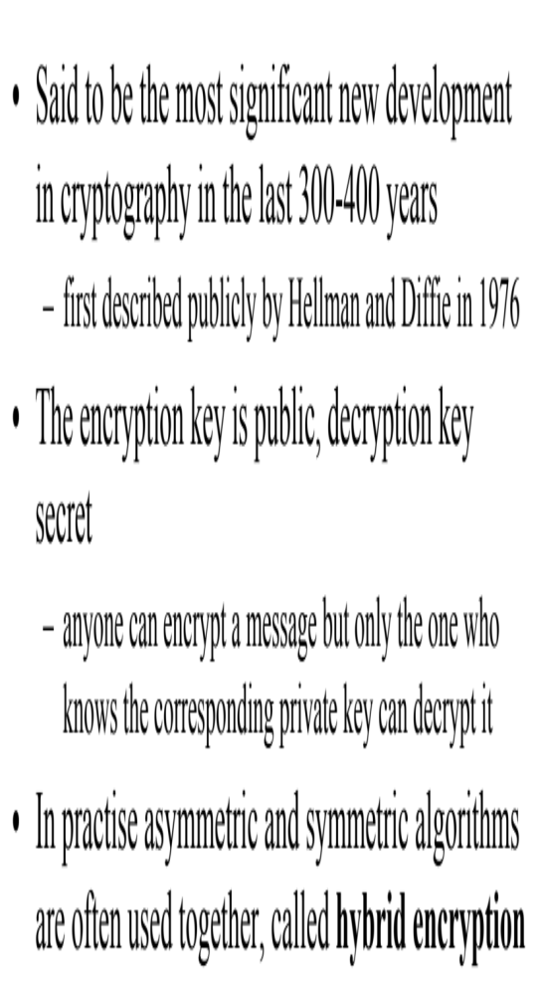
Asymmetric ciphers

Slide 5
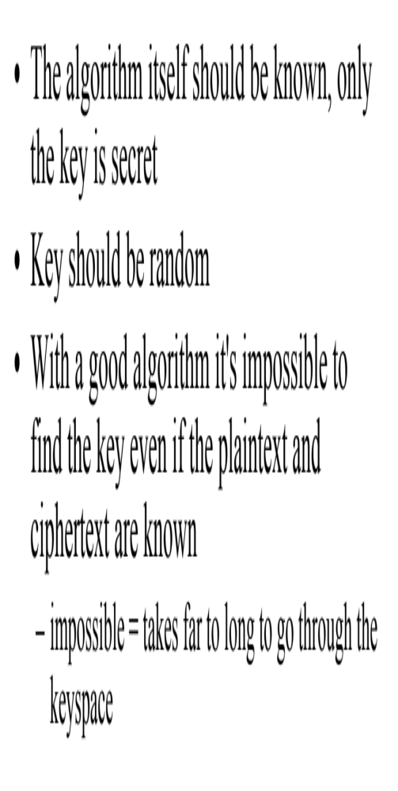
Algorithm requirements

Slide 6
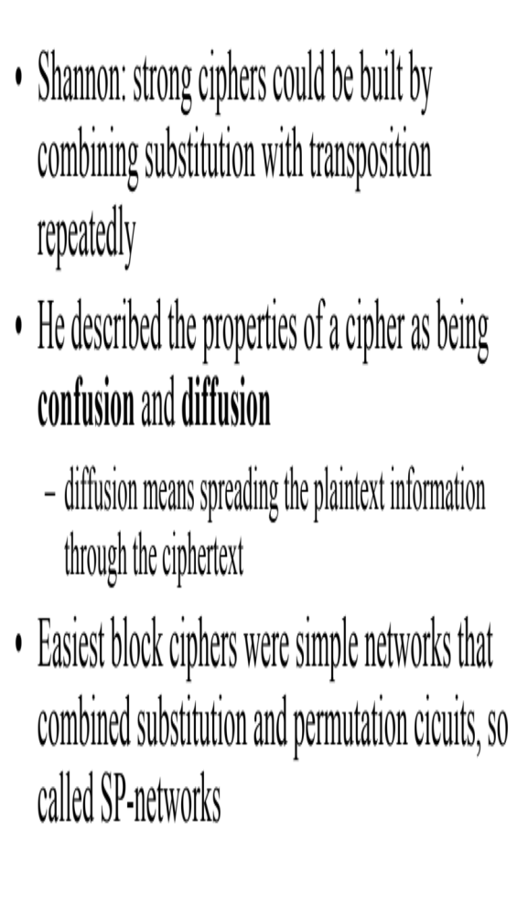
Confusion and diffusion
Confusion = Substitution a --> b
Diffusion = Permutation
abcd --> dacb
Notes:
Substitution-permutation network

Slide 7
Confusion and diffusion
1 | Confusion is a cryptographic technique which is used to create faint cipher texts. | While diffusion is used to create cryptic plain texts.
2. | This technique is possible through substitution algorithm. | While it is possible through transportation algorithm.
3. | In confusion, if one bit within the secret’s modified, most or all bits within the cipher text also will be modified. | While in diffusion, if one image within the plain text is modified, many or all image within the cipher text also will be modified
4. | In confusion, vagueness is increased in resultant. | While in diffusion, redundancy is increased in resultant.
5. | Both stream cipher and block cipher uses confusion. | Only block cipher uses diffusion.
6. | The relation between the cipher text and the key is masked by confusion. | While The relation between the cipher text and the plain text is masked by diffusion.

