Slide 1
Regression analysis
Done By: ASHFAQ HUSSAIN M S

Slide 2
CONTENTS
MULTICOLLINEARITY:
1.1 Introduction
1.2 Detection
1.3 Imputations And Its Remedies
2. PRINCIPAL COMPONENT REGRESSION:
2.1 Introduction
2.2 Steps
2.3 Advantages And Limitations

Slide 3
Multicollinearity

Slide 4
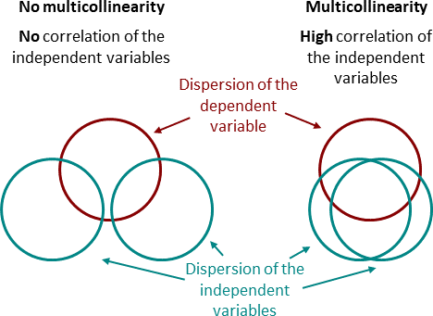
Intro..
Multicollinearity in regression analysis occurs when two or more independent variables in a model are highly correlated, meaning they have a strong linear relationship.
This can cause issues because multicollinearity makes it difficult to determine the individual effect of each predictor on the dependent variable.

Slide 5
Detection…
1. Variance Inflation Factor (VIF)
The VIF quantifies how much the variance of a regression coefficient is inflated due to multicollinearity. For an independent variable X_{i}, the VIF is calculated as:
VIF(Xi​)=1/1−R_{i}²​ ​
where Ri2R_i^2Ri2​ is the coefficient of determination from regressing X_{i} ​ on all other predictors.
A high VIF value (typically above 5 or 10) indicates that X_{i} ​ is highly correlated with other predictors, meaning multicollinearity is present.
2. Correlation coefficient
The pairwise correlation coefficient ρ_{ij}​ between two predictors X_{i} and X_{j​} is given by:
ρ_{ij​} = ​​Cov(X_{i​} , X_{j}​) / ​σ_{i}​​ * σ_{j} where:
Cov(Xi,Xj) is the covariance between X_{i} and X_{j .}
σi and σj​​ are the standard deviations of X_{i} and X_{j} respectively.
High values of ρij​ (usually above 0.7 or 0.8) indicate a strong correlation, signaling potential multicollinearity.

Slide 6
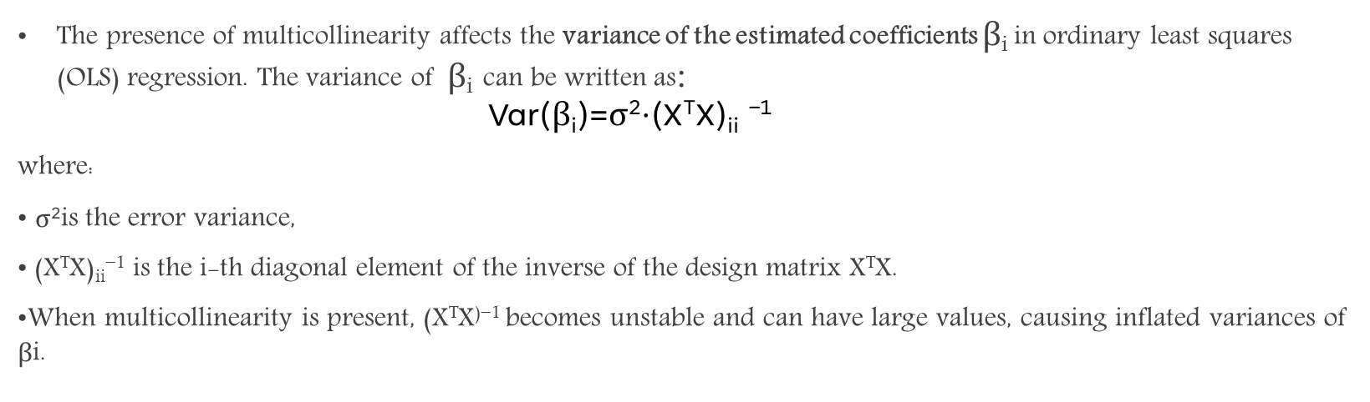
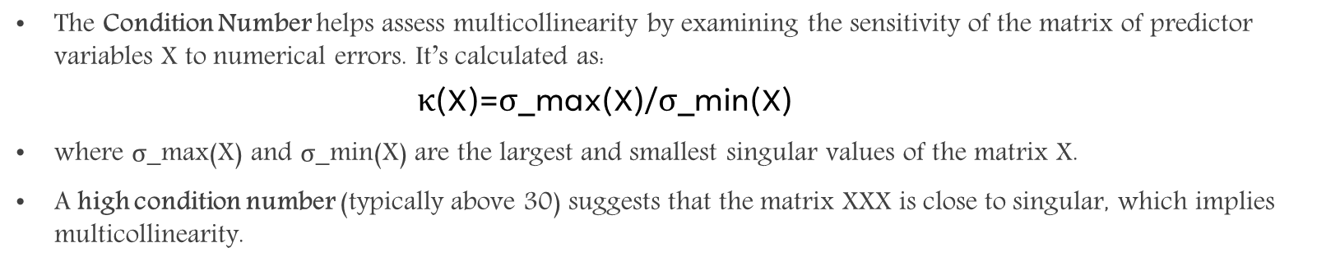
3. Condition Number
The Condition Number helps assess multicollinearity by examining the sensitivity of the matrix of predictor variables X to numerical errors. It’s calculated as:
            κ(X)=σ_max​(X)/σ_min​(X)
where σ_max​(X) and σ_min⁡(X) are the largest and smallest singular values of the matrix X.
A high condition number (typically above 30) suggests that the matrix XXX is close to singular, which implies multicollinearity.
4. Effect on Coefficient Variance
The presence of multicollinearity affects the variance of the estimated coefficients β_{i​} in ordinary least squares (OLS) regression. The variance of ​ β_{i} can be written as:
              $$\text{Var}\text{(}\text{β}\text{​}\text{i}\text{​)=}\text{σ}\text{2}\text{⋅(}\text{X}\text{T}\text{X}\text{)}\text{ii} \text{−1}$$
where:
σ²is the error variance,
(X^{T}X)_{ii}⁻¹​ is the i-th diagonal element of the inverse of the design matrix X^{T}X.
When multicollinearity is present, (X^{T}X⁾⁻¹ becomes unstable and can have large values, causing inflated variances of β​i​.
        $\text{​}$

Slide 7
IMplications
Unstable Coefficient Estimates: Regression coefficients become sensitive to minor changes in the data, leading to unreliable and large standard errors.
Reduced Predictive Power: It becomes harder to determine which variables are truly important, as highly correlated predictors may mask each other's effects.
Inflated Standard Errors: Larger standard errors reduce the statistical significance of predictors, making it challenging to identify which variables are genuinely influential.
remedies
Remove Highly Correlated Predictors: Exclude one of the correlated variables, especially if it has a high VIF or doesn't add significant value to the model.
Combine Predictors: Sometimes, creating a new variable by combining correlated predictors (e.g., taking their average) can address multicollinearity.
Regularization Techniques: Ridge regression (L2 regularization) can reduce the impact of multicollinearity by penalizing large coefficients.
Principal Component Analysis (PCA): PCA can transform correlated predictors into uncorrelated principal components, which can then be used in regression analysis.

Slide 8
Principal component regression…

Slide 9
INTRo…
Principal Component Regression (PCR) is a technique that combines Principal Component Analysis (PCA) and Multiple Linear Regression (MLR).
It's used to address issues of multicollinearity and dimensionality in regression analysis by transforming the predictor variables into a new set of uncorrelated components and then performing regression on these components.

Slide 10
Steps
1. Apply Principal Component Analysis (PCA):
Perform PCA on the predictor variables X to transform them into a set of uncorrelated components, known as principal components.
Each principal component is a linear combination of the original predictor variables, and they are ordered by the amount of variance they explain in the data.
Mathematically, if X is an n×p matrix of predictor variables:
Z=XW
Z is the matrix of principal components,
W is the matrix of eigenvectors from the covariance matrix of X.
2. Select Principal Components:
Choose a subset of the top k principal components (those that explain the most variance) to use in the regression model.
The number of components k is typically chosen to avoid overfitting and to capture a sufficient amount of variance.

Slide 11
3. Perform Regression on Principal Components:
Regress the dependent variable Y on the selected principal components Z₁, Z₂,…, Z_{k}
If Y is an n×1 response variable vector and Z is the matrix of the chosen principal components:
Y=Zβ+ϵ
β is the vector of coefficients for the principal components,
ϵ is the error term.
4. Interpretation:
The resulting regression coefficients correspond to the principal components, not the original variables. This can make interpretation less direct because principal components are combinations of original predictors.
If necessary, the coefficients of the original variables can be recovered by transforming back to the original scale.

Slide 12
Advantages
Reduces Multicollinearity: Since principal components are uncorrelated, PCR removes multicollinearity issues among predictors.
Dimensionality Reduction: PCR reduces the number of predictors by focusing on the principal components that capture the most variance, which is useful when there are many predictors.
Improved Model Stability: The reduced dimensionality and removal of multicollinearity often lead to more stable coefficient estimates.
Limitations
Interpretability: Since PCR uses principal components (combinations of original variables), the model coefficients are not directly interpretable in terms of the original variables.
Assumption of Variance-Importance: PCR assumes that the components with the most variance are the most important for predicting the response, which may not always be true.

Slide 13
THANK YOU!!

