Slide 1
Object Oriented Programming
The basic theme of the object oriented approach is to model the real –world problems.
So, object oriented programming language C++ introduces a new data type called class by which you can define your own data types as class.
Defining the variables of a class data type is known as a class instantiation and such variables are called objects

Slide 2
Object
An object is something that has fixed shape or well defined boundary.
In other words, an object can be a person, a place, or a thing with which the computer must deal.
If you look at your surroundings some objects may correspond to real-world entities such as– student, bank account, book, cars, bags, computer, lock, watch etc

Slide 3
Properties of Objects
(i) each objects has certain attributes.
(ii) each objects has some behaviours or actions or operations associated with it.
For example, the objects ‘computer’ & ‘car’ have the following attributes and operations–
Object : car
Attributes: company, model, colour, & capacity
Operation: speed ( ), average ( ), & break ( )
Object: Computer Attributes: brand, price, monitor resolution, hard disk and RAM size
Operation: Processing( ), display( ) & printing ( )

Slide 4
Each object will have its own identity though its attributes and operation are same, the objects will never become equal.
In case of person object, for instance, two person have the same attributes like name, age and sex, but they are not equal.
Objects are the basic run time entities in an object oriented system.
Thus, in C++, an object is a collection of related variables and function bound together to form a high level entity.
Thus, the variable defines – the state of the object
the function defines – the action or operation that can be performed on the object

Slide 5
Class
A class is a grouping of objects having identical attributes and common behaviour (operations).
It means all objects possessing similar attributes or properties are grouped into the same unit which is called a class.
A class encloses both the data and function into a single unit as shown in the following Figure 8.1

Slide 6
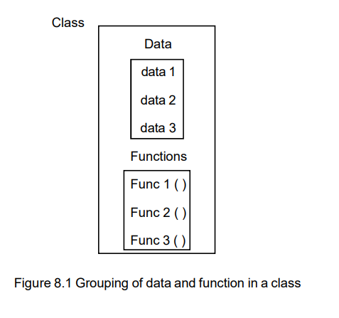

Slide 7
Thus, the entire group of data and code of an object can be built as a user-defined data type using class.
It is obvious that classes are the basic language construct in C++ for creating the user defined data types.
Once a class has been declared, the programmer can create a number of objects associated with that class.
Objects are nothing but the variable of the class data type.
Defining variables of a class data type is known as a class instantiation.

Slide 8
We have come to know that classes contain not only data but also functions.
Data and functions within a class are called members of a class.
The data inside a class is called a data member and the functions are called member function.
The member functions define the set of operations that can be performed on the data member of a class. The syntax of a class declaration is shown below—

Slide 9
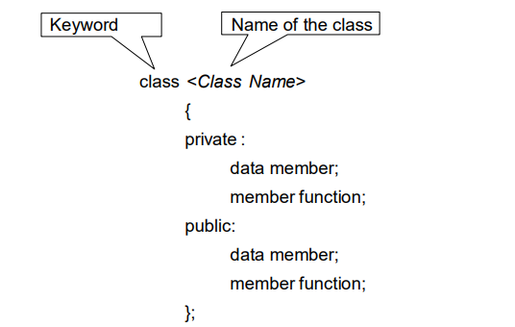

Slide 10
The keyword ‘class’ indicates the name which follows class name, is an abstract data type.
The declaration of a class is enclosed with curly braces and terminated by a semi-colon.
The body of a class contains declaration of data members and member functions.
The members of a class are usually grouped in two sections i.e. private and public, which define the visibility of members.

Slide 11
A class name should be meaningful, reflecting the information it holds.

Slide 12
In general, the data members are declared as private and member functions are declared as public.
In our example, though, we have not specifed the data members as private; yet they are treated as private by default.

Slide 13
Access Control in a Class
The members of a class are generally grouped into three sections by using the following keyword– private public protected
These keywords are called access control specifiers.
These control specifiers are written inside the class and terminated by this ‘:’ symbol.
All the members that follow a keyword (upto another keyword) belong to that type.
If no keyword is specified, then the members are assumed as private member.

Slide 14
Private: Private members are accessible to their own class members only.
They cannot be accessed from outside the class by any member functions.
The members at the beginning of class without any access specifier are private by default.
Hence, writing the keyword ‘private’ at the beginning of a class is optional.

Slide 15
Public: Public members are visible (accessible) outside the class, they should be declared in public section.
All data members are not only accessible to their own members of a class but also can be accessible from anywhere in the program, either by functions that belong to the class or by those external to the class.

Slide 16
DECLARING OBJECTS
A class declaration only builds the structure of objects.
In our example, the class employee does not define any objects of employee but only specifies what it will contain.
Once a class has been declared, we can create variable of that type by using the class name (like any other built-in type variable).
The process of creating objects (variables) of the class is called class instantiation.
For example– int x, y, z; // declaration of integer variables float m, n; // declaration of float variables employee a; // declaration of object or class variable

Slide 17
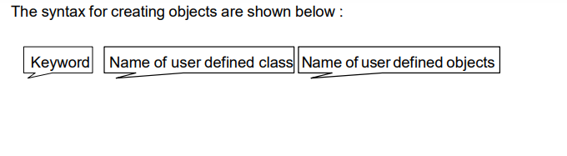

Slide 18
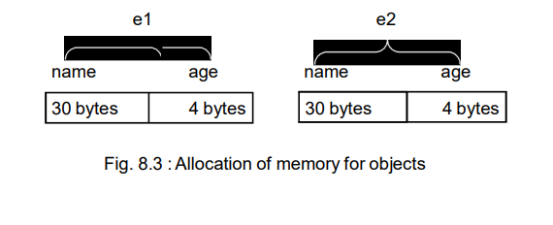
For example, class employee e1, or employee e1; In a single statement we can create more than one object as shown below. employee e1, e2, e3, e4;
Always remember that, at the time of declaration of object, necessary memory space is allocated for an object.
Suppose, we have declared two objects as – employee e1, e2; Both e1 and e2 have the same data members and it is illustrated by the following figure

Slide 19
Here, in the figure the objects e1 and e2 occupy the memory area.
They are not initialized to anything; however the data members of each object will simply contain junk values.
So, our main task is to access the data members of the object and setting them to some specific values.
An object is a conceptual entity having the following properties:
- it is individual - it points to a thing, either physical or logical that is identifiable by the user.
- it holds data as well as operation method that handles data.
- its scope is limited to the block in which it is defined.

Slide 20
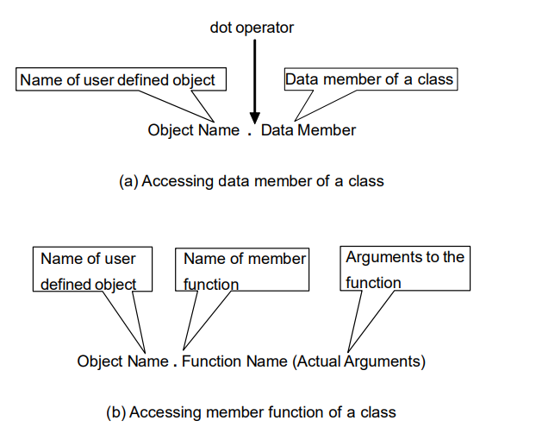
8.5.1 Accessing Class Members
After creating an object of a class, it is the time to access its members. This is the achieved by using the member access operator, dot ( . ). The syntax for accessing members (data and functions) of a class is shown below–

Slide 21
DEFINING MEMBER FUNCTIONS
We have already come to know that a class holds both the data and functions which are called data members and member functions.
The data member of a class must be declared within the body of the class.
The member functions of a class can be defined in two places inside the class definition outside the class definition.
It is obvious that a function should perform the same task, no matter where it is defined.
But the syntax of a member function definition changes depending on the place of its definition, i.e. inside a class or outside a class.

Slide 22
Member Function Inside a Class
In this method, the function is defined inside the class body.
When a function is defined inside a class, it is treated as an inline function.
Remember that if a function contains loop instruction i.e. for, while do, while ...etc. then that function will not be treated as inline function.

Slide 23
Member Function outside a Class
In this method of defining a member function outside a class - first you will have to declare a function prototype within the body of the class and then define the function outside the body of the class.
The function defined outside the body of a class have the same syntax as normal functions i.e. they should have a function header and a function body.
But, there must have a mechanism of binding the functions to the class to which they belong.
This is done by using the scope resolution operation (: :), in the header of the function.
The scope resolution operator acts as an ‘identity-label’ and tells the compiler the class to which the function belongs.
The general form of a member function definition is shown below–

Slide 24
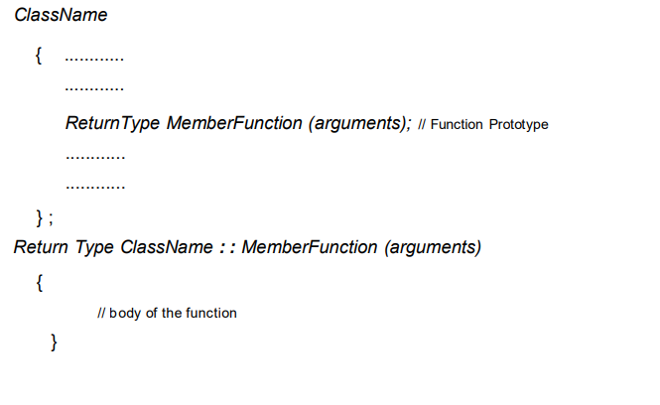

Slide 25
Here, the label ClassName : : tells the compiler that the function MemberFunction is the member of class ClassName.
The scope of the function is restricted to only the objects and other members of the class.

Slide 26
– A program can have several different classes and they can use the same name for different member functions.
The ‘membership label’ (ClassName : :) resolves the ambiguity of the compiler in deciding which function belong’ to which class.
Member functions can access the private data of the class, whereas non-member functions are not allowed to access.
But ‘friend function’ can access the private data member of a class
Member functions of the same class can access all other members of their own class without the use of dot operator

Slide 27
ARRAY OF OBJECTS
We know that arrays hold data of similar type.
Arrays can be of any data type including user defined data type, created by using struct, class etc.
We can create an array of variables by using class data type.
Such an array of variables of class data type is also known as an array of objects which handle a group of objects.

Slide 28
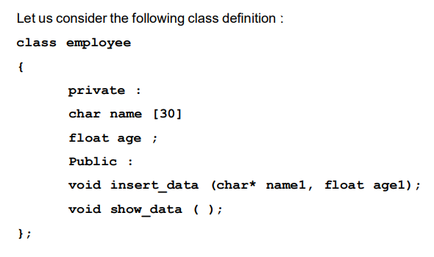

Slide 29

Here, the identifier ‘employee’ is a user defined data type and can be used to create objects that relate to different categories of employees.
For example, the following definition will creates an array of objects of ‘employee’ class–

Slide 30
The array consultant contain 30 objects namely, consultant [0], consultant [1],......... consultant [29], of type employee class.
Similarly, clerk array contains 15 objects and lecturer array contains 20 objects.
We know that as array elements occupy continuous memory locations like the same way as array of objects occupy contiguous memory locations as shown in the fig. 8.4

Slide 31
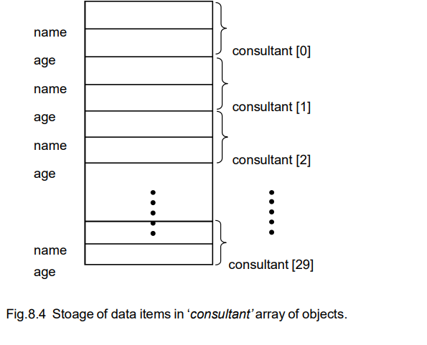

Slide 32
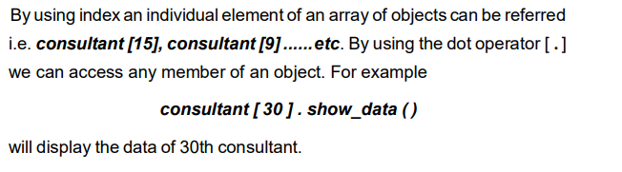

Slide 33
OBJECTS AS FUNCTION ARGUMENTS
Objects can be passed as an argument to a function.
There are three ways of passing objects as function arguments:
a copy of the entire object is passed to the function, which is also called pass-by-value
only the address of the object is sent implicitly to the function, which is also called – pass by-reference.
the address of the object is sent explicitly to the function, which is also called – pass-by-pointer

Slide 34
Pass-by-value
In this technique, a copy of the object is passed to the called function (callee) from the calling function (caller).
Since a copy of the object is passed so any changes made to the object inside the called function do not affect the object used to call the function.
The following program demonstrates the use of objects as function arguments in pass-by-value mechanism.

Slide 35
Pass-by-Reference
In this technique, only the address of the object is sent to the function.
When an address of the object is passed, the address acts as reference pointer to the actual object in the calling funciton.
Therefore, any change made to the objects inside the called function will reflect in the actual object in the calling funciton.

Slide 36
Pass-by-Pointer
In this mechanism also, the address of the object is passed explicitly to the called function from the calling function

Slide 37
FRIEND FUNCITON AND FRIEND CLASS
We have already discussed the fact that the private members of a class cannot be accessible from the outside of the class.
Only the member functions of that class have permission for accessing the private members.
This policy enforces the encapsulation and data hiding techniques.
Let us think of a situation where a user need a function to operate on objects of two different classes.
It means that the function will be allowed to access the private data of both the classes.
In C++, this situation is overcome by using the concept of friend function.
C++ permits a friend function to access the private members of different classes.
The declaration of a friend function must be prefixed by the keyword “friend”.
In the following class is shown a declaration of a friend function.

Slide 38
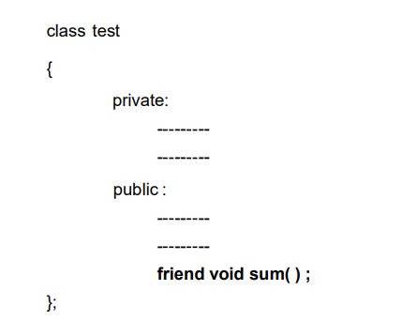

Slide 39
The function can be defined anywhere in the program similar to any normal C++ function.
The function definition does not use either the keyword friend or the scope operator ‘: :’.
The functions that are declared with the keyword ‘friend’ are called friend functions.
A friend function can be a friend to a multiple classes.
The friend function have the following properties :
There is no scope restriction for the friend function; hence they can be called directly without using objects.
Unlike member functions of class, friend function cannot access the members directly. On the other hand, it uses object and dot operator to access the private and public member variables of the class.
Use of friend function is rarely done, because it violates the rule of encapsulation and data hiding. The function can be declared in public or private sections without changing its meaning.

Slide 40
In the above program each of the two classes ‘first’ and ‘second’ has a member function named getvalue () and one private data member.
Notice that, the function sum ( ) is declared as friend function in both the class.
Hence, this function has the ability to access the members of both the classes.
Using sum ( ) function, addition of integers is calculated and displayed.
It is possible to declare all the member functions of a class as the friend functions of another class.
When all the functions need to access another class in such a situation we can declare an entire class as friend class.
Always remember that friendship is not exchangeable.
Its meaning is that - declaring class A to be a friend of class B does not mean that class B is also a friend of class A

Slide 41
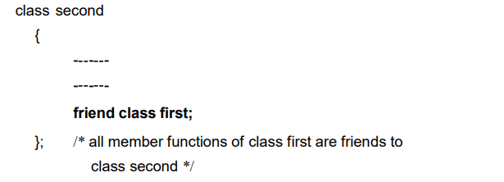

Slide 42
CONSTRUCTORS AND DESTRUCTORS
C++ provides a pair of special member functions called constructor and destructor.
Constructor enables an object to initialize itself when it is created and destructor destroys the object when it is no longer required.

Slide 43
CONSTRUCTORS
A constructor is a special member function in a class that is called when a new object of the class is created.
It, therefore, provides the opportunity to initialize objects as they are created and to ensure that data members only contain valid values.
It is a member function whose task is to initialize the object of its class and allocate the required resources such as memory.
It is distinct from other members of the class because it has the same name as its class.

Slide 44
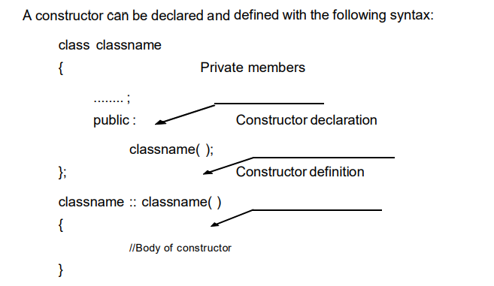

Slide 45
Constructor is executed automatically whenever the class is instantiated i.e., object of the class is created.
It always has the same name as the class in which it is defined
It cannot have any return type, not even void.
It is normally used to initialize the data members of a class.
It is also used to allocate resources like memory to the dynamic data members of a class.
It is normally declared in the public access within the class. For example, let us declare a class with class name ‘circle’. If we use constructor, then the constructor name must also be ‘circle’. T

Slide 46
In the above program, the constructor circle( ) takes the value of radius from the keyboard.
Although the data member is private, the constructor could initialize them.
The statement circle c declares a variable c as object of (type) class circle.
It also calls the constructor implicitly.

Slide 47
The Default Constructors
The constructor which takes no arguments is called the default constructor.
The following code fragment shows the syntax of a default constructor

Slide 48
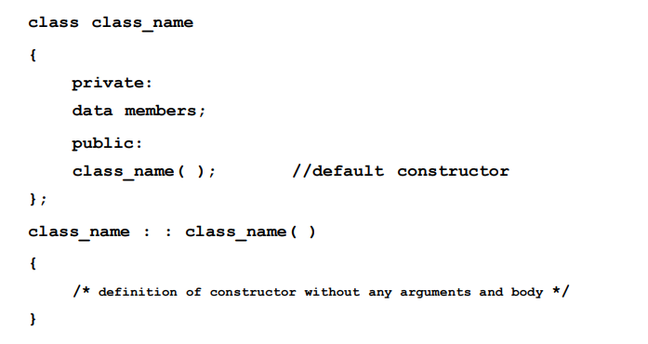

Slide 49
If no constructor is defined for a class, then the compiler supplies the default constructor.

Slide 50
1 Parameterized Constructors
The constructor that can take arguments are called parameterized constructor.
The arguments can be separated by commas and they can be specified within braces similar to the argument list in function.
When a constructor has been parameterized, the object declaration without parameter may not work.
In case of parameterized constructor, we must provide the appropriate arguments to the constructor when an object is declared.
This can be done in two ways:
By calling the constructor explicitly.
By calling the constructor implicitly.
The implicit call method is sometimes known as shorthand method as it is shorter and is easy to implement.

Slide 51
In the above program, the statement
student(int r, int m, int a, );
is a parameterized constructor with two arguments.
In the main( ) function, we see that there are two objects, manoj and rahul of class type student.
The object manoj is initialized with the values 5,430 and16 with the implicit call statement student manoj(5, 430,16);.
The object rahul is initialized with the values 6,380 and 15 with the explicit call statement student rahul = student(6, 380,15);
This statement creates a student object rahul and passes the values 6, 380 and 15 to it.

Slide 52
Constructors with Default Arguments
It is possible to have a constructor with arguments having default values.
It means that if we have a parameterized constructor with n parameters, then we can invoke it with less than n parameters specified in the call.
It is useful when most of the objects to be created are likely to have the same value for some data members.
We need not specify that in every invocation.
For example, suppose we want to record the data of class x (ten) students.
For this, we can consider the same class student as shown in Program 8.2. Most of the students are of age 16. Hence, their birth year is likely to be the same. Only a few of them may have a different year of birth. For this we can use the statement student(int r, int m, int a=16); where the third parameter is given the default value. When we write the following statement student s(1,360); it assigns the values 1 and 360 to the argument r and m respectively and 16 to the argument a by default. Again, if we write student t(2,400,15); it assigns 2, 400 and 15 to r, m and a respectively. Thus, the actual arguments, when specified, overrides the default values

Slide 53
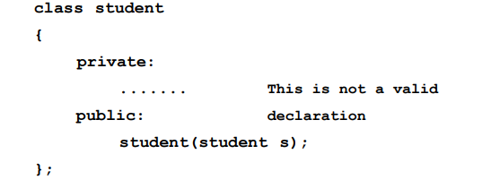
Copy Constructors
Object of the same class cannot be passed as argument to constructor to that class by value method.

Slide 54
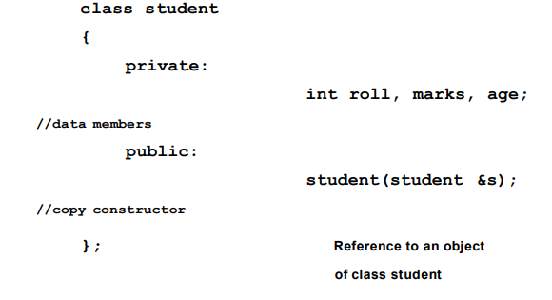
Such type of constructor, i.e., a constructor having parameter which is a reference to object of the same class is called a copy constructor. Thus, the following declaration is a valid declaration.

Slide 55
Copy constructor is also called one argument constructor as it takes only one argument.
The main use of copy constructor is to initialize the objects while in creation, also used to copy an object.
This constructor allows the programmer to create a new object from an existing one by initialization

Slide 57
DESTRUCTORS
Like constructors, destructors are also special member functions used in C++ programming language.
Destructors have the opposite function of a constructor.
The main function of destructors is to free memory and to release resources.
Destructors take the same name as that of the class name preceded by a tilde ~.
A destructor takes no arguments and has no return type.
The general syntax of a destructor is as follows:

Slide 58
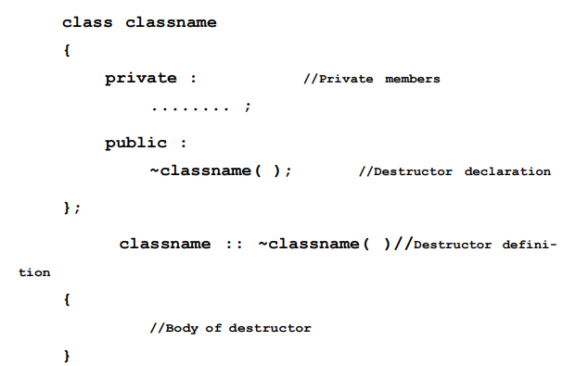

Slide 59
In the above, the symbol tilde ~ represents a destructor which precedes the name of the class.
Like the default constructor, the compiler always creates a default destructor if we donot create one.
Similar to constructors, a destructor must be declared in the public section of a class.
Destructor cannot be overloaded i.e., a class cannot have more than one destructor

Slide 60
The following points should be kept in mind while defining and writing the syntax for the destructor
A destructor must be declared with the same name as that of the class to which it belongs.
But destructor name should be preceeded by a tilde (~).
A destructor should be declared with no return type.
A destructor must have public access in the class declaration.

