Slide 1


2026
LAYOUT REFERENCE
COMMERCIAL ENERGY
Rooftop Solar
+ Storage
Design specimen with illustrative figures and representative images. Do not use for any commercial purpose.
PREPARED FOR
CLIENT NAME
DATE
26 SEP 2026
STATUS
SPECIMEN

Slide 2

LAYOUT REFERENCE
OCEAN RCS
Agenda
01
SITE
What the roof and service can carry
02
SYSTEM
Solar, storage and interconnection
03
ECONOMICS
Savings, incentives and payback
04
NEXT STEPS
Decisions and schedule

Slide 3


01
Clarity starts with the site
ROOF, STRUCTURE, SERVICE AND THE CONSTRAINTS THAT SHAPE THE ARRAY.

Slide 4

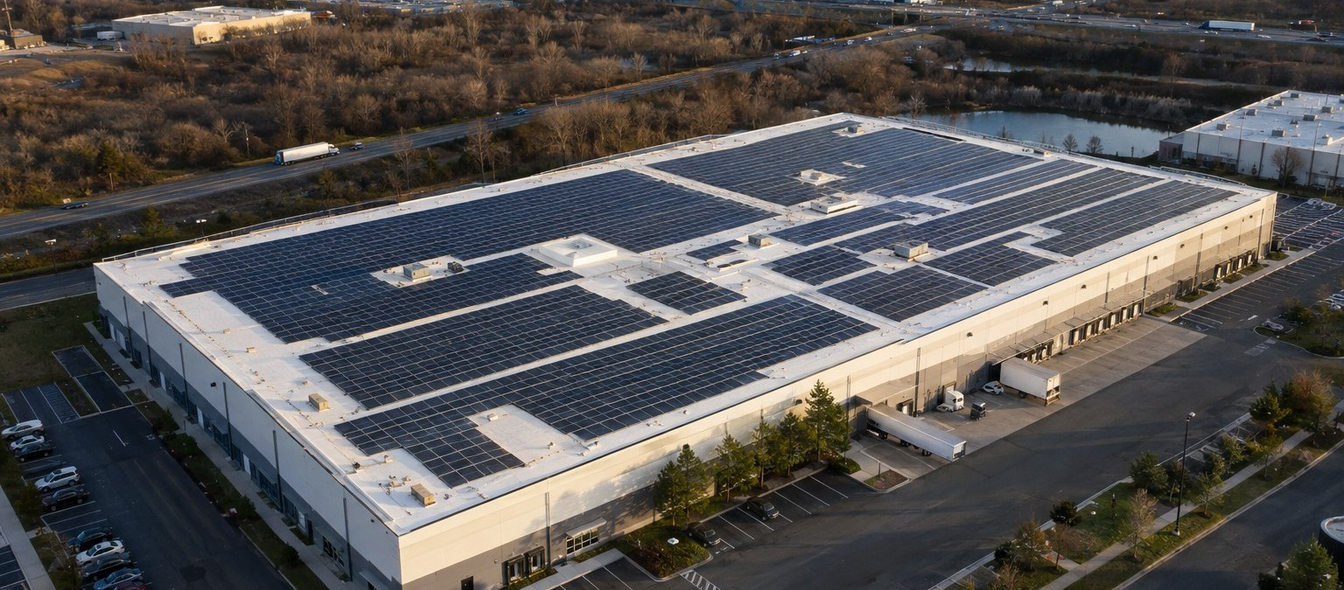
PAGE
SITE
SYSTEM
ECONOMICS
NEXT STEPS
LAYOUT REFERENCE
01
02
03
04
04
OCEAN RCS
01 SITE
The roof can carry about
412 kW of solar
A NEW TPO ROOF, CLEAR ARRAY ZONES AND AN
EXISTING 2,000 A SERVICE.
ARRAY SIZE
412 KW DC
USABLE ROOF
68,400 FT²
SERVICE
2,000 A · 480 V
Representative image of a comparable rooftop array.
OCEAN RCS · DESIGN SPECIMEN · DO NOT USE

Slide 5
PAGE
SITE
SYSTEM
ECONOMICS
NEXT STEPS
LAYOUT REFERENCE
01
02
03
04
05
OCEAN RCS
01 SITE
Four figures define
the opportunity
ILLUSTRATIVE FIGURES FOR THE SPECIMEN.
ARRAY SIZE
STORAGE
SERVICE
PAYBACK
412 kW
1.2 MWh
2,000 A
6.4 yrs
After keep-outs
Two cabinets
To be confirmed
After incentives
ILLUSTRATIVE FIGURES · SPECIMEN
BOTTOM LINE
Payback in 6.4 years with the existing service.
OCEAN RCS · DESIGN SPECIMEN · DO NOT USE

Slide 6


02
A system built for the building
SOLAR, STORAGE AND INTERCONNECTION SIZED TO THE LOAD.

Slide 7


PAGE
SITE
SYSTEM
ECONOMICS
NEXT STEPS
LAYOUT REFERENCE
01
02
03
04
07
OCEAN RCS
02 SYSTEM
Built and verified
by our own crews
Every cabinet is tested, torqued
and logged before handover.
One team owns the work
from design to commissioning.
OCEAN RCS · DESIGN SPECIMEN · DO NOT USE

Slide 8
PAGE
SITE
SYSTEM
ECONOMICS
NEXT STEPS
LAYOUT REFERENCE
01
02
03
04
08
OCEAN RCS
02 SYSTEM
Three parts, one
integrated system
EACH PART IS ENGINEERED TO THE SITE.
01
02
03
Solar array
Battery storage
Interconnection
412 kW DC on the new TPO roof, laid
out around keep-outs and access
paths.
Two 600 kWh cabinets shave peaks
and carry critical loads.
A line-side tap on the existing 2,000 A
service, subject to utility approval.
OCEAN RCS · DESIGN SPECIMEN · DO NOT USE

Slide 9
PAGE
SITE
SYSTEM
ECONOMICS
NEXT STEPS
LAYOUT REFERENCE
01
02
03
04
09
OCEAN RCS
02 SYSTEM
A repeatable path from
brief to handover
01 · BRIEF
02 · DESIGN
03 · VERIFY
04 · DELIVER
Define the decision
Build the system
Commission on site
Hand over
Identify the audience and the
evidence needed.
Engineer the array, storage and
service.
Test, torque and log every
cabinet.
Provide records, training and
support.
OCEAN RCS · DESIGN SPECIMEN · DO NOT USE

Slide 10

03
The numbers that decide it
SAVINGS, INCENTIVES AND PAYBACK ON VERIFIED INPUTS.

Slide 11

PAGE
SITE
SYSTEM
ECONOMICS
NEXT STEPS
LAYOUT REFERENCE
01
02
03
04
11
OCEAN RCS
03 ECONOMICS
Savings grow each year
as utility rates rise
ANNUAL BILL SAVINGS, YEARS 1–10, $K. YEAR 10
HIGHLIGHTED.
Savings rise from
$62K to $104K a year.
BOTTOM LINE
10-year savings of $819K. Payback in 6.4 years.
OCEAN RCS · DESIGN SPECIMEN · DO NOT USE

Slide 12
PAGE
SITE
SYSTEM
ECONOMICS
NEXT STEPS
LAYOUT REFERENCE
01
02
03
04
12
OCEAN RCS
03 ECONOMICS
System summary and
open items
ITEM | SPECIFICATION | STATUS
Solar array | 412 kW DC | Confirmed layout
Battery storage | 1.2 MWh | Pending utility
Interconnection | 2,000 A line-side tap | Application due
Roof | New TPO, 20-year warranty | Complete
ILLUSTRATIVE FIGURES · SPECIMEN
OCEAN RCS · DESIGN SPECIMEN · DO NOT USE

Slide 13

ECONOMICS
38%
Lower grid electricity
spend from the first year
BASIS
12-MONTH INTERVAL DATA
STATUS
ILLUSTRATIVE

Slide 14
PAGE
SITE
SYSTEM
ECONOMICS
NEXT STEPS
LAYOUT REFERENCE
01
02
03
04
14
OCEAN RCS
04 NEXT STEPS
Close with the decision
and its next steps
VERIFIED PROJECT AMOUNT
01
[TBD]
Review the evidence
02
Resolve open assumptions
Approved scope
[TBD]
Terms
[TBD]
03
Confirm the agreed next action
OCEAN RCS · DESIGN SPECIMEN · DO NOT USE
Notes:
Draft layout placeholder. Release mode blocks unresolved values.

