Slide 1


2026
RENEWABLE CONNECTED SYSTEMS
CONFIDENTIAL INTERNAL APPENDIX
Diligence
Appendix
Internal use only. Do not share outside Ocean RCS. Draft for discussion. Do not use, rely on or distribute. Figures and terms may change.
DATE
27 SEP 2026
STATUS
DRAFT
Notes:
Source pages 1 and 8. Internal support for diligence, not a public-facing platform thesis. Ocean RCS is the market-facing brand. Project legal entities may be formed at acquisition, property closing, financing or operations launch. Preliminary information is subject to diligence.

Slide 2

DILIGENCE APPENDIX
OCEAN RCS
Agenda
01
ASSETS
Equipment sourcing and evidence
02
SITES
Incentives and underwriting
03
CONTROLS
Risk owners and capital gates
04
REVIEW
Evidence before capital release
OCEAN RCS · CONFIDENTIAL · INTERNAL USE ONLY · DRAFT · DO NOT USE

Slide 3

PAGE
ASSETS
SITES
CONTROLS
REVIEW
DILIGENCE APPENDIX
01
02
03
04
03
OCEAN RCS
01 EQUIPMENT
Equipment sourcing
requires diligence
DCFC, BESS AND INFRASTRUCTURE INVENTORY
REMAIN SUBJECT TO TRANSACTION REVIEW.
REVIEW AREA | REQUIRED EVIDENCE
Serials / title | Model, title chain, location, custody and serial records
Condition | Inspection, photos, missing parts and commissioning path
Warranty / support | OEM status, serviceability and parts access
Comparable value | Documented public references and invoices
Deployment / protection | Named site or redeployment plan; collateral, escrow and insurance
OCEAN RCS · CONFIDENTIAL · INTERNAL USE ONLY · DRAFT · DO NOT USE
Notes:
Source pages 2-3. Specific equipment transactions remain internal unless used for a transaction-specific investor meeting. Core investor materials should not depend on a single inventory transaction.

Slide 4
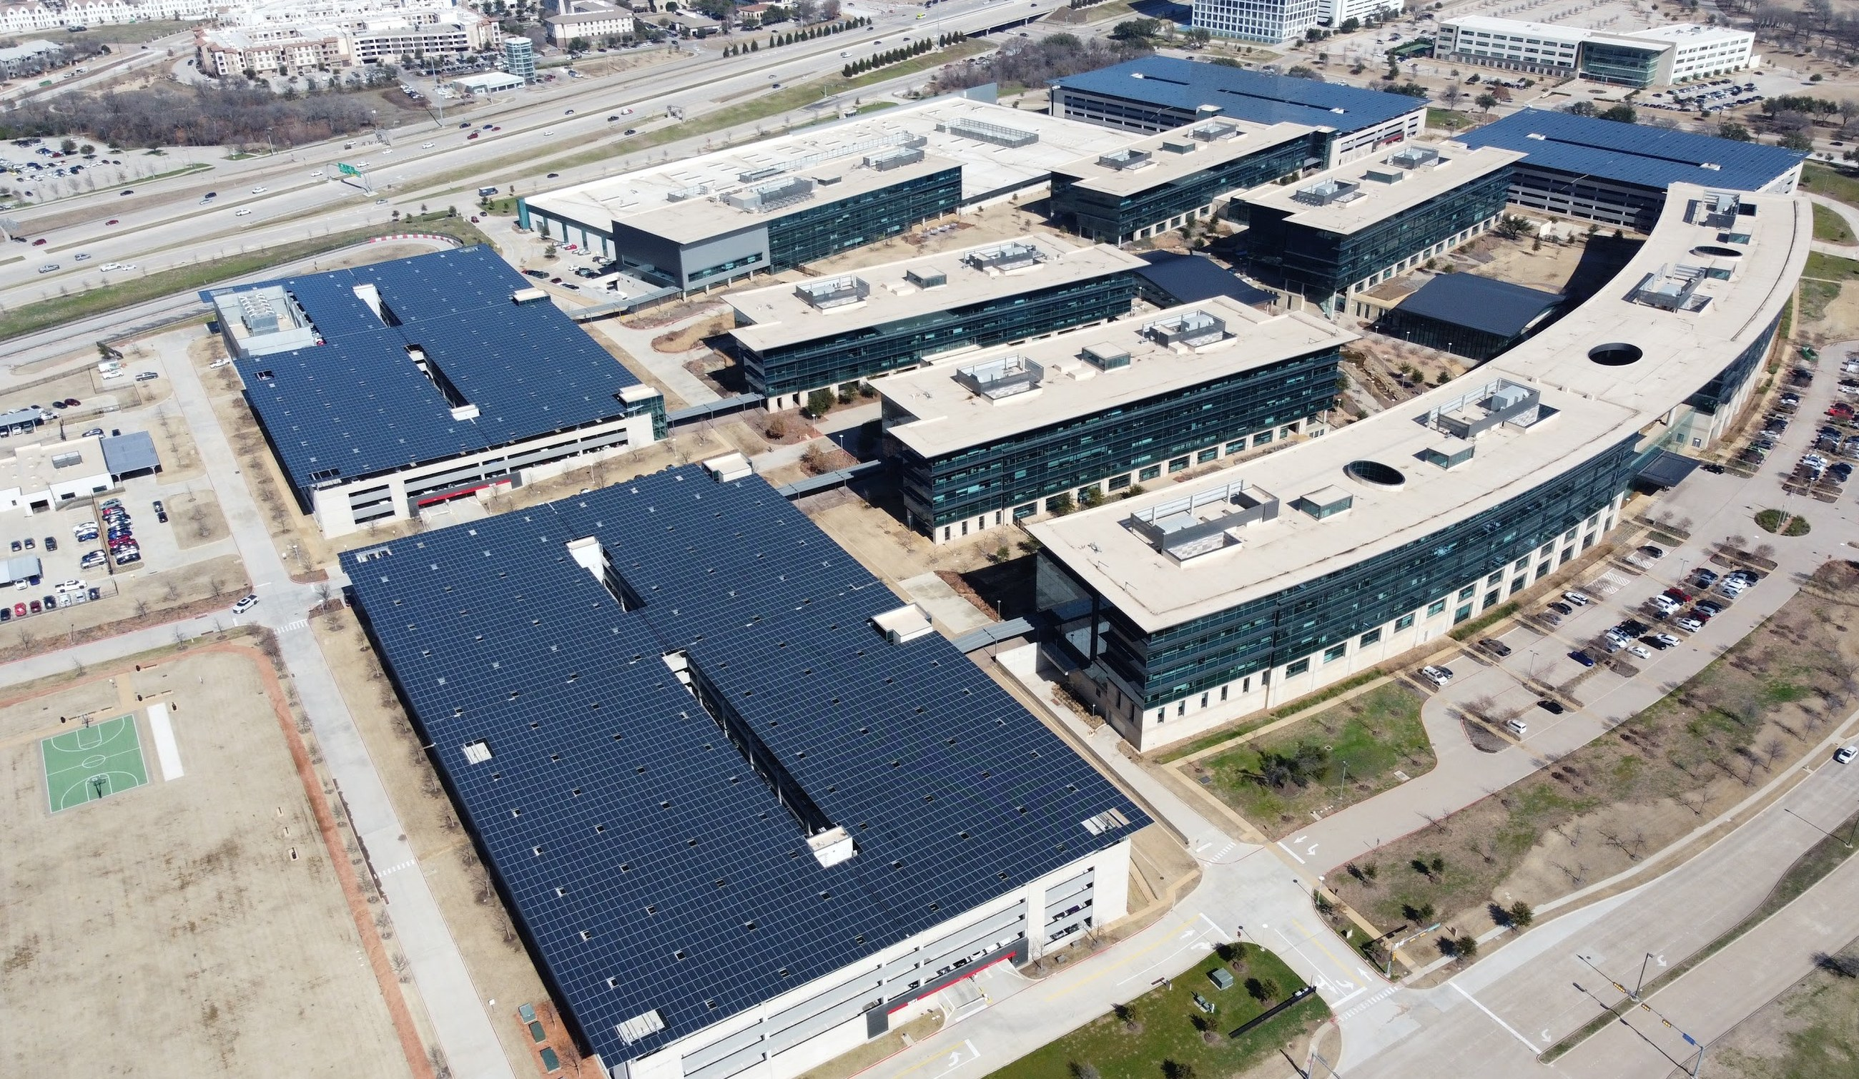
PAGE
ASSETS
SITES
CONTROLS
REVIEW
DILIGENCE APPENDIX
01
02
03
04
04
OCEAN RCS
01 DEPLOYMENT
Project demand
governs equipment fit
Title, condition and serviceability
must support a named
deployment or redeployment
plan.
OCEAN PROJECT PHOTO: DJI_0482
OCEAN RCS · CONFIDENTIAL · INTERNAL USE ONLY · DRAFT · DO NOT USE
Notes:
Source pages 2-3. User confirmed the photo is a real Ocean project. It illustrates the project setting; it is not evidence of charger inventory, equipment ownership or completed diligence.

Slide 5

PAGE
ASSETS
SITES
CONTROLS
REVIEW
DILIGENCE APPENDIX
01
02
03
04
05
OCEAN RCS
02 INCENTIVES
Incentives require
written confirmation
ELIGIBILITY, RESERVATION STATUS AND
DOCUMENTATION PRECEDE CAPITAL PLANNING.
PROGRAM LAYER | CONFIRMATION REQUIRED
Federal | Tax-credit eligibility, domestic content and energy-community review
State / utility | Make-ready, EVSE, storage, solar or managed-charging programs
Local | Permits, grants, economic development or site programs
Capital planning | Award or reservation confirmed before net-capital adjustment
OCEAN RCS · CONFIDENTIAL · INTERNAL USE ONLY · DRAFT · DO NOT USE
Notes:
Source page 4. A screening checklist, not a claim of eligibility, incentive value or award. Current program rules require transaction-specific professional verification.

Slide 6
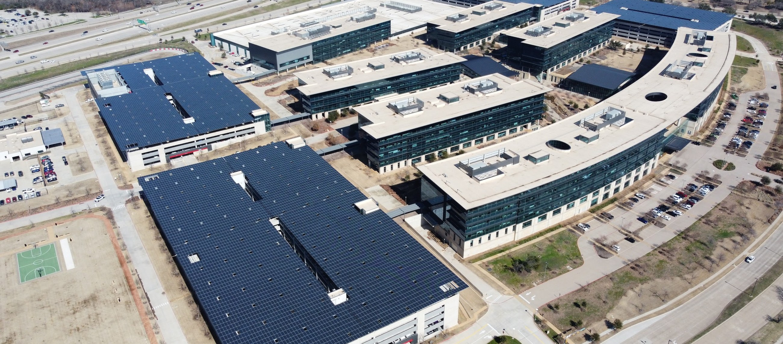
PAGE
ASSETS
SITES
CONTROLS
REVIEW
DILIGENCE APPENDIX
01
02
03
04
06
OCEAN RCS
02 UNDERWRITING
Site underwriting
connects the evidence
PHYSICAL FEASIBILITY, COMMERCIAL DEMAND
AND OPERATING READINESS MUST ALIGN.
SITE
Access, flood, setbacks, parking
POWER
Load, utility path, tariff, switchgear
DEMAND
Charging, fleet, tenant or compute
SCOPE
Civil, electrical, equipment, timing
Ocean project photo: DJI_0482; no site findings inferred
OCEAN RCS · CONFIDENTIAL · INTERNAL USE ONLY · DRAFT · DO NOT USE
Notes:
Source page 5. Physical review also includes site layout. Operating-model evidence includes monitoring, O&M, billing and service plans. This photo does not establish any specific site finding.

Slide 7

PAGE
ASSETS
SITES
CONTROLS
REVIEW
DILIGENCE APPENDIX
01
02
03
04
07
OCEAN RCS
03 RISK CONTROLS
Each risk has an owner
and a go/no-go threshold
RISK CATEGORY | CONTROL STANDARD
Utility / interconnection | Written feasibility and cost path
Permits / zoning | Documented approval path
Equipment | Title, inspection and serviceability
Demand | Contract, LOI or site-specific model
Construction | Scope, budget, schedule and lien controls
OCEAN RCS · CONFIDENTIAL · INTERNAL USE ONLY · DRAFT · DO NOT USE
Notes:
Source pages 5-6. Every risk needs an owner, diligence evidence and a go/no-go threshold. Operating evidence must include monitoring, O&M, billing and service planning.

Slide 8


CAPITAL CONTROLS
5
funding gates require
documented evidence
BASIS
DILIGENCE PROCESS
STATUS
DRAFT
OCEAN RCS · CONFIDENTIAL · INTERNAL USE ONLY · DRAFT · DO NOT USE
Notes:
Source page 7. Five gates: Control, Validate, Fund, Build, Operate. This count describes the appendix process, not assets or commitments.

Slide 9
PAGE
ASSETS
SITES
CONTROLS
REVIEW
DILIGENCE APPENDIX
01
02
03
04
09
OCEAN RCS
04 FUNDING GATES
Capital release
follows evidence
01 · CONTROL
02 · VALIDATE
03 · FUND
04 · BUILD
05 · OPERATE
Rights
Diligence
Approval
Draw controls
Reporting
LOI, option, customer
agreement or
development right.
Utility, permits,
incentives, title and
technical review.
Investor approval, lender
commitment or
customer-funded EPC.
Commissioning and
construction oversight.
Performance data, billing
and O&M.
INTERNAL DILIGENCE ONLY. PRELIMINARY INFORMATION REMAINS SUBJECT TO REVIEW.
OCEAN RCS · CONFIDENTIAL · INTERNAL USE ONLY · DRAFT · DO NOT USE
Notes:
Source pages 7-8. Project-specific legal entities may be formed at acquisition, property closing, financing or operations launch. Multiple lanes may advance before asset-level funding.

